Slide 1

CMPT 413/713: Natural Language Processing
Recurrent Neural Networks
LSTM and GRUs
Zhiyun (Richard) Peng
2026-10-23
Adapted from slides from Angel Chang, Anoop Sarkar, Danqi Chen, Karthik Narasimhan, and Justin Johnson, Chris Manning, Abigail See, Andrej Karpathy
Notes:
http://demo.clab.cs.cmu.edu/NLP/

Slide 2
Different RNN cells

Slide 3
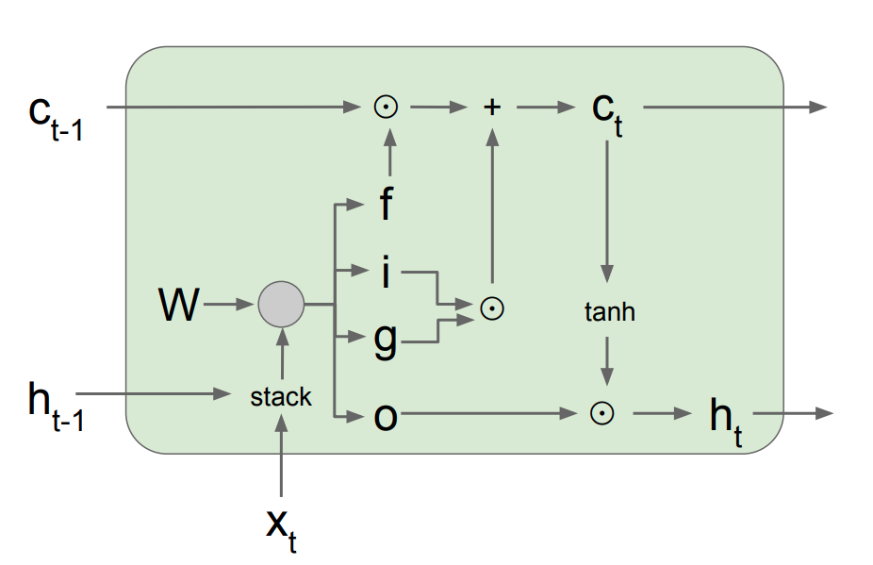
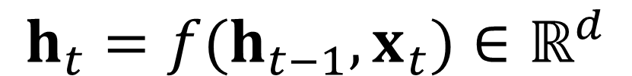
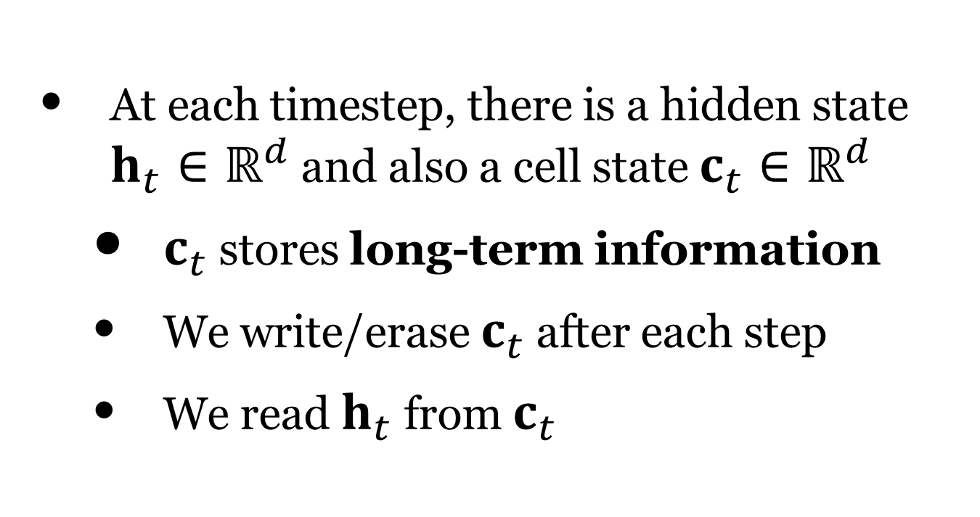
Long Short-term Memory (LSTM)
A type of RNN proposed by Hochreiter and Schmidhuber in 1997 as a solution to the vanishing gradients problem
Work extremely well in practice
Basic idea: turning multiplication into addition
Use “gates” to control how much information to add/erase
$$h_{t}=f(h_{t−1},x_{t})∈ℝ^{d}$$
At each timestep, there is a hidden state $h_{t}∈ℝ^{d}$ and also a cell state $c_{t}∈ℝ^{d}$
  $c_{t}$ stores long-term information
  We write/erase $c_{t}$ after each step
  We read $h_{t}$ from $c_{t}$
Notes:
https://www.analyticsvidhya.com/blog/2021/03/introduction-to-long-short-term-memory-lstm/

Slide 4
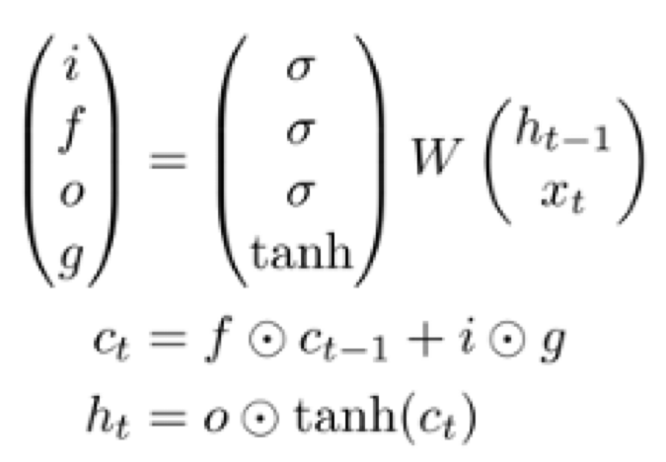
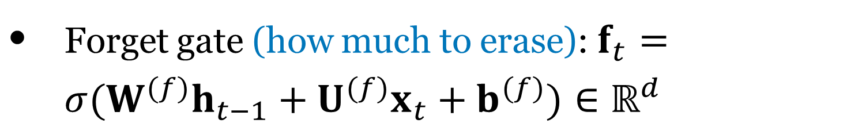
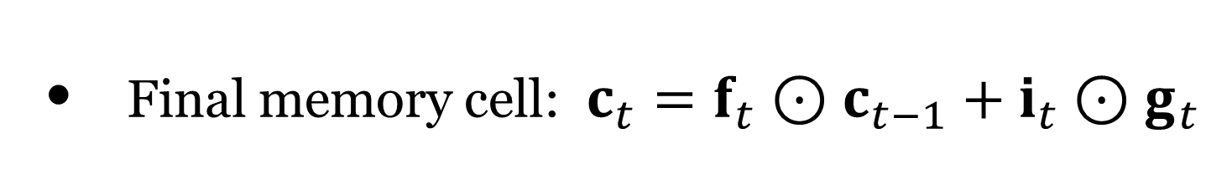
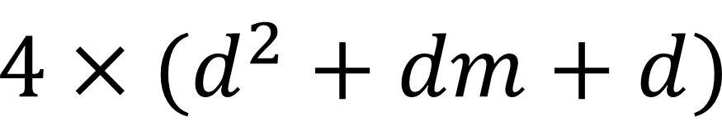
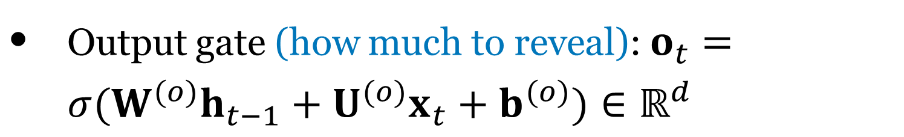

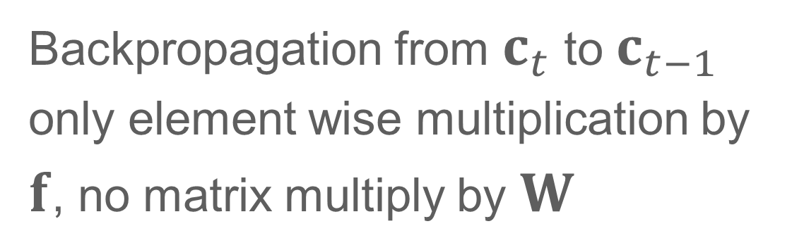
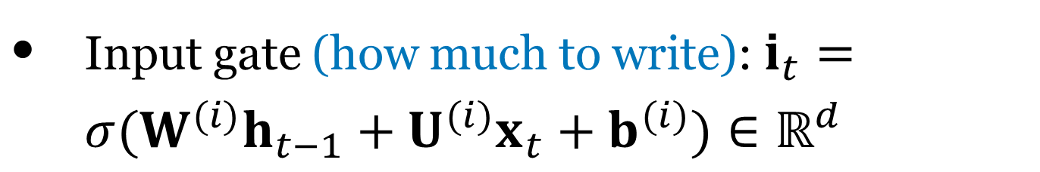
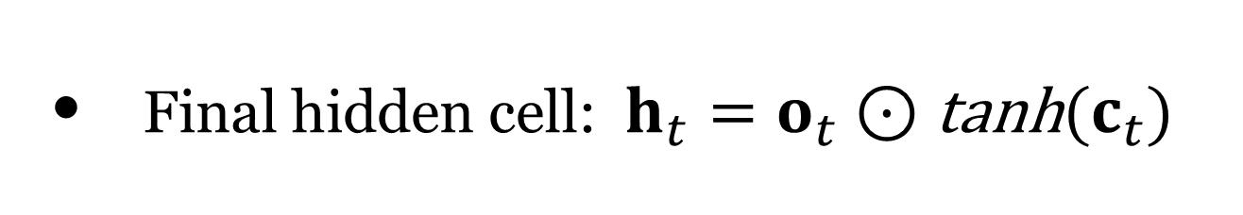
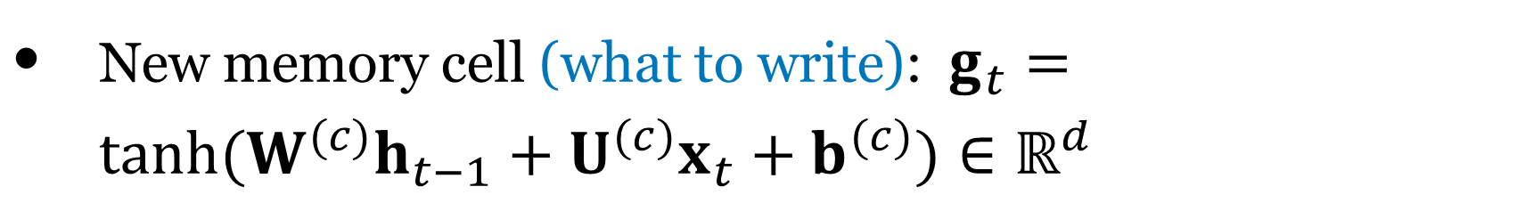

Long Short-term Memory (LSTM)
Backpropagation from $c_{t}$ to $c_{t−1}$ only element wise multiplication by $f$, no matrix multiply by $W$
Use logistic for gating 0 = filter out,
1 = pass through
There are 3 gates and a memory cell:
Input gate (how much to write): $i_{t}=σ(W^{(i)}h_{t−1}+U^{(i)}x_{t}+b^{(i)})∈ℝ^{d}$
Forget gate (how much to erase): $f_{t}=σ(W^{(f)}h_{t−1}+U^{(f)}x_{t}+b^{(f)})∈ℝ^{d}$
Output gate (how much to reveal): $o_{t}=σ(W^{(o)}h_{t−1}+U^{(o)}x_{t}+b^{(o)})∈ℝ^{d}$
Use tanh for output
(zero-centered for
feeding into next layer)
Matrix form
New memory cell (what to write): $g_{t}=tanh(W^{(c)}h_{t−1}+U^{(c)}x_{t}+b^{(c)})∈ℝ^{d}$
element-wise product
Final memory cell: $c_{t}=f_{t}⊙c_{t−1}+i_{t}⊙g_{t}$
Final hidden cell: $h_{t}=o_{t}⊙\text{tanh}(c_{t})$
How many parameters in total?
$$4×(d^{2}+dm+d)$$
$$x_{t}∈ℝ^{m}$$
Notes:
The LSTM cell is composed of three gates and one memory cell. <click>
The three gate cell control whether information is written out or dropped.
<click>
Each of the three gates uses a logistic activation function, which goes from 0 to 1, for gating.
When the activation is 0, the information is filtered out. When the activation is 1, the information is passed through.
<click>
In addition to the three gates, there is also a memory cell which determine what to write out (given the input and previous hidden state).
<click>
The memory cell uses a tanh which is zero-centered for feeding into the next layer.
<click>
The final memory cell is composed of an element-wise product of the forget-gate with the previous cell state, plus the input gate multiplied with the new memory cell.
The final hidden state combines the output gate with the tanh of the cell state.
<click>
The way the LSTM cell is arranged, allows for backpropagation from c_t to c_{t-1} with only element wise multiplication by f. And no matrix multiplications by the weight matrix associated with the hidden state. This allows for the gradients to flow backward without the weight matrix repeatedly being multiplied.
<click>
Here we see the simpler matrix form for the LSTM cell. Perhaps it is useful in elucidating the structure of the cell.
<click>
So the LSTM cell is much more complex than the vanilla RNN cell, with a much larger number of parameters.
If we have a hidden state size of d and a input dimension of m, what is the number of parameters in total?
<click>
It is 4 times (d time d (size of W) + d times m(size of U) + d (size of the bias))
cell state (long-term memory)
hidden state (short-term memory) - working memory
Gates acts as filters on what to keep and what to override
Use sigmoid to control what information is kept / forgotten (0 forgotten/1 kept)
Forget gate on the cell state
Input gate - what information to take from the current input cell
Output gate - what information would go into the next hidden state (combines long term memory and working memory)

Slide 5
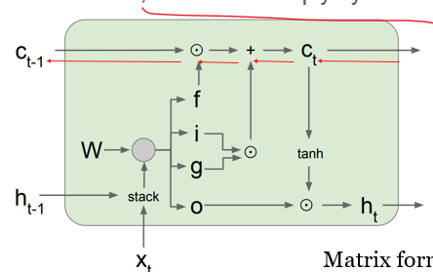
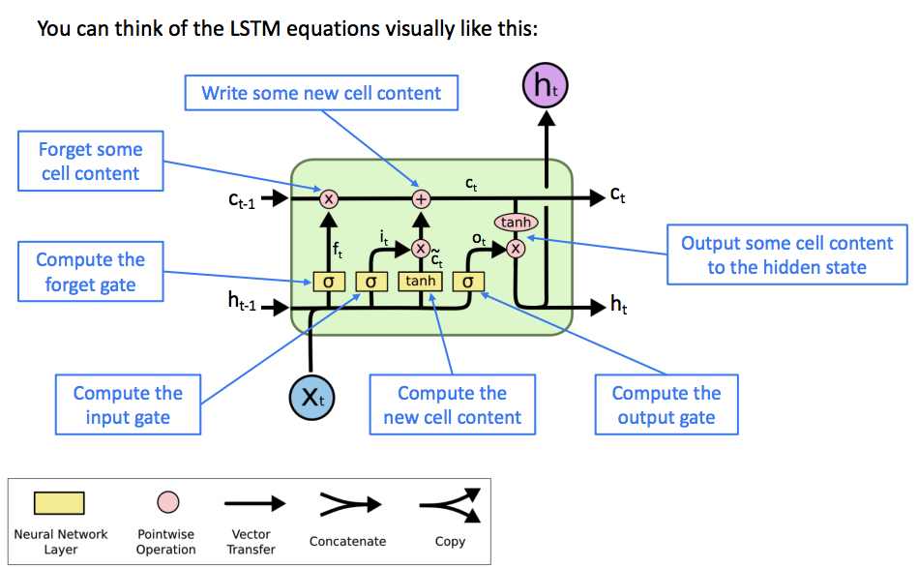
LSTM cell intuitively
http://colah.github.io/posts/2015-08-Understanding-LSTMs/
Notes:
https://blog.floydhub.com/long-short-term-memory-from-zero-to-hero-with-pytorch/
https://towardsdatascience.com/illustrated-guide-to-lstms-and-gru-s-a-step-by-step-explanation-44e9eb85bf21

Slide 6
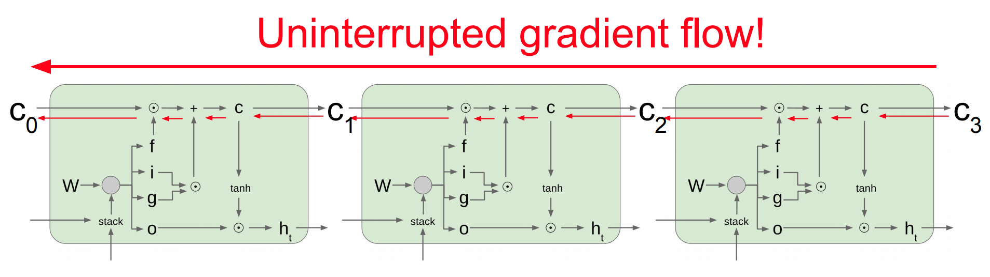
Long Short-term Memory (LSTM)
LSTM doesn’t guarantee that there is no vanishing/exploding gradient, but it does provide an easier way for the model to learn long-distance dependencies
LSTMs were invented in 1997 but finally got working from 2013-2015.

Slide 7
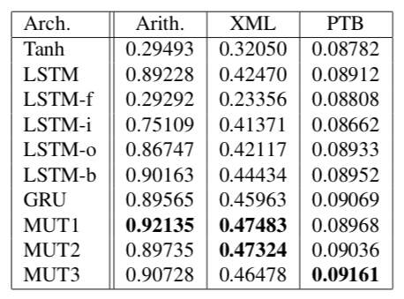
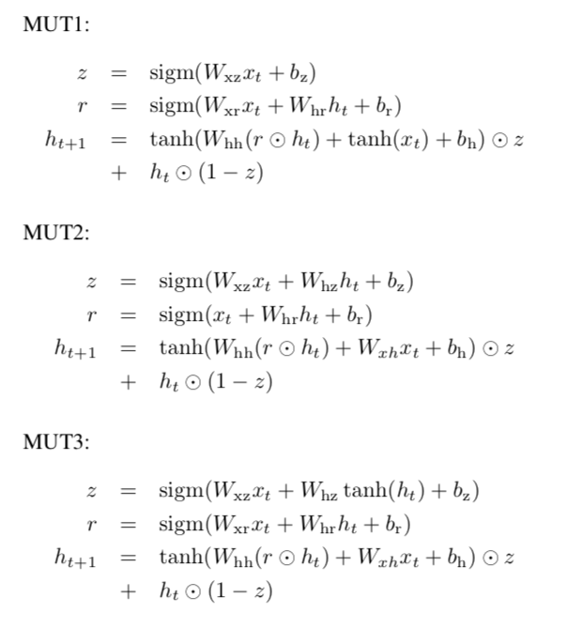
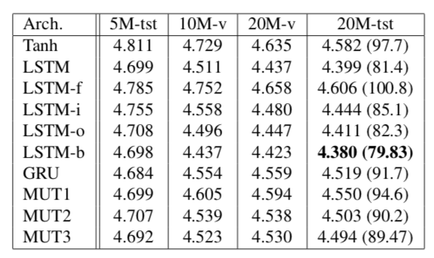
Is the LSTM architecture optimal?
Mutated architecture
(Jozefowicz et al, 2015): An Empirical Exploration of Recurrent Network Architectures

Slide 8


GRU
update
reset
final hidden state
If reset is close to 0, ignore previous hidden state
  Allows model to drop information that is irrelevant in the future
Update gate z controls how much of past state should matter now.
  If z close to 1, then we can copy information in that unit through many time steps! Less vanishing gradient!
Units with short-term dependencies often have reset gates very active
Notes:
GRU simpler than the LSTM cell
No more cell state, just use the hidden state to transfer information
Only two internal gates vs LSTM’s four
Update gate: similar to forget / input: controls what information is forgotten and what is pass on
Reset gate: How many information from hidden state to pass onward

Slide 9
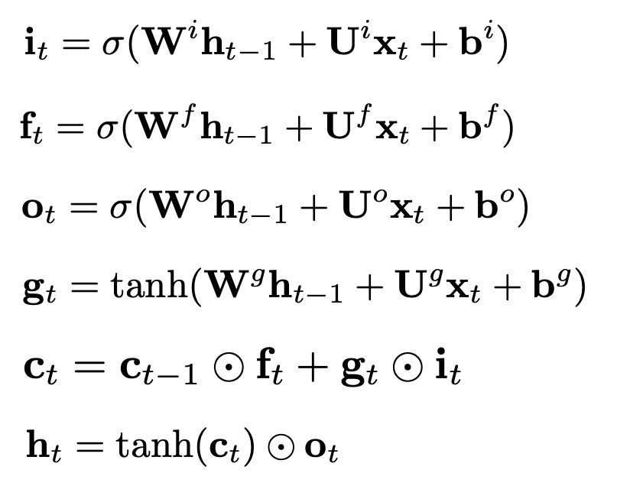
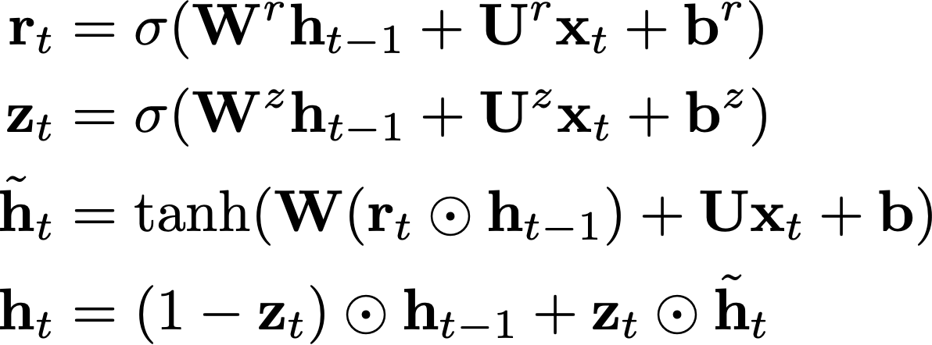
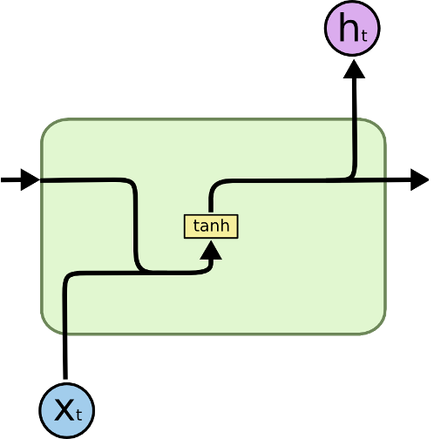
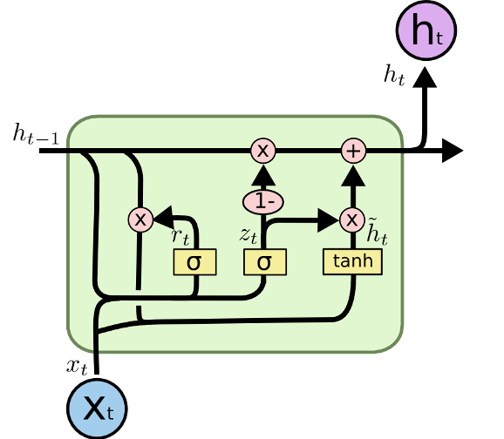
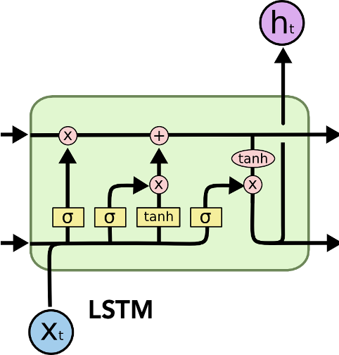
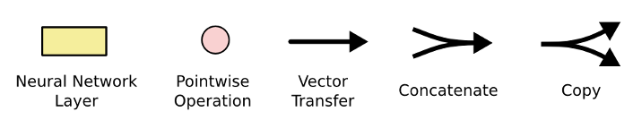
Simple RNN vs GRU vs LSTM
$$h_{t}=g(W_{hh}h_{t−1}+Ux_{t}+b)$$
Simple RNN
GRU
LSTM
http://colah.github.io/posts/2015-08-Understanding-LSTMs/
Notes:
GRU has a reset and forget gate

Slide 10
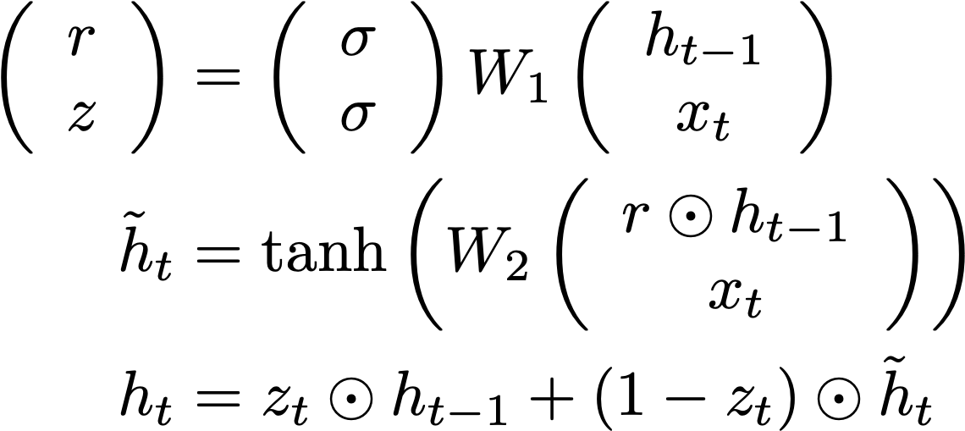
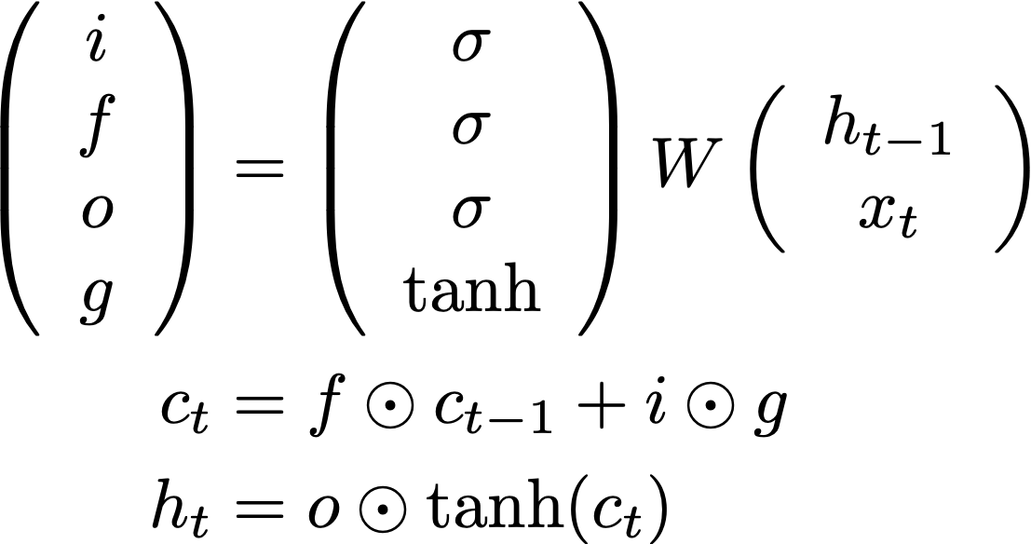
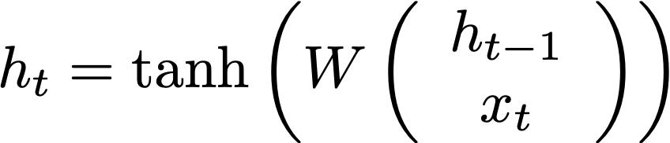
Simple RNN vs GRU vs LSTM
Simple RNN
GRU
LSTM
http://colah.github.io/posts/2015-08-Understanding-LSTMs/
Notes:
GRU has a reset and forget gate

Slide 11
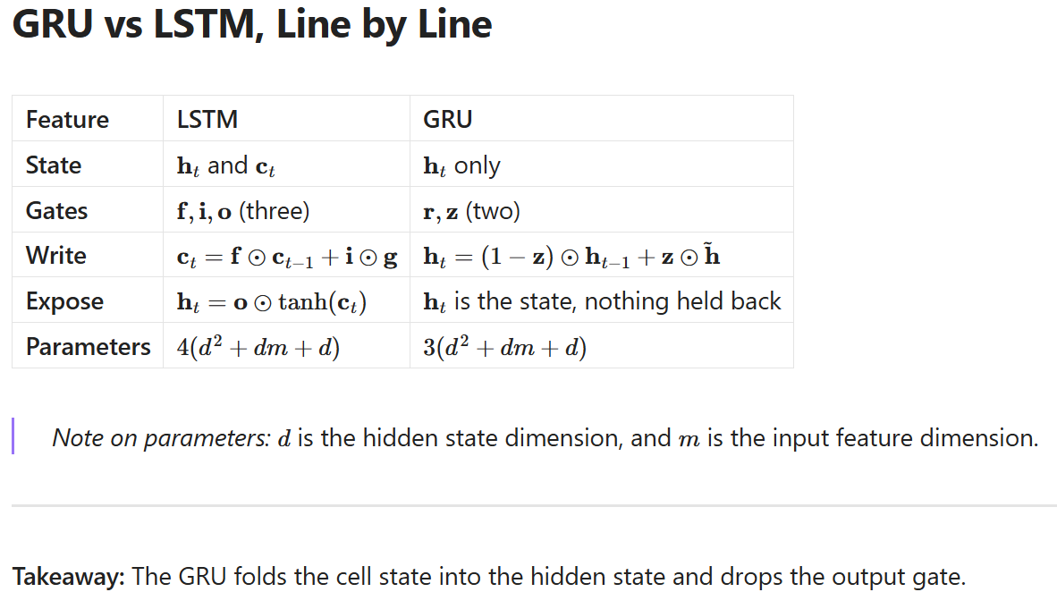
State Update Mechanism
Output Mechanism

Slide 12
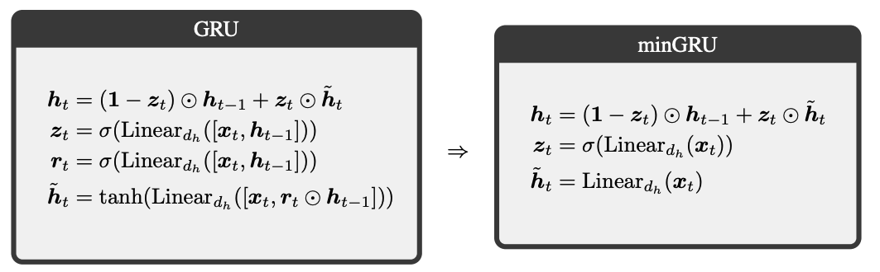
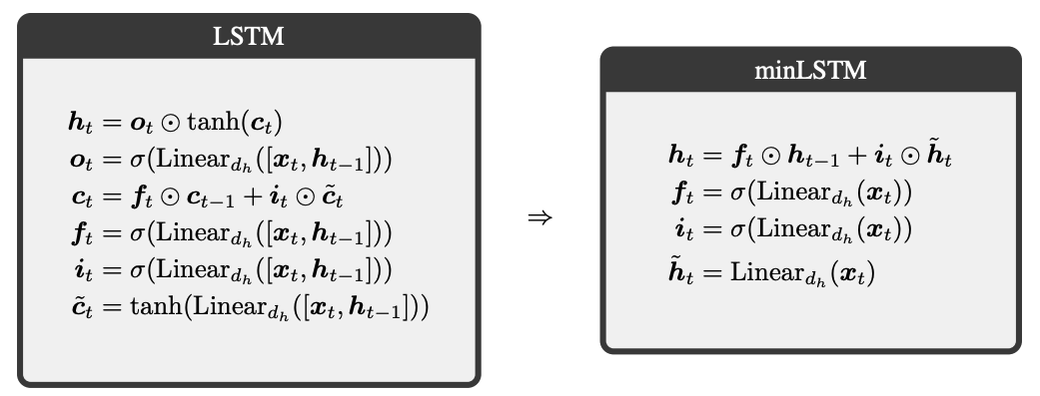
Minimum versions of GRU and LSTM
Can reduce GRU / LSTM cells by
  Cutting out state dependencies from gates
  Remove range restrictions
  Remove output scaling for LSTM
Faster and can be trained in parallel
Were RNNs All We Needed? [Fung et al. 2024]

Slide 13
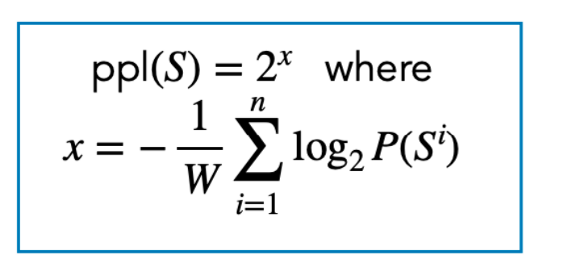
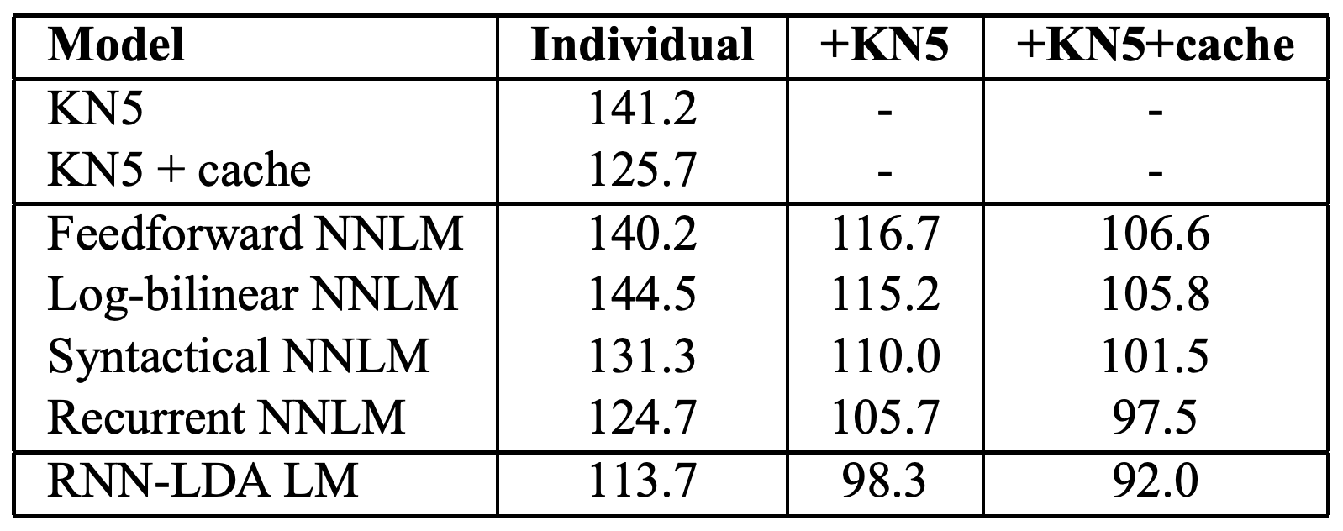

Progress on language models
On the Penn Treebank (PTB) dataset
Metric: perplexity
KN5: Kneser-Ney 5-gram
Latent Dirichlet Allocation
LDA represents text as a mixture of latent topics (e.g., finance, politics, science)
(Mikolov and Zweig, 2012): Context dependent recurrent neural network language model

Slide 14
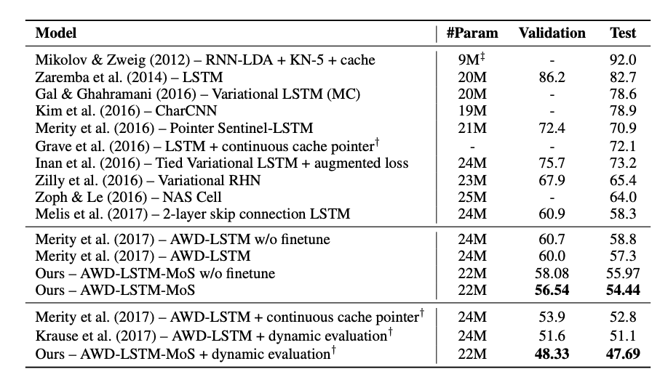
Progress on language models
On the Penn Treebank (PTB) dataset
Metric: perplexity
(Yang et al, 2018): Breaking the Softmax Bottleneck: A High-Rank RNN Language Model

Slide 15
Overview
Review of Vanilla RNN
Training RNNs
Issues with Gradient Flows
LSTMs and GRUs
Applications
Variants: Stacked RNNs, Bidirectional RNNs

Slide 16
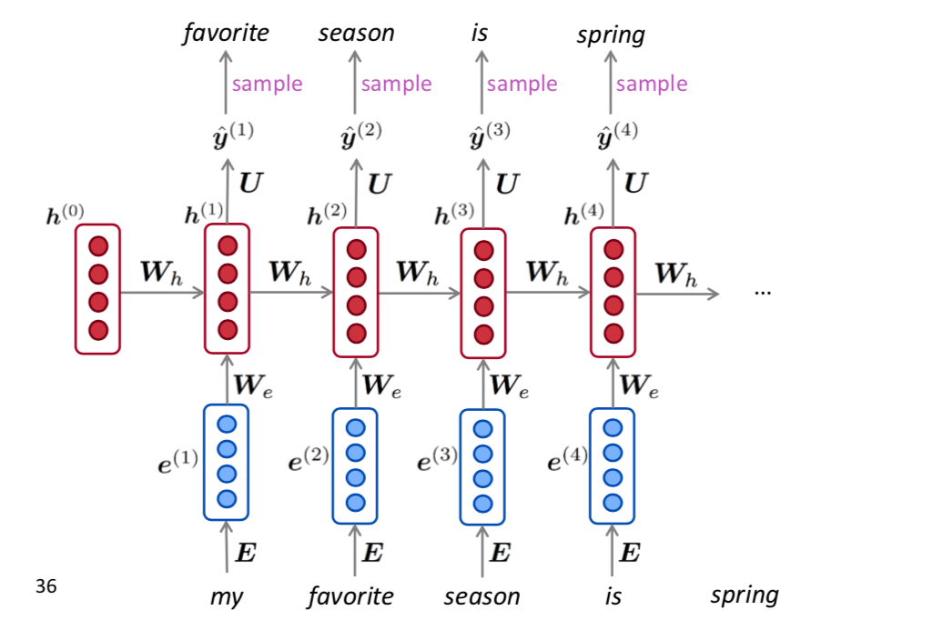
Application: Text Generation
You can generate text by repeated sampling.
Sampled output is next step’s input.

Slide 17

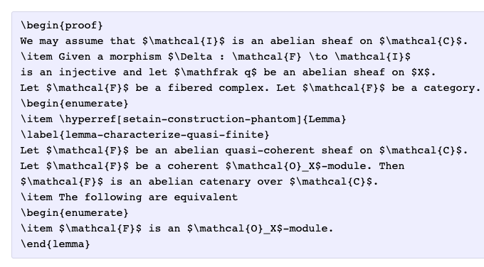
Fun with RNNs
Obama speeches
Latex generation
Andrej Karpathy “The Unreasonable Effectiveness of Recurrent Neural Networks”

Slide 18
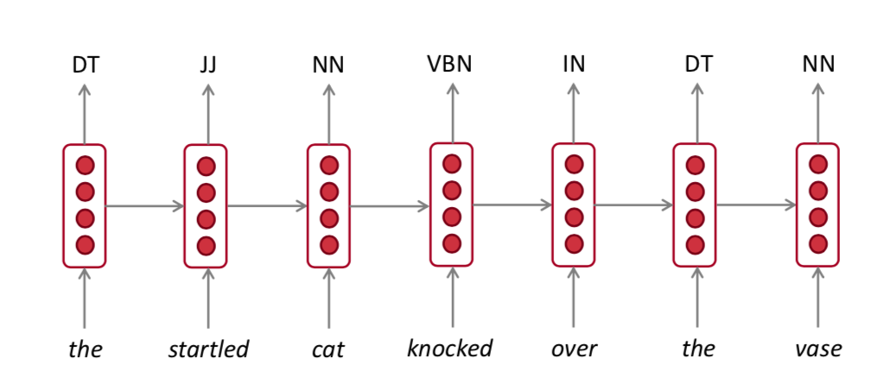
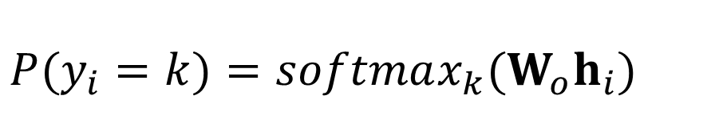
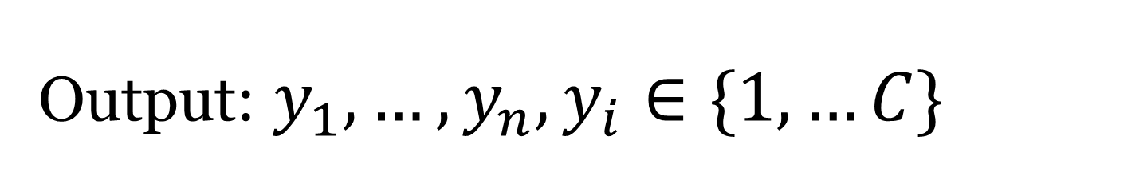
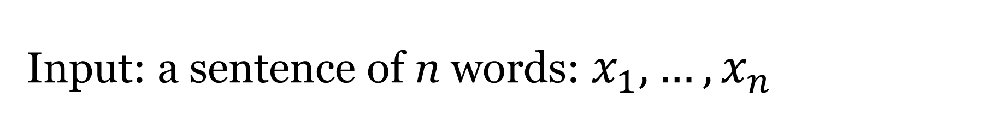
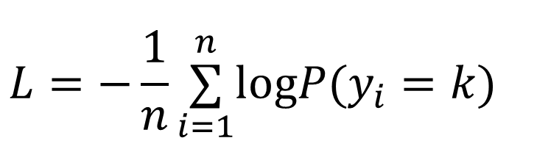
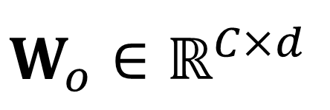
Application: Sequence Tagging
Input: a sentence of n words: $x_{1},…,x_{n}$
Output: $y_{1},…,y_{n},y_{i}∈\{1,…C\}$
$$P(y_{i}=k)=softmax_{k}(W_{o}h_{i})$$
$$W_{o}∈ℝ^{C×d}$$
$$L=−\frac{1}{n}\overset{n}{\underset{i=1}{∑}}logP(y_{i}=k)$$

Slide 19


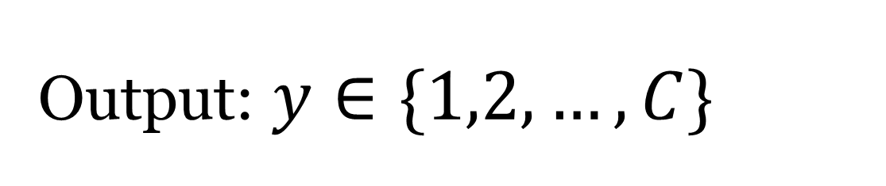
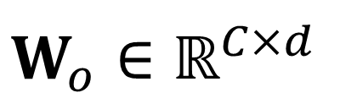
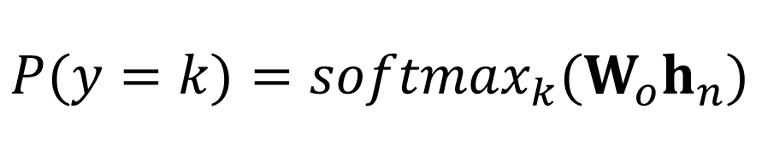
Application: Text Classification
Input: a sentence of n words
Output: $y∈\{1,2,…,C\}$
$$h_{n}$$
the
movie
was
terribly
exciting
!
$$P(y=k)=softmax_{k}(W_{o}h_{n})$$
$$W_{o}∈ℝ^{C×d}$$

Slide 20
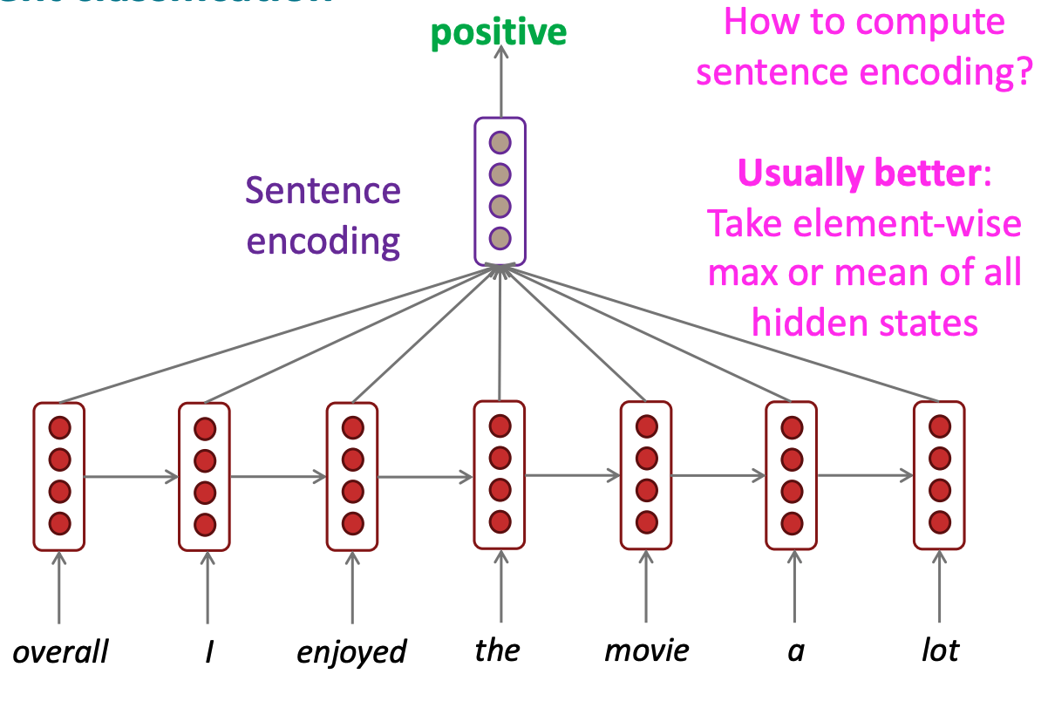
Application: Text classification

Slide 21
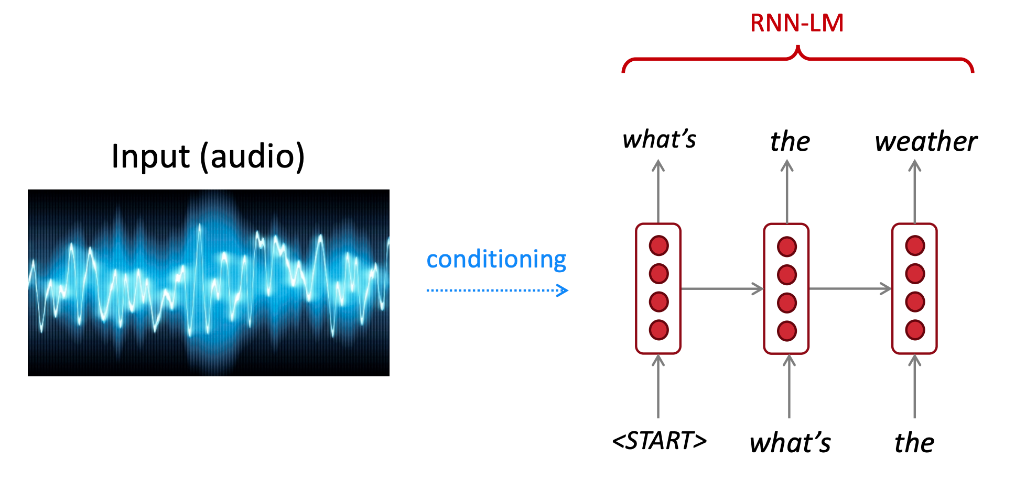
Conditional Text Generation

Slide 22
Multi-layer RNNs
RNNs are already “deep” on one dimension (unroll over time steps)
We can also make them “deep” in another dimension by applying multiple RNNs
Multi-layer RNNs are also called stacked RNNs.

Slide 23
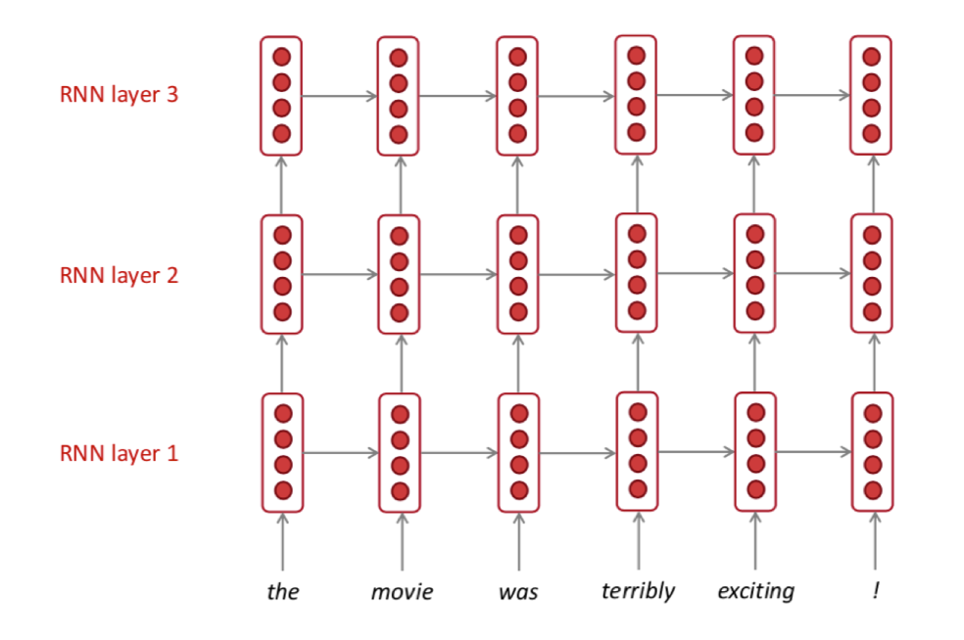
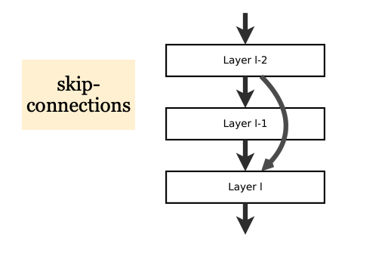
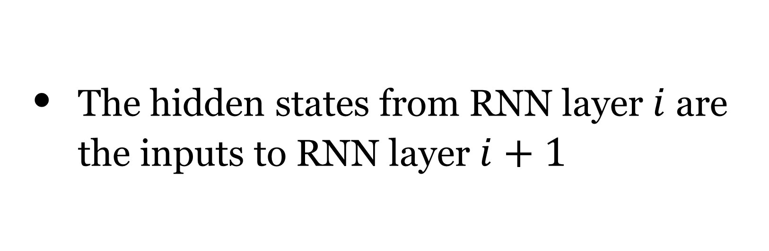
Stacking multi-layered RNNs
The hidden states from RNN layer $i$ are the inputs to RNN layer $i+1$
In practice, using 2 to 4 layers is common (usually better than 1 layer)
Transformer-based networks can be up to 24 layers with lots of skip-connections.

Slide 24
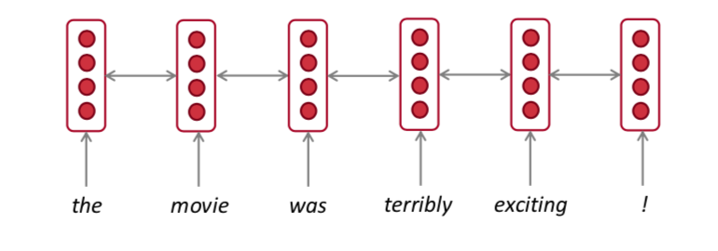
Bidirectional RNNs
Bidirectionality is important in language representations:
terribly:
left context “the movie was”
right context “exciting !”

Slide 25





Bidirectional RNNs
$$h_{t}=f(h_{t−1},x_{t})∈ℝ^{d}$$
$${\overset{→}{h}}_{t}=f_{1}({\overset{→}{h}}_{t−1},x_{t}),t=1,2,…n$$
$${\overset{←}{h}}_{t}=f_{2}({\overset{←}{h}}_{t+1},x_{t}),t=n,n−1,…1$$
$$h_{t}=[{\overset{←}{h}}_{t},{\overset{→}{h}}_{t}]∈ℝ^{2d}$$

Slide 26



Bidirectional RNNs
Sequence tagging: Yes!
Text classification: Yes! With slight modifications.
Text generation: No. Why?
Notes:
Bidirectional sequence generation: https://www.aclweb.org/anthology/D19-1001.pdf

