Slide 1
Optimization of Transductive Conformal Predictors based on Naive Bayes Classifier via Incremental and Decremental Learning
Zhize Guan
Supervisors:
Dr. Evgueni Smirnov
Dr.Rachel Cavill
Maastricht University
Faculty of Science and Engineering
Department of Advanced Computing Sciences
July 13, 2023

Slide 2
Outline
1.Introduction
Motivation
Related Work
Objective and Research Questions
2.Methods
Classification Problem
Naive Bayes Classifier (NBC)
MultinomialNB for Discrete Variables
GaussianNB for Continuous Variables
Conformal Prediction
Nonconformity Measure
Transductive Conformal Predictor (TCP)
TCP based on MultinomialNB
TCP based on GaussianNB
3.Optimized TCP (OTCP)
OTCP based on MultinomialNB
OTCP based on GaussianNB
Time Complexity Analysis
4.Experiments, Results and Discussion
Consistency Test
Comparison between TCP and OTCPG based on MultinomialNB or GaussianNB
Comparison among OTCP based on Different ML Methods
5. Conclusions
Research Question 1
Research Question 2
Research Question 3
Future Research

Slide 3
1.Introduction
Motivation
Related Work
Objective and Research Questions

Slide 4
Motivation
Common ML classificaiton methods
Prediction Point
Conformal Prediciton/Conformal Predictors (CP)
Prediction Set：
Transductive Conformal Predictors（TCP）
High Computationl Complexity

Slide 5
Related Work
Sampling Learning
——by decreasing the training dataset
Inductive Conformal Predictors (ICP)
cross-CP
jack-knife+
Online Learning\Incremental and Decremental Learning (I&D Learning)
——by efficiently learing and unlearning an instance
Optimized TCP based on k-Nearest Neighbors (k-NN), Kernel Density Estimation
(KDE), and Least-Squares SVM (LS-SVM)

Slide 6
Objective
To develop an optimized TCP (OTCP) that utilizes the Naive Bayes classifier (NBC) as its underlying ML method via I&D Learning.
Research Questions
Can the optimized Transductive Conformal Predictors based on Naive Bayes Classifier produce the same exact solutions as standard ones?
Can the optimized Transductive Conformal Predictors based on Naive Bayes Classifier reduce the training time and prediction time significantly?
Can the optimized Transductive Conformal Predictors based on Naive Bayes Classifier reduce more training time and prediction time than other optimized TCP based on different ML methods?

Slide 7
2.Methods
Classification Problem
Naive Bayes Classifier (NBC)
MultinomialNB for Discrete Variables
GaussianNB for Continuous Variables
Conformal Prediction
Nonconformity Measure
Transductive Conformal Predictor (TCP)
TCP based on MultinomialNB
TCP based on GaussianNB

Slide 8
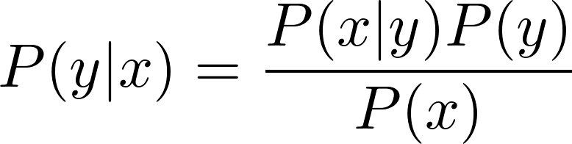

Classification Problem
X: The instance space defined by P input variables X^{p}
Y: The output variable
Q: Some unknown probability distribution over X x Y
D: The training dataset of N instances sampled from X x Y under the i.i.d. assumption
x: The test instace
First, we can assume that we know:
the prior distribution P(y)
the distribution P(x|y) for each y ∈ Y
the distribution P(x)
Then, we can compute the posterior probability P(y|x) for each y ∈ Y according to the Bayes Rule:
The winning class is determined by the Optimal Bayes Rule:

Slide 9
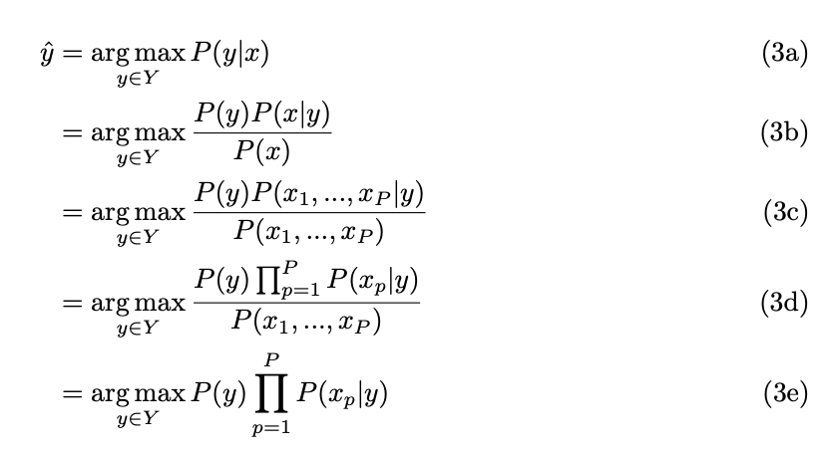
Naive Bayes Classifier (NBC)
The "naive" assumption of independence between each pair of variables.

Slide 10
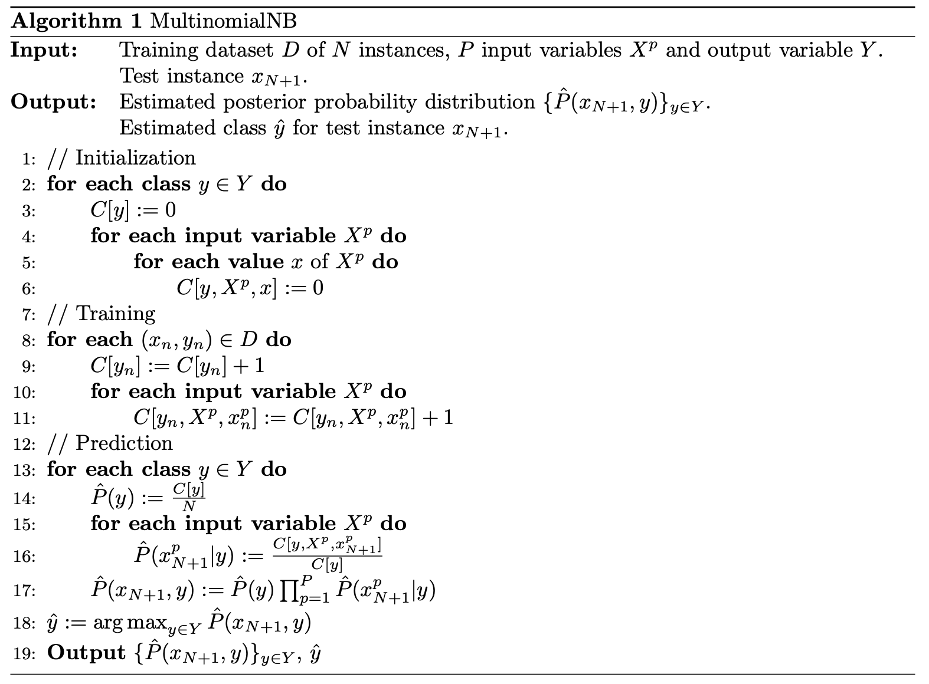
Naive Bayes Classifier ——MultinomialNB for Discrete Variables

Slide 11
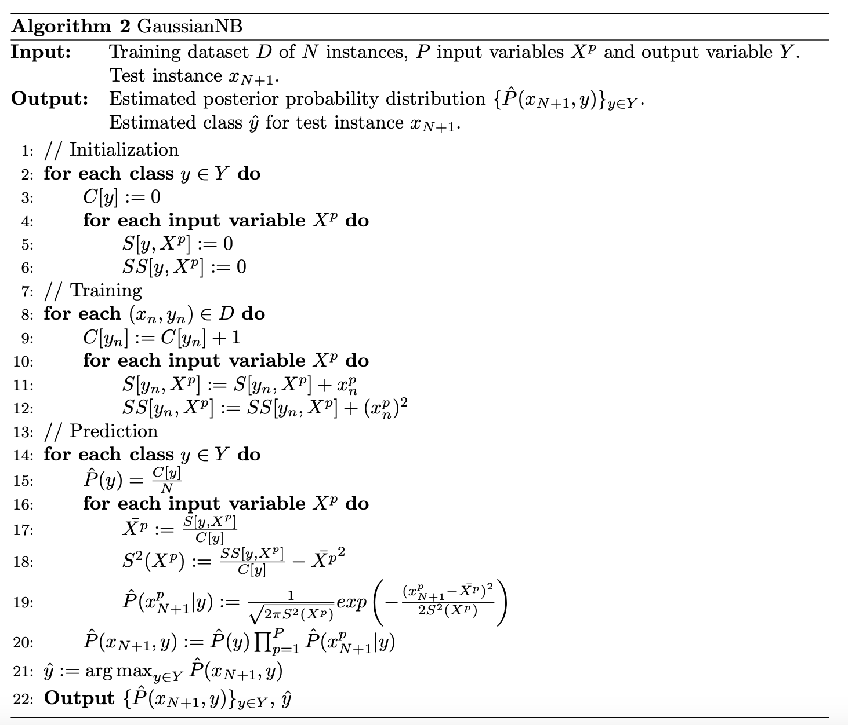
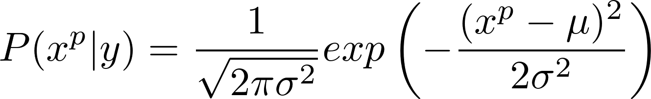
Naive Bayes Classifier ——GaussianNB for Continuous Variables
The parameters µ and σ² are estimated
using maximum likelihood.

Slide 12
Conformal Prediction ——Nonconformity Measure (NM)
The Nonconformity Measure is a real-valued function, which quantifies how much an instance (x, y)
is untypical to a set of instances in the training dataset D.
A: Nonconformity Measure;
C: A classifier ;
D: The training dataset ;
x: The test instance;
y: One possible class;

Slide 13
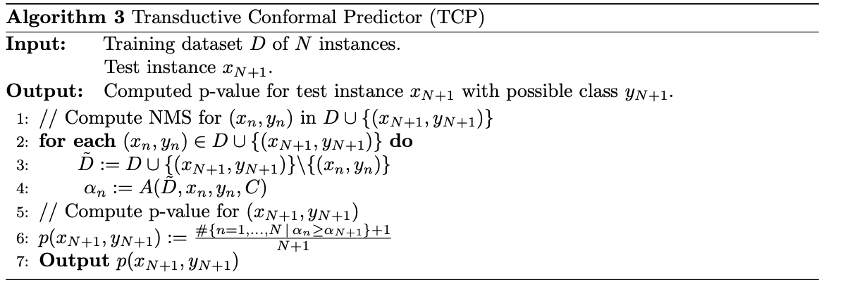
Conformal Prediction ——Transductive Conformal Predictor (TCP)
NMS：Nonconformity Measure Score
Because of the Leave-One-Out (LOO) procedure, TCP needs to train (N+1) · |Y| classifiers in total.

Slide 14
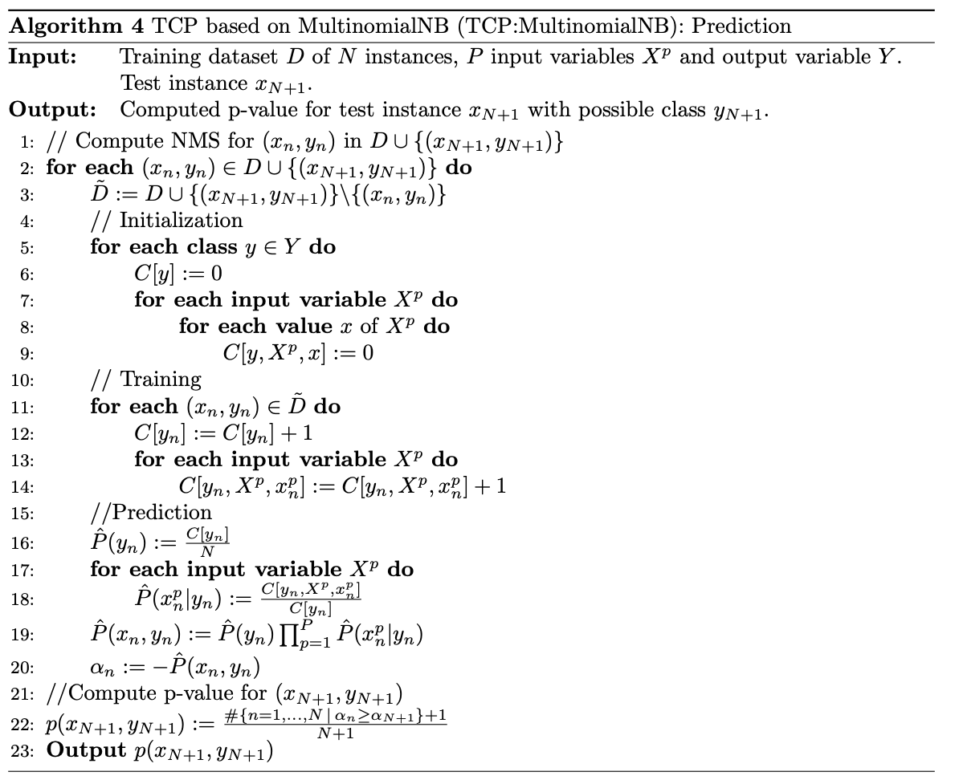
Conformal Prediction ——TCP based on MultinomialNB
Just need to replace the classifier C with MultinomialNB in the TCP Algorithm to get TCP based on MultinomialNB.

Slide 15
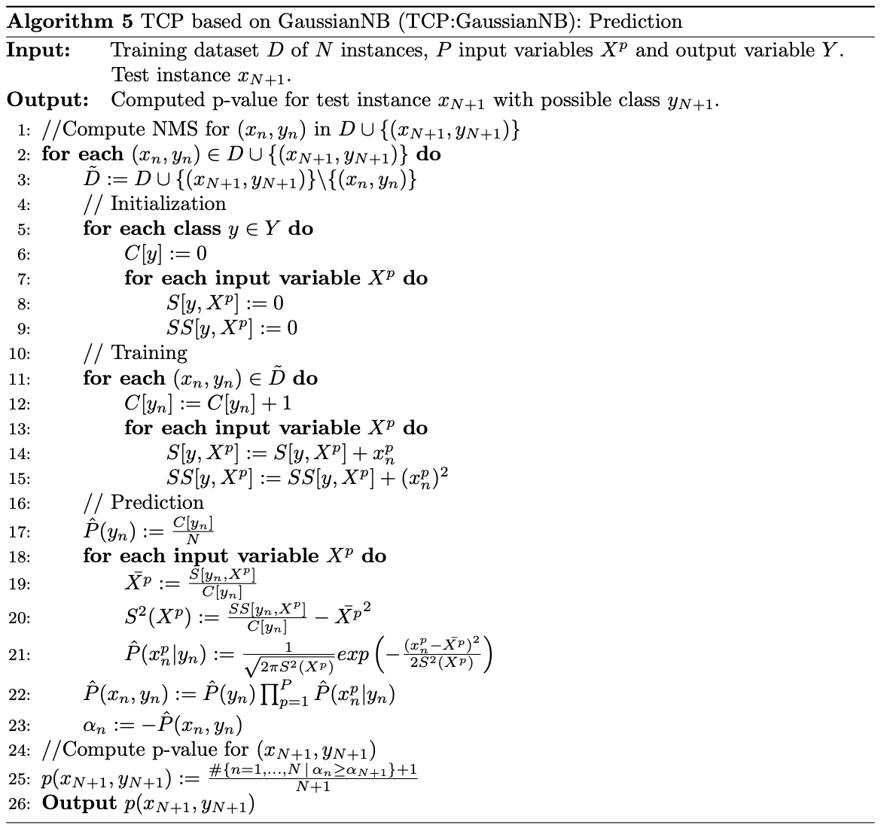
Conformal Prediction ——TCP based on GaussianNB
Just need to replace the classifier C with GaussianNB in the TCP Algorithm to get TCP based on GaussianNB .

Slide 16
3.Optimized TCP (OTCP)
OTCP using MultinomialNB
OTCP using GaussianNB
Time Complexity Analysis

Slide 17
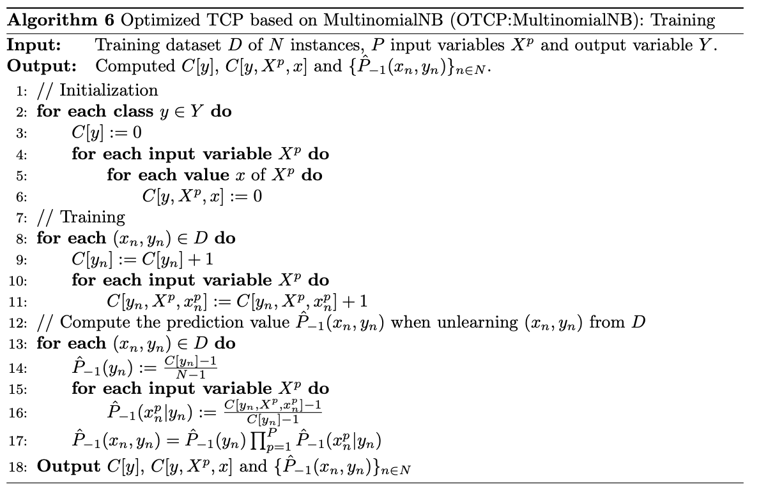
OTCP using MultinomialNB: Training
Unlike TCP, Optimized TCP only needs to train one classifier and then use it to compute the nonconformity measure scores for all instances.

Slide 18
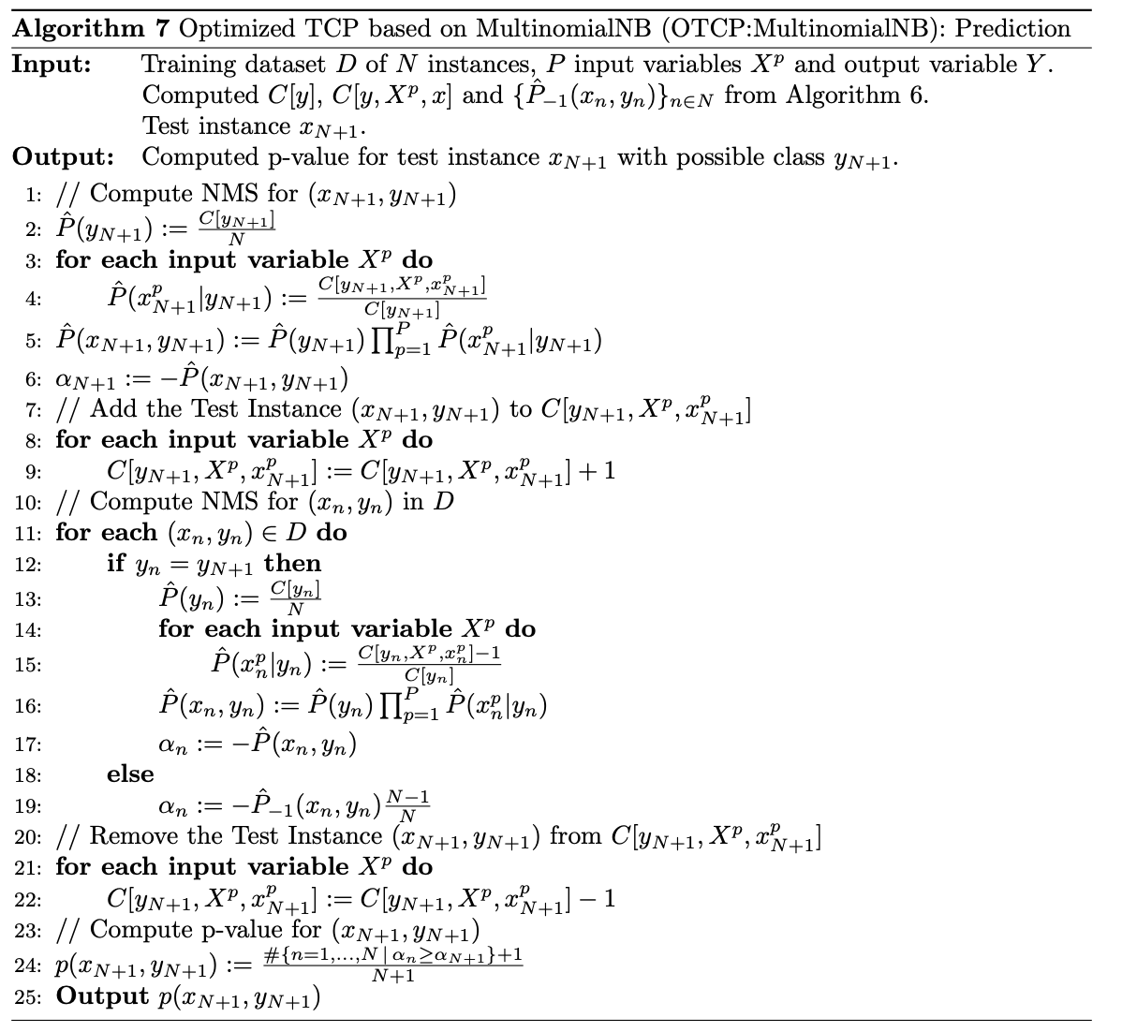
OTCP using MultinomialNB: Prediction
If there are L possible classes, the prediction phase needs to run L times.
L is the number of classes.

Slide 19
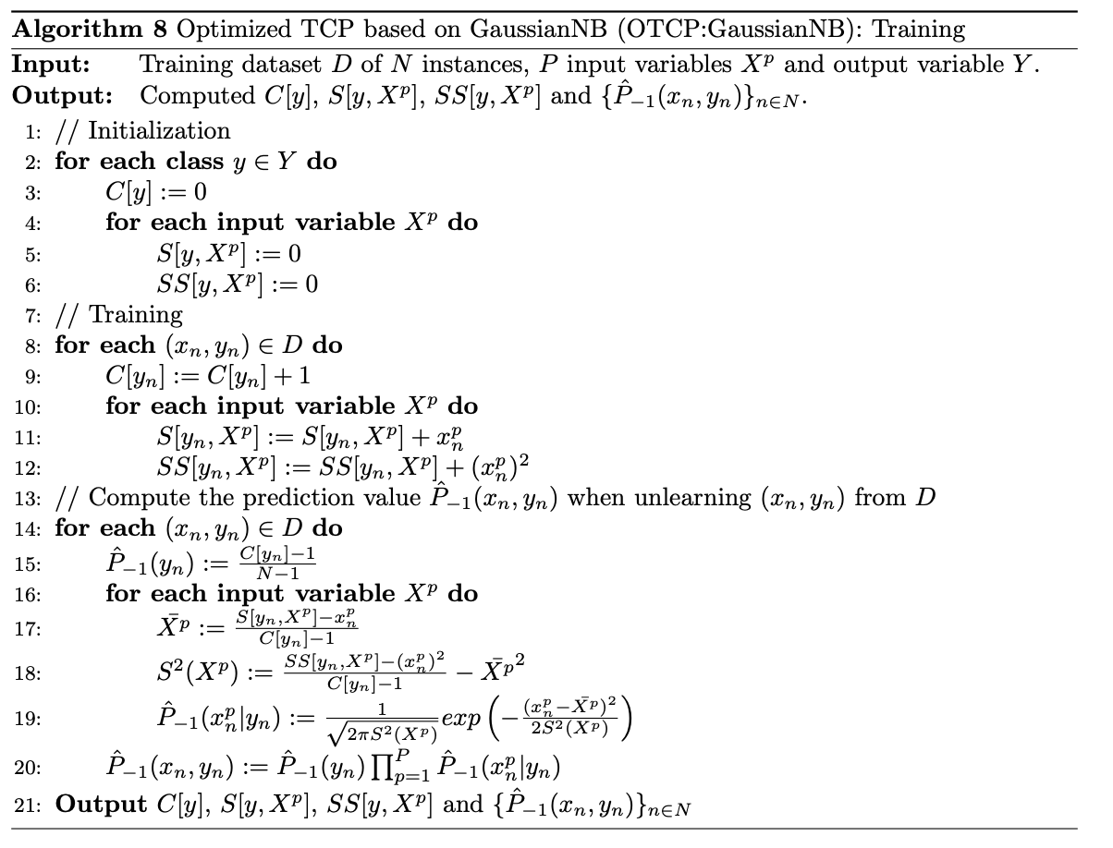
OTCP using GaussianNB: Training
Unlike TCP, Optimized TCP only needs to train one classifier and then use it to compute the nonconformity measure scores for all instances.

Slide 20
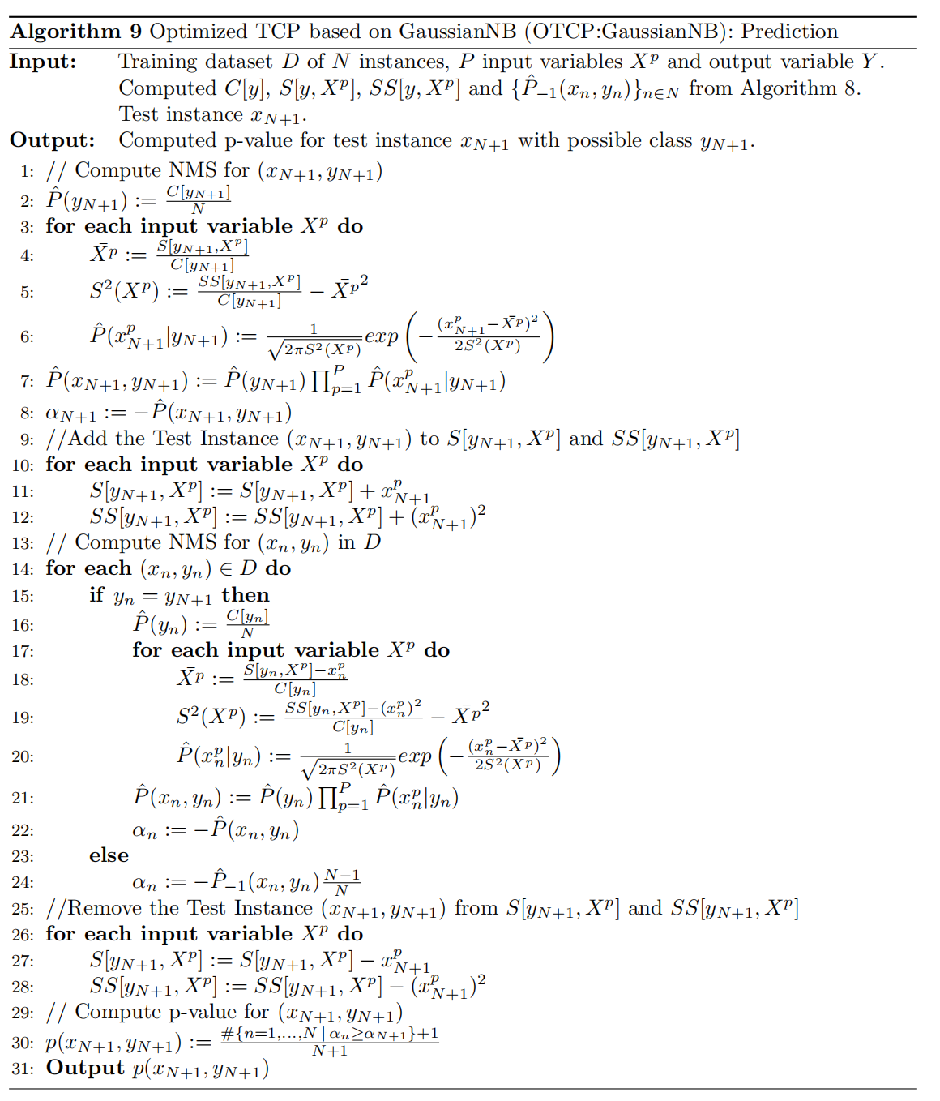
OTCP using GaussianNB: Prediction
If there are L possible classes, the prediction phase needs to run L times.
L is the number of classes.

Slide 21
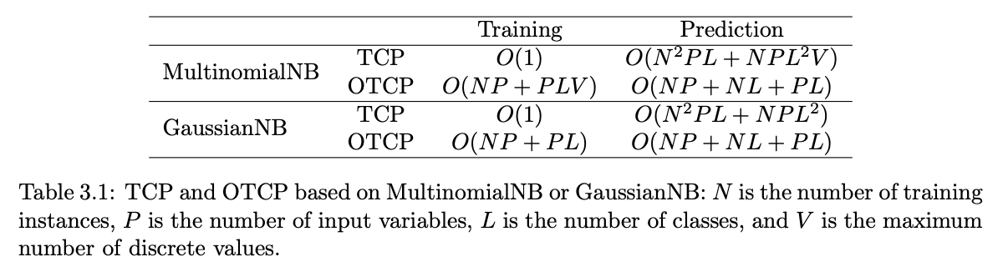
Time Complexity Analysis ——TCP and OTCP based on MultinomialNB or GaussianNB

Slide 22
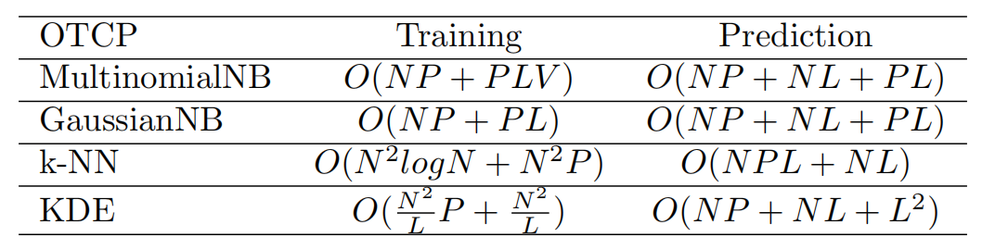
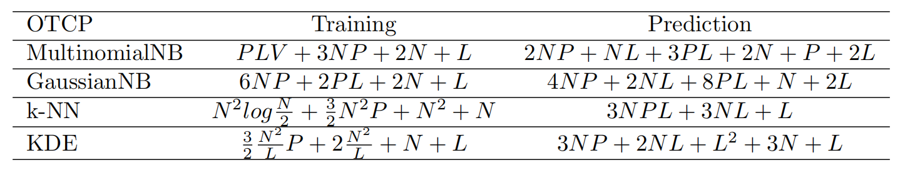
Time Complexity Analysis ——OTCP based on Different ML Methods
Big O Notation
N: number of training instances
P: number of input variables
L: number of classes
In Detail

Slide 23
4.Experiments, Results and Discussion
Consistency Test
Comparison between TCP and OTCPG based on MultinomialNB or GaussianNB
Comparison among OTCP based on Different ML Methods

Slide 24
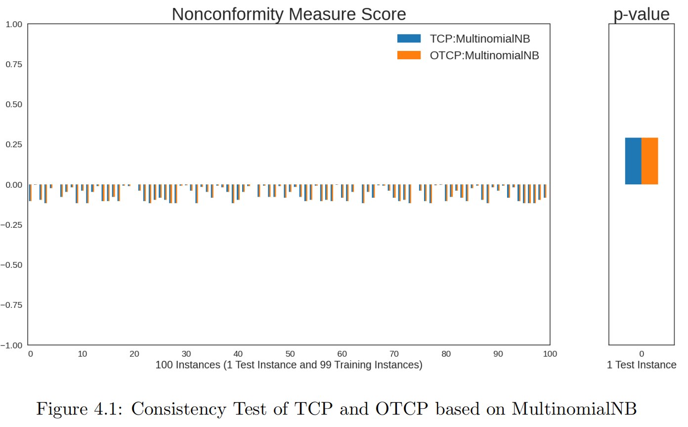
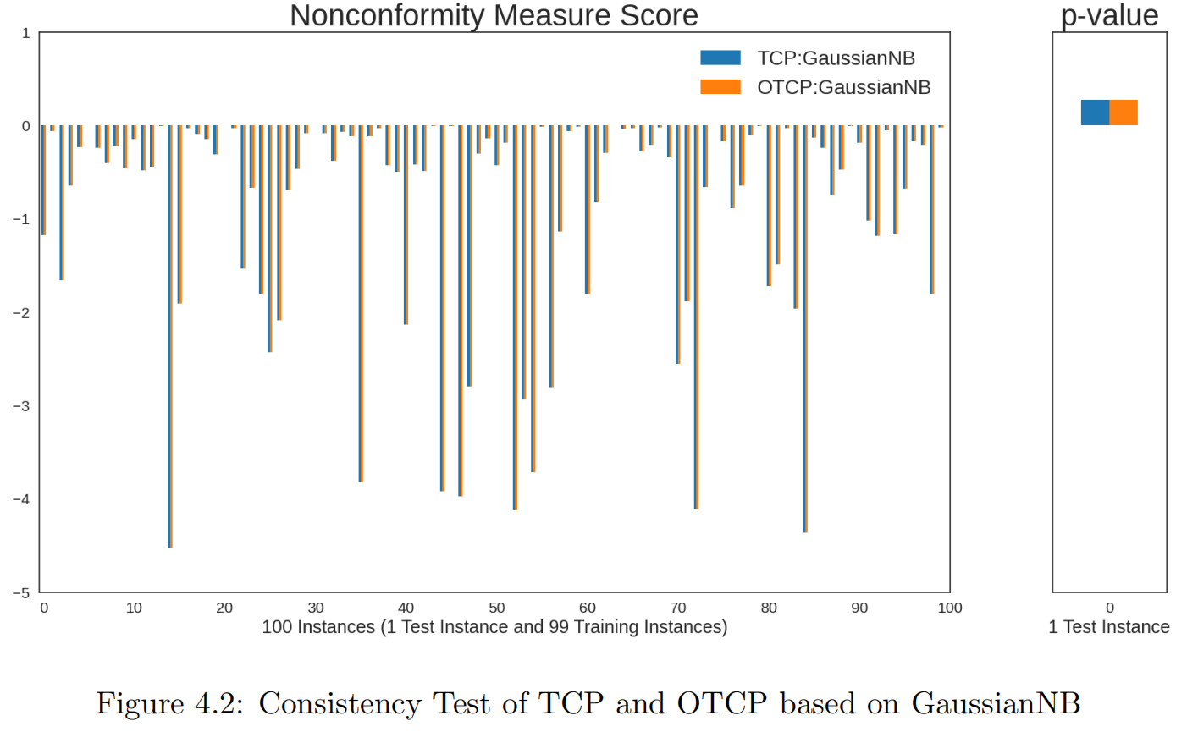
Consistency Test
TCP and OTCP based on MultinomialNB
TCP and OTCP based on GaussianNB

Slide 25
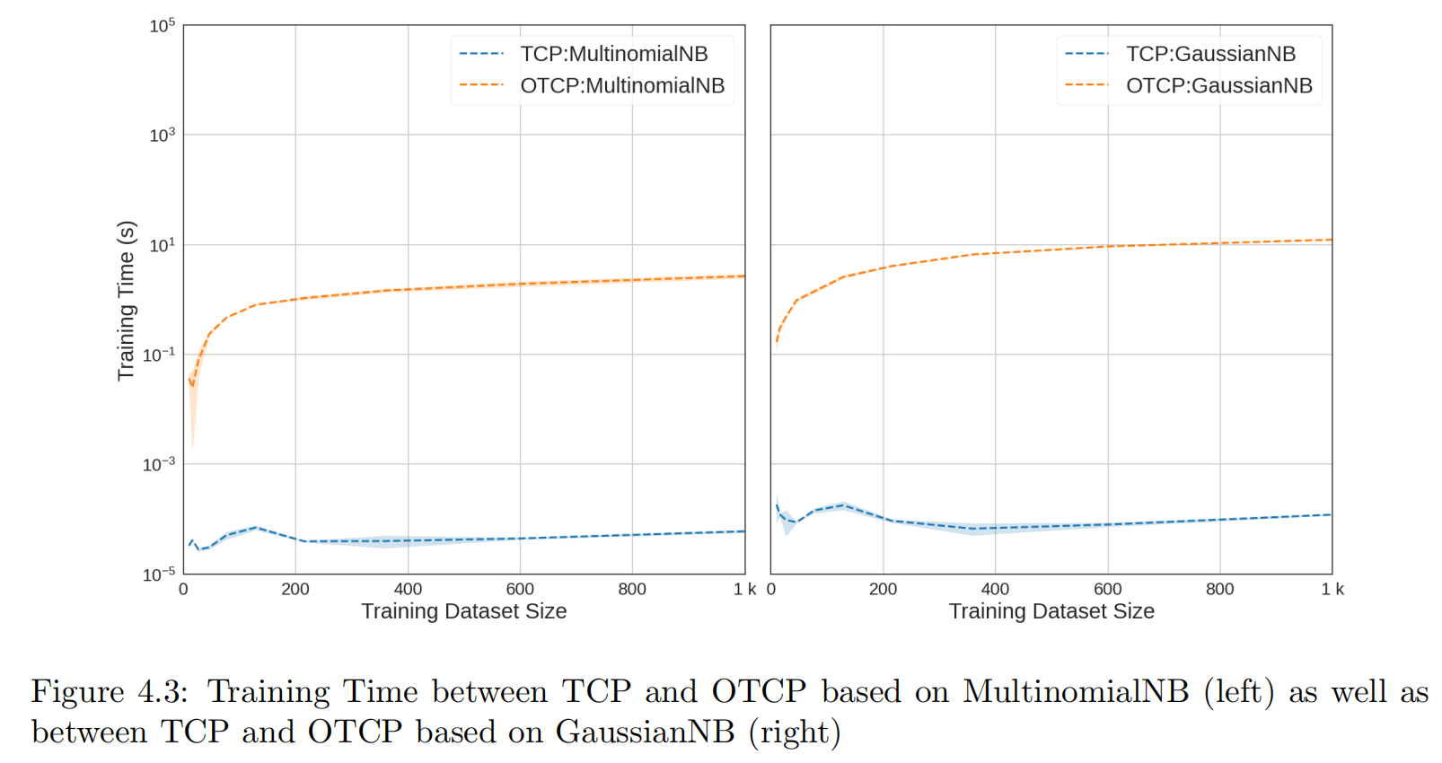
Comparison between TCP and OTCPG based on MultinomialNB or GaussianNB: Training Time

Slide 26
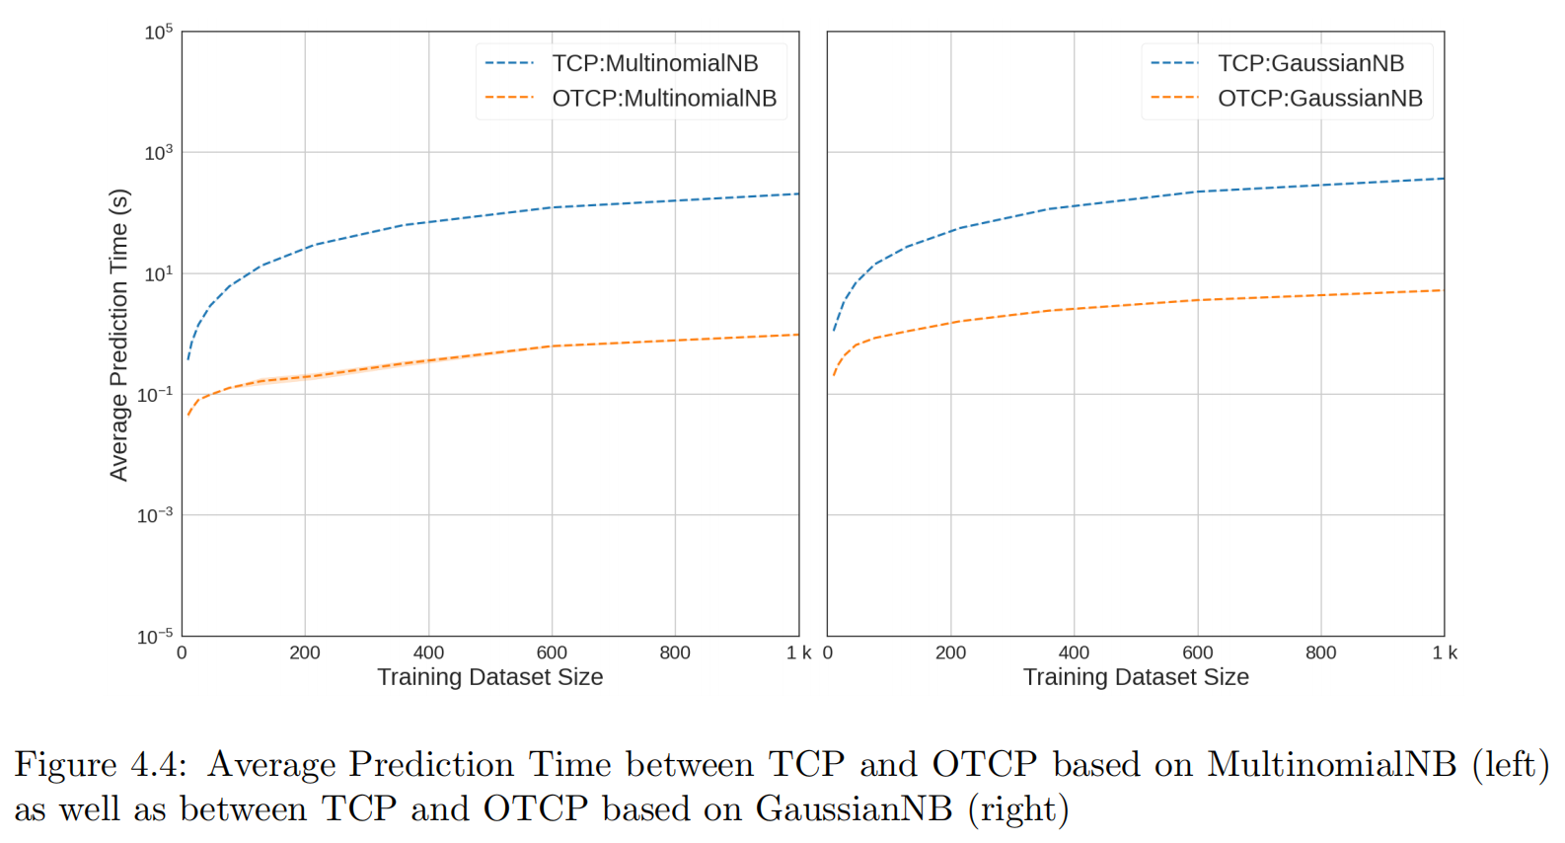
Comparison between TCP and OTCPG based on MultinomialNB or GaussianNB: Average Prediction Time

Slide 27
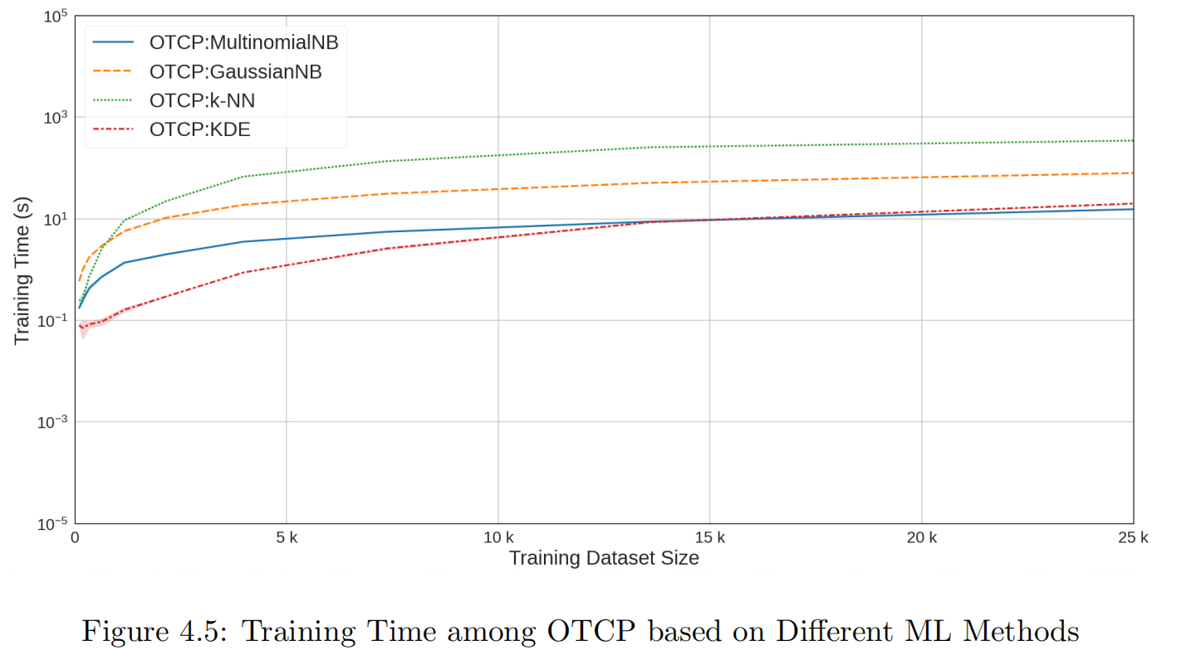
Comparison among OTCP based on Different ML Methods: Training Time

Slide 28
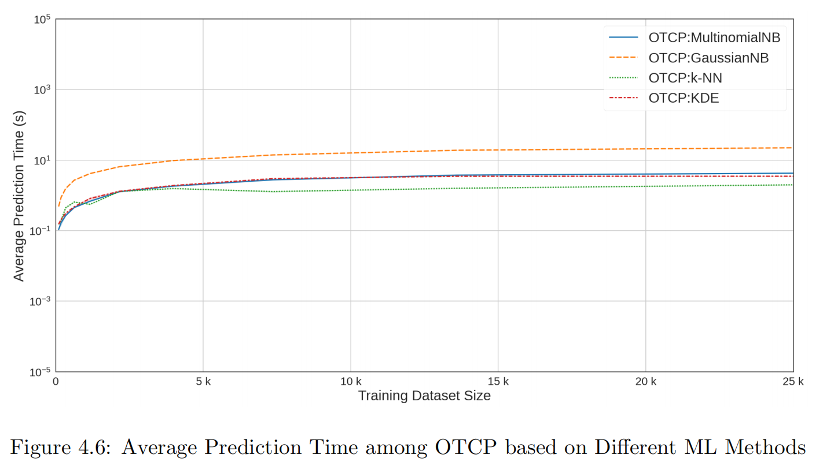
Comparison among OTCP based on Different ML Methods: Average Prediction Time

Slide 29
5.Conclusions
Research Question 1
Research Question 2
Research Question 3
Future Research

Slide 30
Research Question 1
Can the optimized Transductive Conformal Predictors based on Naive Bayes Classifier produce the same exact solutions as standard ones?
Answer:
Positive
TCP and OTCP based on MultinomialNB
TCP and OTCP based on GaussianNB

Slide 31
Research Question 2
Can the optimized Transductive Conformal Predictors based on Naive Bayes Classifier reduce the training time and prediction time significantly?
Answer:
Training time is not comparable, but prediction time is positive.

Slide 32
Research Question 3
Can the optimized Transductive Conformal Predictors based on Naive Bayes Classifier reduce more training time and prediction time than other optimized TCP based on different ML methods?
Answer: For training time
N: number of training instances
P: number of input variables
L: number of classes
V: maximum number of discrete values

Slide 33
Research Question 3
Can the optimized Transductive Conformal Predictors based on Naive Bayes Classifier reduce more training time and prediction time than other optimized TCP based on different ML methods?
Answer: For prediction time
N: number of training instances
P: number of input variables
L: number of classes
V: maximum number of discrete values

Slide 34
Future Research
The first direction is to design OTCP that utilize NBC and have the ability to handle mixed input variables, as opposed to exclusively discrete or continuous variables.
The second research direction aims to address the limitations posed by computational resources.

Slide 35
References
[1] Ulf Johansson, Rikard Konig, Tuve Lofstrom, and Henrik Bostrom. Evolved decision trees as conformal predictors. In 2013 IEEE Congress on Evolutionary Computation, pages 1794–1801. IEEE, 2013.
[2] Stijn Vanderlooy, Ida G Sprinkhuizen-Kuyper, and Evgueni N Smirnov. An analysis of reliable classifiers through roc isometrics. ROC Analysis in Machine Learning, 2006.
[3] Vladimir Vovk, Alexander Gammerman, and Glenn Shafer. Algorithmic learning in a ran_x0002_dom world, volume 29. Springer, 2005.
[4] Harris Papadopoulos, Kostas Proedrou, Volodya Vovk, and Alex Gammerman. Inductive confidence machines for regression. In Machine Learning: ECML 2002: 13th European Conference on Machine Learning Helsinki, Finland, August 19–23, 2002 Proceedings 13, pages 345–356. Springer, 2002.
[5] Vladimir Vovk. Cross-conformal predictors. Annals of Mathematics and Artificial Intelli_x0002_gence, 74:9–28, 2015.
[6] Rina Foygel Barber, Emmanuel J Candes, Aaditya Ramdas, and Ryan J Tibshirani. Pre_x0002_dictive inference with the jackknife+. 2021.
[7] Jing Lei. Fast exact conformalization of the lasso using piecewise linear homotopy. Biometrika, 106(4):749–764, 2019.
[8] Giovanni Cherubin, Konstantinos Chatzikokolakis, and Martin Jaggi. Exact optimization of conformal predictors via incremental and decremental learning. In International Conference on Machine Learning, pages 1836–1845. PMLR, 2021.
[9] Jorgen Hilden. Statistical diagnosis based on conditional independence does not require it. Computers in biology and medicine, 14(4):429–435, 1984.

Slide 36
References
[10] Pat Langley, Wayne Iba, Kevin Thompson, et al. An analysis of bayesian classifiers. In Aaai, volume 90, pages 223–228. Citeseer, 1992.
[11] Pedro Domingos and Michael Pazzani. On the optimality of the simple bayesian classifier under zero-one loss. Machine learning, 29:103–130, 1997.
[12] Joseph L Hellerstein, TS Jayram, Irina Rish, et al. Recognizing end-user transactions in performance management. IBM Thomas J. Watson Research Division Hawthorne, NY, 2000.
[13] Tom M Mitchell. Artificial neural networks. Machine learning, 45(81):127, 1997.
[14] Ilia Nouretdinov, Thomas Melluish, and Volodya Vovk. Ridge regression confidence machine. In ICML, pages 385–392. Citeseer, 2001.
[15] Rikard Laxhammar and G¨oran Falkman. Conformal prediction for distribution-independent anomaly detection in streaming vessel data. In Proceedings of the first international workshop on novel data stream pattern mining techniques, pages 47–55, 2010.
[16] Giovanni Cherubin, Ilia Nouretdinov, Alexander Gammerman, Roberto Jordaney, Zhi Wang, Davide Papini, and Lorenzo Cavallaro. Conformal clustering and its application to botnet traffic. In Statistical Learning and Data Sciences: Third International Sympo_x0002_sium, SLDS 2015, Egham, UK, April 20-23, 2015, Proceedings 3, pages 313–322. Springer, 2015.
[17] Sungkyu Jung, Kiho Park, and Byungwon Kim. Clustering on the torus by conformal prediction. The Annals of Applied Statistics, 15(4):1583–1603, 2021.

Slide 37
References
[18] Giovanni Cherubin and Ilia Nouretdinov. Hidden markov models with confidence. In Sympo_x0002_sium on Conformal and Probabilistic Prediction with Applications, pages 128–144. Springer, 2016.
[19] Vladimir Vovk, Ilia Nouretdinov, and Alexander Gammerman. Testing exchangeability on_x0002_line. In Proceedings of the 20th International Conference on Machine Learning (ICML-03), pages 768–775, 2003.
[20] Ronald A Fisher and Michael Marshall. Iris data set. RA Fisher, UC Irvine Machine Learning Repository, 440:87, 1936.

Slide 38
Thank you

