Slide 1
Zhizheng's experience

Slide 2
Table of contents
Development & Data Analysis of a Resistive Plate Counter (RPC)
Chain-of-Thought Reasoning for Advanced Image Generation
GRPO Optimization under Sampling–Reward Distribution Mismatch
Improving Crystal Structure Prediction via Niggli Reduction

Slide 3
Development & Data Analysis of a Resistive Plate Counter (RPC)

Slide 4
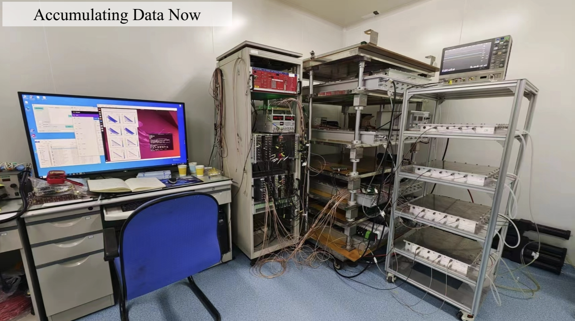

Development & Data Analysis of a Resistive Plate Counter (RPC)

Slide 5
Development & Data Analysis of a Resistive Plate Counter (RPC)
Algorithm
Real world

Slide 6
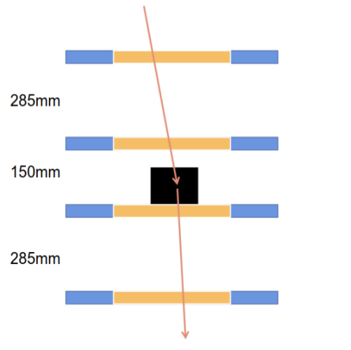
Development & Data Analysis of a Resistive Plate Counter (RPC)
inert gas inside
High Voltage Difference

Slide 7
Chain-of-Thought Reasoning for Advanced Image Generation

Slide 8
Chain-of-Thought Reasoning for Advanced Image Generation
MASK
MASK
MASK
token
token
token
MASK
MASK
MASK
MASK
MASK
MASK
token
token
token
token
MASK
token
MASK
MASK
MASK
token
token
token
MASK
token
MASK

Slide 9

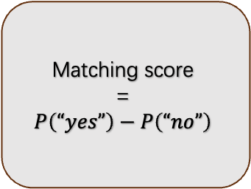
Chain-of-Thought Reasoning for Advanced Image Generation
prompt
Matching score
=
$$P\left(“yes”\right)−P\left(“no”\right)$$
image

Slide 10
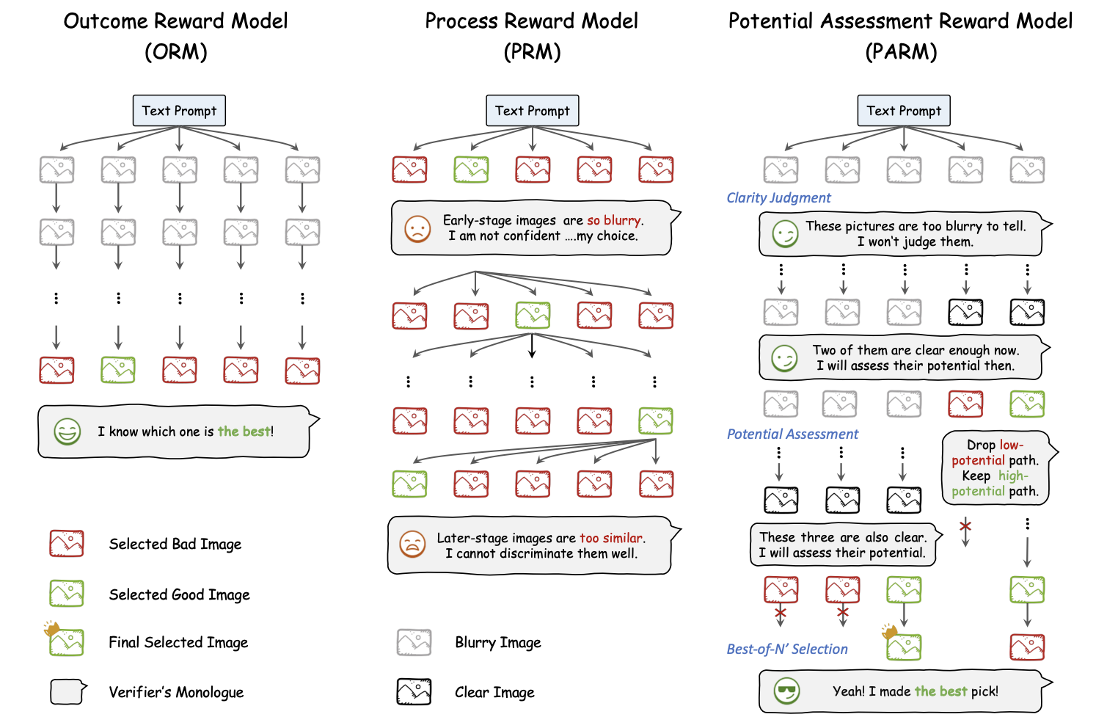
Chain-of-Thought Reasoning for Advanced Image Generation

Slide 11
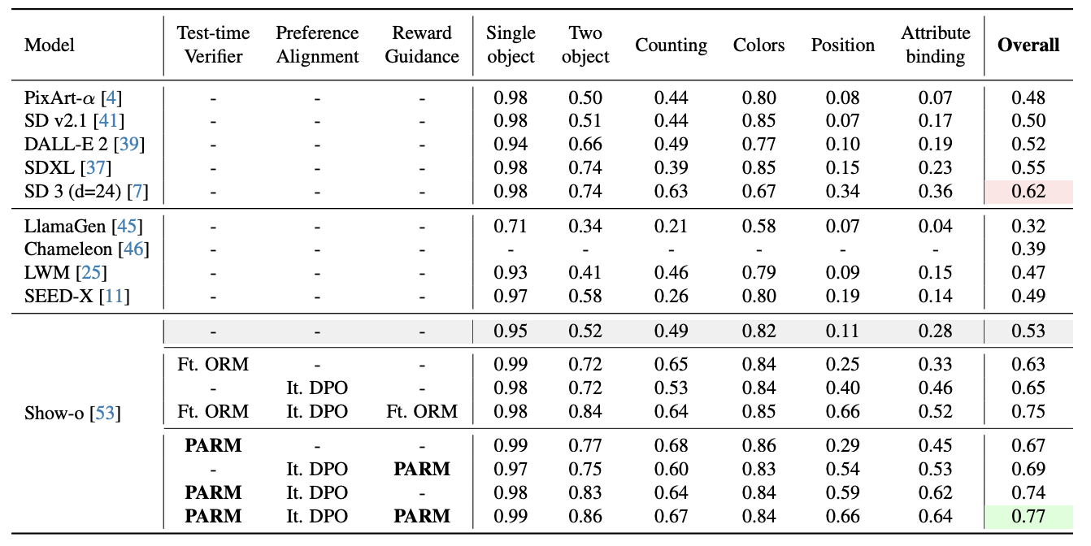
Chain-of-Thought Reasoning for Advanced Image Generation

Slide 12
GRPO Optimization under Sampling–Reward Distribution Mismatch

Slide 13
GRPO Optimization under Sampling–Reward Distribution Mismatch
probability
reward
Action space
Action space

Slide 14
GRPO Optimization under Sampling–Reward Distribution Mismatch
probability
reward
Action space

Slide 15
GRPO Optimization under Sampling–Reward Distribution Mismatch
probability
reward
Action space

Slide 16
GRPO Optimization under Sampling–Reward Distribution Mismatch
reward
probability
Action space

Slide 17
GRPO Optimization under Sampling–Reward Distribution Mismatch
reward
probability diffusion
probability
Action space

Slide 18
GRPO Optimization under Sampling–Reward Distribution Mismatch
reward
probability
Plant a seed!
Action space

Slide 19
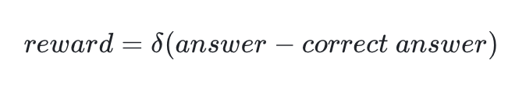
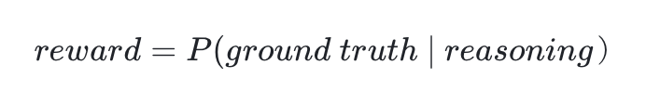
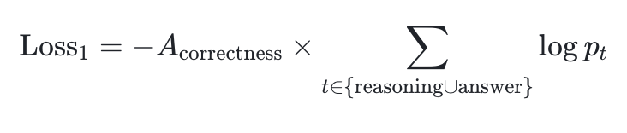
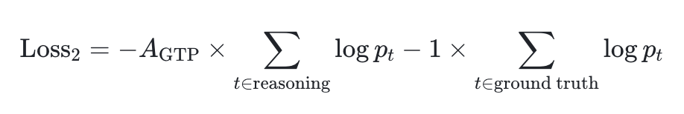
GRPO Optimization under Sampling–Reward Distribution Mismatch
Reasoning_1
answer_1
Reasoning_1
Ground truth
question
Reasoning_2
answer_2
question
Reasoning_2
Ground truth
Reasoning_3
answer_3
Reasoning_3
Ground truth

Slide 20

GRPO Optimization under Sampling–Reward Distribution Mismatch
All reward=0

Slide 21
Evaluating Reasoning-Path Hidden Space for Crystals (Encode→Decode)

Slide 22
Evaluating Reasoning-Path Hidden Space for Crystals (Encode→Decode)
Chemical formula
Crystal structure

Slide 23
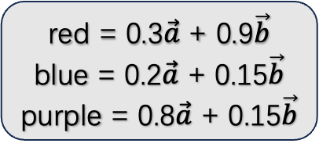
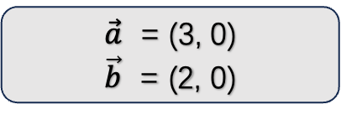
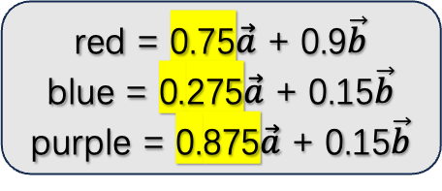
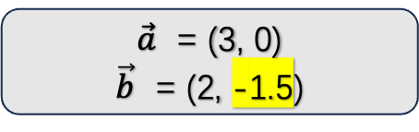
Evaluating Reasoning-Path Hidden Space for Crystals (Encode→Decode)
Chemical formula
Crystal structure
$\vec{a}$ = (3, 0)
$\vec{b}$ = (2, -1.5)
$\vec{a}$ = (3, 0)
$\vec{b}$ = (2, 0)
red = 0.75$\vec{a}$ + 0.9$\vec{b}$
blue = 0.275$\vec{a}$ + 0.15$\vec{b}$
purple = 0.875$\vec{a}$ + 0.15$\vec{b}$
red = 0.3$\vec{a}$ + 0.9$\vec{b}$
blue = 0.2$\vec{a}$ + 0.15$\vec{b}$
purple = 0.8$\vec{a}$ + 0.15$\vec{b}$

Slide 24
Evaluating Reasoning-Path Hidden Space for Crystals (Encode→Decode)
Niggli-reduced cell
Niggli reduction

Slide 25
Evaluating Reasoning-Path Hidden Space for Crystals (Encode→Decode)
Chemical formula
Cell representation in the dataset
predict
niggli
Predicted cell
MSE
Niggli-reduced cell

Slide 26
Thanks!

