Slide 1

CUATS Coding Challenge 2025
Khalimat Murtazalieva
Team:
KPZ Trading
Members:
Zhixuan Liu
Pritthijit Nath
Khalimat Murtazalieva
February 2025

Slide 2
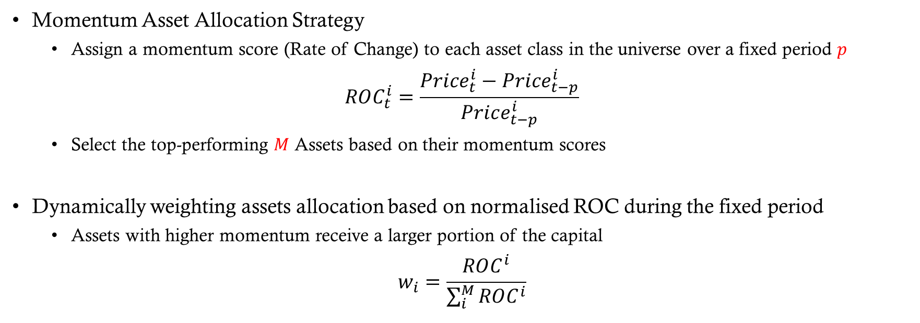
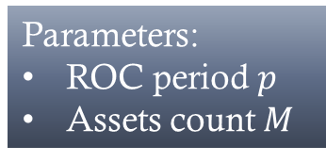
Strategy Dynamically-weighted Momentum Asset allocation
Parameters:
ROC period $p$
Assets count $M$
Momentum Asset Allocation Strategy
Assign a momentum score (Rate of Change) to each asset class in the universe over a fixed period $p$
$$ROC_{t}^{i}=\frac{Price_{t}^{i}−Price_{t−p}^{i}}{Price_{t−p}^{i}}$$
Select the top-performing $M$ Assets based on their momentum scores
Dynamically weighting assets allocation based on normalised ROC during the fixed period
Assets with higher momentum receive a larger portion of the capital
$$w_{i}=\frac{ROC^{i}}{\sum_{i}^{M}{ROC^{i}}}$$
Notes:
Profit from the anomaly in asset’s short-term performance to

Slide 3
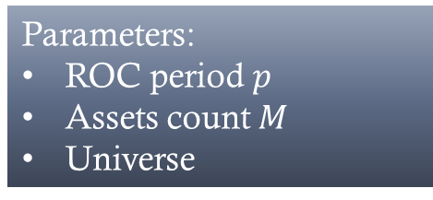
Implementation
Parameters:
ROC period $p$
Assets count $M$
Universe
Universe Selection: SPY, EFA, IEF, VNQ, GSG.
ROC Calculation over the past 6-day period
Selecting the top 3 assets with highest momentum scores
Assigning weights to selected assets by momentum score proportions
Set holdings (long only) and liquidate unselected assets
Monthly Rebalance
Universe
Selection
Compute ROC
Rank and Select
Assign Proportional Weights
Set Holdings & Liquidate
Monthly Rebalance

Slide 4
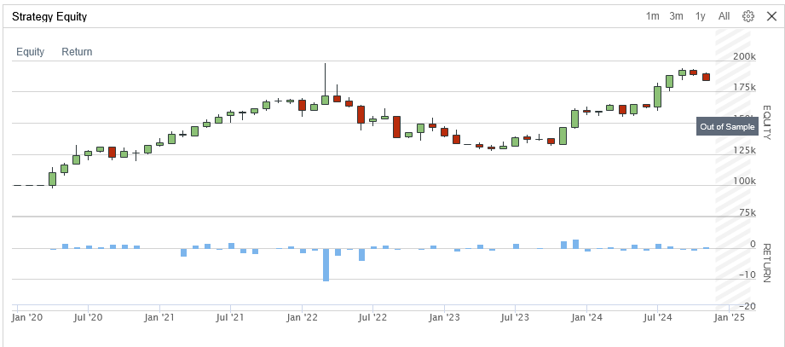
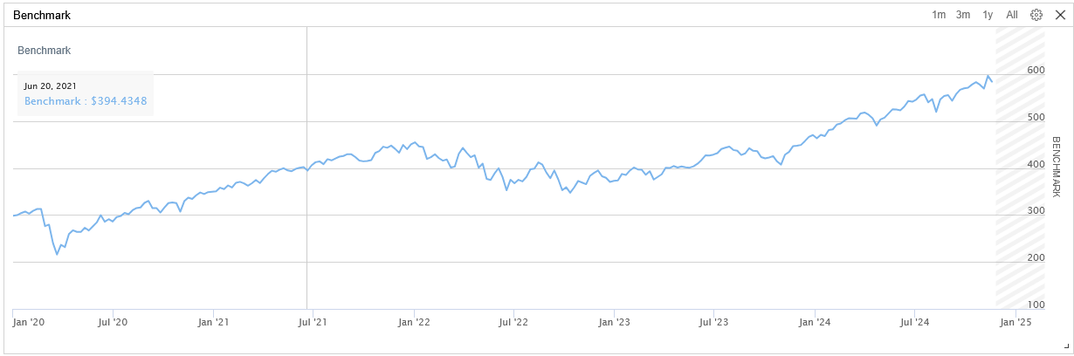

Parameter Tuning ROC period $p$
Limitations:
limited number of assets
Profit from Short term Anomaly!

Slide 5
Reselecting universe The most liquid assets
Parameters:
ROC period $p$
Assets count $M$
Universe
Universe Selection:
SPY, EFA, IEF, VNQ, GSG, QQQ, IWM, AAPL, MSFT, TSLA, AMZN, NVDA, META, BABA
ROC Calculation over the past 3-day period
Selecting the top 5 assets with highest momentum scores
Assigning weights to selected assets by momentum score proportions
Set holdings (long only) and liquidate unselected assets
Monthly Rebalance
Universe
Selection
Compute ROC
Rank and Select
Assign Proportional Weights
Set Holdings & Liquidate
Monthly Rebalance

Slide 6
Backtesting Results
Asset Universe Expansion

Slide 7
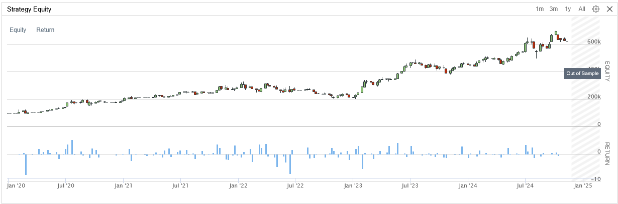
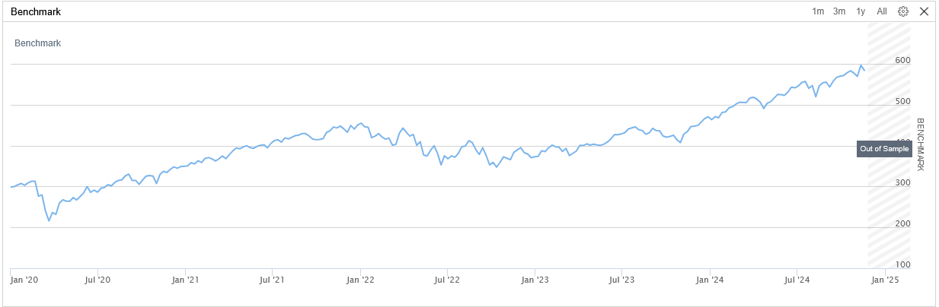

Slide 8
Metrics comparison
Parameter Set | SPY, EFA, IEF, VNQ, GSG (ROC of 6 days, long 3 top performing assets) | SPY, EFA, IEF, VNQ, GSG, QQQ, IWM, AAPL, MSFT, TSLA, AMZN, NVDA, META, BABA (ROC of 3 days, long 5 top performing assets)
Sharpe Ratio | 0.542 | 1.125
Compounding Annual Return | 13.316 % | 45.266 %
Max Drawdown | 34.9 % | 38.3 %
Beta | 0.386 | 0.886
Alpha | 0.038 | 0.24

Slide 9
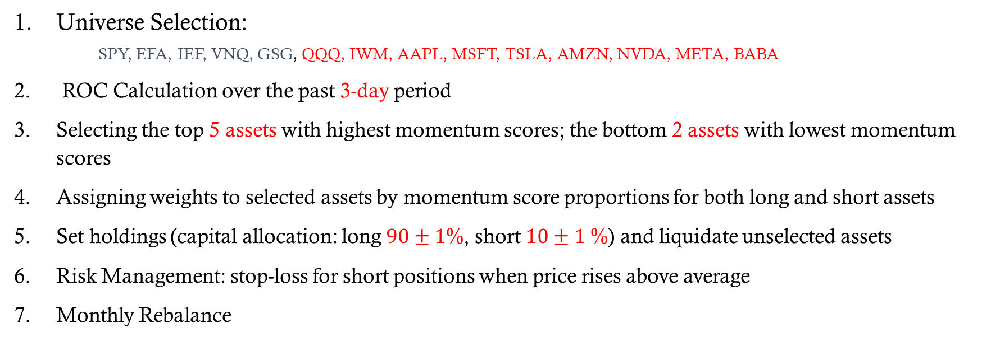
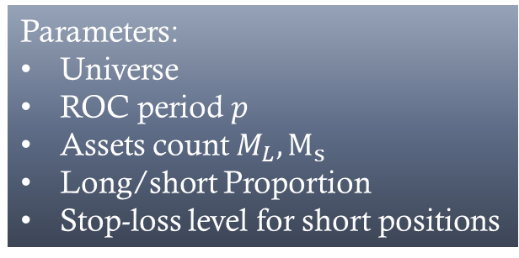
Long/short strategies The most liquid assets
Parameters:
Universe
ROC period $p$
Assets count $M_{L}, M_{s}$
Long/short Proportion
Stop-loss level for short positions
Universe Selection:
SPY, EFA, IEF, VNQ, GSG, QQQ, IWM, AAPL, MSFT, TSLA, AMZN, NVDA, META, BABA
ROC Calculation over the past 3-day period
Selecting the top 5 assets with highest momentum scores; the bottom 2 assets with lowest momentum scores
Assigning weights to selected assets by momentum score proportions for both long and short assets
Set holdings (capital allocation: long $90±1$%, short $10±1$%) and liquidate unselected assets
Risk Management: stop-loss for short positions when price rises above average
Monthly Rebalance
Universe
Selection
Compute ROC
Rank and Select
Assign Proportional Weights
Set Holdings & Liquidate
Monthly Rebalance

Slide 10
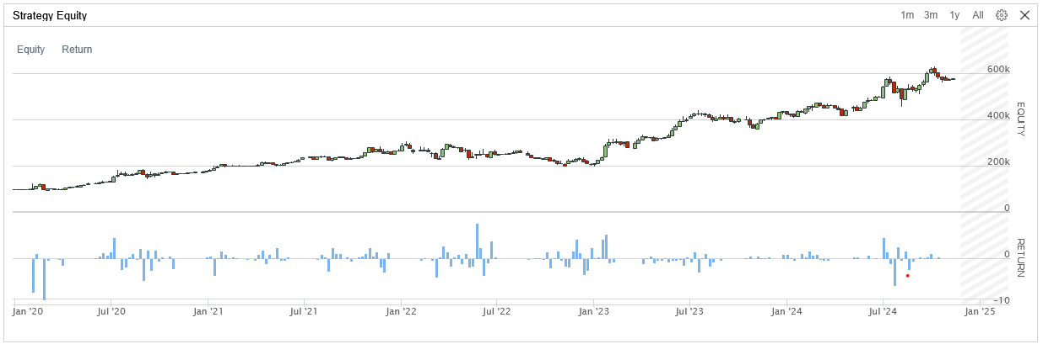
Long only
Benchmark
Long Short

Slide 11
Metrics comparison
Parameter Set | SPY, EFA, IEF, VNQ, GSG (ROC of 6 days, long 3 top performing assets) | SPY, EFA, IEF, VNQ, GSG, QQQ, IWM, AAPL, MSFT, TSLA, AMZN, NVDA, META, BABA (ROC of 3 days, long 5 top performing assets) | SPY, EFA, IEF, VNQ, GSG, QQQ, IWM, AAPL, MSFT, TSLA, AMZN, NVDA, META, BABA (ROC of 3 days, long 5 short 2)
Sharpe Ratio | 0.542 | 1.125 | 1.118
Compounding Annual Return | 13.316 % | 45.266 % | 42.756 %
Max Drawdown | 34.9 % | 38.3 % | 34.8 %
Beta | 0.386 | 0.886 | 0.893
Alpha | 0.038 | 0.24 | 0.216
To optimise long/short strategy, should reconsider universe selection that includes negatively correlated assets!

Slide 12
Takeaways
Deployed a Dynamically-weighted Momentum Asset allocation Strategy
Effective in capturing short-term movement opportunities, fast reaction
A broader range of assets (increased market exposure) improves returns
Long/short strategies preferred for portfolios with negatively correlated assets

