Slide 1
Introduction to Reinforcement Learning

Slide 2
Welcome
CST8509: Reinforcement Learning
Meet your Professors
Lectures: Todd Kelley
Office: T315
Phone: 613-727-4723 x7474
Email: kelleyt@algonquincollege.com
Labs: Ali Mohamed Ali <mohamea2@algonquincollege.com>
Contact your Professor
email me with enquiries (can expect reply same or next day)
email me to arrange office-hour style meetings

Slide 3
Logistics
Weekly schedule
Lecture Mondays 1:00-3:00pm in C346
Lab Section 101 Wednesdays 5:00 to 7:00pm in B320
Lab Section 102 Wednesdays 7:00 to 9:00pm in B119
One hour (average) of asynchronous (Hybrid) activity
Let's look at the Course Section Information on Brightspace
Let's look at the submission requirements on Brightspace
Late lab/assignment submissions are subject to a penalty:
10% < 1 week
100% > 1 week

Slide 4
Expectations for Assignments
Unless an Assignment or Lab explicitly states that it is a group activity, ALL practical and theory work in this course is individual work:
You must complete solutions by yourself
You are allowed to participate in study groups and use ChatGPT or similar facilities.
You are allowed to help each other understand the concepts of the course.
You are not allowed to copy or use for any purpose any portion of a solution from another student, from ChatGPT, or from any other source.
You are not allowed to provide any portion of your solution to anyone else.

Slide 5
Tips for Success
Assignments are large bodies of work that cannot reasonably be completed in one or two sessions, even long sessions
Get started early
Get clarification and help early
Make good use of Lab Periods

Slide 6
Tips for Success (cont'd)
Rule One: 15 minute rule
if you are frustrated and not making progress for 15 minutes, you need to
take a break, move on to another part of the assignment, switch to other course work, come back to it later
sleep on it
seek help from a peer
seek help from the instructor

Slide 7
Tips for Success (cont'd)
Rule Two: Don't leave it to the last few days before the due date
Rule One is not feasible without Rule Two
Get started early, read through and understand the focus of the assignment and the tasks, as soon as you can
Keep up with the course pace (every week, you're expected to put in about 5 hours of time in addition to 5 hours of Hybrid Activities, Lectures, and Labs)

Slide 8
Excessive Help
You are trying to increase your OWN knowledge and skill so that you can convince an employer to hire you
Beware of receiving excessive help
Getting the right amount of help when it’s needed is important
It’s just as important to not get too much help
Do it yourself (you need to learn how to):
read EVERY word of the Lab and Assignment Documents
consult course materials and resources
apply what you read and what you see in videos
solve apparent inconsistencies/problems

Slide 9
Don't take shortcuts in Labs
Like excessive help, shortcuts are bad
Suppose you are training for a marathon
your coach wants you to run a five kilometer training route
You feel overloaded and find a shortcut on the route to reduce it to one kilometer
You saved so much time doing it your way!
The short cut took so much less time and effort: where’s the problem?
If you cannot explain your own work in a demonstration, you risk getting a zero on the lab or assignment

Slide 10
Plagiarism
Cheating is unacceptable
You may not copy or provide code or text: don't plagiarize
The person you copy from is in just as much trouble as you
Adherence to acceptable standards of academic honesty is an important aspect of the learning process at Algonquin College. Academic work submitted by a student is evaluated on the assumption that the work presented by the student is his or her own, unless designated otherwise. For further details consult Algonquin College Policies AA18(https://www.algonquincollege.com/policies/files/2016/04/AA18.pdf) and
AA20 (https://www.algonquincollege.com/policies/files/2016/04/AA20.pdf)

Slide 11
Overview of this course
Introduction to RL
Foundational Principles of RL
Mathematical definitions
RL Algorithms
Solving RL problems
Game-based, maze based, etc
Robotics
Create 3
OpenAI Gymnasium/Gym, Gazebo

Slide 12
Week 1 Outcomes
What is Reinforcement Learning?
Agent
Environment
Reward
Policy
Value Function
Model

Slide 13
From CST8504: Reinforcement Learning
Reinforcement Learning is a third type of Machine Learning
Based on Markov Decision Processes
Used for agent-based systems
Agent uses a policy for choosing an action in each time step
Each action taken results in a reward
The goal is for the agent to learn a policy that maximizes the reward

Slide 14
Who's who of Reinforcement Learning
Andrew Barto, University of Massachusetts Amherst
Richard Sutton, University of Alberta (Co-founder of Edmonton office of DeepMind)
textbook
David Silver, University of Alberta PhD graduate, now at DeepMind and University College London
David Silver's RL course on Youtube
https://www.youtube.com/playlist?list=PLzuuYNsE1EZAXYR4FJ75jcJseBmo4KQ9-

Slide 15
How broad and applicable is Reinforcement Learning?
David Silver lecture 1 (youtube), 6:29
(venn diagrams showing RL is at the intersection of many different fields of human endeavor)

Slide 16
RL vs Supervised and Unsupervised learning
How does reinforcement learning compare to other machine learning (supervised, and unsupervised)?
David Silver lecture 1 - 9:35

Slide 17
RL Examples
David Silver Lecture 1: 12:45 - examples of RL, starting with stunt manoeuvers model helicopter (training is done offline with a model of a helicopter world)
David Silver Lecture 1: after helicopter - video games (many Atari games better than humans) decisions at 15HZ (3 or 4 days of training per game)
Tetris: https://www.cbc.ca/player/play/2296942659841
our coffee robot?
monkey and banana?

Slide 18
RL Movie: AlphaGo
Go board game
AlphaGo movie
begins with Demis Hassabis (co-founder of DeepMind)
After Fan Hui, we see David Silver
At 30:00 the start of the first match

Slide 19
Reinforcement Learning Problem
Reward is a scalar feedback signal R_{t}
R_{t} represents how well the agent is doing at Step t
reinforcement learning problems are set up such that goal is to maximize cumulative reward
Reward Hypothesis: All goals can be described by the maximization of expected cumulative reward

Slide 20
Reward
reward can be received along the way, or it might come all at the end
if shorter time is better, then reward per step can be negative, which favors shorter episodes
to maximize reward overall, agent may need to accept small or negative rewards short-term to maximize the total reward

Slide 21
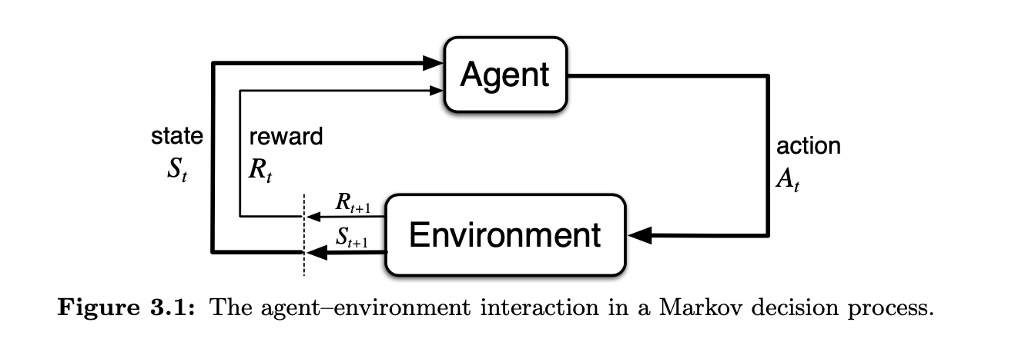
Anatomy of a Reinforcement Learning Problem
agent and environment diagram
our algorithm operates in the agent

Slide 22
Anatomy of a Reinforcement Learning Problem
each time step, the agent receives Reward, Observation, and performs Action
the time series of Reward, Observation, and Actions is the data for Reinforcement learning
the history at time step t is H_{t} = R₁, O₁, A₁, ... , R_{t}, O_{t}, A_{t}

Slide 23
Anatomy of a Reinforcement Learning Problem
the agent picks the next action at time t based on the information/data contained in H_{t}
the environment determines Observations and Rewards
processing the whole history is cumbersome after many steps
State is a summary of the information that is used to determine what happens next (t+1)

Slide 24
State
S_{t} = f(H_{t})
environment state (not usually directly accessible by the agent) S_{t}^{e} is whatever information is used to pick the next observation and reward
agent state S_{t}ª is directly accessible to the agent, the agent keeps track of this, and it's used (somehow) to select the next action
The programmer is responsible for the (somehow) in the previous point. The programmer decides what the function is:
S_{t}ª = f(H_{t}) for some function f of the programmer's choosing

Slide 25
Markov State
Important question in RL is whether the state satisfies the Markov Property, in other words, is it a Markov State
what is the definition of a Markov State?
The probability of each possible value for S_{t} and R_{t} depends only on the immediately preceding state and action, S_{t-1} and A_{t-1}
what is the intuition behind a Markov State?
examples:
linear motion of a particle in classical mechanics
does the position constitute a Markov state?
does the position and velocity constitute a Markov state?

Slide 26
Markov State
helicopter example (position, velocity, angular velocity, angular position, wind velocity)
S_{t}^{e} environment state is Markov
H_{t} is Markov, S_{t} = f(H_{t}) = H_{t}
It's always possible to come up with a Markov state, but we want to identify the Markov states that are more useful for us, efficient, less redundancy, etc.

Slide 27
Rat Example
David Silver Lecture 1, 47:54
depending on what function is chosen for f(H_{t}), the question mark can be electric shock, cheese, or unknown.

Slide 28
RL Agents
RL Agents may include one or more of the following
Policy: function that maps state to action
Value Function: represents the value (how good is it?) of each state or action
Model: agent's internal representation of the environment, as opposed to the environment itself

Slide 29
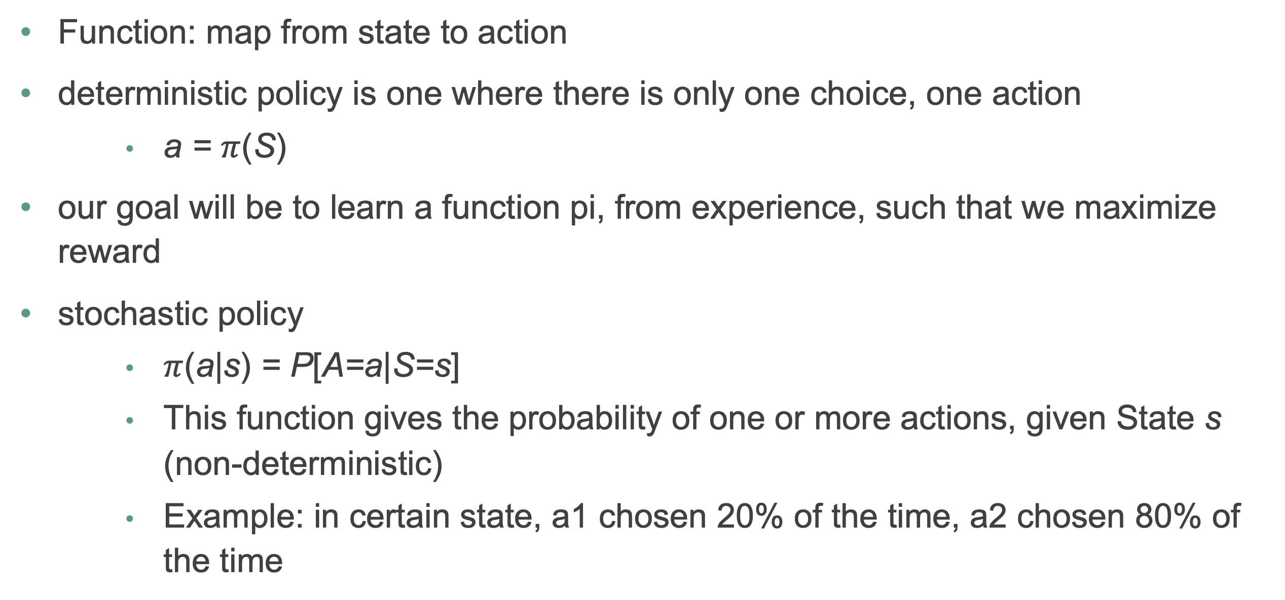
Policy
Function: map from state to action
deterministic policy is one where there is only one choice, one action
a = $π$(S)
our goal will be to learn a function pi, from experience, such that we maximize reward
stochastic policy
$π$(a|s) = P[A=a|S=s]
This function gives the probability of one or more actions, given State s (non-deterministic)
Example: in certain state, a1 chosen 20% of the time, a2 chosen 80% of the time

Slide 30
Value Function
the value function indicates how good it is to be in a particular state with respect to expected future reward
used to pick actions, interacts with policy
the value function for a policy is the sum of the expected reward for all future states

Slide 31
Value Function (cont'd)
in the case of Atari games, as states are visited, value goes up and down, because
if something good is about to happen, value function is elevated
after something good happens, that reward is behind you, and not included in the future reward
in other words the value function does not include the sum of rewards received so far, just future reward, which oscillates: David Silver Lecture 1: 1:02:15

Slide 32
Model
allows inferences about how the environment will behave
model indicates or implies the next state and next reward.
From Sutton, page 7: "Models are used for planning, by which we mean any way of deciding on a course of action by considering possible future situations before they are actually experienced."
David Silver Lecture 1: Transition model (predicts states) Reward Model (predicts rewards)
not all Reinforcement Learning Problems/Solutions include a model

Slide 33
Maze Example
David Silver, Lecture 1: 1:08:00

Slide 34
Taxonomy of RL Agents
David Silver Lecture 1:11:0
Value Based
no policy (choose actions based on Value function)
value function
Policy Based
Policy
no value function

Slide 35
Taxonomy of RL Agents
Actor Critic
Policy (actor)
Value Function (critic)
Model Free
Policy and/or Value Function
no Model
Model Based
Policy and/or Value Function
Model

Slide 36
Key Subproblems
Learning vs Planning, David Silver Lecture 1: 1:16:10
reinforcement learning
planning
balancing exploitation and exploration
Example:
Always go to a good restaurant (exploit the good restaurant)
Randomly choose a new restaurant (exploration, might be better, might be worse. This is our chance to find better, but it's a risk)
prediction (evaluate future reward) vs control (optimize policy)

Slide 37
Time to check your learning!
Let’s see how many key concepts you recall by answering the following questions!
What is the Markov Property?
What are the possible components in an RL agent?
What is a policy in the context of RL?
What is a value function in the context of RL?
What is a model in the context of RL?

