Slide 1
CST8509 Part II

Slide 2
Today's Agenda
Midterm results
Gazebo
RViz
Dynamic Programming
Monte Carlo

Slide 3
Toolbox
Today we add Gazebo and Rviz to our RL toolbox:
Gymnasium (Environments)
Stable-Baselines3 (Algorithm implementations/agents)
Gazebo (?? Simulation)
Rviz (?? Robot Visualization)

Slide 4
Gazebo
Gazebo is a simulator: https://gazebosim.org/home
Simulates environments
Simulates robots
Plugin-based physics, rendering, and GUI libraries
ROS integration

Slide 5
Gazebo Versions
Gazebo versions can be confusing, because there are two choices:
Classic Gazebo (version 11), or Gazebo11 or Gazebo-11 or Classic Gazebo
Ignition Gazebo (version Fortress, Harmonic, etc). Note that Ignition Gazebo has been renamed to just Gazebo! This Gazebo choice can be called Gazebo, Ignition Gazebo, Gazebo Sim.
We will use Classic Gazebo 11 for Lab 4
To Install Classic Gazebo 11 on Ubuntu-desktop 22.04
sudo apt update && sudo apt upgrade
curl -sSL http://get.gazebosim.org | sh

Slide 6
RL with Create3 robot
First let's imagine applying RL to our Create3 robots from CST8504
Environment:
Image publisher
Recording publisher (we'll ignore voice commands for now)
Agent:
Hands Module
Move Module
Actions: Twist Messages from Move Module
Reward:
Need to add a reward generator
Need to be careful with step duration, moving target, etc

Slide 7

Our Create 3 Setup (Last Semester)
Robot of ROS 2 Nodes
Nodes on network communicate
Thinking Part
Wheels/Moving Part
Create 3
192.168.186.2
Your Laptop
WIFI: from your router
Loaner Laptop
Camera/Speaker/Microphone
Ubuntu 22.04/ROS2 Humble
Wired:192.168.186.3
WIFI: from your router

Slide 8
Our Create 3 Setup (Simulated)
Robot of ROS 2 Nodes
Gazebo Nodes are on Laptop
Nodes on Laptop communicate
This still uses the Laptop Camera (remember we made the turtlesim move with our actual hand in front of the laptop camera)
Lab4 involves adding a Virtual Gazebo Camera that sees the Gazebo world
Loaner Laptop
Camera/Speaker/Microphone
Ubuntu 22.04/ROS2 Humble
Wheels/Moving Part
Thinking Part
Create 3
Gazebo

Slide 9
Why is Gazebo so important for our RL?
Assuming we work out the details RL with the Create3, how will we train the agent?
Q: Who is going to move their hand around during training?
What if training takes 3 days, won't that person get tired?
Q: How do we maintain robot safety in early training stages?
During training, the robot tries a dangerous action?
A: If the hand person and the robot are simulated, they can't get tired or hurt
Gazebo can simulate the robot, the person/hand, and the environment

Slide 10
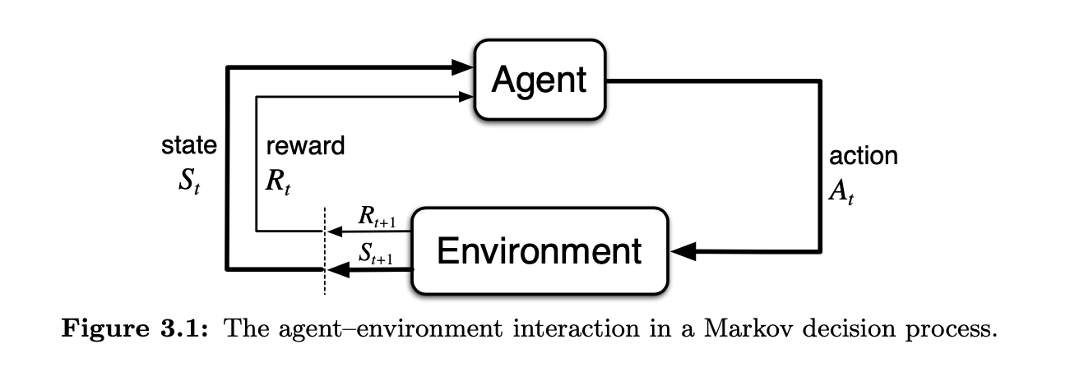
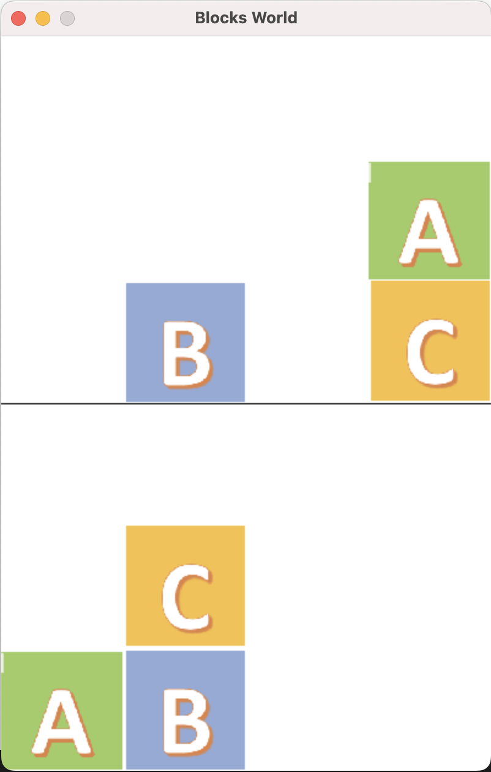
RL Diagrams so far
PyGame
action A_{t}
render()
Agent:
Q-Learning or
Stable-baselines3:
DQN or PPO or…
R_{t}
R_{t+1}
Gymnasium Environment
Prolog model
Swiplserver
S_{t}
S_{t+1}

Slide 11
Where do ROS 2 and Gazebo fit into this picture?
The Robot Operating System (ROS 1 and ROS 2) is a set of software libraries and tools for building robot applications.
Gazebo supports ROS integration
Gazebo version of Create3 publishes on ROS 2 topics

Slide 12
RL Diagrams with virtual Create 3
Loaner Laptop
ROS 2 Nodes Communicating
G
Gazebo
Create 3
action A_{t}
Agent:
Q-Learning or
Stable-baselines3:
DQN or PPO or…
R_{t}
R_{t+1}
Gymnasium Environment
S_{t}
S_{t+1}

Slide 13
iRobot Create 3 Simulator
iRobot has already done the work of creating the Gazebo simulated Create 3
AWS has already done the work of creating the Gazebo AWS small house world
iRobot Create 3 Simulator:
https://iroboteducation.github.io/create3_docs/sim/setup/
Instructions for installing and running (we use Classic Gazebo 11):
https://github.com/iRobotEducation/create3_sim

Slide 14
Adding a Camera to Create3
Unified Robotic Description Format (URDF)
File format used in ROS
File format used for Create 3 simulator
Build process will convert this to SDF
Simulation Description Format (SDF)
New format created for use in Gazebo
Intended to address shortcomings of URDF
Xacro
XML macro language (both URDF and SDF are XML)

Slide 15
URDF Details
We won't be digging deeper than just adding our camera in Lab 4, but for those who want to dig deeper:
https://docs.ros.org/en/iron/Tutorials/Intermediate/URDF/Building-a-Visual-Robot-Model-with-URDF-from-Scratch.html

Slide 16
Rviz
Graphical interface for viewing robot, sensor data, maps, and more.
https://turtlebot.github.io/turtlebot4-user-manual/software/rviz.html

Slide 17
Dynamic Programming
DP is a collection of algorithms to compute optimal policies given a perfect model
Policy Evaluation: compute the state-value function v for an arbitrary policy
Iteratively follow the policy, use Bellman Equation to update value function (keep doing this until differences from previous are "small")
Policy Improvement: make it greedy with respect to the new value function
Policy Iteration: iterate policy evaluation and improvement
drawback is that each of its iterations involves policy evaluation
Value Iteration: like Policy Iteration but…
Difference is that Policy Evaluation is stopped after one iteration

Slide 18
Dynamic Programming
Jupyter Notebook implements iterative value iteration:
dynamic.ipynb

Slide 19
Monte Carlo
Dynamic Programming required knowing the model in advance (results of actions)
Monte Carlo methods are based on averaging sample returns
Complete an episode and afterwards, record the returns such that returns are averaged over time
All episodes must terminate
State looping: distinguish between visits to the same state in a single episode:
first-visit methods
every-visit methods

Slide 20
MC methods
How to ensure every action is tried:
Exploring starts: try a random state/action pair at the beginning of each episode
Can't be used with an environment
Consider only policies that are stochastic with a nonzero probability of selecting all actions in each state
epsilon-soft policies: every action has a chance
epsilon-greedy: example of epsilon-soft policy

Slide 21
Monte Carlo
The agent goes to the end of an episode without changing the Q-table
After an episode ends, the agent backs up and updates the q-table (just until the first change)
monte_carlo.ipynb implements algorithm on Page 111 of Sutton + Barto textbook

