Slide 1
CST 8506 – Machine Learning
Final Project – Group 8
Leaf Species Classification Using Machine Learning
Applying CRISP-DM to the UCI Leaf Dataset
Hye Ran Yoo 041145212
Peng Wang 041107730
Yinyuan Chen 041146649
Apr 3, 2026 | Algonquin College

Slide 2
Presentation Outline
Presenter: Yinyuan Chen
1. Introduction & Project Overview
2. Business Understanding
3. Data Understanding – Feature & Image Datasets
4. Classification (Hye Ran Yoo)
– Data Preparation, Modelling, Evaluation
5. Clustering (Peng Wang)
– Data Preparation, Modelling, Evaluation
6. Outlier Detection (Yinyuan Chen)
– Data Preparation, Modelling, Evaluation
7. Discussion of Results
8. Conclusion & Future Work
9. Q & A
Presenter Assignments
Hye Ran Yoo : Total Slides 11
Data Understanding (Slides 6-7)
Classification (Slides 13–21)
Peng Wang : Total Slides 10
Explore Data, Data Quality (Slides 8-11)
Clustering (Slides 23–27)
Conclusion (Slides 36)
Yinyuan Chen : Total Slides 10
Intro, Business Understanding (Slides 2-5)
Outlier Detection (Slides 29–32)
Discussion (Slides 34–35)

Slide 3
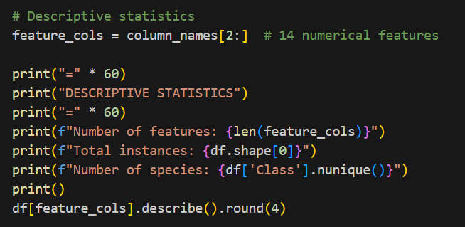
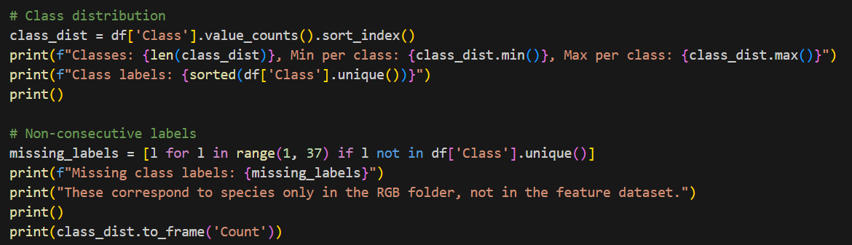
1. Introduction
Presenter: Yinyuan Chen
• Plant species identification is critical in botany, ecology, agriculture,
and environmental conservation
• Traditional approaches rely on manual inspection by trained experts
→ time-consuming and prone to subjective errors
• This project applies machine learning methods to the UCI Leaf Dataset
– 340 leaf specimens from 30 plant species
– 14 numerical features extracted from digital images
– Additional RGB and BW image datasets
• Three core tasks:
1) Classification (Peng Wang)
2) Clustering (Hye Ran Yoo)
3) Outlier Detection (Yinyuan Chen)
• Framework: CRISP-DM (Cross-Industry Standard Process for Data Mining)

Slide 4
2. Business Understanding – Project Plan
Presenter: Yinyuan Chen
Workload Distribution
Project Timeline
Task / Subtask | Student Name
Introduction | All Members-Peng Wang
Business Understanding | All Members-Yinyuan Chen
Data Understanding | All Members-Hye Ran Yoo
Classification – Prep, Model, Eval | Hye Ran Yoo
Clustering – Prep, Model, Eval | Peng Wang
Outlier Detection – Prep, Model, Eval | Yinyuan Chen
Discussion of Results | All Members
Conclusion | All Members
Phase | Deadline
Part 1: Business + Data + Prep | March 27, 2026
Part 2: Modelling | Mar 28 – Apr 1
Report Finalization | April 2, 2026
Presentation | April 8, 2026

Slide 5
2. Business Understanding – Objectives & Situation
Presenter: Yinyuan Chen
Business Objectives:
• Develop a reliable system for automatic plant species recognition
• Evaluate how well different ML techniques distinguish 30 plant species
• Compare traditional ML on features vs. deep learning on images
Situation Assessment:
• UCI Leaf Dataset – publicly available, CC BY 4.0 license
• Small dataset: 340 instances across 30 classes (8–16 per species)
• Image dataset: 443 RGB images (40 species), 340 BW images (30 species)
• Tools: Python, scikit-learn, PyTorch, Power BI
Data Mining Goals:
• Classification: Naïve Bayes, SVM, MLP, Stacking, CNN
• Clustering: K-Means, DBSCAN, GMM (EM)
• Outlier Detection: LOF, Isolation Forest, One-Class SVM
Success Metrics: Accuracy, Precision, Recall, F1, ARI, NMI, Silhouette

Slide 6
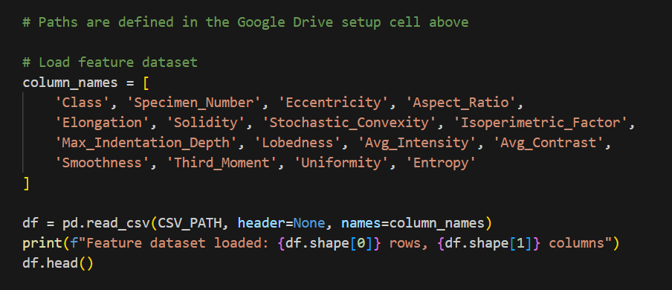
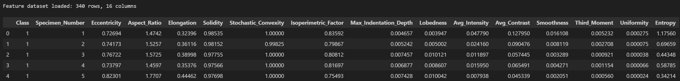
3. Data Understanding – Feature Dataset
Presenter: Hye Ran Yoo
• Source: UCI Machine Learning Repository (Silva & Marçal, 2013)
• leaf.csv: 340 instances, 16 columns
– Column 1: Species class label (30 unique, non-consecutive: 1–15, 22–36)
– Column 2: Specimen number
– Columns 3–16: 14 numerical features
• Features divided into two groups:
Shape: Eccentricity, Aspect Ratio, Elongation, Solidity,
Stochastic Convexity, Isoperimetric Factor,
Max Indentation Depth, Lobedness
Texture: Avg Intensity, Avg Contrast, Smoothness,
Third Moment, Uniformity, Entropy

Slide 7
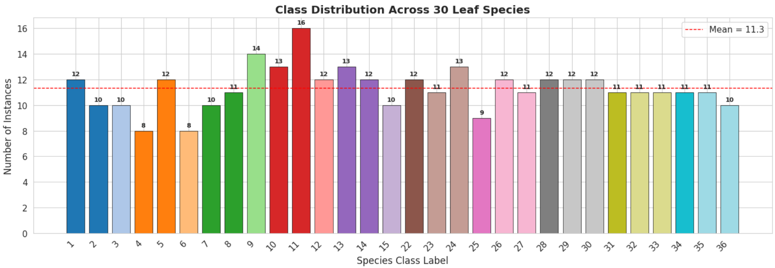
3. Data Understanding – Image Dataset
Presenter: Hye Ran Yoo
Data Sources & Usages:
CSV (14 features): Main input dataset (PCA, LDA, SVM, Stacking)
RGB Images (443 imgs): Input for CNN feature extraction
BW Images (340 imgs): Used for analyzing leaf contours and shapes
Two Image Types: RGB (443 imgs) & BW (340 imgs)
Dataset Size Issue: 340 total images is too small for Deep Learning (CNN) ➔ Explains why SVM performed better
Class Mismatch: 40 species (RGB) vs. 30 species ➔ Filtering required
Dimension Inconsistency:
Found mixed image orientations (720x960 & 960x720) during Quality Check ➔ Forced resize to 128x128px for CNN input
Missing Classes: IDs 16~21 are absent in the main feature data
Class Distribution: Average 11.3 imgs per class ➔ Relatively balanced
Property | RGB Images | BW Images
Total images | 443 | 340
Species (folders) | 40 | 30
Dimensions | 720 × 960 px | 720 × 960 px
Colour mode | RGB (3-channel) | Binary (1-bit)
File format | JPG | JPG

Slide 8
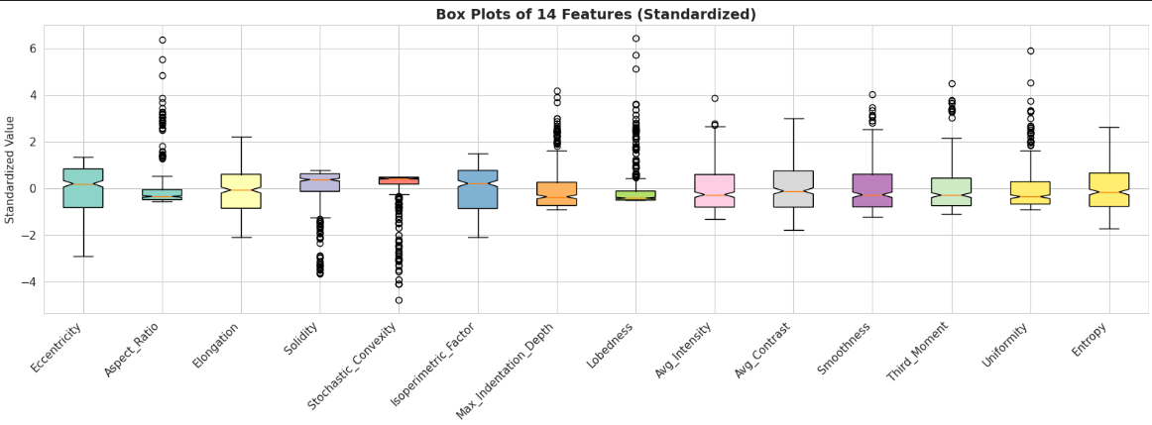
3. Explore Data – Feature Distributions
Presenter: Peng Wang
• Visualizing Outliers: For Outlier Detection
Visually proves how many extreme, abnormal data points (black circles) exist in our dataset.
• Standardized Scale:
All features scaled to Mean=0 for easy comparision.
• Key Point(Block Circles) :
Bad : Confuses AI ➔ Needs Outlier Detection.
Golden Hint: Easily find uniquely shaped plants!
• Our Strategy:
Instead of dropping outliers and losing rare leaf data ➔ used PCA & LDA to reduce noise (while keeping valuable hints)

Slide 9
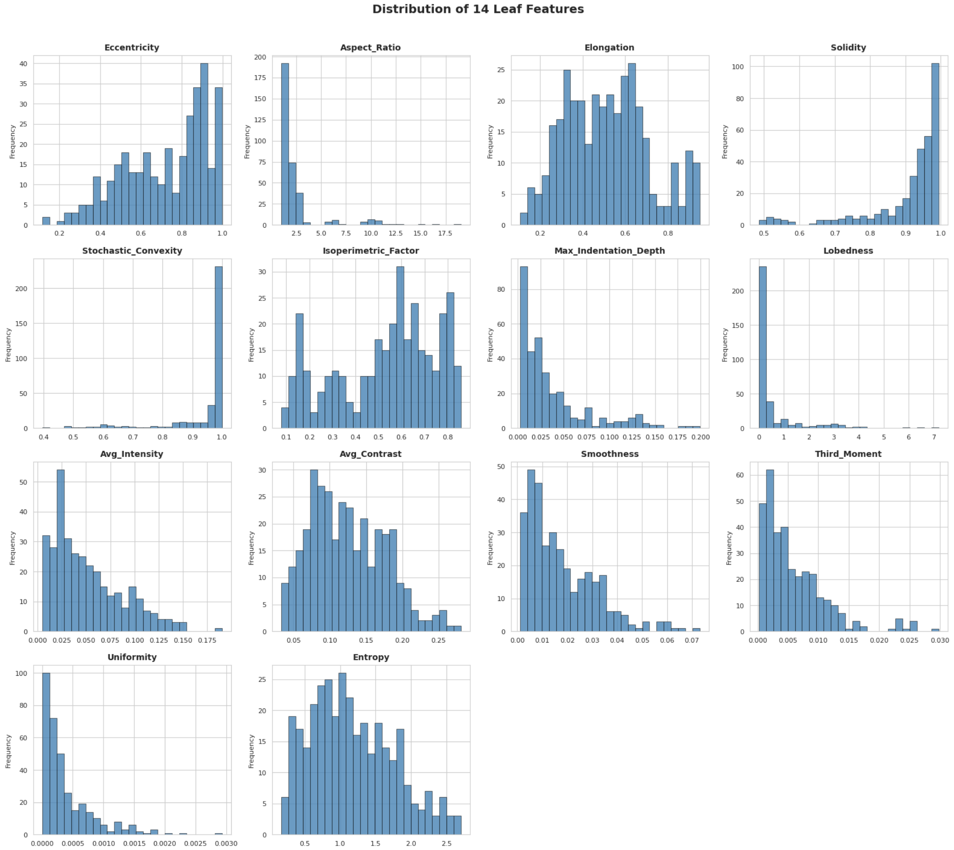
3. Explore Data – Feature Distributions (Histograms)
Presenter: Peng Wang
• Messy Distributions :
Most features are heavily skewed to one side
(e.g., Lobedness, Uniformity).
• Good Features (Red Boxes):
'Elongation' is widely spread out,
giving the AI clear hints to classify species.
• Conclusion:
Features have completely different shapes and scales
➔ Standardization is strictly required!

Slide 10
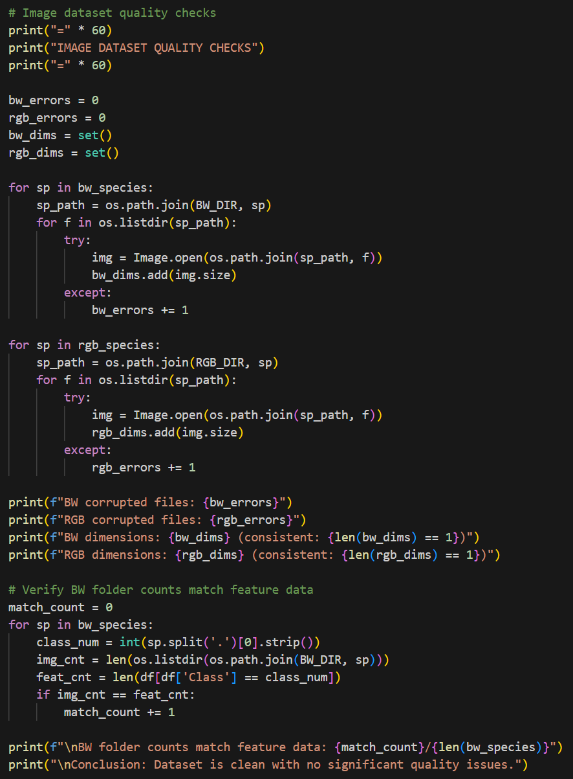
3. Data Quality Verification
Presenter: Peng Wang
• Feature Dataset Quality:
✓ No missing values in all 340 rows × 16 columns
✓ No duplicate rows
✓ All features are float type; labels & specimen # are integers
✓ All values within plausible ranges
✓ 30 class labels match 30 BW image species folders
• Image Dataset Quality:
✓ All images open without errors
✓ Consistent 720 × 960 pixel dimensions
✓ BW folder image count matches feature dataset per species
• Note: RGB folder has 10 extra species (16–21, 37–40)
not present in the feature dataset
→ Dataset is clean and well-structured
→ No special treatment needed beyond standard preparation

Slide 11
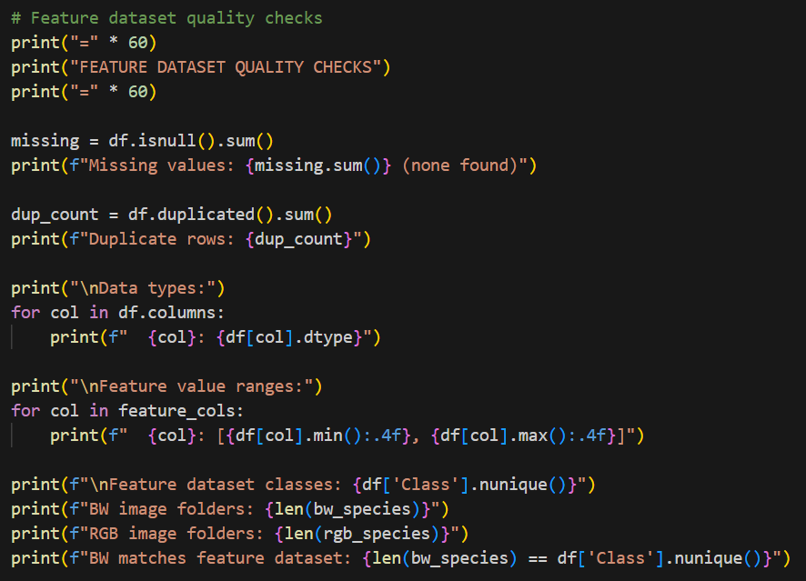
3. Data Quality Verification
Presenter: Peng Wang

Slide 12
SECTION 4
Classification
Naïve Bayes | SVM | MLP | Stacking | CNN Features
Presenter: Hye Ran Yoo

Slide 13
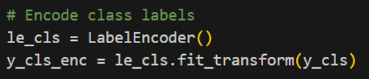
4.1 Classification – Data Preparation
Presenter: Hye Ran Yoo
Select & Clean Data
Feature Selection:
• Target: Species class label (Column 1)
• Excluded: Specimen Number (Column 2) – just an identifier
• Retained: All 14 numerical features
• Image dataset: Only 30 species present in BW & feature data
Data Cleaning:
• Non-consecutive class labels (1–15, 22–36) encoded to 0–29 using LabelEncoder
• No missing values, duplicates, or erroneous entries

Slide 14
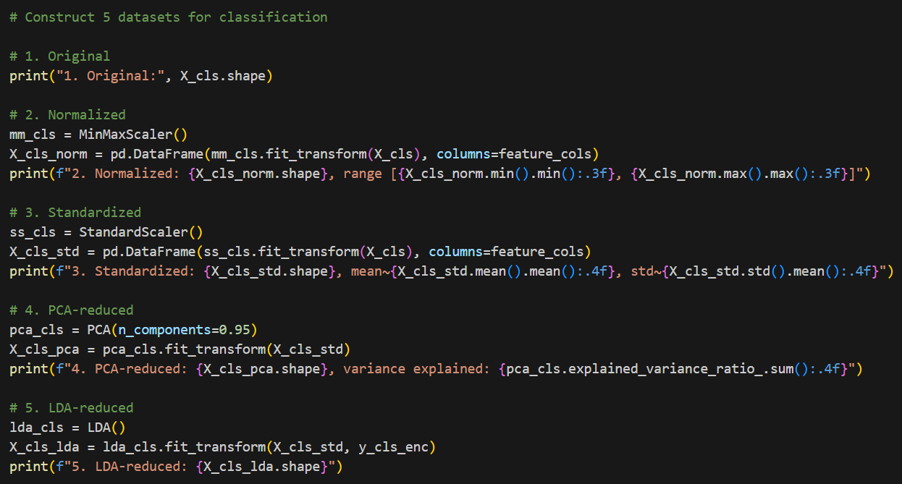
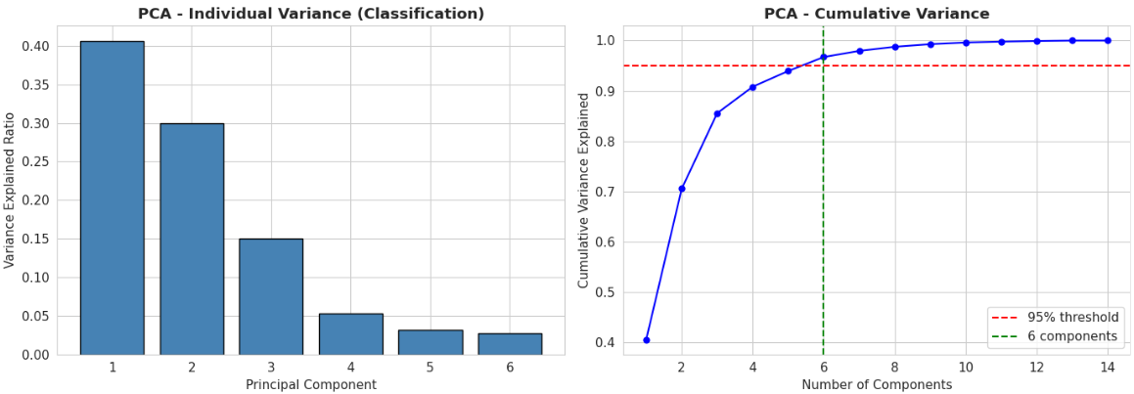
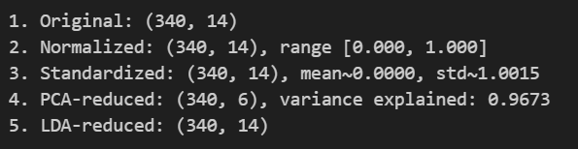
4.1 Classification – Construct Data
Presenter: Hye Ran Yoo
Normalization, Standardization, PCA, LDA
6 Prepared Datasets:
1. Original (14 features, unscaled)
2. Normalized (min-max to [0,1])
3. Standardized (z-score)
4. PCA-reduced (6 components)
5. LDA-reduced (14 components)
6. CNN-extracted (256-dim vectors)
Split: 80/20 stratified Train: 272 | Test: 68
95%

Slide 15
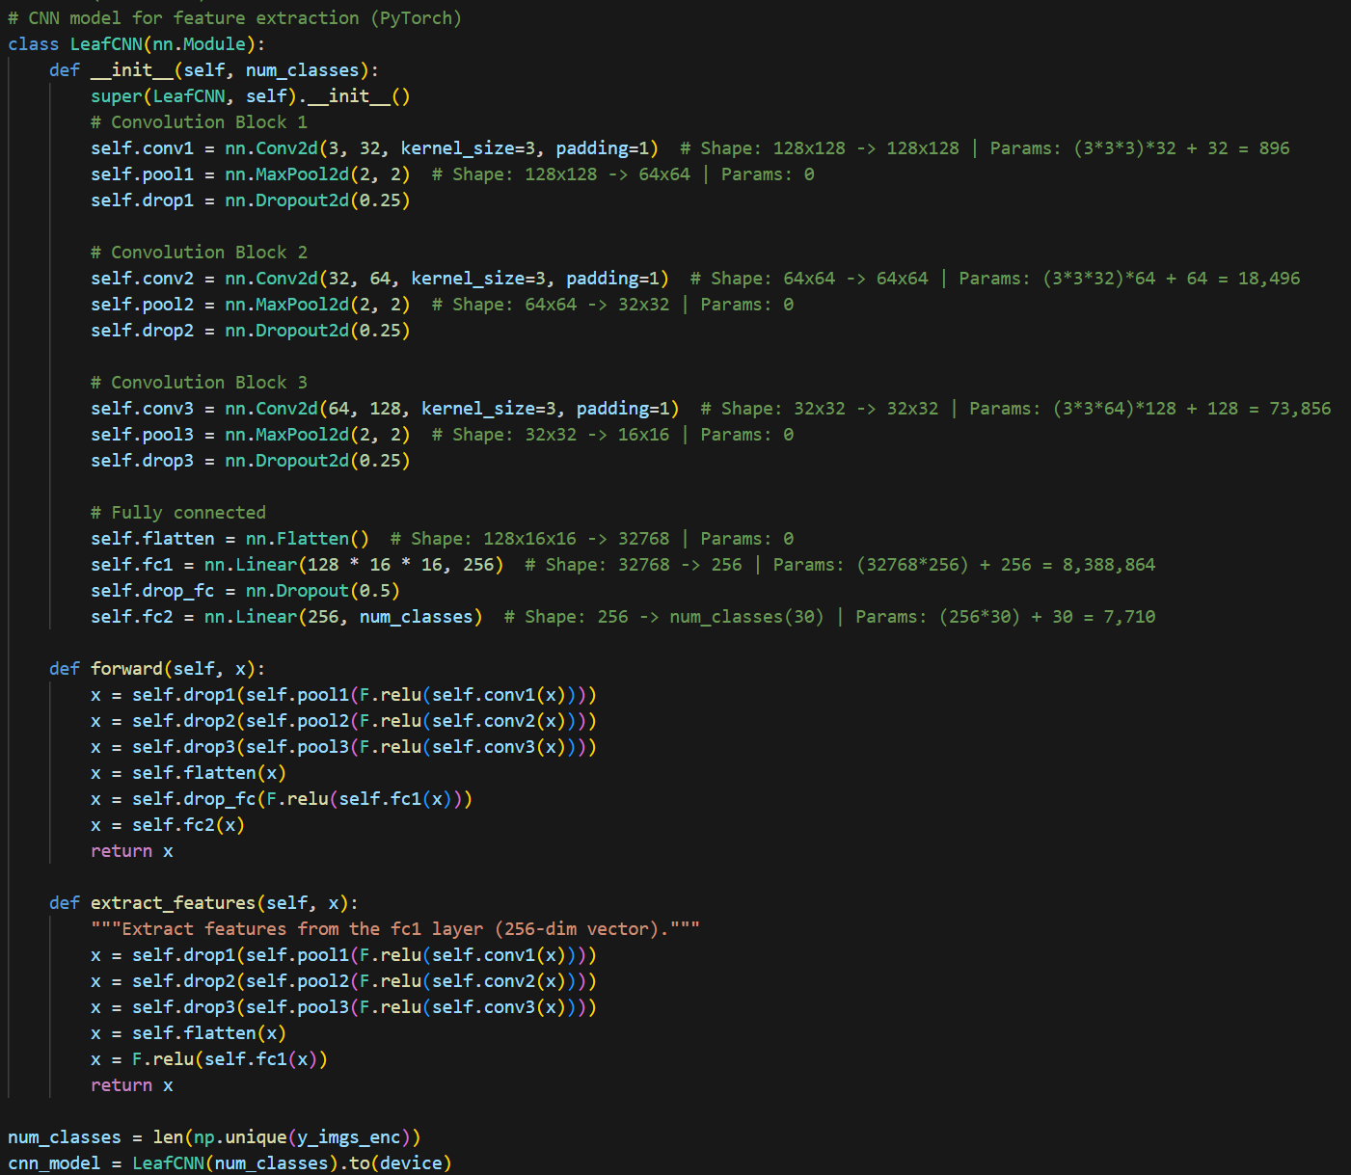
4.1 Classification – CNN Feature Extraction
Presenter: Hye Ran Yoo
PyTorch LeafCNN Model
CNN Architecture:
• 3 Conv blocks (Conv2d → MaxPool → Dropout)
• Input: 128×128 RGB images
• Output: 256-dim feature vector
• Total parameters: 8,489,822
Purpose:
• Extract image features for traditional
ML classifiers (NB, SVM, MLP)
• Also used as full CNN classifier
Limitation:
• Only ~11 images per class
• Insufficient for training from scratch

Slide 16
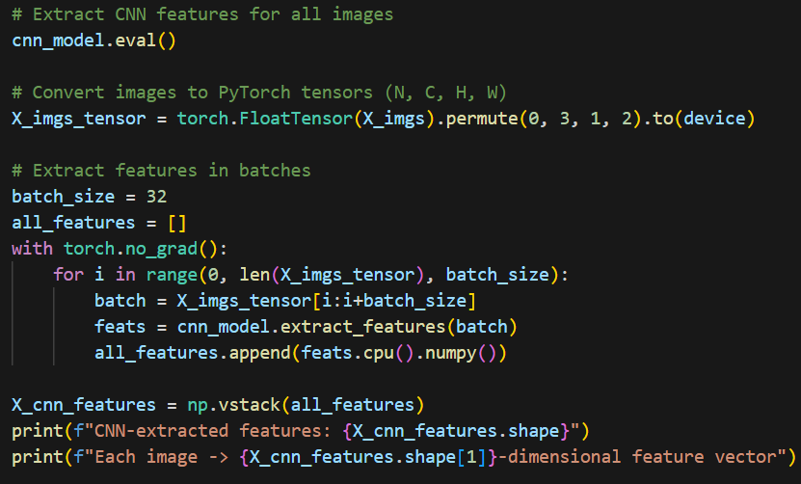

4.1 Classification – CNN Feature Extraction
Presenter: Hye Ran Yoo
PyTorch LeafCNN Model
Key Steps of CNN Feature Extraction:
• Batch Processing:
Processed all 340 images in small batches (size=32) to prevent memory overload.
• Hidden Layer Extraction:
Stopped the CNN right before the final prediction to extract a 256-Dimensional Feature Vector.
• The Core Achievement:
Upgraded our dataset from 14 human-measured features ➔ to 256 AI-discovered hidden visual patterns!

Slide 17
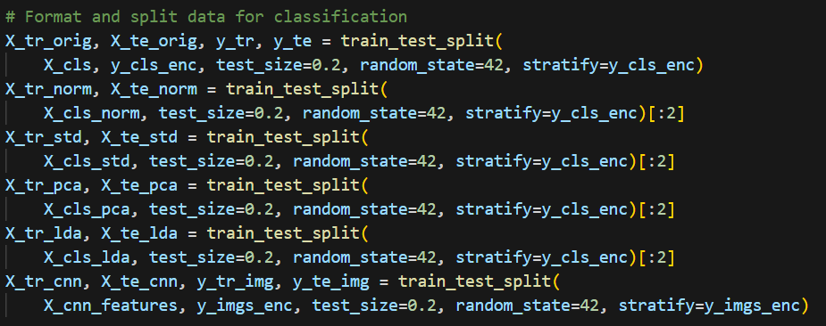
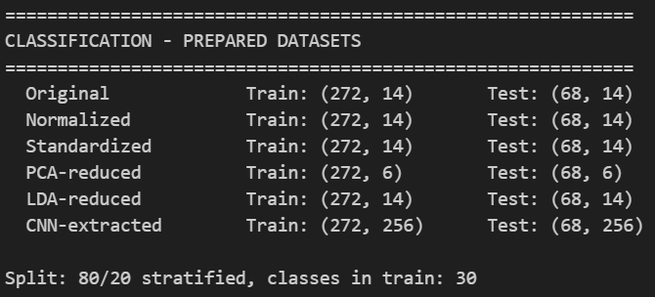
4.1 Classification – Integrate Data/Format Data
Presenter: Hye Ran Yoo
• 80/20 Split:
All 6 dataset versions were identically divided into
Train (272) and Test (68).
• Fairness (stratify=y):
Guaranteed that all 30 species are equally represented in
both sets to prevent any bias.
• Reproducibility (random_state=42):
Locked the randomness to ensure consistent evaluation.
• Code Efficiency ([:2]):
Sliced the output to grab only the feature data (X_train, X_test)
without uselessly copying the exact same answer labels (y).

Slide 18
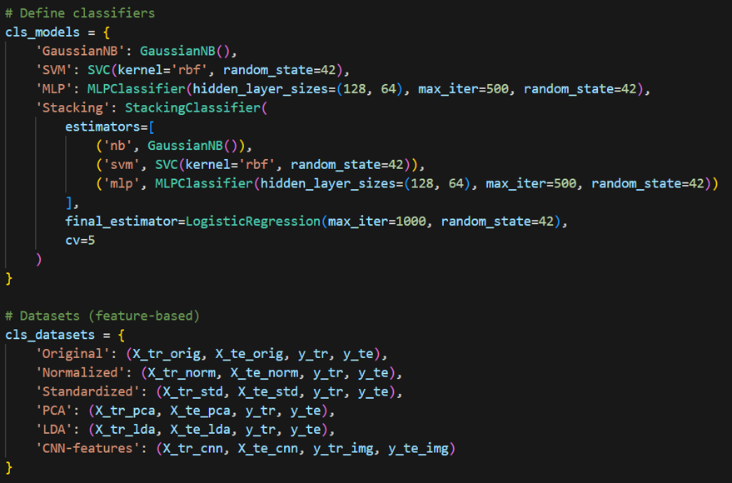
4.2 Classification – Model Selection
Presenter: Hye Ran Yoo
4 Classification Models:
1. Gaussian Naïve Bayes
Probabilistic baseline; assumes
feature independence
2. SVM (RBF kernel)
Finds optimal hyperplane;
handles non-linear boundaries
3. MLP (128→64 hidden layers)
Learns complex non-linear mappings
4. Stacking Ensemble
NB + SVM + MLP → Logistic Regression
meta-learner with 5-fold CV

Slide 19
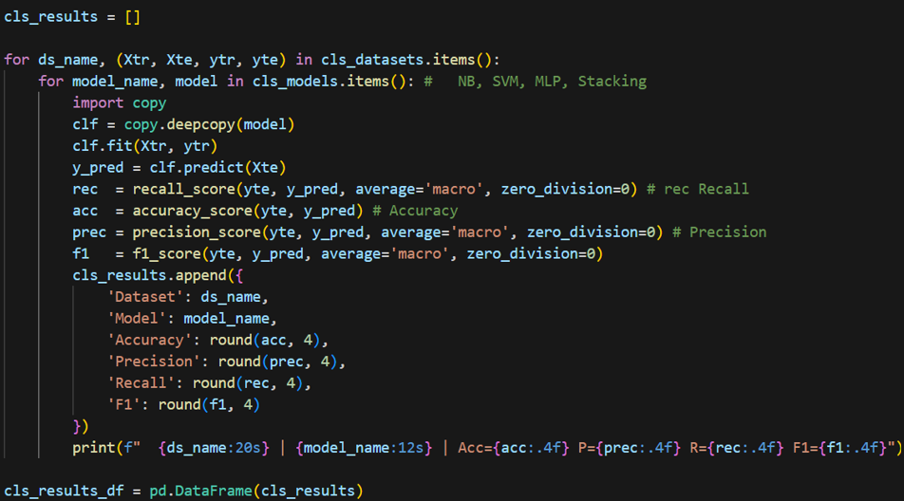
4.2 Classification – Training & Evaluation Code
Presenter: Hye Ran Yoo
Test Design:
• 6 datasets × 4 models = 24 experiments
• 80/20 stratified train-test split
– Train: 272 instances
– Test: 68 instances
– All 30 classes represented
• Metrics (macro-average):
– Accuracy
– Precision
– Recall
– F1-Score
• Macro-average:
equal weight to all 30 classes regardless of size

Slide 20
4.2 Classification – Results (Feature Data, PCA, LDA, CNN)
Presenter: Hye Ran Yoo
Dataset | Model | Accuracy | Precision | F1-Score
Original | GaussianNB | 0.7941 | 0.8000 | 0.7867
Original | SVM | 0.3529 | 0.2773 | 0.2724
Original | MLP | 0.7353 | 0.7176 | 0.7094
Original | Stacking | 0.5147 | 0.4770 | 0.4704
Normalized | GaussianNB | 0.7941 | 0.8000 | 0.7867
Normalized | SVM | 0.5147 | 0.4877 | 0.4740
Normalized | MLP | 0.7353 | 0.7333 | 0.7171
Normalized | Stacking | 0.6471 | 0.6122 | 0.6075
Standardized | GaussianNB | 0.7941 | 0.8000 | 0.7867
Standardized | SVM | 0.6765 | 0.6750 | 0.6567
Standardized | MLP | 0.8088 | 0.8472 | 0.7979
Standardized | Stacking | 0.6912 | 0.6889 | 0.6662
Dataset | Model | Accuracy | Precision | F1-Score
PCA | GaussianNB | 0.6324 | 0.6067 | 0.6003
PCA | SVM | 0.6176 | 0.6128 | 0.5951
PCA | MLP | 0.7059 | 0.7278 | 0.6896
PCA | Stacking | 0.6471 | 0.6833 | 0.6288
LDA | GaussianNB | 0.7794 | 0.8022 | 0.7597
LDA | SVM | 0.8382 | 0.8467 | 0.8313
LDA | MLP | 0.8382 | 0.8661 | 0.8243
LDA | Stacking | 0.7794 | 0.7917 | 0.7565
CNN-feat | GaussianNB | 0.5000 | 0.4561 | 0.4473
CNN-feat | SVM | 0.0882 | 0.0349 | 0.0363
CNN-feat | MLP | 0.4265 | 0.3679 | 0.3710
CNN-feat | Stacking | 0.4559 | 0.4611 | 0.4126
★ Best Classification Result: Dataset LDA Model SVM Accuracy 0.8382 Precision 0.8467 Recall 0.85 F1 0.8313

Slide 21
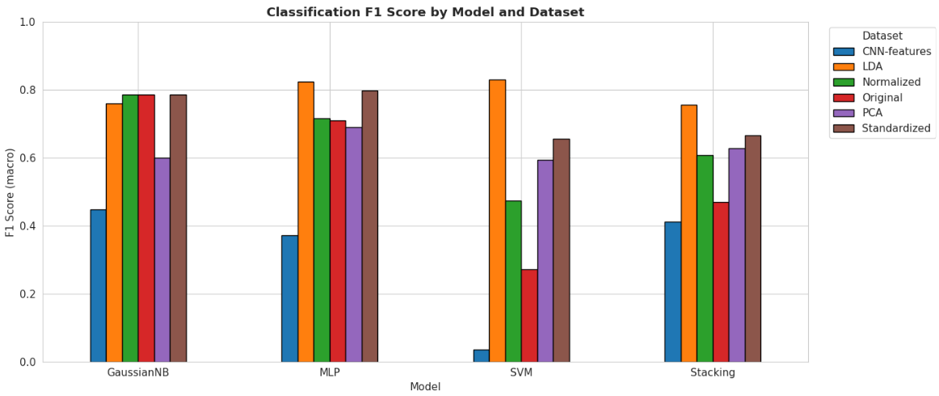
4.3 Classification – Evaluation & Key Findings
Presenter: Hye Ran Yoo
• LDA is the most effective data preparation:
LDA effectively maximized the distance between species, boosting accuracy for all models.
SVM accuracy: 35.29% (Original) → 83.82% (LDA) – huge improvement! (maximizes between-class variance)
• CNN Limitations: 340 images were insufficient for deep learning. The 14 CSV features were much more effective.
• SVM vs. Stacking: Complex ensembles (Stacking) overfitted the small dataset, while SVM maintained high accuracy.

Slide 22
SECTION 5
Clustering
K-Means | DBSCAN | Gaussian Mixture Model (EM)
Presenter: Peng Wang

Slide 23
5.1 Clustering – Data Preparation
Presenter: Peng Wang
Feature Selection:
• Class label & Specimen Number removed (unsupervised)
• True labels retained separately for evaluation only
• All 14 features initially included
– Shape features: Eccentricity, Aspect Ratio, Elongation, ...
– Texture features: Avg Intensity, Contrast, Smoothness, ...
Data Construction:
• Same 6 dataset versions: Original, Normalized, Standardized,
PCA-reduced, LDA-reduced, CNN-extracted
• Standardization is critical for distance-based algorithms
• PCA expected to help by removing noisy dimensions
Key Difference from Classification:
• Full dataset used (340 instances) – no train-test split
• Labels only used for external validation (ARI, NMI)

Slide 24
5.2 Clustering – Model Selection & Code
Presenter: Peng Wang
clu_models = {
'KMeans': KMeans(n_clusters=30,
random_state=42, n_init=10),
'DBSCAN': DBSCAN(eps=2.0, min_samples=3),
'GMM': GaussianMixture(n_components=30,
random_state=42)
}
for ds_name, X_data in clu_datasets.items():
for model_name, model in clu_models.items():
clust = copy.deepcopy(model)
labels = clust.fit_predict(X_data)
ari = adjusted_rand_score(y_clu_enc, labels)
nmi = normalized_mutual_info_score(
y_clu_enc, labels)
sil = silhouette_score(X_data, labels)
3 Clustering Algorithms:
1. K-Means (k=30)
Partitional; assigns to nearest centroid
iteratively until convergence
2. DBSCAN
Density-based; no predefined k
eps=2.0, min_samples=3
Can detect arbitrary-shaped clusters
3. Gaussian Mixture Model (EM)
Probabilistic; assumes data from mixture
of 30 Gaussian distributions
Metrics: ARI, NMI, Silhouette Score

Slide 25
5.2 Clustering – Results
Presenter: Peng Wang
Dataset | Model | Clusters | ARI | NMI
Original | KMeans | 30 | 0.2584 | 0.6238
Original | DBSCAN | 3 | 0.0121 | 0.1997
Original | GMM | 30 | 0.2925 | 0.6585
Normalized | KMeans | 30 | 0.3807 | 0.7132
Normalized | DBSCAN | 1 | -1.000 | -1.000
Normalized | GMM | 30 | 0.3371 | 0.6931
Standardized | KMeans | 30 | 0.3528 | 0.7104
Standardized | DBSCAN | 3 | 0.0122 | 0.1903
Standardized | GMM | 30 | 0.3558 | 0.6977
PCA | KMeans | 30 | 0.3177 | 0.6791
PCA | DBSCAN | 1 | -1.000 | -1.000
PCA | GMM | 30 | 0.3320 | 0.6908
LDA | KMeans | 30 | 0.4930 | 0.7830
LDA | DBSCAN | 15 | 0.0318 | 0.3872
LDA | GMM | 30 | 0.4553 | 0.7667
CNN-feat | KMeans | 30 | 0.1794 | 0.5551
CNN-feat | DBSCAN | 1 | -1.000 | -1.000
CNN-feat | GMM | 30 | 0.1794 | 0.5551
★ BEST: K-Means on LDA (ARI=0.493, NMI=0.783)

Slide 26
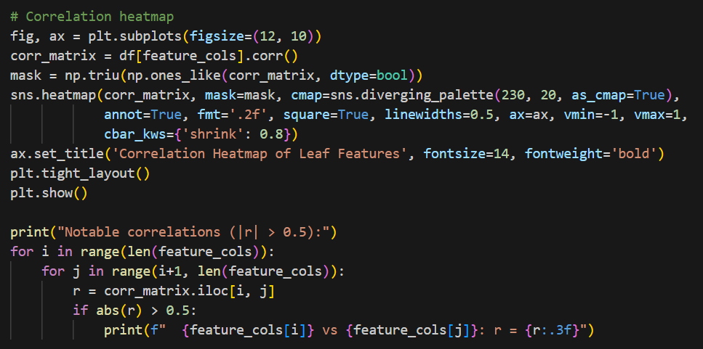
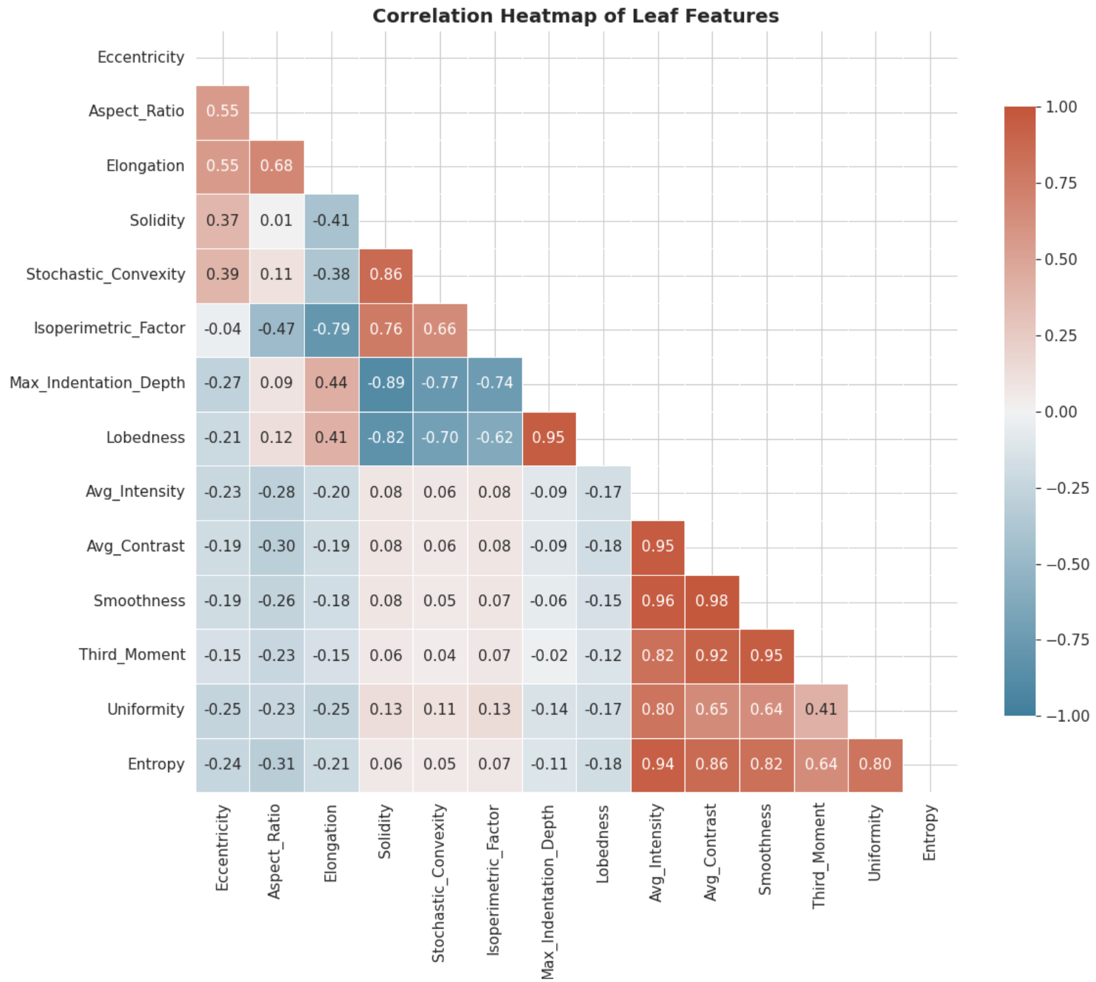
5.2 Clustering – Visualizations
Presenter: Peng Wang

Slide 27
5.3 Clustering – Evaluation & Key Findings
Presenter: Peng Wang
1. LDA-reduced data produces the best clusters
• K-Means ARI: 0.258 (Original) → 0.493 (LDA)
• LDA projects into space that separates classes
2. DBSCAN struggled with high-dimensional data
• Collapsed all points into 1 cluster on Normalized, PCA, CNN
• Density-based approach couldn't find separation
• Better eps/min_samples tuning needed
3. K-Means and GMM performed comparably
• K-Means slightly better on most datasets
• Both benefited from standardization and LDA
4. Moderate ARI (<0.5) suggests 30 species are not easily separable using unsupervised methods alone
• High NMI (0.55–0.78) indicates partial agreement
• Expected given large # classes and small samples

Slide 28
SECTION 6
Outlier Detection
LOF | Isolation Forest | One-Class SVM
Presenter: Yinyuan Chen

Slide 29
6.1 Outlier Detection – Data Preparation
Presenter: Yinyuan Chen
Feature Selection:
• All 14 numerical features retained
• Class label & Specimen Number excluded
• Focus on high-variance / skewed features for anomaly detection:
– Lobedness (skew=3.116), Aspect Ratio (3.325)
– Uniformity (2.125), Solidity (-2.061)
Key Differences from Other Tasks:
• Potential outliers are NOT removed during cleaning
– Detecting them is the objective!
• Full dataset (340 instances) used, no train-test split
• Contamination parameter set to ~10%
Standardization is critical: LOF and One-Class SVM
rely on distance measures; unscaled features would
have disproportionate influence

Slide 30
6.2 Outlier Detection – Model Selection & Code
Presenter: Yinyuan Chen
out_models = {
'LOF': LocalOutlierFactor(
n_neighbors=20, contamination=0.1),
'IsolationForest': IsolationForest(
contamination=0.1, random_state=42),
'OneClassSVM': OneClassSVM(
nu=0.1, kernel='rbf', gamma='scale')
}
for ds_name, X_data in out_datasets.items():
for model_name, model in out_models.items():
det = copy.deepcopy(model)
preds = det.fit_predict(X_data)
# 1 = inlier, -1 = outlier
n_outliers = (preds == -1).sum()
pct = n_outliers / len(preds) * 100
3 Outlier Detection Algorithms:
1. Local Outlier Factor (LOF)
Density-based; compares local density
to neighbors → sparse regions = outlier
2. Isolation Forest
Tree-based; anomalies need fewer splits
to be isolated → efficient & scalable
3. One-Class SVM
Learns decision boundary around
normal data; points outside = outlier
All use contamination ≈ 10%

Slide 31
6.2 Outlier Detection – Results
Presenter: Yinyuan Chen
Dataset | Model | Outliers | % Outliers
Original | LOF | 34 | 10.00
Original | Isolation Forest | 34 | 10.00
Original | One-Class SVM | 32 | 9.41
Normalized | LOF | 34 | 10.00
Normalized | Isolation Forest | 34 | 10.00
Normalized | One-Class SVM | 34 | 10.00
Standardized | LOF | 34 | 10.00
Standardized | Isolation Forest | 34 | 10.00
Standardized | One-Class SVM | 36 | 10.59
PCA | LOF | 34 | 10.00
PCA | Isolation Forest | 34 | 10.00
PCA | One-Class SVM | 34 | 10.00
LDA | LOF | 34 | 10.00
LDA | Isolation Forest | 34 | 10.00
LDA | One-Class SVM | 38 | 11.18
Cross-Method Agreement
(Standardized Data)
ALL 3 methods: 15 outliers
At least 2: 31 outliers
ANY method: 58 outliers
→ 15 robust outliers represent
genuine anomalies confirmed
by all detection approaches
Key: One-Class SVM is most sensitive (38 outliers on LDA)
LOF & Isolation Forest are highly consistent (34 across most datasets)

Slide 32
6.3 Outlier Detection – Evaluation & Key Findings
Presenter: Yinyuan Chen
Future Work:
• Examine botanical characteristics of identified outliers
• Test impact of outlier removal on classification & clustering
• Explore ensemble outlier detection methods
1. Consistent results across data preparations
• Most combinations: ~10% outliers (34/340)
• Confirms outlier detection is robust to scaling choices
2. One-Class SVM is the most sensitive detector
• Detected more outliers on LDA (38) and Standardized (36)
• May be overdetecting in some cases
3. Cross-method agreement strengthens confidence
• 15 instances flagged by ALL 3 methods → most reliable outliers
• These represent specimens with genuinely unusual morphology
4. Highly skewed features drive detection
• Aspect_Ratio (skew=3.325), Lobedness (3.116)
• Specimens with extreme values in these features flagged

Slide 33
SECTION 7
Discussion of Results
Presenter: All Members

Slide 34
7. Discussion – Impact of Data Preparation
Presenter: Yinyuan Chen
Data Preparation > Model Selection
• LDA consistently produced the BEST results across all tasks:
– Classification: SVM accuracy 35% → 84% with LDA
– Clustering: K-Means ARI 0.26 → 0.49 with LDA
• Standardization outperformed Original/Normalized for SVM and MLP (distance-based / gradient-based)
• PCA (unsupervised) showed mixed results:
– 6 components explain 96.73% variance
– But information loss hurt classification accuracy
– Doesn't optimize for class separability
• Takeaway: Supervised dimensionality reduction (LDA) is highly beneficial when # classes is large relative to sample size

Slide 35
7. Discussion – CNN Features & Summary
Presenter: Yinyuan Chen
CNN-Based Features:
• Consistently underperformed across ALL tasks
• Only ~11 images per class – insufficient for CNN from scratch
• 256-dim CNN features did NOT beat 14 hand-crafted features
• Solution: Transfer learning (ResNet/VGG pre-trained on ImageNet)
Best Results Summary
Task | Best Dataset | Best Model | Key Metric
Classification | LDA | SVM / MLP | Accuracy = 83.82%
Clustering | LDA | K-Means | ARI = 0.493, NMI = 0.783
Outlier Detection | Standardized | All 3 (agreement) | 15 robust outliers
Central Finding: Data preparation strategy has a GREATER impact on performance than model selection. The CRISP-DM methodology correctly emphasizes Data Preparation as a critical phase.

Slide 36
8. Conclusion
Presenter: Yinyuan Chen
Project Summary:
• Applied CRISP-DM to UCI Leaf dataset (340 specimens, 30 species)
• Addressed 3 ML tasks: Classification, Clustering, Outlier Detection
• Systematically compared 6 data preparations × multiple algorithms
Classification:
• SVM on LDA: 83.82% accuracy, 84.67% precision, 83.13% F1
• MLP on LDA achieved identical accuracy
Clustering:
• K-Means on LDA: ARI = 0.493, NMI = 0.783
• Moderate agreement expected given 30 classes, small samples
Outlier Detection:
• 15 robust outliers identified by all 3 methods
• Consistent ~10% detection rate across preparations
Key Insight:
• Data preparation (especially LDA) > model selection
• CNN features need more data; recommend transfer learning

Slide 37
References
• Silva, P. & Marçal, A. (2013). Leaf [Dataset]. UCI Machine Learning Repository.
https://doi.org/10.24432/C53C78
• Chapman, P., Clinton, J., Kerber, R., et al. (2000). CRISP-DM 1.0:
Step-by-step data mining guide. SPSS Inc.
• Pedregosa, F., Varoquaux, G., Gramfort, A., et al. (2011).
Scikit-learn: Machine learning in Python. JMLR, 12, 2825–2830.
• Breunig, M. M., Kriegel, H. P., Ng, R. T., & Sander, J. (2000).
LOF: Identifying density-based local outliers. ACM SIGMOD, 29(2), 93–104.
• Liu, F. T., Ting, K. M., & Zhou, Z. H. (2008). Isolation forest.
IEEE ICDM, 413–422.

Slide 38
Questions & Answers
Thank you for your attention!
Hye Ran Yoo 041145212
Peng Wang 041107730
Yinyuan Chen 041146649
CST 8506 – Machine Learning | Group 8 | Algonquin College

