Slide 1
Gymnasium Environments

Slide 2
Agenda
This week:
Gymnasium custom environment: an upgrade for our Lab 1 CliffWalking environment class
Pygame for rendering
BlocksWorld-v0 environment (future Assignment 1)
stable-baselines3

Slide 3
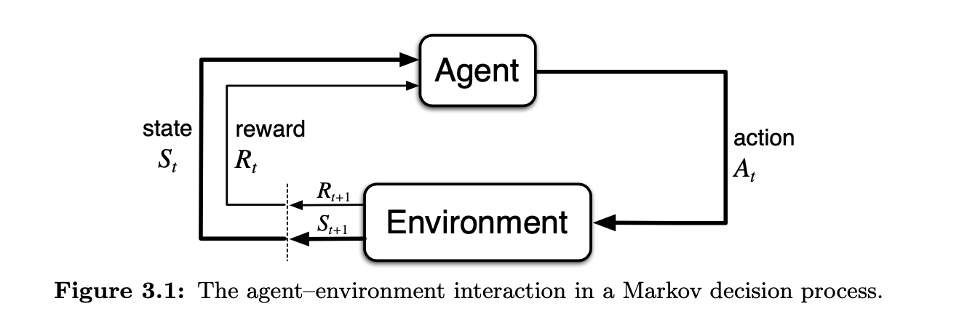
What we've implemented so far
Lab 1 Agent: <your_algonquin_id>_lab2_qlearning_agent.py
Lab 1 Environment: <your_algonquin_id>_lab2_cliff_env.py (simple "homemade" gridworld and CliffWalking)
Lab 2: <your_algonquin_id>_lab2_cliff_env.py replaced with gymnasium environment
Lab 2: <your_algonquin_id>_lab2_qlearning_agent.py updated to work with gymnasium environment

Slide 4
Where the implementation is going
Lab 2: upgrade our cliffwalking environment to Gymnasium
Turn the Prolog blocks world into a Gymnasium BlocksWorld-v0 environment (assignment 1)
Use PyGame for rendering our environments
Our <your_algonquin_id>_lab2_qlearning_agent.py implementation still plays the role of agent
stable-baselines3 is a set of standard RL algorithms that work with Gymnasium environments
We can use the stable-baselines3 algorithms: DQN, PPO, for new agents

Slide 5
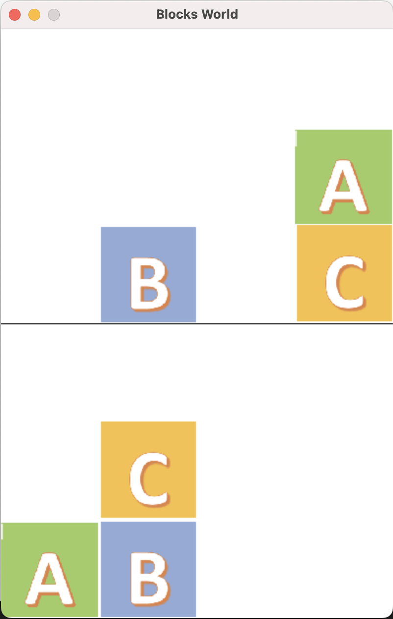
Diagram comparison (Assignment 1)
PyGame
action A_{t}
render()
Agent:
Q-Learning or
Stable-baselines3:
DQN or PPO or…
R_{t}
R_{t+1}
Gymnasium Environment
Prolog model
Swiplserver
S_{t}
S_{t+1}

Slide 6
Important Sites
Basic Components from Lab1:
https://medium.com/data-science/math-of-q-learning-python-code-5dcbdc49b6f6
Custom environment for Gymnasium Lab 2:
https://gymnasium.farama.org/tutorials/gymnasium_basics/environment_creation/#
PyGame is often used by Gymnasium Environments for rendering:
https://dr0id.bitbucket.io/legacy/pygame_tutorial00.html
https://dr0id.bitbucket.io/legacy/pygame_tutorial01.html
Stable-baselines3:
https://stable-baselines3.readthedocs.io/en/master/guide/install.html

Slide 7
Gym to Gymnasium
Gymnasium is common as the successor to Gym
import gymnasium as gym
Reset method takes seed as parameter (for reproducing random sequences)
reset(self, seed=None, options=None)
Step method returns truncated
return observation, reward, terminated, truncated, info

Slide 8
Creating a Gymnasium Environment
https://gymnasium.farama.org/tutorials/gymnasium_basics/environment_creation/#
Steps to creating a new Gymnasium environment:
import gymnasium as gym
from gymnasium import spaces # note: from gymnasium, not from gym
Make the <somename>Env python class extend gymnasium.env
Implement/override the gymnasium.env methods:
__init__(self, render_mode=None, size=5)
reset(self, seed=None, options=None)
step(self, action)->return observation, reward, terminated, False, info
render(self)
close(self)

Slide 9
Creating a Gymnasium Environment
Define the state space and action space
Example from gynmasium docs:
# Observations for the gridworld example are dictionaries with the agent's and the target's location.
# Each location is encoded as an element of {0, ..., `size`}^2, i.e. MultiDiscrete([size, size]).
self.observation_space = spaces.Dict(
{
"agent": spaces.Box(0, size - 1, shape=(2,), dtype=int),
"target": spaces.Box(0, size - 1, shape=(2,), dtype=int),
} )
# We have 4 actions, corresponding to "right", "up", "left", "down"
self.action_space = spaces.Discrete(4)

Slide 10
Creating a Gymnasium Environment
Define the state space and action space
In this case, the observation is a dictionary of 3-letter-state integers:
self.observation_space = spaces.Dict(
{
"agent": spaces.Discrete(len(self.states)),
"target": spaces.Discrete(len(self.states)),
}
)
self.action_space = spaces.Discrete(len(self.actions))

Slide 11
Creating a Gymnasium Environment
Define the state space and action space
In this case (per the coming Assignment 1 document), the observation is a single larger integer representing both the current state and target at the same time:
self.observation_space = spaces.Discrete(len(self.states))
self.action_space = spaces.Discrete(len(self.actions))

Slide 12
StableBaselines MlpPolicy vs MultiInputPolicy
Dictionary observations:
self.observation_space = spaces.Dict(
{
"agent": spaces.Discrete(len(self.states)),
"target": spaces.Discrete(len(self.states)),
}
)
self.action_space = spaces.Discrete(len(self.actions))
In the agent
# For spaces.Dict observations, use MultiInputPolicy
import gymnasium as gym
env = gym.make("aisd_examples/BlocksWorld-v0", render_mode="human")
model = DQN("MultiInputPolicy", env, verbose=1)
model.learn(total_timesteps=10000, log_interval=4)

Slide 13
StableBaselines MlpPolicy vs MultiInputPolicy
Observation is a discrete number:
self.observation_space = spaces.Discrete(len(self.states))
self.action_space = spaces.Discrete(len(self.actions))
In the agent
# for spaces.Discrete observation_space, use MlpPolicy (Multi-Layer-Perceptron)
import gymnasium as gym
env = gym.make("aisd_examples/BlocksTarget-v0", render_mode="human")
model = DQN("MlpPolicy", env, verbose=1)
model.learn(total_timesteps=10000, log_interval=4)

Slide 14
Put our environment in a package to install
As outlined in the Gymnasium docs (they use the name gymnasium_env):
<algonquin_id>_blocksworld_env/
pyproject.toml
blocksworld_env/ # gymnasium_env/ would be at this level
__init__.py
envs/
__init__.py
blocks_world.py

Slide 15
Using our custom environment
Using our custom blocksworld environment with Discrete observations <your_algonquin_id>_lab2_qlearning_agent.py from Lab 2:
#from medium_qlearning_env import Env
import blocksworld_env
import gymnasium as gym
import matplotlib.pyplot as plt
import numpy as np
import time
import os
# create environment
#env = Env()
env = gym.make(”blocksworld_env/BlocksWorld-v0", render_mode="human")
# QTable : contains the Q-Values for every (state,action) pair
qtable = np.random.rand(env.observation_space.n, env.action_space.n).tolist()

Slide 16
Using our custom environment
Using our environment (Discrete observations) with stable-baselines3:
import gymnasium as gym
import blocksworld_env
from stable_baselines3 import DQN
env = gym.make("blocks_world/BlocksWorld-v0", render_mode="human")
model = DQN("MlpPolicy", env, verbose=1) # for non-dictionary Discrete observation where state and target are combined
model.learn(total_timesteps=10000, log_interval=4)
model.save("dqn_blocks")
del model # remove to demonstrate saving and loading
model = DQN.load("dqn_blocks")
obs, info = env.reset()
while True:
action, _states = model.predict(obs, deterministic=True)
obs, reward, terminated, truncated, info = env.step(action)
if terminated or truncated:
obs, info = env.reset()

Slide 17
Prolog Blocks world environment (Assignment 1)
% situation calculus blocks world (just one fluent, clear is defined with on)
:- dynamic on/3.
% target means this is the goal (not used because Python picks random state)
target:-on(a,4,[]),on(b,c,[]),on(c,a,[]).
% reset asserts the initial state
reset:-
retractall(on(_,_,[])),
assert(on(a,1,[])),
assert(on(b,3,[])),
assert(on(c,a,[])).

Slide 18
Prolog Blocks world environment
grounded(A,B,C):-
legal(A,B,C),
(place(A);place(B);place(C)),!.
legal(A,B,C):-
block(A),block(B),A=b,B=a,!,fail
;
block(B),block(C),B=c,C=b,!,fail
;
block(A),block(C),A=c,C=a,!,fail
;
true.
state(S):-
(block(A);place(A)),dif(A,a),
(block(B);place(B)),dif(B,b),
(block(C);place(C)),dif(C,c),
dif(A,B),
dif(B,C),
dif(A,C),
grounded(A,B,C),
atomics_to_string([A,B,C],S).

Slide 19
Prolog Blocks world environment
current_state(S):-
on(a,A,[]),
on(b,B,[]),
on(c,C,[]),
atomics_to_string([A,B,C],S).
step(Act):- poss([Act]),
on(a,A,[Act]),
on(b,B,[Act]),
on(c,C,[Act]),
retractall(on(_,_,[])),
assert(on(a,A,[])),
assert(on(b,B,[])),
assert(on(c,C,[])).
% action(Act) means Act is concievable
action(Act):-
Act = move(A,B,C),
block(A),
(block(B);place(B)),
(block(C);place(C)),
dif(A,B),
dif(A,C),
dif(B,C).

Slide 20
PyGame for rendering
# import the pygame module, so you can use it
import pygame
class Display():
def __init__(self):
# initialize the pygame module
pygame.init()
# load and set the logo
logo = pygame.image.load("logo32x32.png")
pygame.display.set_icon(logo)
pygame.display.set_caption("Blocks World")
# create a surface on screen that has the given size
# define a variable to control the main loop
self.running = True
IMAGE_SIZE_X = 100
IMAGE_SIZE_Y = 100
DEFAULT_IMAGE_SIZE = (IMAGE_SIZE_X, IMAGE_SIZE_Y)
self.screen = pygame.display.set_mode((4*IMAGE_SIZE_X,6*IMAGE_SIZE_Y))
#see screen.py on brightspace

