Slide 1
Stable-Baselines3 DQN

Slide 2
Blocks with Target 2x4, 4x4, 5x5, …. 10x10
.
Which Algorithm?
DQN working better than PPO in early experiments
DQN is a popular choice for this type of problem (e.g.Rubik’s Cube)
Basics of DQN
Q-Network (Policy): A neural network (often MlpPolicy or CnnPolicy) that takes the state as input and outputs Q-values for each possible discrete action.
Target Network: A slowly updated, identical copy of the Q-network used to compute the target Q-value, which helps stabilize training by preventing the network from chasing its own tail.
Replay Buffer: Stores past experiences to break the correlation between consecutive samples, allowing the agent to learn from a diverse, random batch of past data.
Epsilon-Greedy Exploration: The agent balances exploration and exploitation by choosing a random action with probability (epsilon) or the best-predicted action

Slide 3
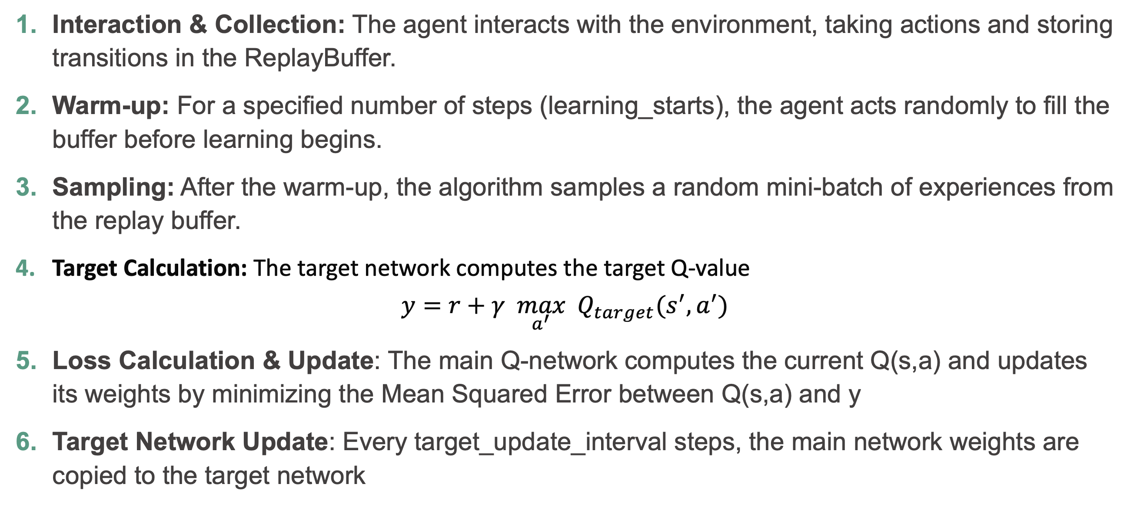
DQN
Interaction & Collection: The agent interacts with the environment, taking actions and storing transitions in the ReplayBuffer.
Warm-up: For a specified number of steps (learning_starts), the agent acts randomly to fill the buffer before learning begins.
Sampling: After the warm-up, the algorithm samples a random mini-batch of experiences from the replay buffer.
Target Calculation: The target network computes the target Q-value
$$y=r+γ \max_{a^{′}} Q_{target}(s^{′},a^{′})$$
Loss Calculation & Update: The main Q-network computes the current Q(s,a) and updates its weights by minimizing the Mean Squared Error between Q(s,a) and y
Target Network Update: Every target_update_interval steps, the main network weights are copied to the target network

Slide 4
DQN action space must be Discrete
The Python-based environment, blocks with target, uses MultiDiscrete actions
Q: How can we train DQN on this environment?
A: wrap it!

Slide 5
DiscreteActionWrapper
class DiscreteActionWrapper(gym.ActionWrapper):
def __init__(self, env):
super().__init__(env)
# Assume env.action_space is MultiDiscrete([2, 3])
self.dims = env.action_space.nvec
self.action_space = gym.spaces.Discrete(np.prod(self.dims))
def action(self, action):
# Convert single integer back to tuple for the inner env
return np.unravel_index(action, self.dims)

Slide 6
Applying wrappers to an environment
# Define a function that applies all your wrappers
def make_custom_env():
import gymnasium as gym
# using 4 blocks and 4 positions right now
env = gym.make("blocks_env/BlocksTargetPython-v0", num_blocks=4, num_positions=4)
# Manually pass kwargs to each wrapper here
env = TimeLimit(env, max_episode_steps=200)
env = DiscreteActionWrapper(env)
return env
# Use the function as the env_id, and create 4 parallel copies
env = make_vec_env(make_custom_env, n_envs=4)

Slide 7
Logs and trained model storage
# Create directories for models and logs
models_dir = "models/dqn"
logs_dir = "logs/dqn"
os.makedirs(models_dir, exist_ok=True)
os.makedirs(logs_dir, exist_ok=True)

Slide 8
DQN hyperparameters
model = DQN("MultiInputPolicy", env, learning_starts=100, device=”cuda", batch_size=512, verbose=1, tensorboard_log=logs_dir)
https://stable-baselines3.readthedocs.io/en/master/modules/dqn.html
MultiInputPolicy: observations are a dictionary with current and target
env: our wrapped environment
learning_starts: number of random actions before learning starts
device=“cuda”: use CUDA GPU (would be “mps” on a Mac), or “auto”, or “cpu”
batch_size=512: batch size for update
tensorboard_log=logs_dir: log training progress to the specified directory for viewing with tensorboard

Slide 9
Tensorboard
Tensorboard can plot information stored in the appropriate format
Can view graphs of training progress, comparing several runs

Slide 10
Training the model
# Train for 1,000,000 timesteps with progress reports every 10,000 steps
callback = ProgressCallback(check_freq=10000)
model.learn(total_timesteps=1000000, log_interval=1, callback=callback)
model.save(f"{models_dir}/dqn_blocks_world")

Slide 11
Logging
With tensorboard_log=logs_dir, SB3 initializes a global logger that handles multiple output formats simultaneously: terminal (stdout) and TensorBoard binary files
ProgressCallback has access to this same logger via self.logger. Any custom metrics recorded in the callback using self.logger.record("key", value) will automatically appear in TensorBoard graphs.
log_interval=1: For DQN, this tells SB3 to write a data point to TensorBoard every 1 episode. This includes standard metrics like rollout/ep_rew_mean and train/loss.
check_freq=10000: callback only triggers its logic every 10,000 timesteps.
The Result: high-resolution data in TensorBoard (every episode), while terminal/callback reports will only update in massive 10,000-step jumps

Slide 12
Running trained models
model = DQN.load(f"{models_dir}/dqn_blocks_world", env)
obs = env.reset()
for _ in range(1000):
action, _states = model.predict(obs, deterministic=True)
#obs, reward, terminated, truncated, info = env.step(action)
obs, reward, terminated, info = env.step(action)

