Slide 1
Docker & Docker Compose Primer
Why containers?
Reproducible environments
Portable across machines
Clean isolation of ROS2 + Gazebo + Python venv

Slide 2
Docker Image (The Blueprint)
An image is a read-only, executable package that includes everything needed to run an application—code, runtime, libraries, environment variables, and config files.
Immutable: Once built, an image cannot be changed. If you update the code, you must build a new image.
Layered: Images are made of multiple stacked layers (e.g., a base OS layer, a runtime layer, and an app layer).
Source: You create images from a Dockerfile, which is a script containing all the build instructions.
Storage: They are stored on disk and can be shared via registries like Docker Hub.

Slide 3
Docker Container (The Instance)
A container is a live, isolated execution unit created from an image.
Mutable: Containers have a thin "writable layer" on top of the read-only image. This allows them to write logs or temporary data during runtime without affecting the original image.
Isolated: Every container has its own file system, network stack, and process space, even if multiple containers are running from the same image.
Ephemeral: Containers are meant to be temporary. When a container is deleted, any changes in its writable layer are lost unless they were saved to persistent volumes.
Action: You start a container using the docker run command.

Slide 4
Key Concepts
Images vs Containers
Dockerfile basics: FROM, RUN, COPY, ARG
Volumes, Networks, Privileged mode

Slide 5
FROM
Understanding FROM in a Dockerfile What FROM Does Defines the base image your container is built on (e.g., FROM osrf/ros:humble-desktop) Sets the starting filesystem → Includes OS packages, tools, ROS versions, Python versions Determines compatibility with ROS, Gazebo, GPU drivers, etc. Every instruction that follows (RUN, COPY, ENV, …) builds on top of this base layer.

Slide 6
RUN
What RUN Does Executes a command inside the image at build time Produces a new image layer after the command completes Used for installing packages, configuring the system, cloning repos, building software, etc.

Slide 7
apt command template
RUN apt-get update && apt-get install -y \
package-name-1 \
package-name-2 \
&& rm -rf /var/lib/apt/lists/*
When you run apt-get update, it downloads package indexes (lists) into /var/lib/apt/lists/. These files are only needed during the installation phase and can take up dozens or even hundreds of megabytes.

Slide 8
COPY
COPY
What COPY Does Copies files or directories from your host machine into the image Used to bring in: ✅ Source code ✅ Configuration files ✅ Patches and assets ✅ Launch files, URDFs, worlds, etc. Creates a new filesystem layer in the image

Slide 9
CMD
What CMD Does Specifies the default command that runs when a container starts Acts as the container’s entry behavior (what it does by default) Can be overridden with: docker run <image> <my command> docker compose run <service> <my command>

Slide 10
ROS2 in Docker
Why Docker for ROS2?
• DDS discovery issues
• Host networking needs
• GPU and X11 passthrough

Slide 11
WSL2 installation
Powershell commands:
Install wsl: wsl --install
View available distros: wsl --list --online
Install specific version: wsl --install -d Ubuntu-22.04
Check installed versions: wsl --list --verbose
Change default distro: wsl --set-default Ubuntu-22.04

Slide 12
Docker Desktop (WSL2)
Docker Desktop manages two hidden WSL2 distributions (docker-desktop and docker-desktop-data) that run the actual Docker Engine. It then "injects" the Docker CLI and Docker-Compose into your Ubuntu WSL2 instance via symlinks, making them available as if they were installed there.

Slide 13
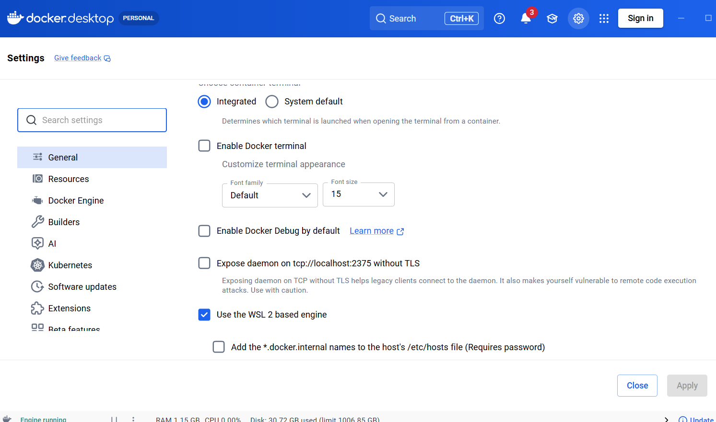
Docker WSL2 mode

Slide 14
Linux Installation
https://docs.docker.com/engine/install/ubuntu/
sudo apt update
sudo apt install ca-certificates curl gnupg lsb_release -y
sudo install -m 0755 -d /etc/apt/keyrings
curl -fsSL https://download.docker.com/linux/ubuntu/gpg | sudo gpg --dearmor -o /etc/apt/keyrings/docker.gpg
sudo chmod a+r /etc/apt/keyrings/docker.gpg
echo "deb [arch=$(dpkg --print-architecture) signed-by=/etc/apt/keyrings/docker.gpg] https://download.docker.com/linux/ubuntu $(lsb_release -cs) stable" | sudo tee /etc/apt/sources.list.d/docker.list > /dev/null
sudo apt update
sudo apt install docker-ce docker-ce-cli containerd.io docker-buildx-plugin docker-compose-plugin docker-compose -y
sudo usermod -aG docker $USER

Slide 15
Accessing shell
$ docker compose exec -it <container> bash
You need to insert the correct container name

Slide 16
Command explanation
docker compose exec: Tells Docker Compose to execute a command in an existing, running service container. Unlike docker compose run, it does not start a new container.
"-it": These combined flags stand for Interactive (-i) and TTY (-t).
-i (Interactive): Keeps the standard input (STDIN) open, allowing you to type commands.
-t (TTY): Allocates a "pseudo-terminal," which formats the output to look like a standard terminal (with colors and proper line wrapping).
Note: In newer versions of Docker Compose, -it is often the default behavior, but it is frequently included for clarity or backward compatibility.
<container>: This is the name of the service defined in your docker-compose.yml file (e.g., web, db, or api).
bash: The specific command to run inside the container. In this case, it starts the Bash shell, allowing you to interact with the container's command

Slide 17
docker-compose Overview
Compose simplifies multi-arg builds
Defines environment, volumes, devices
Allows SSH agent forwarding for private repos

Slide 18
Example docker-compose file
services:
ros_sim:
build:
context: .
args:
- ROS_DISTRO=${ROS_DISTRO:-humble}
image: ros_sim:latest
container_name: ros_sim_container
# Host networking needed for ROS 2 DDS discovery
network_mode: "host"
ipc: "host"
environment:
- DISPLAY=${DISPLAY:-:0}
- RMW_IMPLEMENTATION=rmw_fastrtps_cpp
- ROS_DOMAIN_ID=${ROS_DOMAIN_ID:-0}
# Gazebo/Ignition settings
- IGNITION_VERSION=${IGNITION_VERSION:-fortress}
- GZ_VERSION=${GZ_VERSION:-harmonic}
# NVIDIA GPU Acceleration
- NVIDIA_VISIBLE_DEVICES=all
- NVIDIA_DRIVER_CAPABILITIES=all
volumes:
# X11 for GUI
- /tmp/.X11-unix:/tmp/.X11-unix
# Optional: Device access (for physical robots)
- /dev:/dev
privileged: true
stdin_open: true
tty: true

Slide 19
Yet another docker-compose.yml
services:
gui-demo:
build: .
image: xeyes-demo:latest
container_name: xeyes_container
environment:
# Pass the host's DISPLAY variable to the container
- DISPLAY=${DISPLAY}
volumes:
# Mount the X11 Unix socket for GUI communication
- /tmp/.X11-unix:/tmp/.X11-unix:rw
# Required for some GUI permissions on native Linux
network_mode: "host“
ipc: "host"

Slide 20
1. Service Definition
services:: This is the top-level key. Every item under it (like gui-demo) represents a containerized application.
gui-demo:: This is the internal name Compose uses to identify this specific service.
2. The Build Phase (Creating the Image)
build: .: This tells Docker to look in the current directory (.) for a file named Dockerfile. It will execute the instructions in that file to create an image.
image: xeyes-demo:latest: This assigns a specific name (tag) to the image after it is built. Without this, Docker would give the image a random ID.
3. The Runtime Phase (Starting the Container)
container_name: xeyes_container: Instead of Docker generating a random name like peaceful_hopper, this forces the container to be named xeyes_container so you can easily run docker exec against it.
Environment & GUI
environment:: This section sets variables inside the container's shell.
- DISPLAY=${DISPLAY}: This is the "secret sauce." It takes the value of DISPLAY from your host machine (e.g., :0 or 172.x.x.x) and passes it into the container. This tells GUI apps where to "draw" their windows.
Volumes (Sharing Files)
volumes:: Maps a folder on your host to a folder inside the container.
- /tmp/.X11-unix:/tmp/.X11-unix:rw: This is a special "Unix Socket" file used for communication between the GUI app and the graphics server. By mounting it, the container can talk directly to your screen hardware.
Networking & Permissions
network_mode: "host": This puts the container on the same network stack as your computer (rather than a private virtual bridge). This is often necessary for X11 authentication to work smoothly on native Linux.
ipc: "host": "Inter-Process Communication." Many GUI apps (like those using shared memory for speed) need to share the host's IPC namespace to display graphics without lag or "memory access" errors.

Slide 21
Xeyes example Dockerfile
# Use Ubuntu as the base image
FROM ubuntu:24.04
# Avoid interactive prompts during package installation
ENV DEBIAN_FRONTEND=noninteractive
# Install x11-apps (contains xeyes) and sudo for convenience
RUN apt-get update && apt-get install -y \
x11-apps \
sudo \
&& rm -rf /var/lib/apt/lists/*
# Create a non-root user (optional but recommended for GUI apps)
RUN useradd -m developer && \
echo "developer ALL=(ALL) NOPASSWD:ALL" >> /etc/sudoers
USER developer
WORKDIR /home/developer
# Default command to keep container alive for 'docker exec'
CMD ["sleep", "infinity"] # what happens if we change to [“xeyes”]?

