Slide 1
CST8509 Value Function Approx

Slide 2
Today's Agenda
Review Quiz
Value Function Approximation
Add actors to Gazebo simulated worlds

Slide 3
Qlearning: example of Temporal Distance Learning
Monte Carlo: need to go all the way to the end of an episode, then can learn
Temporal Distance: time in RL is measured in steps
TD(0): Learn from looking one step ahead (state vs next-state):
qtable[state][action] = qtable[state][action] + alpha * (reward + gamma * max(qtable[next_state]) - qtable[state][action])
qtable: the table of action-values approximating the action-value function
state: the current state
action: the current action
alpha: step size
reward: reward received from taking action in state
gamma: discount factor
next_state: the state resulting from taking action in state

Slide 4
Value Function Approximation: Large Scale problems
So far we have constructed a qtable(state,action)
value for every state/action pair
What about
Backgammon: 10²⁰ states
Computer Go: 10¹⁷⁰ states
Cannot represent that whole qtable explicitly

Slide 5
Value Function Approximation
Solution for large MDPs: Estimate value function with function approximation
w is a vector of weights of a neural network
vˆ ( s , w ) ≈ v _{π} ( s ) or
qˆ ( s , a , w ) ≈ q _{π} ( s , a )
Generalize from seen states to unseen states
Update parameter w using MC or TD learning

Slide 6
Value function approximation and DQN
Q-Learning: learn Q, the action-value function q(s,a)
DQN: Deep Q-Network
DQN is similar to Q-learning except:
No Q-table, we have Q-network instead
Instead of updating Q-table, DQN trains Q-network
Q-network implements an approximation of Q
Input to Q-network is State, output is action values (same number of outputs as actions)

Slide 7
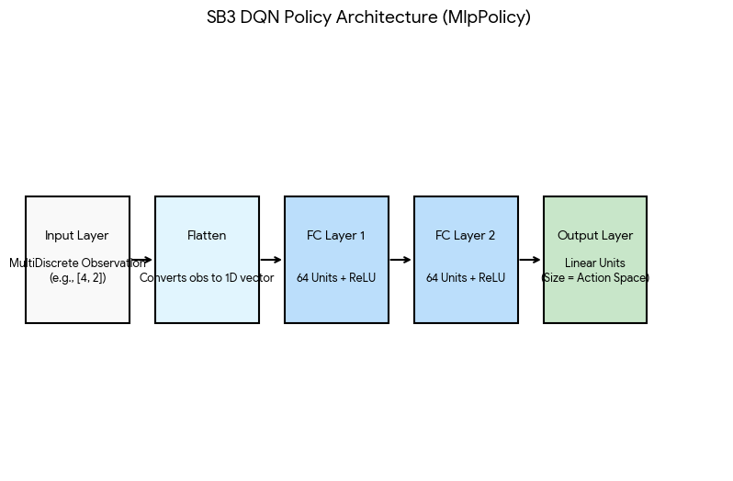
There are two of these neural networks: Online and Target:
DQN Online and Target Networks
Online Network: Actively updated via gradients during every training step to minimize the loss function (MSE based on temporal difference (TD) error).
Target Network: A lagged copy of the online network used to provide stable Q-value targets. It is updated less frequently using a hard update or soft update (Polyak update) governed by the (small) tau parameter.

Slide 8
DQN Loss Function
$$L = E[{\left(r +γ * max Q_{target\left(s', a'\right)}- Q_{online\left(s, a\right)}\right)}^{2}]$$

Slide 9
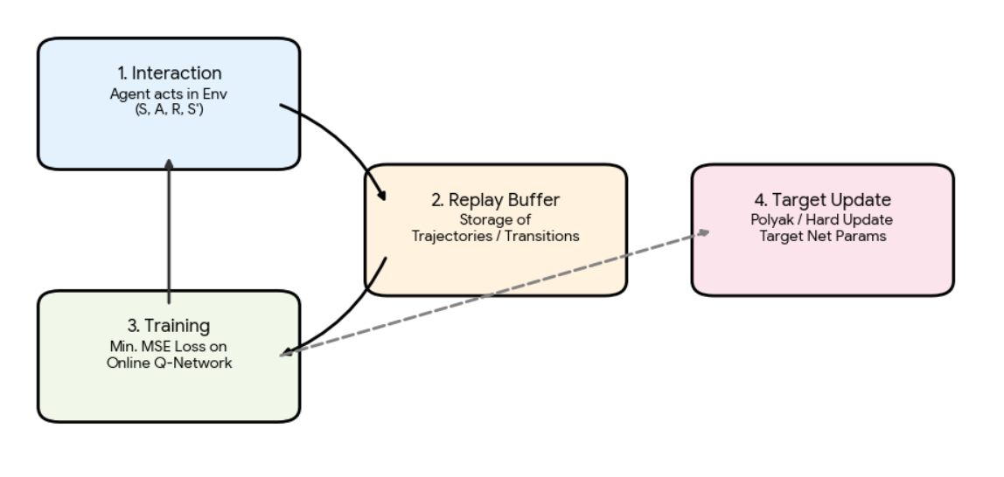
DQN Algorithm

Slide 10
DQN training
Interaction: Agent collects (s, a, r, s') transitions from the environment. “learning_starts” are done before training
Replay Buffer: Transitions are stored to break temporal correlations.
Optimization: Online Q-Network trains on random batches from the buffer. Done by default every 4 interactions (after learning_starts)
Target Update: Weights are copied to the Target Network for stability. Done every 10000 steps by default.

Slide 11
PPO and value function approximation
PPO has and Actor Network and a Critic Network (Value function)

Slide 12
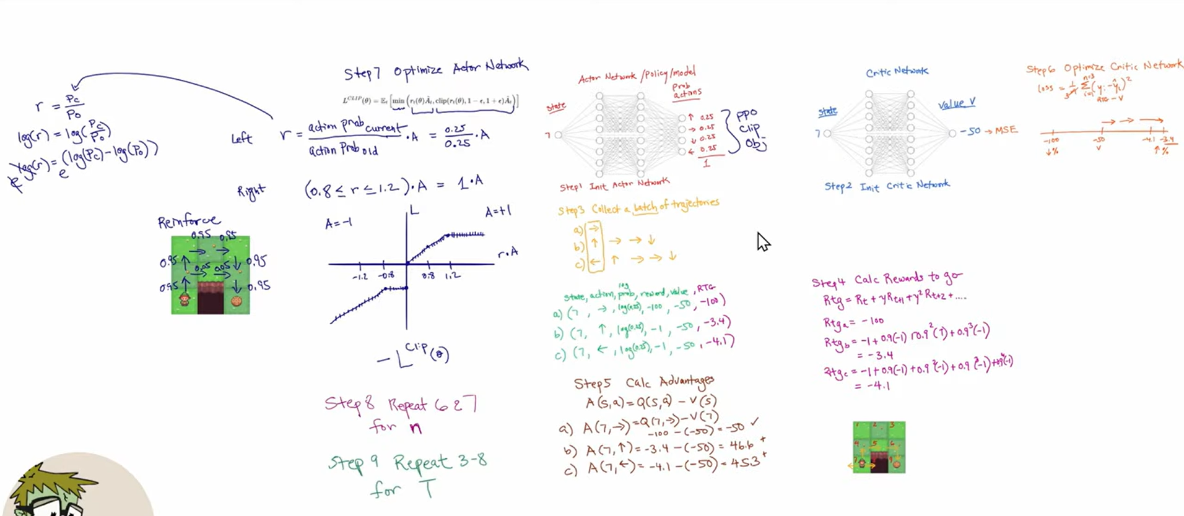
https://www.youtube.com/watch?v=5VHLd9eCZ-w

Slide 13
Actors in Gazebo worlds
Details here: https://gazebosim.org/docs/harmonic/actors
Skeletal animation: arms and legs move (for example)
Trajectory animation: actor moves in world

Slide 14
Red Ball to follow
Simple box following trajectory can be adapted to red ball: https://classic.gazebosim.org/tutorials?tut=actor
<actor name="animated_ball">
<link name="link">
<visual name="visual">
<geometry>
<sphere>
<radius>.2</radius>
</sphere>
</geometry>
<material name="red">
<ambient>1 0 0 1</ambient>
<diffuse>1 0 0 1</diffuse>
<specular>0 0 0 0</specular>
<emissive>0 0 0 1</emissive>
</material>
</visual>
</link>

Slide 15
Red Ball trajectory
<script>
<loop>true</loop>
<delay_start>0.000000</delay_start>
<auto_start>true</auto_start>
<trajectory id="0" type="square">
<waypoint>
<time>0.0</time>
<pose>1 -1 1 0 0 0</pose>
</waypoint>
<waypoint>
<time>1.0</time>
<pose>1 1 1 0 0 0</pose>
</waypoint>
<waypoint>
<time>2.0</time>
<pose>1 1 1 0 0 0</pose>
</waypoint>
<waypoint>
<time>3.0</time>
<pose>1 -1 1 0 0 0</pose>
</waypoint>
<waypoint>
<time>4.0</time>
<pose>1 -1 1 0 0 0</pose>
</waypoint>
</trajectory>
</script>
</actor>

Slide 16
Add to AWS small house
Can place the code for the red ball actor in
~/create3_ws/src/aws-robomaker-small-house-world/worlds/small_house.world
Let's also try adding the humanoid actor from the café world

Slide 17
Reinforcement Learning /w red ball
Similar to having the create3 follow the index finger
Have create3 follow red ball in simulation
Assignment 2:
need gymnasium environment
This environment creates ROS 2 node
Step function publishes Twist message to cmd_vel
Return reward and new state (image or just offset?)

