Slide 1
Final Review

Slide 2
Today's Agenda
Questions/Discussion on Assignment 2
Review DQN (with num_blocks X num_positions block-stacking)
Review RL Slides
About Written Questions

Slide 3
RL Diagrams with virtual Create 3
Loaner Laptop
ROS 2 Nodes Communicating
Gazebo
AWS Small House
G
Create 3
action A_{t}
Camera
image_raw
Agent:
Q-Learning or
Stable-baselines3:
DQN or PPO or…
R_{t}
R_{t+1}
Gymnasium Environment
S_{t}
S_{t+1}
ROS 2 Node
Step:
publish to cmd_vel
Wait for stop_status
Process image_raw
Return observation + reward

Slide 4
DQN (num_blocks X num_positions)
DQN with large state space (6 blocks, 6 positions):
Limit episodes to 200 steps
In early training, agent sees more block configurations
learning_starts=2000
Perform 2000 steps before training Q-network

Slide 5
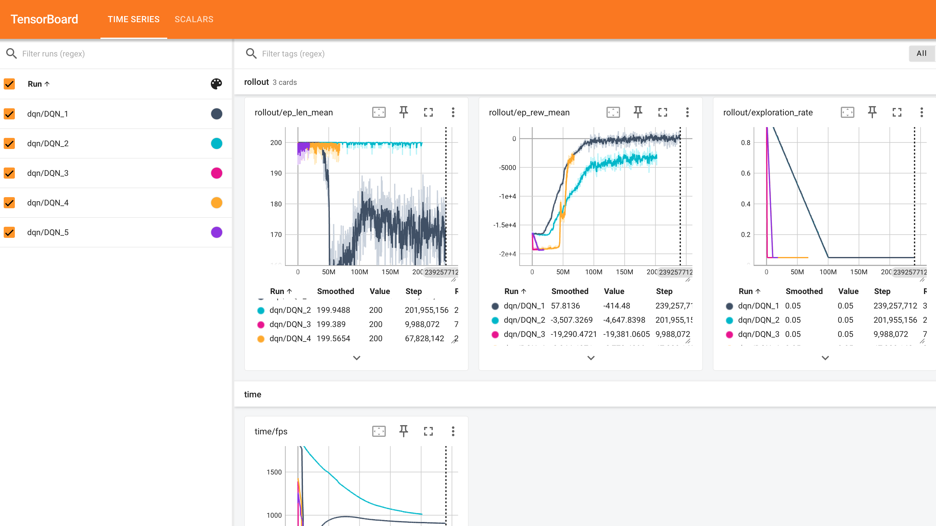

Slide 6
DQN on 6x6 block-stacking
Curriculum Learning: Make problem easier at the beginning and increase difficulty in subsequent additional training runs:
Keep same dimensionality 6x6 (needs to be same environment, just easier)
Introduce “difficulty level” : number of steps between start and target (DQN_4 run has difficulty_level=2)
Introduce “start_flat” : mode where every episode starts with block on its corresponding position, forcing num_positions=num_blocks (DQN_4 run has start_flat=True)

Slide 7
DQN Q-network structure
Default structure is [64,64]
Q-network structure is increased to [512,512,256] in DQN5 run
Current configuration: 6 1-hot vectors of length 12
Target configuration: 6 1-hot vectors of length 12
MultiInputPolicy -> input is vector of length 144
Capacity: the first 512-layer has enough surface area to learn specific combinations of block positions
Separation: Deep layers (3 total) help the model learn that a 1 in the 7th bit (Block a on Position 1) combined with a 1 in the 13th bit (Block b on Block a) represents a stack

Slide 8
Slides
CST8509_01_RL_Intro
Basic concepts and definitions
CST8509_02_MDP
MDPs, more on Value functions, Policy
CST8509_03_Gymnasium
Practical Agent – Environment infrastructure, Prolog, Pygame
CST8509_04_StableBaselines3
SB3 features: Wrappers, Callbacks, Vectorized Environments

Slide 9
Slides (cont'd)
CST8509_05_DQN_StableBaselines3
DQN practical aspects
CST8509_07_Gazebo_DynamicP_MC
Gazebo Simulation, Dynamic Programming, Monte Carlo Methods
CST8509_08_Docker
Solution for python virtual environments and ROS2 workspaces
CST8509_09_Value_Fn_approx
Realistic large State/Action spaces
DQN and value function approximation
PPO and value function approximation

Slide 10
About Written Questions
Example Written Questions from Midterm and Midterm Review
"Time to check your learning" slides
Some Multiple Choice questions can be rephrased into written questions

Slide 11
Written Question Additional Examples
How can Reinforcement Learning be applied to problems where the number of states is huge?
Describe at a high level how the DQN algorithm does value function approximation
Describe at a high level how the PPO algorithm does value function approximation
Where would a neural network appear in a Reinforcement Learning Problem/Solution?
What are possible sources of training data for a neural network in a Reinforcement Learning Problem/Solution?

Slide 12
Written Question Additional Examples
Give an overview of the strategy used in Assignment 2 to set up a Reinforcement Learning solution with simulation for training a Create3 robot to do some arbitrary task, for example, the red-ball-following task of Assignment 2. Your overview should mention the major tools, technologies, and projects used, their purpose and how they interact in the solution.
Suppose you are running an SB3 agent on a gymnasium environment with unsatisfactory results. What areas could you explore in order to improve results?

