Slide 1
Artificial intelligence software development
CST8510 Week 9
Dr. Hari M Koduvely

Slide 2

Agenda for Today
Theory: 6:00PM – 8:00PM
Right infrastructure for ML Systems
Four layers of infrastructure
ML Resource Management
ML Platform
Lab: 8:00PM – 10:00PM
Standup Meetings
This Photo by Unknown author is licensed under CC BY.

Slide 3
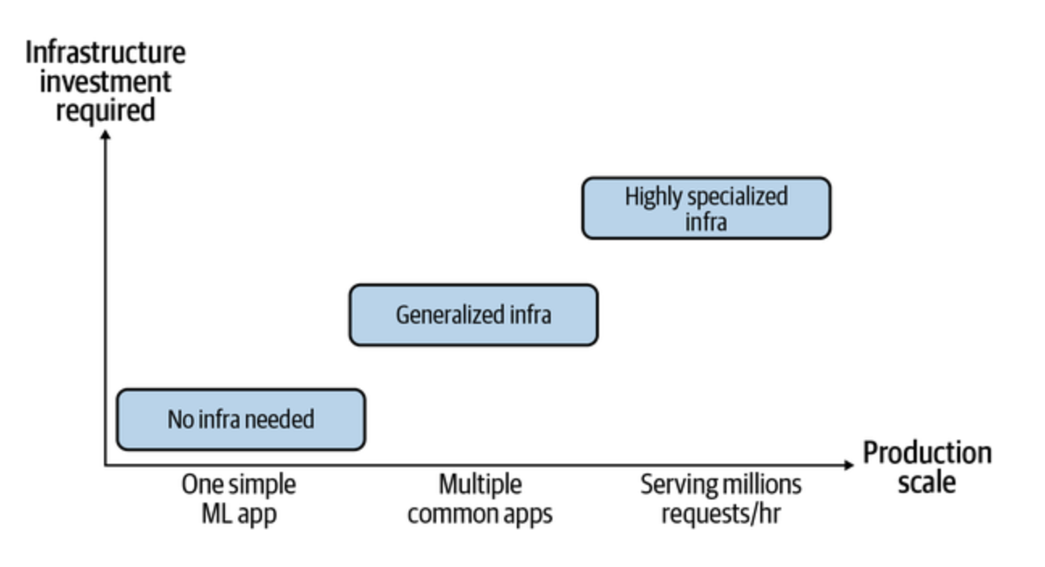
Infrastructure and Tooling for MLOps
Infrastructure requirement of different companies.

Slide 4
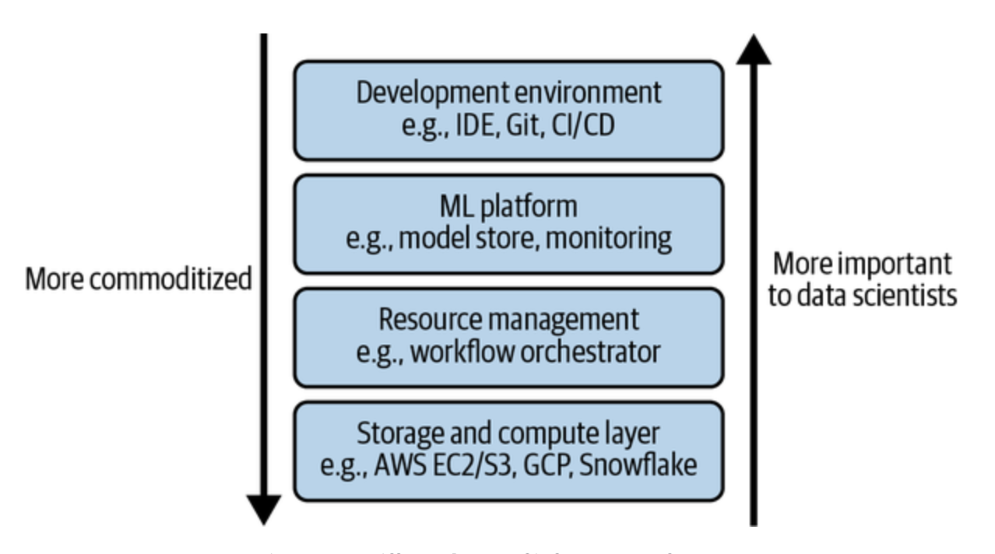
Four Layers of Infrastructure

Slide 5
Four Layers of Infrastructure
Storage and Compute
Layer where data is collected and stored
ML workloads are run
Resource Management
Schedule and orchestrate ML workloads
Airflow, Kubeflow etc.
ML Platform
Model stores, feature stores and monitoring tools
SageMaker, MLFlow
Development Environment
Layer where code is written and experiments are run

Slide 6
Storage and Compute Layer
Storage layer is where data is stored and collected
At the basic level storage can be on
Hard Drive Disk (HDD)
Solid State Drive (SSD)
Storage layer is completely commoditized and moved to cloud

Slide 7
Storage and Compute Layer
Compute layer refers to all the compute resources available
Amount of compute resources available determines the scalability of ML workloads
The compute layer can usually be sliced into smaller compute units to be used concurrently
Threads
Containers
Pods

Slide 8
Storage and Compute Layer
Compute units are characterized by two metrics.
How much memory it has (GB units)
How fast it runs an operation (FLOPS)
Amount of compute resources available determines the scalability of ML workloads.
Compute Utilization – Ratio of the number of FLOPS a job can run to the number of FLOPs a compute unit is capable of handling.
Practically one can only achieve utilization ~ 50%

Slide 9
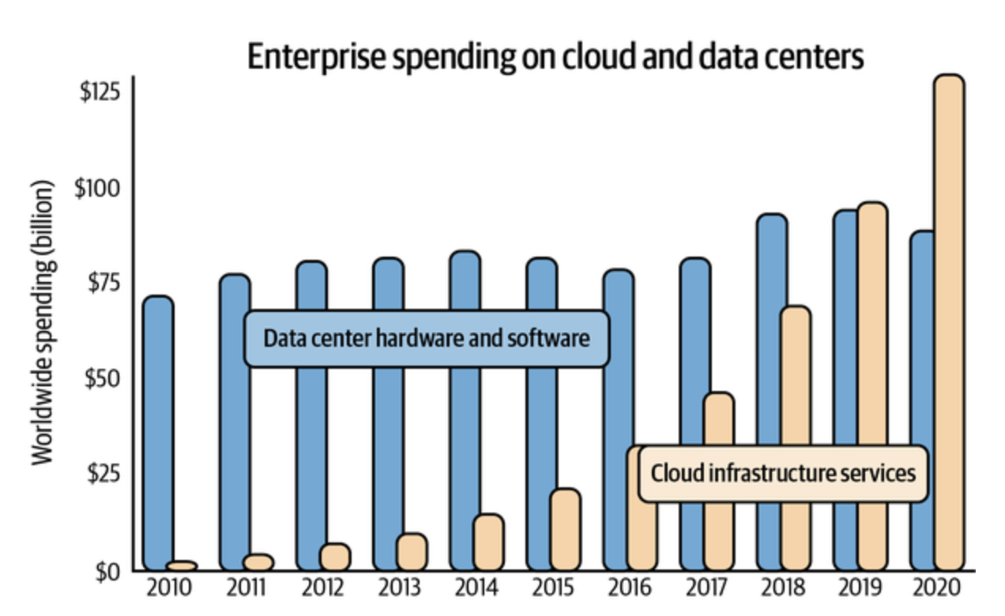
Storage and Compute Layer
Cloud spending accounts for approximately 50% cost of revenue of public software companies (analysis by a16z capital venture)
Some companies are doing "cloud repatriation"

Slide 10
Development Environment
Environment is where:
Code is written
Experiments are conducted
Interaction with production environment happens
Dev environment consists of the following components:
IDE (Jupyter Notebook, VS Code, Pycharm etc.)
Versioning software (Git, DVC, Weights and Biases etc.)
CI/CD (Jenkins etc.)

Slide 11
Notebooks
Notebooks are more than just IDEs, one can include:
Images
Documentation in LaTeX
Other artifacts like tables
Notebooks are Stateful
Retains state after run is completed
If program fails, one can restart from where it failed
Ideal for doing experiments with large datasets
Order of execution of the cells is important to keep track

Slide 12
Notebooks
Companies like Netflix used Notebooks in the production env
Other tools are developed to run on top of Notebooks
Papermill - for spawning multiple notebooks with different parameter sets
Commuter - A notebook hub for viewing, finding, and sharing notebooks within an organization.
nbdev - a library to write documentation and tests in the same place

Slide 13
Containers
Production workloads spread out on multiple instances.
Number of instances dynamically changes upon demand for predictions.
When a new instance is created, one needs to install dependencies using a list of predefined instructions.
Container technology is used for this purpose

Slide 14
Docker Containers
A lightweight, stand-alone, and executable software package.
Includes everything needed to run a piece of software (code, runtime, system tools, libraries, and settings)
Containers isolate software from its environment, ensuring that it works consistently across different systems.
Docker containers are built from images.
These are templates containing the application's code, runtime, and other dependencies.
Notes:
Containers:
Basic Concept: A container is a standard unit of software that packages up code and all its dependencies so the application runs quickly and reliably from one computing environment to another. It's a lightweight, standalone, executable package that includes everything needed to run a piece of software, including the code, runtime, system tools, system libraries, and settings.
Isolation: Containers virtualize the operating system, meaning each container can have its own set of processes, filesystem, and network interfaces, but they share the same kernel of the host operating system.
Portability: Because they contain everything needed to run an application, containers are highly portable. They can run on any system that supports containerization technology like Docker, regardless of the underlying infrastructure.
Use Case: Containers are used to run individual applications or services in a modular way. This is ideal for microservices architectures, where each component of the application runs in its own container

Slide 15
Benefits of Docker Containers
Portability: Containers can run on any system with Docker installed, regardless of the underlying infrastructure.
Consistency: Containers ensure that applications behave the same way in development, testing, and production environments.
Isolation: Containers run in their own environment, minimizing conflicts with other applications or system components.
Scalability: Containers can be easily scaled up or down, making it simpler to manage application loads and resources.
Version control and sharing: Docker images can be versioned and shared through repositories like Docker Hub, enabling collaboration and easy updates.

Slide 16
Example of a Docker Container
Download the latest PyTorch base image.
Clone NVIDIA’s apex repository on GitHub, navigate to the newly created apex folder, and install apex.
Set fancy-nlp-project to be the working directory.
Clone Hugging Face’s transformers repository on GitHub, navigate to the newly created transformers folder, and install transformers.

Slide 17
Example of a Docker Container
FROM pytorch/pytorch:latest
RUN git clone https://github.com/NVIDIA/apex
RUN cd apex && \
python3 setup.py install && \
pip install -v --no-cache-dir --global-option="--cpp_ext" \
--global-option="--cuda_ext" ./
WORKDIR /fancy-nlp-project
RUN git clone https://github.com/huggingface/transformers.git && \
cd transformers && \
python3 -m pip install --no-cache-dir.

Slide 18
PODs
Basic Concept: A pod is a group of one or more containers, with shared storage/network, and a specification for how to run the containers. It is the smallest deployable unit of computing that can be created and managed in Kubernetes.
Shared Context: Containers in the same pod share the same IP address and port space, and can find each other via localhost. They can also share mounted storage.
Atomic Unit: In Kubernetes, the pod is the atomic unit of scaling. When you scale an application up or down, you're actually increasing or decreasing the number of pods.
Use Case: Pods are used when there is a need for a few containers to work together very closely as a single cohesive unit of service.

Slide 19
Resource Management
In the pre-cloud world resources were limited.
Focus was then on maximizing resource utilization.
In the cloud world focus is on using resources cost-effectively.
Two characteristics of ML workflows that influence their resource management.
Repetitiveness
Dependencies

Slide 20
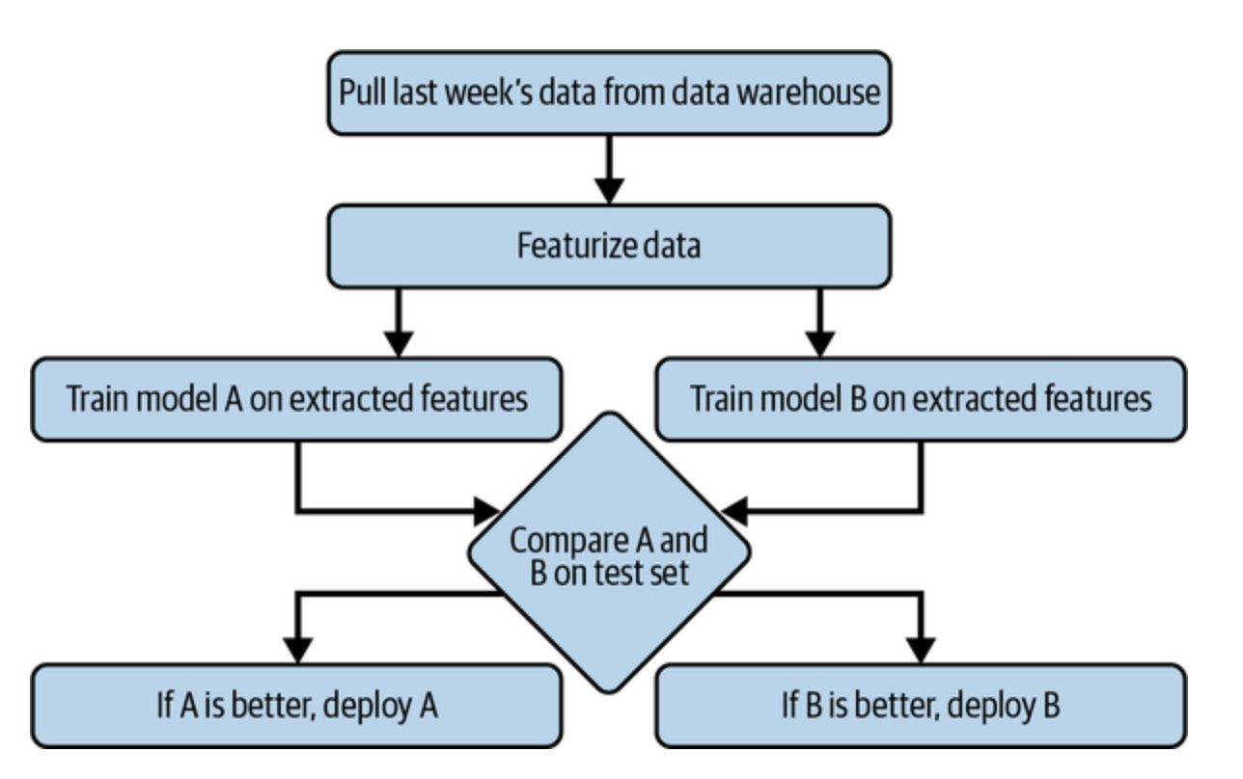
Schedulers and Orchestrators
Cron -.scheduling repetitive jobs to run at fixed times.
Can not handle the dependencies between the jobs it runs.
Schedulers are Cron programs that can handle dependencies.
Takes in the DAG of a workflow and schedules each step accordingly.
Tend to leverage queues to keep track of jobs
Need to be aware of the resources available and the resources needed to run each job

Slide 21
Schedulers and Orchestrators
Example of scheduling a job using Slurm
#!/bin/bash
#SBATCH -J JobName
#SBATCH --time=11:00:00 # When to start the job
#SBATCH --mem-per-cpu=4096 # Memory, in MB, to be allocated per CPU
#SBATCH --cpus-per-task=4 # Number of cores per task

Slide 22
Schedulers and Orchestrators
Schedulers are concerned with when to run jobs and what resources are needed to run those jobs.
Orchestrators are concerned with where to get those resources.
Schedulers deal with job-type abstractions such as DAGs, priority queues, user-level quotas.
Orchestrators deal with lower-level abstractions like machines, instances, clusters, service-level grouping, replication, etc.
It can dynamically increase/decrease the number of instances in the available instance pool.
Most well-known orchestrator today is Kubernetes.

Slide 23
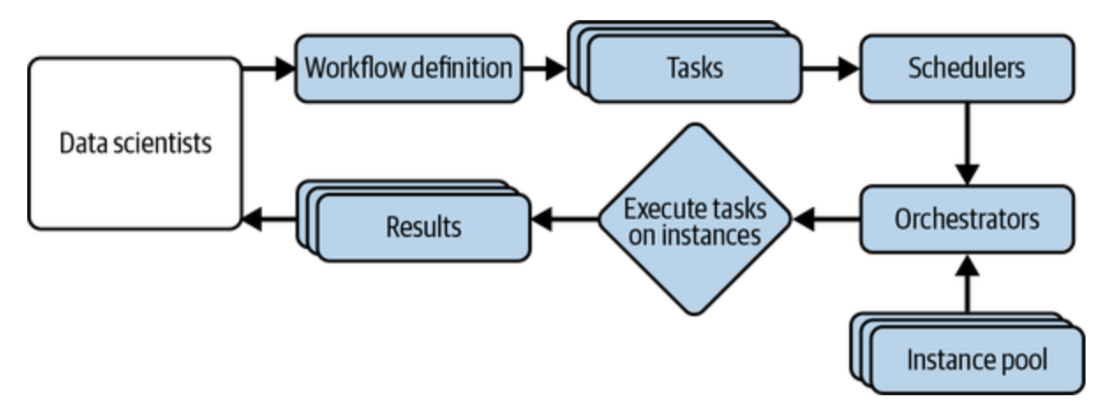
Workflow Management
They allow you to specify your workflows as DAGs.
Workflows can be defined using either code (Python) or configuration files (YAML).
Once a workflow is defined, the underlying scheduler usually works with an orchestrator to allocate resources to run the workflow

Slide 24
Airflow
One of the first workflow management tool.
Developed at Airbnb and open sourced.
Contains a huge library of operators.
Easy to use with different cloud providers, databases, storage options.

Slide 25
Airflow Drawbacks
Airflow is monolithic - it packages the entire workflow into one container.
Airflow’s DAGs are not parameterized - you can’t pass parameters into your workflows.
If you want to run the same model with different learning rates, you’ll have to create different workflows!
Airflow’s DAGs are static - it can’t automatically create new steps at runtime as needed.
Next generation of workflow orchestrators Argo and Prefect address these issues.

Slide 26
ML Platform
ML Platform is a relatively new concept like MLOps
No universal standard definition exists.
The shared set of tools for ML deployment makes up the ML platform.
Most important components:
Model Deployment
Model Store
Feature

Slide 27
ML Platform
Two important criteria for evaluating the component tools:
Whether the tool works with your cloud provider or allows you to use it on your own data center.
Need to run and serve models from a compute layer, and usually tools only support integration with a handful of cloud providers.
Whether it is an open source or a managed service:
Opensource tools can be hosted by engineers
Less about data security and privacy.
More Eng resources are required.
Managed services could be more expensive.
May not comply with regulations of data storage and privacy.

Slide 28
ML Platform – Model Deployment
A deployment service helps in both pushing models and their dependencies to production and exposing them as endpoints.
Deployment is the most mature among all ML platform components.
All major cloud providers offer tools for deployment:
AWS – SageMaker
Azure – AzureML
GCP – VerTexAI
Startups:
MLFlow Models:
Seldon
Cortex
Ray-Serve

Slide 29
ML Platform – Model Store
To help with debugging and maintenance, it is not sufficient to store model object alone
Information about models stored:
Model Definition: Loss function, number of layers of NN, number of parameters in each layer
Model Parameters: Actual values of the model parameters after training.
Featurize and Predict functions
Dependencies: Python packages
Data: Pointers to data storage
Model Generation Code: Pointers to Github repo
Experiment artifacts: Loss curves, performance metrics
Tags

Slide 30
ML Platform – Feature Store
Why Feature store is needed ?
Feature management
Feature computation
Feature consistency
Popular tools for feature store:
Feast:
Strong in creating batch features
Weak in creating streaming features
Tecton:
Capable of storing both online and batch features
Require deep integration

Slide 31
Summary of Today's Learning
Different layers of ML infrastructure.
Scheduling and orchestration of different ML tasks.
ML resource management
Important components of ML platform

Slide 32
Thank You

