Slide 1
Machine Translation
Phrase Alignment
Stephan Vogel
Spring Semester 2011

Slide 2
Overview
Why Phrase Alignment?
Phrase Pairs from Viterbi Alignment
  Heuristics
  Some Analysis
Phrase Pair Extraction as Sentence Splitting
Additional Phrase Pair Features

Slide 3
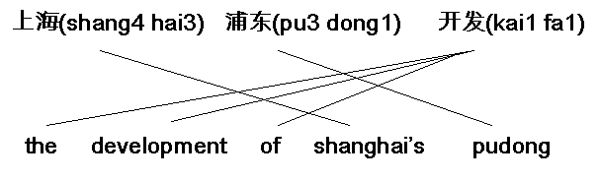
Alignment Example
One Chinese word aligned to multi-word English phrase
In lexicon individual entries with ‘the’, ‘development’, ‘of’
Difficult to generate from words
  Main translation ‘development’
  Test if insertions of ‘the’ and ‘of’ improves LM probability
Easier to generate if we have phrase pairs available

Slide 4
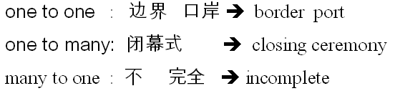




Why Phrase to Phrase Translation
Captures n x m alignments
Encapsulates context
Local reordering
Compensates segmentation errors

Slide 5
How to get Phrase Translation
Typically: Train word alignment model and extract phrase-to-phrase translations from Viterbi path
  IBM model 4 alignment
  HMM alignment
  Bilingual Bracketing
Genuine phrase translation models
  Integrated segmentation and alignment (ISA)
  Phase Pair Extraction via full Sentence Alignment
Notes:
  Often better results when training target to source for extraction of phrase translations due to asymmetry of alignment models
  Phrases are not fully integrated into the alignment model, they are extracted only after training is completed – how to assign probabilities?

Slide 6
Phrase Pairs from Viterbi Path
Train your favorite word alignment (IBMn, HMM, …)
Calculate Viterbi path (i.e. path with highest probability or best score)
The details ….

Slide 7
Word Alignment Matrix
Alignment probabilities according to lexicon
e_{I}
e₁
f₁
f_{J}

Slide 8
Viterbi Path
Calculate Viterbi path (i.e. path with highest probability)
e_{I}
e₁
f₁
f_{J}

Slide 9
Phrases from Viterbi Path
Read off source phrase – target phrase pairs
e_{I}
e₁
f₁
f_{J}

Slide 10
Extraction of Phrases
foreach source phrase length l {
foreach start position j1 = 1 … J – l {
foreach end position j2 = j1 + l – 1 {
min_i = min{ a(j) : j = j1 … j2 }
max_i = max{ a(j) : j = j1 … j2 }
SourcePhrase = f_{j1} … f_{j2}
TargetPhrase = e_{min_i} … e_{max_i}
store SourcePhrase ‘#’ TargetPhrase
}
}
}
Training in both directions and combine phrase pairs
Calculate probabilities
Pruning: take only n-best translations for each source phrase

Slide 11
Dealing with Asymmetry
Word alignment models are asymmetric; Viterbi path has:
  multiple source words – one target word alignments
  but no one source word – multiple target words alignments
Train alignment model also in reverse direction, i.e. target -> source
Using both Viterbi paths:
  Simple: extract phrases from both directions and merge tables
  ‘Merge’ Viterbi paths and extract phrase pairs according to resulting pattern

Slide 12
Combine Viterbi Path
e_{I}
F->E
E->F
Intersect.
e₁
f₁
f_{J}

Slide 13
Combine Viterbi Paths
Intersections: high precision, but low recall
Union: lower precision, but higher recall
Refined: start from intersection and fill gaps according to points in union
Different heuristics have been used
  Och
  Koehn
Quality of phrase translation pairs depends on:
  Quality of word alignment
  Quality of combination of Viterbi paths

Slide 14
Heuristics
Grow-Diag
Grow-Diag-Final
…

Slide 15
Heuristics
To establish word alignments based on the two GIZA++ alignments, a number of heuristics may be applied.
Default heuristic: grow-diag-final
  starts with the intersection of the two alignments
  and then adds additional alignment points.
Other possible alignment methods:
  intersection
  union
  grow (only add block-neighboring points)
  grow-diag (without final step)

Slide 16
The GROW Heuristics
GROW-DIAG-FINAL(e2f,f2e):
neighboring = ((-1,0),(0,-1),(1,0),(0,1),
(-1,-1),(-1,1),(1,-1),(1,1))
alignment = intersect(e2f,f2e);
GROW-DIAG();
FINAL();
Define neighborhood
  horizontal and vertical
  if ‘diag’ then also the corners
Unclear if sequence in neighborhood makes a difference
6 | 4 | 8
1 | X | 3
5 | 2 | 7

Slide 17
The GROW Heuristics
GROW-DIAG():
generate intersection and union
current_points = intersection // start with intersec.
iterate until no new points added
loop over current_points p // expand existing points
loop over neighboring_points p’ // here ‘diag’ comes in
if p’ in union // select from union
if row or col uncovered
add p’ to current_points

Slide 18
The GROW Heuristics: Adding Final
Final():
loop over points in union
if row OR col empty // row or col or both are free
add point to alignment
Final-And():
loop over points in union
if row AND col empty // row and col are both free
add point to alignment
Final adds disconnected points
The ‘And’ makes it more restrictive
There can still remain gaps, resulting from originally non-aligned and NULL aligned positions

Slide 19
Reading-Off Phrase Pairs
Extract phrase pairs consistent with the word alignment:
Words in phrase pair are only aligned to each other, and not to words outside
BP(f₁^{J},e₁^{J},A) = { ( f_{j}^{j+m},e_{i}^{i+n} ) }:
forall (i',j') in A : j<=j' <= j+m <-> i <= i' <= i+n
Formally: set of phrase pair such that for all points in alignment, if j’ is within a source phrase then i’ is within the corresponding target phrase
Notice: gaps allow to extract additional phrase pairs

Slide 20
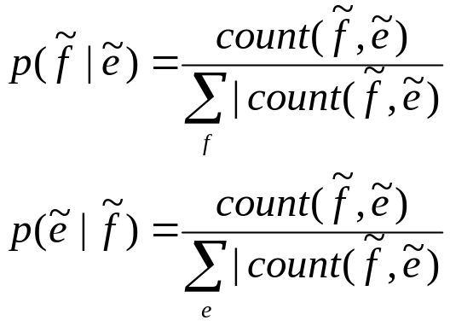
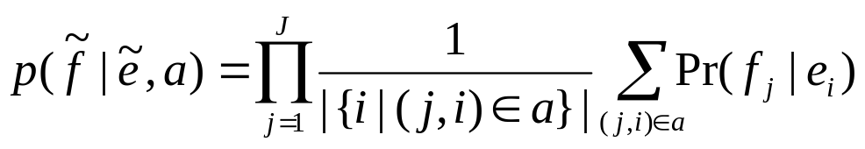
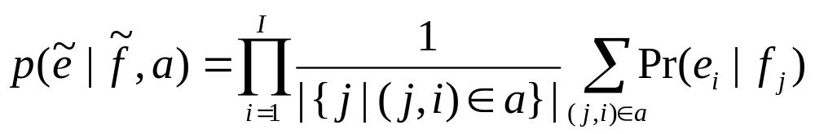
Scoring Phrases
Relative frequency – both directions
Lexical features (lexical weighting)

Slide 21
Overgeneration
e_{I}
e₁
f₁
f_{J}
Extract all n:m blocks (phrase-pairs ) which have at least one link inside and no conflicting link (i.e. in same rows and columns) outside
Will extract many blocks when alignment has gaps
Note: not all possible blocks shown

Slide 22
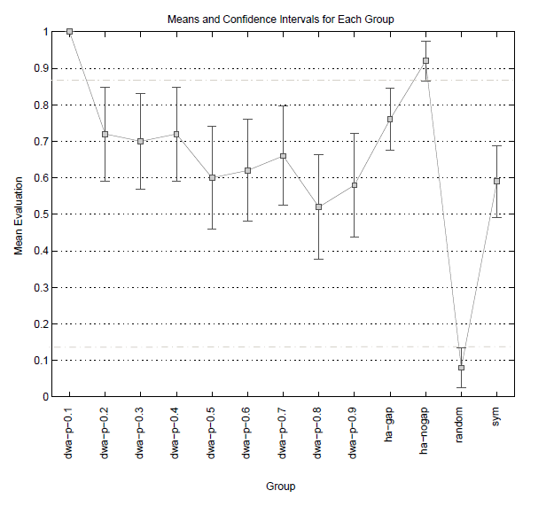
Bad Phrase Pairs from Perfect Alignment
Accuracy for phrase pairs extracted from different word alignments
  DWA-0.1 high precision WA
  Dwa-0.9 high recall WA
  Hg-*: human WA, PPs
  with and without gaps in WA
  Sym: IBM4 symmetrized
  Random: random target
  range
Overgeneration from
gappy WA

Slide 23
Dealing with Memory Limitation
Phrase translation tables are memory killers
  Number of phrases quickly exceeds number of words in corpus
  Memory required is multiple of memory for corpus
  We have corpora of 200 million words ->
  >1 billion phrase pairs
Restrict phrases
  Only take short ones (default: 7 words)
  Only take frequent ones
Evaluation modus
  Load only phrases required for test sentences (i.e. extract from large phrase translation table)
  Extract and store only required phrase pairs (i.e. part of training cycle at evaluation time)

Slide 24
Number of (Source) Phrases
Small corpus: 40k sentences with 400k words
 | Count | freq > 1 | >2 | >5
1 | 9,026 | 5796 | 4516 | 2998
2 | 83,289 | 30,352 | 18,696 | 8,682
3 | 173,817 | 35,743 | 17,583 | 6,016
4 | 210,496 | 23,837 | 9,643 | 2,595
5 | 208,583 | 14,046 | 4,870 | 1,113
6-10 | 735,989 | 16,617 | 4,291 | 709
Number of phrases quickly exceeds number of words in corpus
Numbers are for source phrases only; each phrase typically has multiple translations (factor 5 – 20)

Slide 25
Analyzing Phrase Table: Sp-En
Distribution of src-tgt length
Well-behaved
  Not too many unbalanced phrase pairs
 | 1 | 2 | 3 | 4 | 5 | 6 | 7
1 | 21,661 | 12,966 | 4,187 | 868 | 126 | 36 | 13
2 | 10,470 | 73,617 | 35,162 | 14,064 | 3,272 | 556 | 123
3 | 2,532 | 24,361 | 95,477 | 48,293 | 20,990 | 5,549 | 898
4 | 525 | 6795 | 35,804 | 84,395 | 49,752 | 22,186 | 6,411
5 | 147 | 1,566 | 10,846 | 38,412 | 63,911 | 41,838 | 19,183
6 | 42 | 363 | 2,778 | 13,064 | 33,504 | 46,774 | 30,983
7 | 21 | 96 | 653 | 3,670 | 12,929 | 25,882 | 32,321

Slide 26
When Things Go Wrong
Chinese-English phrase table
Distribution of src-tgt length
Rather flat distribution – rather strange
 | 1 | 2 | 3 | 4 | 5 | 6 | 7
1 | 1,242,416 | 5,259,150 | 6,482,169 | 4,702,934 | 2,909,623 | 1,788,751 | 1,159,036
2 | 578,861 | 2,043,285 | 2,325,681 | 1,644,596 | 972,143 | 547,920 | 320,796
3 | 83,571 | 217,707 | 261,963 | 210,683 | 133,646 | 77,695 | 45,377
4 | 9,779 | 17,423 | 22,057 | 21,467 | 16,457 | 11,096 | 7,179
5 | 1,514 | 2,060 | 2,579 | 2,816 | 2678 | 2,410 | 1,920
6 | 291 | 300 | 372 | 369 | 409 | 465 | 516
7 | 61 | 59 | 51 | 89 | 91 | 106 | 125

Slide 27
When Things Go Wrong
Frequency of phrase pairs
Notice: some high frequency words end up with large number of translations (very noisy)
Need to prune phrase table before using
  Memory
  Speed in decoder
 | #src | #pairs | #pairs/#src | max
1 | 6,276 | 23,544,275 | 3751.48 | 1,675,086
2 | 18,032 | 8,433,321 | 467.69 | 52,025
3 | 11,796 | 1,030,644 | 87.37 | 11,987
4 | 4,404 | 105,458 | 23.95 | 1,794
5 | 1,443 | 15,977 | 11.07 | 935
6 | 486 | 2,722 | 5.60 | 122
7 | 188 | 582 | 3.10 | 44

Slide 28
Non-Viterbi Phrase Alignment
Desiderata:
  Use phrases up to any length
  Can not store all phrase pairs -> search them on the fly
  High quality translation pairs
  Balance with word-based translation

Slide 29
Phrase Alignment As Sentence Splitting
Search translation for one source phrase
e_{I}
e₁
f₁
f_{j1}
f_{j2}
f_{J}

Slide 30
Phrase Alignment As Sentence Splitting
What we would like to find
e_{I}
e_{i2}
e_{i1}
e₁
f₁
f_{j1}
f_{j2}
f_{J}

Slide 31
Phrase Alignment As Sentence Splitting
Calculate modified IBM1 word alignment: don’t sum over words in ‘forbidden’ (grey) areas
Select target phrase boundaries which maximize sentence alignment probability
  Modify boundaries i₁ and i₂
  Calculate sentence alignment
  Take best
i₂
i₁
j1
j2

Slide 32
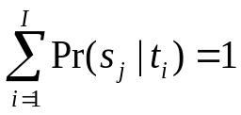
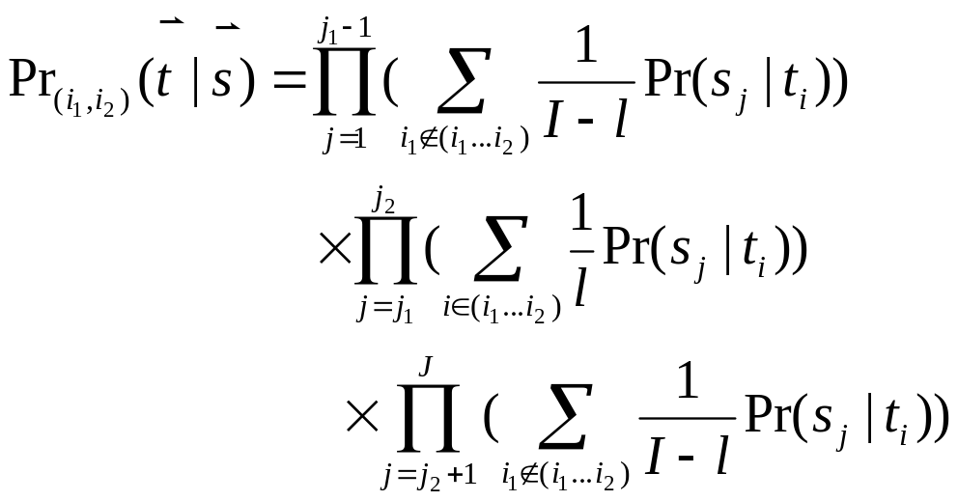
Phrase Extraction via Sentence Splitting
Calculate modified IBM1 word alignment: don’t sum over words in ‘forbidden’ areas
  l = i₂ – i₁ + 1 is length of target phrase
  Pr(s_{j}|t_{i}) are normalized over columns, i.e.
Select target boundaries to maximize sentence alignment probability
(i₁, i₂) = argmax_{(i1,i2)} { Pr_{(i1,i2)}(s|t) }

Slide 33
Phrase Alignment
Search for optimal boundaries
e_{I}
e₁
f₁
f_{j1}
f_{j2}
f_{J}

Slide 34
Phrase Alignment
Search for optimal boundaries
e_{I}
e₁
f₁
f_{j1}
f_{j2}
f_{J}

Slide 35
Phrase Alignment
Search for optimal boundaries
e_{I}
e₁
f₁
f_{j1}
f_{j2}
f_{J}

Slide 36
Phrase Alignment
Search for optimal boundaries
e_{I}
e₁
f₁
f_{j1}
f_{j2}
f_{J}

Slide 37
Phrase Alignment
Search for optimal boundaries
e_{I}
e₁
f₁
f_{j1}
f_{j2}
f_{J}

Slide 38
Phrase Alignment
Search for optimal boundaries
e_{I}
e₁
f₁
f_{j1}
f_{j2}
f_{J}

Slide 39
Phrase Alignment
Search for optimal boundaries
e_{I}
e₁
f₁
f_{j1}
f_{j2}
f_{J}

Slide 40
Phrase Alignment
Search for optimal boundaries
e_{I}
e₁
f₁
f_{j1}
f_{j2}
f_{J}

Slide 41
Phrase Alignment
Search for optimal boundaries
e_{I}
e₁
f₁
f_{j1}
f_{j2}
f_{J}

Slide 42
Phrase Alignment
Search for optimal boundaries
e_{I}
e₁
f₁
f_{j1}
f_{j2}
f_{J}

Slide 43
Phrase Alignment – Best Result
Optimal target phrase
e_{I}
e₁
f₁
f_{j1}
f_{j2}
f_{J}

Slide 44
Phrase Alignment – Use n-best
Use all translation candidates with scores close to the best one
e_{I}
e₁
f₁
f_{j1}
f_{j2}
f_{J}

Slide 45


Looking from Both Sides
Calculate both and
Interpolate the probabilities from both direction and
Find the target phrase boundary (i₁, i₂) which is
Interpolation factor c can be tuned on development test set

Slide 46
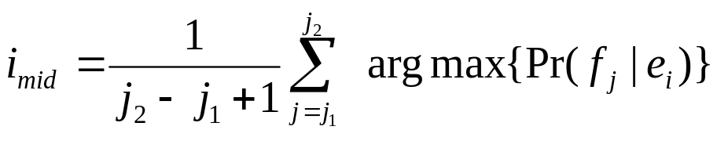
Speed-Up
Fast estimate of expected target phrase position
  Use maximum lexical probability for each source phrase word
  Take average position
  Consider only boundaries around that expected position
Restrict target phrase length
  E.g. only 1.5 times longer than source phrase

Slide 47
Additional Phrase Pair Features
Length balance feature
  Use |len(f) - len(e)| as feature
  Use fertility-based length model
High frequency word features
  We over-generate and under-generate punctuations and high frequency words (the, a, is, and, …)
  Add counts, how often words are seen in target phrase
  Or use word pairs as binary features (seen – not seen)
POS match, i.e. each SrcPOS – TgtPOS pair is a binary feature
Syntactic features: chunk boundaries, sub-tree alignment, …
Feature weights trained on dev data

Slide 48
Just-In-Time Phrase Pair Extraction
Given a test sentence: find occurrences of all substrings (n-grams) in the bilingual corpus
Use suffix array to index source part of corpus
  Space efficient (for each word – one pointer)
  Search requires binary search
  Can find n-grams up to any n (restricted within sentence boundaries)
Extract phrase-translation pairs
  Find phrase alignment based on word alignment
  Can use Viterbi alignment (could be pre-calculated)
  Or use new phrase alignment approach
Mixed approach: high frequency phrases aligned offline, low frequency phrases aligned online
Suffix array toolkit by Joy Ying Zhang
http://projectile.sv.cmu.edu/research/public/tools/salm/salm.htm)

Slide 49
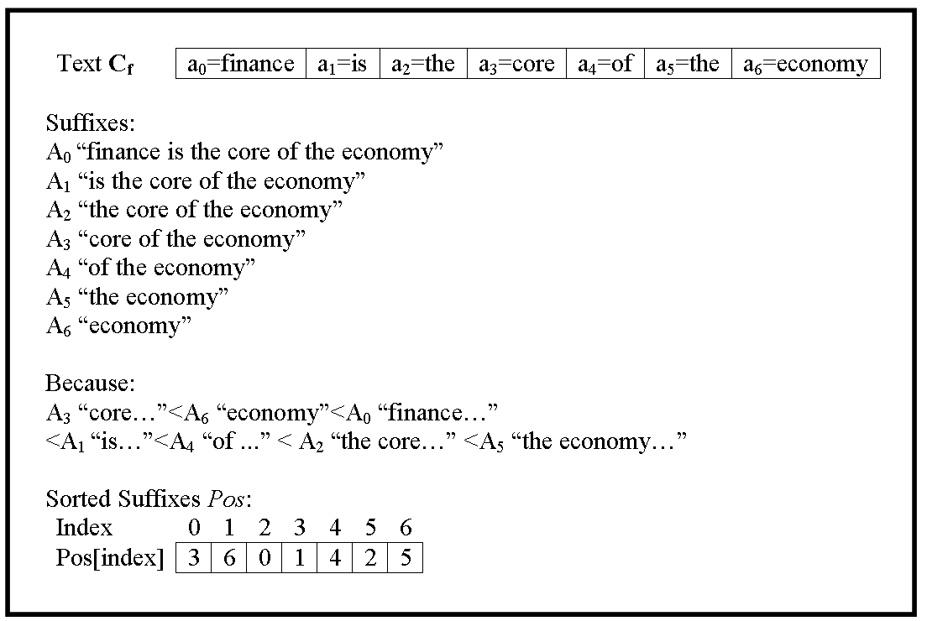
Indexing a Corpus using a Suffix Array

Slide 50
Indexing a Corpus using a Suffix Array
finance
is
the
core
of
the
economy
the …
For alignment the sentence numbers are needed:
  Insert <sos> markers into the corpus
  Insert sentence numbers into the corpus

Slide 51
Searching a String using a Suffix Array
Search “the economy”
1. step: search for range of “the” => [l₁, r₁]
2. step: search for range of “the economy” within [l₁, r₁] => [l₂, r₂]
finance
is
the
core
of
the
economy
the …
the economy …

Slide 52
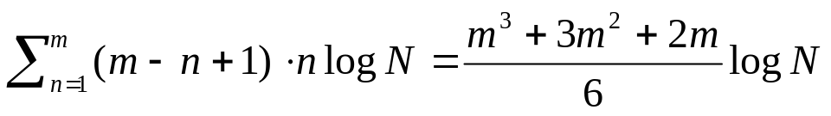
Locating all Sub-Strings of a Sentence
For a testing sentence f=f₁, f₂, ..., f_{i}, ..., f_{m}, we want to locate all the substrings of f in the corpus
Naïve method:
  Enumerate all substrings in f, and search their occurrences
  Locate a phrase of n words in a corpus of N words requires O(n·logN)
  f has 1 phrase of m-words, 2 with (m-1) words, and …, m single word “phrases”
  which is O(m³logN)
Smarter method:
  A phrase exists in the corpus only when all its sub-phrases exist
  Construct search table bottom-up

Slide 53
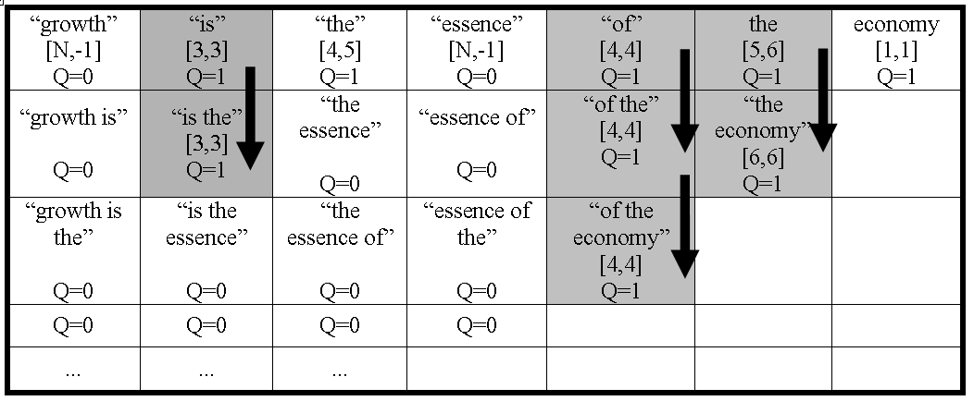
Locating all Sub-Strings of a Sentence
Testing sentence: “growth is the essence of the economy”

Slide 54
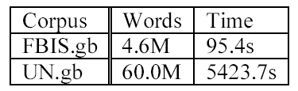
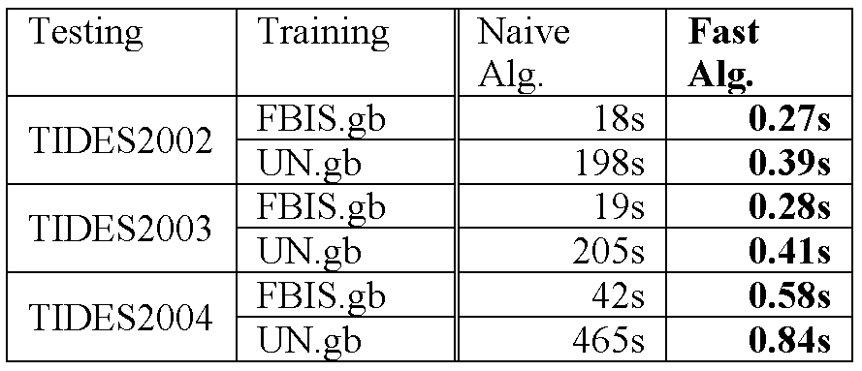
Time Complexity
Indexing the training corpus
  O(NlogN) time for corpus of N words
Locating all the sub-strings of a testing sentence of m words
  O(m·logN) (compare to O(m³logN) of the naïve algorithm)

Slide 55
Non-Contiguous Phrases
Examples:
  Der Zug kommt heute mit 10 Minuten Verspaetung an
  Today the train will arrive 10 minutes late
  Je ne veux plus jouer
  I do not want to play anymore
  Pierre ne mange pas
  Pierre does not eat
Sometimes within bounds of longer contiguous phrases, but does not generalize
Sometimes completely out of bounds

Slide 56
Consequences
At word alignment time
  Same problems as with contiguous phrases due to 1:n restrictions
At phrase alignment time
  Standard phrase extraction does not consider disjoint phrases
  Typically, there will be conflicting alignment points which prevent the extraction
  Even if no conflicting alignment points, the extracted phrase pair would still be wrong
  The two fragments of a non-contiguous phrase can be extracted as two separate phrases pairs
At decoding time
  Non-contiguous on source side -> generate translation for each fragment
  Non-contiguous on target side -> generate on part of the translation

Slide 57
Some Work on Non-Contiguous Phrases
Simard et al. Translating with non-contiguous phrases, 2005
Cancedda et al. An elastic-phrase model for statistical machine translation
Galley and Manning. Accurate non-hierarchical phrase-based translation
Notice: hierarchical models (e.g. Hiero) extract non-contiguous phrases
  ne X pas :: not X
  je ne veux plus X :: I do not want X anymore

Slide 58

Finding Non-Contiguous Phrases
(Galley and Manning, 2010)
Assume a sentence is segmented into (possibly non-continuous) phrases
  Each phrase is characterized by a coverage set (i.e. set of positions)
Assume a sentence pair has same number of phrases on source and target side
  (f, e) -> s = (s₁, …, s_{K}) :: t = (t₁, …, t_{K})
  A pair of coverage sets (s_{k}, t_{k}) is consistent with word alignment A if
Notice: no restriction in the number of gaps
For non-contiguous phrase pairs: exponential in max phrase length
Use suffix array to find non-contiguous phrases (Lopez, 2007)

Slide 59
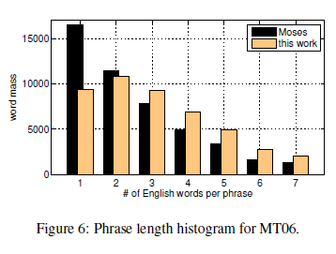
Benefits from Non-Contiguous Phrases
Translation quality goes up: Galley and Manning report
  improved BLEU and TER scores
  compared to Moses and Joshua
  across multiple Ch-En test sets
Interesting: length
of matching phrases
increases

Slide 60
Summary
Phrase alignment based on underlying word alignment
Different phrase alignment approaches
  From Viterbi paths
  Phrase alignment as optimizing sentence splitting
Looking from both side to cope with asymmetry of word alignment models
Phrase translation table is huge: Restrict phrase to short and/or high frequency phrases
Online phrase alignment
  Use suffix array to index all phrases in corpus
  Efficient way to find all phrase in a sentence
  Actual alignment takes time
Non-contiguous phrases
  Efficient search with suffix array
  Significant improvement in translation quaility
  Longer matching phrases

