Slide 1
GraphQL and BFF

Slide 2
web研发模式的发展
Jsp
ajax
Spa
BFF

Slide 3
前后端交互困境
「你自己请求 2 个接口再组装不就行了？」 - 后端同学追求服务下沉和解耦。
「少一次 HTTP 啊，加一个接口有那么难么？」 - 前端同学离用户最近，需要考虑用户体验灵活性。

Slide 4
BFF
2015 年，Sam Newman 对此提出了 Pattern: Backends For Frontends，简称 BFF

Slide 5
GraphQL
GraphQL - A Query Language for APIs
It was developed and open-sourced by Facebook.
other companies like Netflix or Coursera were working on comparable ideas to make API interactions more efficient

Slide 6
什么是GraphQL

Slide 7
REST方式获取数据

Slide 8
GraphQL

Slide 9
Reasons to Use GraphQL
GraphQL APIs have a strongly typed schema
No more overfetching and underfetching
GraphQL enables rapid product development

Slide 10
The Schema Definition Language (SDL)
type Post {
name: String!
age: Int!
posts: [Post!]!
}
type Person {
name: String!
age: Int!
}
type Post {
title: String!
author: Person!
}
https://www.howtographql.com/basics/2-core-concepts/

Slide 11
Architecture
GraphQL server with a connected database
GraphQL server that is a thin layer in front of a number of third party or legacy systems and integrates them through a single GraphQL API

Slide 12
GraphQL server with a connected database

Slide 13
GraphQL layer that integrates existing systems

Slide 14
Resolvers
A function on a GraphQL server that's responsible for fetching the data for a single field
Query: {
human(obj, args, context, info) {
return context.db.loadHumanByID(args.id).then(
userData => new Human(userData)
)
}
}

Slide 15
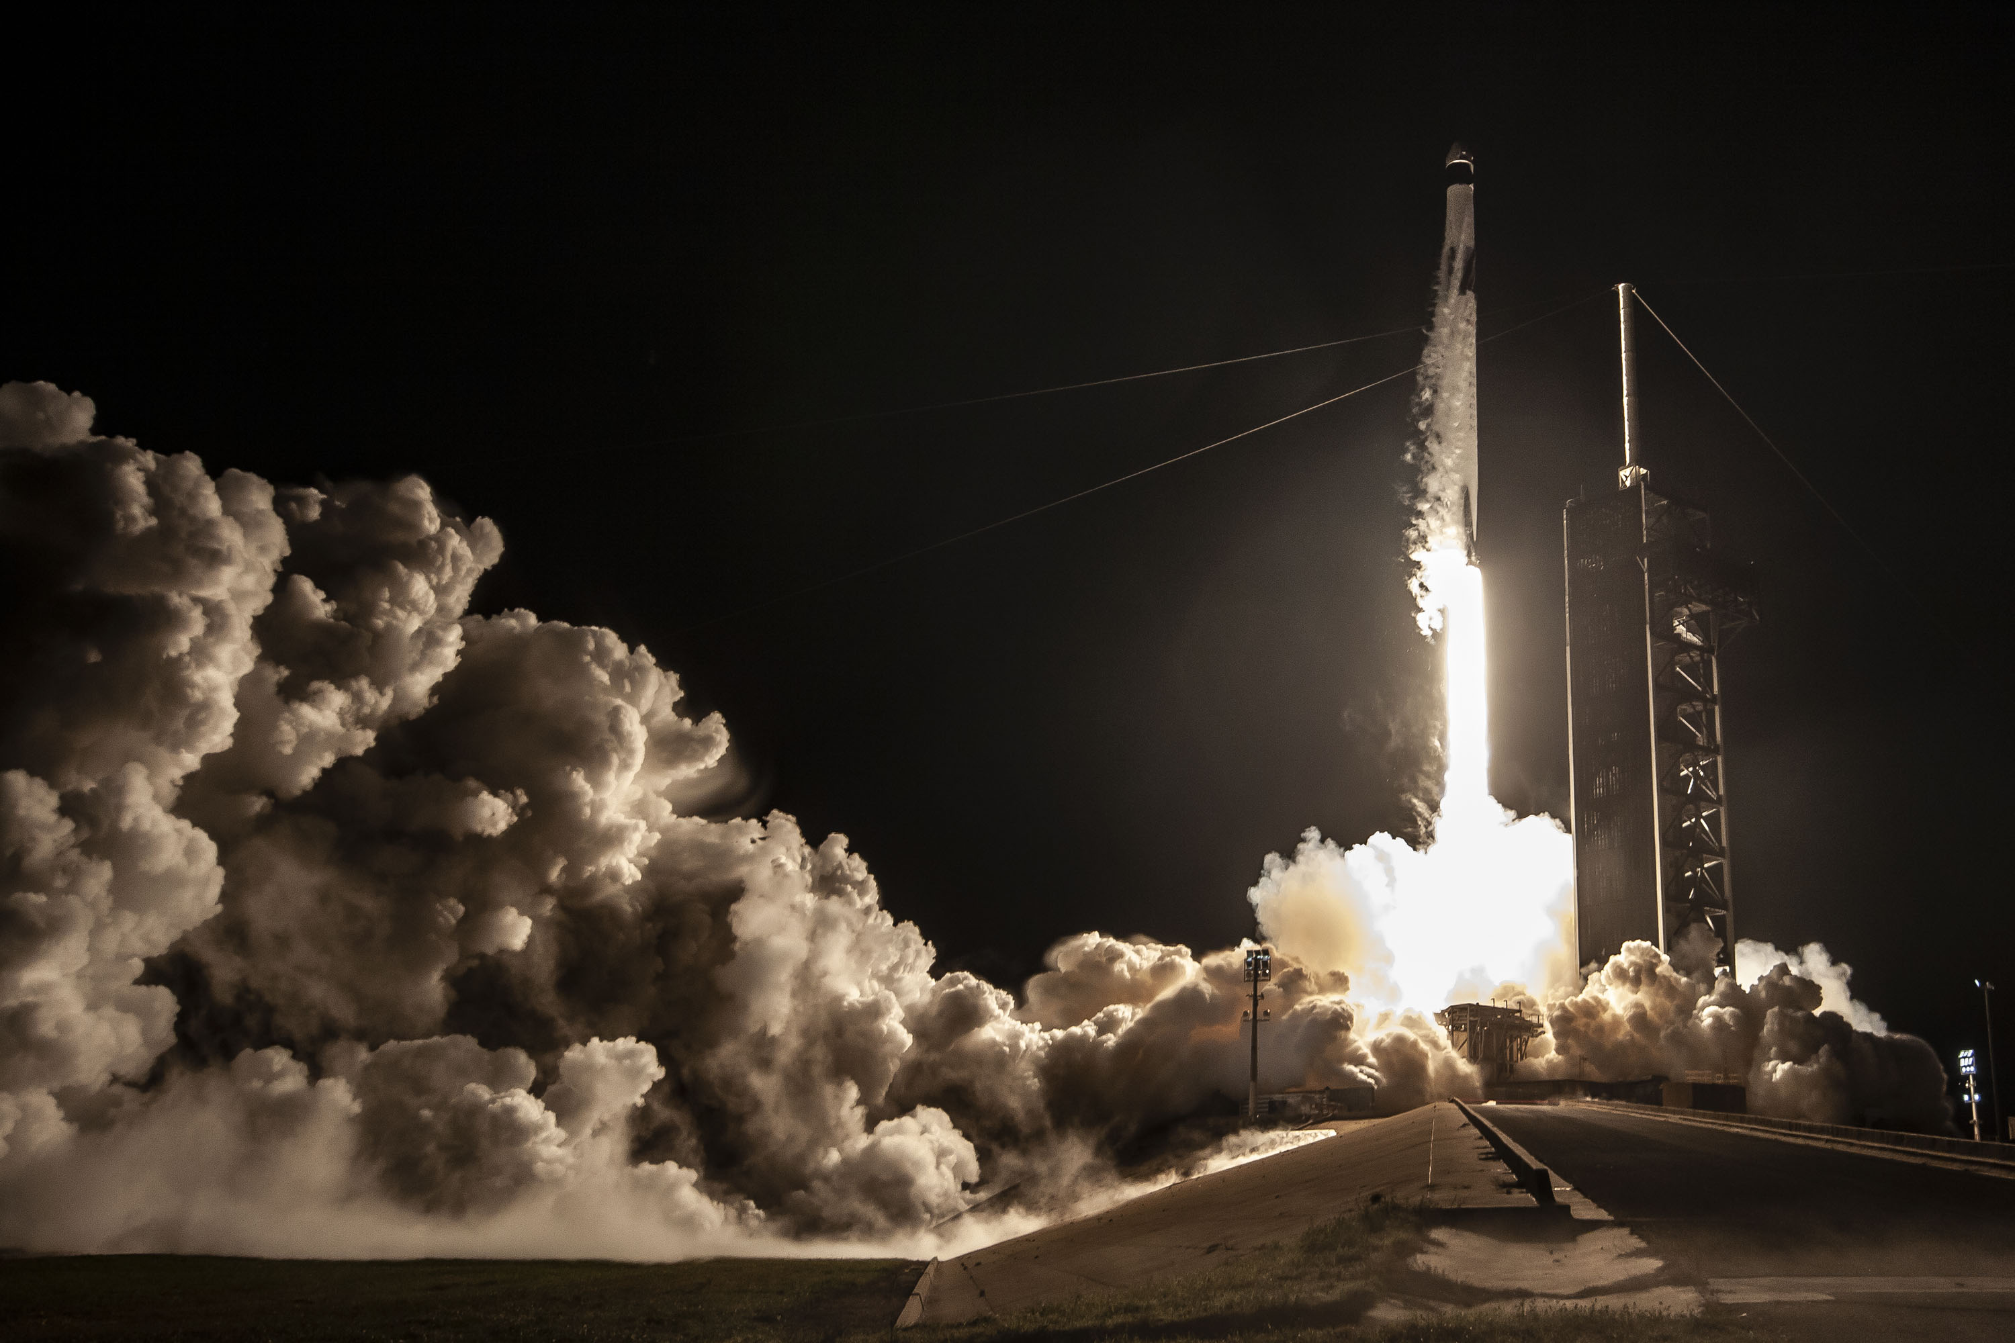
Apollo实践

Slide 16
参考资料
BFF https://samnewman.io/patterns/architectural/bff/#bff https://www.zhihu.com/question/264563447
在微服务下使用GraphQL构建BFF https://medium.com/tech-tajawal/backend-for-frontend-using-graphql-under-microservices-5b63bbfcd7d9
为什么要使用GraphQL https://www.prisma.io/blog/top-5-reasons-to-use-graphql-b60cfa683511
GraphQL教程 https://www.howtographql.com

Slide 17
Thank you

