Slide 1
ORC Files
Owen O’Malley
owen@hortonworks.com
December 2012

Slide 2
Top Level
A single file as output of each task.
Dramatically simplifies integration with Hive
Lowers pressure on the NameNode
Support for the Hive type model
Complex types (struct, list, map, union)
New types (datetime, decimal)
Encoding specific to the column type
Split files without scanning for markers
Bound the amount of memory required for reading or writing.

Slide 3
File Structure
Break file into sets of rows called a stripe.
Default stripe size is 250 MB
Large size enables efficient read of columns
Footer
Contains list of stripes
Types, number of rows
Count, min, max, and sum for each column
Postscript
Contains compression parameters
Size of compressed footer

Slide 4
Stripe Structure
Index
Required for skipping rows
Currently every 10,000 rows
Position in each stream
Min and max for each column
Could include bit field or bloom filter
Data
Required for table scan
Footer
Directory of stream locations

Slide 5
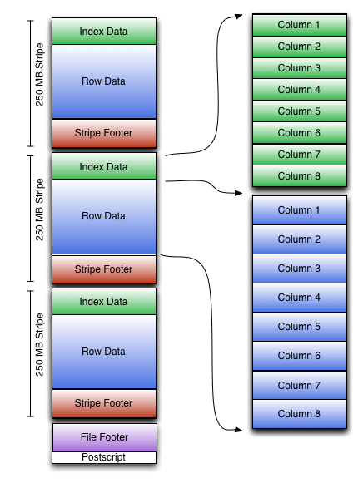
File Layout

Slide 6
Integer Column Serialization
Two streams
Present bit stream – is the value non-null?
Data stream – stream of integers
Run Length Encoding
First byte specifies
Run length
Whether they are literals or duplicates
Duplicates can step by -128 to +127
Protobuf style variable length integers

Slide 7
String Column Serialization
Use a dictionary to uniquify column values
Speeds up predicate filtering
Improves compression
Sort dictionary
Four streams
Present bit stream – is the value non-null?
Dictionary data – the bytes for the strings
Dictionary length – the length of each entry
Row data – the row values

Slide 8
Compression
All streams will be compressed using a codec
Choice of: none, LZO, Snappy, and Zlib
Codecs are used as block compressors
ORC can jump over compressed blocks
Positions in the stream are block start location and an offset into the block
Compression is done incrementally as block is produced to optimize memory use
Compression is specified in table properties.

Slide 9
Projection and Predicate Filtering
Projection
Hive does column projection for file formats
Currently only top level columns
ORC stores rows split into primitive types
Easy to load a subset of the columns
Predicate Filtering
Use index to skip row groups that don’t pass

Slide 10
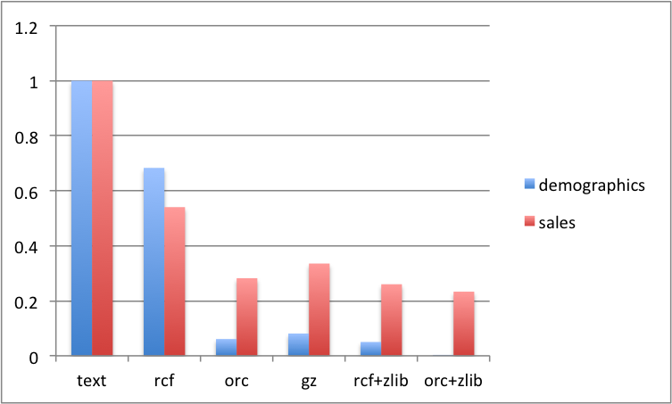
Example File Sizes
Data set from TPC-DS

Slide 11
Final notes
Metadata is stored using Protocol Buffers
Allows addition and removal of fields
Reader must support seeking to a given row
Concurrent reads of the same file are possible using separate RecordReaders
ORC doesn’t include checksums, since that is done in HDFS
Writer may at some point reorder rows to improve compression.

Slide 12
Comparison
 | RC File | Trevni | ORC File
Hive Type Model | N | N | Y
Separate complex columns | N | Y | Y
Splits found quickly | N | Y | Y
Default column group size | 4MB | 64MB* | 250MB
Files per a bucket | 1 | > 1 | 1
Store min, max, sum, count | N | N | Y
Versioned metadata | N | Y | Y
Run length data encoding | N | N | Y
Store strings in dictionary | N | N | Y
Store row count | N | Y | Y
Skip compressed blocks | N | N | Y
Store internal indexes | N | N | Y

