Slide 1


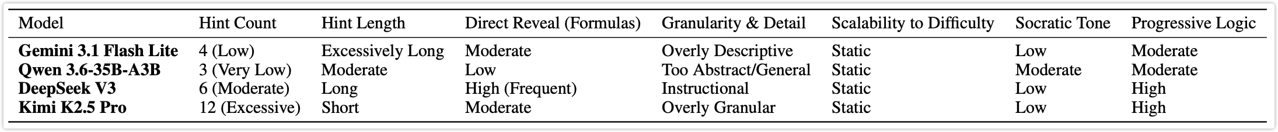
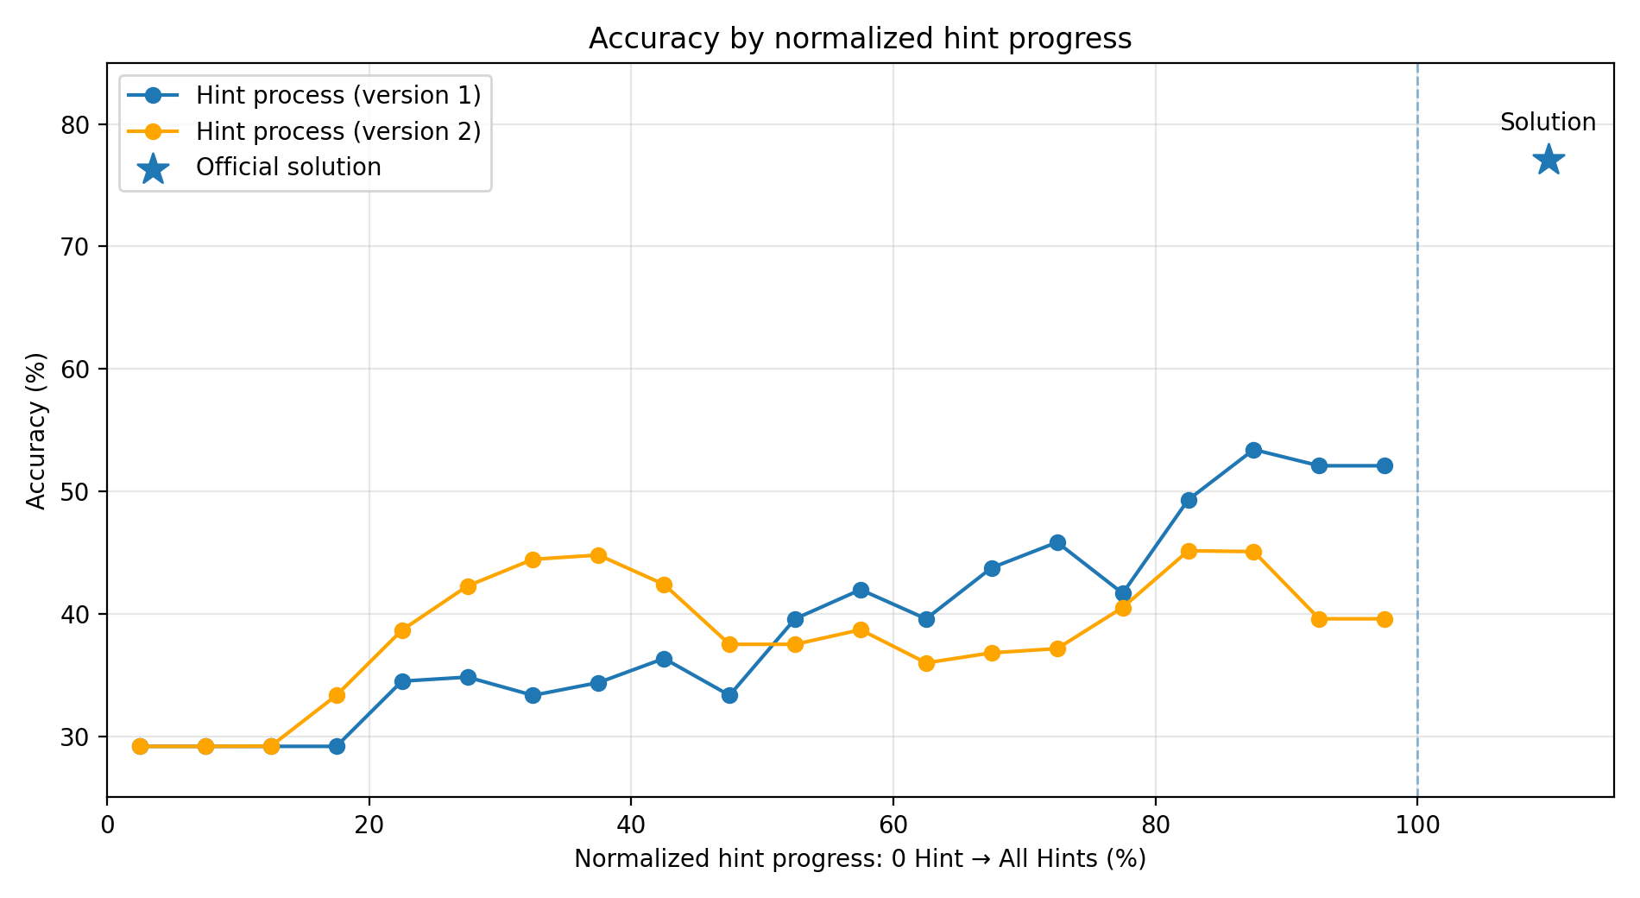
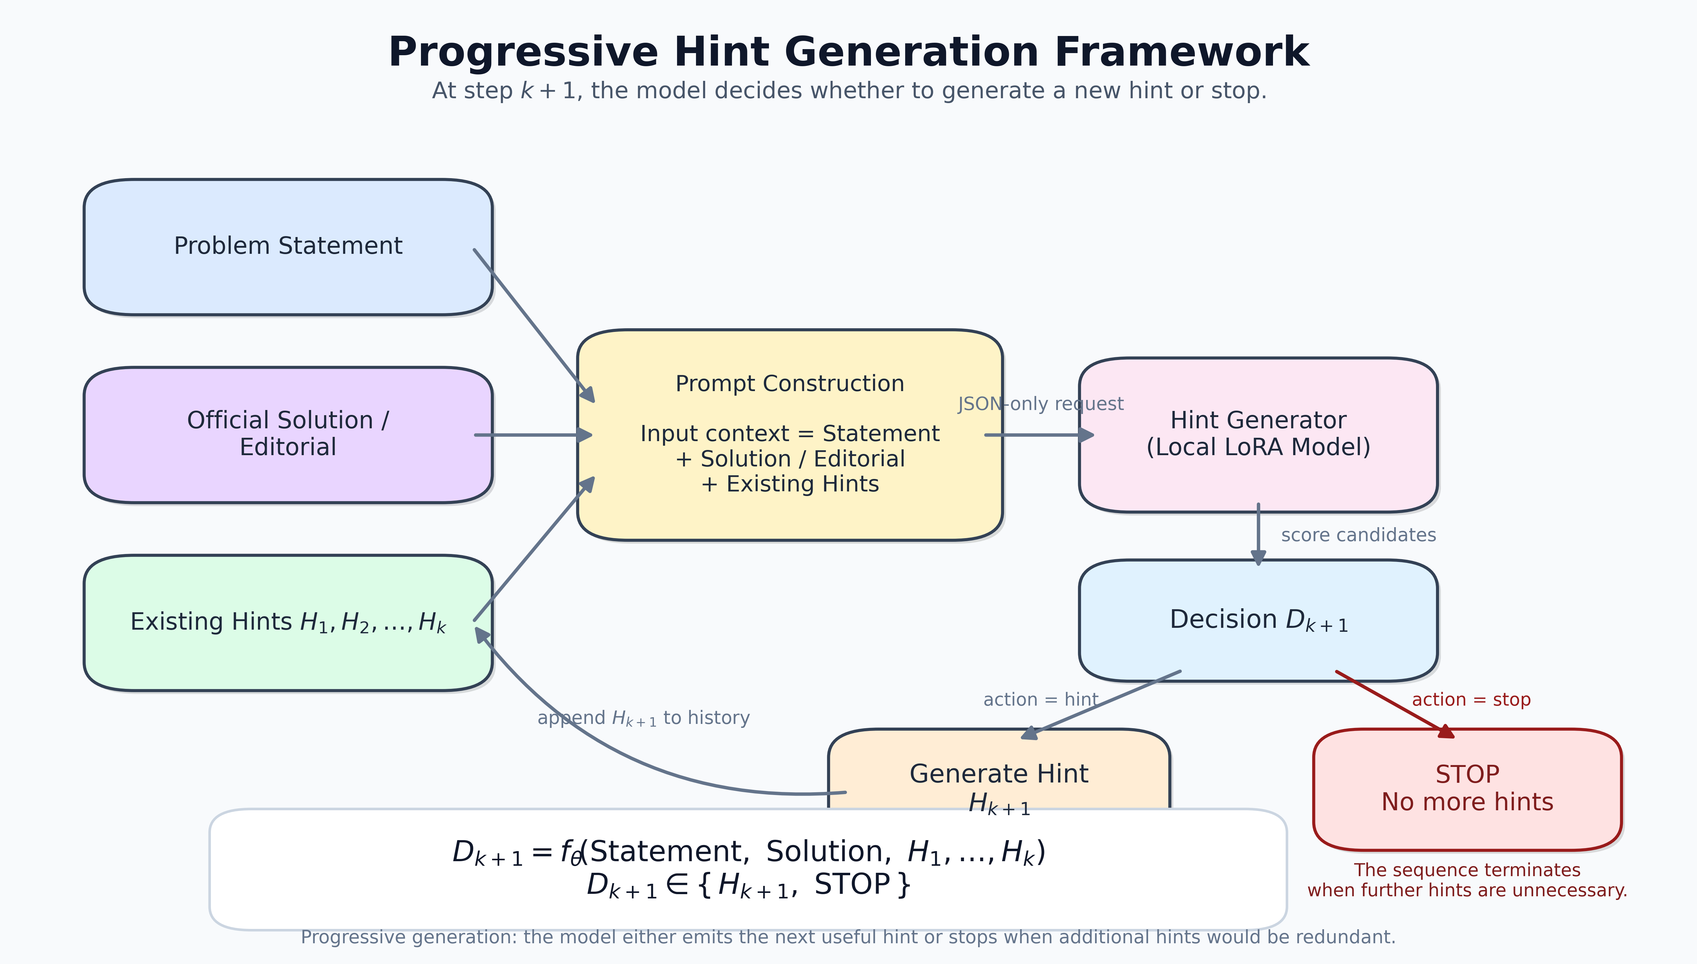
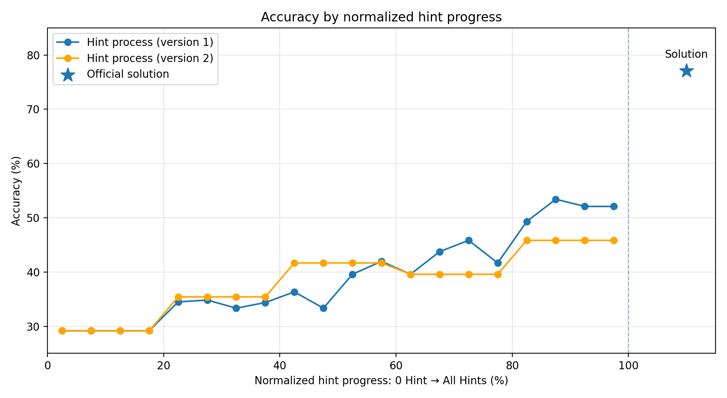
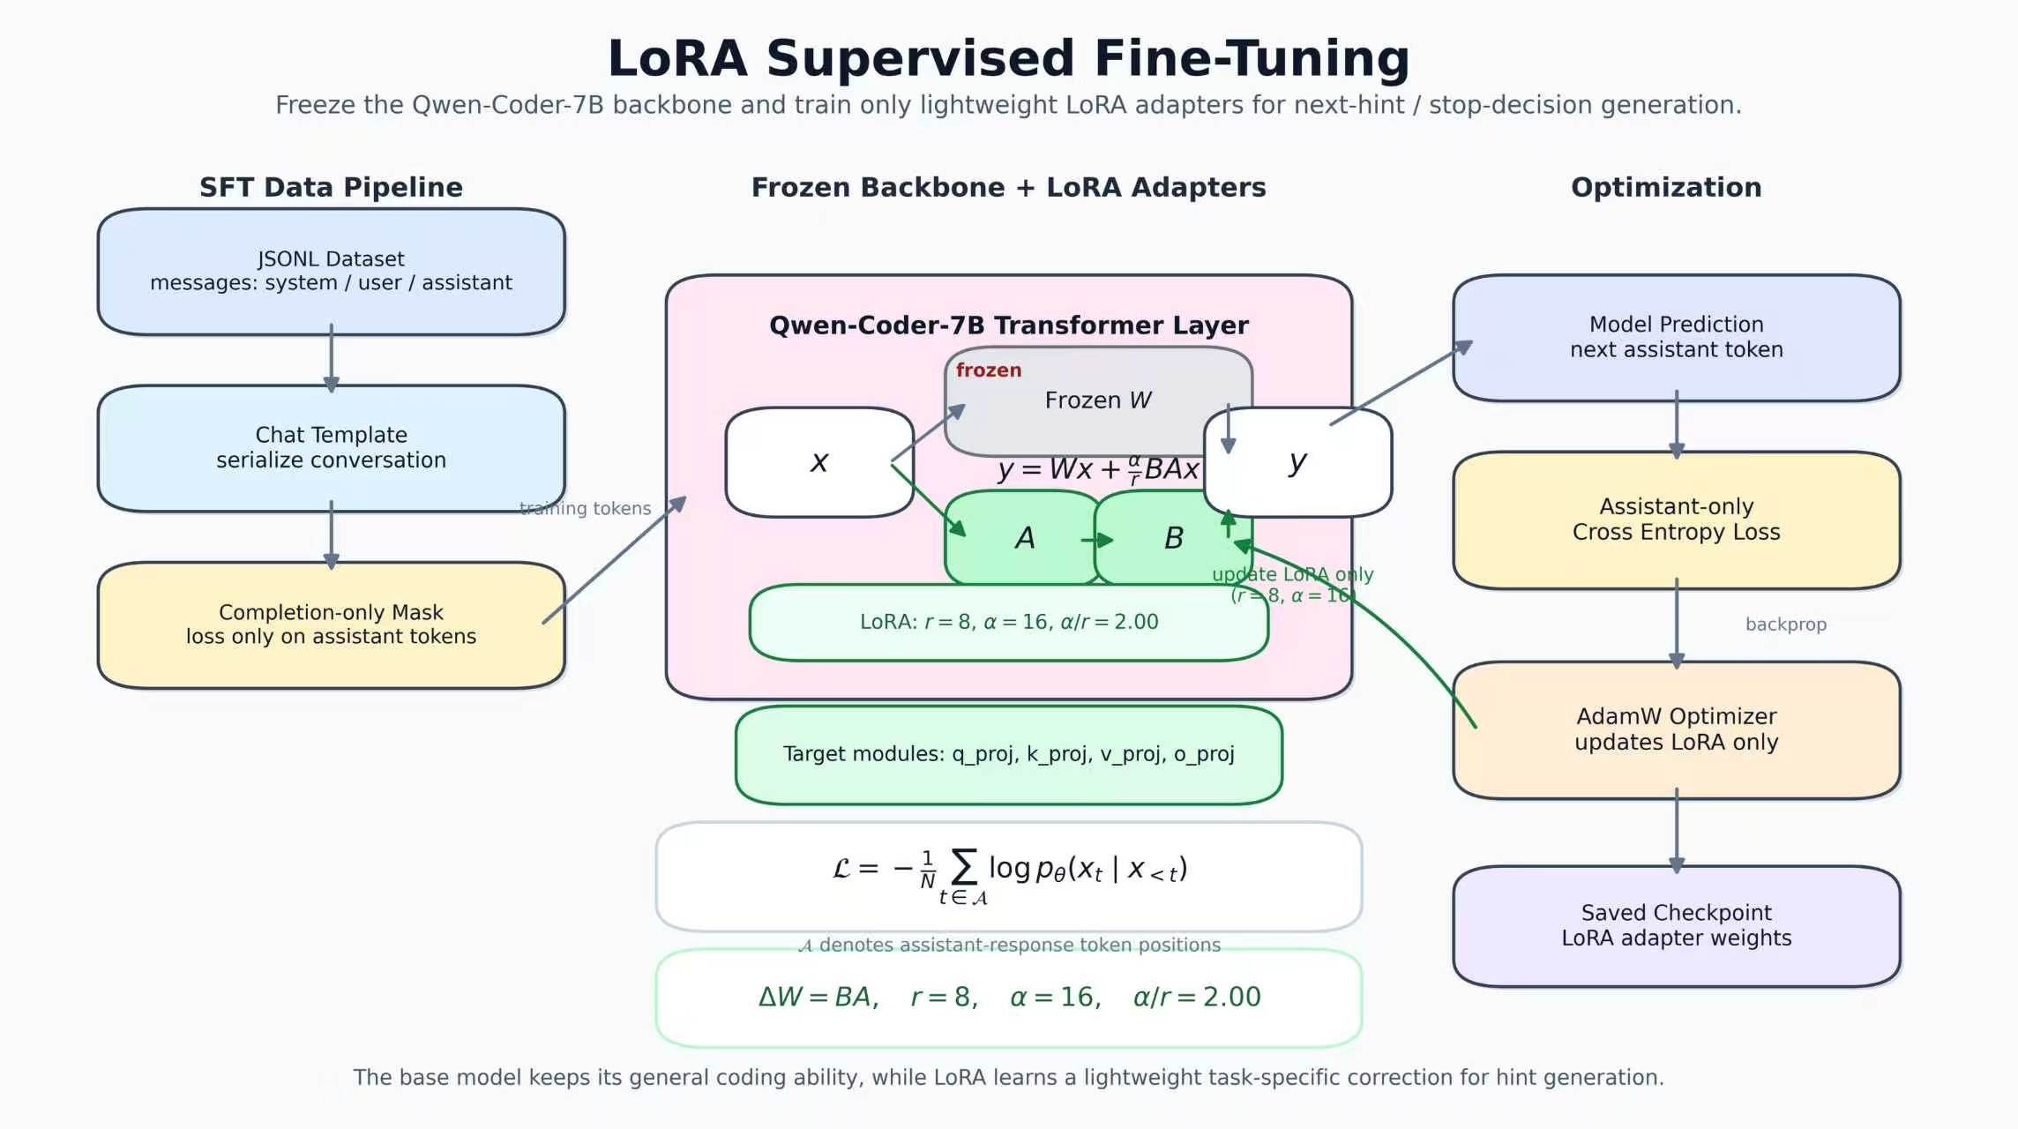
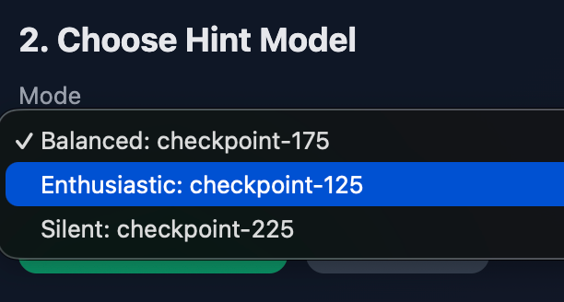
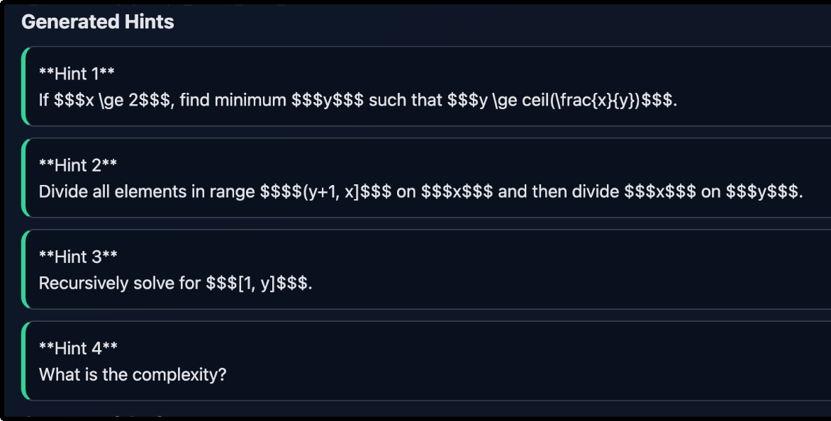
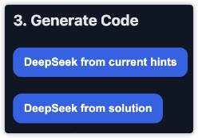
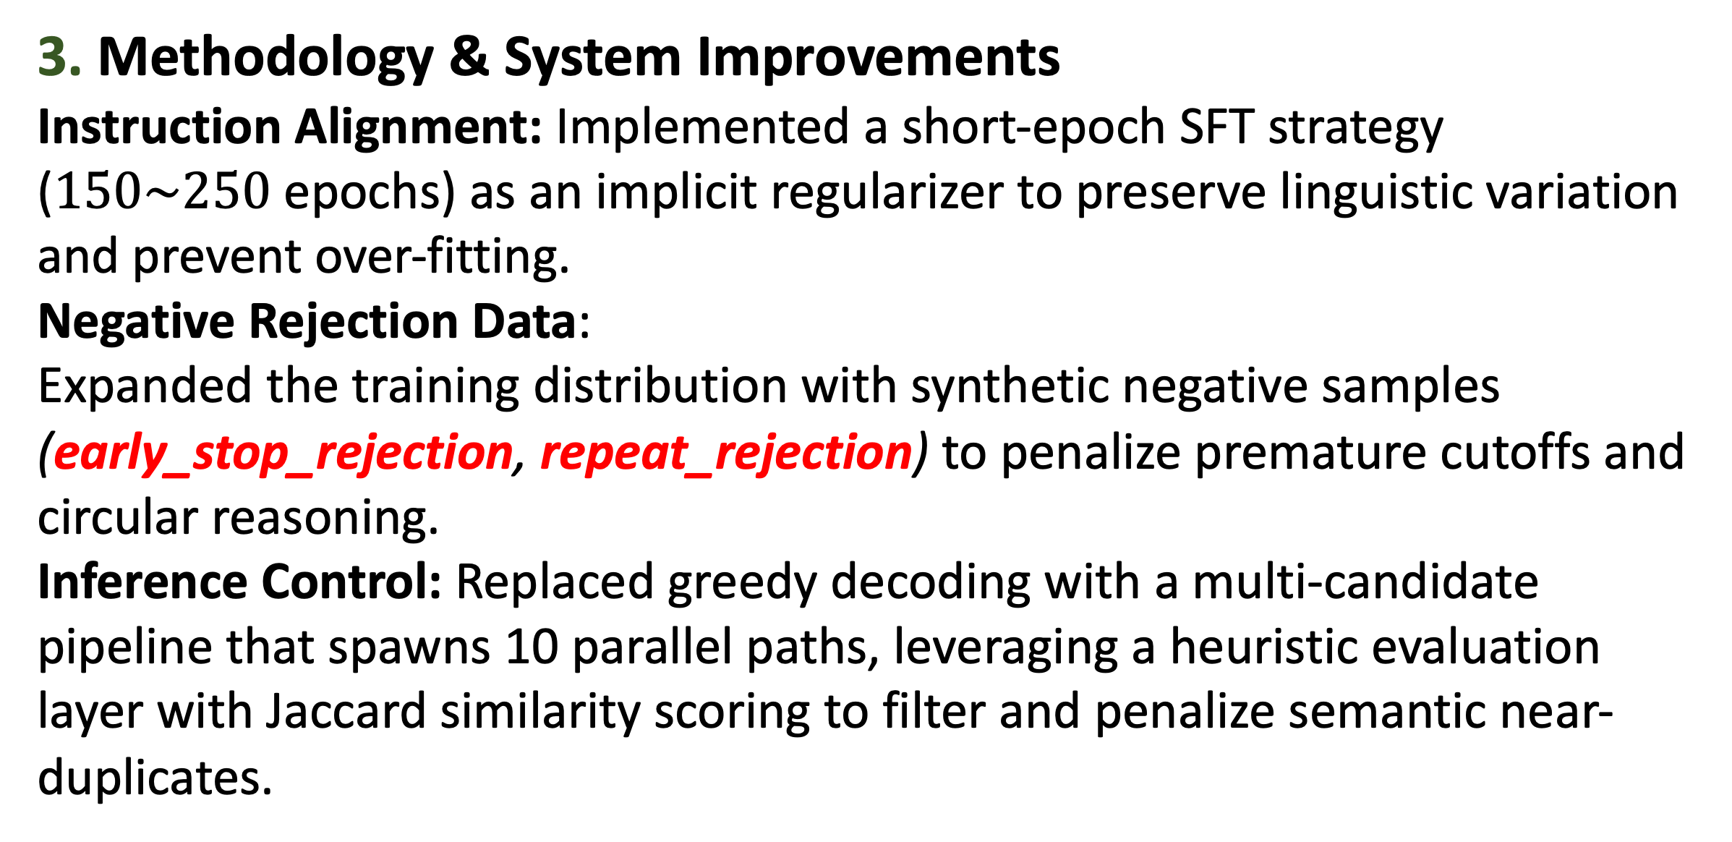
Deep Learning Hint Agent: A Next-Action Decision Framework for Progressive Competitive Programming Hints
Haikun Zhao, Ninghuan Chen
Affiliation:IIIS
1. Abstract & Introduction
Problem:
In competitive programming (e.g., Codeforces), general LLMs in a zero-shot setting fail to provide adaptive hints. They either leak full solutions prematurely or provide descriptive, static text that undermines the pedagogical goal of provoking human critical thinking.
Our Core Idea:
Instead of modeling the multi-turn hint dialogue as a single continuous sequence (which forces the model to learn a statistical average length), we reformulate hint generation as a Next-Hint Decision Policy.
4. Empirical Results & Analysis
4.1. Zero-Shot Multi-Model Benchmarks
The Static Fallacy: Commercial models (Gemini-3.1, DeepSeek V3, Qwen3.6, Kimi K2.5 Pro) perform poorly on problems across Ratings 800–3300.
4.2. External Solver
Evaluation Loop
Automated Sandbox:
Deployed DeepSeek-V4-Pro
as a proxy user to write C++17
codes under sequential hint
trajectories.
Trajectory Tracking:
Progress is tracked via multi-bit
tracking strings from 0 Hint to
the solution upper-bound.
(e.g., 000111 means starting
from the 3rd hint, Deepseek
can write AC code.).
4.3. Fine-Tuned Agent Empirical Curves
Output Distribution (Fig 1): Version 2 (No solution hint generation) faces context limits in deep layers. Implementing a Hard Truncation (Generally, no effective hints can be given after step 4) creates a strange statistical curve.
Solver Accuracy (Fig 2):Version 1 (With solution hint generation): Accuracy climbs approximately monotonically from 29.2% to 53.3% (Solution test: 77.1%), validating coherent pedagogical scaffolding.Version 2 (Capped at 4): Establishes a stable performance plateau at 45.8%, preserving early-stage precision.
2. Data Collection & Processing
Multi-Source Pipeline: Overcame Codeforces Cloudflare protection by scraping contest metadata, blog editorials, and Luogu mirror statements, using automated retry loops to eliminate dynamic rendering blocks.
Dataset & Alignment: Structured data into unified statement, hints, and solutions payloads, and engineered custom data typologies (raw_hint_decision, synthetic_early_stop_rejection, synthetic_repeat_rejection) for robust SFT alignment.
3. Methodology & System Improvements
Instruction Alignment: Implemented a short-epoch SFT strategy ($150\sim 250$ epochs) as an implicit regularizer to preserve linguistic variation and prevent over-fitting.
Negative Rejection Data:
Expanded the training distribution with synthetic negative samples (early_stop_rejection, repeat_rejection) to penalize premature cutoffs and circular reasoning.
Inference Control: Replaced greedy decoding with a multi-candidate pipeline that spawns 10 parallel paths, leveraging a heuristic evaluation layer with Jaccard similarity scoring to filter and penalize semantic near-duplicates.
5. Limitations & Future Directions
Evaluation Alignment: A mismatch exists between the high-level conceptual hints generated by our agent and the engineering execution bottleneck (syntax/compilation) of the proxy solver.
Generalization Paradigm: Demonstrates a resource-efficient framework where specialized small language models act as "cognitive scaffolding" to unlock the latent reasoning of larger, un-tuned general foundation models without prohibitive full-scale training costs.
6. Demo
We have developed an interactive UI demo that allows users to select from three distinct profiles of hint models.
The interface supports progressive,
step-by-step hint generation on demand.
Furthermore, users can leverage an integrated
DeepSeek solver to synthesize execution-ready
code directly from the
accumulated hint sequence.
Deep Learning 2026 Spring

