Slide 1
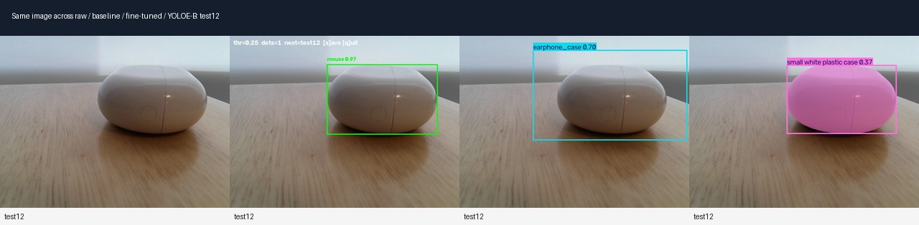
Object Detection with YOLO11 and YOLOE
Pretrained baseline → fine-tuned YOLO11n → YOLOE text prompts
0/17
17/17
17/17
same 17 webcam test images
3 custom objects
controlled model comparison
pretrained YOLO11n
fine-tuned YOLO11n
YOLOE text prompts
(appearance-based)
1

Slide 2
How YOLO11 works
A one-stage detector turns an image into multi-scale feature maps and directly predicts boxes + classes.
Input image
Backbone
Neck / PAN
Anchor-free head
Output
camera frame
resized to 640×640
Conv + C3k2 + SPPF
extract visual features
up-sample + concat
fuse small/large object cues
directly predict box coordinates
+ class scores
bounding box
class + confidence
C3k2
C2PSA
Closed-set labels
Efficient feature block: keeps the model lightweight while improving feature extraction.
Spatial attention: helps the detector focus on important regions instead of treating all features equally.
Pretrained YOLO11n can only output its fixed COCO-style label vocabulary unless it is fine-tuned.
Why this matters in my experiment: chip_bag, pepper_shaker, and earphone_case are not native COCO labels, so the baseline can localize similar shapes but cannot name the exact objects.
2

Slide 3
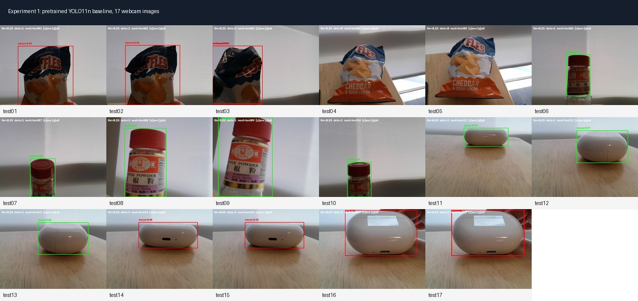
Experiment 1 — Pretrained YOLO11n baseline
I converted the original live webcam demo into a logged, repeatable evaluation on the same 17 images.
# capture_baseline.py
MODEL_PATH = './models/yolo11n.pt'
CAM_INDEX = 1
CONF = 0.25
# Press s to save raw image + annotated image
# CSV: class, confidence, box, ground_truth, correct
# low-confidence boxes (<0.50) are drawn in red
0/17
0.25
17
target label correct
threshold exposes weak detections
fixed test images
Failure 1: wrong COCO class
Failure 2: only generic match
Failure 3: high-conf wrong label
chip bag → person / suitcase / backpack
pepper shaker → bottle, not the product class
earphone case → mouse, up to 0.97 on test12
3

Slide 4
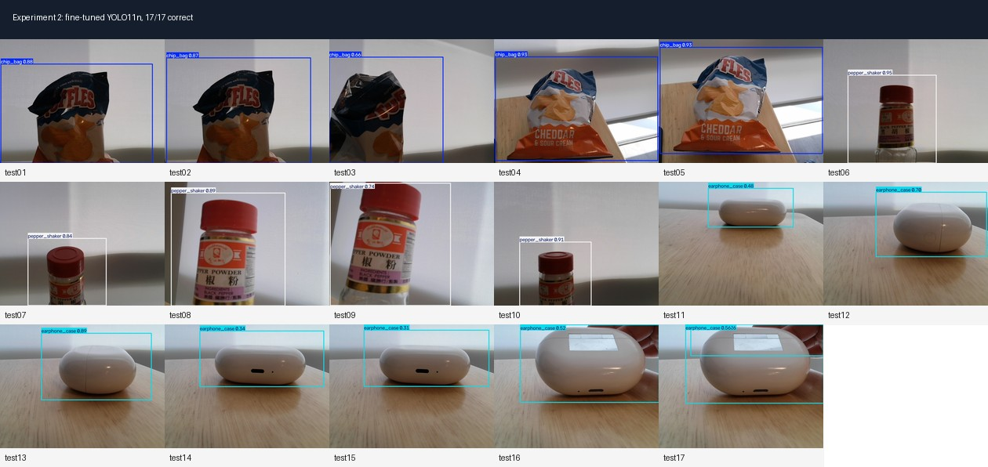
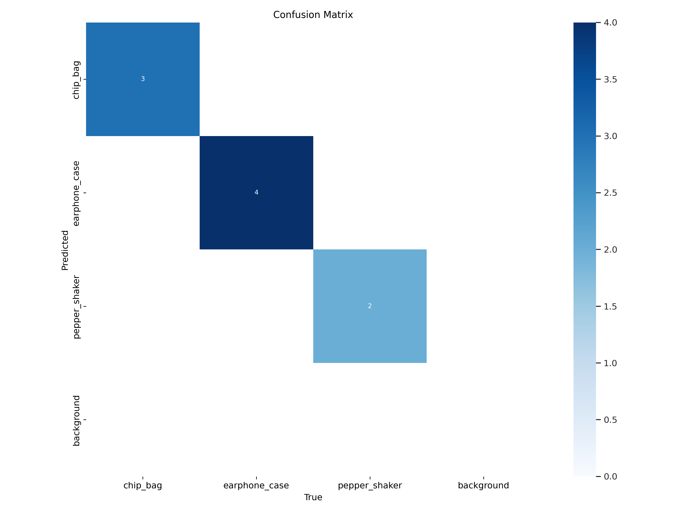
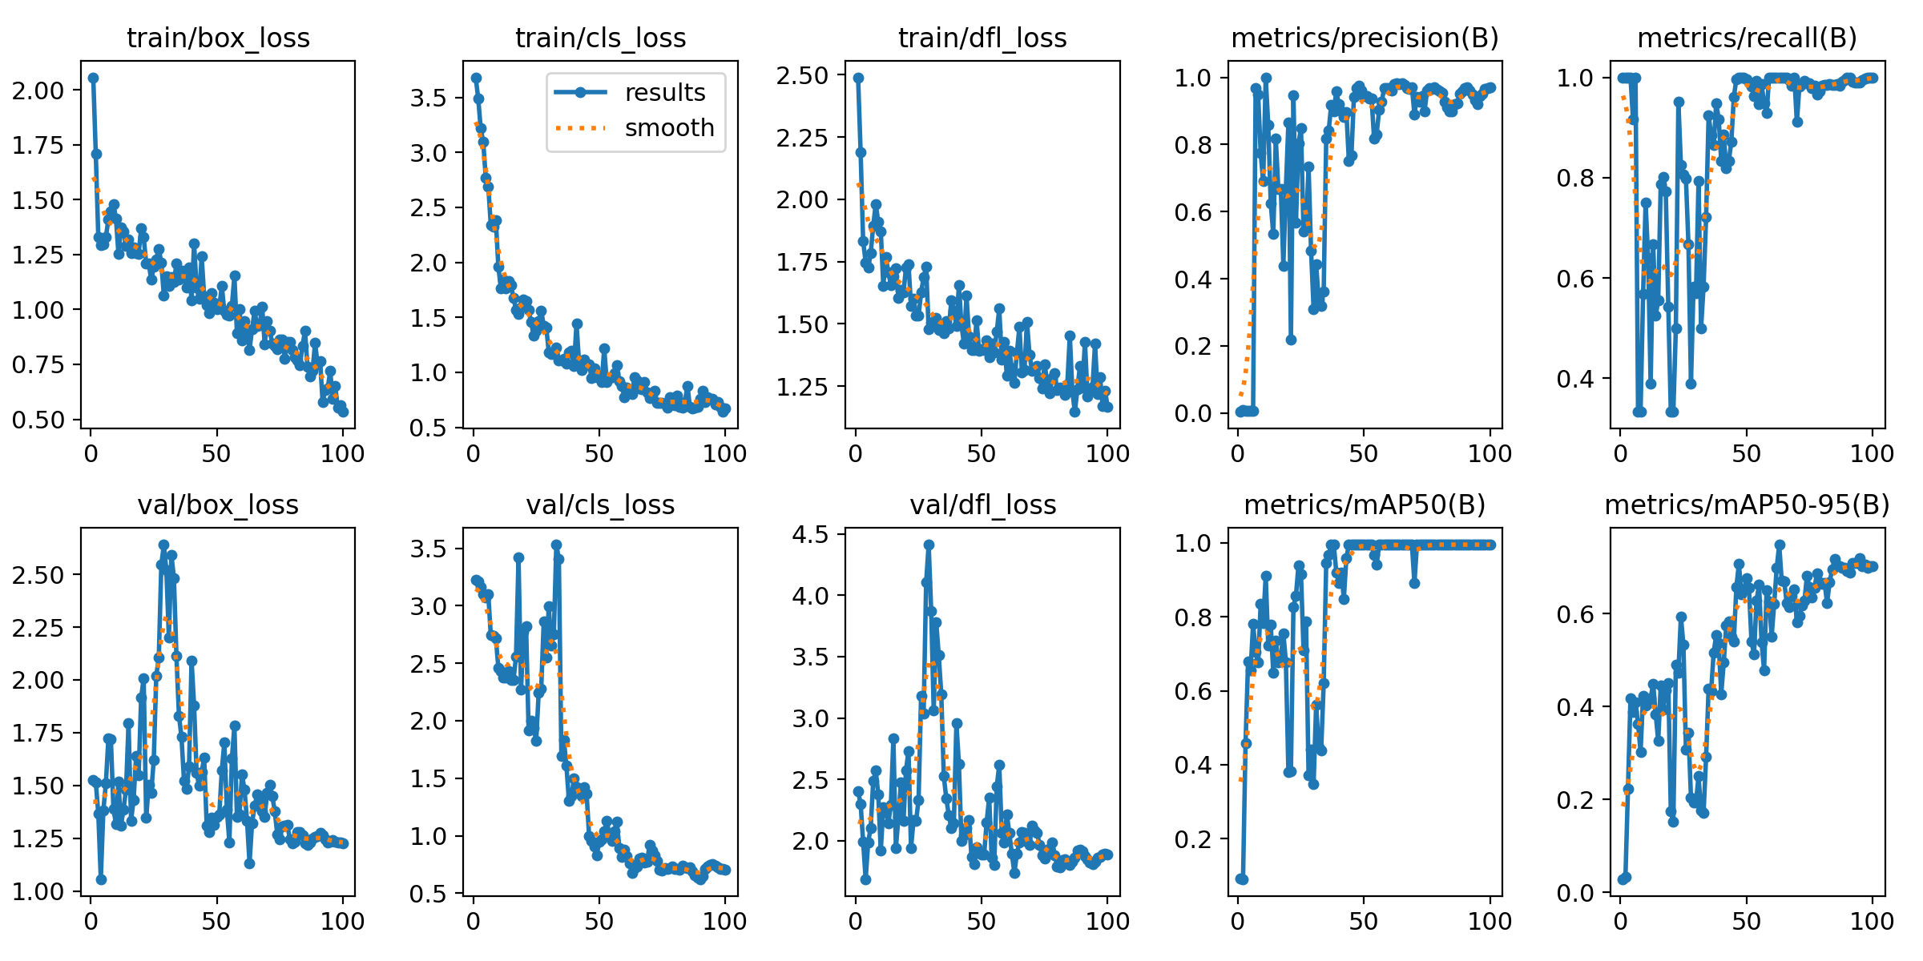
Experiment 2 — Fine-tuned YOLO11n
Fine-tuning changed the label space while keeping the same YOLO11n base model for a fair comparison.
Data
Training
Validation
Webcam test
47 phone photos
33/9/5 split, 112 augmented
Colab T4, 100 epochs
yolo11n.pt (not yolo11s)
mAP50 0.995
mAP50-95 0.749; val n=9
17/17 correct
mean conf ~0.82
Important details: test15 was the weakest correct detection (~0.312), and test17 produced an extra low-confidence box.
test12 shows confidence is not correctness: baseline mouse 0.97 was wrong; the correct fine-tuned prediction was lower (~0.88).
Because the validation set has only 9 images, the 17-image webcam test is the more meaningful evidence.
4

Slide 5
Open-set object detection and YOLOE
Open-set / open-vocabulary detection lets the user provide new target categories at inference time.
Closed-set YOLO11
Open-set detection
YOLOE changes
Class list is fixed after training
Good when labels are known and annotated
Needs fine-tuning for new classes
The class vocabulary is supplied at test time
Texts or prompts become semantic targets
Performance depends on prompt-object alignment
RepRTA: text-prompt adaptation
SAVPE: visual-prompt encoder (not used here)
LRPC: lightweight region-prompt classifier
image → visual features
→ Detect head
→ fixed class logits
user words
+ image features
→ match regions to prompts
model.set_classes(
names,
model.get_text_pe(names)
)
What changed conceptually: YOLOE replaces a fixed class-logit head with prompt / embedding matching, so a phrase can define what the detector should look for.
5

Slide 6
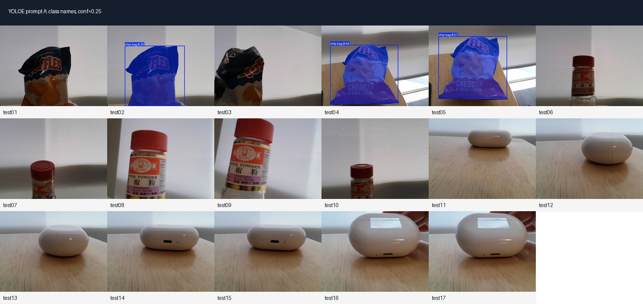
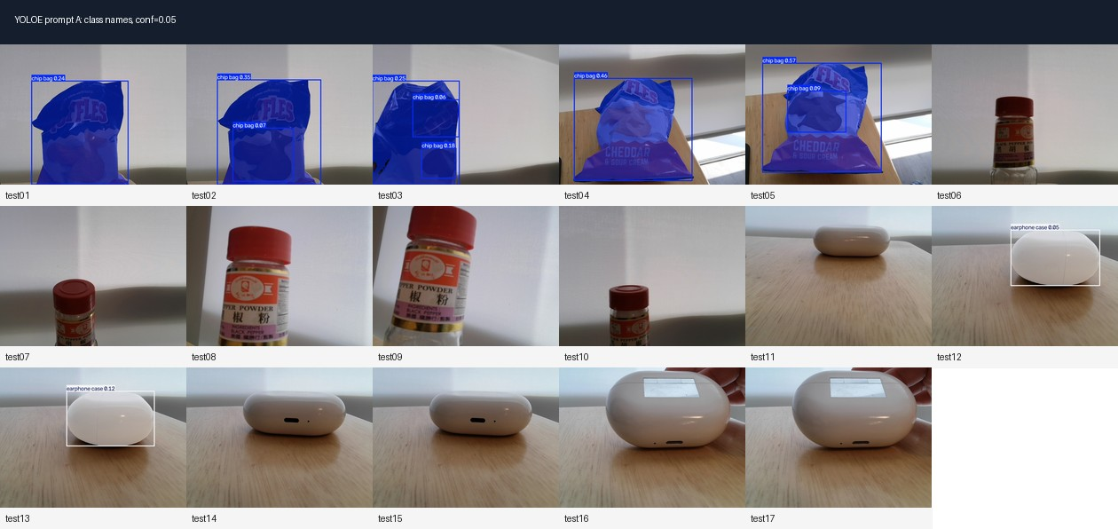
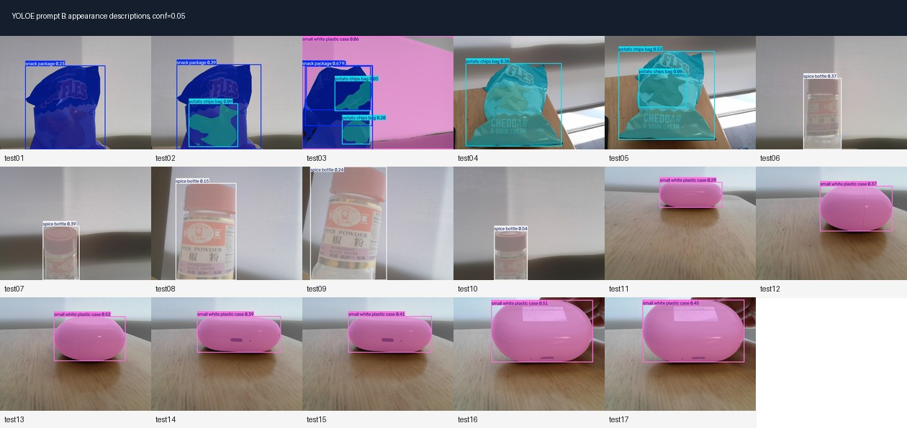
Experiment 3 — YOLOE text prompt sensitivity
Same YOLOE model, same 17 images; only the text prompt wording and confidence threshold changed.
Prompt A: class names
Prompt A + lower conf
Prompt B: appearance-based
chip bag
pepper shaker
earphone case
conf = 0.25
3/17
7/17
snack package
spice bottle
small white plastic case
17/17
same text prompts
conf = 0.05
correct
correct
correct
Key lesson: this was not YOLOE visual prompting. It was YOLOE text prompting, and appearance-based wording aligned better with the image features than product/category names.
6

Slide 7
Final comparison, limitations, and repository
The strongest result is not only the scores, but the controlled comparison across the same images.
Method
Correct
Training
Main control
Lesson
YOLO11n pretrained
0/17
none
same 17 images
fixed label space failed
YOLO11n fine-tuned
17/17
47 images
same base model
custom labels solved gap
YOLOE Prompt A
3→7/17
none
same model/images
class names were weak
YOLOE Prompt B
17/17
none
text prompt only
appearance words worked
Limitations
Repository package
Final takeaway
47 training images only
single scene + similar lighting
validation split only 9 images
test03 duplicate / non-mutual prompts in YOLOE
three experiment folders
raw + annotated images
CSV logs, labels, best.pt
README and reproducible commands
Fine-tuning is reliable with labels
YOLOE is flexible without training
prompt wording is a real experimental variable
Final message: supervised fine-tuning gave stable closed-set accuracy; YOLOE showed open-set flexibility, but only when text prompts described visible appearance rather than assumed object identity.
7

