Slide 1
Bid : Robot or Human ?
Bean Solution
Group Member: Xin Sun, Zhi Li, Minchen Wang, Hongdou Li, Bowen Ma
Notes:
Hi everyone, we are from team Bean solution. Today we are going to present how to use machine learning model to detect bids made by robot from bids made by human.

Slide 2




Outline
Research Question & Dataset
Preprocess Data
Summarized Data
Model Fitting Process
Decision Tree
Random Forest
Gradient Boosting
Model Comparison

Slide 3

Research Question
Issue :
Human bidders are unable to to win auctions
because of robot competitors.
As a result, online auction sites worry about
losing customers.
Notes:
Nowadays robot bidders crowd on online auction sites, making human bidders frustrated about not winning auctions. As a result online auction sites worry about losing customers.

Slide 4

Research Question
Goal :
Identify online auction bids placed by robots
Help the site owners easily remove these robots to prevent unfair activities.
Notes:
Our goal is to help these business owners identify robot bids so that they can correctly remove robot bids. Prevent fraudulent bids and unfair competition.

Slide 5
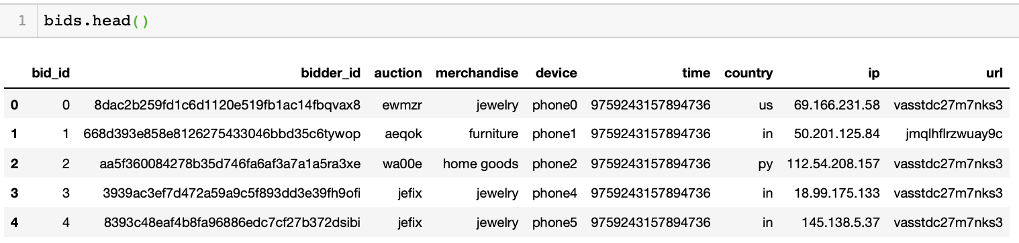
Dataset Summary
bid.csv
bid_id, bidder_id, auction, merchandise, device, time, country, ip, url
7.66 million rows (each row represents a unique bid)
Kaggle Link: https://www.kaggle.com/c/facebook-recruiting-iv-human-or-bot
Notes:
We obtained two datasets from Kaggle. The first one is bid csv which provides 7.6m unique bids information. Each bid contains information of bid_id, bidder_id, auction, merchandise, type of phone used to make, time, country, ip,

Slide 6

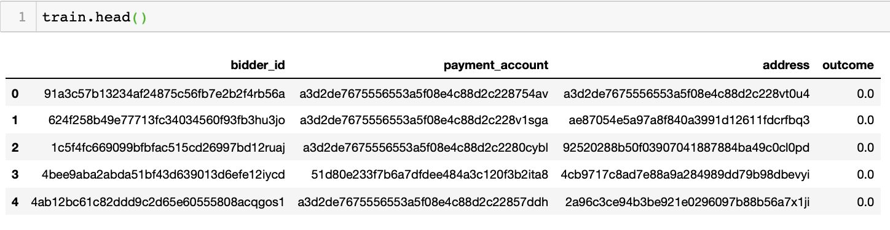
Dataset Summary
train.csv
bidder_id, payment_account, address, outcome
2,013 rows (each row represents a unique bidder)
Label:
0.0: human
1.0: robot

Slide 7
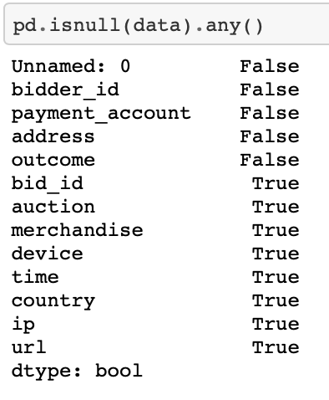
Preprocess Data
Step 1: Join data on bidder_id
Step 2: Clean data - missing values
Check null values for each feature
Notes:
removed 29 rows (29 bidders) missing bids info.
2,701 rows (184 bidders) missing only country info.
It makes no sense to impute for missing values since these are all categorical info. We decide to remove these rows. (2,730 rows)
resulting data with 3,068,523 rows

Slide 8
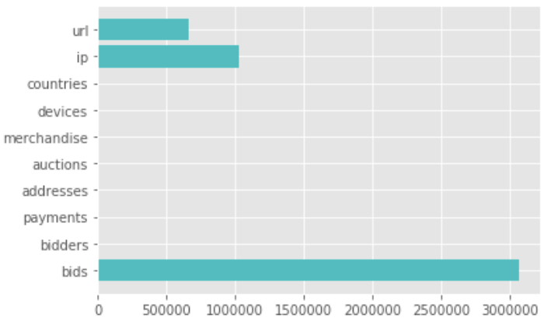
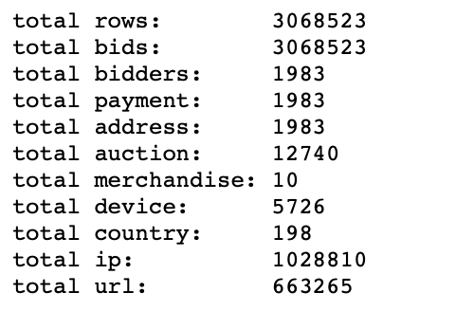
Preprocess Data: EDA & Summarized Data
Total counts of each feature in raw data
Notes:
we computed total counts of unique values in each column, this only tells us that these three columns have much more variations than the rest.
Total counts of each feature shows us large variation in scales. To explore further, we will compute the average.
From this output, we can see the payment and address are one-to-one correspondence to bidder. Since our outpue, whether a bid is made from a human or robot, is label based on bidder, we can igonre these two features for future analysis. Since merchandise and country are compared low in this situation, we can just treat themselves as a feature for analysis.
Let's first check merchandise and country, to see if there exist siginificant difference between human and robots.

Slide 9
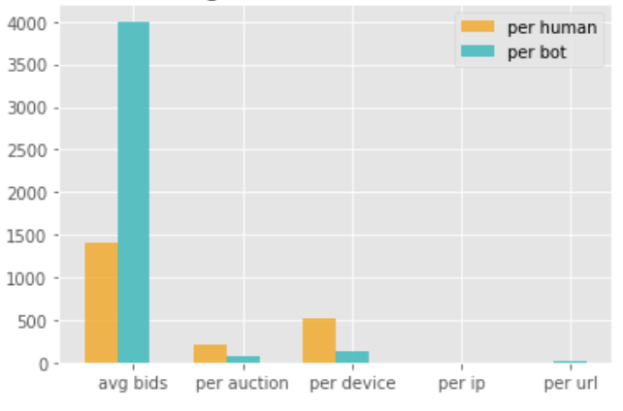
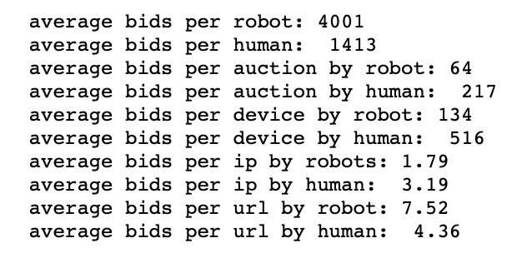
Preprocess Data: EDA & Summarized Data
Average bids per human vs. bot
Notes:
distinct difference between bids made by human and bots per auction, per device. Features related to number of bids, auction, device draw our attention.

Slide 10
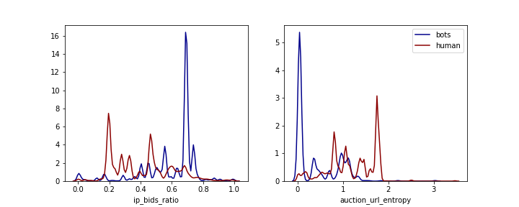
Preprocess Data: Feature Engineering
Feature 1: Counts of unique ip to counts of total bids ratio
Robots are more likely to use different ip addresses than human
Feature 2: Uncertainty (entropy) of referral url per auction for each user
Human tend click random urls whereas robots are given targeted urls.
Notes:
Keep in mind, our goal is to find characteristics that distinguish robots from human. (distinction between human behavior and robot behaviors)

Slide 11
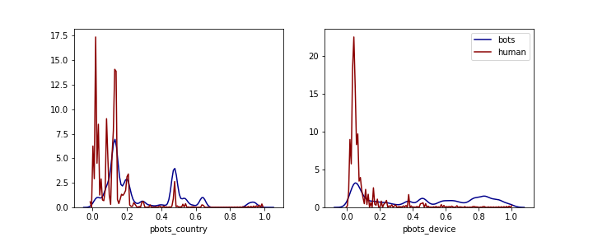
Preprocess Data: Feature Engineering
Feature 3: Proportion of bots vs. human per country
Some countries may generate more robots than others
Feature 4: Proportion of bots vs. human per device
Some devices may be more compatible with robots

Slide 12
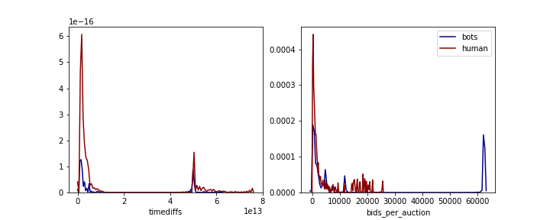
Preprocess Data: Feature Engineering
Feature 5: Time Difference per user
Robots have capacity to make different bids in shorter time interval
Feature 6: Total number of bids a user made in an auction
Robots have the capacity to make way more bids than human.

Slide 13
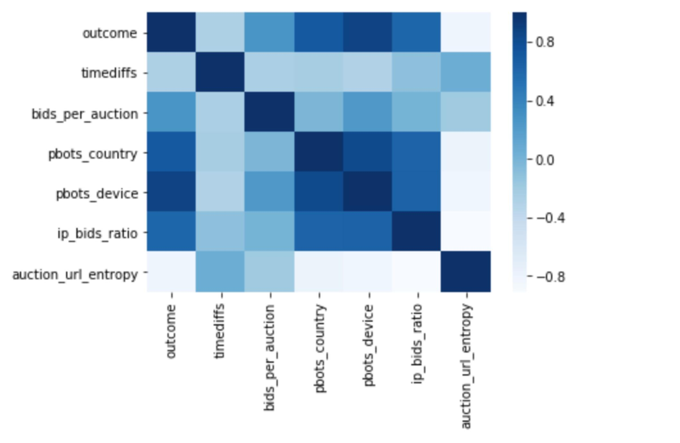
Feature Engineering : Correlation Matrix HeatMap
Notes:
This plot is the correlation matrix heatmap for our engineered features. Dark blue in this heatmap means two variables are highly positively correlated with each other. The white color in this heatmap indicates that two features are highly negatively correlated with each other. From this plot, we can infer that proportion of bots per device, proportion of bots for each country and number of unique ip to number of bids ratio are highly positively correlated with our outcome. While the mean per auction url entropy for each user are highly negatively correlated with our outcome. However, the variable time differ per user does not show clearly correlation with our outcome
·

