Slide 1
GYM PROGRESS TRACKER DATABASE
CPRO 1301: FINAL PROJECT
JOASH DALIGCON (000358654)
LANCE MIRANO (000368826)

Slide 2
1
DATABASE DESIGN
xx

Slide 3
Overview
This database manages aspects of gym operations such as member registration, attendance tracking, and payment transactions. It also monitors members’ progress through attributes such as calorie intake, height and weight for effective fitness management. Furthermore, it keep tracks of trainer assignments and equipment usage, that can aid in determining training insights and optimizing the overall gym experience.

Slide 4
Business Rules
Each member may be supervised by a trainer
Each member can train zero or many members
Each member has zero or many payment records
Each payment record is made by one and only one member
Each attendance record is linked to one and only one member
Each member can have zero or many attendance records
Each fitness record is associated to one and only one member
Each member can have zero or many fitness records
Each gym equipment can be used by zero or many members
Each member can use zero or many gym equipment once per day

Slide 5
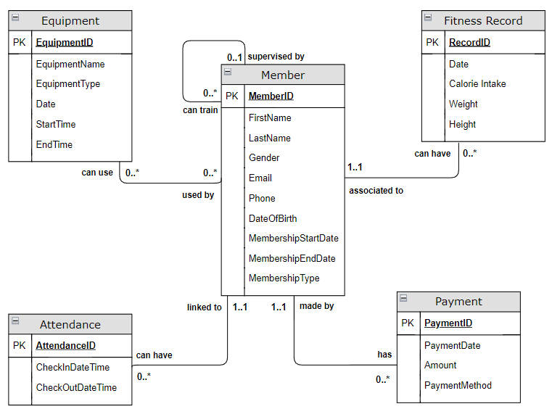
Conceptual Model
Notes:
Entities, Attributes, Relationships, Cardinality

Slide 6
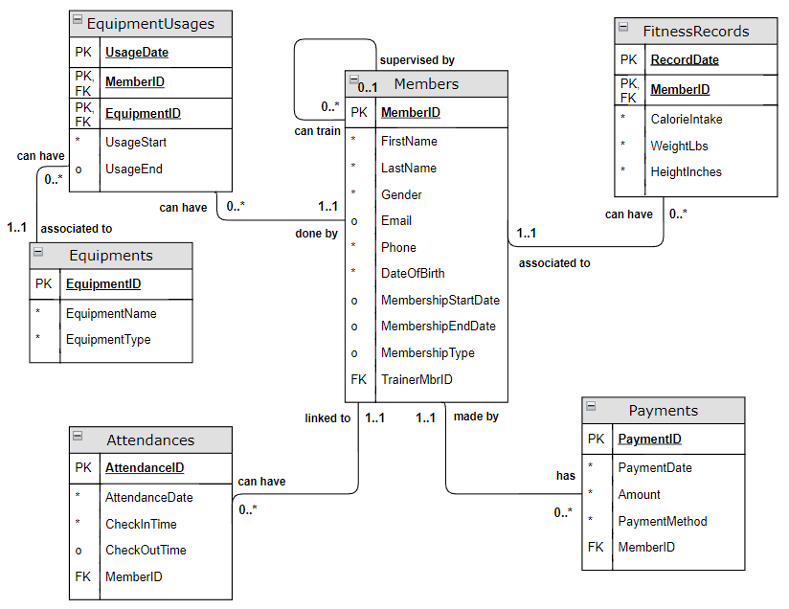
Relational Model
Notes:
Relational Schema, Normalization, Primary Keys, Foreign Keys Converted strong entities to relations Converted 1:N – Added FK on N-side of relationship Converted M:N – Added new relation EquipmentUsages

Slide 7
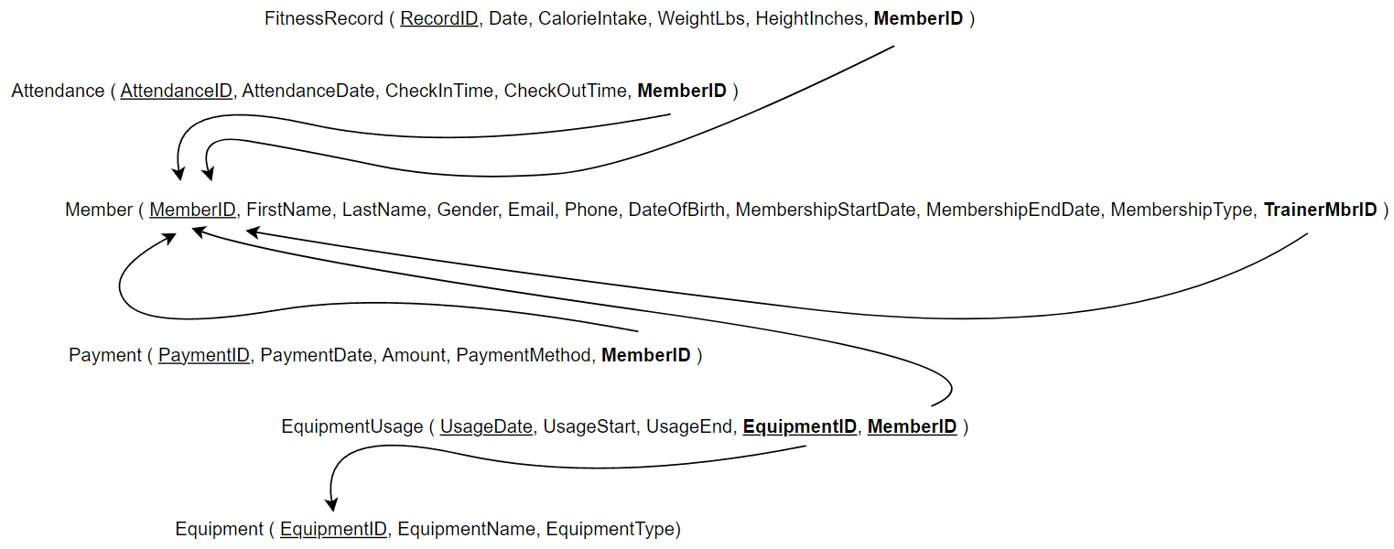
Relational Schema
Notes:
Relational Schema, Normalization, Primary Keys, Foreign Keys Converted strong entities to relations Converted 1:N – Added FK on N-side of relationship Converted M:N – Added new relation EquipmentUsages

Slide 8
2
DATABASE PROGRAMMING
xx

Slide 9
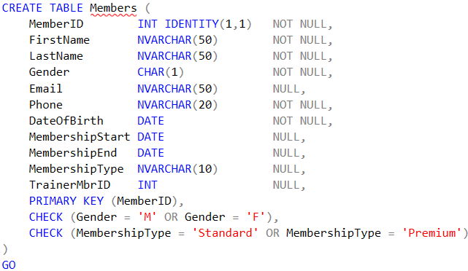
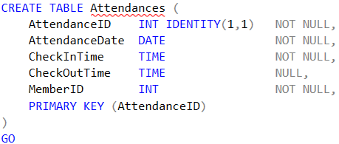
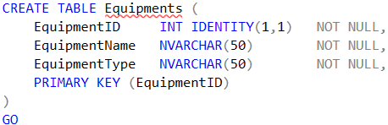
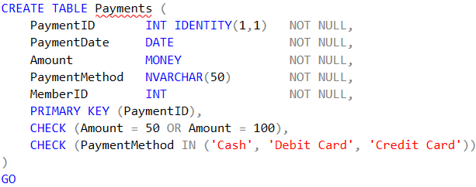
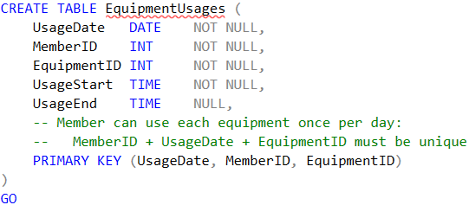
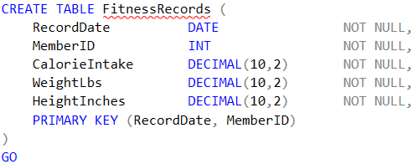
Creating the tables
Notes:
Data Types, Constraints, Indentation

Slide 10
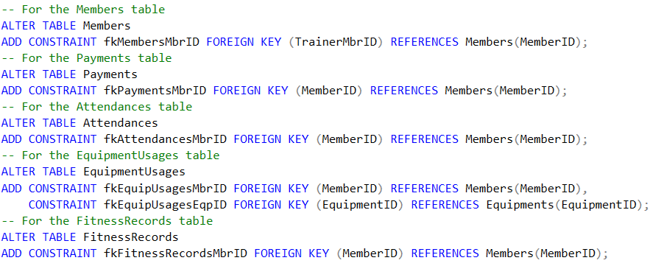
Adding Foreign Keys
Notes:
Naming convention

Slide 11
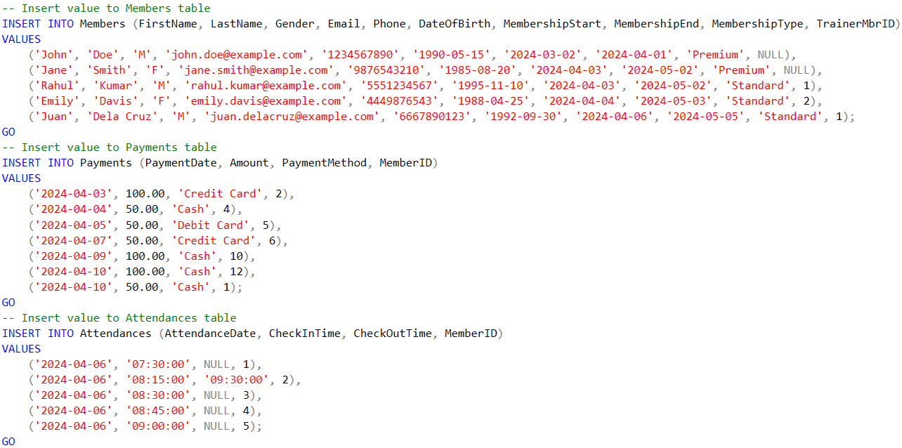
Inserting Values (1)

Slide 12
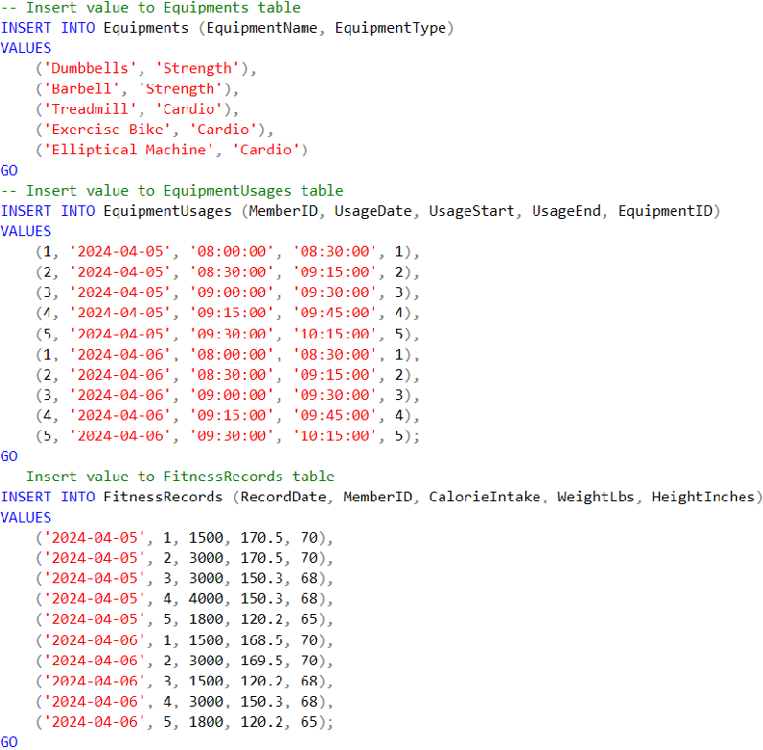
Inserting Values (2)

Slide 13
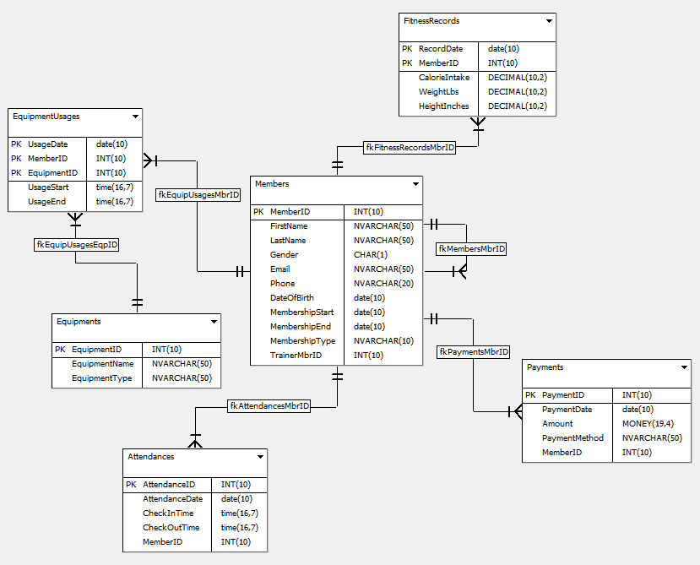
Physical Model
Notes:
From SQLGate

Slide 14
3
DATABASE PROGRAMMING & QUERYING
xx

Slide 15
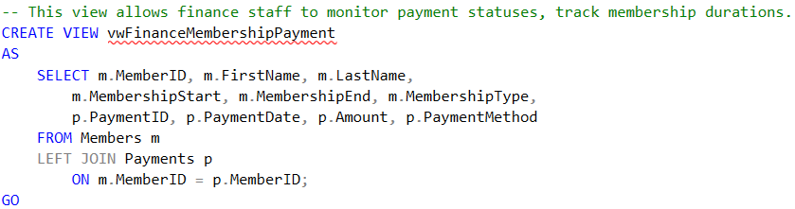
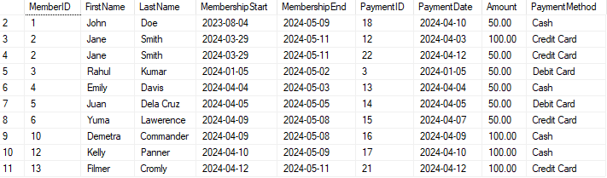
Sample View Definitions (1)
Notes:
Coding convention “vw” prefix for Views

Slide 16
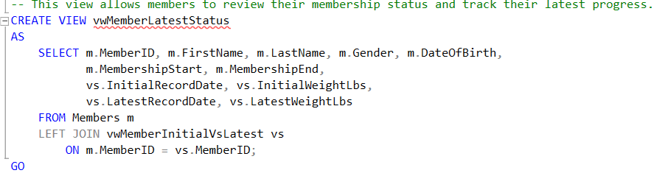
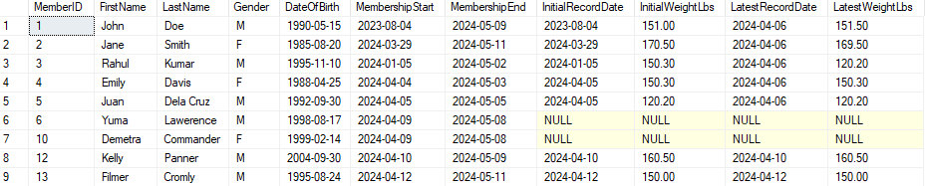
Sample View Definitions (2)

Slide 17
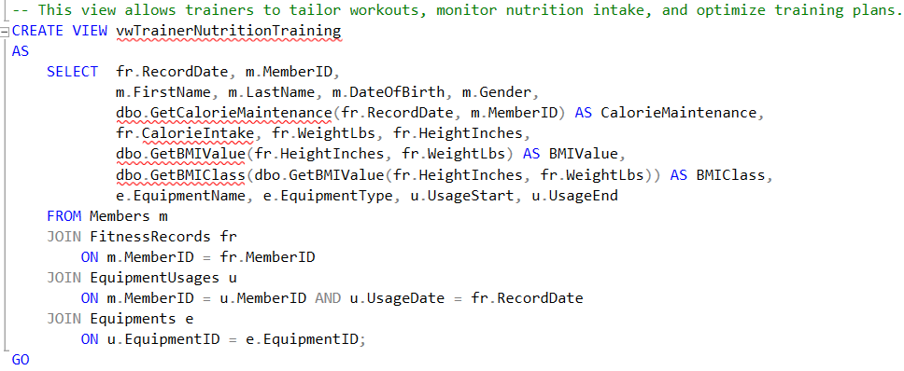
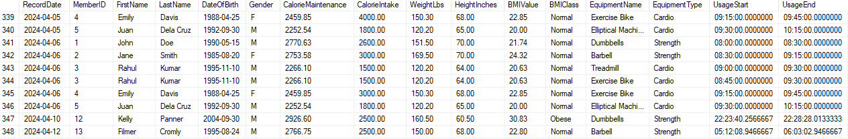
Sample View Definitions (3)

Slide 18
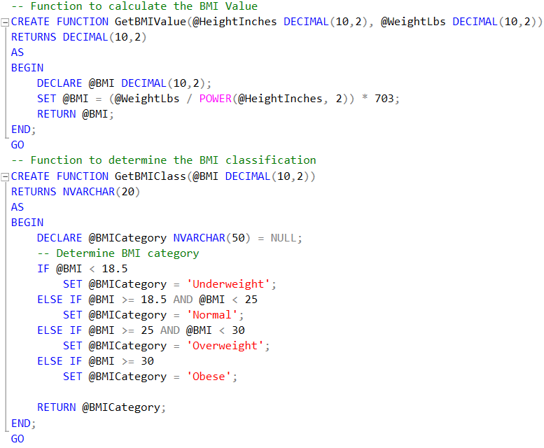
Sample Function Definitions

Slide 19
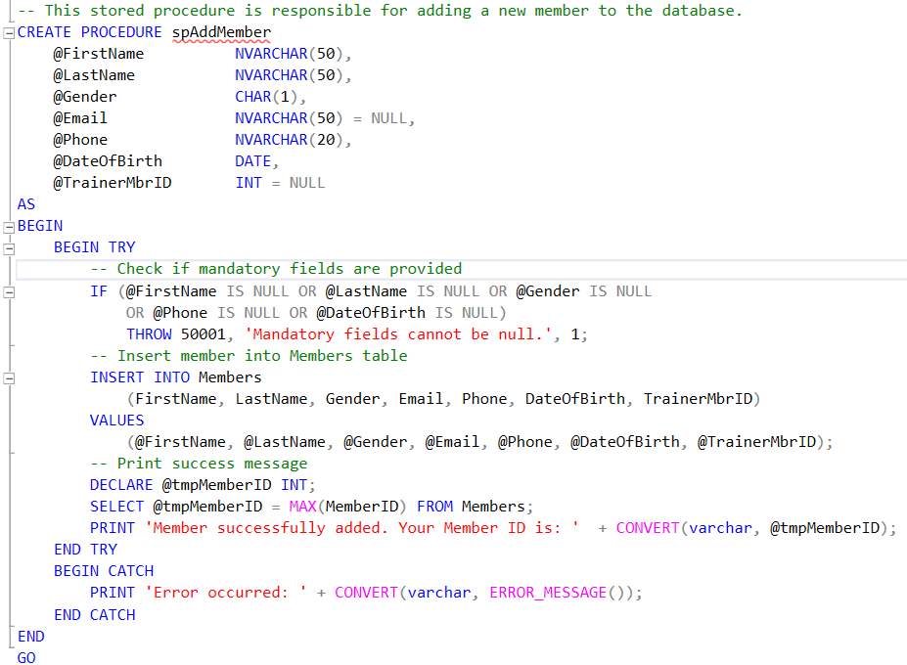
Sample Stored Proc. Definitions (1)
Notes:
Error handling, check mandatory fields

Slide 20
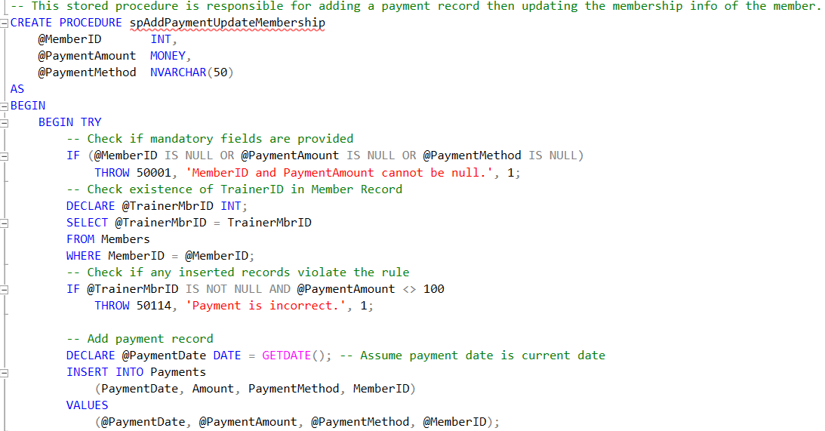
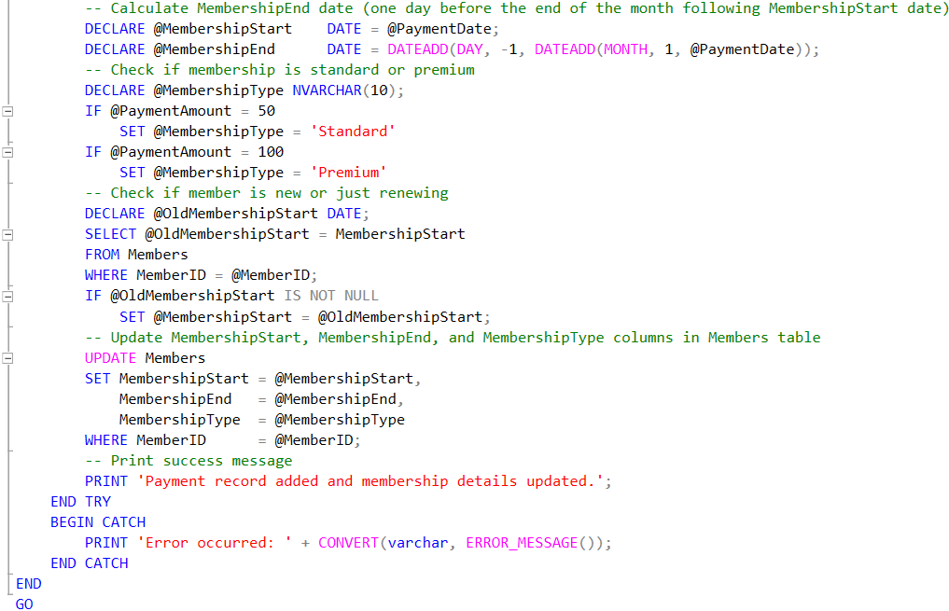
Sample Stored Proc. Definitions (2)

Slide 21
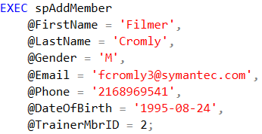

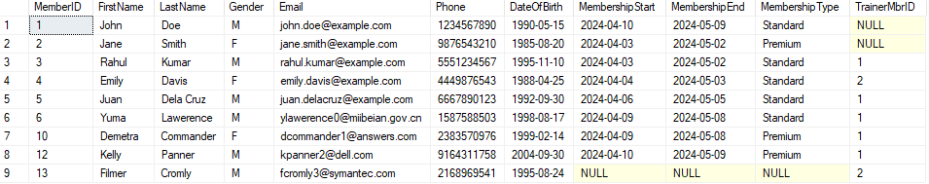
Members Table

Slide 22


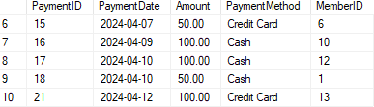
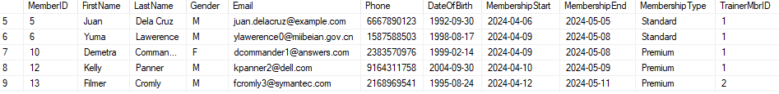
Payments Table

Slide 23




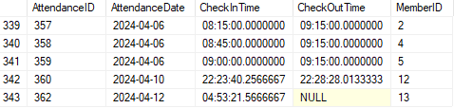
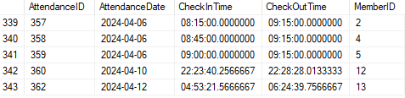
Attendances Table

Slide 24


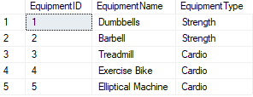
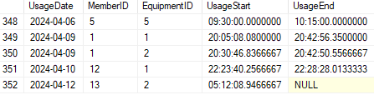
Equipments & Usages Table

Slide 25


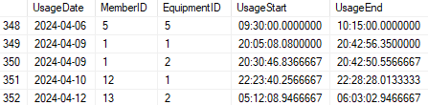
Equipment Usages Table

Slide 26
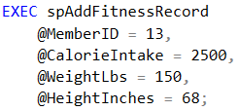

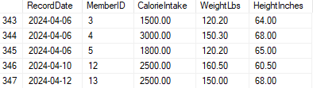
Fitness Records Table

Slide 27
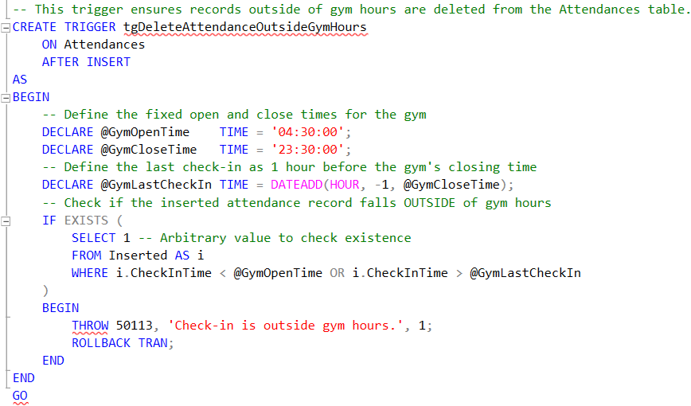

Sample Trigger Definitions (1)

Slide 28
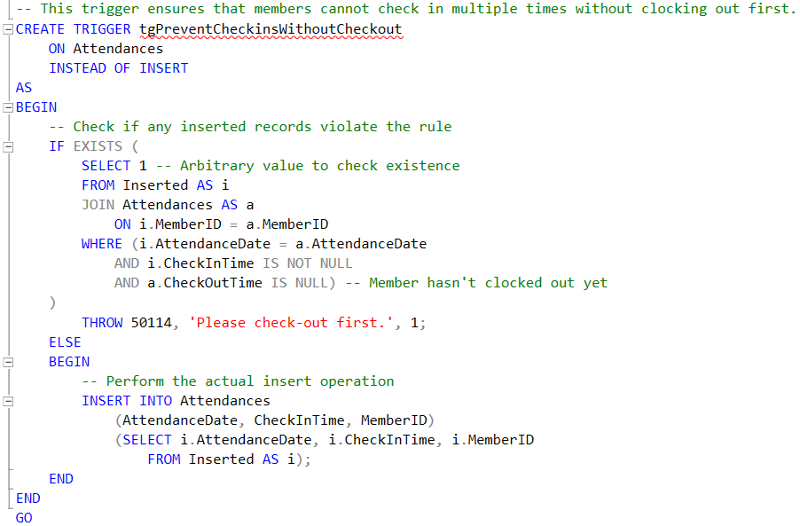

Sample Trigger Definitions (2)

Slide 29
THANKS!
Does anyone have any questions?
Template by: Slidesgo

