Slide 1
FLSH
An API & front-end to track and grade public resources & utilities
Brooke Dalton
Tarum Fraz
Zach Holbrook
Beth Oliver
Devin Siems
Notes:
brooke

Slide 2
FLSH Goals
An accessible database for public utilities you like to keep track of and share, review, and evaluate with your friends and comrades
Public restrooms
Public wifi
Bike racks
Vending machines
Accessible outlets
Water fountains
A front-end web application that allows users to login to a server, see and select utilities to show their location on a map
Servers that can share select utilities with each other

Slide 3
FLSH High-Level Goals
A server with a RESTful API specified that allows database accesses and manipulation.
Submitting reviews of existing resources that append to existing data, or new resources
Dedicated databases for bathroom reviews with fine-grain variables, and more generic reviews for other resources
Potentially extensible database?
A front-end that knows how to make API calls and displays pins on a map
Notes:
brooke

Slide 4
Sprint 1
As a developer (server-maintainer), I want to have some clearly specified API to submit and access data
As a developer, there needs to be some model we utilize to deal with database accesses
As a developer, I want a server that can respond to simple GETs DELETEs and PUTs
As a developer, I need API calls to respond parsably (preferably through JSON)
Notes:
tarum

Slide 5
Sprint 2
As a user, I need a passably clean front-end that shows bathroom locations on the map
As a user, I need to be able to submit resources (bathrooms & etc) through the front-end
As a user, I need to append review data to existing reviews
Notes:
Beth

Slide 6
Sprint 3
As a user, I would like to prevent non-trusted people from seeing the resources I care about
As a user, I would like to remove useless reviews and pins
As a developer, I would like to see the server extended to non-bathroom public resources
As a user, I need to filter which resources I am interested in
Notes:
devin

Slide 7
Sprint 4
As a user, I need to be able to see more than just bathrooms
As a user, I want pictures that show off the bathroom
As a user, I would like to have multiple reviews pooled together in the same map pin
Notes:
devin

Slide 8
Design Decisions
We want users to run their own servers, and own their own databases.
Users can host multiple servers for multiple friend groups.
If everyone can see your favorite bathrooms, they’ll trash them!
We want our code (front-end & back-end) to be accessible: executable from the get-go, auditable, forkable
This means no Google, Amazon, etc., services and API keys!

Slide 9



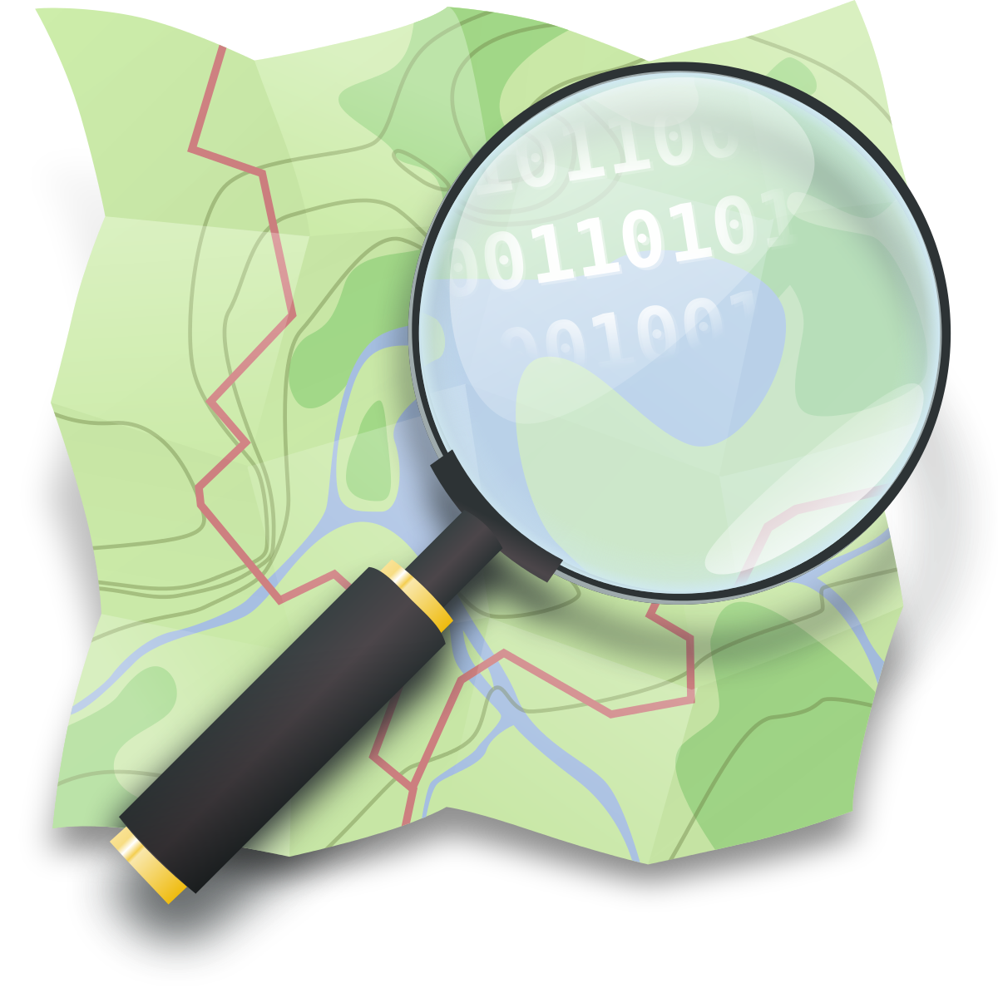


Technology
Python
Leaflet.js
OpenStreetMap
Flask-SQLchemy
Notes:
zach

Slide 10
System Architecture
Front-end
API
Flask (A Python Web Framework)
Flask-RESTful
RESTful APIs are all the rage now
Flask-SQLchemy
SQLite (a nice RBDMS)
Authenticate-User
Submit-Resource
Append-Review
Query
Leaflet.js
OpenStreetMap
OSM Nominatim
JSHashes
Query-Results
Notes:
zach

Slide 11
Challenges
Brooke teaching the rest of us Flask/Flask-RESTful/Flask-SQLAlchemy
Doing proper API calls and authentication in JavaScript
Embedding JavaScript into HTML and then HTML and CSS into JavaScript
Designing an extensible database that can deal with multiple user-negotiated resources
Finding datasets we can use to pump into the server to show proof-of-concept
Working w/ schedules
Notes:
tarum

