Slide 1
Family Relatives Ontology
Artificial Intelligence
Laboratory 2
Student:
Nurulla Zholdoshov

Slide 2
Goal
The goal of this ontology is to find family relatives in the family tree.
For this purpose, my ontology helps the user to find, who are their ancestors? Who are their descendants? How related the family relationships?

Slide 3
Vocabulary
Self-standing | modifiers | relations | definable
Male | Father | hasChild | dob (Date of Birth)
Female | Mother | hasParent | dod (Date of Death)
Parent | Son | hasGrandchild
Grandparent | Daughter | hasGrandparent
Child | Grandfather | isChild
Grandchild | Grandmother | isGrandchild
Married | Brother | isGrandparent
Sibling | Sister | isParent
 | Wife | married
 | Husband | siblings
 | Granddaughter | hasAncestor
 | Grandson | hasDescendant

Slide 4
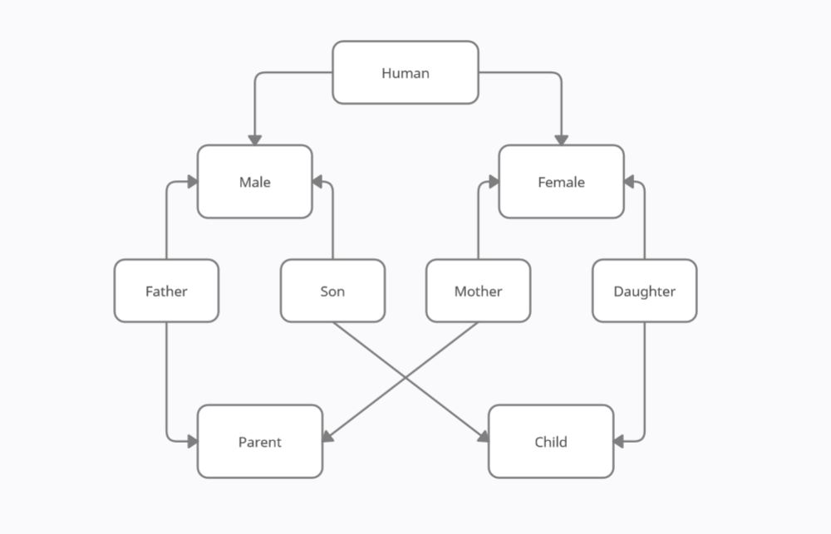
Conceptual Model

Slide 5
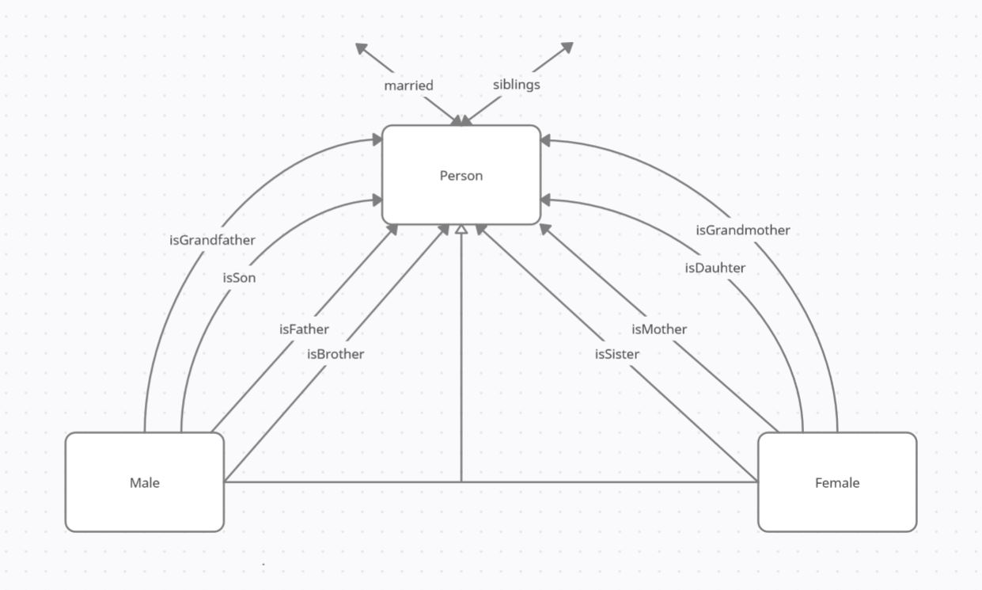
Conceptual Model

Slide 6
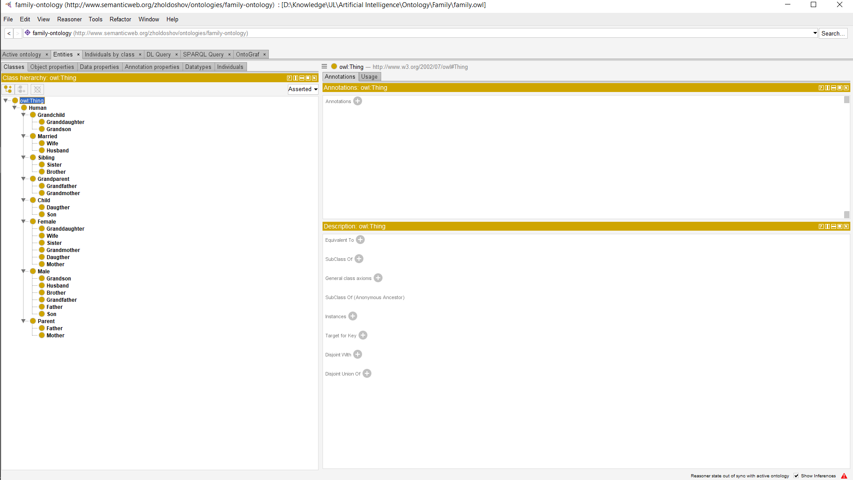
Classes

Slide 7
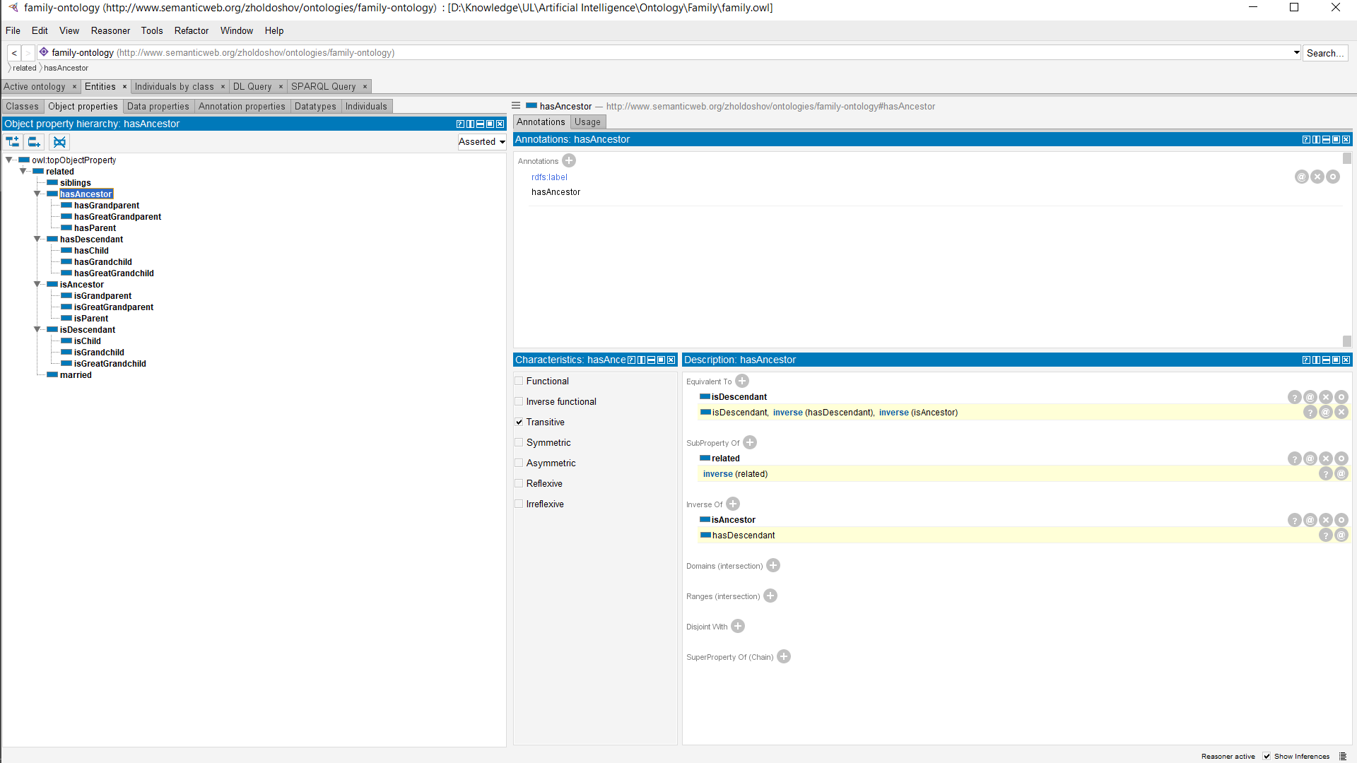
Object Properties

Slide 8
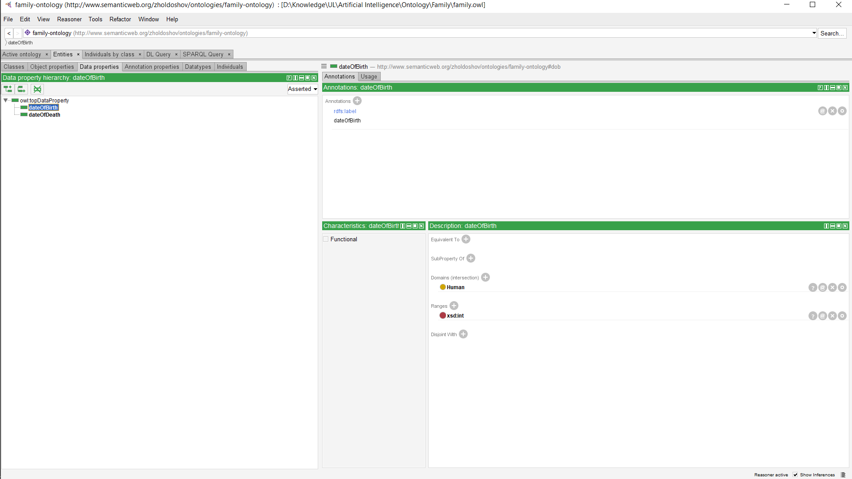
Data Properties

Slide 9
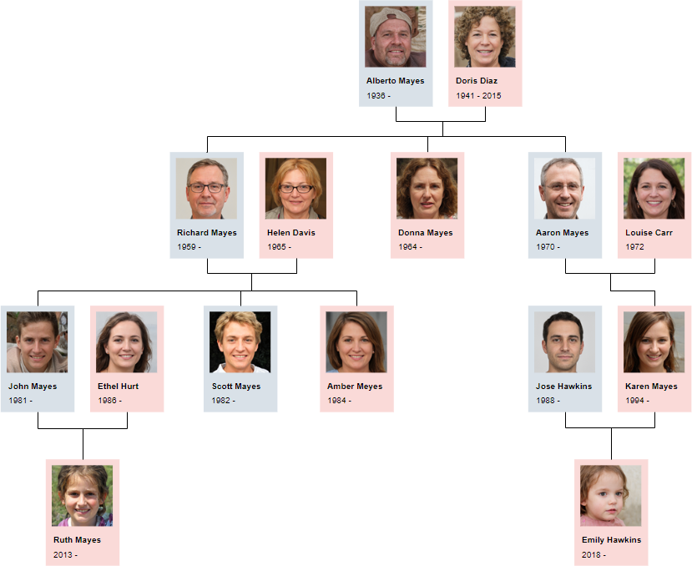
Individuals

Slide 10
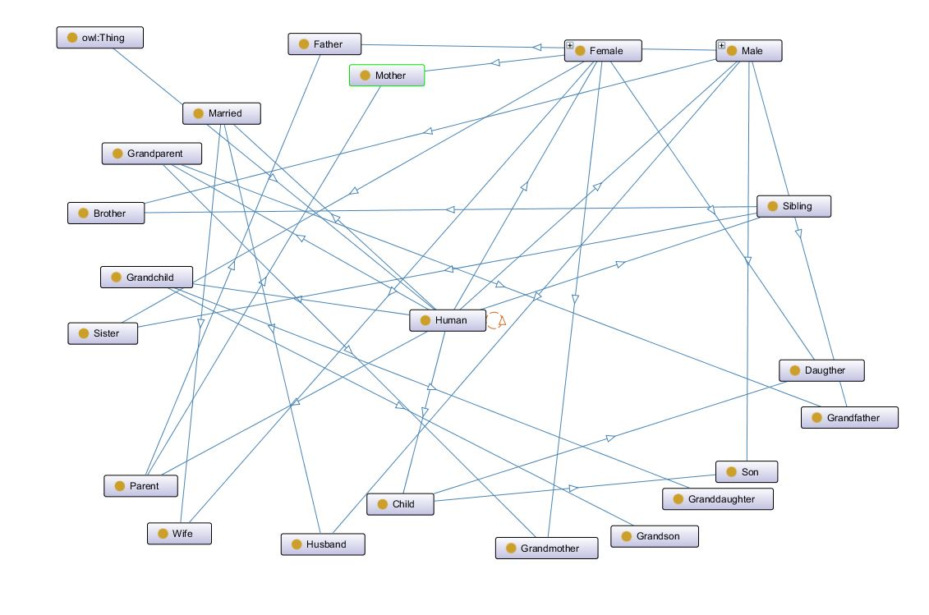
OntoGraf

Slide 11
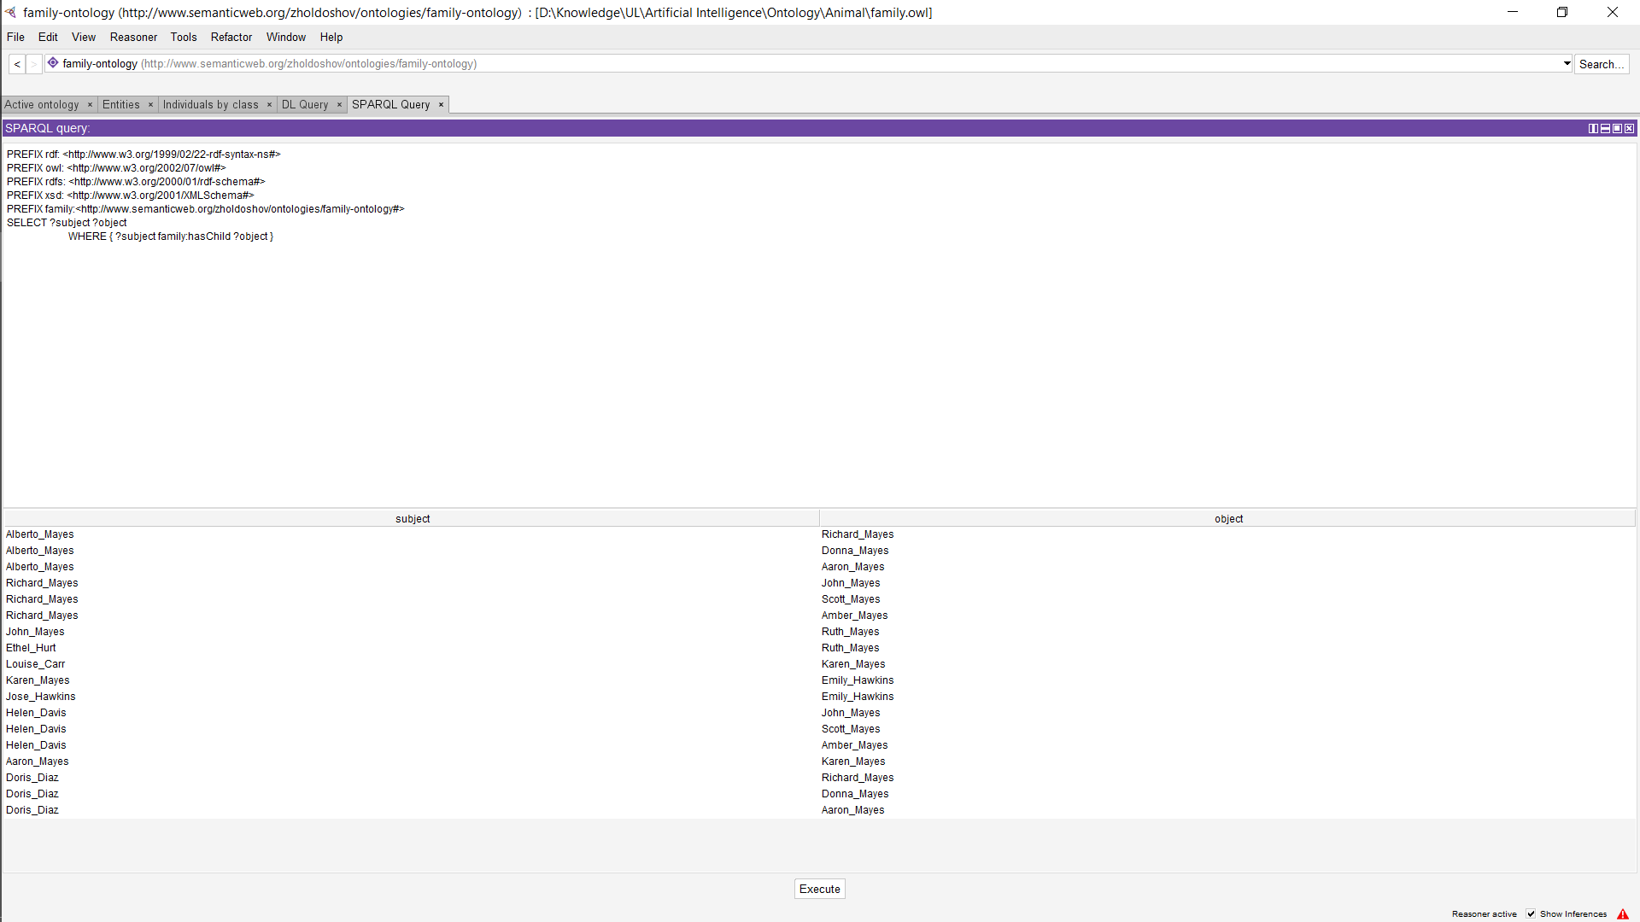
Queries

Slide 12
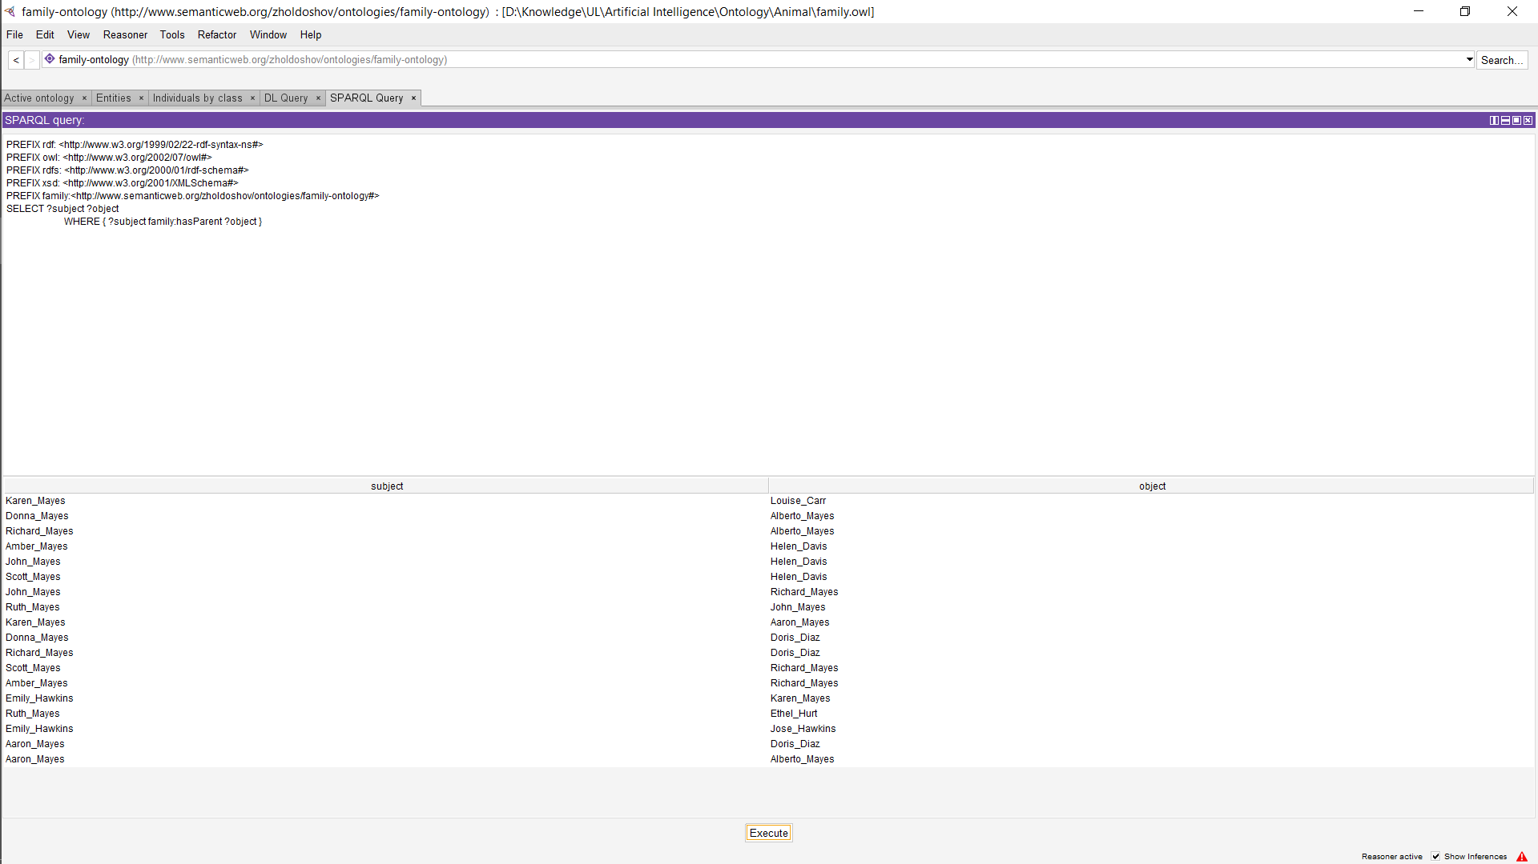
Queries

Slide 13
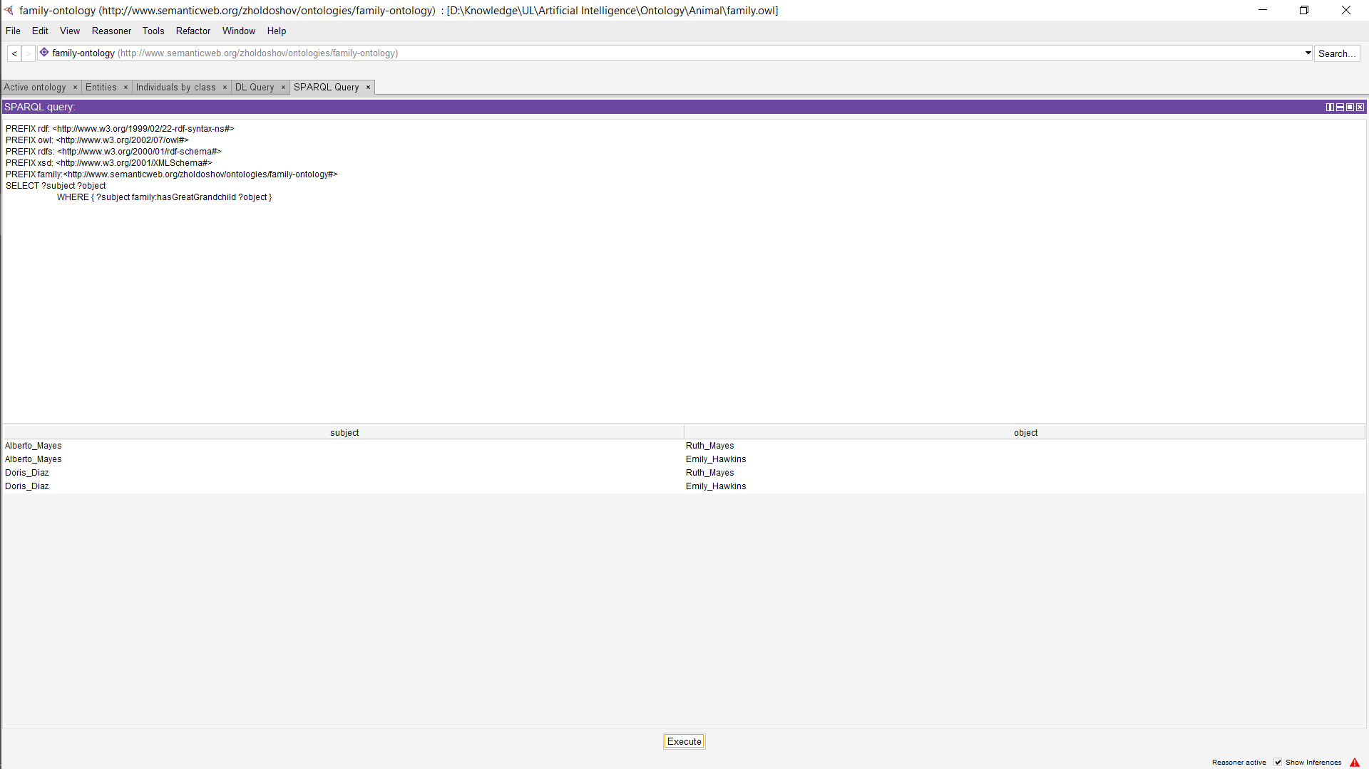
Queries

Slide 14
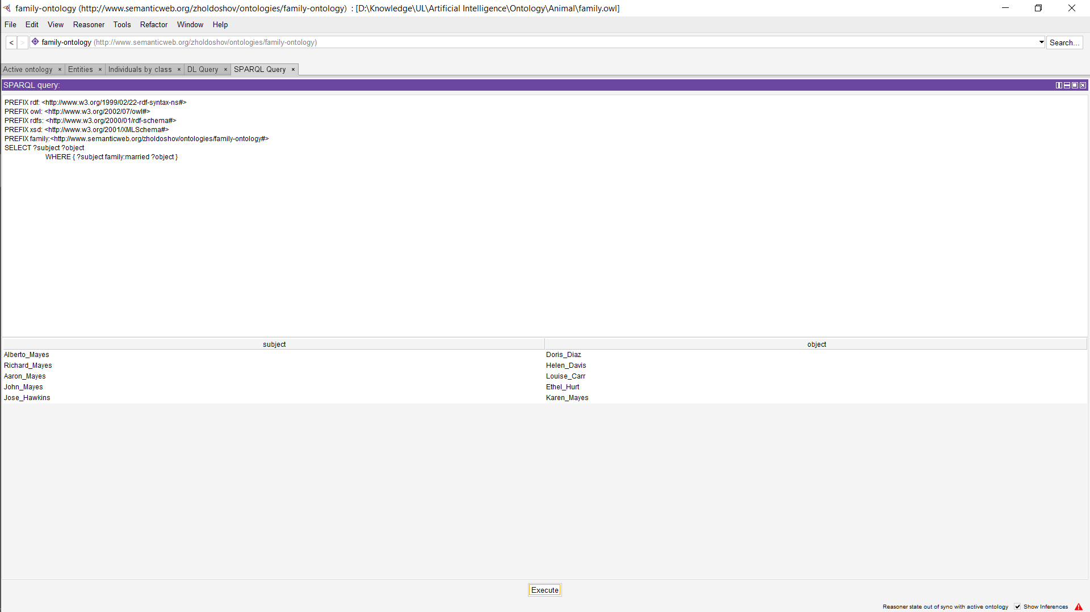
Queries

Slide 15
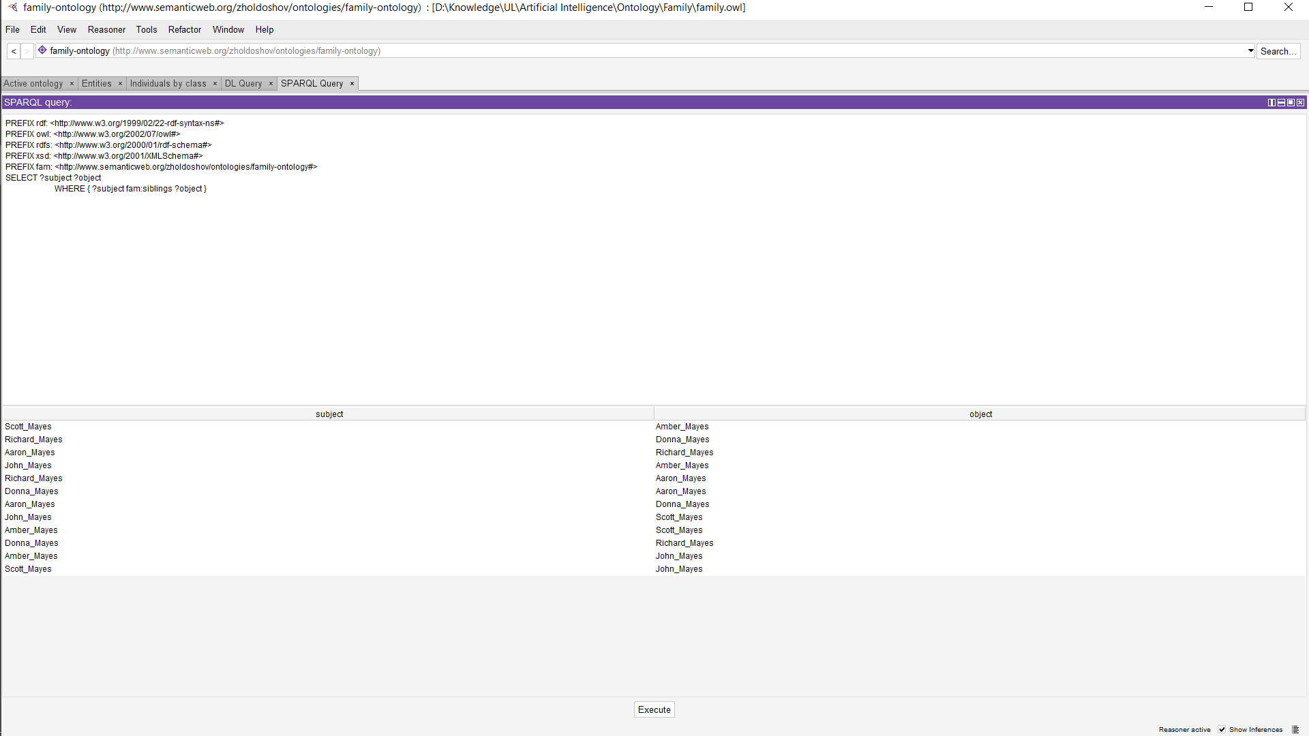
Queries

Slide 16
Conclusion
The hard part was choosing topic, but after watching some tutorials and finding topic “Family relatives” it was pretty easy.
I can say this project was interesting for me, because using this ontology I can find my all distant relations.

