Slide 1
Interlocking 3D puzzles using V-reps
그래픽스 및 기하처리 연구실
정보컴퓨터공학부 예기즈바에브 졸란

Slide 2
Contents
Bounding cage
The Material-Aware division
Recovering the model’s shape
Simulated Annealing
Concept of Simulated Annealing in research
Novelties of the work
Research plan

Slide 3
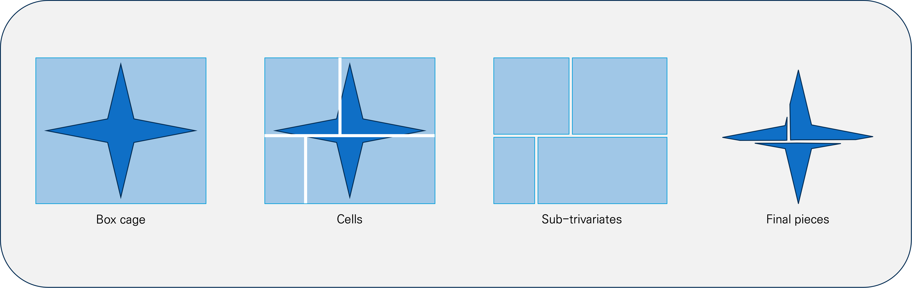
Bounding cage
The bounding cage acts as a continuous volumetric domain that can be cut.
The bounding cage is generated as a 3D box with 8 control points that perfectly map the internal math to reality.
The empty cell problem: When the BSP algorithm splits the cage based strictly on box volume, it ignores the model's actual geometry.
The input mesh
Current pipeline of dividing to pieces

Slide 4
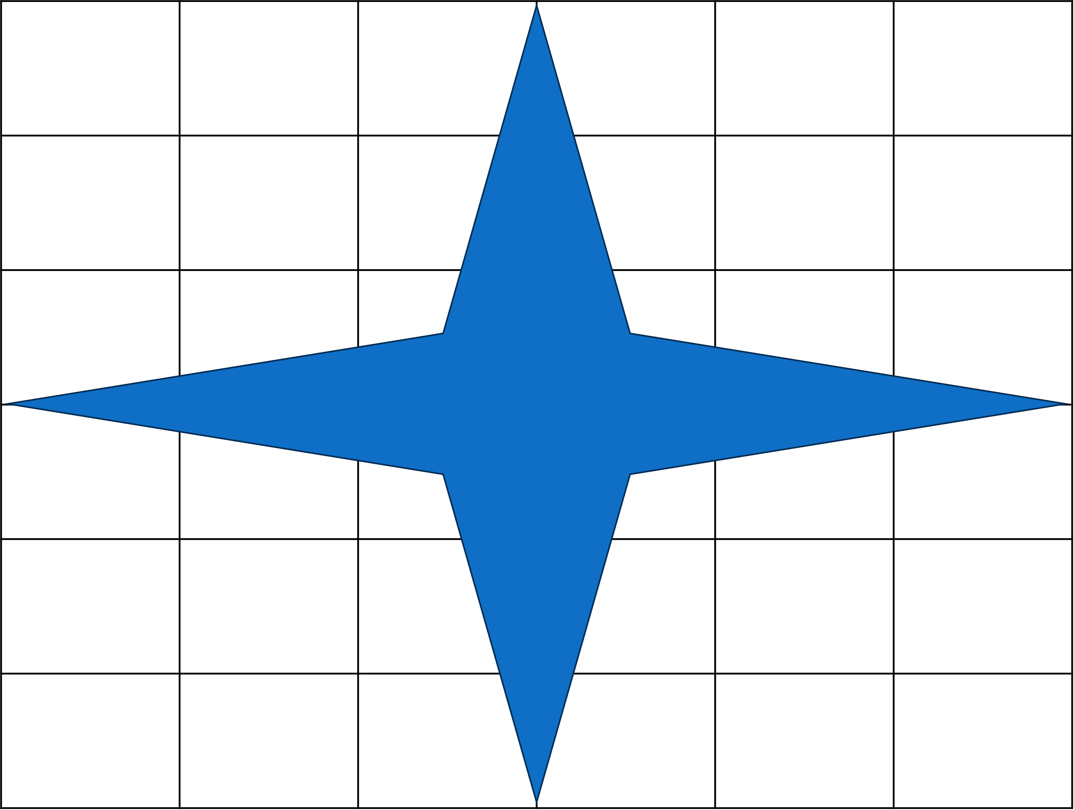
The Material-Aware Solution
The model is voxelised with a 3D prefix sum, enabling instant volume queries to evaluate candidate cut planes.
The BSP algorithm divides model that it will have more than 15% and less than 85% of the divided part.
To prevent extreme size disparities, the algorithm always selects the cell containing the highest material volume for the next split.
Empty cells
The representation of a mesh in voxels
Example of checking a cut candidate
Redeciding cut position

Slide 5
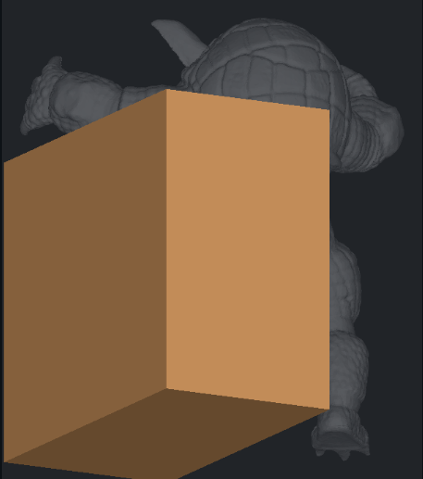
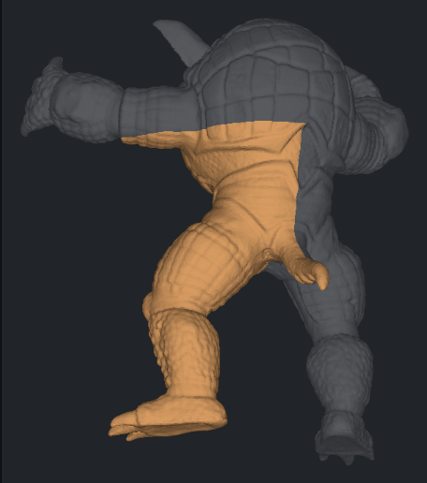
Recovering the Model’s shape
In the BSP division process, the puzzle pieces remain as rigid, box-like sub-trivariates.
After the division process, high-resolution geometry is recovered by tessellating each cell and performing Boolean operations and intersections with the initial mesh input.
By intersection, the exterior boundary of the puzzle pieces inherits the exact surface of the initial model, and internal faces will be perfectly flat.
Sub-trivariate cell
Final piece extracted by Boolean and intersection

Slide 6
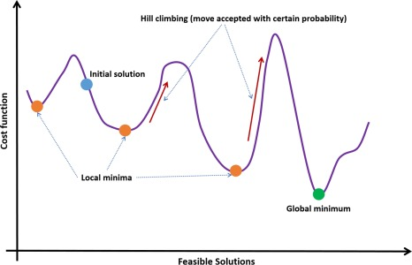
Simulated Annealing
The Objective: Find a mathematically optimal BSP cut that perfectly balances material volume while maintaining the piece connectivity.
Iterative Search: The algorithm continuously generates new candidate cut planes by slightly shifting the (u,v,w) coordinates.
Probabilistic Acceptance:
  It always accepts a shift that improves the volume balance.
  To avoid getting trapped in a sub-optimal solution, it will occasionally accept a worse shift.
The probability of accepting a worse shift depends on a "temperature" variable. Early on (high temperature), it explores the space widely. As time passes (low temperature), it strictly fine-tunes the best position.

Slide 7
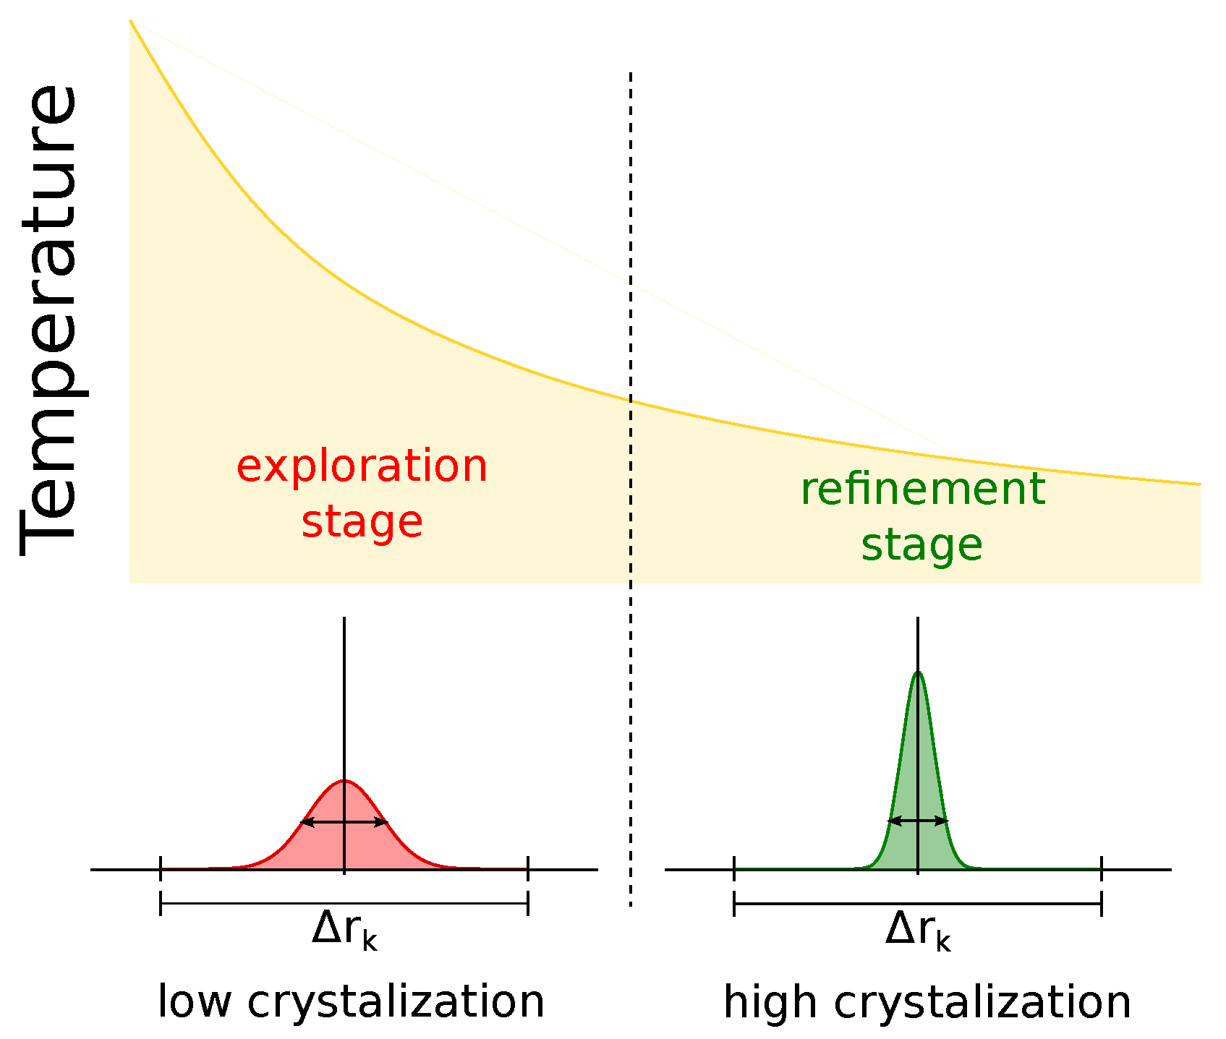
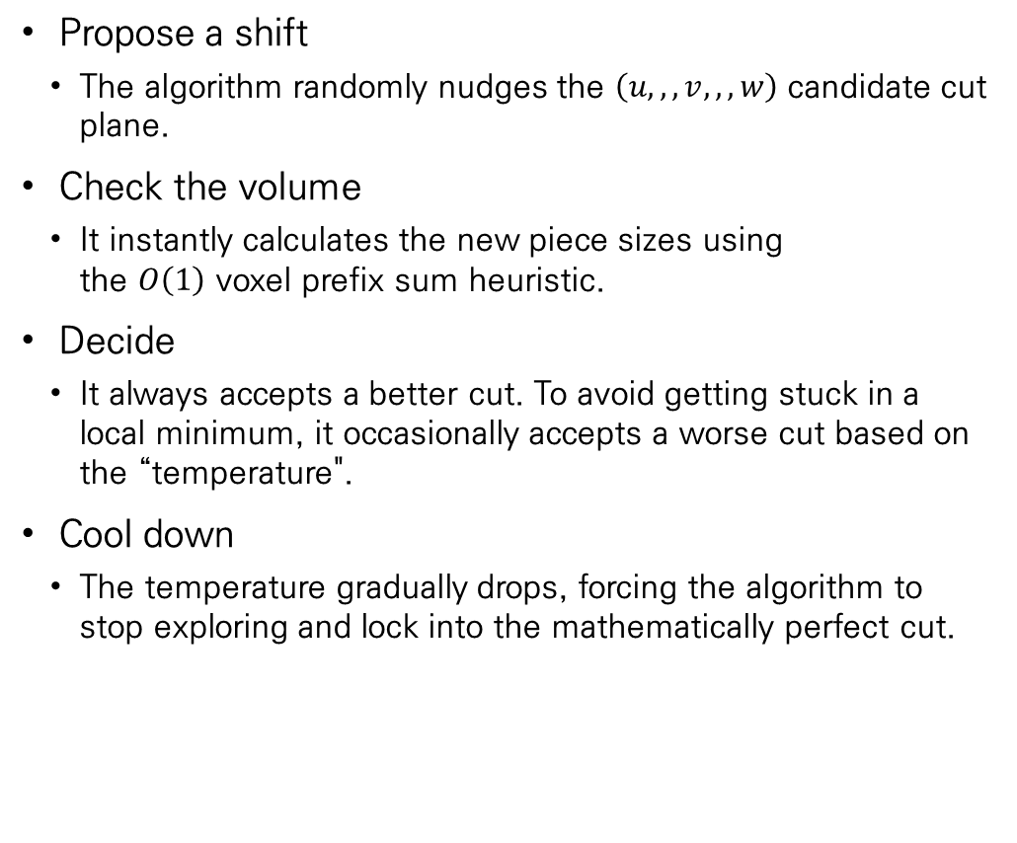
Concept of Simulated Annealing in research
Propose a shift
  The algorithm randomly nudges the $\left(u,,,v,,,w\right)$ candidate cut plane.
Check the volume
  It instantly calculates the new piece sizes using the $O\left(1\right)$ voxel prefix sum heuristic.
Decide
  It always accepts a better cut. To avoid getting stuck in a local minimum, it occasionally accepts a worse cut based on the “temperature".
Cool down
  The temperature gradually drops, forcing the algorithm to stop exploring and lock into the mathematically perfect cut.

Slide 8
Novelties of work
Assembly planning as a design constraint
  Rather than treating kinematic assembly as a post-calculation verification step, the assembly planner is embedded directly inside the generation loop.
Self-locking joints are defined in the trivariate parameter domain.
  Interlocking joints are defined directly in the continuous trivariate (u,v,w) parameter space rather than via discrete voxels. This allows the locking mechanisms to seamlessly inherit the bounding cage's mapping and remain geometrically valid across curved, freeform faces.

Slide 9
Research plan
2026, September
  BSP division verification
2026, October
  Joints of pieces
2026, October-November
  Puzzle repair algorithms(via candidate concept: Simulated annealing)
2026, December-January
  Verification of the algorithm via printing 3D puzzles

