Slide 1
Astronomy Model
Amirreza Dolatpour Fathkouhi
Fall 2024

Slide 2
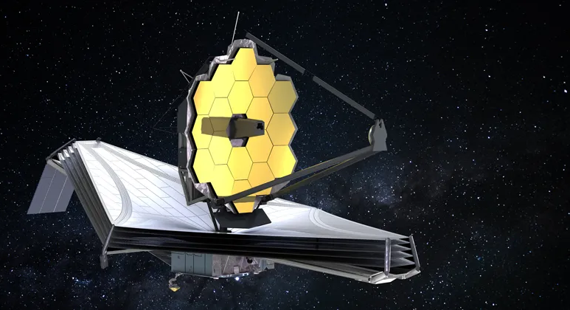
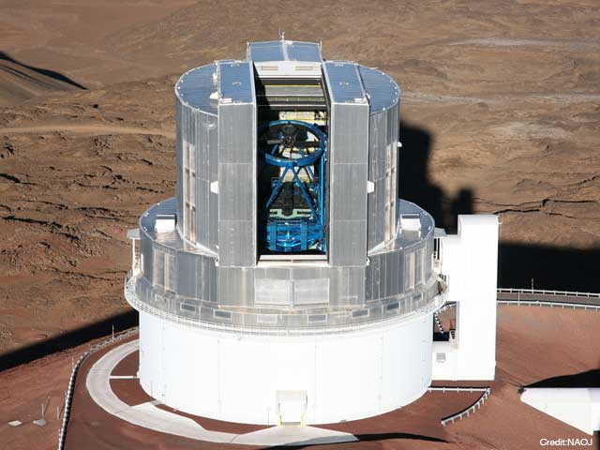


Astronomy Image Overview
Images:
Captured by satellites or telescopes.
Mainly consist of galaxies, stars and quasars.
Different surveys capture images with different resolutions:
SDSS, DESI, BOSS, EBOSS, etc.

Slide 3
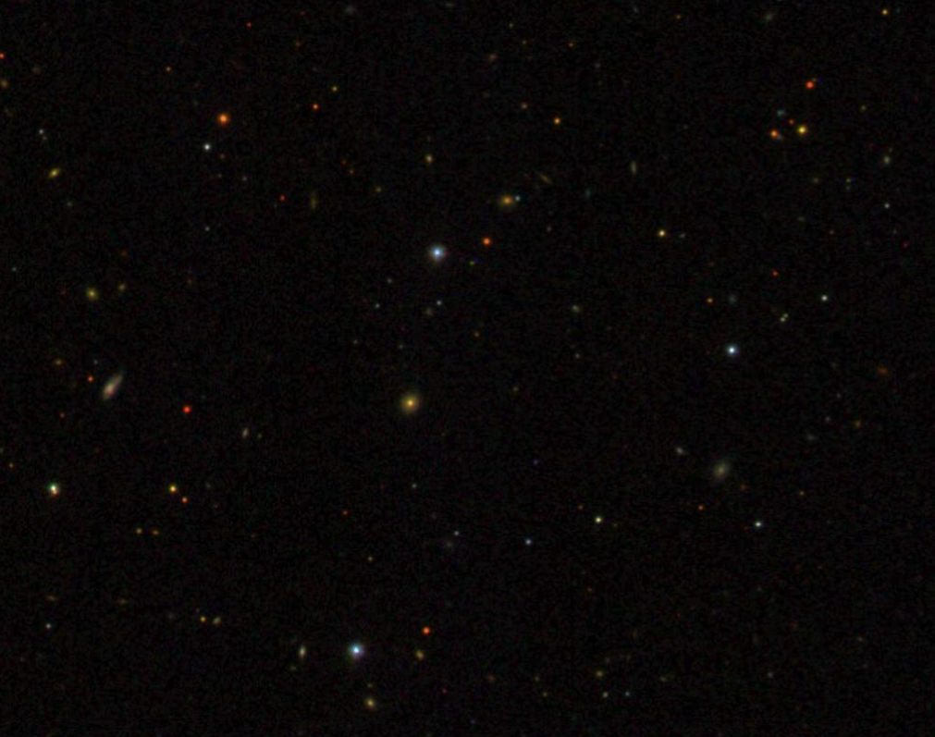
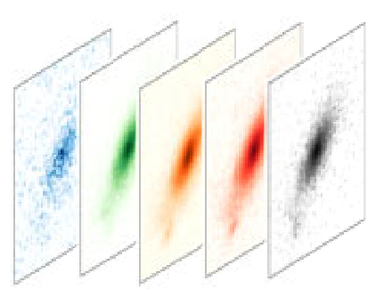
Astronomy Image Overview
Images can have different number of channels.
DESI and SDSS images have 3 and 5 channels, respectively.
Raw images contain various types of noise and anomalies.
Additionally, sparsity.

Slide 4
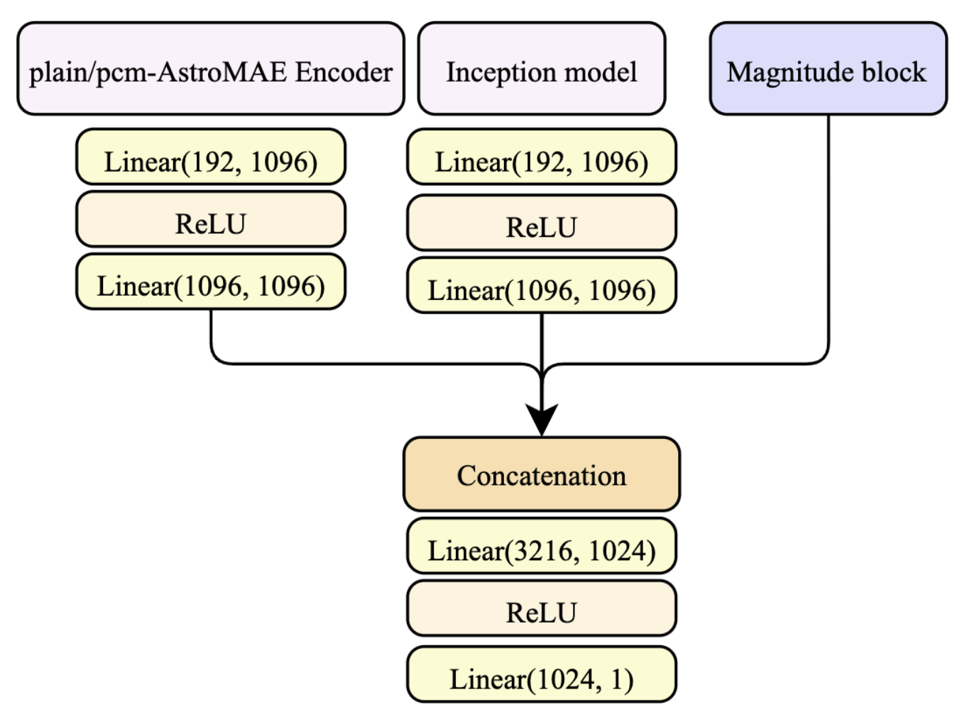
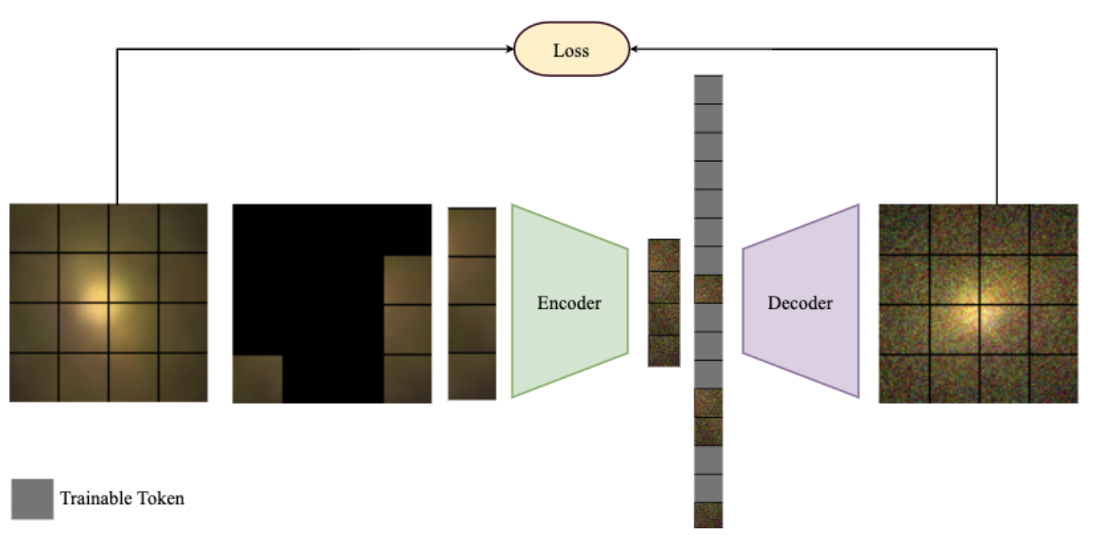
AstroMAE: Redshift Prediction Using a Masked Autoencoder with a Novel Fine-Tuning Architecture[1]
AstroMAE:
Pretraining:
AstroMAE is pretrained using a masked autoencoder [2].
Fine-tuning:
Pretrained Encoder:
The decoder part of the AstroMAE is discarded.
Inception Model.
In the last inception block, the branch with a kernel size of 5 × 5 is omitted.
Because the input is too small to apply a convolution with a 5 × 5 kernel.
Magnitude Block:
Includes a multi-layer perceptron:
Five linear layers with ReLU activation functions between them.

Slide 5
AstroMAE: Redshift Prediction Using a Masked Autoencoder with a Novel Fine-Tuning Architecture[1]
Dataset:
The preprocessed dataset provided by Pasquet et al. [3]:
Contains 659,857 images with 64 corresponding physical properties.
Images and physical properties are retrieved from SDSS DR8 and DR12, respectively.
Images contain five bands:
u, g, r, i, and z frames.
The size of each image is 64 × 64 × 5.
Fine-tuning data:
Images along with their corresponding magnitude values, including u, g, r, i, z and redshift as the target.
Image transformation:
Crop from the center to a size of 32 × 32 × 5.
Random rotation at 45 degrees.
Horizontal and vertical flip.
Gaussian noise is used during fine-tuning.

Slide 6
Reference
[1] Fathkouhi, A. D., & Fox, G. C. (2024, September). AstroMAE: Redshift Prediction Using a Masked Autoencoder with a Novel Fine-Tuning Architecture. In 2024 IEEE 20th International Conference on e-Science (e-Science) (pp. 1-10). IEEE.
[2] He, K., Chen, X., Xie, S., Li, Y., Dollár, P., & Girshick, R. (2022). Masked autoencoders are scalable vision learners. In Proceedings of the IEEE/CVF conference on computer vision and pattern recognition (pp. 16000-16009).
[2] Pasquet-Itam, J., & Pasquet, J. (2018). Deep learning approach for classifying, detecting and predicting photometric redshifts of quasars in the Sloan Digital Sky Survey stripe 82. Astronomy & Astrophysics, 611, A97.

