Slide 1
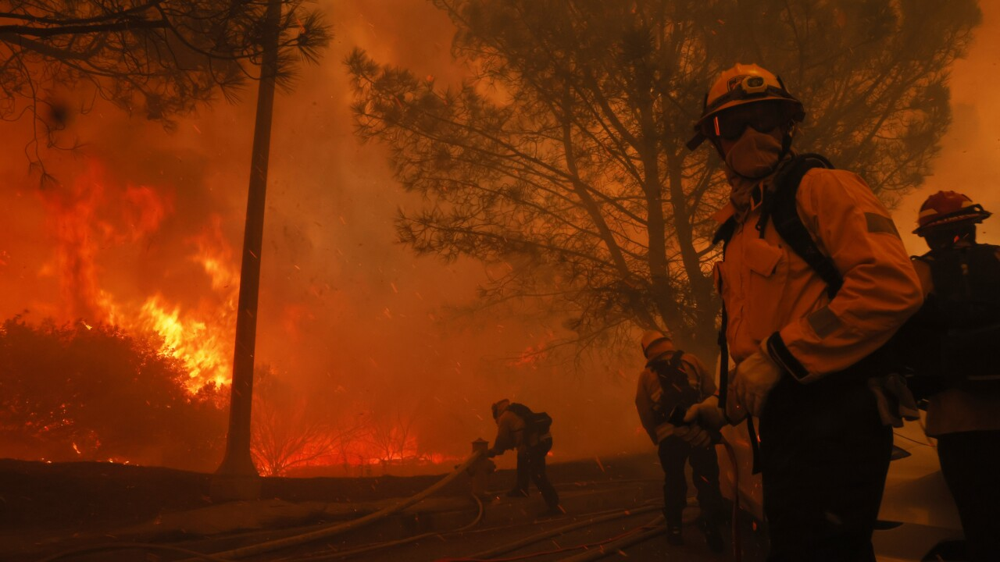


Wildfire Prediction: Embed Your Impact in Every Line of Code
In collaboration with: Impact Ventures

Slide 2

Meet the Team:
Nahid Boustani
Harsh Singh Virk
Dae Hwang
Emanuel Leonce
Zachary Holland
Founder & Owner
M.Sc. - Systems Engineering
B.Sc. - Computer Science
Mechanical Engineer
M.S - Data Science (In-progress)
B.S - Mechanical Engineering
Data Scientist
M.S - Data Science (In-progress)
B.S - Agricultural and biosystems engineering
Data Engineer
M.S - Data Science (In-progress)
B.S - Computer Science & Computer Engineering
B.A - Applied Mathematics

Slide 3
The Problem
As climate change intensifies, wildfires have become more frequent, destructive, and unpredictable. These fires:
Threaten human life and wildlife directly through rapid and uncontrollable spread
Destroy homes, infrastructure, and natural ecosystems
Release large volumes of greenhouse gases
Lead to major social and economic losses
The team is exploring whether our datasets on wildfire emissions, weather patterns, and fuel conditions can be used to predict the duration of wildfires, which is critical for:
Emergency response
Risk mitigation
Resource planning

Slide 4
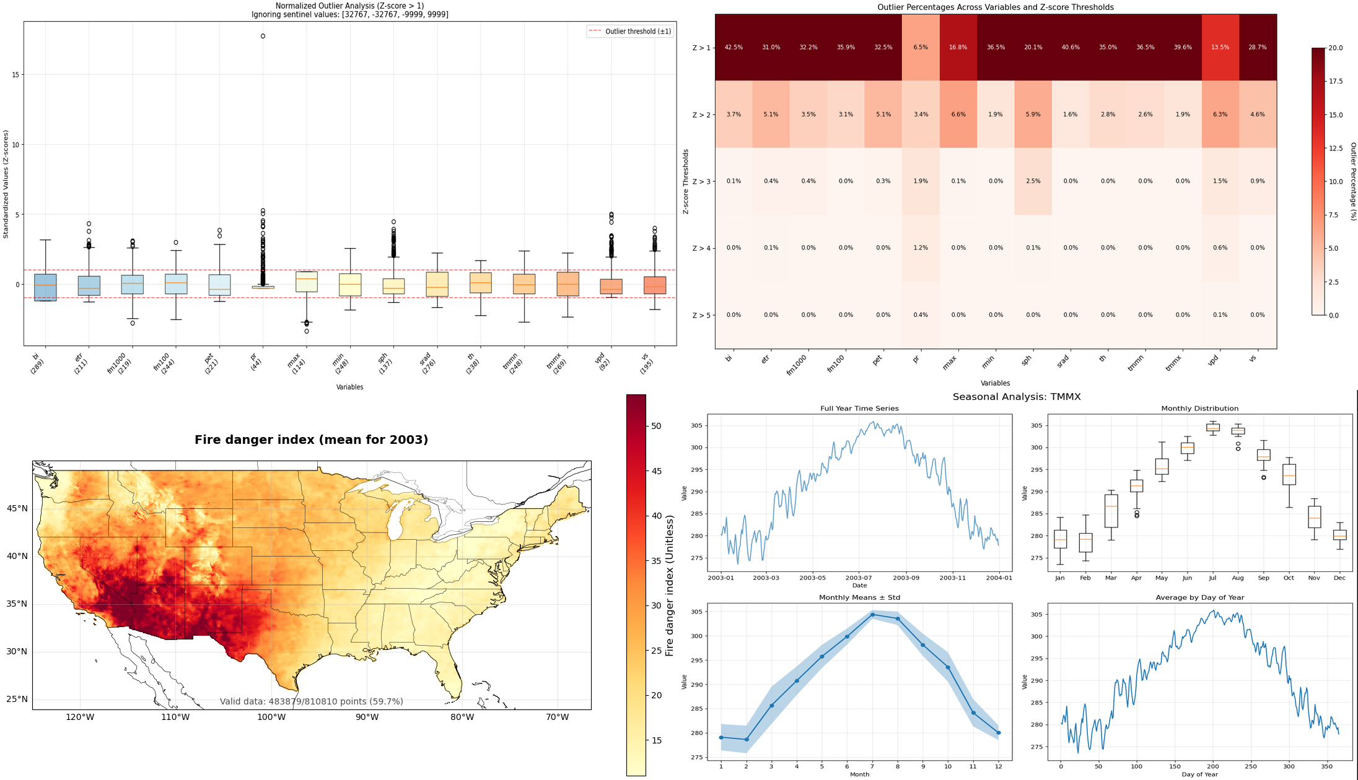
Datasets
1. Wildfire Emissions Data
Source: USDA Missoula Fire Lab Emission Inventory (MFLEI)
Size: ≈7.5 million unique wildfire snapshots
Stored: In a Google Cloud Platform (GCP) relational database, partitioned by year
Content Includes:
Geospatial coordinates
Event dates
Fuel characteristics
Burn severity
Emissions estimates (ECO2 and other GHG outputs)
2. Weather Data
Source: Daily weather records from 2003–2015
Format: netCDF (.nc) files
Size: ≈4 billion data points across 150 files
Stored: Originally in Google Drive
Structure: Masked arrays containing climate variables per grid cell, recorded daily
Extracted Variables:
bi: Fire danger index
etr & pet: Evapotranspiration metrics
fm100 / fm1000: Fuel moisture content
pr: Precipitation
rmax / rmin: Relative humidity
sph: Atmospheric moisture
srad: Solar radiation
th: Wind direction
tmmn / tmmx: Temperature
vpd: Vapor pressure deficit
vs: Wind speed

Slide 5




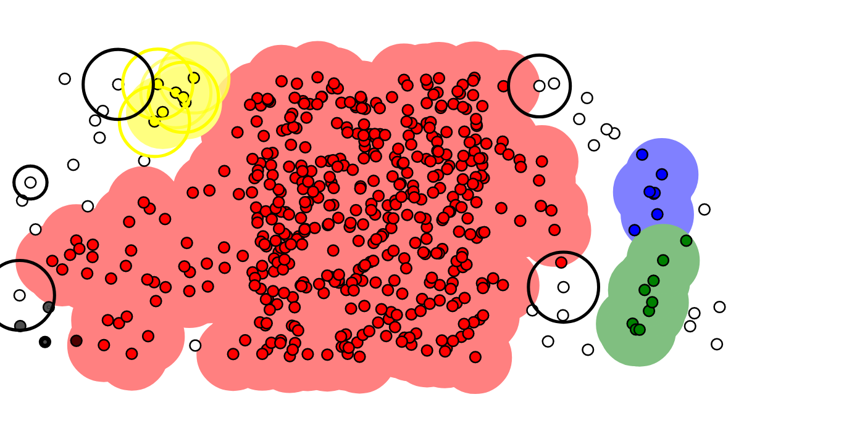

Data Engineering
.netCDF → Parquet
Emission Data
≈7.5M rows
Snapshot of Fire
2003 - 2015
Weather Data
≈ 4.B Datapoints
Recorded Daily
15 Variables
2003 - 2015
150+ .netCDF files
Broken out by Variable & Year (bi_2003, ptr_2004)
Script to convert files to Parquet
Pipeline to GCP
Bucket Storage for Hundreds of Files
Design & Document File System
Script to mass push files to BigQuery
.
Route to BigQuery
Clean NULL/NAs
Spatial-Temporal Join (Lat & Long + Date)
Added 15 variables to Emission dataset
Data Imputation
20% of Emission Data missing values
Three-tiered approach:
Hot-Deck (1%)
KNN (40%)
Yearly & Seasonal Avg (59%)
Cluster Emission Data
DBSCAN
Unique Global ‘fire_id’ added
Dropped around 2-3% of the total dataset
Route to Vertex AI
Feature Selection
Narrow down 40 variables to 29
Convert final table back to Parquet

Slide 6
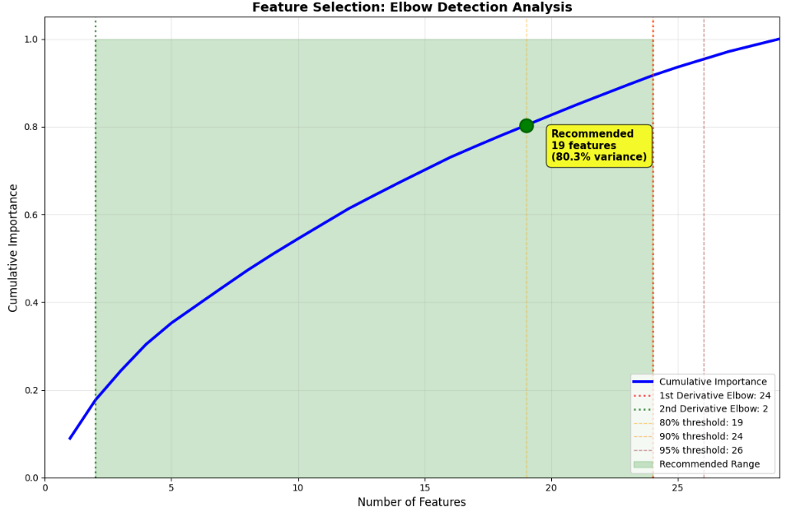
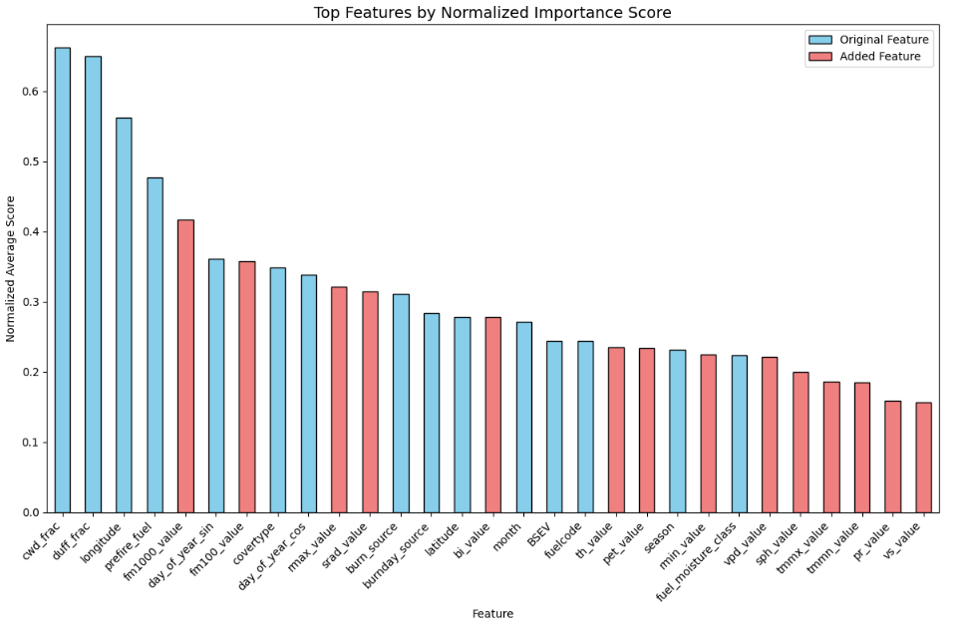
Feature Selection Approach
Scoring Method: Combined 5 statistical tests (Pearson, Spearman, MI, ANOVA, VIF) into normalized composite scores
Used group-aware K-fold validation to keep fire event clusters together
Elbow Analysis: Applied 1st and 2nd derivative methods to identify optimal feature count
2nd derivative suggested 2 features (too aggressive due to sharp early drop-off)
1st derivative recommended 24 features
Final Decision: Selected 27 features
Tree-based models handle larger feature sets effectively
Chose higher count for preliminary exploratory analysis
Final VIF adjustment had minimal impact (1-2 feature difference)
Deliverables: Created feature subsets at multiple thresholds (80%, 90%, 95%) and different scoring methods for future flexible modeling approaches
Key Insight: Top 2 features (cwd_frac, duff_frac) show ~73% importance each, explaining the aggressive 2nd derivative result

Slide 7
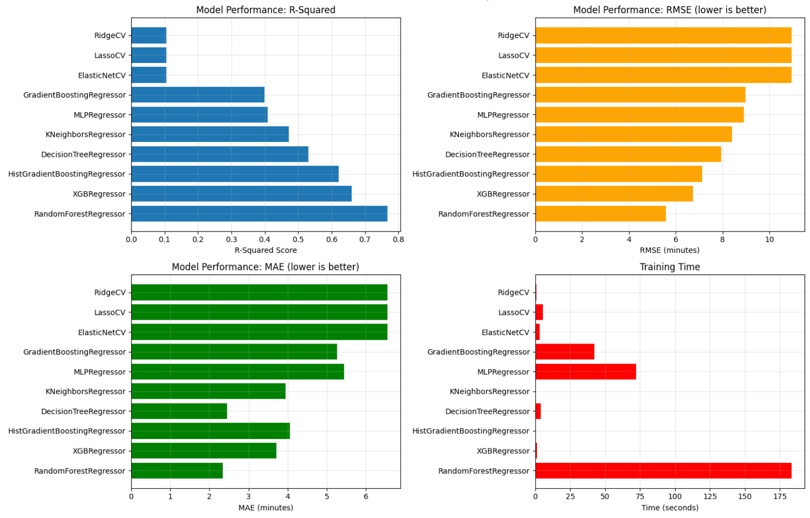
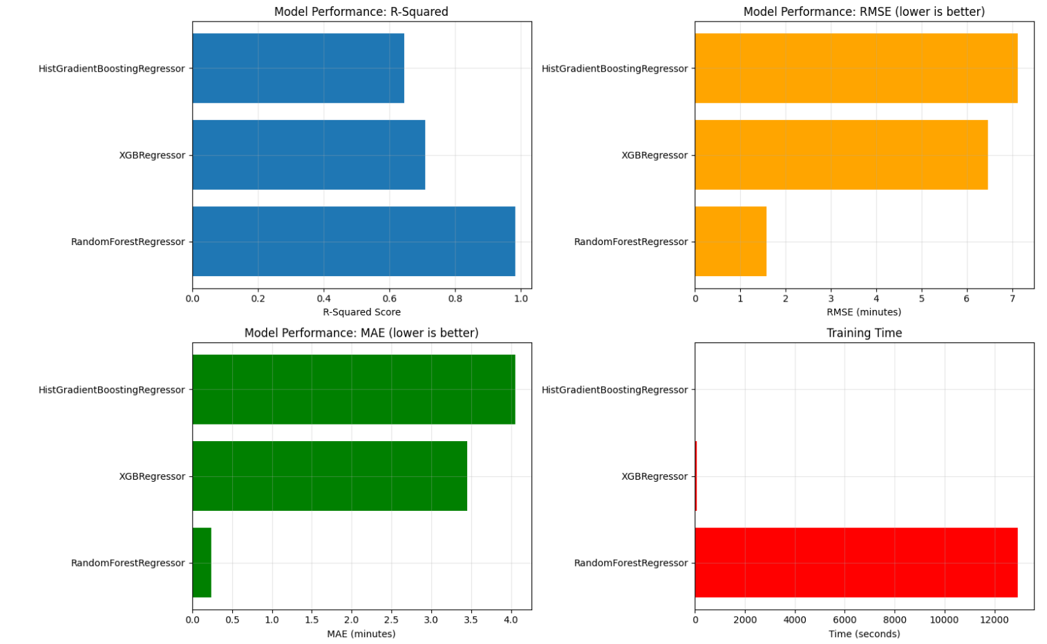
Preliminary Modeling Results
Sampling 40+ Models
Full Dataset
Model | R-Squared | RMSE | MAE | Time Taken (s)
RandomForest | 0.767941 | 5.576604 | 2.343324 | 183.530110
XGB | 0.660985 | 6.740312 | 3.709696 | 1.157452
HistGradientBoosting | 0.621168 | 7.125147 | 4.053571 | 0.657190
DecisionTree | 0.530251 | 7.934201 | 2.453123 | 3.772769
KNeighbors | 0.472875 | 8.404794 | 3.952008 | 0.028228
Model | R-Squared | RMSE | MAE | Time Taken (s)
RandomForest | 0.982488 | 1.584477 | 0.241504 | 12938.888829
XGB | 0.708323 | 6.466421 | 3.452912 | 59.350322
HistGradientBoosting | 0.645840 | 7.125465 | 4.051264 | 24.651113

Slide 8
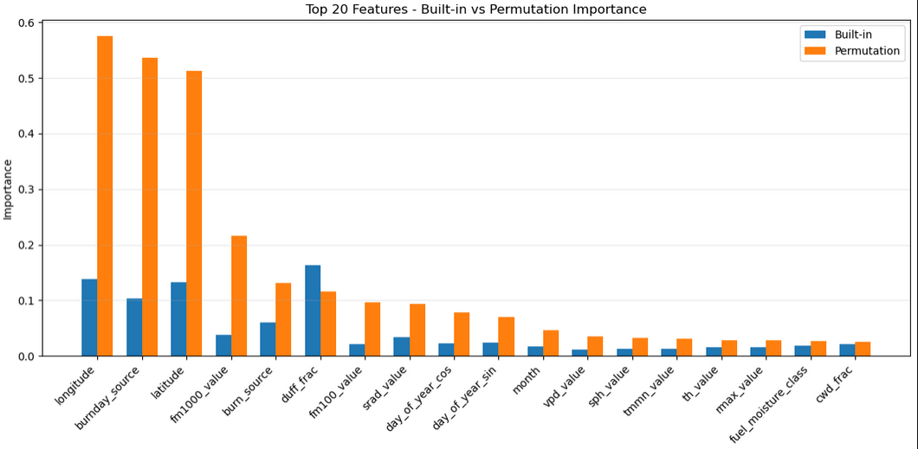
Feature Importance
What Was Done
Evaluated feature importance using two approaches:
Built-in feature importance from tree-based models
Permutation importance across multiple models
Models used:
Random Forest
XGBoost
HistGradientBoosting
Methodological Differences
Built-in importance is fast but depends on model internals
Permutation importance is model-agnostic and reflects actual performance impact
Permutation handles feature interactions and multicollinearity more reliably
Key Findings
Top consistent features across methods: (longitude, latitude, burnday_source, duff_frac, fm1000_value)
Temporal features like day_of_year_sin and day_of_year_cos showed moderate influence
Some features were overestimated by built-in scores but had minimal impact in permutation
Conclusion
Using both methods provided a balanced view of what truly drives model performance
Permutation importance confirmed the reliability of the top-ranked features and highlighted potential overfitting from model-specific heuristics

Slide 9
Analysis & Conclusion
Key Findings
Evaluated 40+ regression models using LazyPredict with row-level and group-based approaches
Tree-based models (Random Forest, XGBoost, HistGradientBoosting) consistently outperformed others
Some early models achieved R² > 0.95 but showed clear overfitting from repeated labels and lack of fire-level independence
Group-aware modeling yielded more realistic results, confirming fire duration is learnable with proper model structure
Extensive feature selection identified key predictors:
duff_frac, latitude, fm1000_value, fuelcode, vpd_value
Impact & Value
Though preliminary, this work establishes critical groundwork for future wildfire modeling by:
Confirming duration prediction feasibility
Delivering a refined, validated feature set
Building a scalable, explainable ML pipeline
Enabling group-aware, temporal, and classification approaches
The project bridges raw fire-day data to structured predictive modeling, accelerating future wildfire analytics development. Our dual exploratory-predictive approach surfaced the most learnable relationships, validating expected variables from external research while revealing unexpected predictors

Slide 10
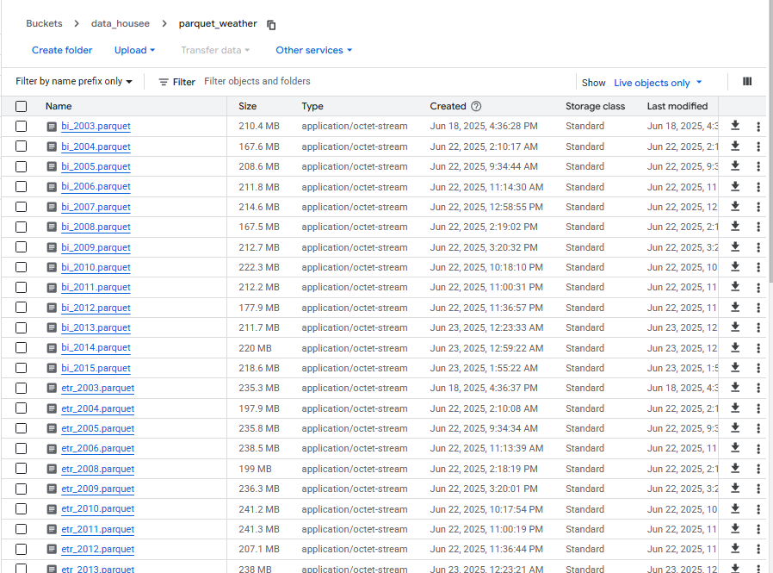
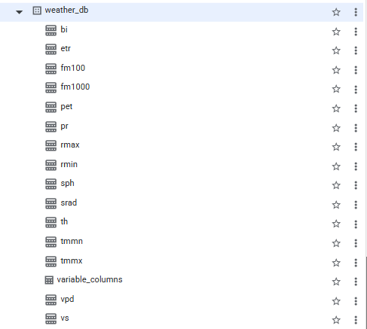
Delivered & Future Foundation
Performed comprehensive EDA on seasonal weather patterns
Converted 150+ weather files to Parquet format for long-term usability
Mapped out GCP environment usage to support future teams
Combined datasets with 15 weather-at-capture variables and 20+ derived ML features
Created a documented, iterative data engineering process with 1M rows recovered, 1M+ fires identified, and full versioning
Validated data engineering choices using SQL and Python to refine logic and guide preprocessing
Built a feature selection pipeline enabling automatic routing of subsets to Vertex AI
Designed a modular ML pipeline with group-aware splitting, aggregated features, and reproducible preprocessing
Completed preliminary modeling to identify strong baselines, evaluate feature impact, and capture key lessons.
150+ Singular Files → Structured Database

Slide 11
Lessons Learned
Understand your data early – Being familiar with your data, attributes, and relationships is half the battle
Map before you build – Define architecture, intent, workload, and flow before starting
Know your stack – Cloud platform knowledge is key for efficiency and scalability
Optimize SQL queries – Poorly written queries slow down both pipelines and teams
Leverage domain expertise – Domain knowledge leads to better assumptions and features
Feature selection is messy – Importance scores are often exploratory, not definitive
Document as you go – Proactive documentation saves time and avoids confusion
Pause and reflect – Critical thinking upfront helps prevent costly rework
Even “bad” results are valuable – Negative or unclear findings still guide better decisions

Slide 12
🔥 Thanks for Listening! 🔥
We are excited to see how this foundation can support future wildfire research and operational tools.

