Slide 1
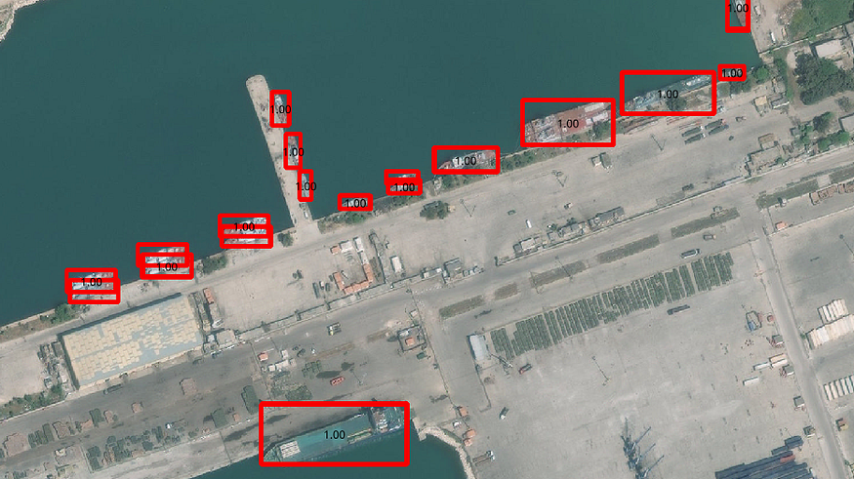
Maritime Vessel Detection
DS 6050 - Group 10

Slide 2
Group 10
Kevin Guan
Quality Engineer
M.S Data Science (In-Progress)
B.S. Biological Engineering
Bardia Nikpour
DevOps Engineer
M.S Data Science (In-Progress)
B.S Computer Engineering
Zachary Holland
Data Scientist/DevOps Engineer
M.S Data Science (In-Progress)
B.S Computer Science
B.S Applied Mathematics

Slide 3
Problem Statement
This project aims to compare and evaluate several popular deep learning approaches for maritime vessel detection in satellite imagery. We want to:
Compare the performance of three widely-used object detection models on the ShipRSImageNet dataset
Examine how different backbone architectures affect detection results when used with certain models
Analyze the trade-offs between detection accuracy, localization precision, and computational requirements for these different configurations

Slide 4
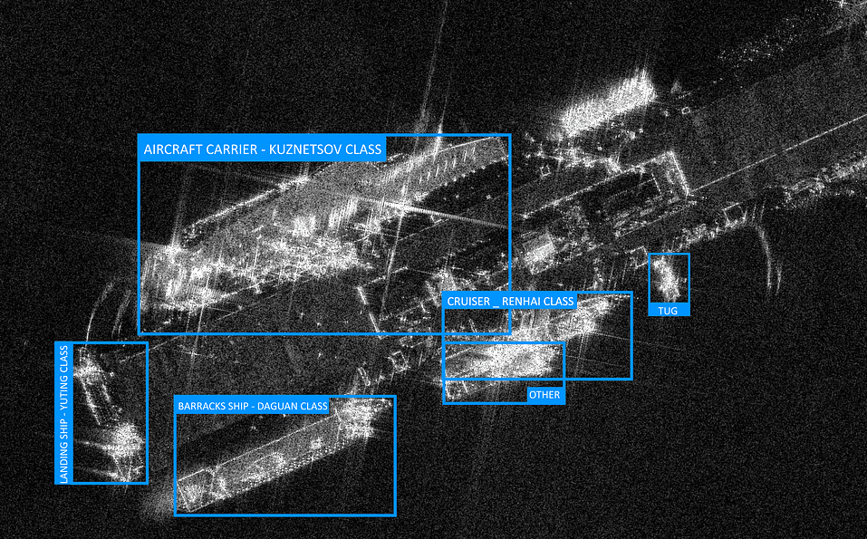
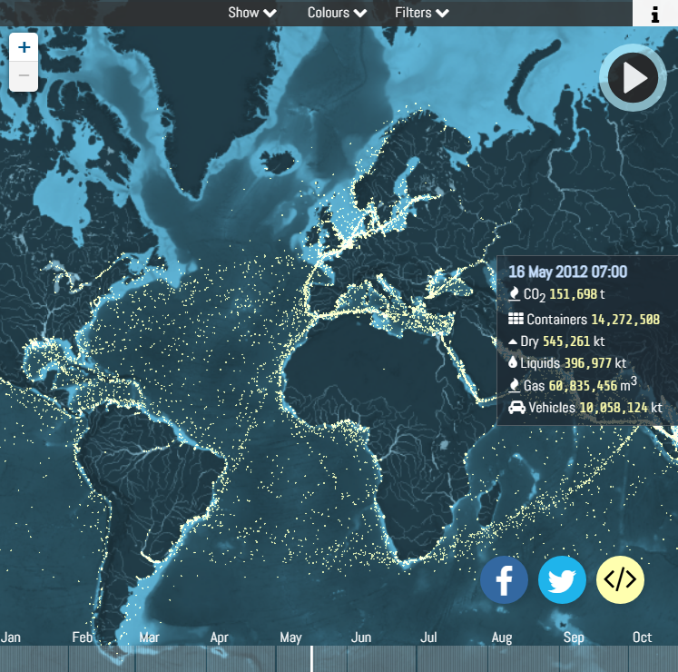
Motivation & Challenges
Military Applications:
Threat Analysis: Help prevent/detect smuggling, piracy, terrorist activities, military posture
Rapid Response: Faster detection supports data driven decision-making
Commercial Applications:
Optimized Shipping Routes: Improves traffic flow and scheduling
Illegal Fishing Detection: Flags violations for authorities
Challenges
High Background Noise: Water, waves, and clutter cause false positives or hide small vessels
Environmental Conditions: Weather and lighting changes obscure vessels and affect image quality
Scalability : Vast areas and diverse ship types demand efficient, adaptable algorithms

Slide 5
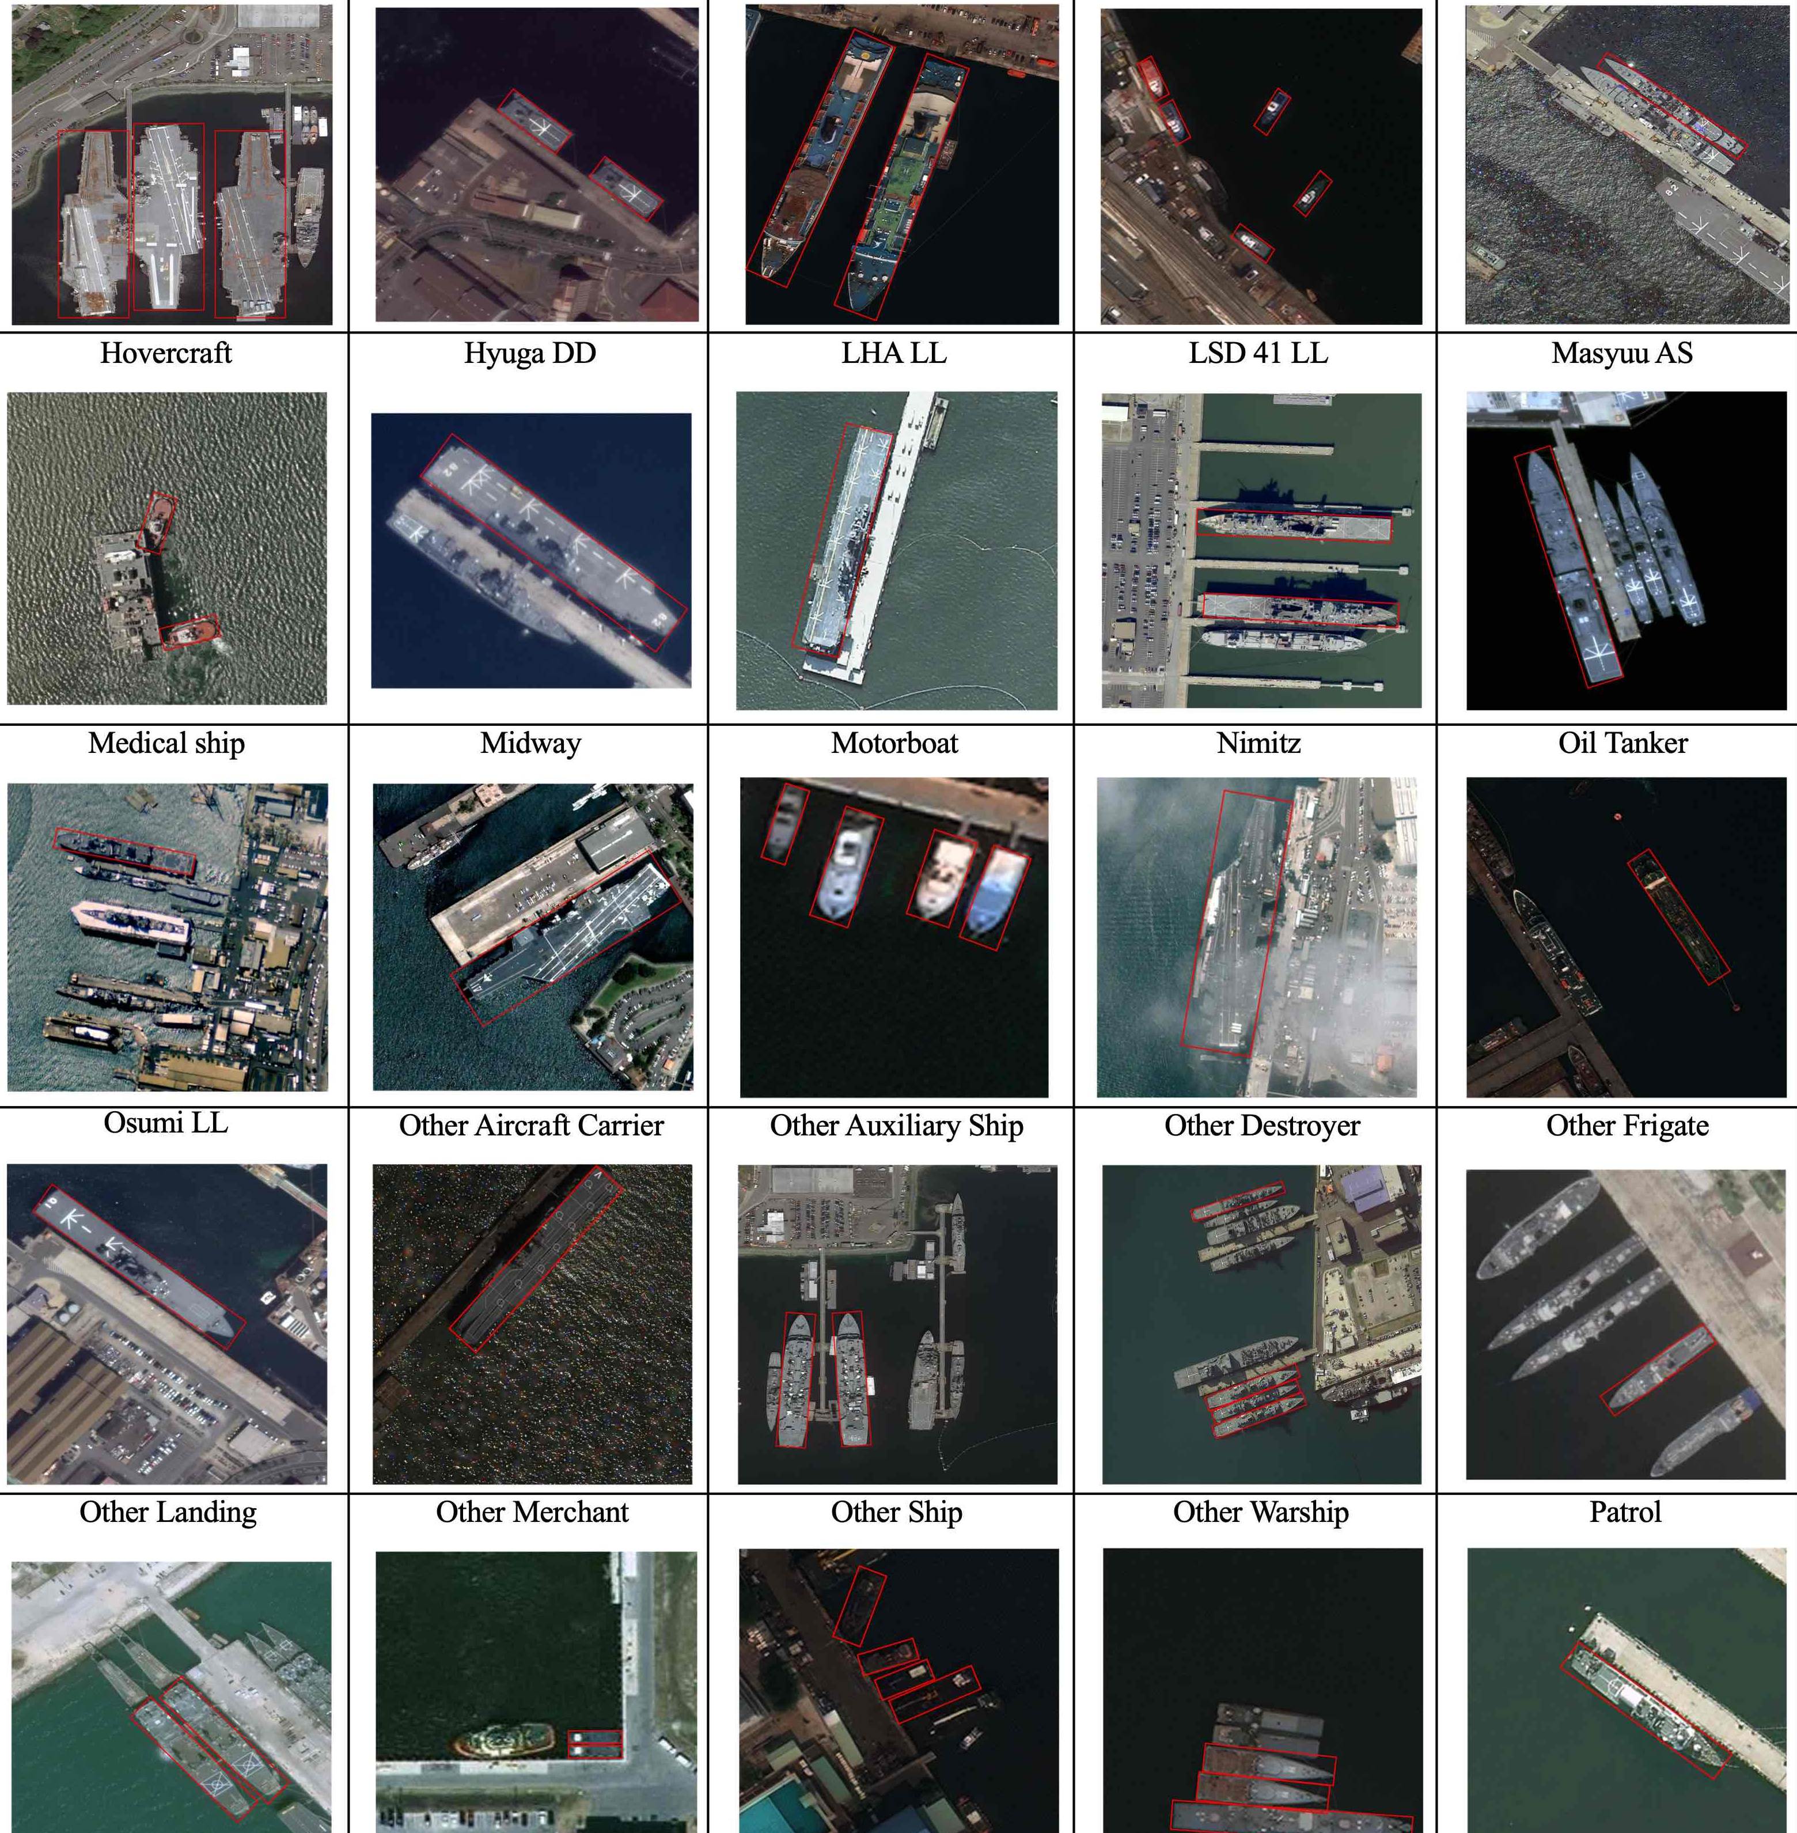
Dataset Overview
Dataset: ShipRSImageNet
~3,435 high-resolution images & 17,573 ship instances
Multi-source data
WorldView-3
xView
HRSC2016
FGSD
Airbus
GaoFen-2 (Chinese Satellite)
JiLin-1 (Chinese Satellite)
50 ship classes (commercial, military) with horizontal, oriented, and polygon bounding boxes
Characteristics:
Images around 930×930 pixels
Highly variable conditions:
Geography
Resolutions
Weather

Slide 6
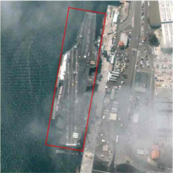
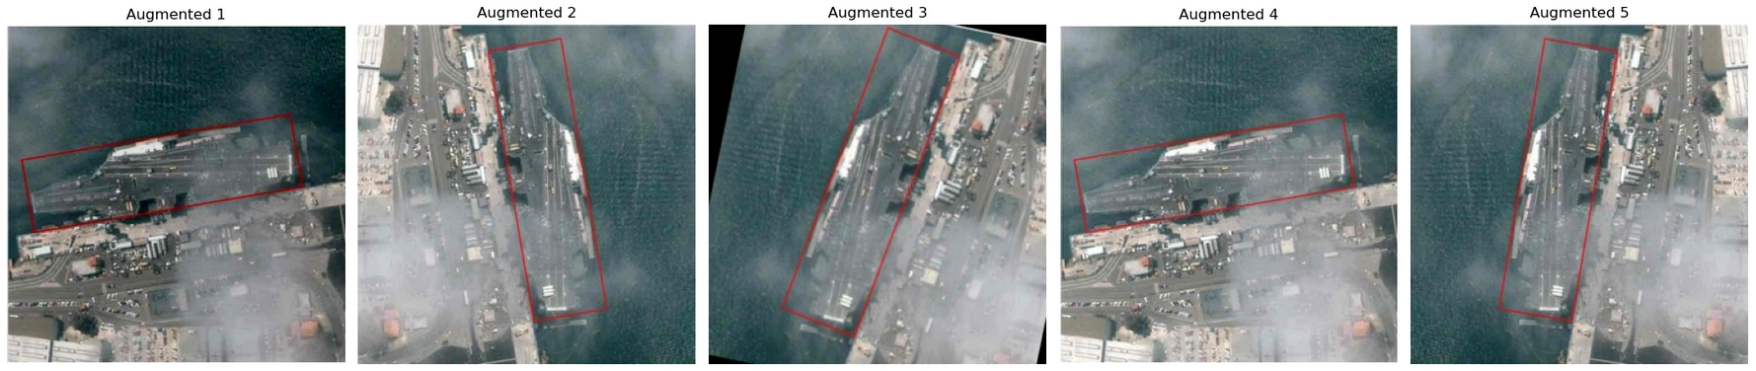
Augmentation & Preprocessing
Annotation Verification
Inspect and correct bounding boxes or misalignment or label inaccuracies
Image Resizing & Normalization
Standardize image dimensions and normalize pixel values for consistent model input
Data Splitting
Divide data into train, validation, and test sets with no scene overlap, ensuring vessel type balance
Augmentation Techniques
Geometric Transforms: Random flips (horizontal/vertical), rotations, cropping
Color & Lighting Adjustments: Brightness/contrast jitter, hue shifts
Synthetic Overlays: Partial cloud cover, wave clutter, fog effects to mimic real-world conditions

Slide 7
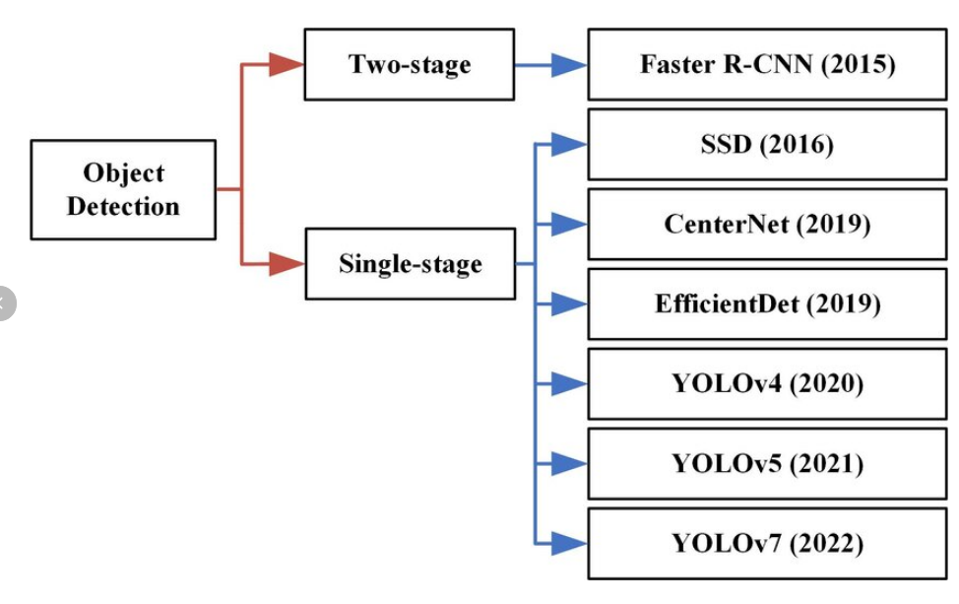
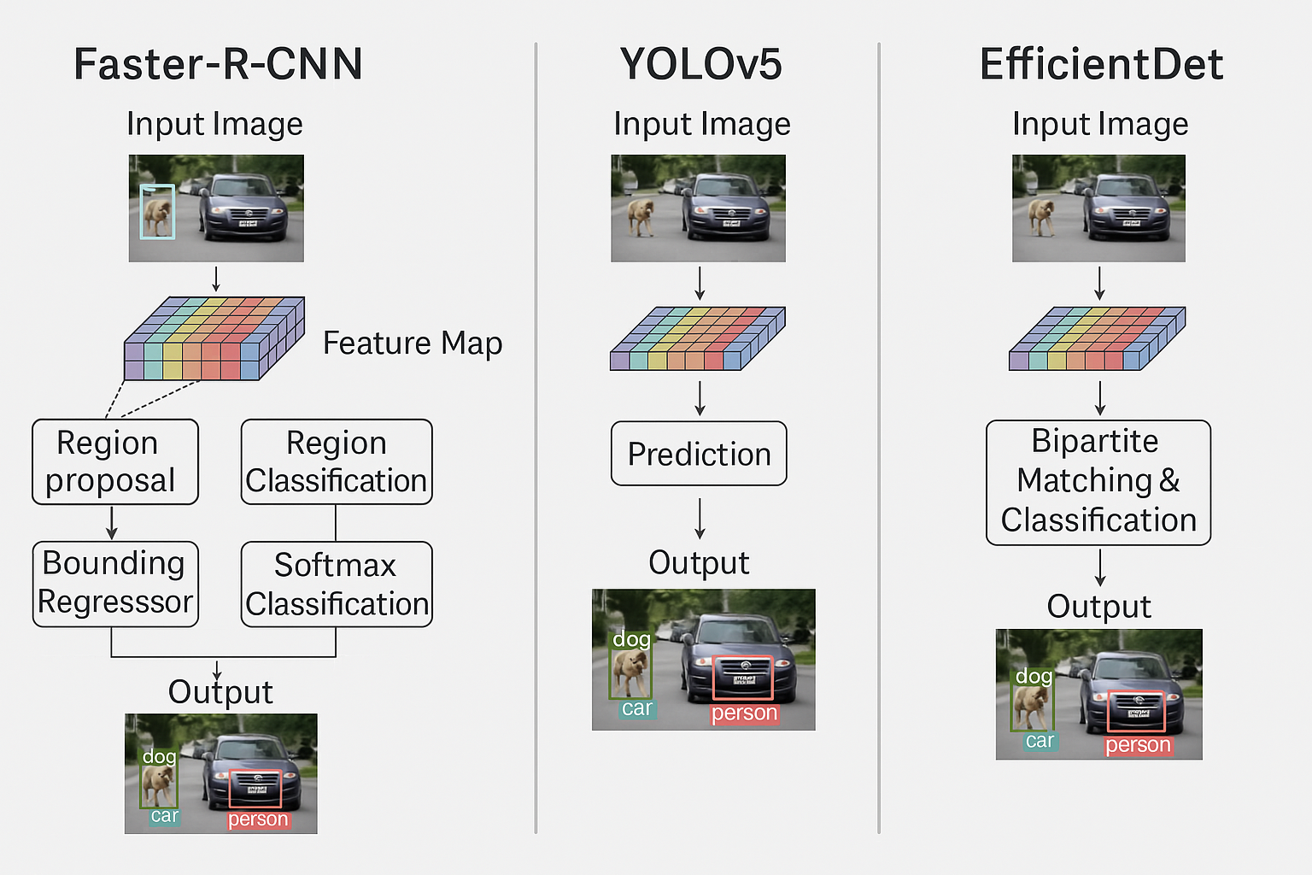
Proposed Methodology
Model Comparison:
Faster R-CNN: Two-stage detector with a Region Proposal Network (RPN) for high accuracy
YOLOv8: Single-stage, end-to-end detection known for real-time or near real-time performance
EfficientDet: Employs compound scaling for balanced accuracy/efficiency
Uniform Training Settings: Standard preprocessing, data augmentation, same splits for fairness
In-depth R-CNN Backbone Analysis (Faster R-CNN focus):
ResNet-50: Strong general-purpose backbone with pre-integrated FPN; only the classifier head is modified
MobileNetV3: Lightweight and edge-optimized; a solid speed-accuracy trade-off with minimal tuning
EfficientNet-B0: Custom setup with selected layers and FPN, balancing efficiency and accuracy
SqueezeNet: Ultra-compact, using fire modules and a 4-level FPN for constrained environments
ShuffleNetV2: Highly efficient with dynamic FPN logic, ideal for real-time, low-power inference
ConvNeXt-Tiny: Modern ResNet-style backbone with efficient FPN and strong representation quality
Fine-tuning & Optimization Strategies:
Regularization: L1, L2 to handle overfitting
Dropout: Finetune for robust generalization.
Learning Rate Schedules: Step decay, cosine adjustment to stabilize training
Data Augmentation: Reinforce resilience to environmental variability

Slide 8
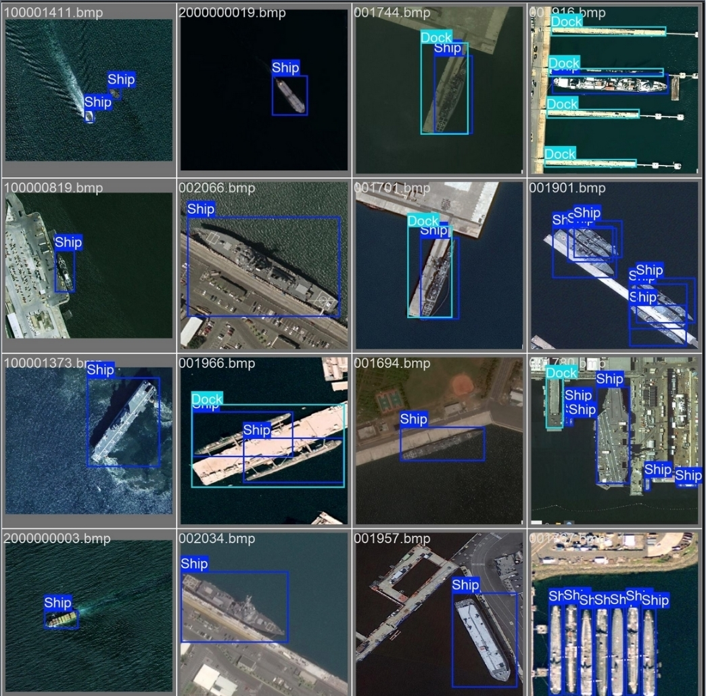
Results: YOLOv8
YOLOv8-M: Best overall performance
• mAP@0.5: 0.8714 • Precision: 0.8331 • FPS: 34.86
Best balance of accuracy and speed
YOLOv8-S: Highest recall (0.8526)
• Slightly lower precision and speed • Good choice when maximizing detection coverage is critical
YOLOv8-L: Solid, but underwhelming
• No accuracy gain over M • Slower inference (27.34 FPS) → less efficient for real-time use

Slide 9
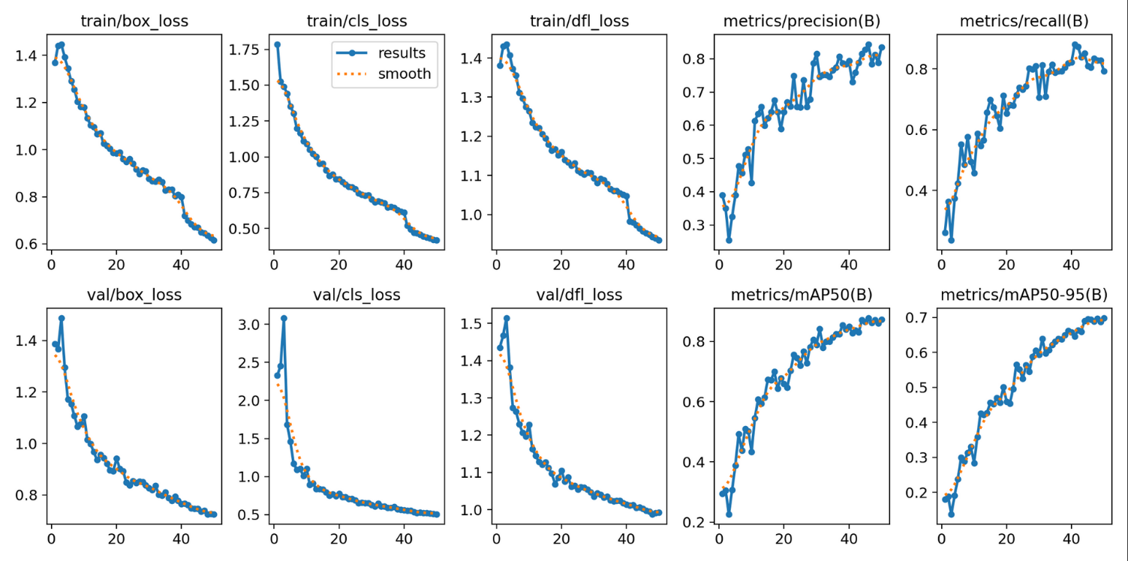
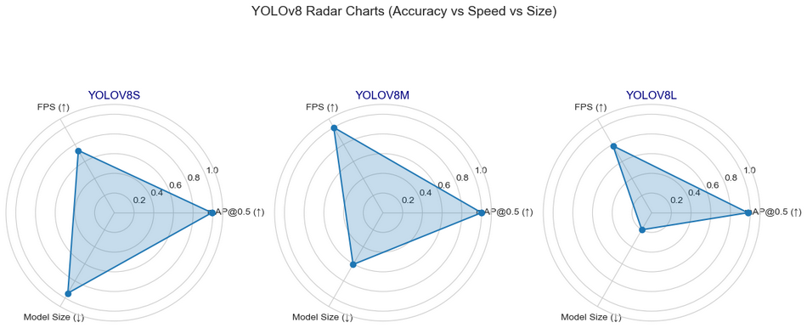
Training Results
Radar chart highlighting performance

Slide 10
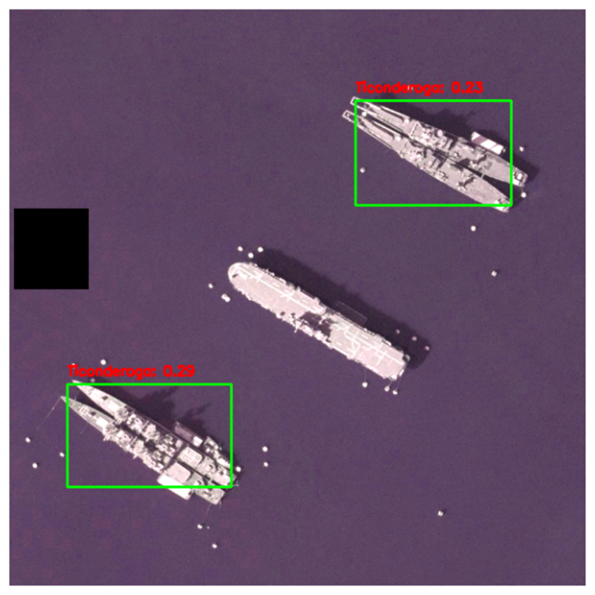
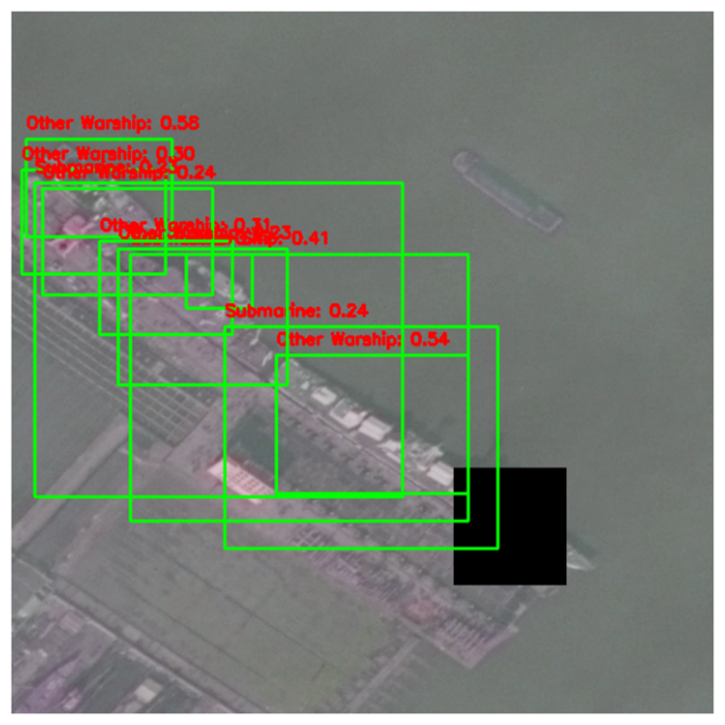
Results: EfficientDet
EfficientDet – Final Metrics
Classification Loss: 0.159
Regression Loss: 0.179
Batch Loss: 0.338
Total Loss: 0.353
Training Duration: 20 epochs
Data Tripling via augmentation
Improved performance vs. 10-epoch baseline (Total Loss: 0.681 → 0.353)
Only model set up to classify the type of vessel, not just location

Slide 11
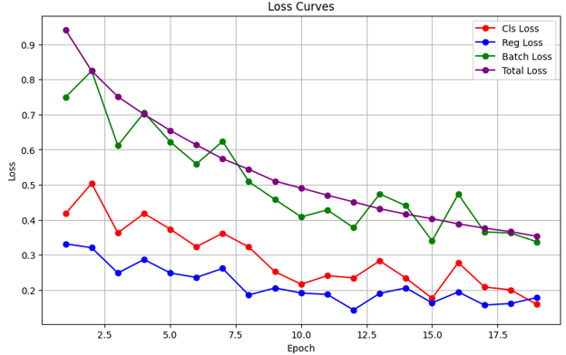
EfficientDet

Slide 12
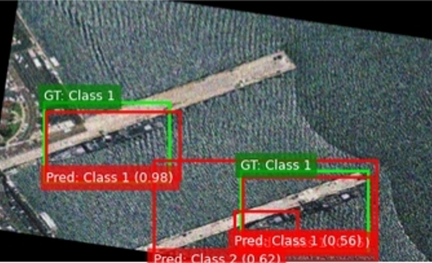
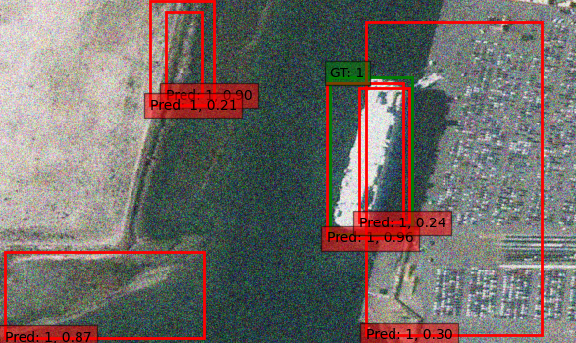
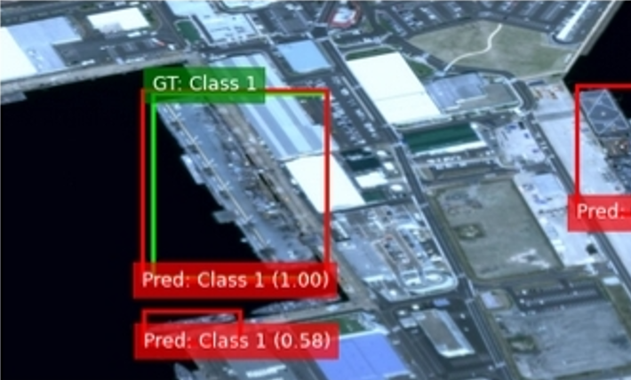
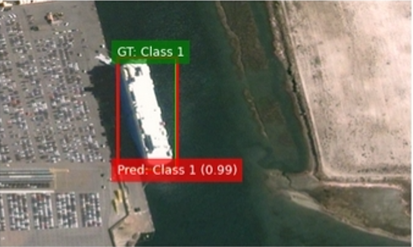
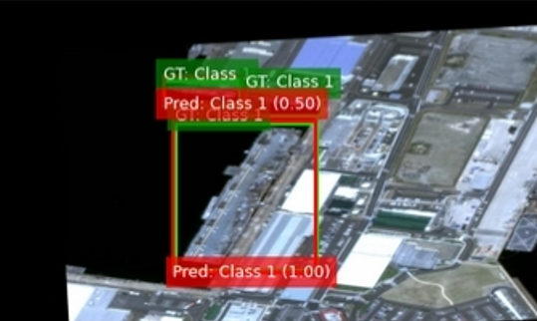
Results: Faster R-CNN
ResNet-50 (mAP: 0.4738)
→ Best overall detection accuracy, but was slow and resource-heavy
MobileNet-V3 (mAP: 0.3662) → Best speed-accuracy trade-off, suitable for real-time applications with limited compute
EfficientNet-B0 (mAP: 0.2123) → Moderate recall but poor precision; a middle-ground option with limited utility
ShuffleNet-V2 (mAP: 0.0448) → Fast but extremely low accuracy — not suitable for high-resolution vessel detection.
SqueezeNet (mAP: 0.1714) → Small and deployable, but too weak for meaningful results.
ConvNeXt-Tiny (mAP: 0.1009)
→ Slowest and underperformed on all fronts — not viable for continued use.

Slide 13
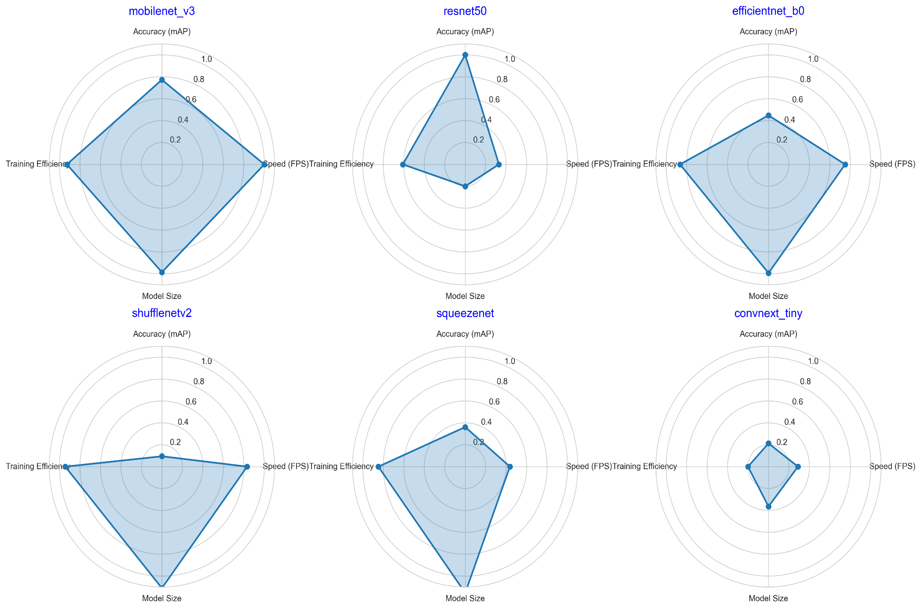
Faster R-CNN

Slide 14
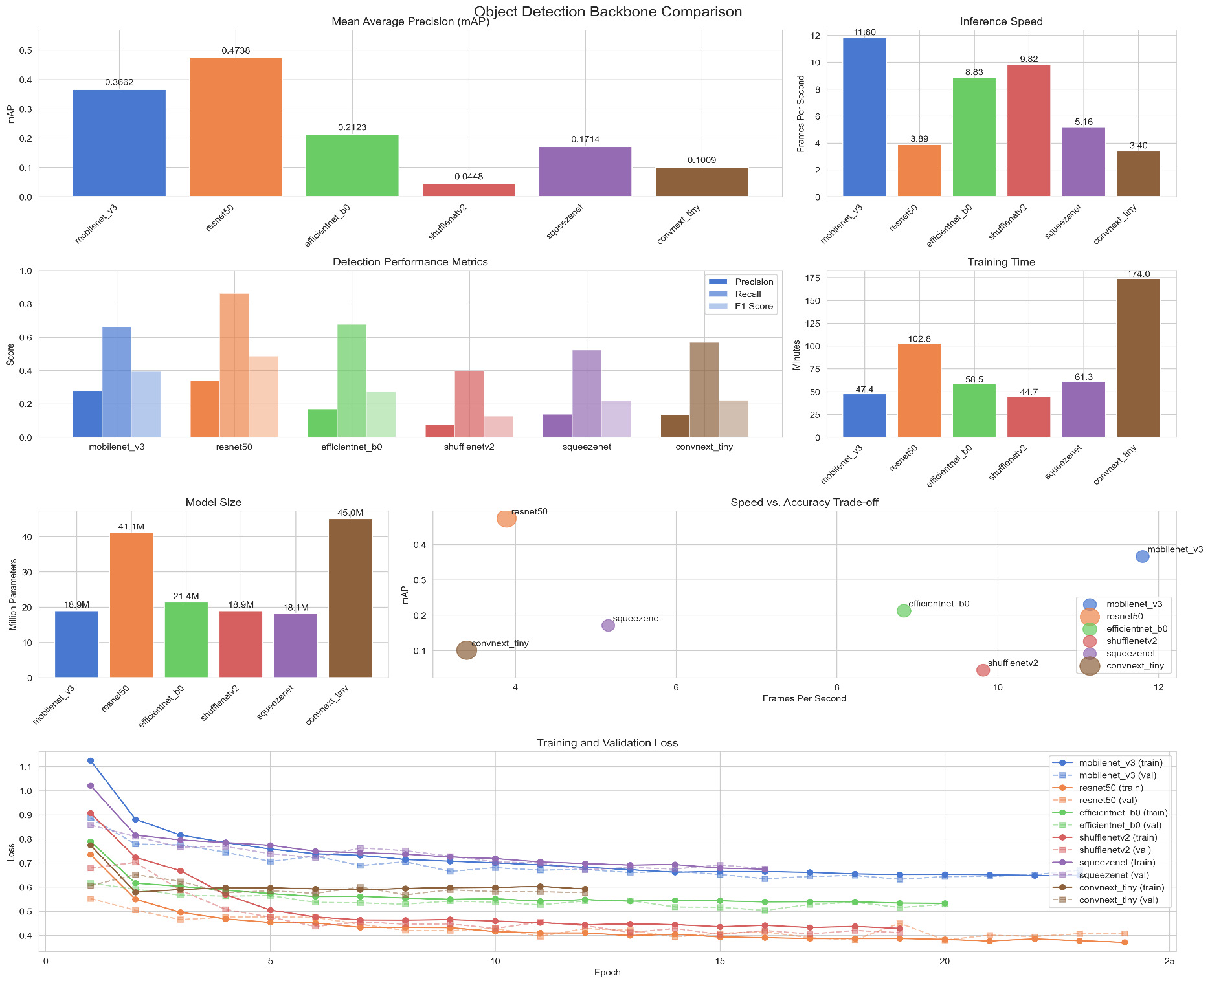

Slide 15
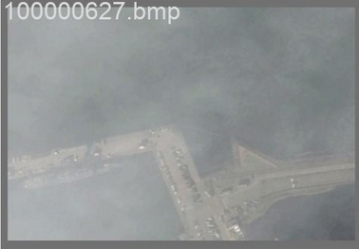
Cloud Coverage In this image, dense cloud cover makes it difficult to detect the ship, highlighting how environmental conditions can obscure targets and reduce model reliability.
Interesting Finds
The Sandbar Problem
We have a very complex scene here. The model correctly identified the target but misclassified a sandbar as a vessel with 87% confidence, revealing the difficulty of distinguishing similar-looking structures.

Slide 16
Conclusion
Research Questions:
Best backbone for Faster R-CNN for accurate vessel localization?
→ Faster R-CNN + ResNet-50, though slow, had the highest localization precision
2. Impact of backbone networks?
→ Backbones significantly affected both speed and accuracy. ResNet-50 maximized precision, MobileNetV3 offered strong balance, and ShuffleNetV2/SqueezeNet were too weak for complex scenes
3. Best model trade-off?
→ YOLOv8-M was absolutely the most balanced model, combining high accuracy (mAP@0.5 of 0.8714) with great inference, making it ideal for practical deployment for this use case

Slide 17
Thanks for listening!

