Slide 1
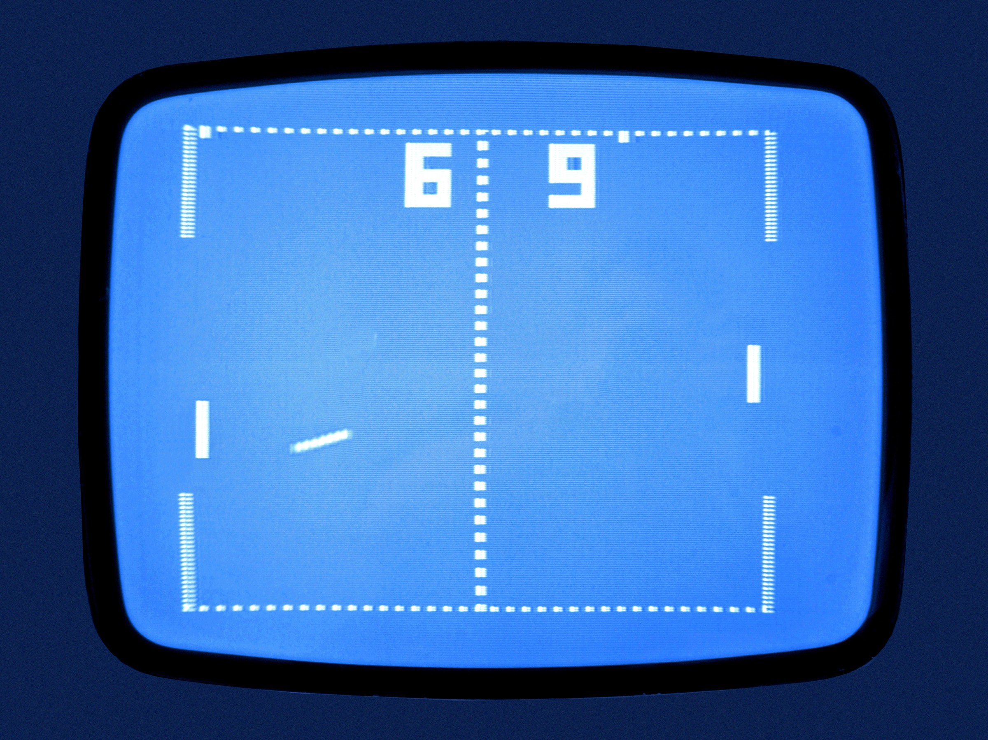
Pong
PONG

Slide 2
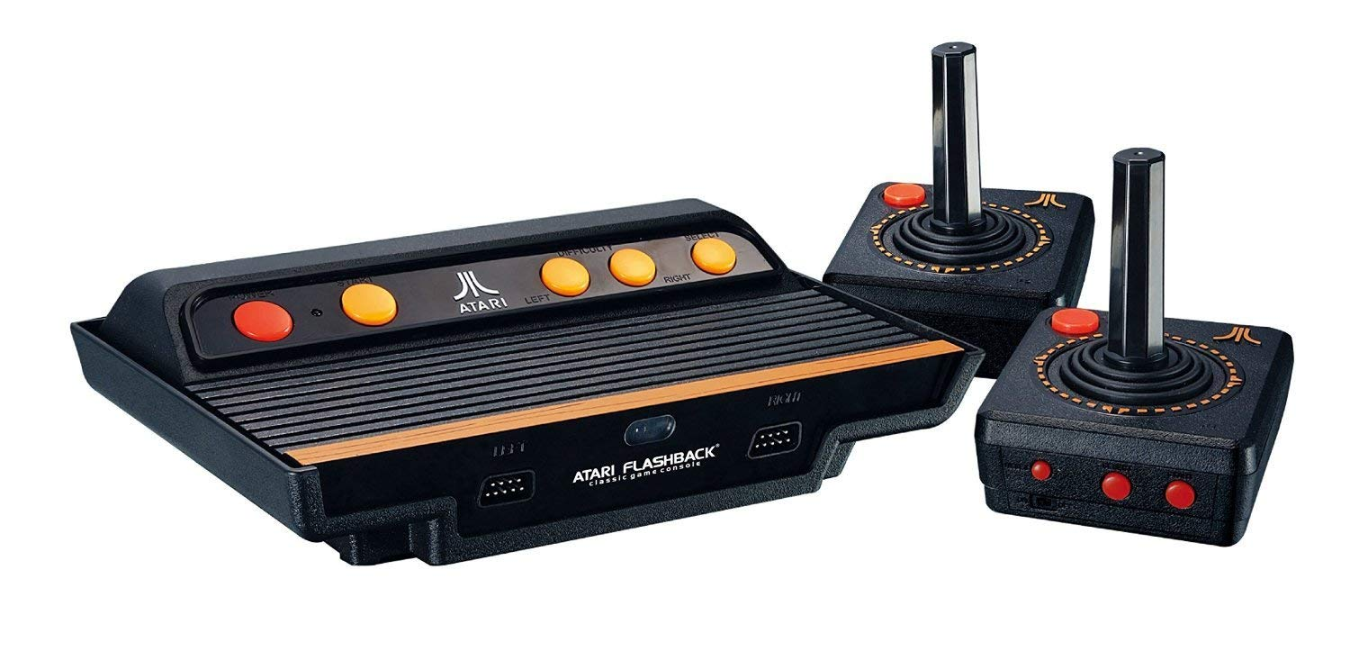
Pong is one of the earliest arcade video games. It is a table tennis sports game featuring simple two-dimensional graphics. The game was originally manufactured by Atari, which released it in 1972.
First game developed by Atari

Slide 3
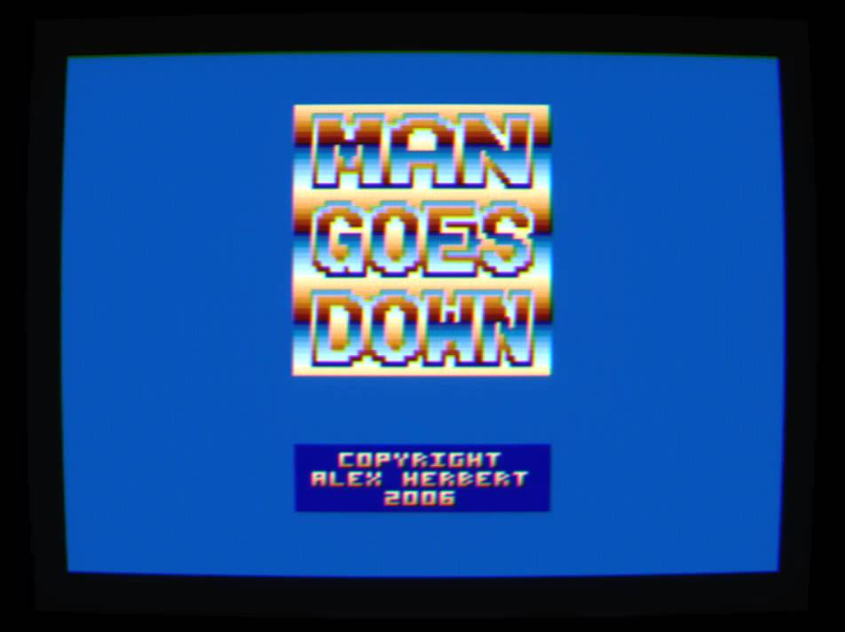
Pong is a two dimensional sports game that simulates table
tennis. The player controls an in-game paddle by moving it vertically across the left or right side of the screen. They can compete against another player controlling a second paddle on the opposing side.

Slide 4
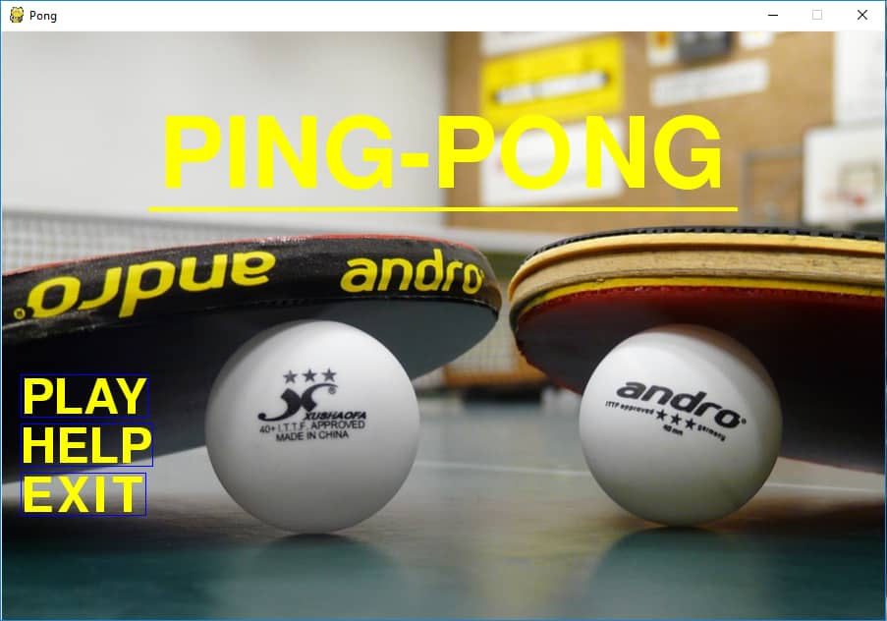

Slide 5
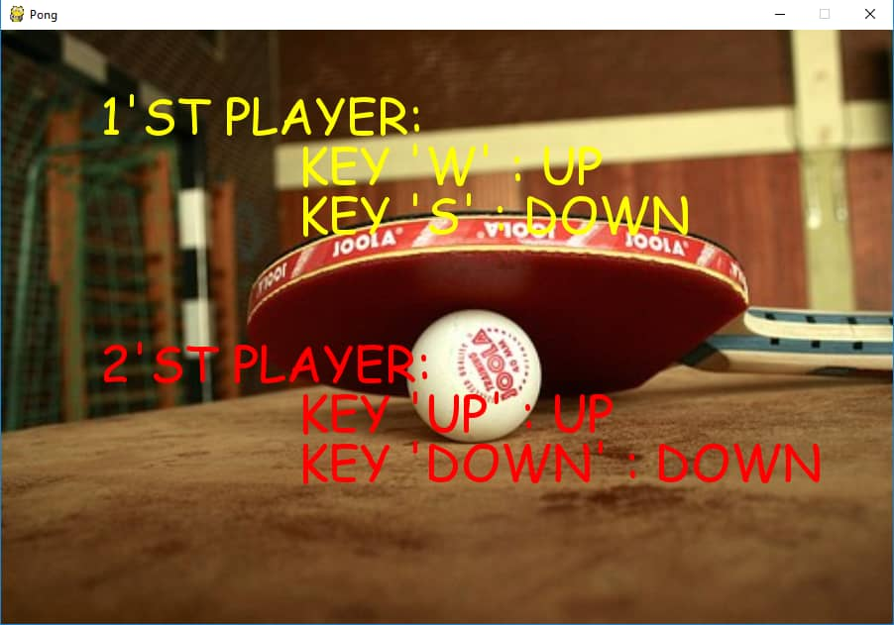

Slide 6
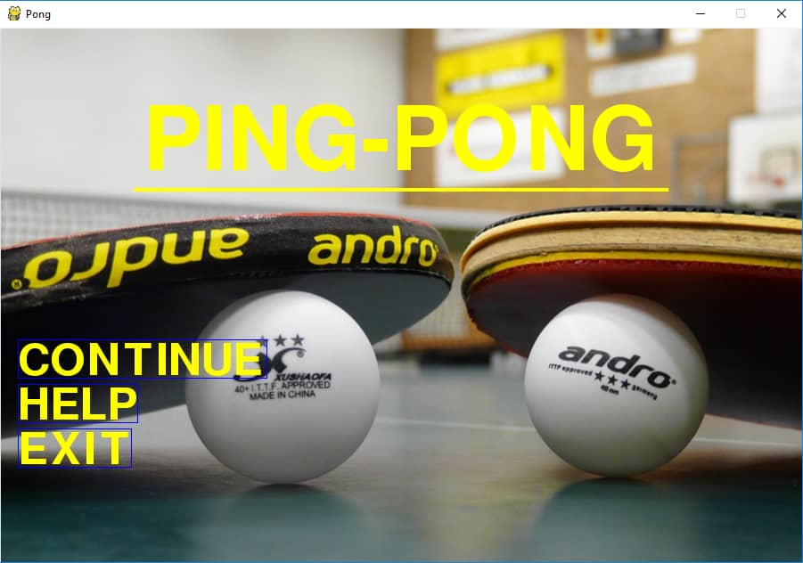

Slide 7


