Slide 1
Deep Learning Final Project
108753206李鈺祥、109753106王中伶

Slide 2
CONTENTS
01
02
03
Introduction
Method
Result

Slide 3
01
Introduction

Slide 4
People or Machine
Daily Meditation Tranquility
Daily Meditation: Light Up Your Life
Daily Meditations, Prayers and Mindfulness Exercises
Daily Meditation: The Temple
Written by Human

Slide 5
02
Method

Slide 6
Dataset of Generation
Training Data
Testing Data
HuffPost News
5000筆155字以內之新聞內文
5000筆上述內文之對應標題
5000筆155字以內之新聞內文

Slide 7
Framework of Generation
10000筆Huffpost新聞
5000筆訓練資料
T5-Michau
T5-finetune
Transformer
5000筆測試資料
Predict
Predict
Predict

Slide 8
Dataset of Classification
Training Data
Testing Data
4000 筆人所寫之標題
4000 筆機器產生之標題
1000 筆人所寫之標題
1000 筆機器產生之標題

Slide 9
Framework of Classification
5000筆人寫標題
5000筆機器產生標題
4000筆標題
1000筆標題
4000筆標題
1000筆標題
Training Data
Testing Data
Bert Classification
Result

Slide 10
T5
T5是Google於2019年釋出的預訓練模型，比2017年釋出的BERT
https://arxiv.org/abs/1910.10683
擁有更多單詞量與參數量
更彈性的自然語言形式的輸入輸出框架
對於生成類的任務相當強悍
依據任務前綴詞，可使用同個模型，支援不同任務
對於各種自然語言處理的相關任務，幾乎都可以勝任

Slide 11
T5-Michau
Michau/t5-base-en-generate-headline
https://huggingface.co/Michau/t5-base-en-generate-headline

Slide 12
T5-Fine-tune
SQuAD（Stanford Question Answering Dataset）任務
Exact Match常為評估方式之一
評估5個Epoch的Exact Match

Slide 13
Exact Match on Different Epochs

Slide 14
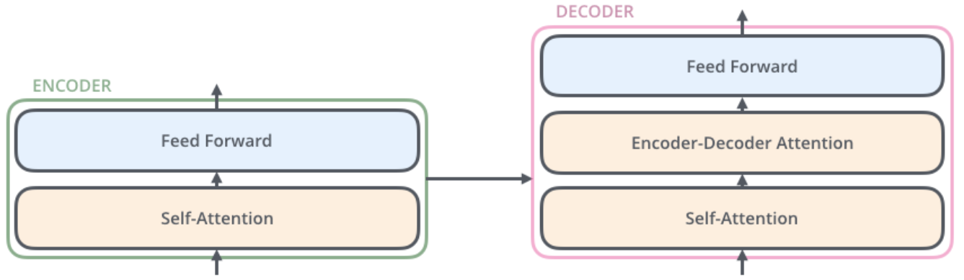
Transformer Summarizer
資料格式：Tuple→Iterator
Seq2Seq + Attention
Epoch: 5
圖片來源：http://jalammar.github.io/illustrated-transformer/

Slide 15
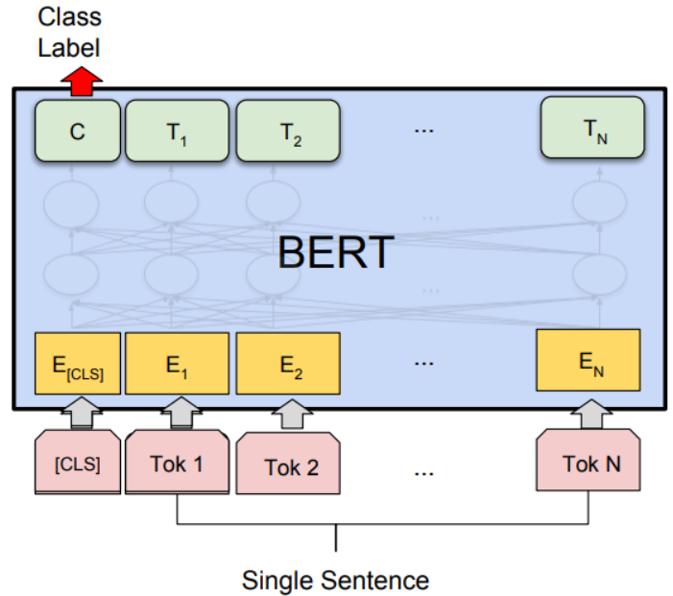
Bert Classification
Pre-trained: bert-large-uncased
0為人寫標題；1為機器產生標題
圖片來源：https://www.geeksforgeeks.org/sentiment-classification-using-bert/

Slide 16
03
Result

Slide 17
On race relations, President Obama is feeling optimistic. At least, that’s how he comes across in an interview with NPR’s Steve Inskeep, who asks if “the United States is more racially divided than it was” when he took office. “No,” Obama says, “I actually think that it’s probably in its day-to-day interactions less racially divided.”

Slide 18
Generation
Trump White House Leadership
Transformer
Obama Says The United States Is 'Probably Less Racially Divided'
T5-fine-tune
President Obama: Is America More Racially Divided Than It Was When He Takes Office?
T5-Michau
Why I Am Optimistic About The Future Of Race Relations In America
Written by Human

Slide 19
Classification
T5-Michau
T5-Fine-tune
Transformer
F1-score
85.67%
63.99%
87.99%

Slide 20
Classification
T5-Michau
T5-Fine-tune
Transformer
False Negative
10.40%
35.50%
13.20%

Slide 21
Reference
Headliner.
https://as-ideas.github.io/headliner/
T5-Michau. https://huggingface.co/Michau/t5-base-en-generate-headline

Slide 22
Thanks for listening

