Slide 1
醫病訊息決策與對話語料分析
109753205 賴建郡、109753203蕭郁君、109753106王中伶

Slide 2
CONTENTS
01
02
03
系統架構
系統解說
結果分析

Slide 3
01
系統架構

Slide 4
系統架構
Training data
Rule-based
Simple
Transformer NER
Bert MRC
Bagging

Slide 5
Rule-based
Simple
Transformer NER
Bert MRC
系統架構
明確特徵
各類別分開訓練
全部類別訓練
文意理解模型

Slide 6
02
系統解說

Slide 7
family
profession
id
contact
money
Rule-based
time
bagging
Rule-based
stop words
result

Slide 8
location
name
money
family
time
education
profession
Simple Transformer
NER
轉簡體中文
bagging
Simple
Transformer NER
stop words
轉繁體中文
result

Slide 9
name
Simple Transformer
NER
bagging
Simple
Transformer NER
stop words
result

Slide 10
all entities
Simple Transformer
NER
轉簡體中文
bagging
Simple
Transformer NER
stop words
轉繁體中文
result

Slide 11
Bert MRC
all entities
Bert-MRC
bagging
stop words
result

Slide 12
Bagging
依照表現高到低之次序合併
清除相同或重疊特徵
base file
added file
article_id
article_id
start_position
start_position
end_position
end_position
entity_text
entity_text
entity_type
entity_type

Slide 13
Bagging
依照表現高到低之次序合併
清除相同或重疊特徵
base file
added file
0
article_id
article_id
0
2
start_position
start_position
2
6
end_position
end_position
4
entity_text
entity_text
entity_type
entity_type

Slide 14
Bagging
依照表現高到低之次序合併
清除相同或重疊特徵
base file
added file
0
article_id
article_id
0
2
start_position
start_position
2
4
end_position
end_position
6
entity_text
entity_text
entity_type
entity_type

Slide 15
Stop words
將不合理於某類別之字串清除

Slide 16
03
結果分析

Slide 17
Public Leaderboard
82.30%
76.60%
71.63%
Recall
F1-score
Precision

Slide 18
Private Leaderboard
78.11%
F1-score

Slide 19
嘗試方法
crf
Bi-lstm+crf
Simple Transformer NER
bert-MRC
LMR
特徵
將訓練資料
轉為簡體中文
攤平刪除相同特徵
排序過濾重疊特徵
簡體中文
Bagging方式
模型

Slide 20
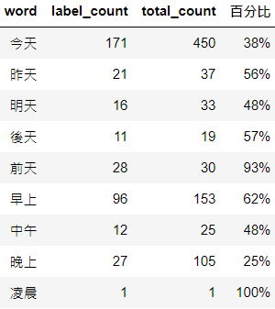
詞頻分析

Slide 21
Thanks for Listening

