Slide 1
Football Manager Price & Recommender
Roy Zhang

Slide 2
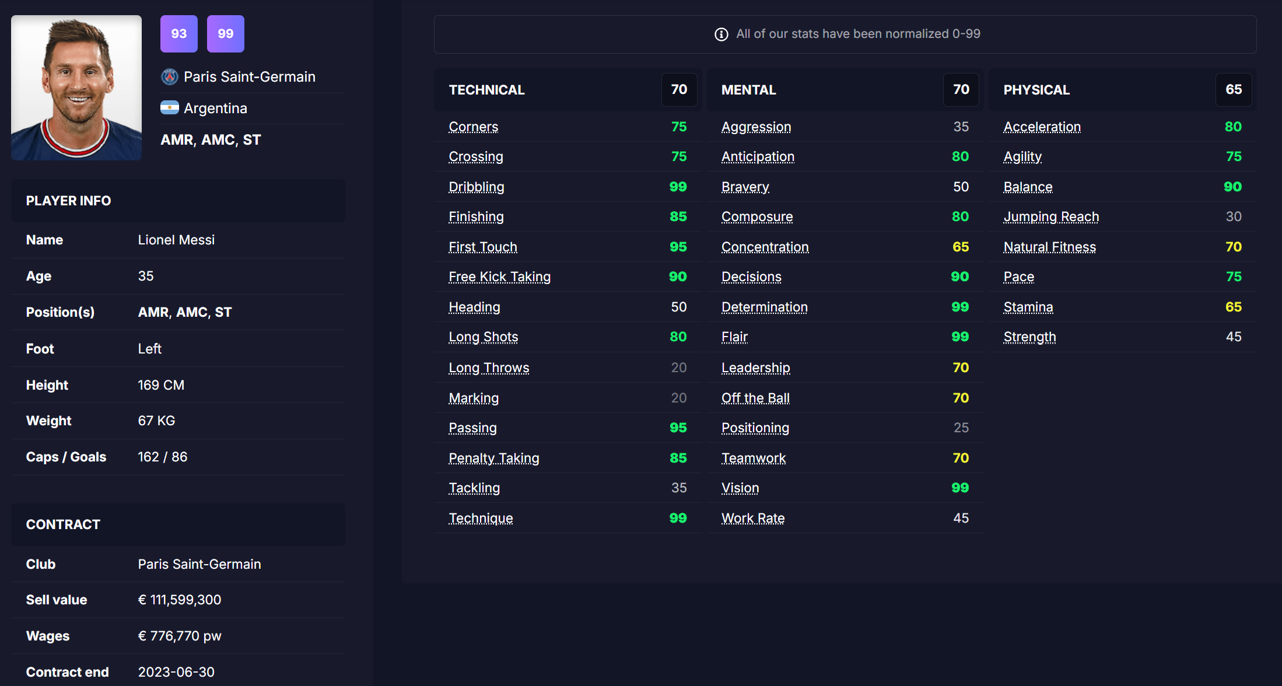
Data - FMInside
~20k players
In-game attributes
Contract & Miscellaneous

Slide 3
Methodology
Pricer
Recommender
Random Forest
Attributes + Age + Contract Status ~ Sale Price
Find players with user-selected filter
Provide the best, youngest, and cheapest player available for purchase

Slide 4
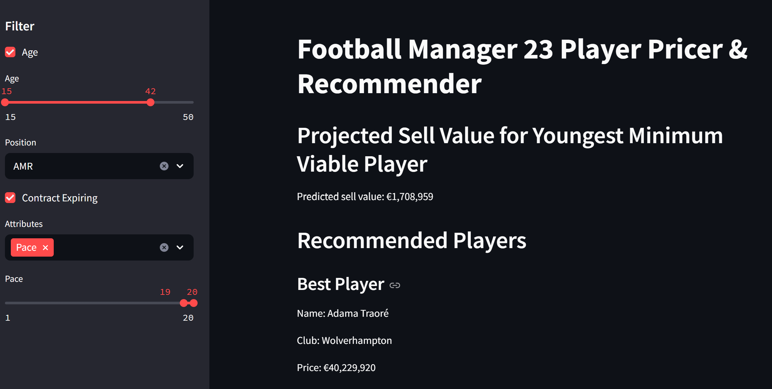
Streamlit App

Slide 5
Next Steps
Optimize pricer model
Add customized filter
Include goalkeepers

