Slide 1
Football Manager Player Pricer & Recommender
Roy Zhang

Slide 2
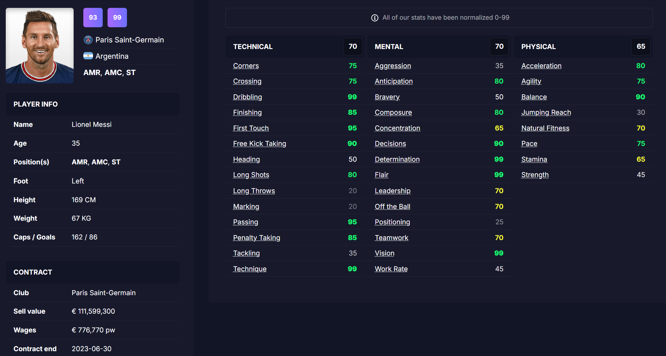
Obtaining Data - FMInside
ability & potential
attributes
variable of interest

Slide 3
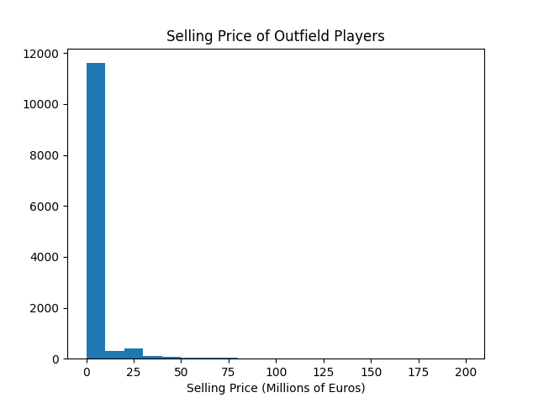
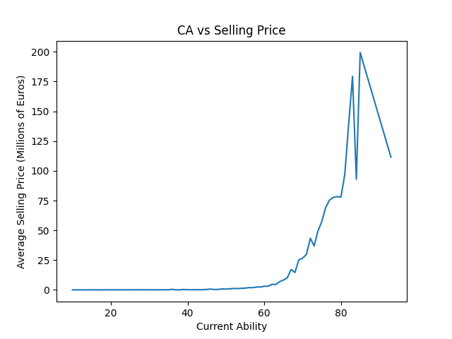
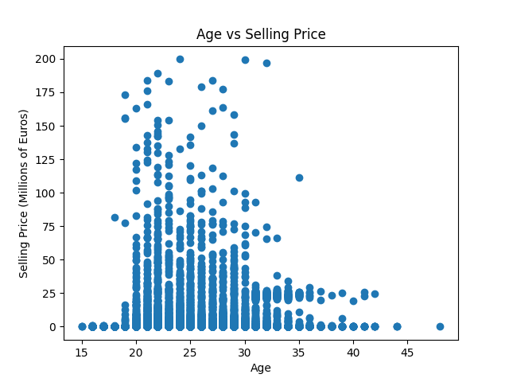
EDA
Skewness is key problem
Noticeable trend between
selling price and ability

Slide 4
Next Steps
Complete data collection (~60% done)
Create a regression model on sell value
Features:
User can add attribute filters to obtain an expected minimum selling value.
Recommend cheapest and best players based on the filters.
Optional: add goalkeepers

