Slide 1
Project

Slide 2
Project Assignment
Complete a small text searching engine using hash tables.
Basic requirements:
Excerpt an essay (1KB<=essay size<=1MB) from anywhere and save it as “text.txt”.
Write a program for the text searching.
The program receives several queries. Each query contains a keyword.
You program should output all the sentences containing this keyword. (A sentence is ended up with a period “.”)
Test different queries (at least 10 queries) by yourselves.
Try to use different hashing functions and/or collision resolving methods.
Extend your work as you like.
Discuss the advantage and deficiency of your work.
Submit your assignment (inputs/outputs, codes and report >10p.) in .zip or .rar.
Deadline: Nov. 28, 2021.

Slide 3
Project Assignment
完成一个小的文本搜索引擎使用哈希表。
基本要求:
从任何地方摘录一篇文章(1KB<=文章大小<=1MB)并将其保存为“text.txt”。
编写一个文本搜索程序。
程序接收几个查询。每个查询都包含一个关键字。
你的程序应该输出所有包含这个关键字的句子。(句子以句号结束。)
自己测试不同的查询(至少10个查询)。
尝试使用不同的哈希函数和/或冲突解决方法
如果你喜欢，可以扩展你的工作。
讨论你工作的优点和缺点。
以。zip或。rar格式提交作业(输入/输出，代码和报告>10p.)。
截止日期:2021年11月28日。

Slide 4
Project Assignment
Example
“text.txt”:In the beginning God created the heaven and the earth. And the earth was without form, and void; and darkness was upon the face of the deep. And the Spirit of God moved upon the face of the waters. And God said, Let there be light: and there was light.
Query 1: God
Output1:
In the beginning God created the heaven and the earth.
And the Spirit of God moved upon the face of the waters.
And God said, Let there be light: and there was light.
Query 2: earth
Output 2:
And the earth was without form, and void; and darkness was upon the face of the deep.

Slide 5
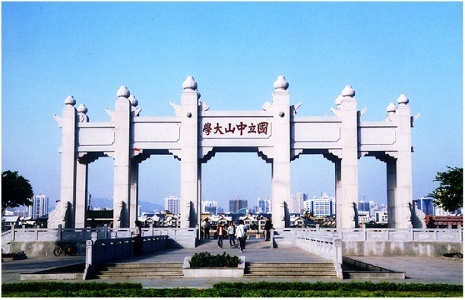
完成一个小的文本搜索引擎使用哈希表。
基本要求:
从任何地方摘录一篇文章(1KB<=文章大小<=1MB)并将其保存为“text.txt”。
编写一个文本搜索程序。
程序接收几个查询。每个查询都包含一个关键字。
你的程序应该输出所有包含这个关键字的句子。(句子以句号结束。)
自己测试不同的查询(至少10个查询)。
尝试使用不同的哈希函数和/或冲突解决方法
Thank you!

