Slide 1

Vim – Vi IMproved
1. Vim
2. Standar directories
3. Plugin manager
4. YouCompleteMe
5. Snippets

Slide 2
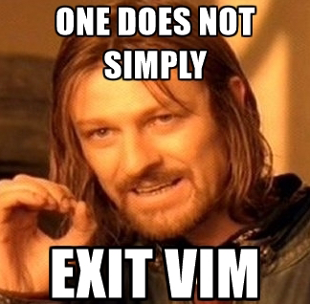
1. Vim
:wq?
yanking?
:%s/foo/bar/gc?
Where are these idiom COME FROM?

Slide 3
1. Vim
1965-1966 use QED at Berkeley Timesharing System
rewrite QED for MIT Compatible Time-Sharing System at Bell Labs
another version of QED for the Multics project
ed, which base on QED, come with Unix
ed is a true line editor. It was written and widely used in the days of the teletype printer. So it’s behaviour is a bit of wired.

Slide 4


Slide 5
1. Vim
In 1975, George Coulouris developed an improved version of ed on the Unix system, which is called em, aka, “editor for mortals”.
Joy starting with Coulouris’ source code, built out an improved version of ed called ex, for “extended ed.” Version 1.1 of ex was bundled with the first release of BSD Unix in 1978.
For the second release of BSD in 1979, an executable named vi was introduced that did little more than open ex in visual mode.

Slide 6
1. Vim
But vi was a direct descendant of ed, which meant that the source code could not be modified without an AT&T source license. This motivated several people to create open-source versions of vi. STEVIE (ST Editor for VI Enthusiasts) appeared in 1987
In 1988, using the existing STEVIE vi clone as a starting point, Moolenaar began work on Vim, which was released for the first time in 1991 as “Vi Imitation.”
Moolenaar keep adding more features and surpassed vi. In 1993, Vim 2.0 released as “Vi Improved”.

Slide 7
2. Standar directories
In /usr/local/share/vim74
plugin, scripts loaded when Vim startup
syntax, contains Vim scripts for syntax highlighting
indent, contains files to automatically compute the indent for a type of file
ftplugin, for scripts that are only used for a specific filetype
colors, used to get different colors
autoload, autoload scripts when needed

Slide 8
2. Standar directories
Try vim-airline

Slide 9
3. Plugin manager
WHY?
add new plugin is easy, but want Delete?
want upgrade?
not easy for a newbie
does not take advantage of VCS

Slide 10
3. Plugin manager
HOW?
:set runtime?
upgrade the runtimepath of Vim

Slide 11
3. Plugin manager
vim-plug vs. Vundle.vim
multi-thread installation
lazyload

Slide 12
4. YouCompleteMe
Why autocompletation is complecated?
Bingo?
Lexical & Syntax analysis
Take advantage of Clang/llvm
Compilation Database

Slide 13
4. YouCompleteMe
Client/server architecture
vim-script is just a client, ycmd is the server running behind each vim instance.
:YcmDebugInfo

Slide 14
5. Snippets
" where to store your private snippet
let g:UltiSnipsSnippetsDir = '~/.vim/mycoolsnips'
" search each 'runtimepath' directory for the subdirectory names in order
let g:UltiSnipsSnippetDirectories = ['mycoolsnips', 'UltiSnips']
See Ultisnips Docs

