Slide 1
C++面向对象程序设计
第四章
继承/派生

Slide 2
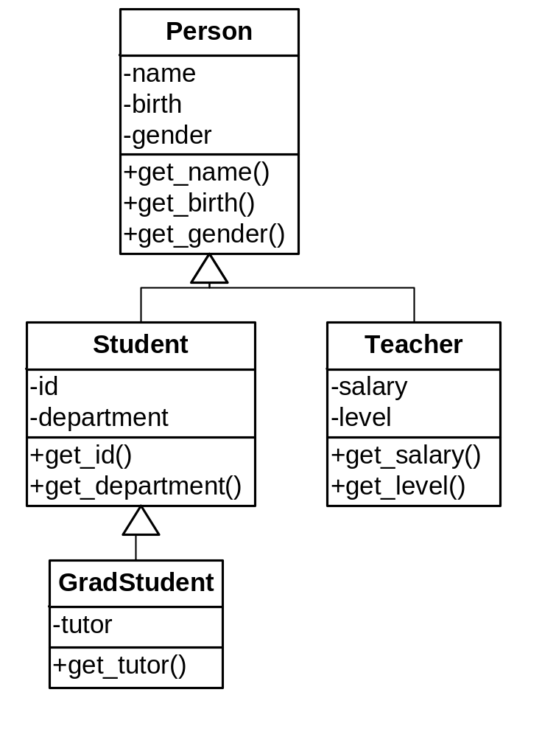
继承/派生
利用已有的类，进行扩充构成新类的机制
基类/父类
派生类/子类
基类和派生类是一种is a的关系

Slide 3
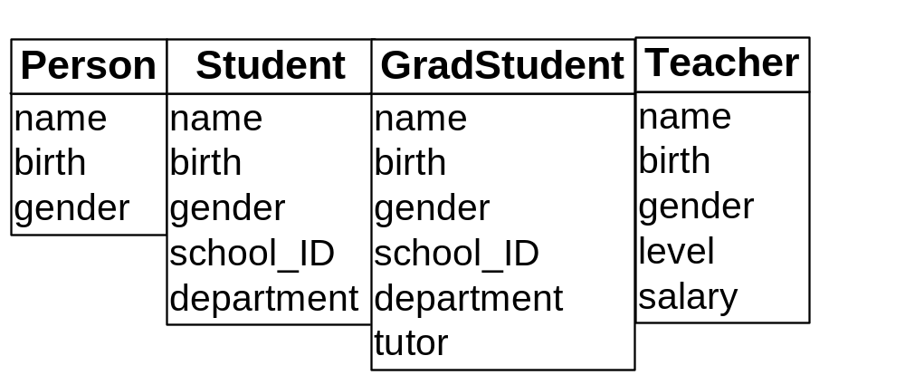
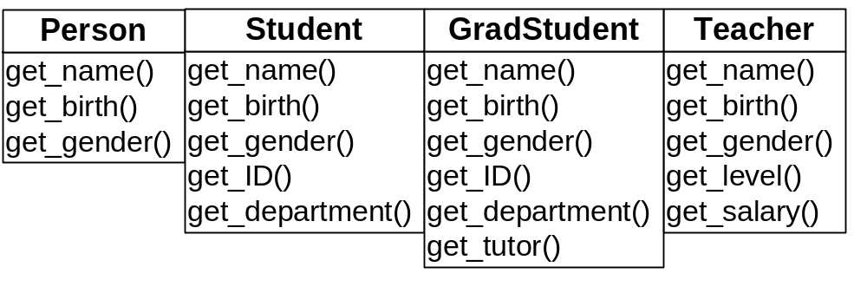
派生类对象的构成

Slide 4
派生类
class Person {
private:
string name;
Date birth;
bool gender;
};
class Teacher : public Person
{
private:
int salary;
int level;
};
class Student : public Person
{
private:
string ID;
int department;
};
class GradStudent : public Student {
private:
Teacher *tutor;
};

Slide 5
成员函数
class Person {
public:
string get_name();
Date get_date();
bool get_gender();
};
class Teacher : public Person {
public:
int get_salary();
int get_level();
};
class Student: public Person {
public:
string get_id();
int get_department();
};
class GradStudent: public Student {
public:
Teacher *get_tutor();
};

Slide 6
派生类的访问权限
private成员：只在本类中可以访问，在派生类中不可访问的成员
protected成员：在本类及派生类中能访问的成员
class Base {
public: int a;
protected: int b;
private: int c;
};
class Derived :public Base {
void f() {
cout << a << b << c;
}
};
void f(Derived &d) {
cout << d.a<< d.b<< d.c;
}

Slide 7
派生类的访问权限
基类的私有成员被派生类继承，但是不能被派生类访问
派生类可以访问继承的保护成员，但是不能一个访问基类对象的保护成员
class Base {protected: int x; };
class Derived : public Base{
void f( ) {
Base b;
cout << b.x;
cout << x;
}
};

Slide 8
改变访问权限
使用using声明改变基类成员权限
class Person {
public:
string get_name();
Date get_date();
bool get_gender();
};
class Student : public Person {
private:
using Person::get_name;
};

Slide 9
名字隐藏
派生类的成员名字如果与基类相同，将隐藏基类成员
class Person {
public:
void set(string name);
void set(bool gender);
};
class Student : public Person{
public:
void set(int department); // hide base member functions
};
void f(Student &s) {
s.set(“12345”);
s.set( true );
s.Person::set(“12345”); //ok
s.Person::set(true); //ok
}

Slide 10
练习
4.2.5
4.4.1

Slide 11
派生类的构造
创建派生类对象时，基类的构造函数会被自动调用
class Person {
public:
Person(string aname = “”, bool agender = false) {
name = aname; gender = agender;
}
private:
string name;
bool gender;
};
class Student : public Person {
private:
int department;
};
int main() {
Student d; // default constructor of Person is called
}

Slide 12
派生类的构造函数
派生类可以定义自己的构造函数，用于初始化派生类扩展的部分
class Person {
public:
Person(string aname = “”, bool agender = false)
{ name = aname; gender = agender; }
private:
string name;
bool gender;
};
class Student : public Person{
public:
Student(int dep) { department = dep; }
private:
int department;
};

Slide 13
派生类的构造
如果派生类没有构造函数，或者没有显示调用，那么基类中的默认构造函数会被自动调用。如果基类的构造函数需要参数，怎么办？
class Person {
public:
Person(string aname, bool agender)
{ name = aname; gender = agender; }
private:
string name;
bool gender;
};
class Student : public Person {
public:
Student(string name, bool gender, int dep)
: department(dep) , Person ( name, gender )
{ }
private:
int department;
};

Slide 14
派生类构造的多米诺骨牌效应
创建一个派生类对象时，必须显式或者隐式的调用基类的构造函数
在一个多层的继承结构里面，创建一个派生类对象时，所有的基类的构造函数都会被调用

Slide 15
多层继承结构的派生类构造
class Person {
public:
Person( ) { cout << “construct Person”; }
};
class Student : public Person {
public:
Student( ) { cout << “construct Student”; }
};
class GradStudent : public Student {
public:
GradStudent( ) { cout << “construct GradStudent”; }
};
int main( ) {
GradStudent gs;
}

Slide 16
派生类的析构
派生类对象被销毁时，基类的析构函数会被自动调用。如果派生类和基类都有析构函数，那么他们都会被调用。
class Person {
public:
~Person() {
cout <<“destruct Person” <<endl;
}
};
class Student : public Person{
public:
~Student() {
cout << “destruct Student” << endl;
}
};

Slide 17
派生类构造和析构顺序
class Person {
public:
Person() { cout << “construct Person” << endl; }
~Person() { cout << “destruct Person” <<endl; }
};
class Student : public Person{
public:
Student() { cout << “construct Student” <<endl; }
~Student() { cout << “destruct Student” <<endl; }
};
int main() {
Student s;
}

Slide 18
析构函数与资源的释放
派生类析构函数只负责派生类增加部分的分配资源的析构
class Base {
public:
Base() {
s = new char[3];
}
~Base() {
delete[ ] s;
}
private:
char *s;
};
class Derived : public Base {
public:
Derived() {
sd = new char[5];
}
~ Derived () {
delete[ ] sd;
}
private:
char *sd;
};
int main() {
Derived d;
}

Slide 19
练习
4.5.4 P152
1,3,4,5,6,7,8,9,10,12题

Slide 20
对象和对象指针的复制
对象复制
Student s;
Person p = s; //slice
Student s = p; //error
对象的指针复制
Student *pD = new Student;
Person *pB = pD; //correct 基类指针指向派生类对象
或者直接写：Person *pB = new Student;
pB = new Teacher; //多态性在这里体现

Slide 21
dynamic_cast
Person *pB = new Student;
Student *pD2 = pB; //error
Student *pD3 = dynamic_cast<Student *>(pB);
Person *pB = new Teacher;
Student *pD = dynamic_cast<Student *>(pB);
//转换失败，得到空指针
Student *pD2 = static_cast<Student *>(pB);
//static_cast转换时不做检查，访问pD2的后果不堪设想

Slide 22
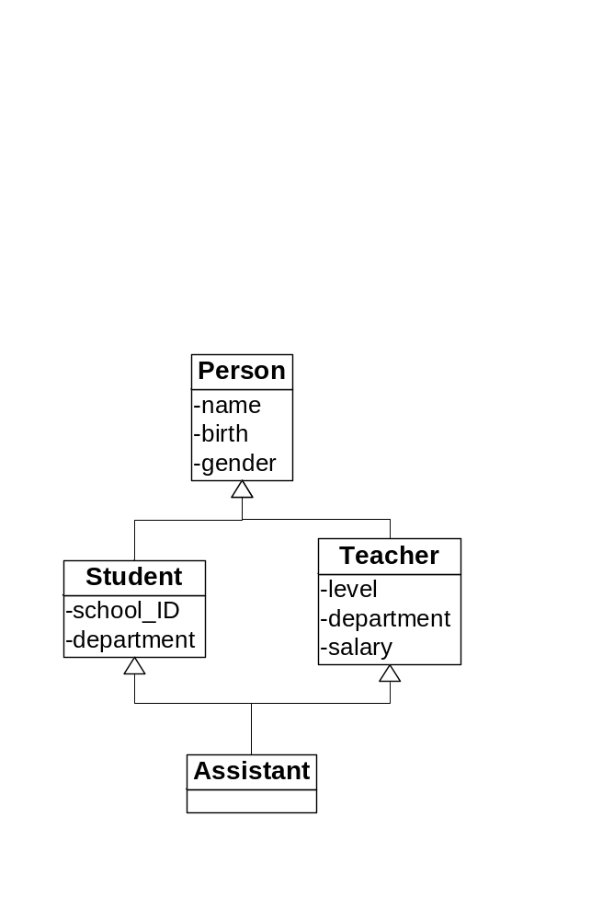
多继承
在C++中允许一个派生类有多个基类，这种继承叫做多继承。只有一个基类的继承被称为单继承
多继承表达的是“派生类既是一种基类A，又是一种基类B”关系。

Slide 23
多继承
class Assistant : public Student, public Teacher
{
public:
Assistant(string school_ID, int department, double salary)
:Student(school_ID, department),
Teacher(ASSISTANT, department, salary)
{
}
}

Slide 24
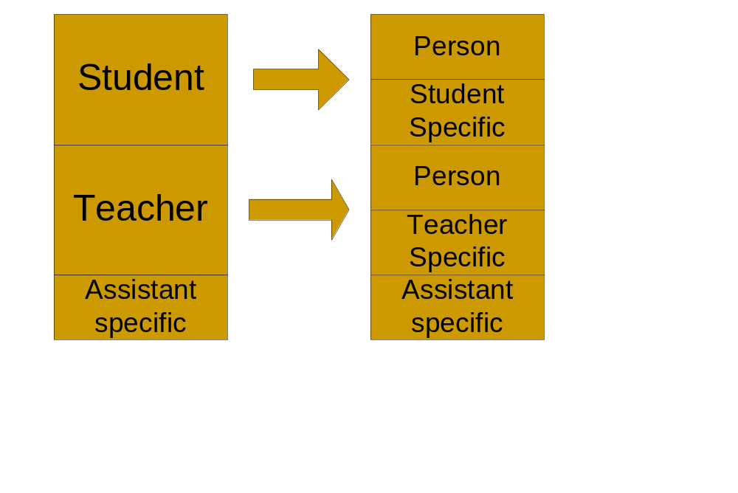
对象布局

Slide 25
虚基类virtual base
class Person {
};
class Student : virtual public Person {
};
class Teacher : virtual public Person {
};
class Assistant : public Student, public Teacher {
};
虚基类Person在派生类Assistant的对象中只有一份

Slide 26
多继承时对象的复制
Assistant assist;
Student s = assist; //OK
Teacher t = assist; //OK
Student *ps = &assist; //OK
Teacher *pt= &assist //OK
派生类对象的指针可以赋给任何一个基类类型的指针

Slide 27
练习
4.7.3 P164
  2, 3, 4

Slide 28
公有继承与私有继承
class Derived : private Base {
//…
};
class Derived: protected Base {
//…
};

Slide 29
私有继承
class Base {
public: int a;
protected: int b;
private: int c;
};
class Derived : private Base{
void f() {
cout << a << b << c;
}
};
int main() {
Derived d;
cout << d.a << d.b << d.c;
}

Slide 30
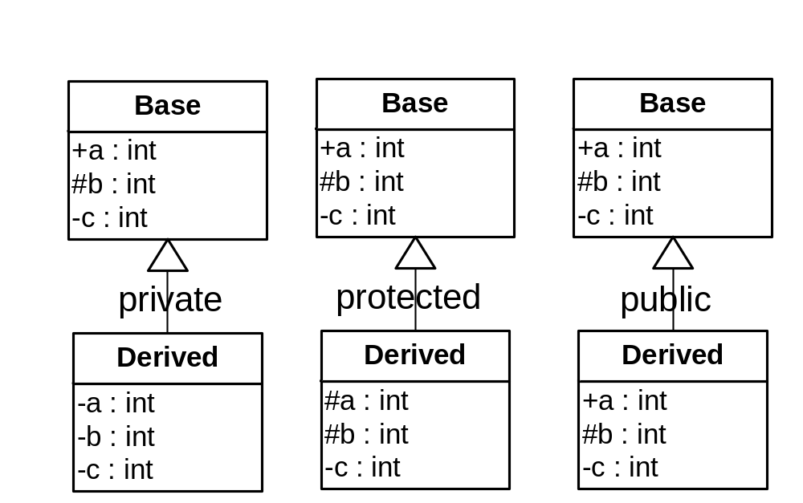
三种不同的继承方式

Slide 31
struct与class的区别
struct 默认是public继承
struct Derived : Base { /*…*/};
class默认是private继承
class Derived : Base { /*…*/}

Slide 32
常见错误
4.9
  1，2，3，4，5

Slide 33
编程范式Programming Paradigm
过程化程序设计Procedural Programming
  典型C语言程序设计
  本书第二章
基于对象的程序设计Object-Based Programming
  本书第三章
面向对象的程序设计Object-Oriented Programming
  本书第五章
泛型程序设计Generic Programming
  本书第七章

Slide 34
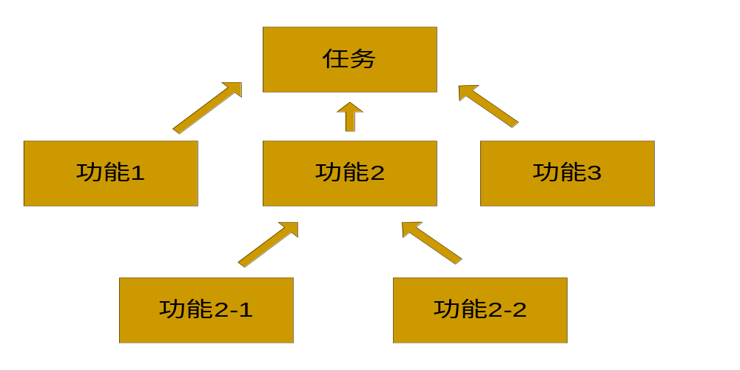
过程化的程序设计
将功能逐层分解，直到每个功能都能用单个函数来实现——自顶向下的程序设计方法
比如设计一个自动算24的程序

Slide 35
基于对象的程序设计
找出程序中需要使用的数据类型
为数据类型提供一套操作
比如：设计一个图书馆管理系统
书
日期
学生
教师
搜索树/哈希表
……

