Slide 1
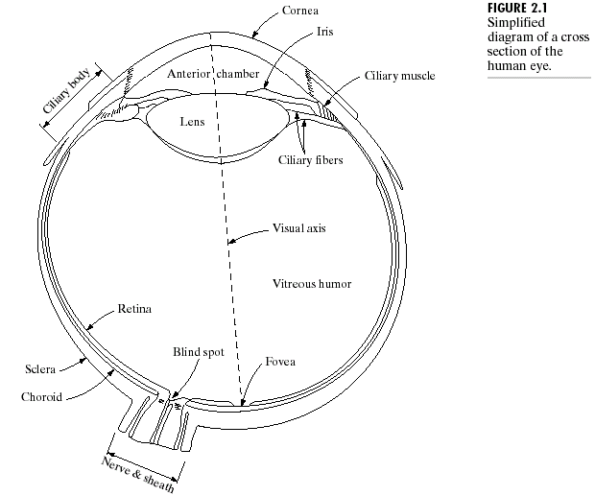
Chapter 2: Digital Image Fundamentals

Slide 2
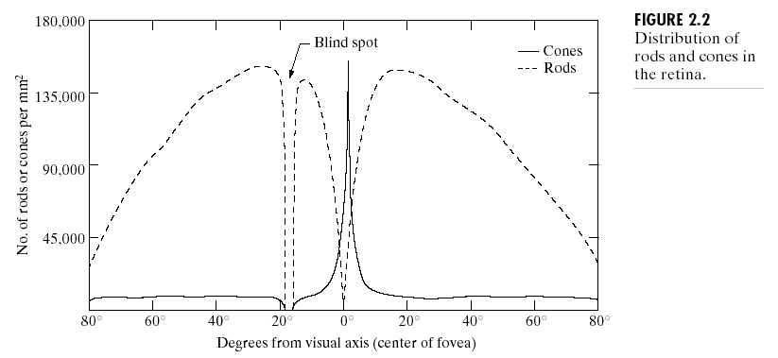
Chapter 2: Digital Image Fundamentals

Slide 3
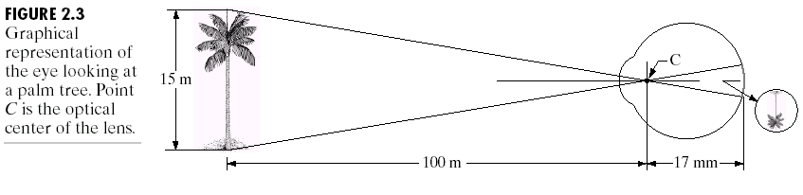
Chapter 2: Digital Image Fundamentals

Slide 4
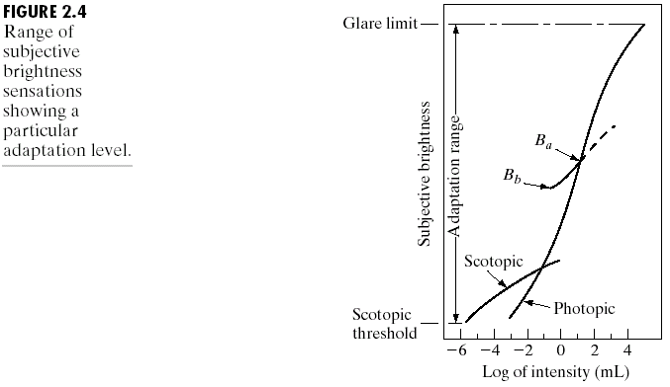
Chapter 2: Digital Image Fundamentals

Slide 5
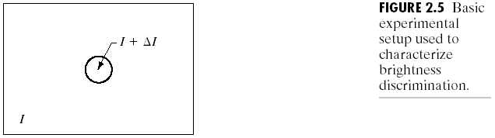
Chapter 2: Digital Image Fundamentals

Slide 6
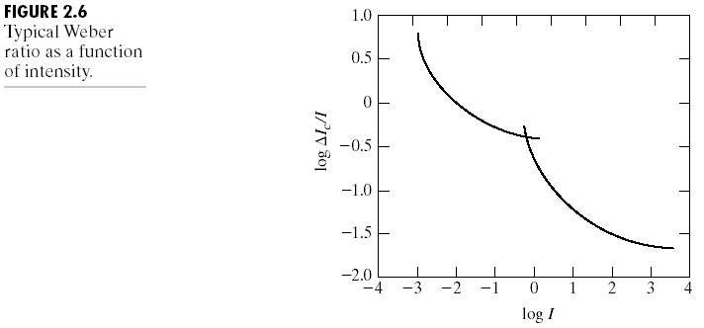
Chapter 2: Digital Image Fundamentals

Slide 7
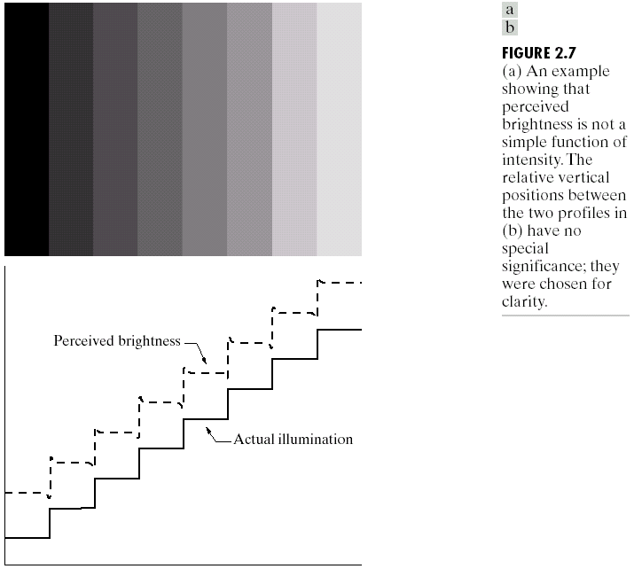
Chapter 2: Digital Image Fundamentals

Slide 8
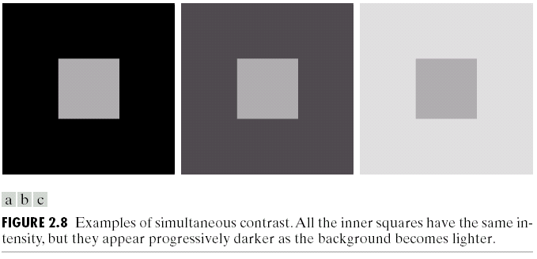
Chapter 2: Digital Image Fundamentals

Slide 9
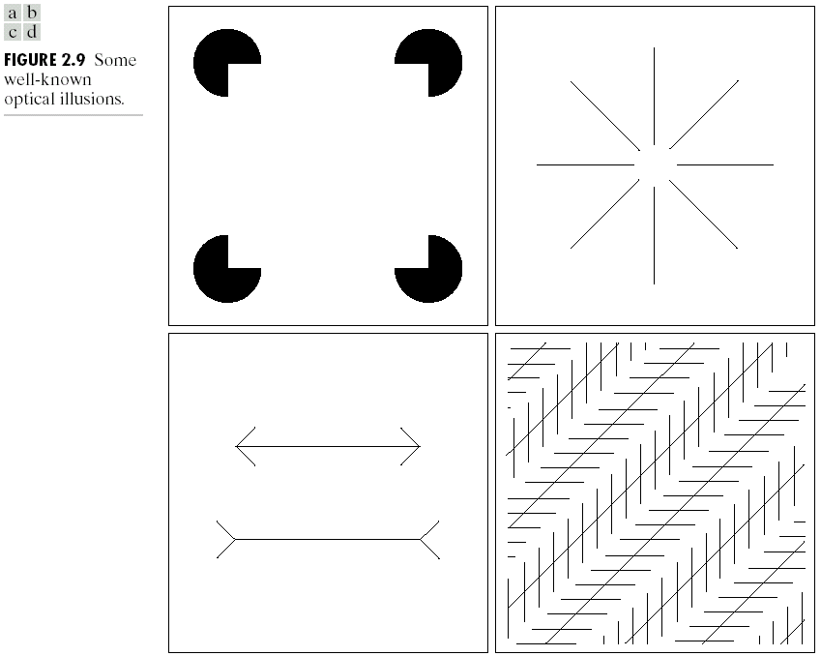
Chapter 2: Digital Image Fundamentals

Slide 10
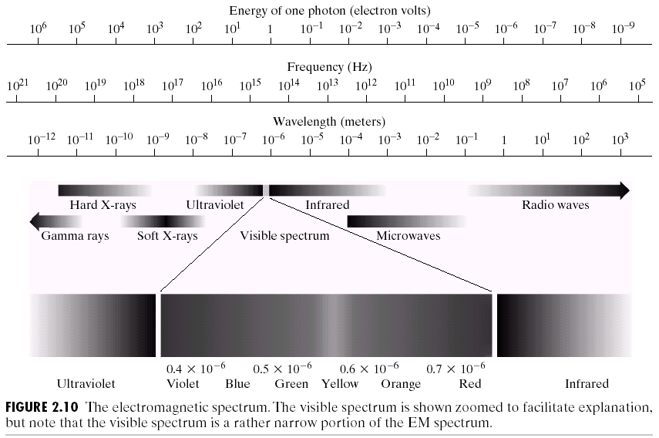
Chapter 2: Digital Image Fundamentals

Slide 11
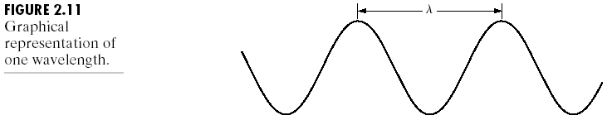
Chapter 2: Digital Image Fundamentals

Slide 12
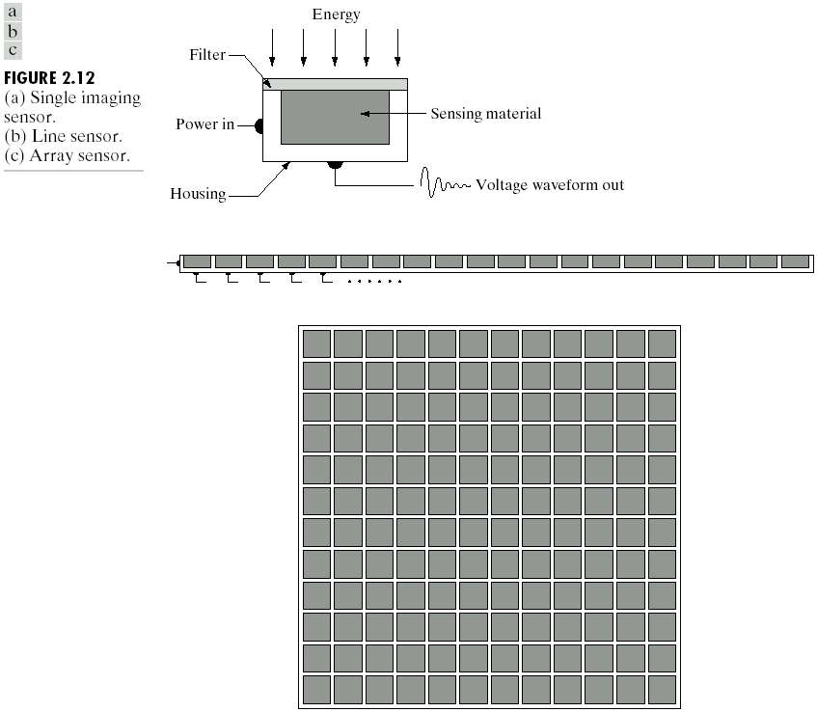
Chapter 2: Digital Image Fundamentals

Slide 13
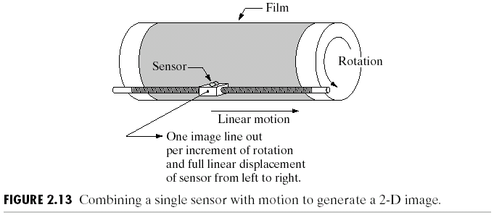
Chapter 2: Digital Image Fundamentals

Slide 14
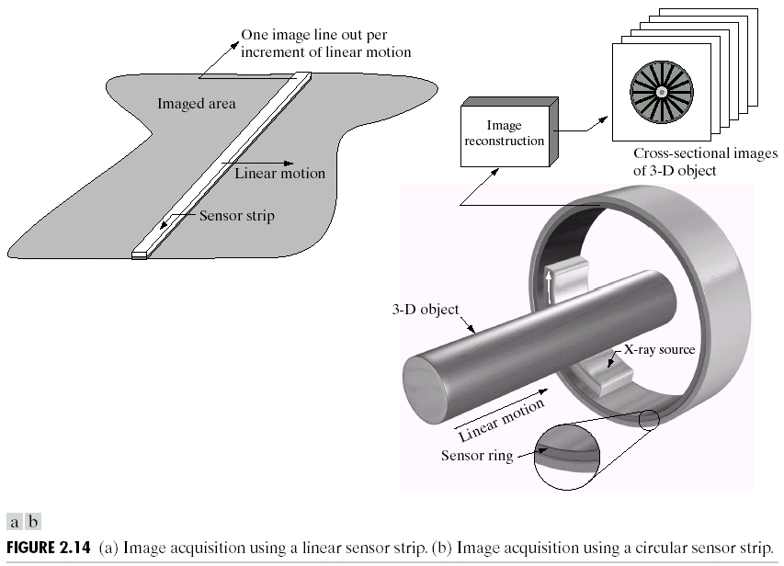
Chapter 2: Digital Image Fundamentals

Slide 15

Chapter 2: Digital Image Fundamentals

Slide 16

Chapter 2: Digital Image Fundamentals

Slide 17

Chapter 2: Digital Image Fundamentals

Slide 18
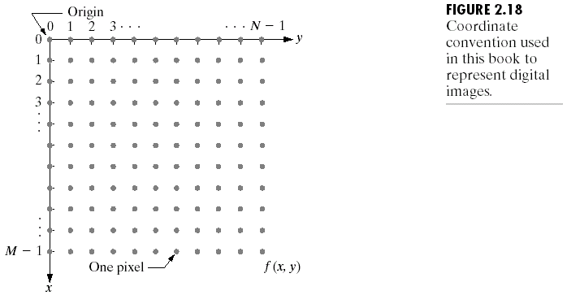
Chapter 2: Digital Image Fundamentals

Slide 19
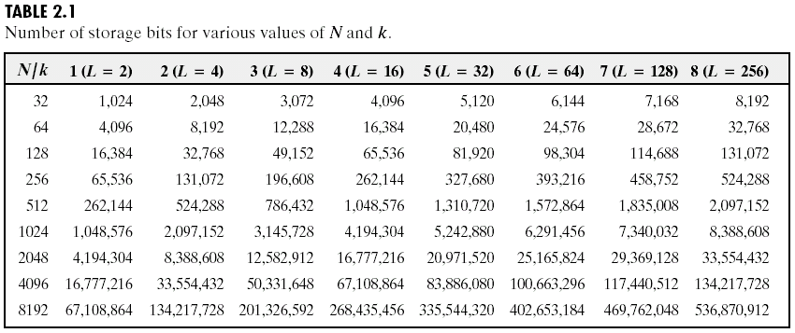
Chapter 2: Digital Image Fundamentals

Slide 20
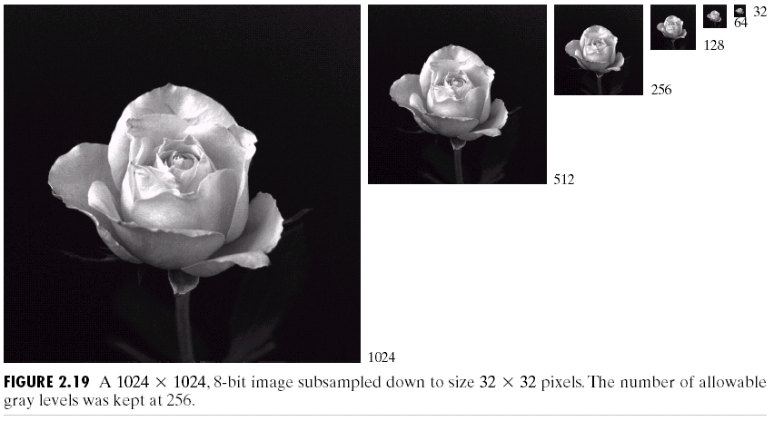
Chapter 2: Digital Image Fundamentals

Slide 21
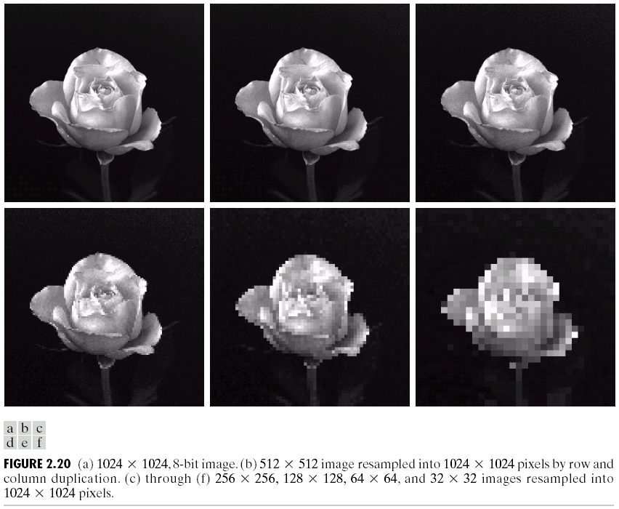
Chapter 2: Digital Image Fundamentals

Slide 22

Chapter 2: Digital Image Fundamentals

Slide 23

Chapter 2: Digital Image Fundamentals

Slide 24
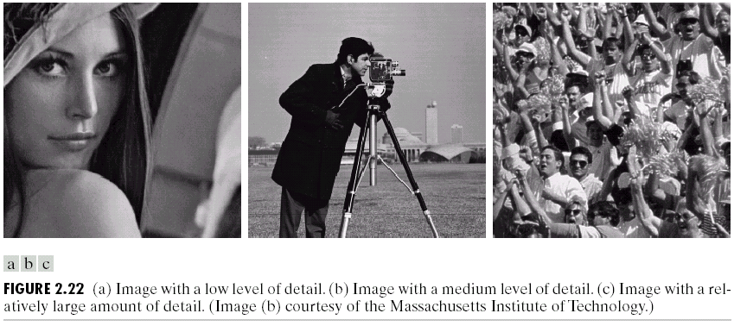
Chapter 2: Digital Image Fundamentals

Slide 25
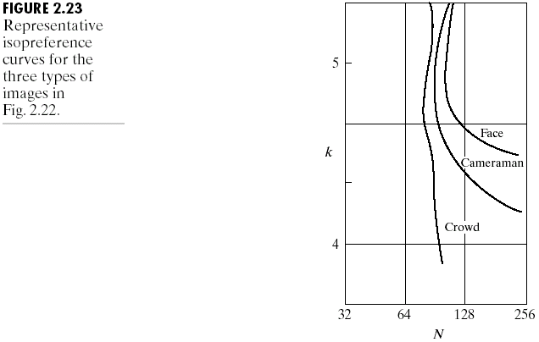
Chapter 2: Digital Image Fundamentals

Slide 26
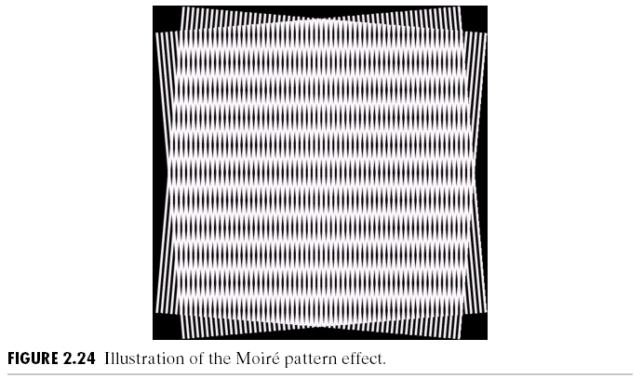
Chapter 2: Digital Image Fundamentals

Slide 27
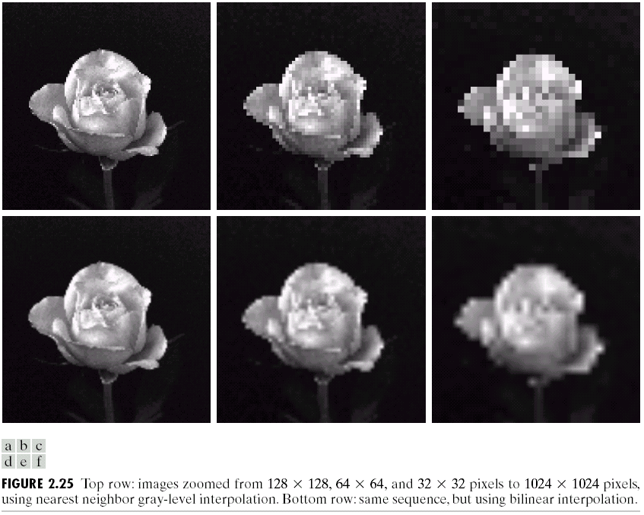
Chapter 2: Digital Image Fundamentals

Slide 28
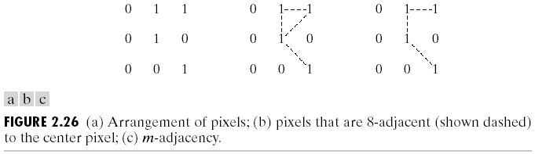
Chapter 2: Digital Image Fundamentals

