Slide 1
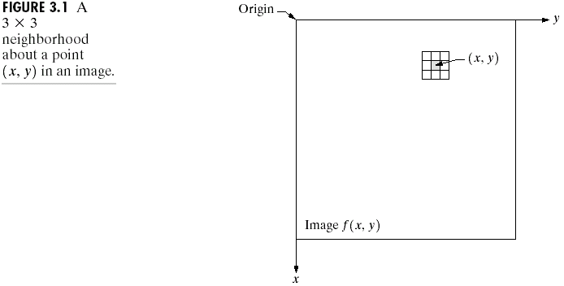
Chapter 3
Image Enhancement in the
Spatial Domain

Slide 2
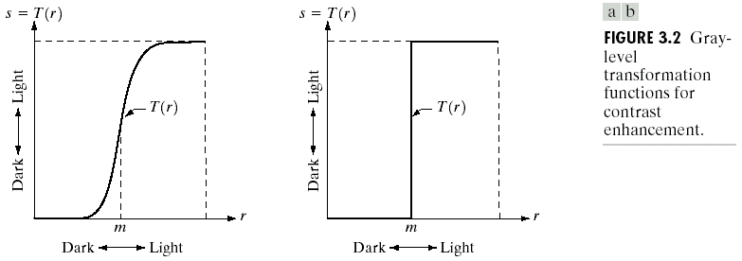
Chapter 3
Image Enhancement in the
Spatial Domain

Slide 3
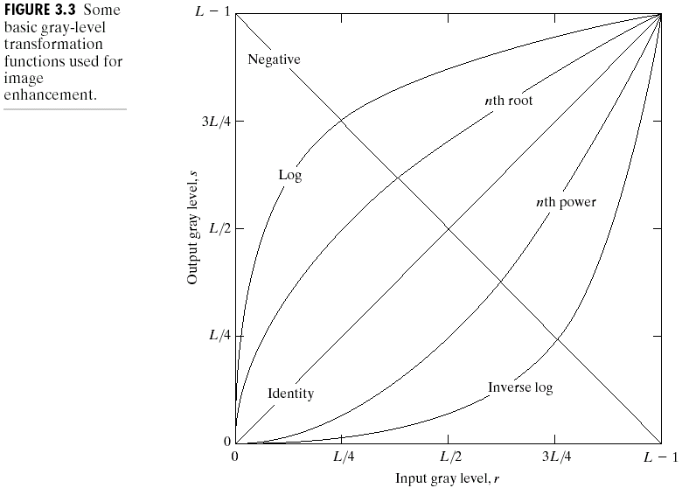
Chapter 3
Image Enhancement in the
Spatial Domain

Slide 4
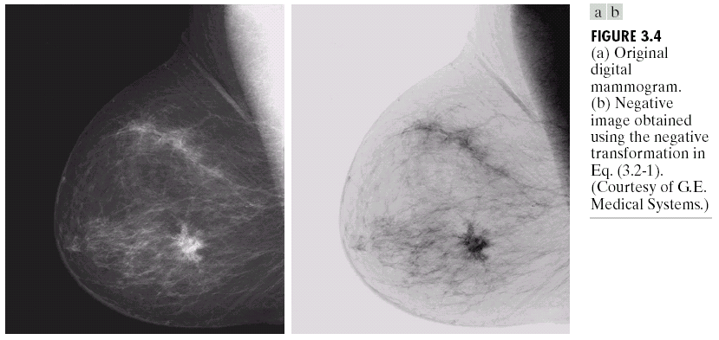
Chapter 3
Image Enhancement in the
Spatial Domain

Slide 5
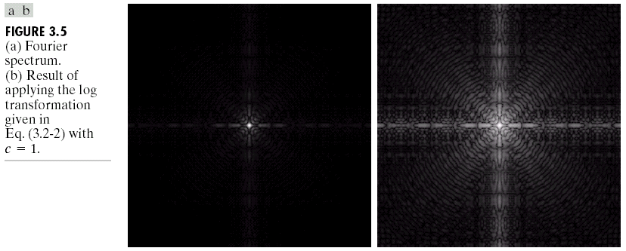
Chapter 3
Image Enhancement in the
Spatial Domain

Slide 6
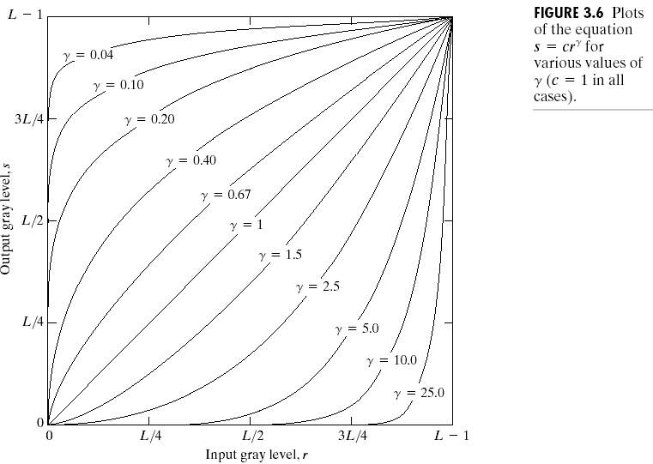
Chapter 3
Image Enhancement in the
Spatial Domain

Slide 7
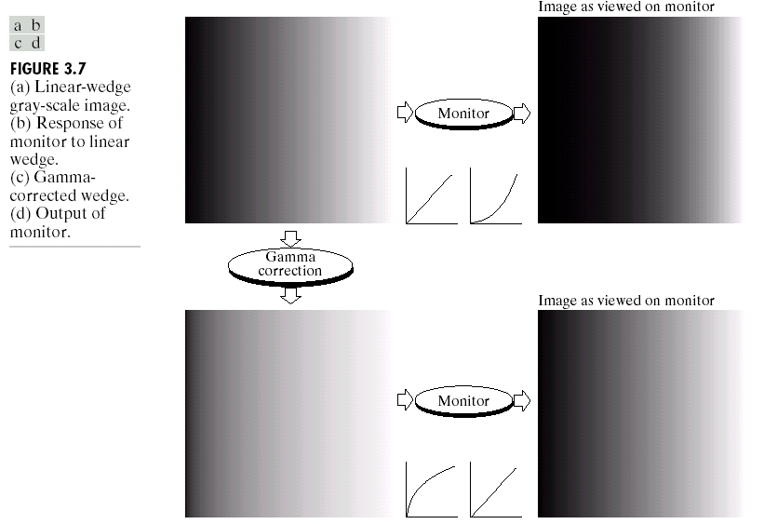
Chapter 3
Image Enhancement in the
Spatial Domain

Slide 8
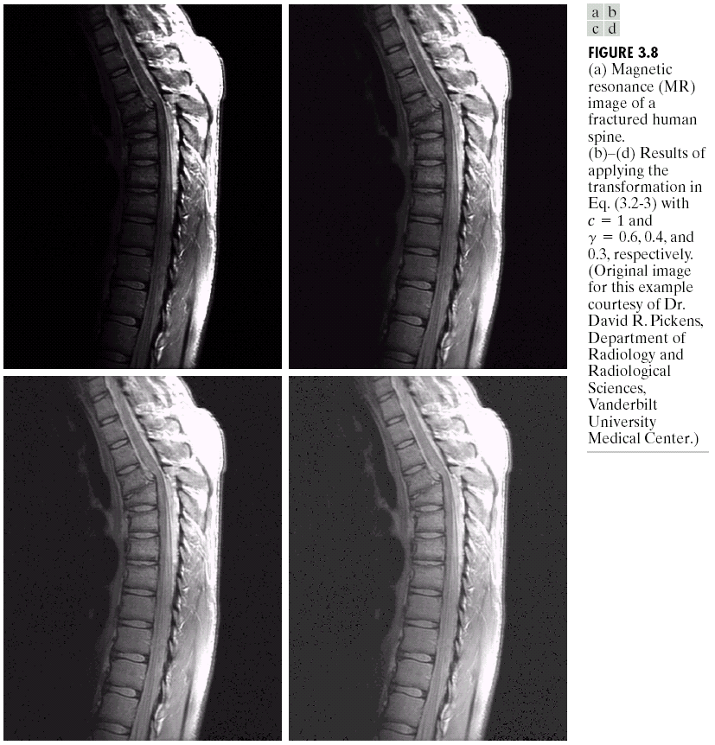
Chapter 3
Image Enhancement in the
Spatial Domain

Slide 9
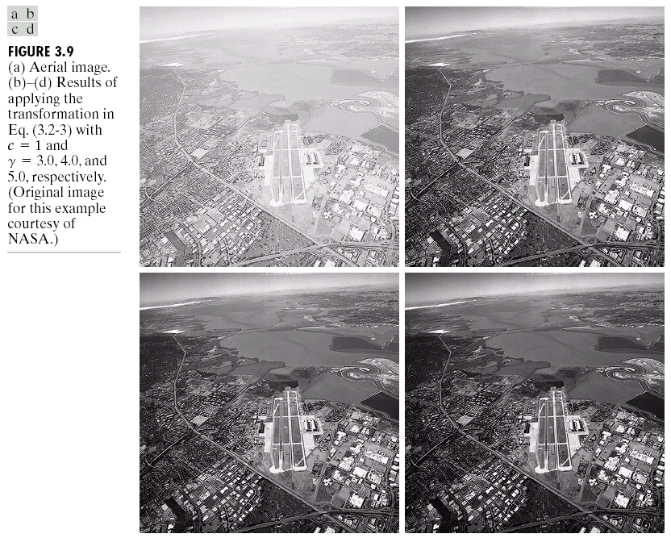
Chapter 3
Image Enhancement in the
Spatial Domain

Slide 10

Chapter 3
Image Enhancement in the
Spatial Domain

Slide 11
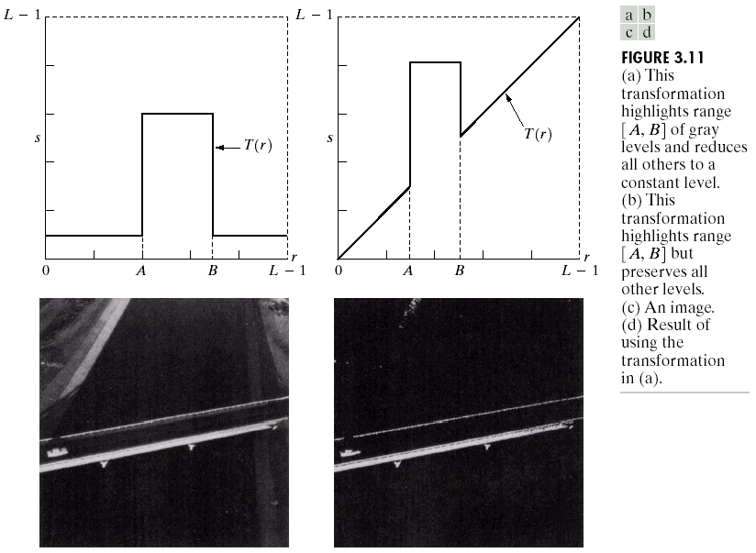
Chapter 3
Image Enhancement in the
Spatial Domain

Slide 12
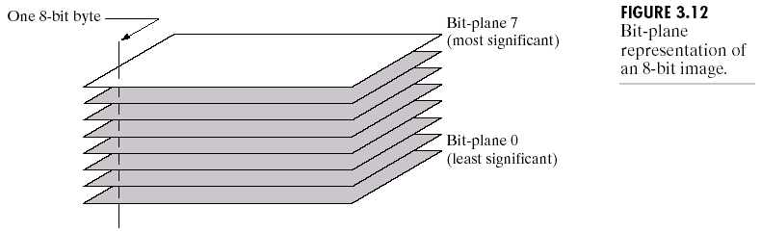
Chapter 3
Image Enhancement in the
Spatial Domain

Slide 13
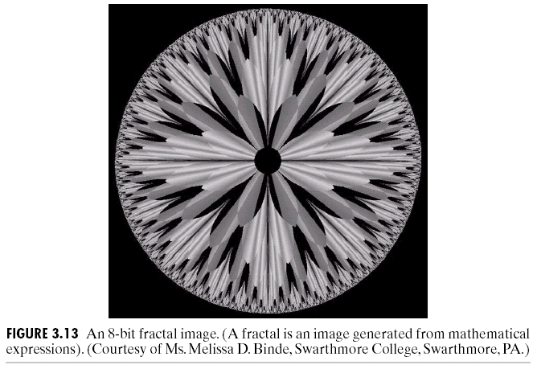
Chapter 3
Image Enhancement in the
Spatial Domain

Slide 14
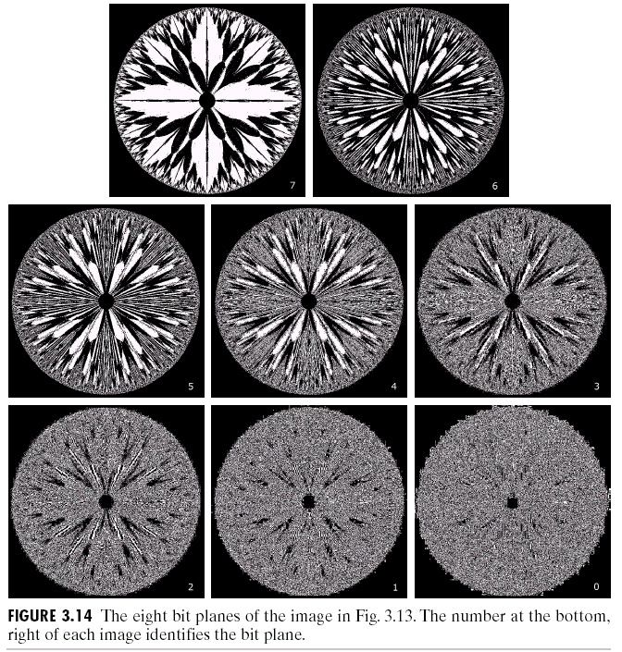
Chapter 3
Image Enhancement in the
Spatial Domain

Slide 15
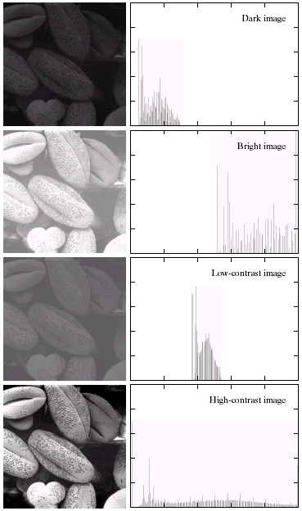

Chapter 3
Image Enhancement in the
Spatial Domain

Slide 16
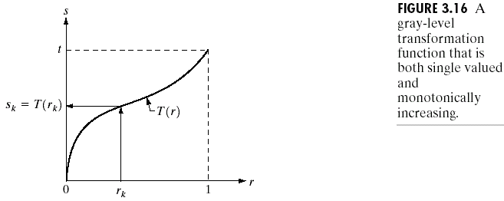
Chapter 3
Image Enhancement in the
Spatial Domain

Slide 17
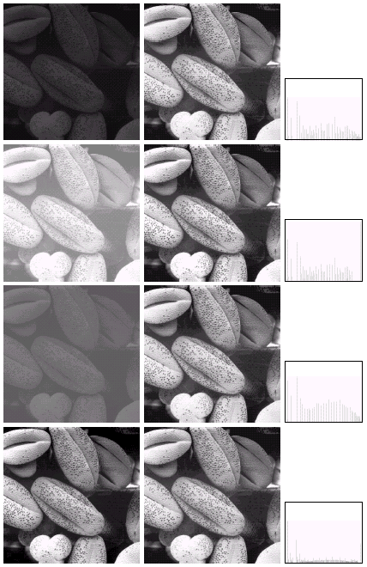

Chapter 3
Image Enhancement in the
Spatial Domain

Slide 18
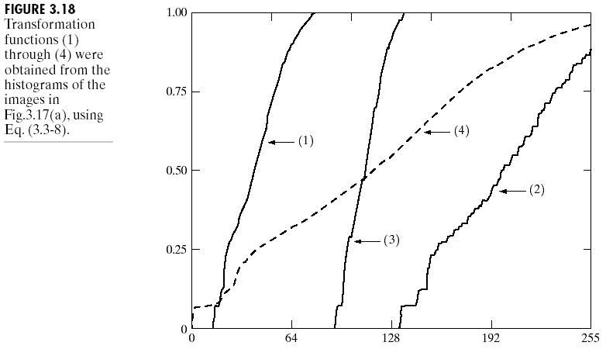
Chapter 3
Image Enhancement in the
Spatial Domain

Slide 19
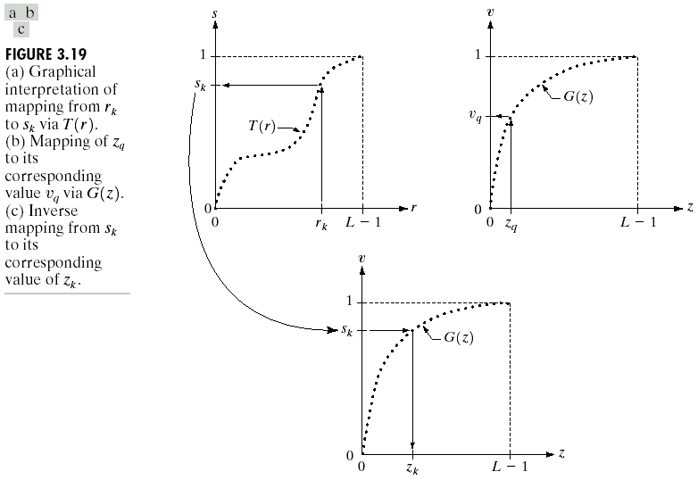
Chapter 3
Image Enhancement in the
Spatial Domain

Slide 20
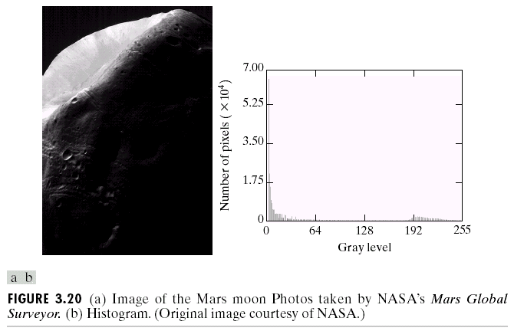
Chapter 3
Image Enhancement in the
Spatial Domain

Slide 21
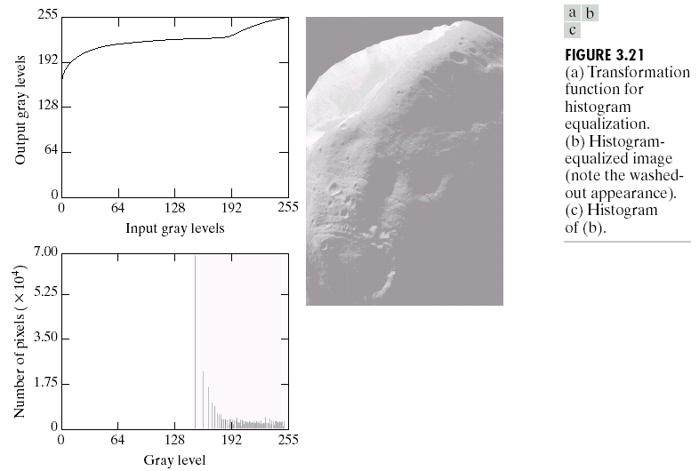
Chapter 3
Image Enhancement in the
Spatial Domain

Slide 22
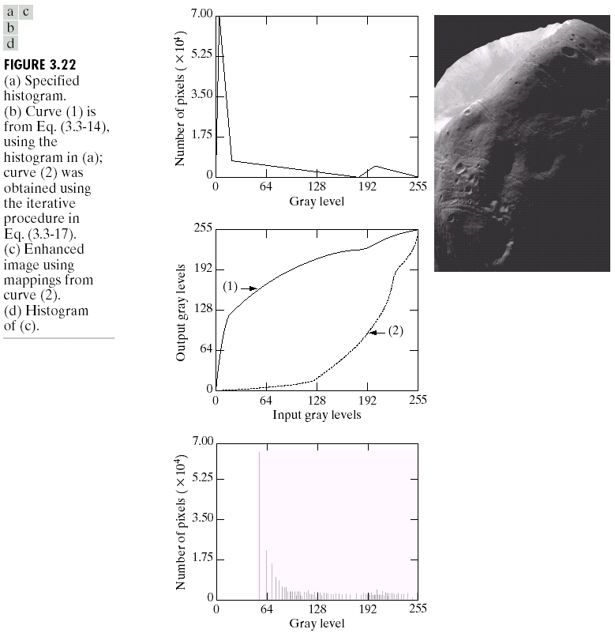
Chapter 3
Image Enhancement in the
Spatial Domain

Slide 23
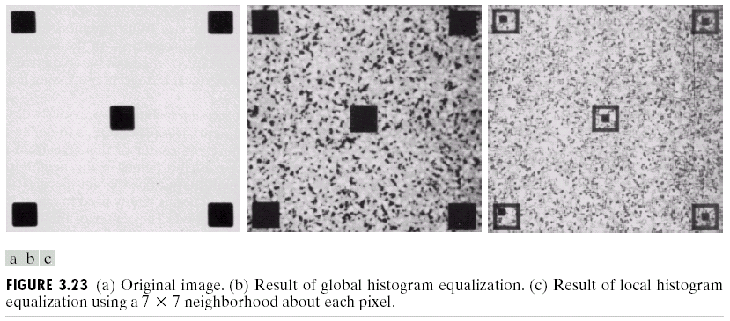
Chapter 3
Image Enhancement in the
Spatial Domain

Slide 24
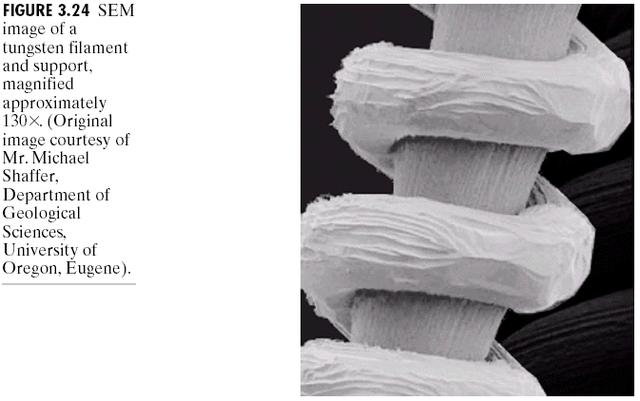
Chapter 3
Image Enhancement in the
Spatial Domain

Slide 25
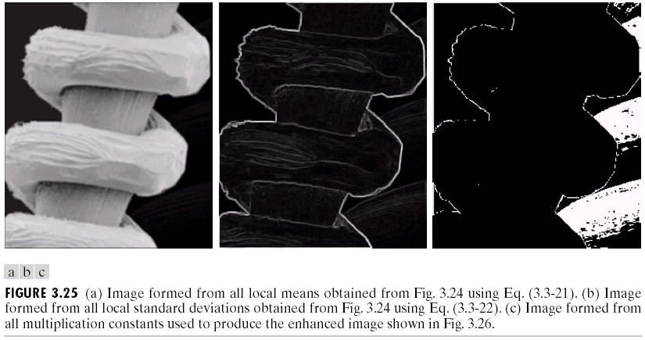
Chapter 3
Image Enhancement in the
Spatial Domain

Slide 26
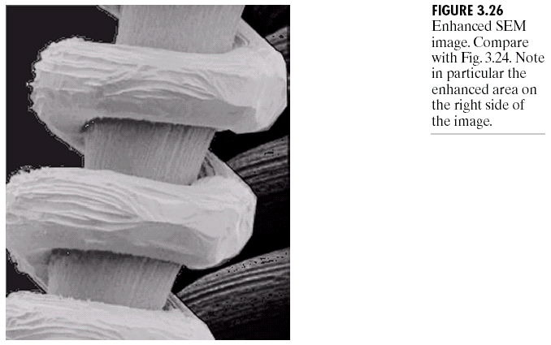
Chapter 3
Image Enhancement in the
Spatial Domain

Slide 27
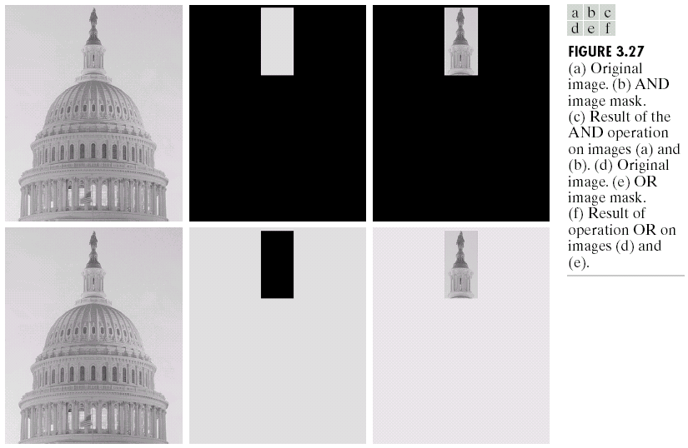
Chapter 3
Image Enhancement in the
Spatial Domain

Slide 28
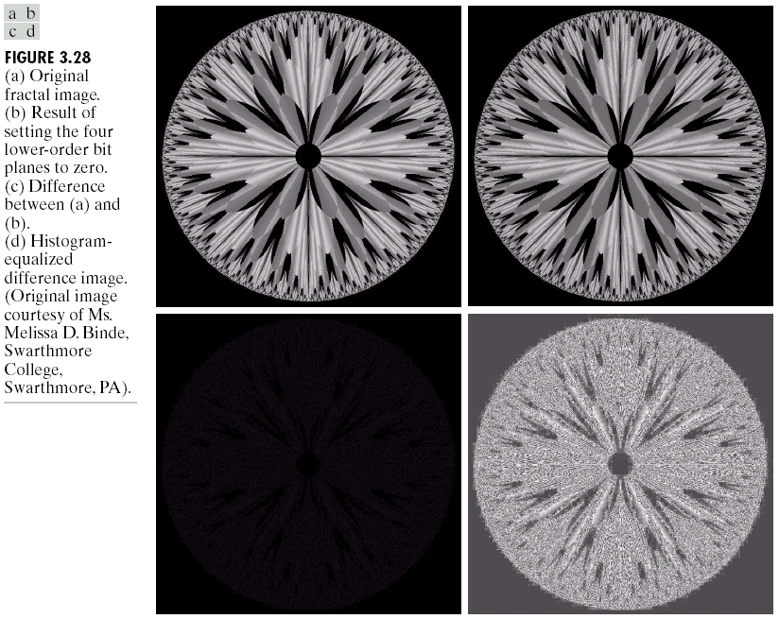
Chapter 3
Image Enhancement in the
Spatial Domain

Slide 29
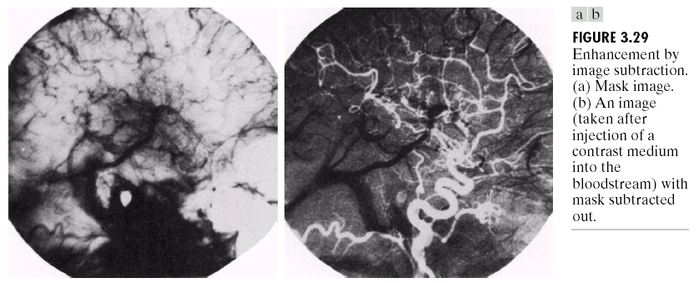
Chapter 3
Image Enhancement in the
Spatial Domain

Slide 30
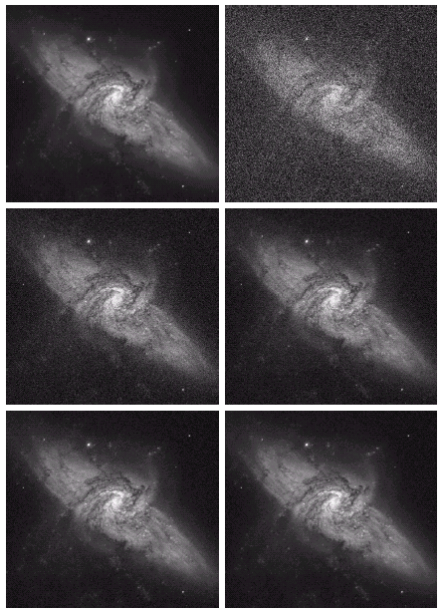
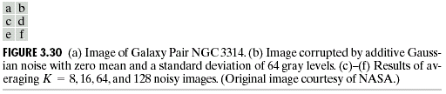
Chapter 3
Image Enhancement in the
Spatial Domain

Slide 31
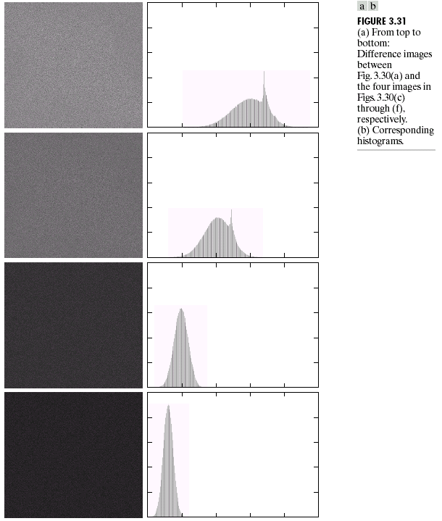
Chapter 3
Image Enhancement in the
Spatial Domain

Slide 32
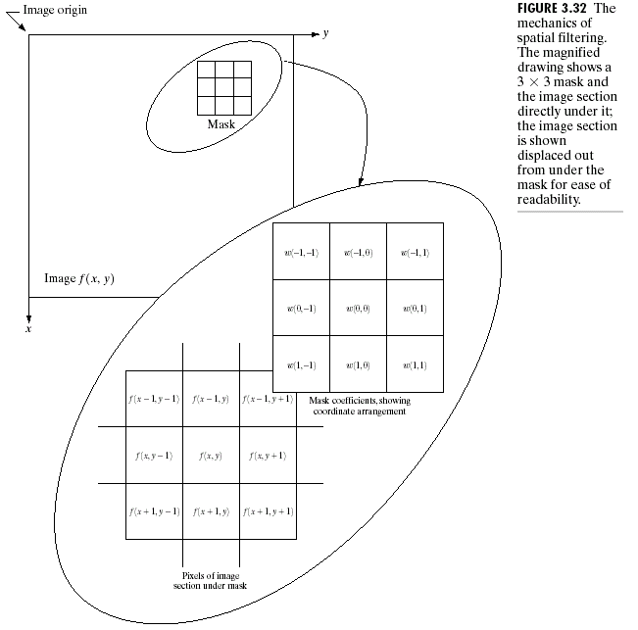
Chapter 3
Image Enhancement in the
Spatial Domain

Slide 33
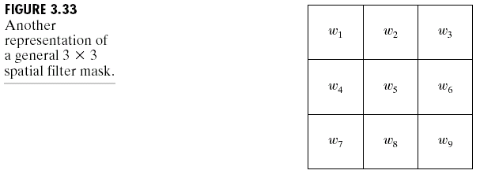
Chapter 3
Image Enhancement in the
Spatial Domain

Slide 34
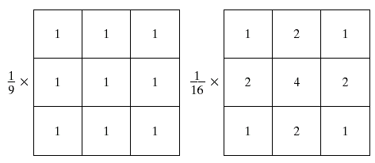
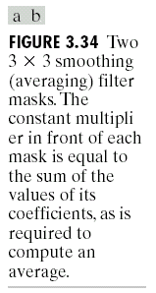
Chapter 3
Image Enhancement in the
Spatial Domain

Slide 35
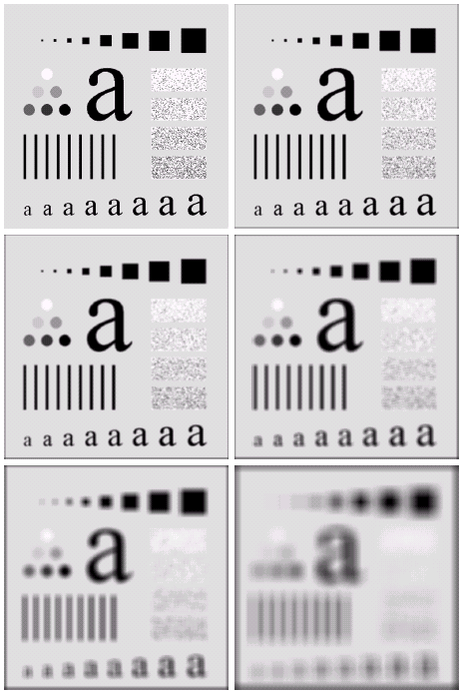
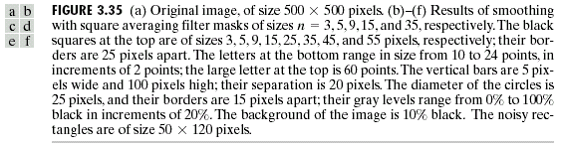
Chapter 3
Image Enhancement in the
Spatial Domain

Slide 36
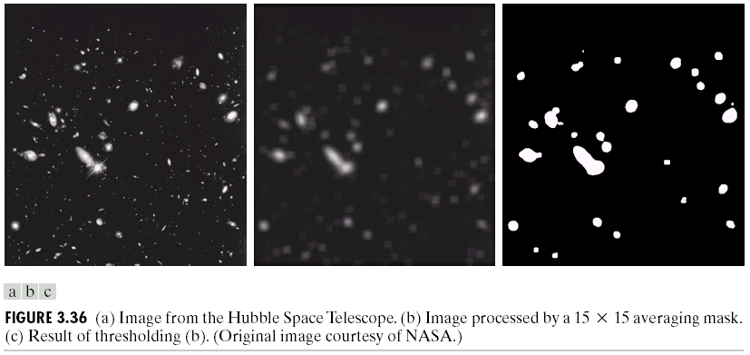
Chapter 3
Image Enhancement in the
Spatial Domain

Slide 37

Chapter 3
Image Enhancement in the
Spatial Domain

Slide 38
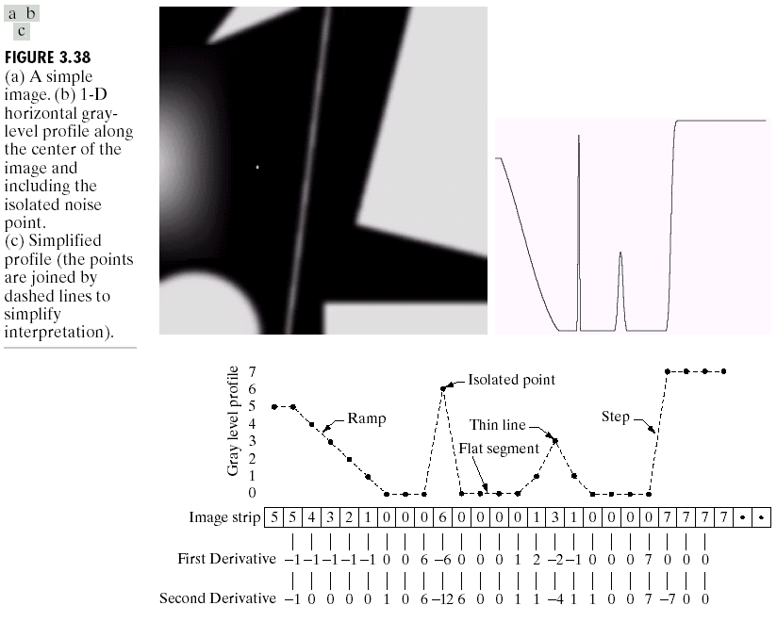
Chapter 3
Image Enhancement in the
Spatial Domain

Slide 39
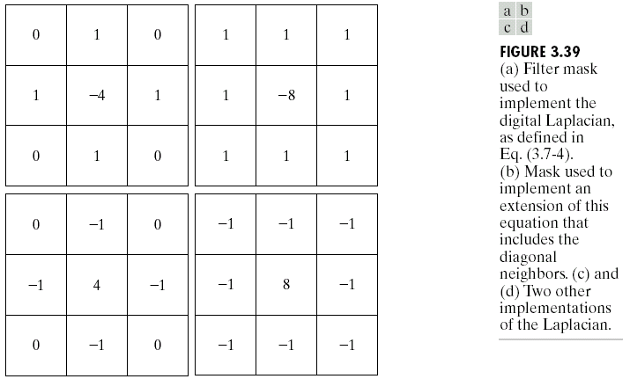
Chapter 3
Image Enhancement in the
Spatial Domain

Slide 40
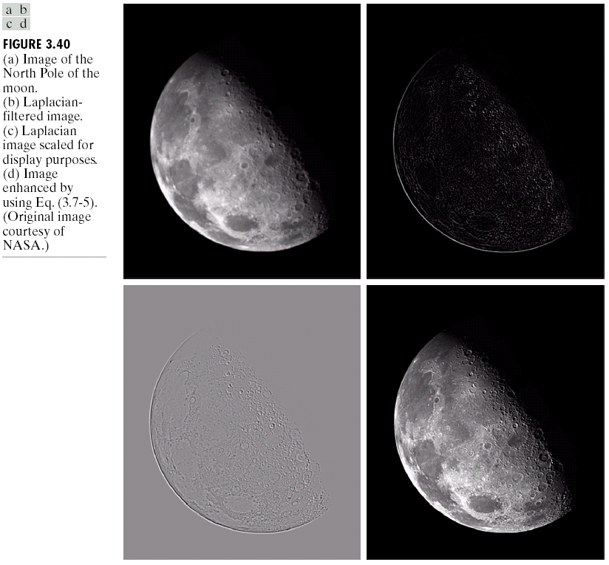
Chapter 3
Image Enhancement in the
Spatial Domain

Slide 41
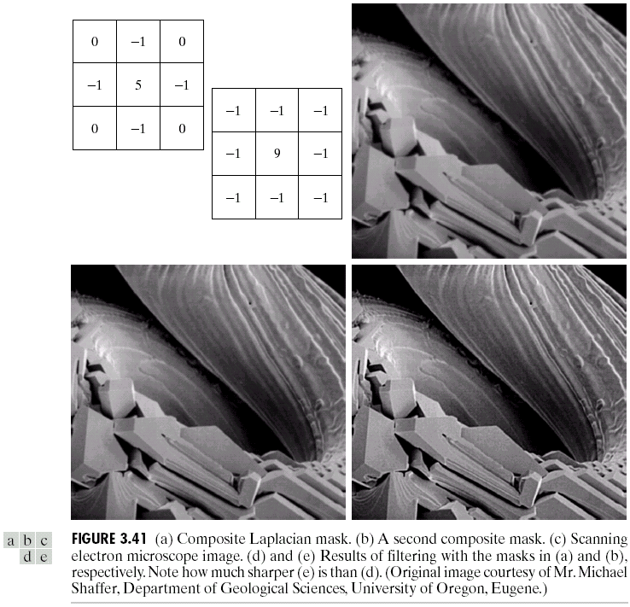
Chapter 3
Image Enhancement in the
Spatial Domain

Slide 42
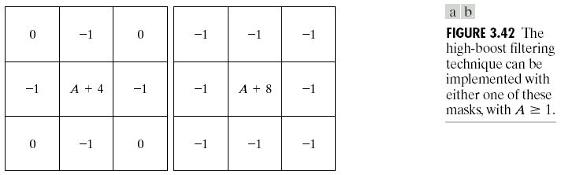
Chapter 3
Image Enhancement in the
Spatial Domain

Slide 43
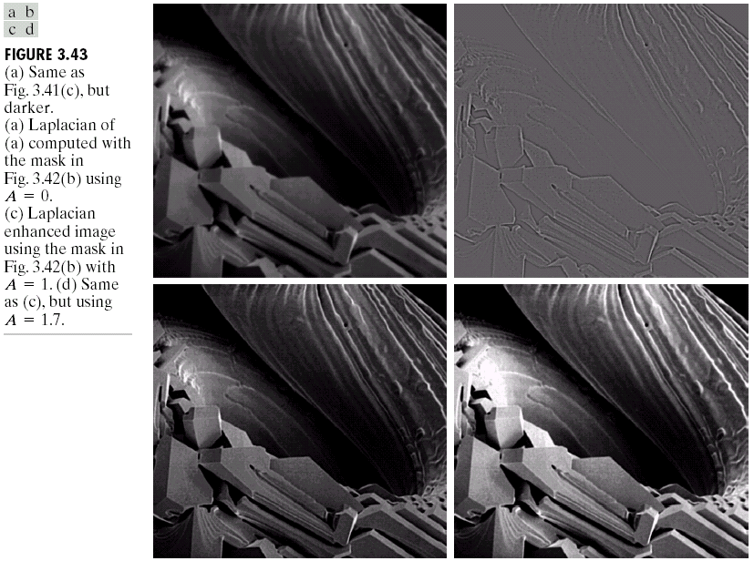
Chapter 3
Image Enhancement in the
Spatial Domain

Slide 44
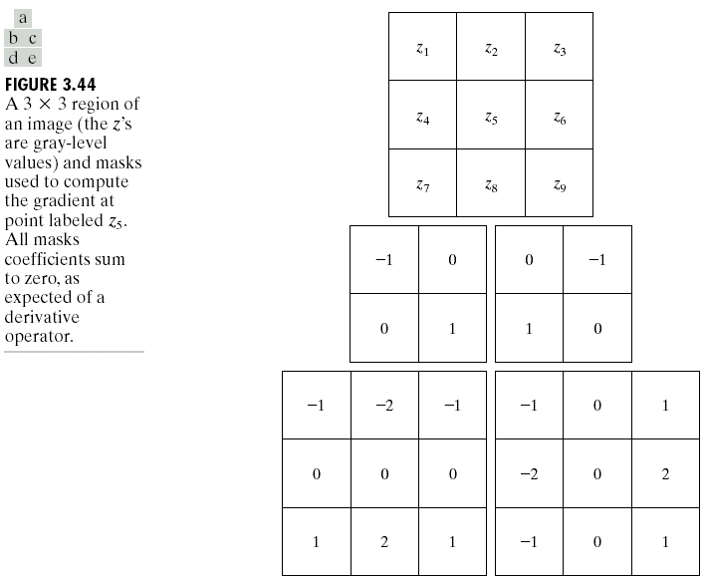
Chapter 3
Image Enhancement in the
Spatial Domain

Slide 45
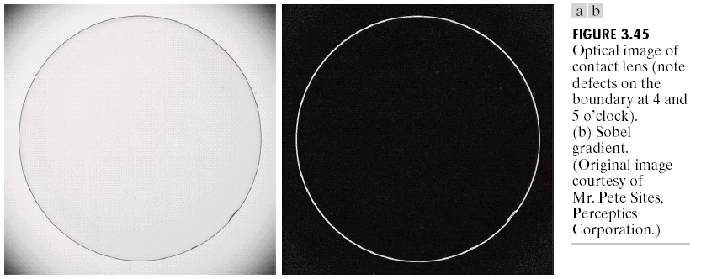
Chapter 3
Image Enhancement in the
Spatial Domain

Slide 46
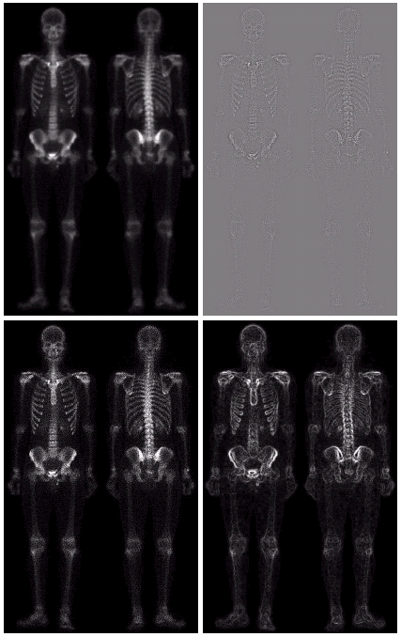
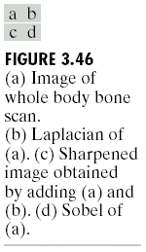
Chapter 3
Image Enhancement in the
Spatial Domain

Slide 47
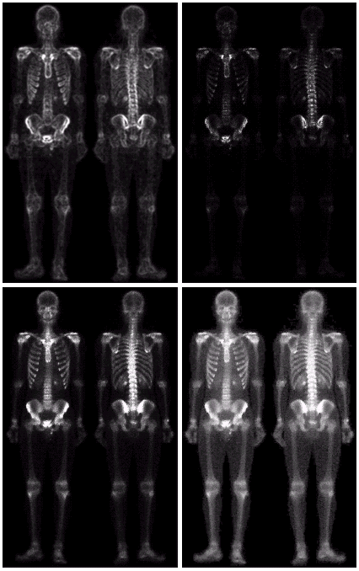
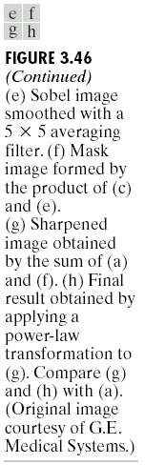
Chapter 3
Image Enhancement in the
Spatial Domain

Slide 48
Chapter 3
Image Enhancement in the
Spatial Domain

