Slide 1
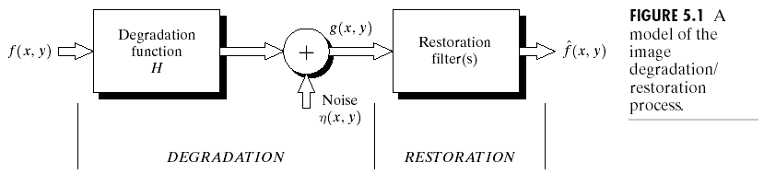
Chapter 5
Image Restoration

Slide 2
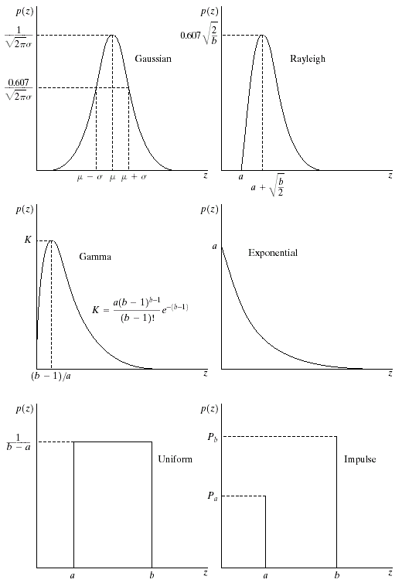
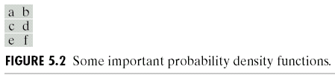
Chapter 5
Image Restoration

Slide 3
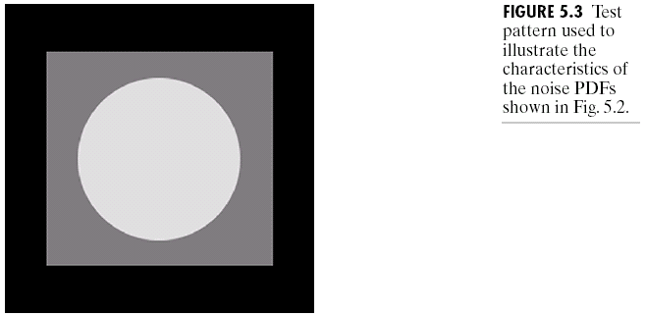
Chapter 5
Image Restoration

Slide 4
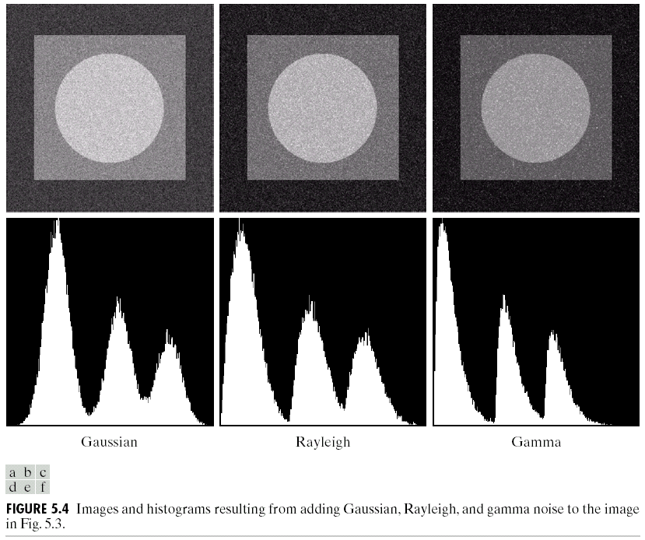
Chapter 5
Image Restoration

Slide 5
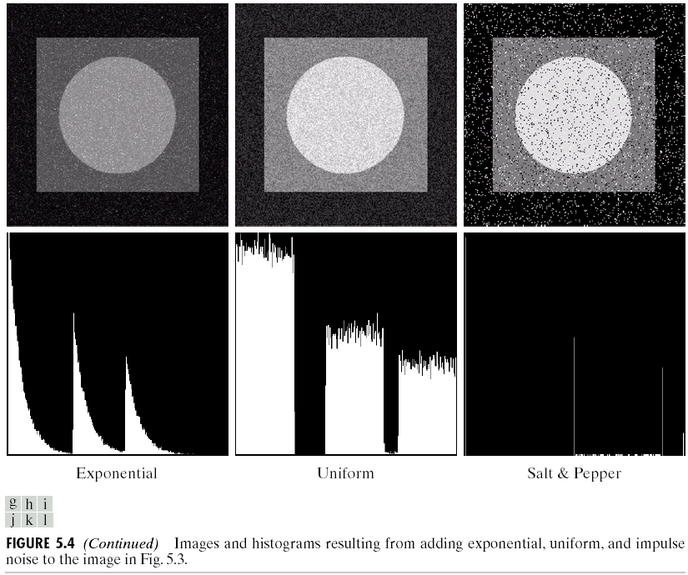
Chapter 5
Image Restoration

Slide 6
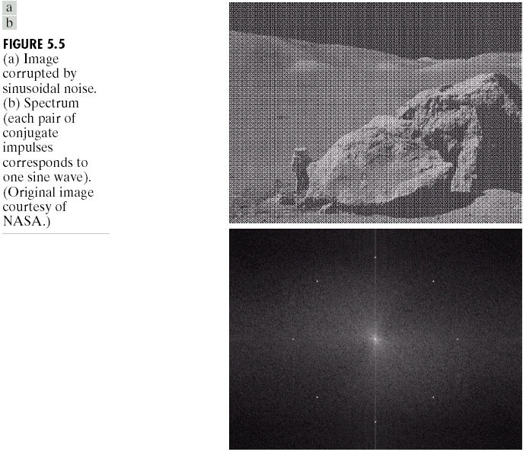
Chapter 5
Image Restoration

Slide 7
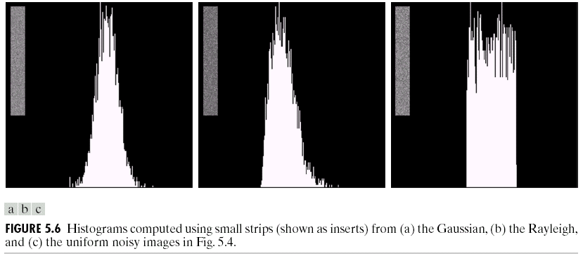
Chapter 5
Image Restoration

Slide 8
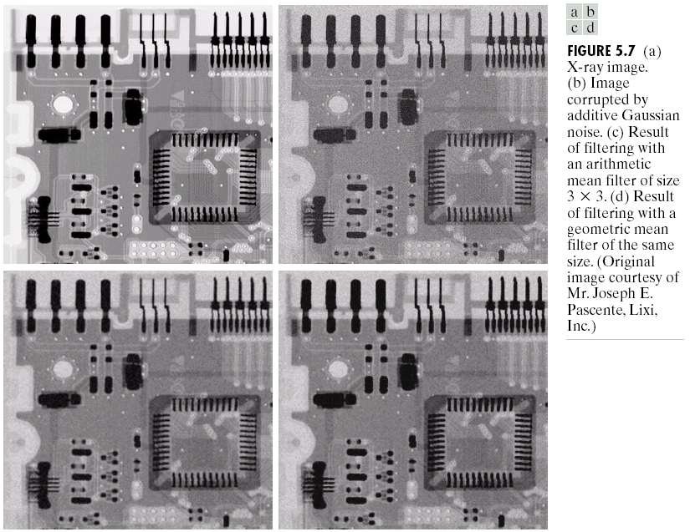
Chapter 5
Image Restoration

Slide 9
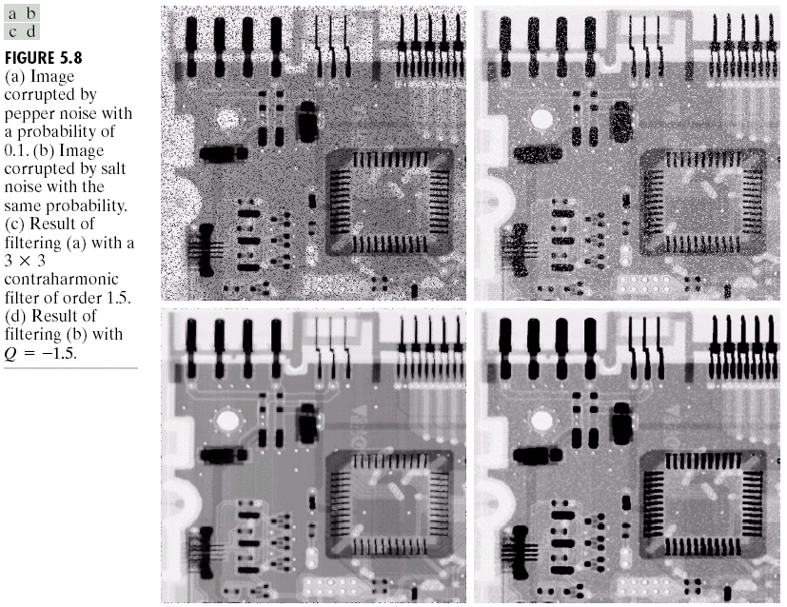
Chapter 5
Image Restoration

Slide 10
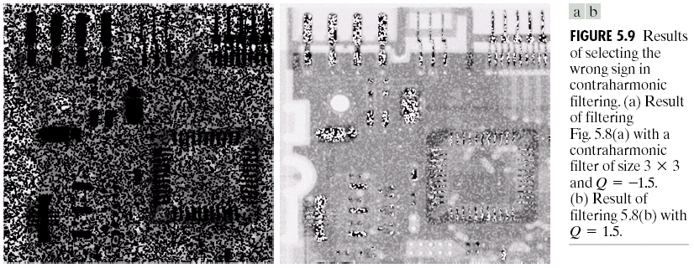
Chapter 5
Image Restoration

Slide 11
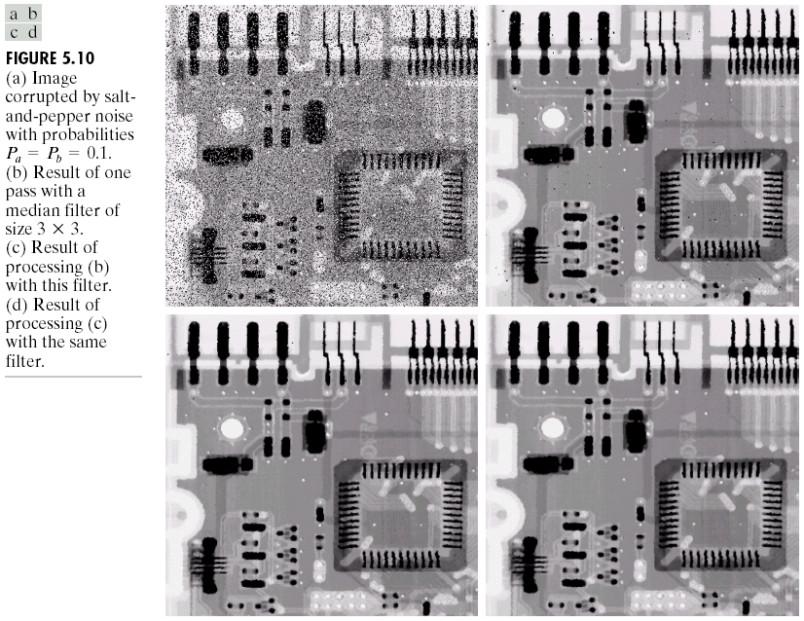
Chapter 5
Image Restoration

Slide 12
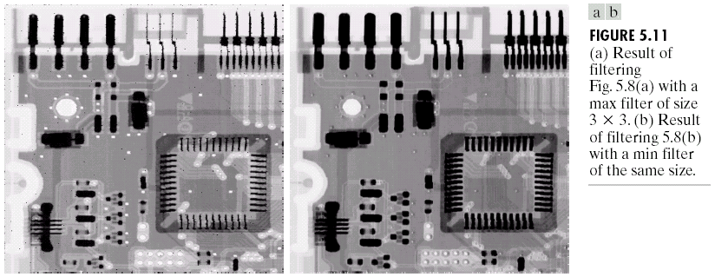
Chapter 5
Image Restoration

Slide 13
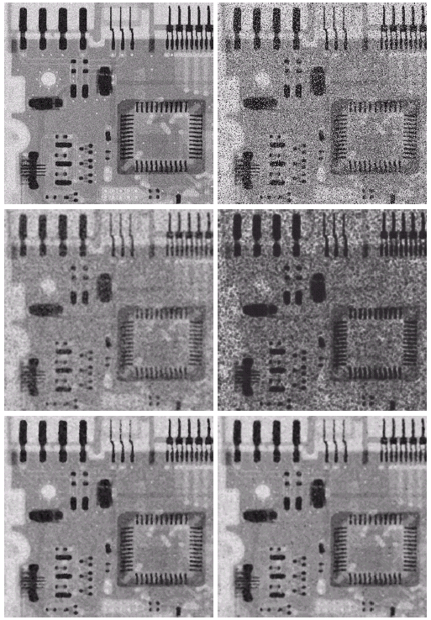

Chapter 5
Image Restoration

Slide 14
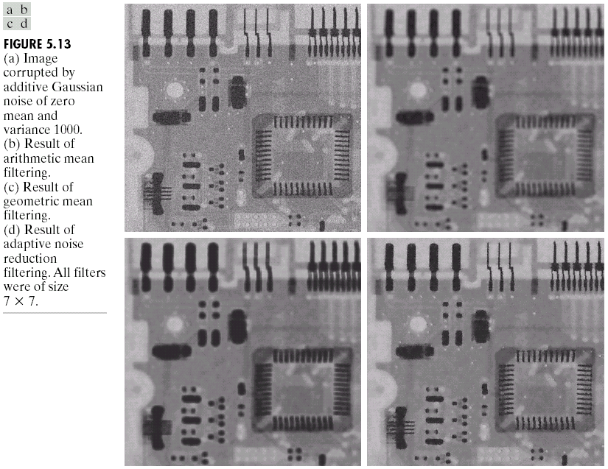
Chapter 5
Image Restoration

Slide 15
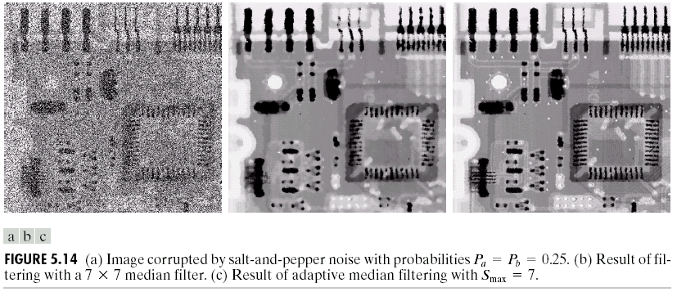
Chapter 5
Image Restoration

Slide 16
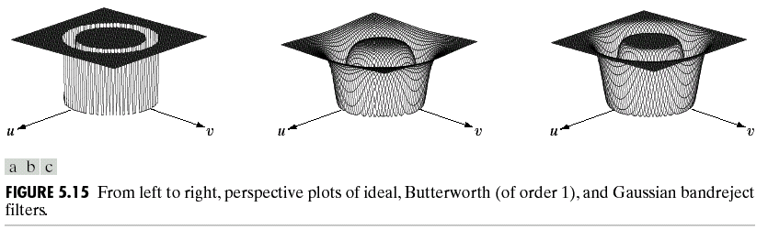
Chapter 5
Image Restoration

Slide 17
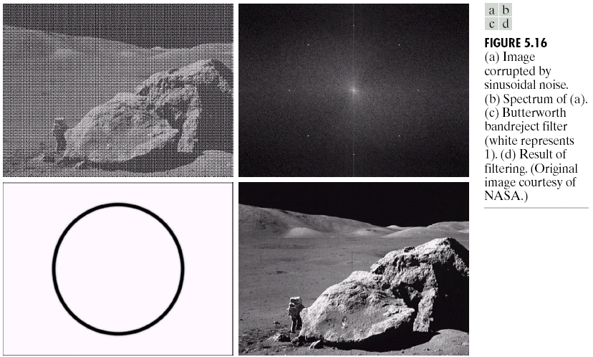
Chapter 5
Image Restoration

Slide 18
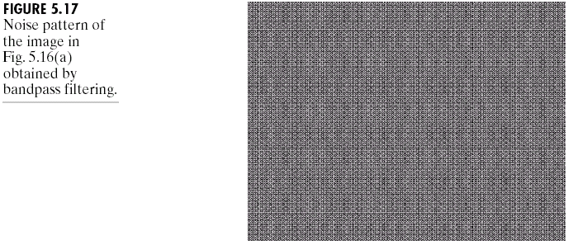
Chapter 5
Image Restoration

Slide 19
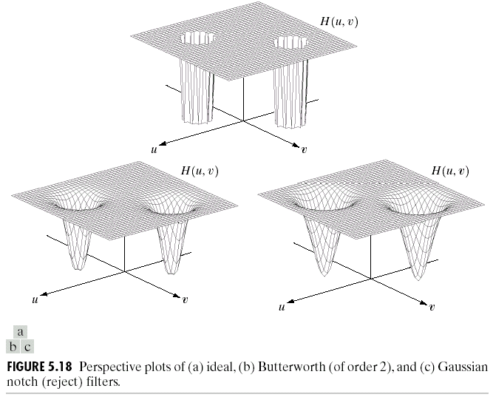
Chapter 5
Image Restoration

Slide 20
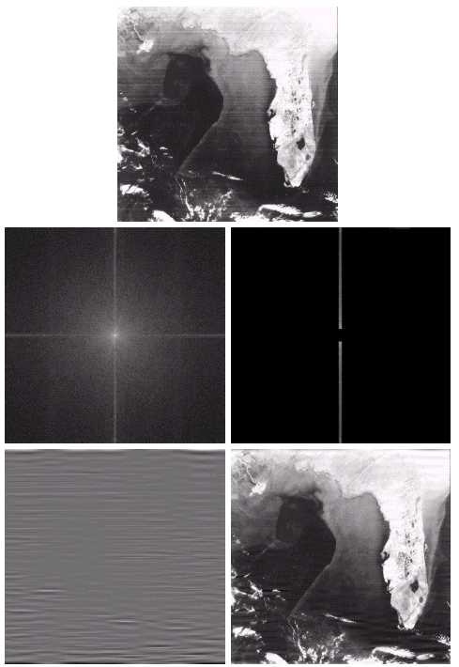
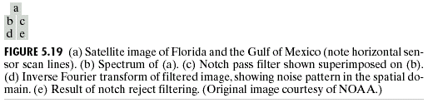
Chapter 5
Image Restoration

Slide 21
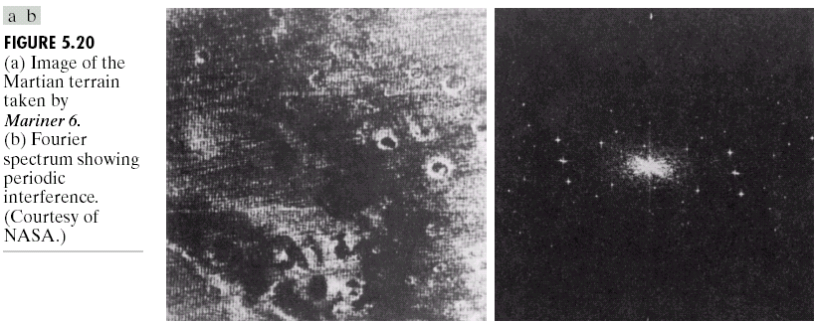
Chapter 5
Image Restoration

Slide 22
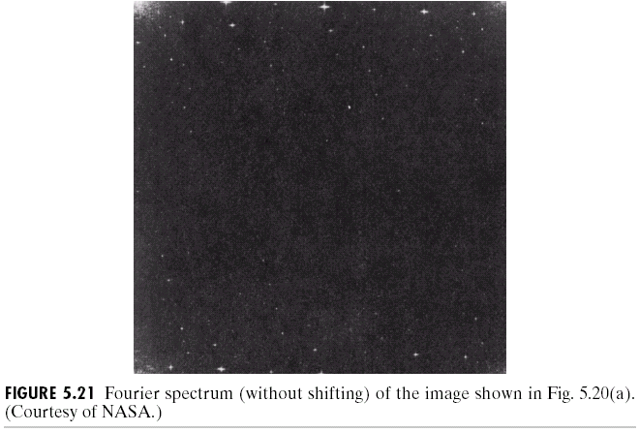
Chapter 5
Image Restoration

Slide 23
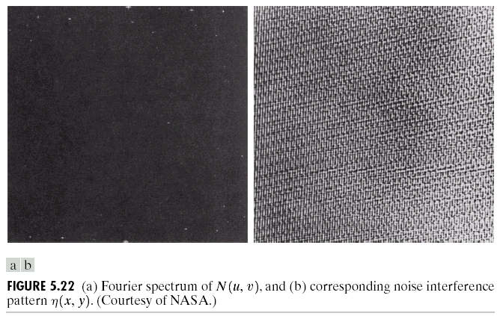
Chapter 5
Image Restoration

Slide 24
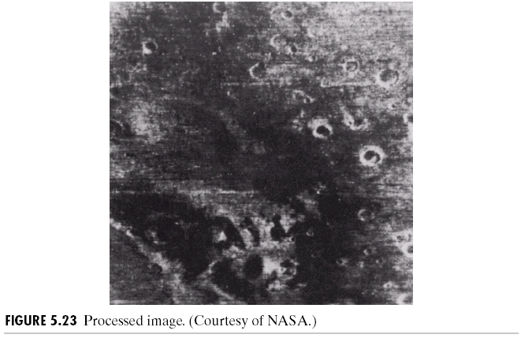
Chapter 5
Image Restoration

Slide 25
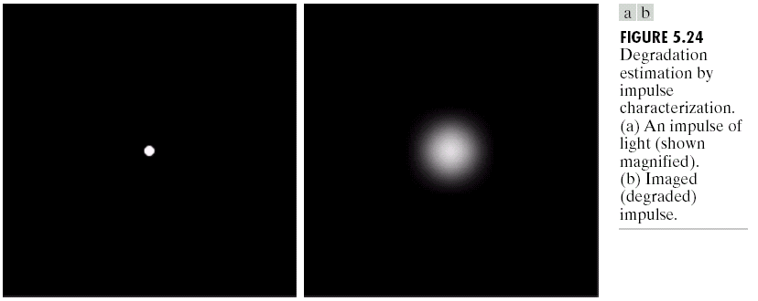
Chapter 5
Image Restoration

Slide 26
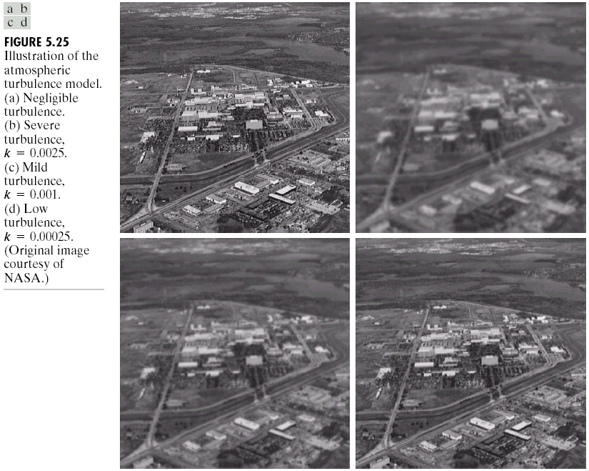
Chapter 5
Image Restoration

Slide 27
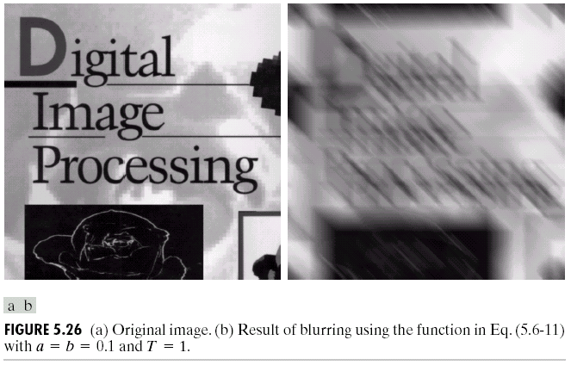
Chapter 5
Image Restoration

Slide 28
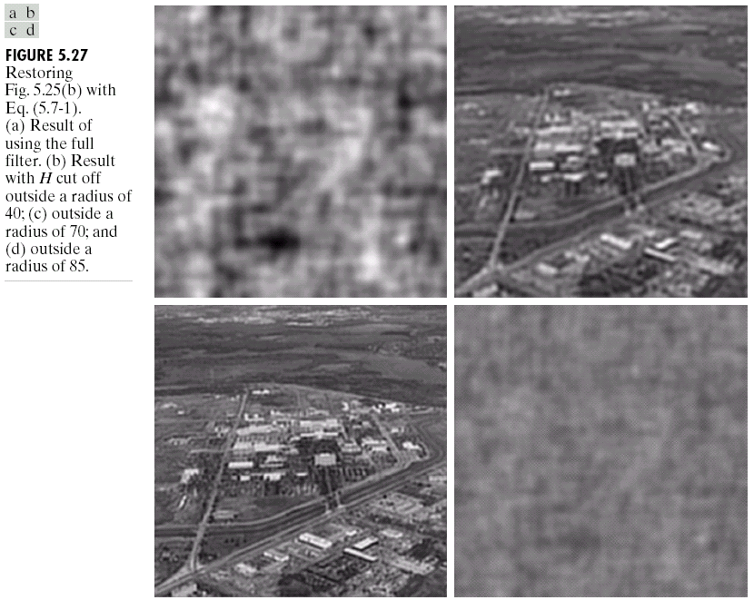
Chapter 5
Image Restoration

Slide 29
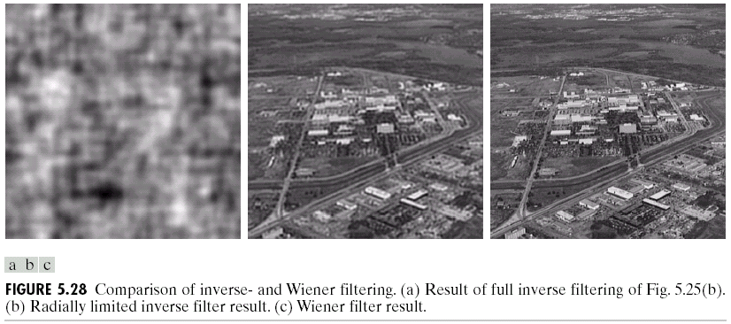
Chapter 5
Image Restoration

Slide 30
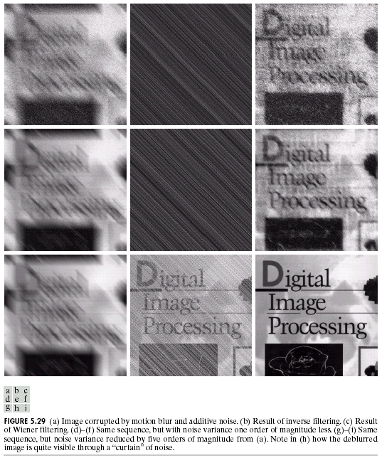
Chapter 5
Image Restoration

Slide 31
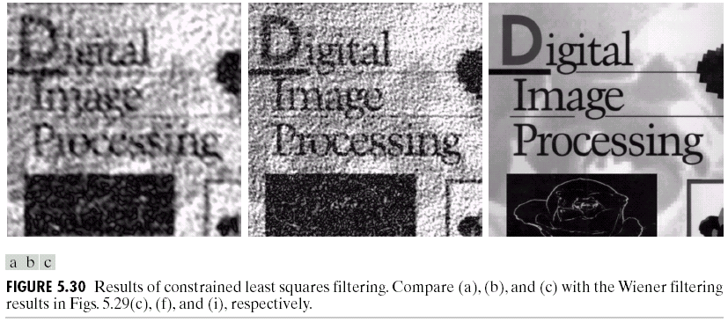
Chapter 5
Image Restoration

Slide 32
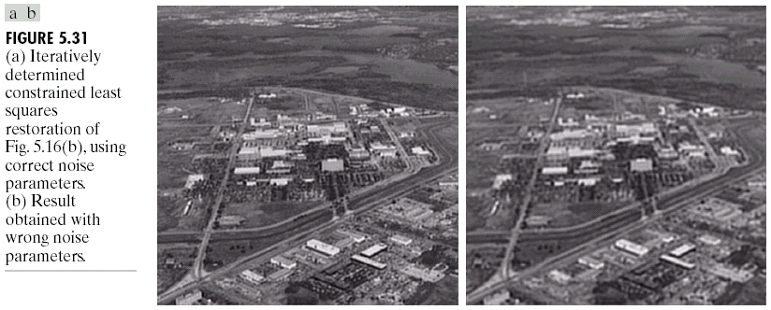
Chapter 5
Image Restoration

Slide 33
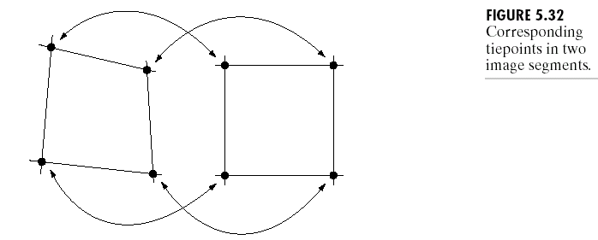
Chapter 5
Image Restoration

Slide 34
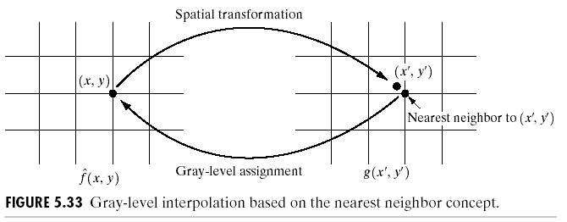
Chapter 5
Image Restoration

Slide 35
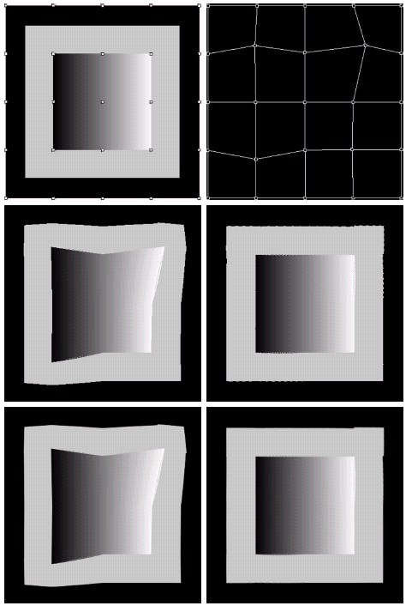
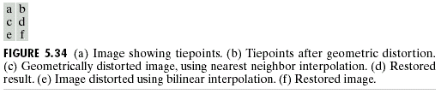
Chapter 5
Image Restoration

Slide 36
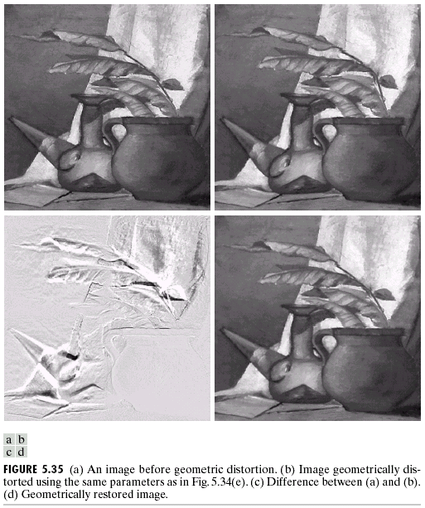
Chapter 5
Image Restoration

Slide 37
Chapter 5
Image Restoration

Slide 38
Chapter 5
Image Restoration

Slide 39
Chapter 5
Image Restoration

Slide 40
Chapter 5
Image Restoration

