Slide 1
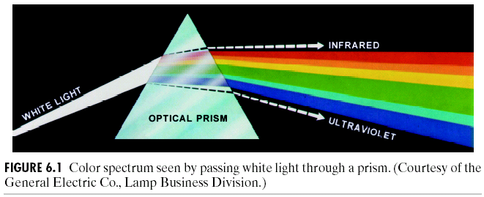
Chapter 6
Color Image Processing

Slide 2
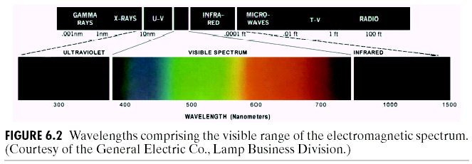
Chapter 6
Color Image Processing

Slide 3
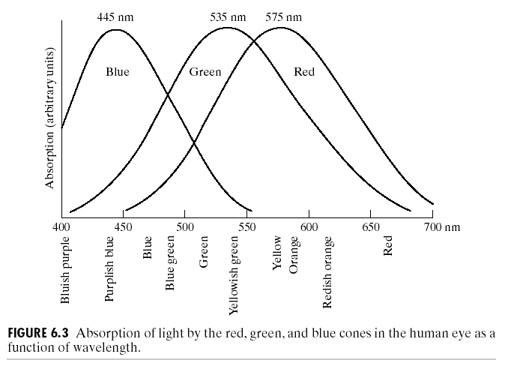
Chapter 6
Color Image Processing

Slide 4
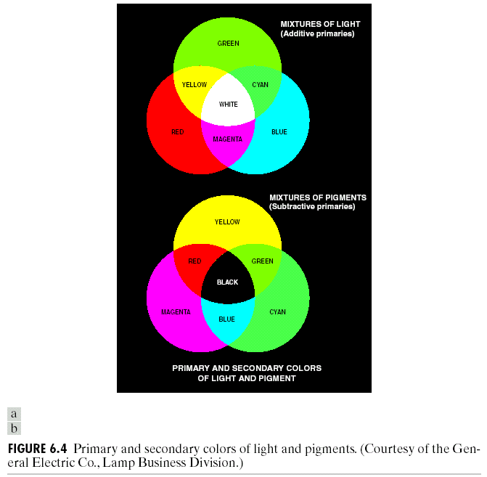
Chapter 6
Color Image Processing

Slide 5
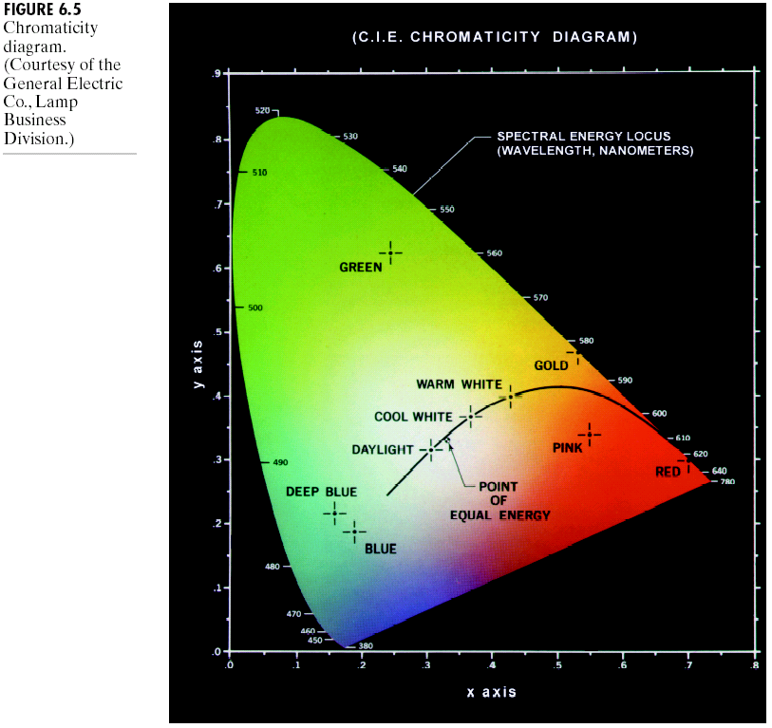
Chapter 6
Color Image Processing

Slide 6
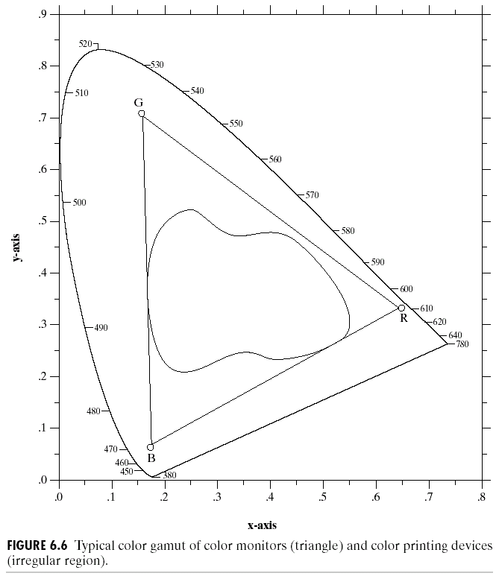
Chapter 6
Color Image Processing

Slide 7
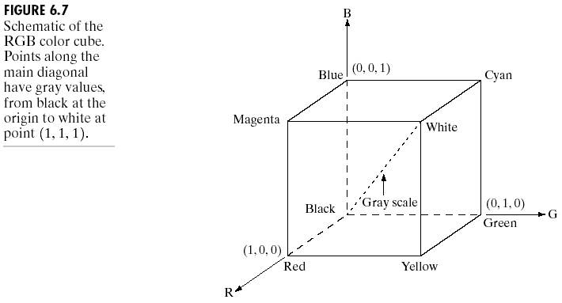
Chapter 6
Color Image Processing

Slide 8
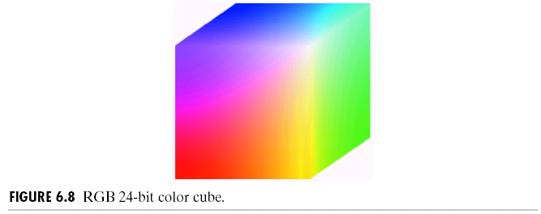
Chapter 6
Color Image Processing

Slide 9
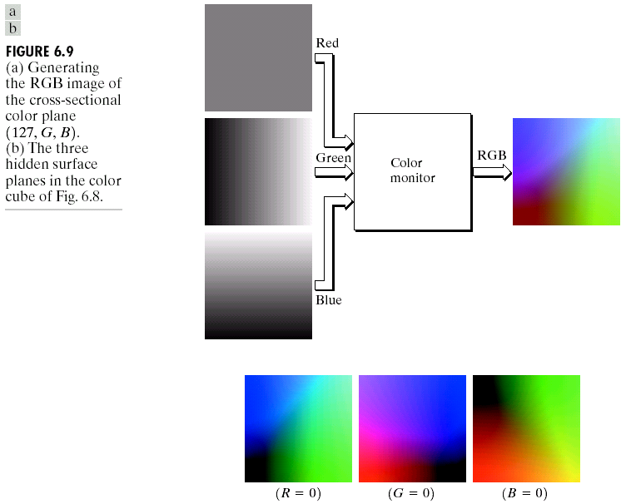
Chapter 6
Color Image Processing

Slide 10
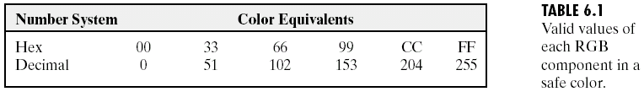
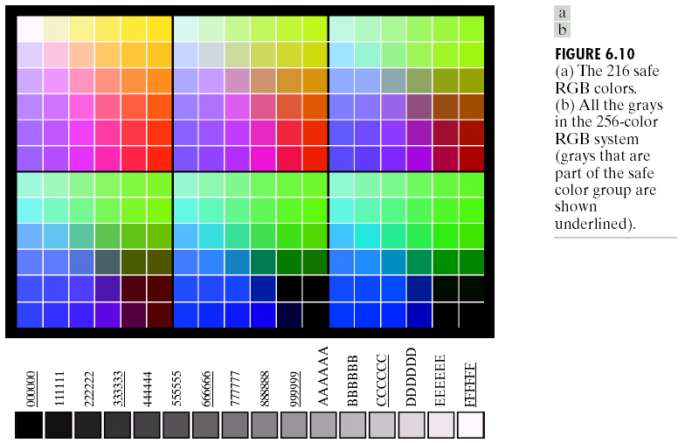
Chapter 6
Color Image Processing

Slide 11
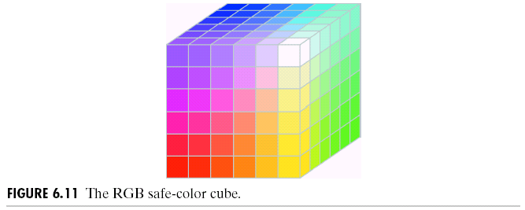
Chapter 6
Color Image Processing

Slide 12
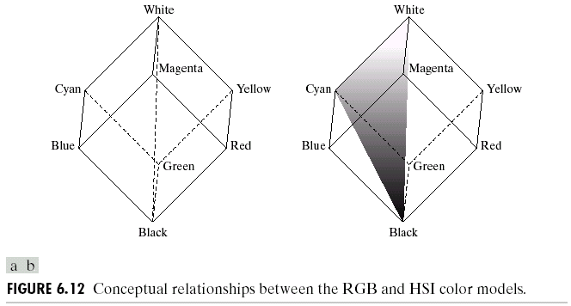
Chapter 6
Color Image Processing

Slide 13
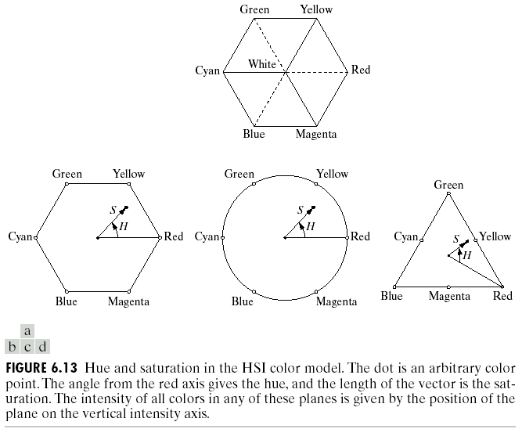
Chapter 6
Color Image Processing

Slide 14
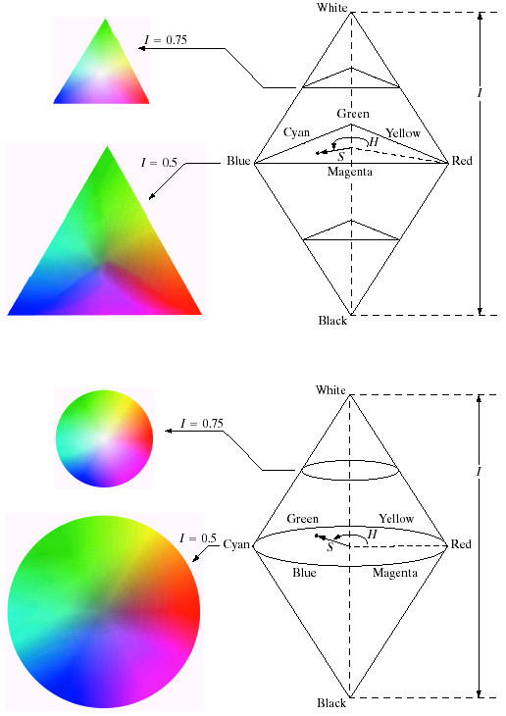

Chapter 6
Color Image Processing

Slide 15
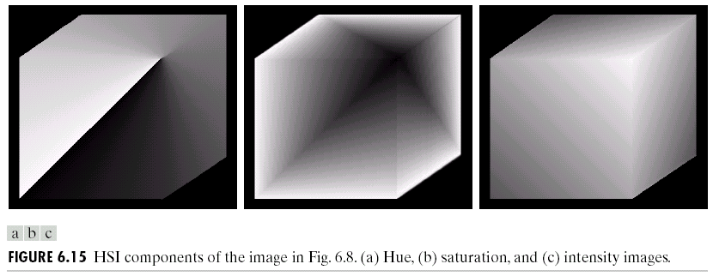
Chapter 6
Color Image Processing

Slide 16
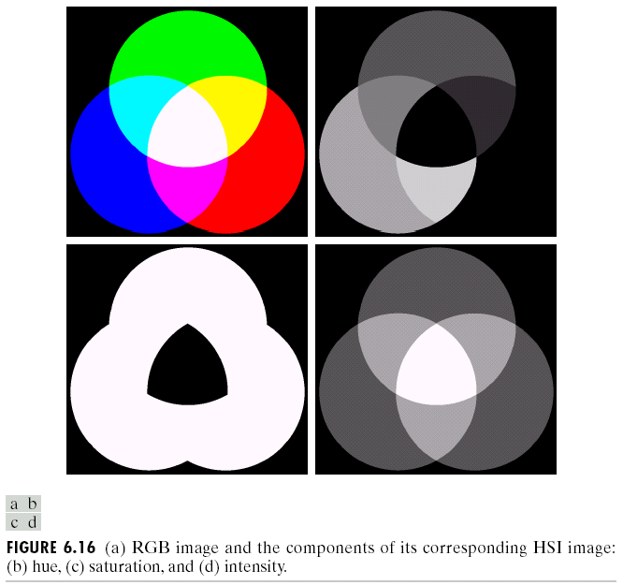
Chapter 6
Color Image Processing

Slide 17
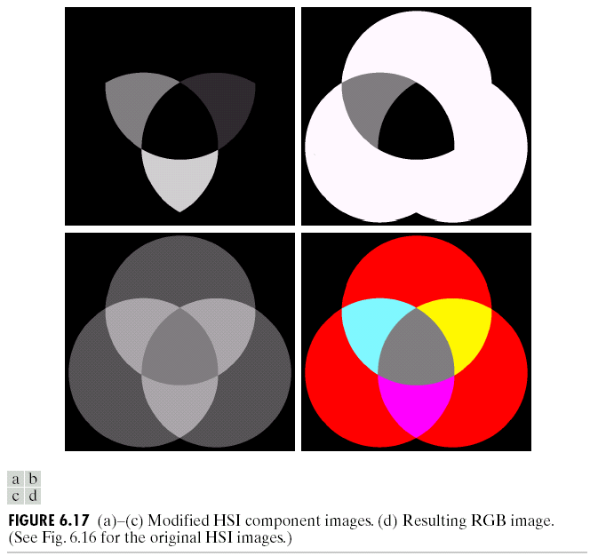
Chapter 6
Color Image Processing

Slide 18
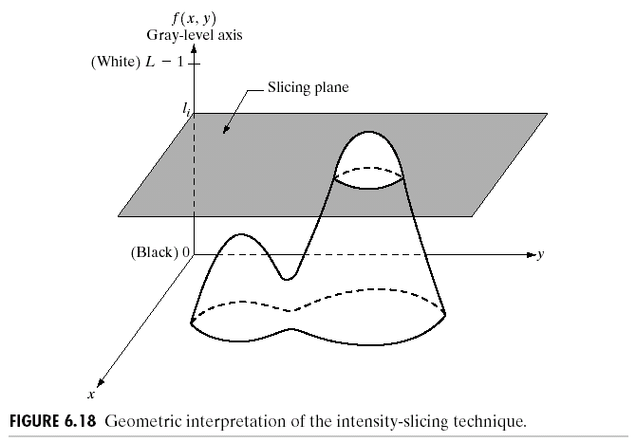
Chapter 6
Color Image Processing

Slide 19
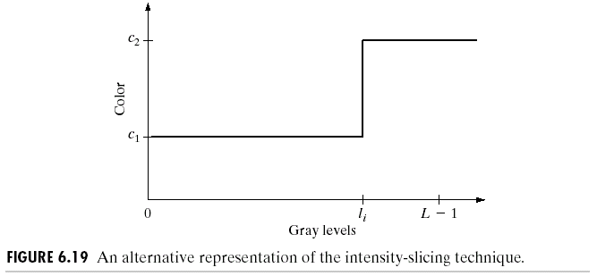
Chapter 6
Color Image Processing

Slide 20
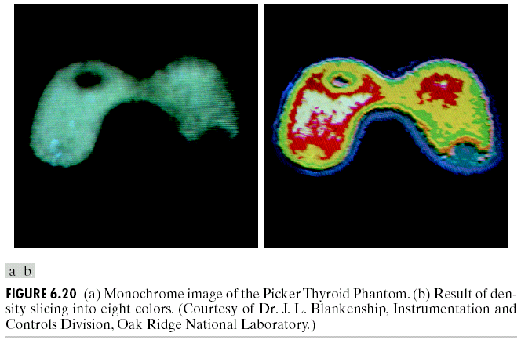
Chapter 6
Color Image Processing

Slide 21
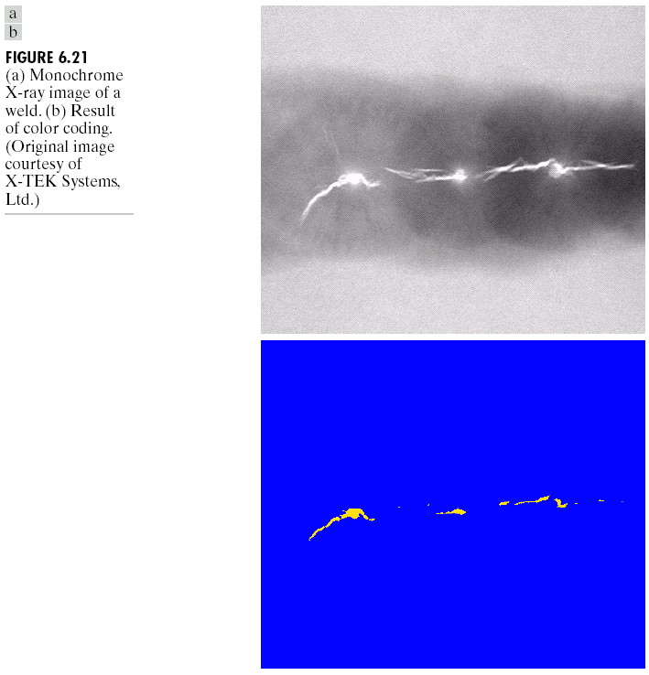
Chapter 6
Color Image Processing

Slide 22
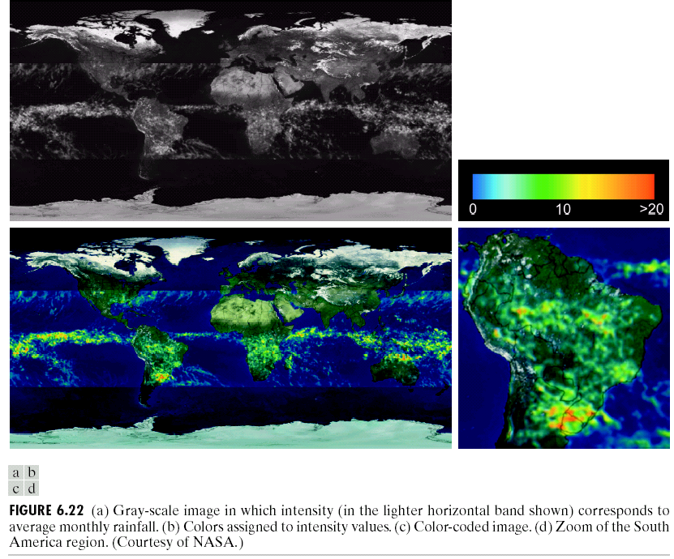
Chapter 6
Color Image Processing

Slide 23
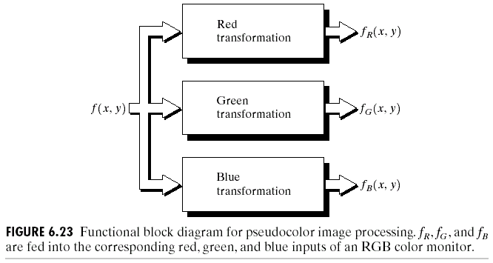
Chapter 6
Color Image Processing

Slide 24
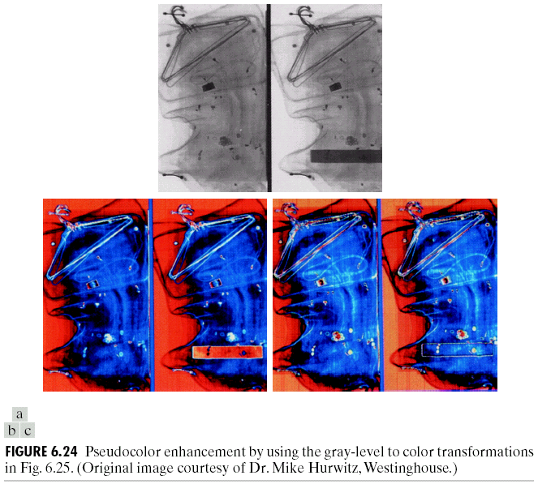
Chapter 6
Color Image Processing

Slide 25
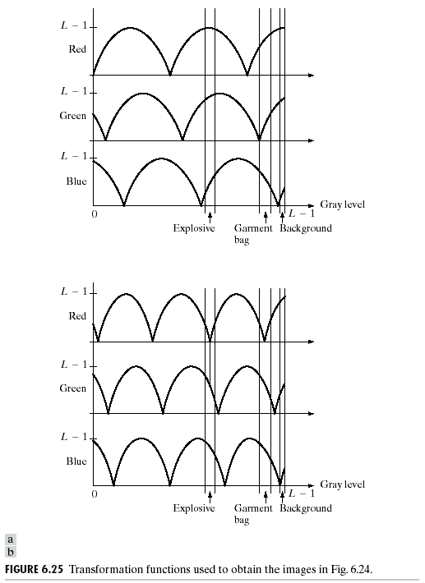
Chapter 6
Color Image Processing

Slide 26
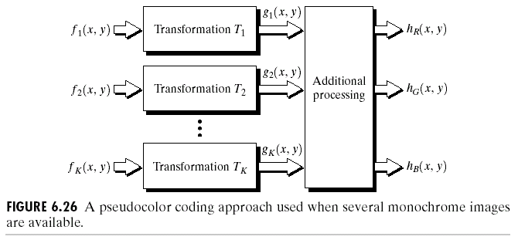
Chapter 6
Color Image Processing

Slide 27
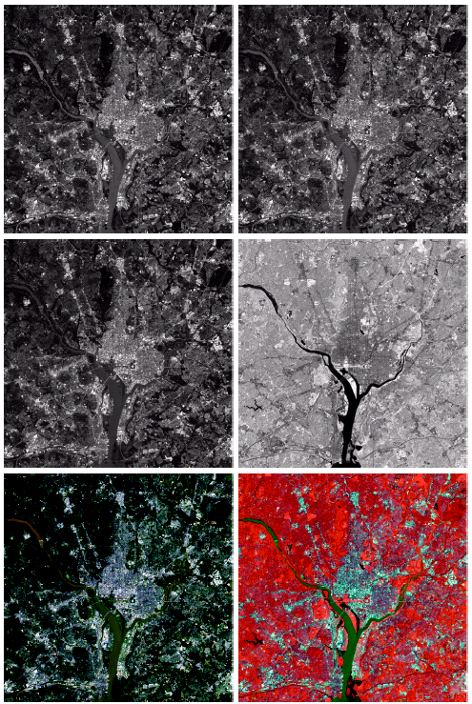

Chapter 6
Color Image Processing

Slide 28
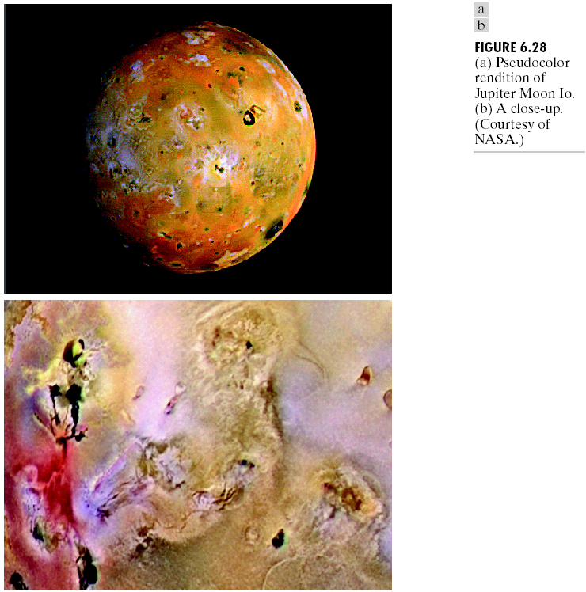
Chapter 6
Color Image Processing

Slide 29
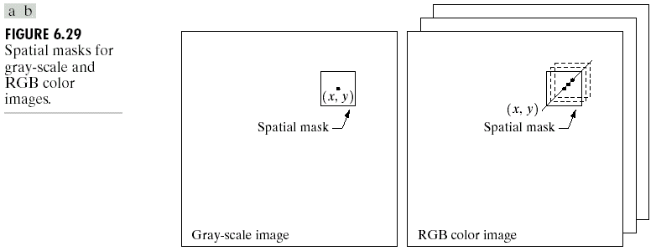
Chapter 6
Color Image Processing

Slide 30
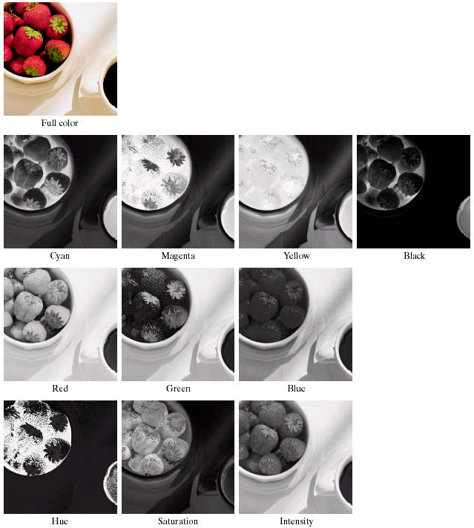
Chapter 6
Color Image Processing

Slide 31
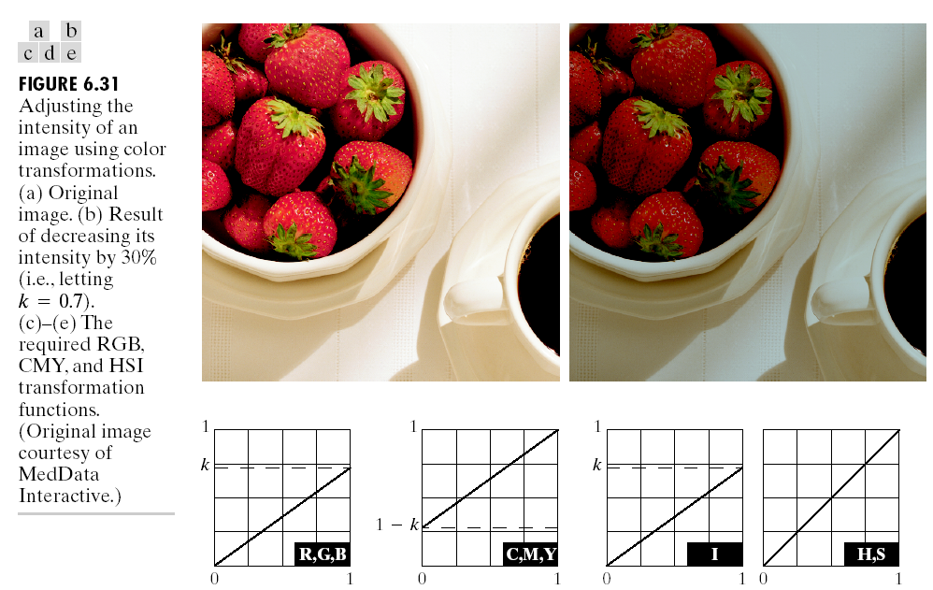
Chapter 6
Color Image Processing

Slide 32
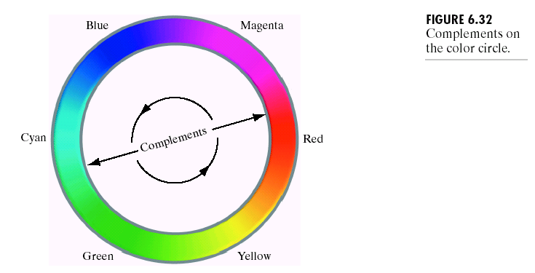
Chapter 6
Color Image Processing

Slide 33
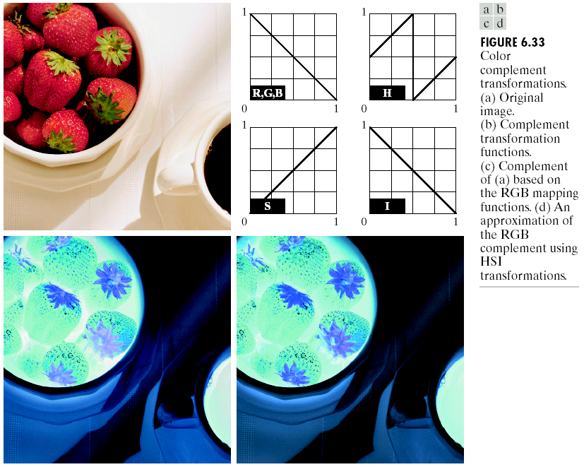
Chapter 6
Color Image Processing

Slide 34
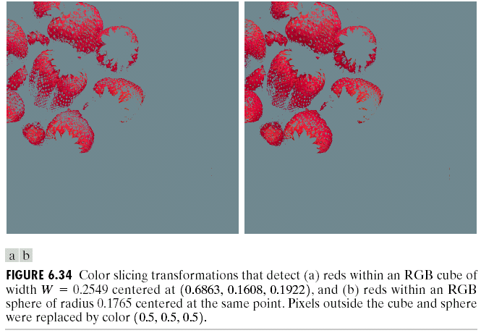
Chapter 6
Color Image Processing

Slide 35
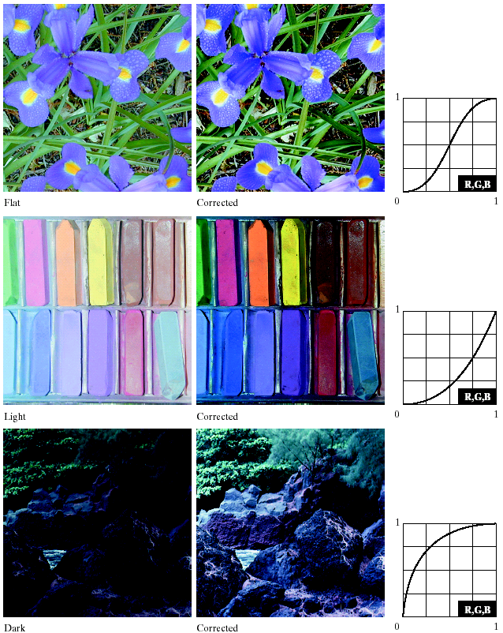
Chapter 6
Color Image Processing

Slide 36
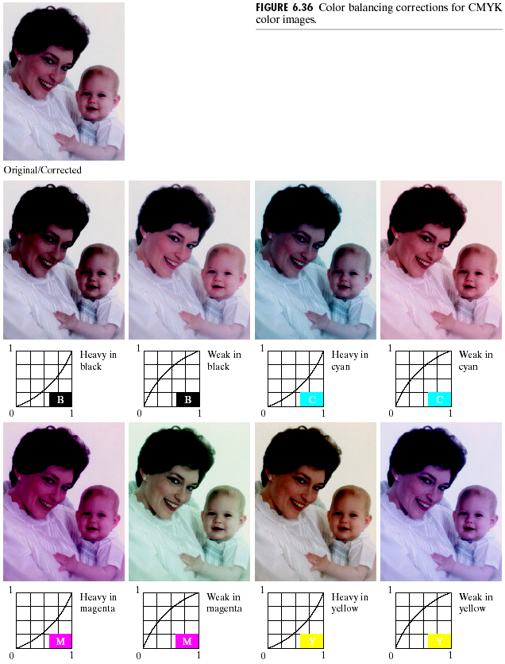
Chapter 6
Color Image Processing

Slide 37
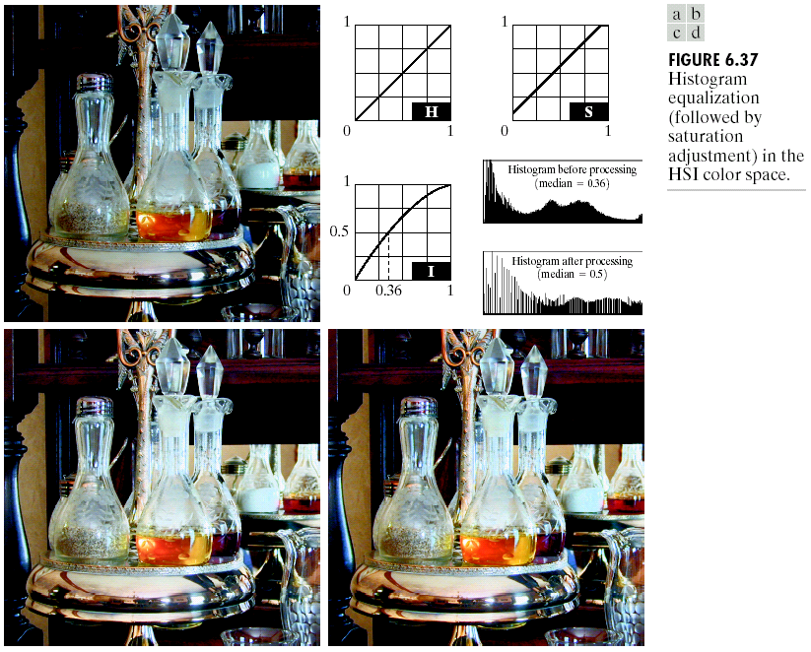
Chapter 6
Color Image Processing

Slide 38
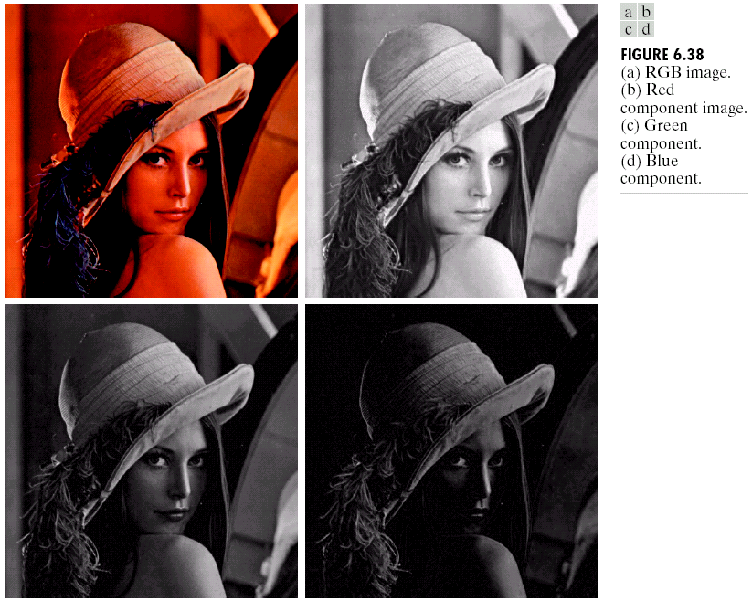
Chapter 6
Color Image Processing

Slide 39
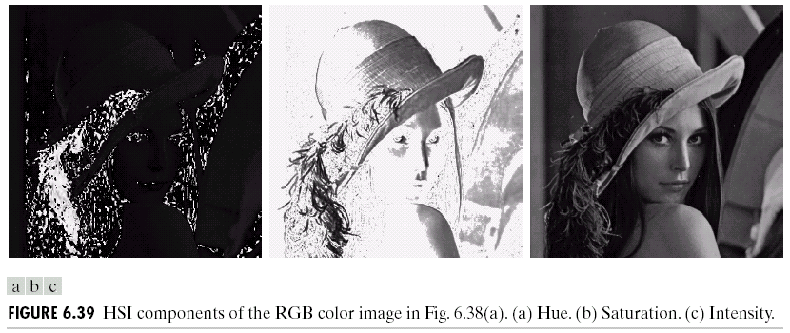
Chapter 6
Color Image Processing

Slide 40
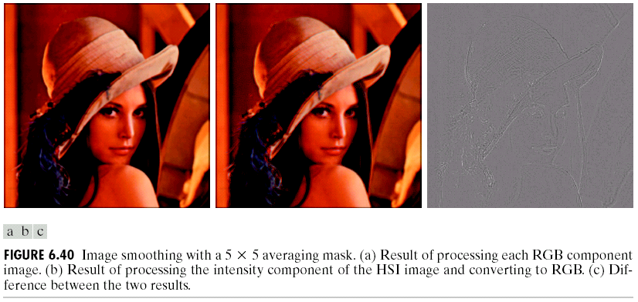
Chapter 6
Color Image Processing

Slide 41
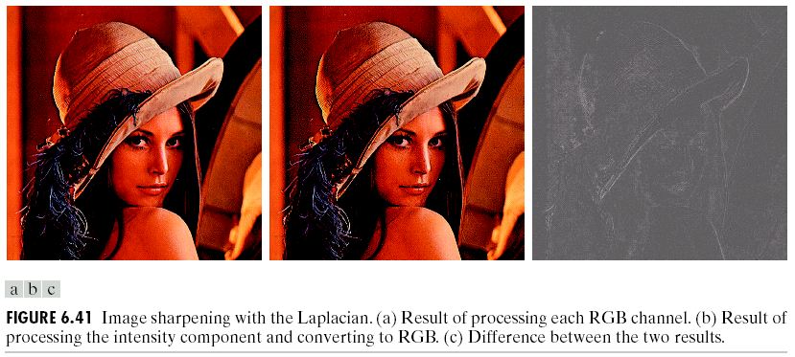
Chapter 6
Color Image Processing

Slide 42
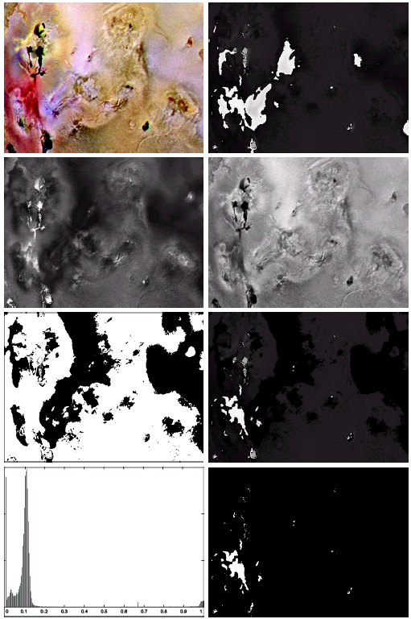

Chapter 6
Color Image Processing

Slide 43
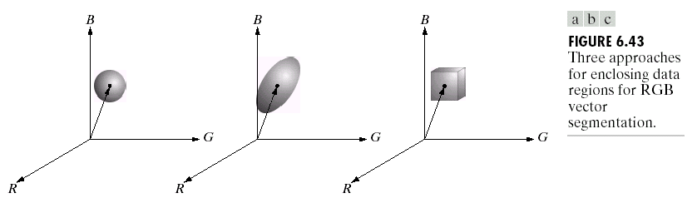
Chapter 6
Color Image Processing

Slide 44
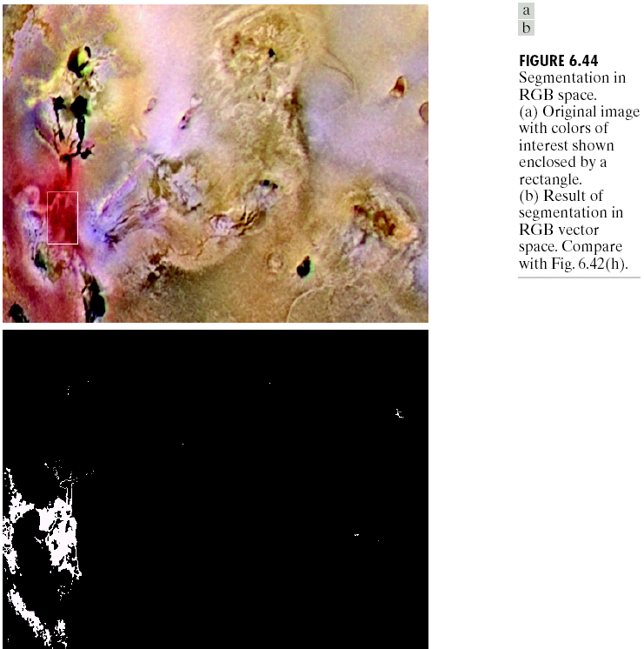
Chapter 6
Color Image Processing

Slide 45
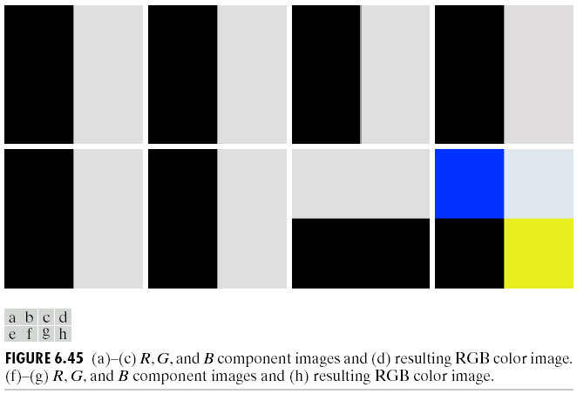
Chapter 6
Color Image Processing

Slide 46
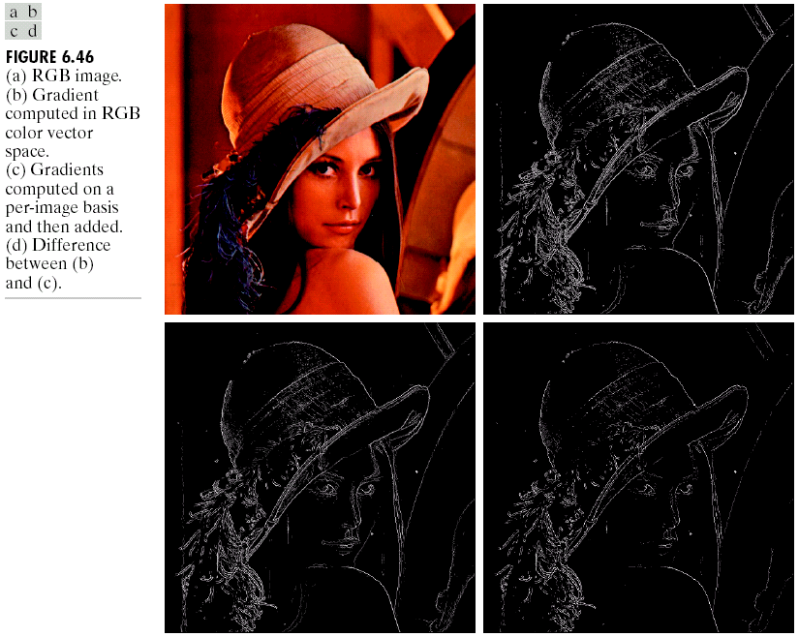
Chapter 6
Color Image Processing

Slide 47
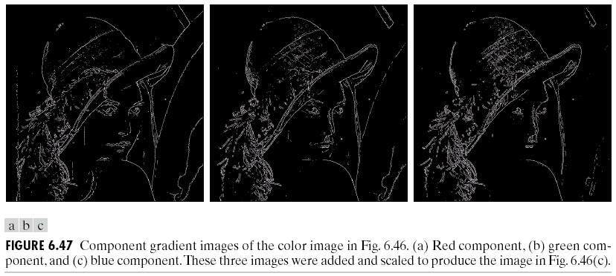
Chapter 6
Color Image Processing

Slide 48
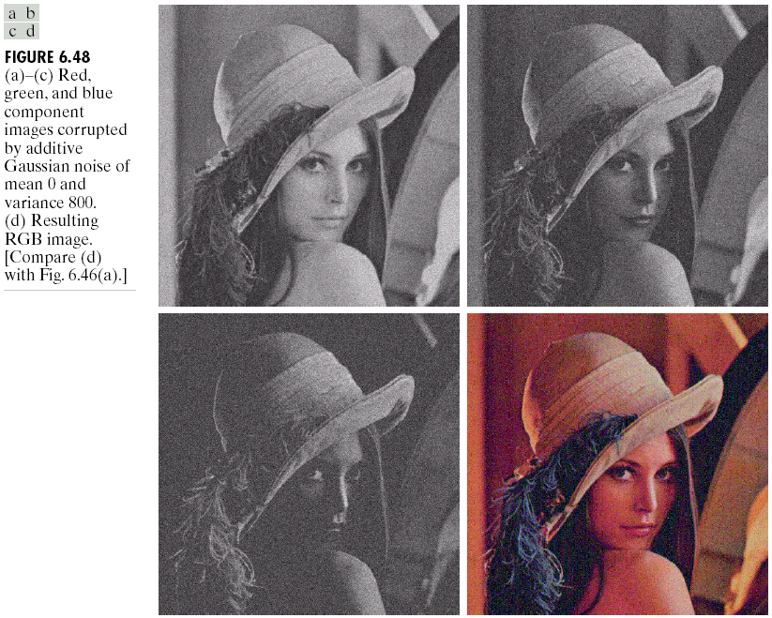
Chapter 6
Color Image Processing

Slide 49
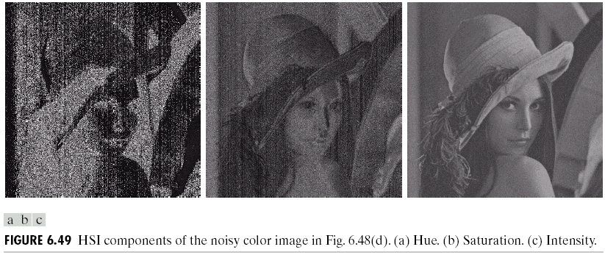
Chapter 6
Color Image Processing

Slide 50

Chapter 6
Color Image Processing

Slide 51

Chapter 6
Color Image Processing

