Slide 1
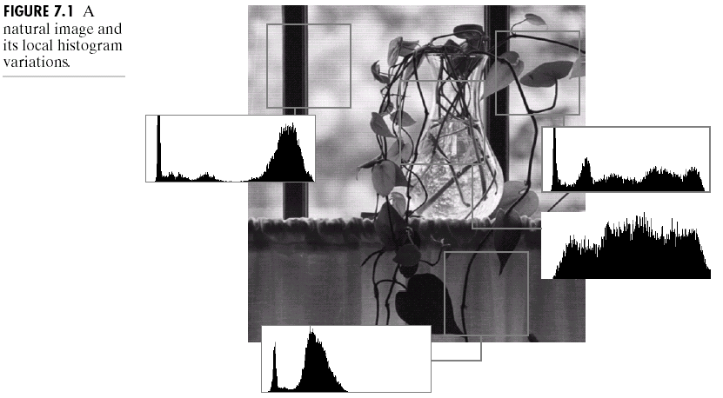
Chapter 7
Wavelets and Multiresolution Processing

Slide 2
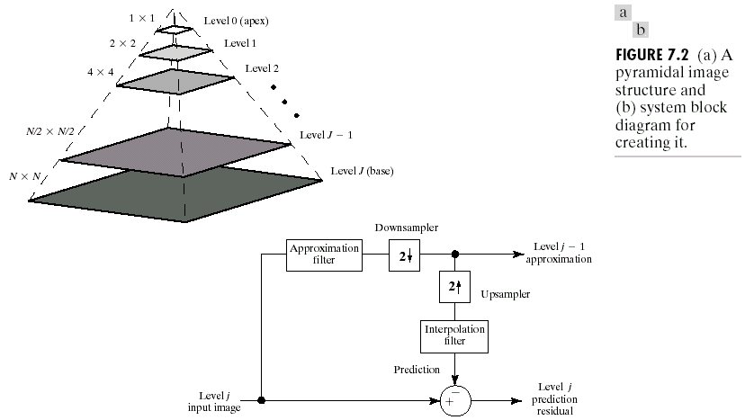
Chapter 7
Wavelets and Multiresolution Processing

Slide 3
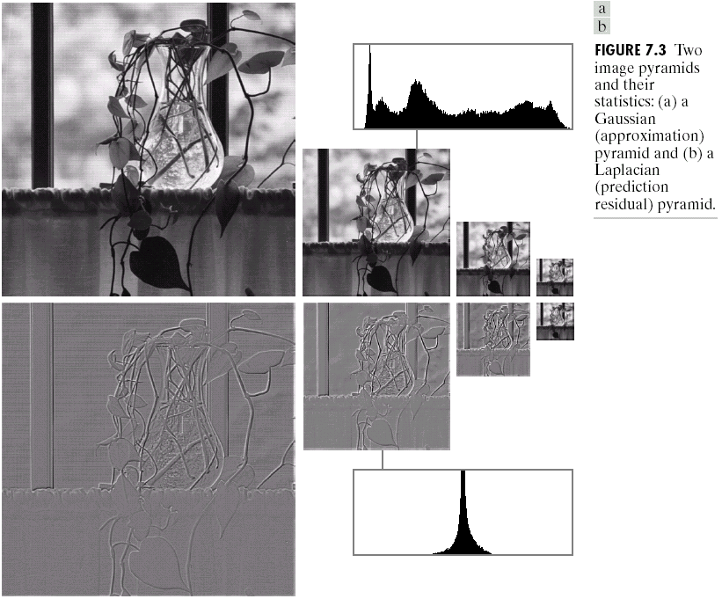
Chapter 7
Wavelets and Multiresolution Processing

Slide 4
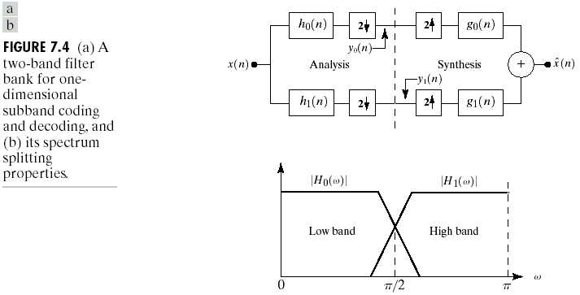
Chapter 7
Wavelets and Multiresolution Processing

Slide 5
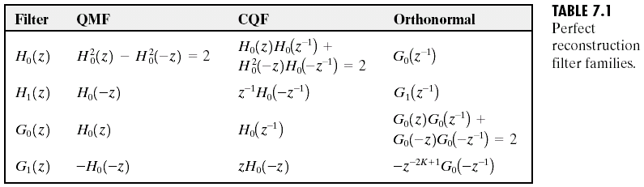
Chapter 7
Wavelets and Multiresolution Processing

Slide 6
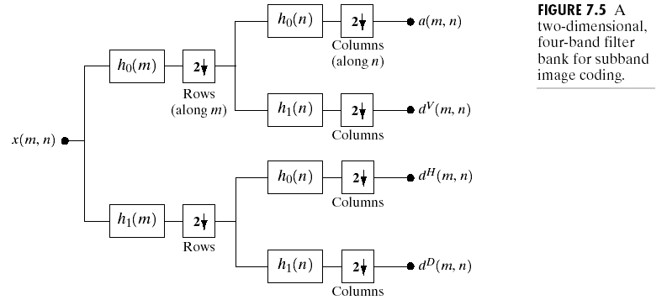
Chapter 7
Wavelets and Multiresolution Processing

Slide 7
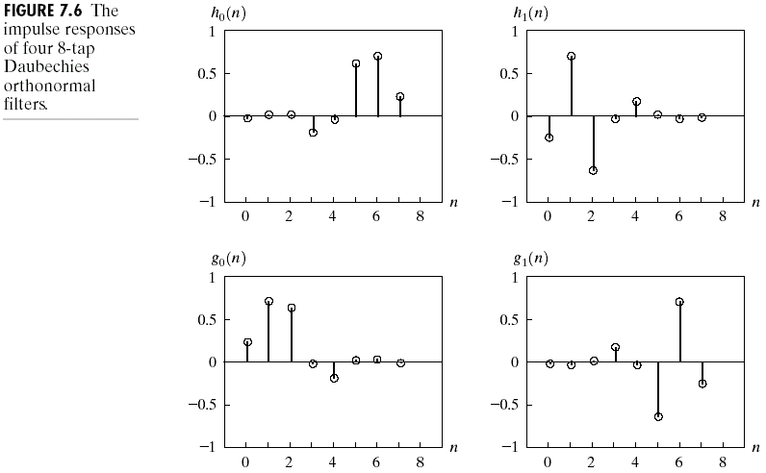
Chapter 7
Wavelets and Multiresolution Processing

Slide 8
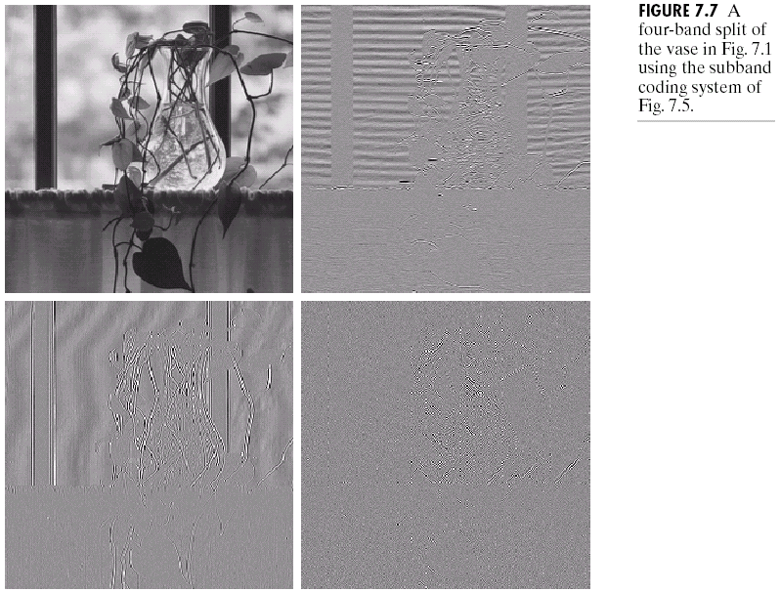
Chapter 7
Wavelets and Multiresolution Processing

Slide 9
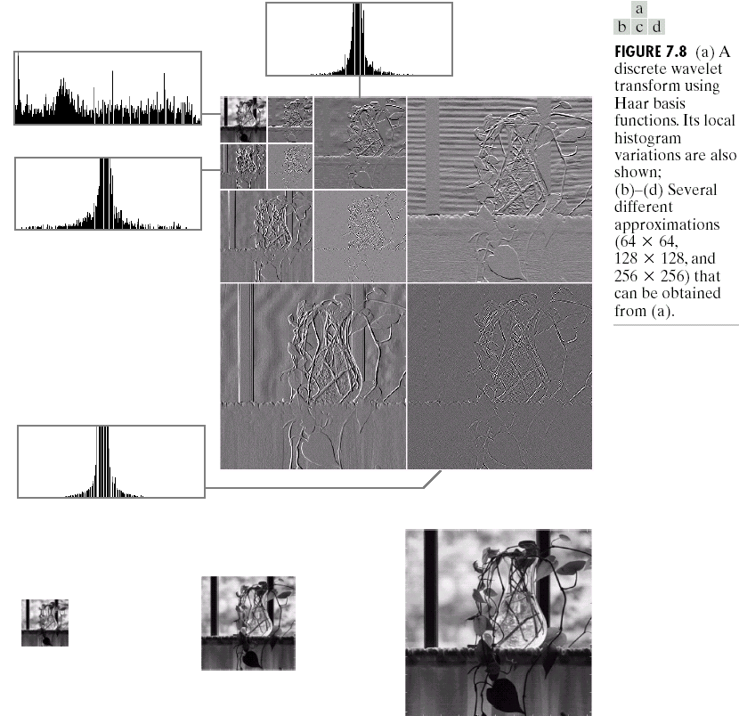
Chapter 7
Wavelets and Multiresolution Processing

Slide 10
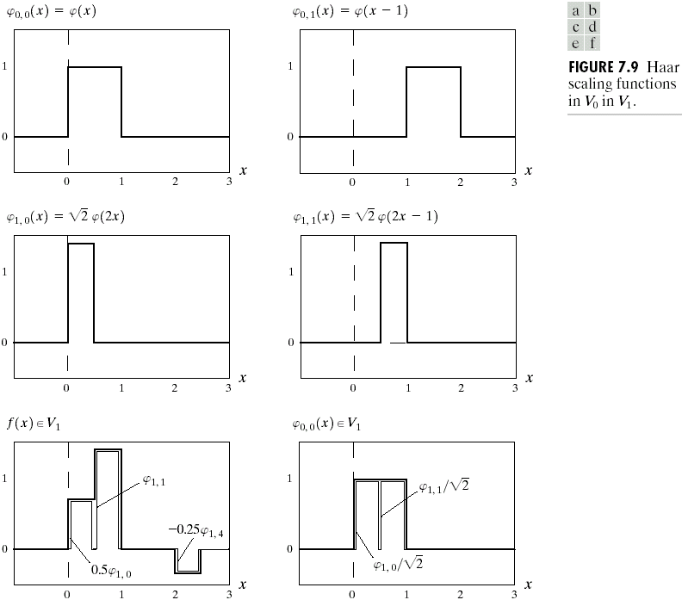
Chapter 7
Wavelets and Multiresolution Processing

Slide 11
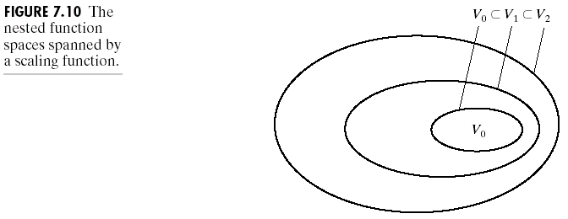
Chapter 7
Wavelets and Multiresolution Processing

Slide 12
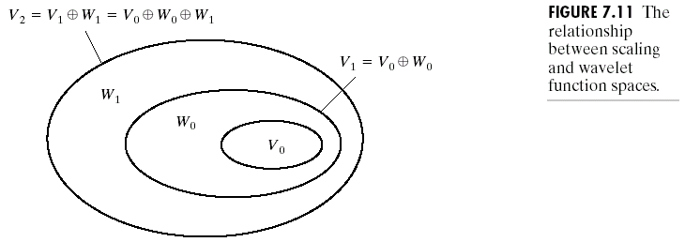
Chapter 7
Wavelets and Multiresolution Processing

Slide 13
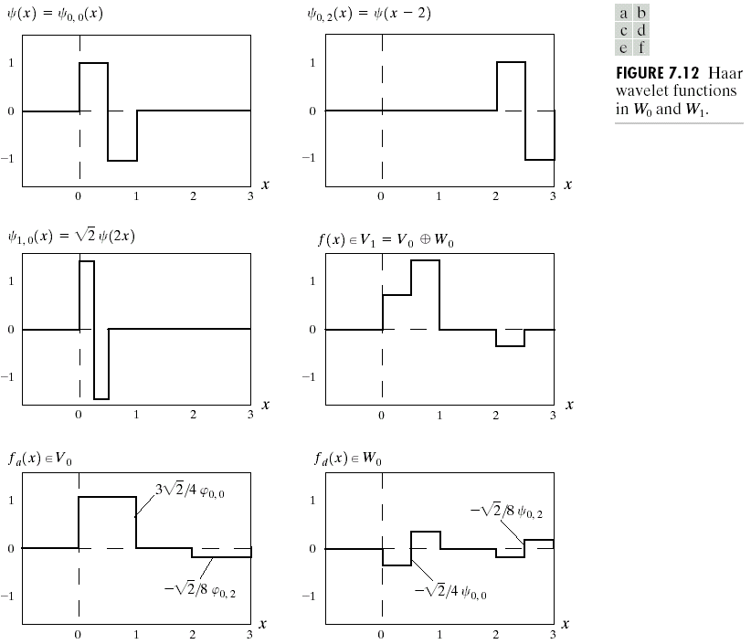
Chapter 7
Wavelets and Multiresolution Processing

Slide 14
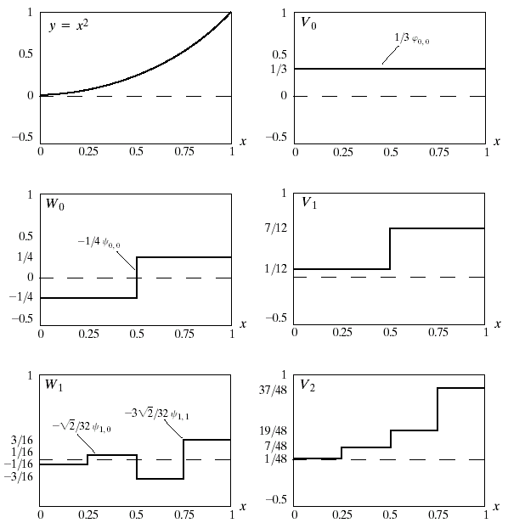
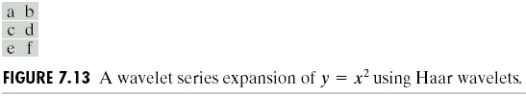
Chapter 7
Wavelets and Multiresolution Processing

Slide 15
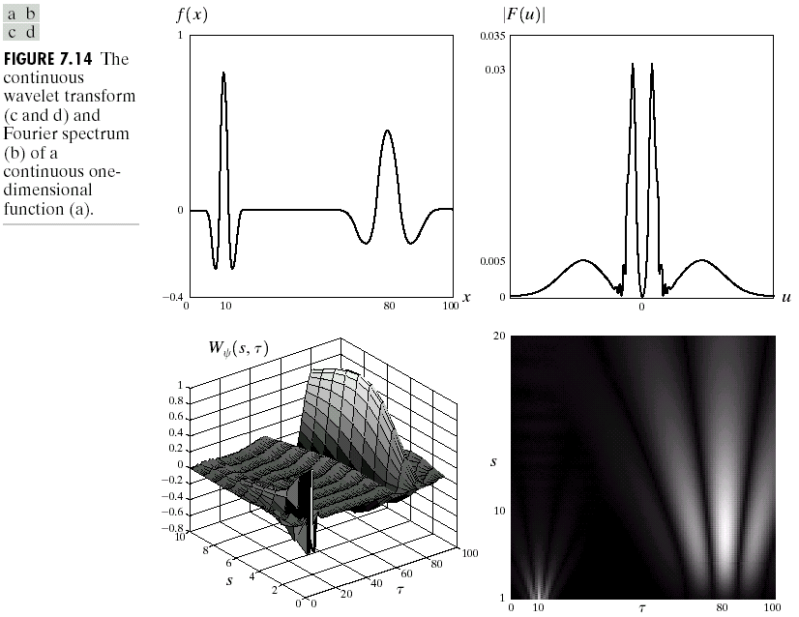
Chapter 7
Wavelets and Multiresolution Processing

Slide 16
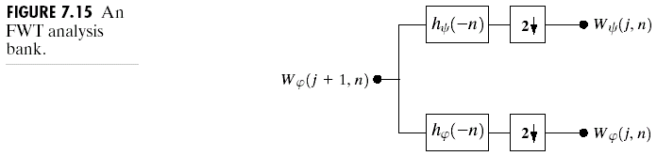
Chapter 7
Wavelets and Multiresolution Processing

Slide 17
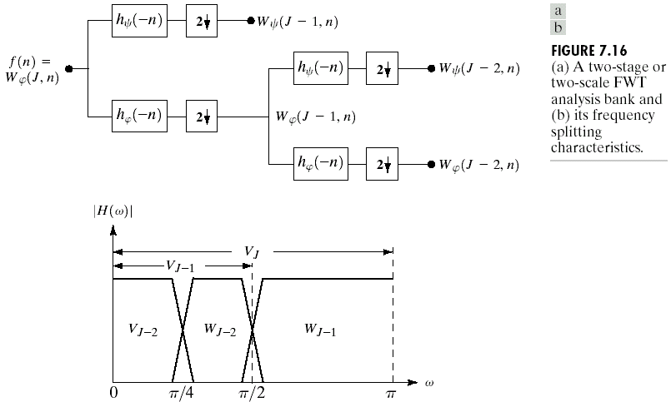
Chapter 7
Wavelets and Multiresolution Processing

Slide 18
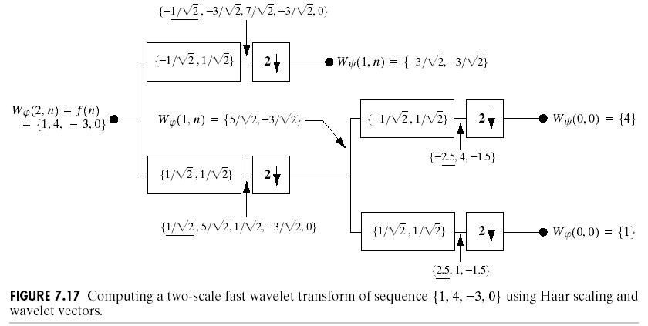
Chapter 7
Wavelets and Multiresolution Processing

Slide 19
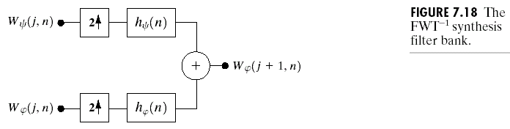
Chapter 7
Wavelets and Multiresolution Processing

Slide 20
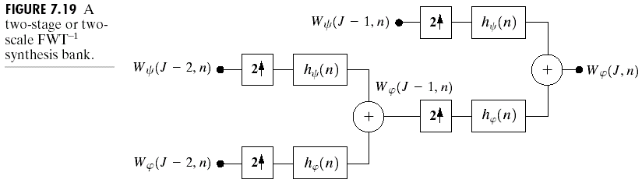
Chapter 7
Wavelets and Multiresolution Processing

Slide 21
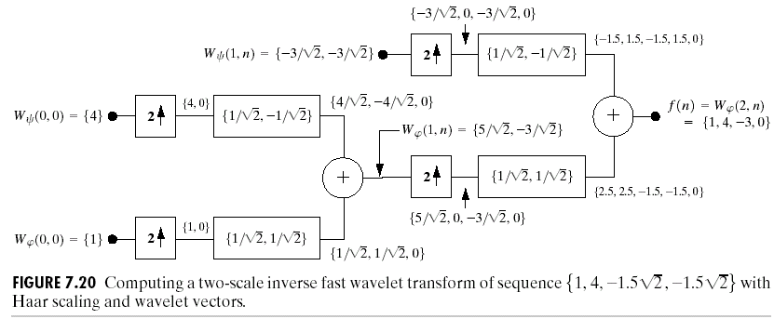
Chapter 7
Wavelets and Multiresolution Processing

Slide 22
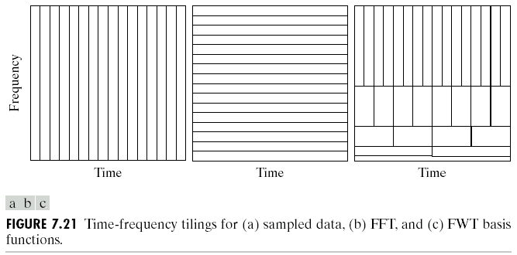
Chapter 7
Wavelets and Multiresolution Processing

Slide 23
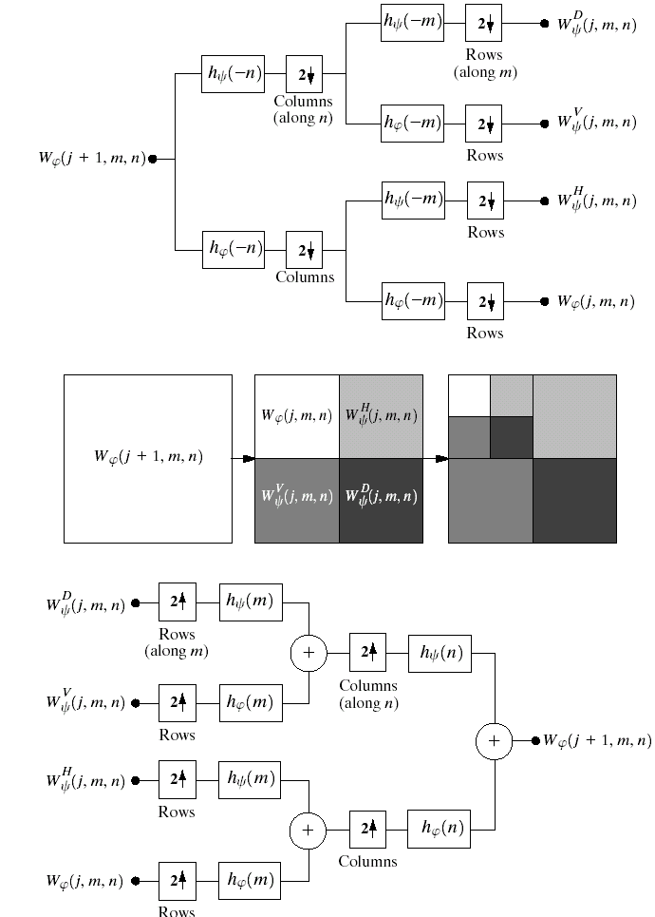
Chapter 7
Wavelets and Multiresolution Processing

Slide 24
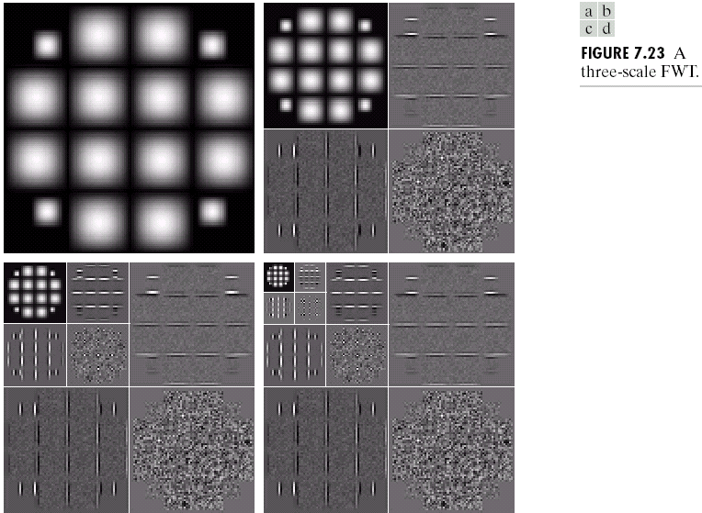
Chapter 7
Wavelets and Multiresolution Processing

Slide 25
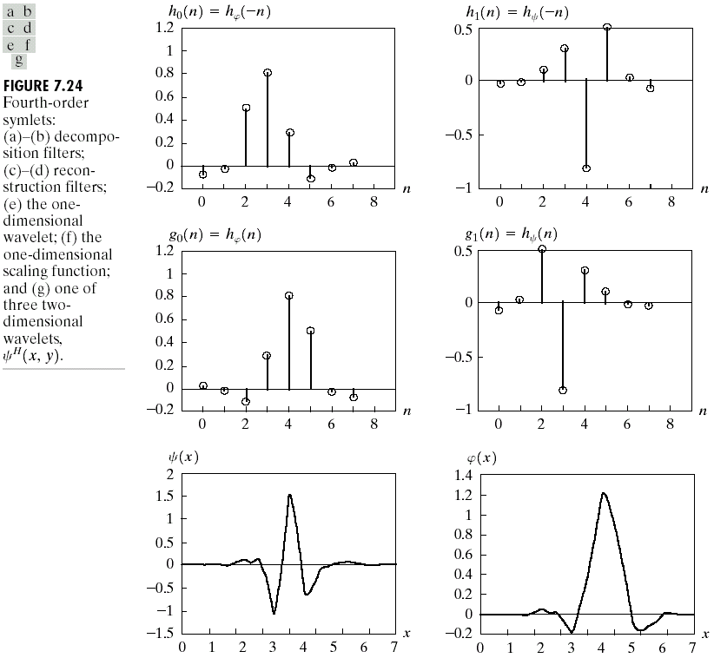
Chapter 7
Wavelets and Multiresolution Processing

Slide 26
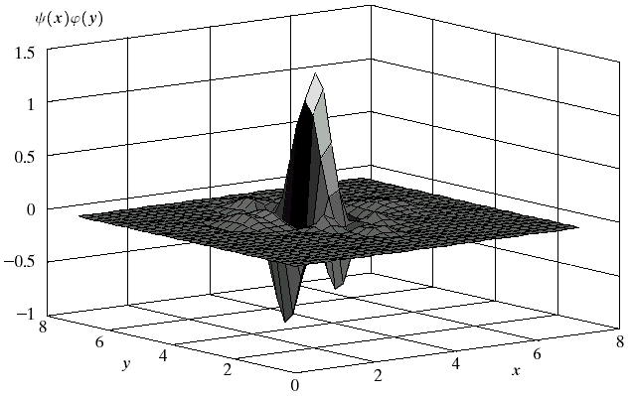
Chapter 7
Wavelets and Multiresolution Processing
Fig. 7.24 (Con’t)

Slide 27
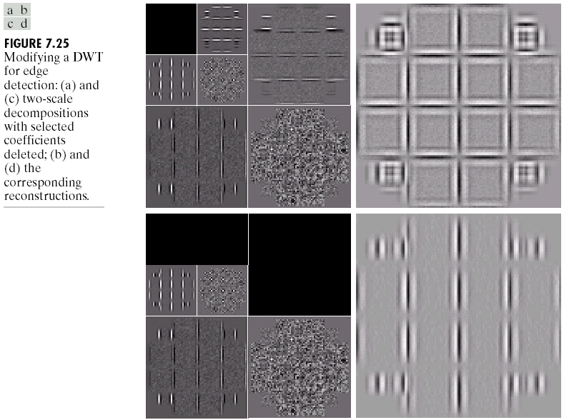
Chapter 7
Wavelets and Multiresolution Processing

Slide 28
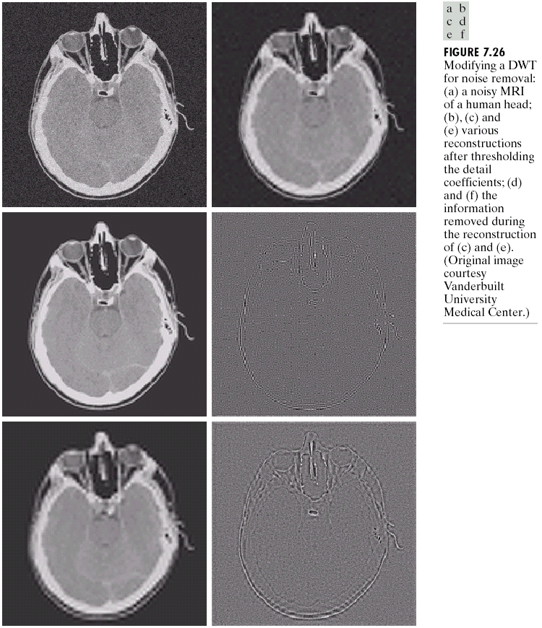
Chapter 7
Wavelets and Multiresolution Processing

Slide 29
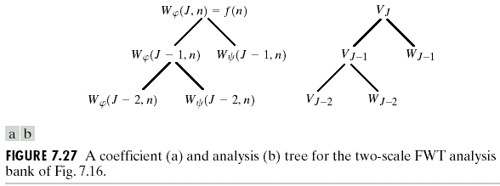
Chapter 7
Wavelets and Multiresolution Processing

Slide 30
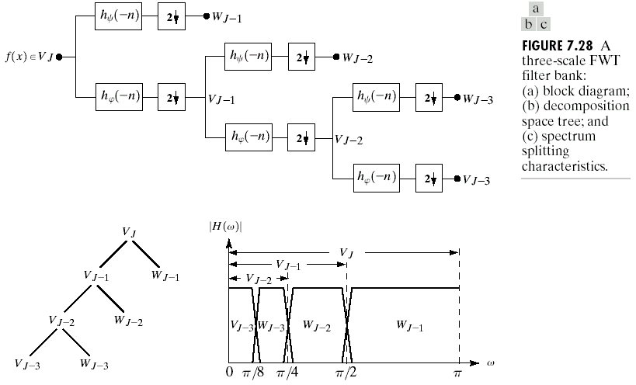
Chapter 7
Wavelets and Multiresolution Processing

Slide 31
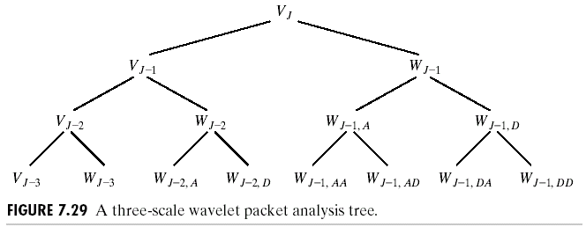
Chapter 7
Wavelets and Multiresolution Processing

Slide 32
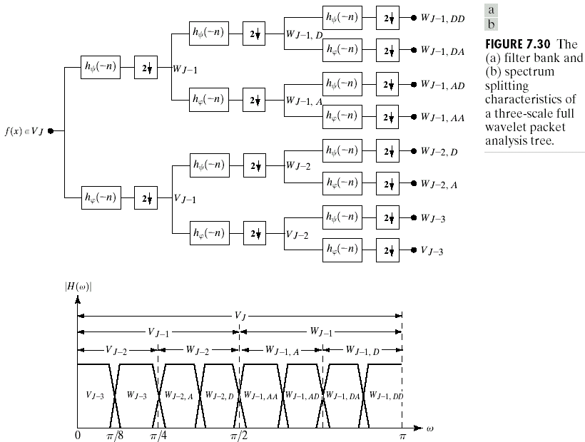
Chapter 7
Wavelets and Multiresolution Processing

Slide 33
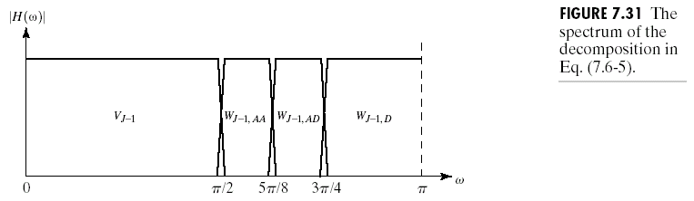
Chapter 7
Wavelets and Multiresolution Processing

Slide 34
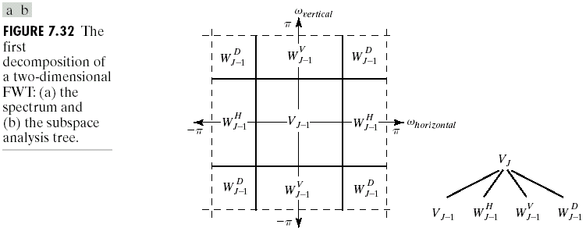
Chapter 7
Wavelets and Multiresolution Processing

Slide 35
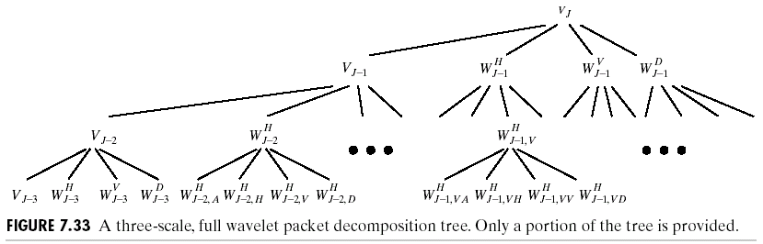
Chapter 7
Wavelets and Multiresolution Processing

Slide 36
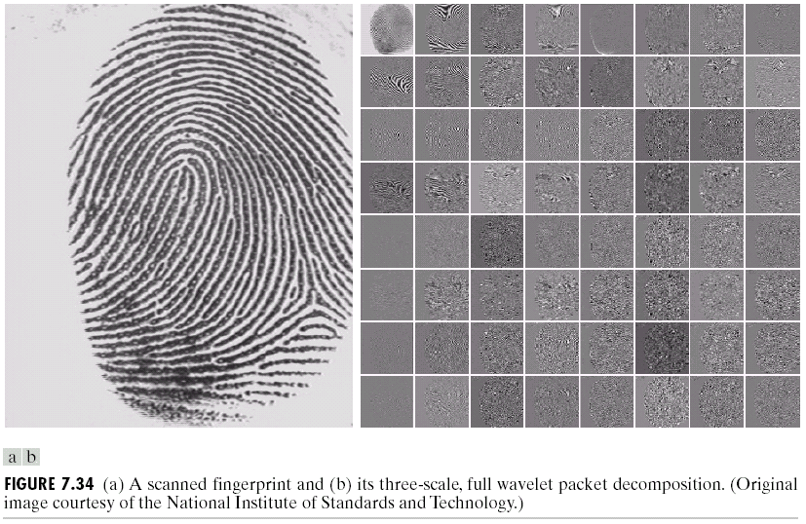
Chapter 7
Wavelets and Multiresolution Processing

Slide 37
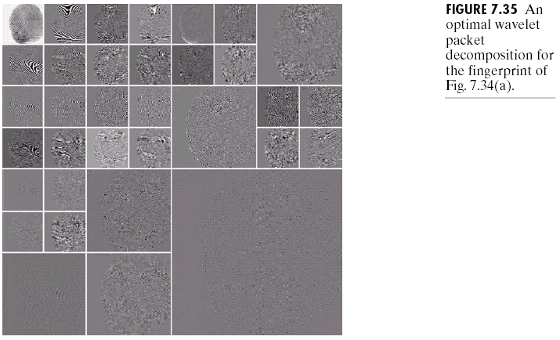
Chapter 7
Wavelets and Multiresolution Processing

Slide 38
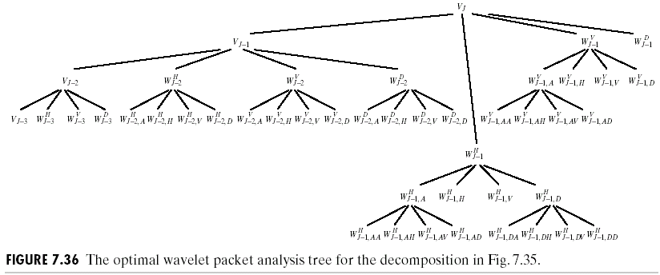
Chapter 7
Wavelets and Multiresolution Processing

Slide 39
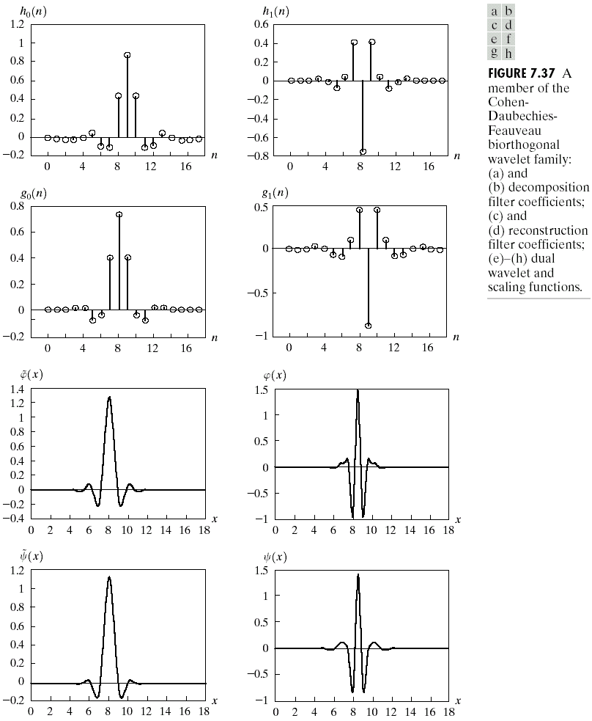
Chapter 7
Wavelets and Multiresolution Processing

