Slide 1
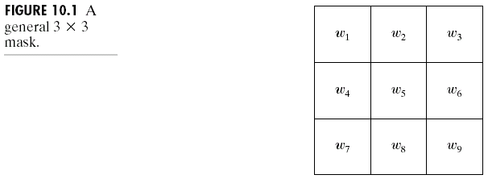
Chapter 10
Image Segmentation

Slide 2
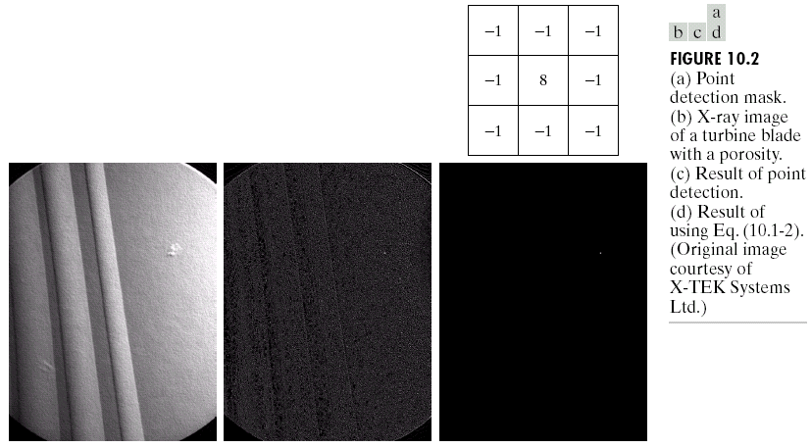
Chapter 10
Image Segmentation

Slide 3
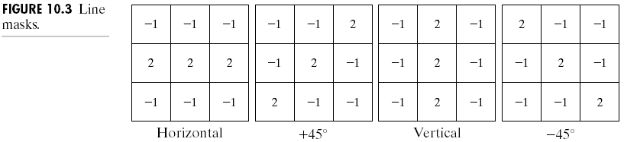
Chapter 10
Image Segmentation

Slide 4
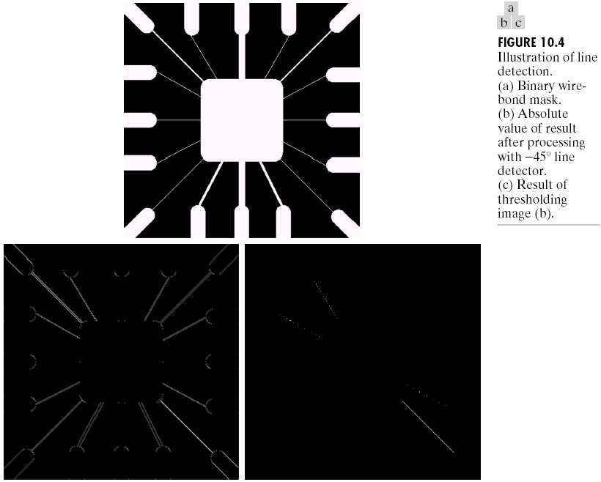
Chapter 10
Image Segmentation

Slide 5
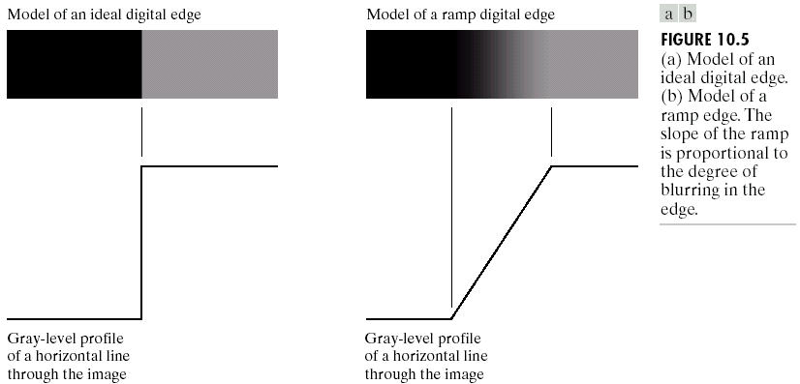
Chapter 10
Image Segmentation

Slide 6
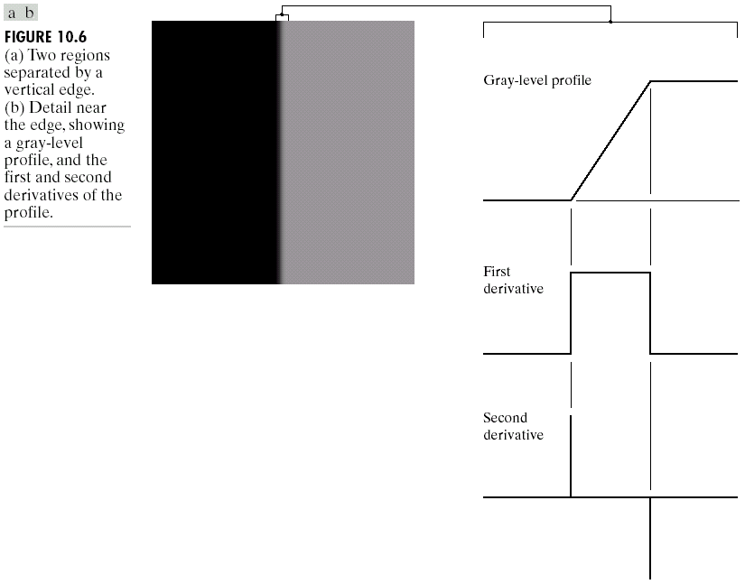
Chapter 10
Image Segmentation

Slide 7
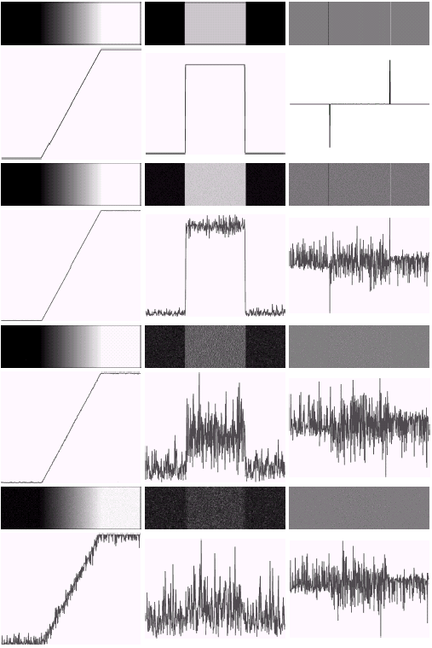

Chapter 10
Image Segmentation

Slide 8
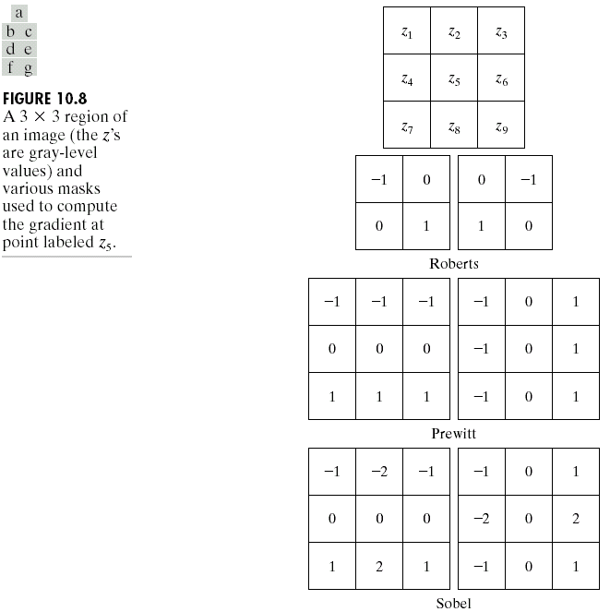
Chapter 10
Image Segmentation

Slide 9
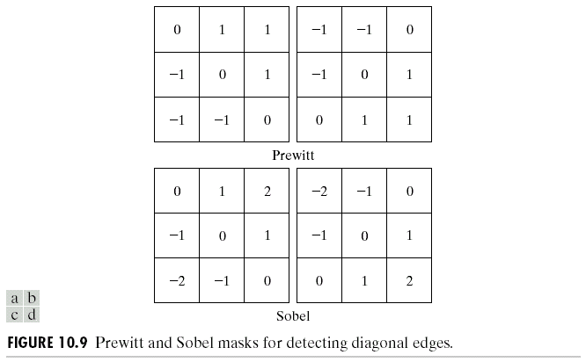
Chapter 10
Image Segmentation

Slide 10
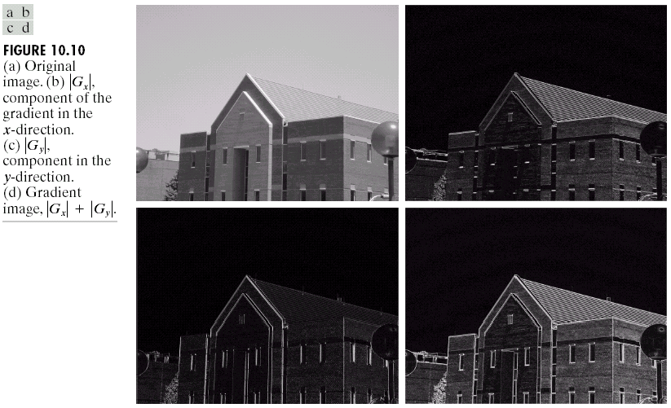
Chapter 10
Image Segmentation

Slide 11
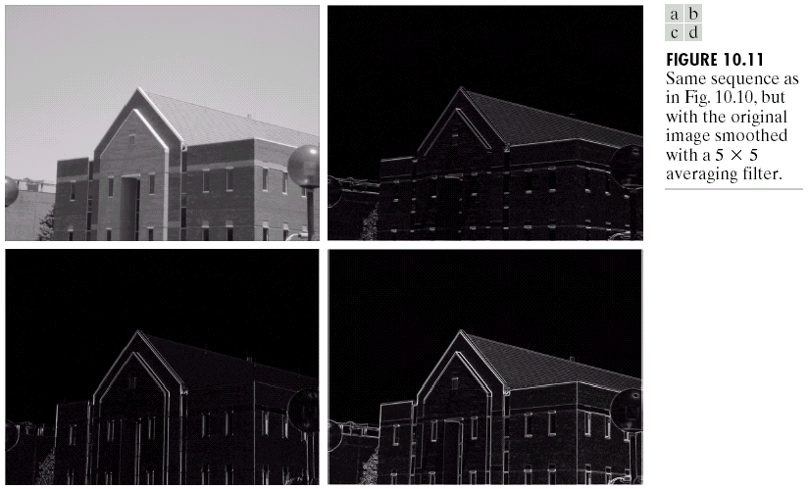
Chapter 10
Image Segmentation

Slide 12
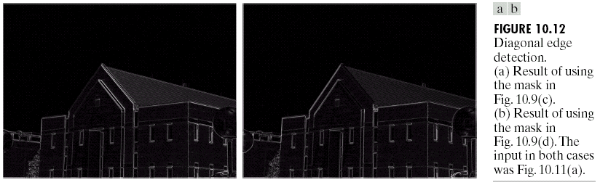
Chapter 10
Image Segmentation

Slide 13
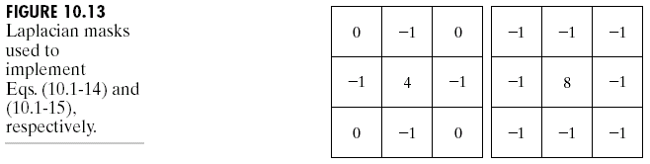
Chapter 10
Image Segmentation

Slide 14
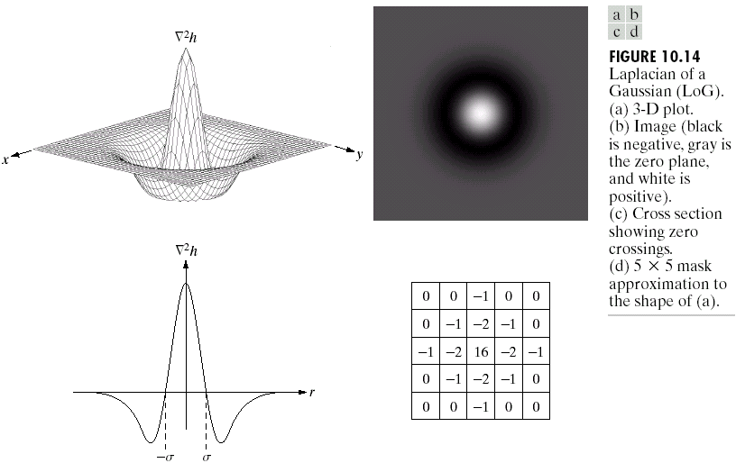
Chapter 10
Image Segmentation

Slide 15
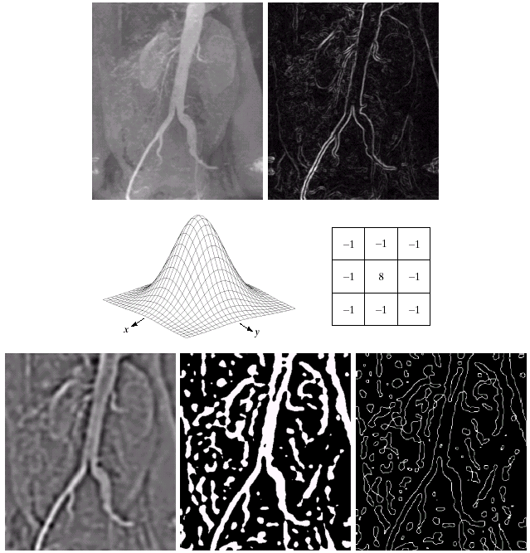
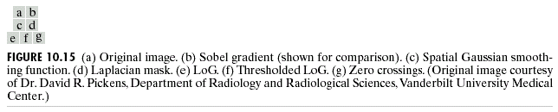
Chapter 10
Image Segmentation

Slide 16
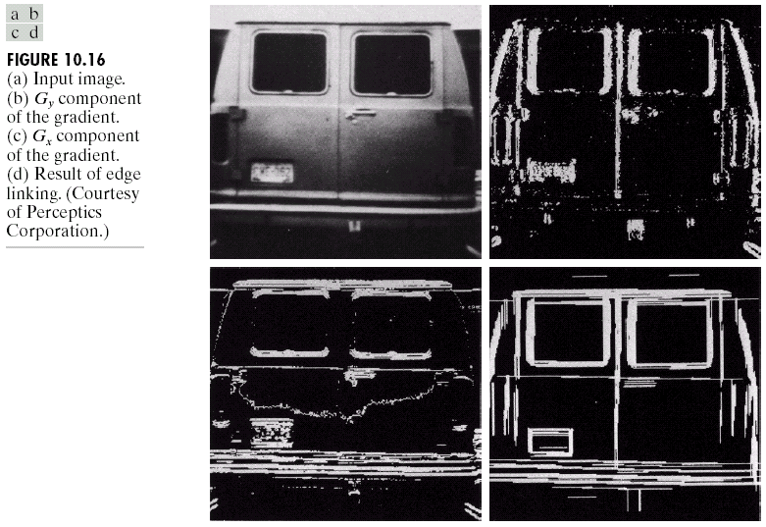
Chapter 10
Image Segmentation

Slide 17
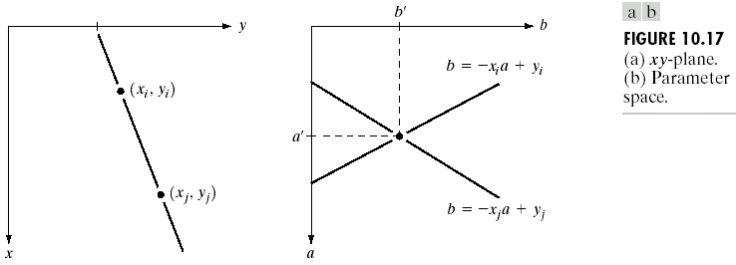
Chapter 10
Image Segmentation

Slide 18
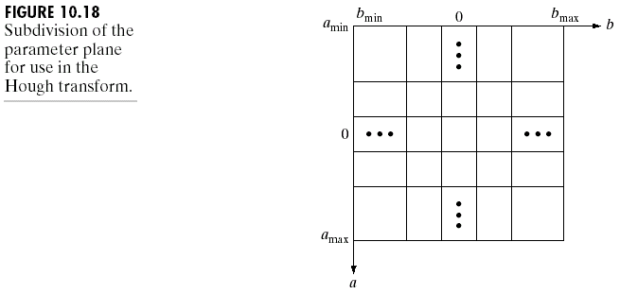
Chapter 10
Image Segmentation

Slide 19
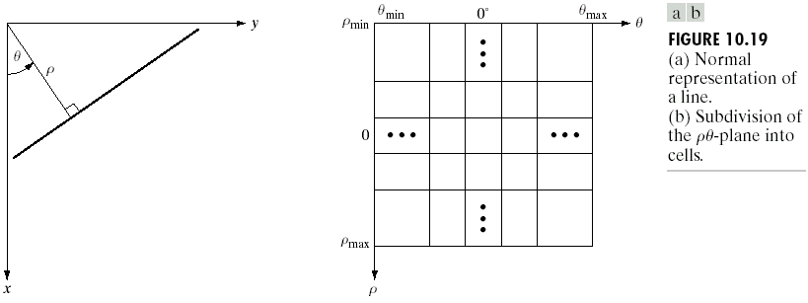
Chapter 10
Image Segmentation

Slide 20
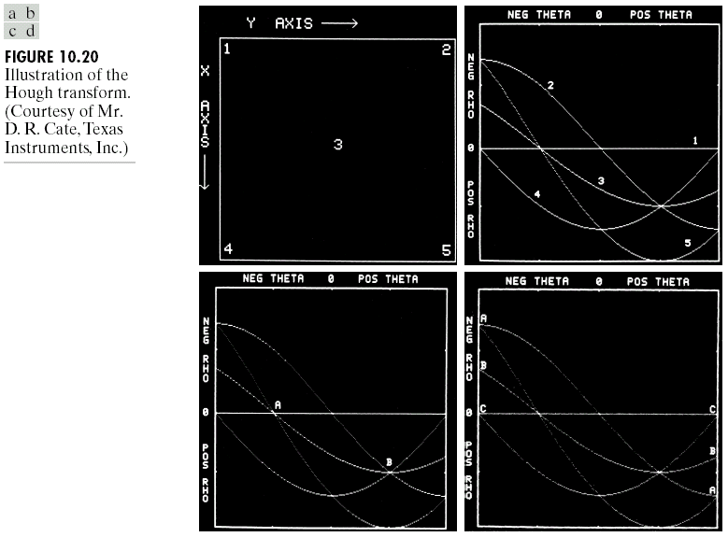
Chapter 10
Image Segmentation

Slide 21
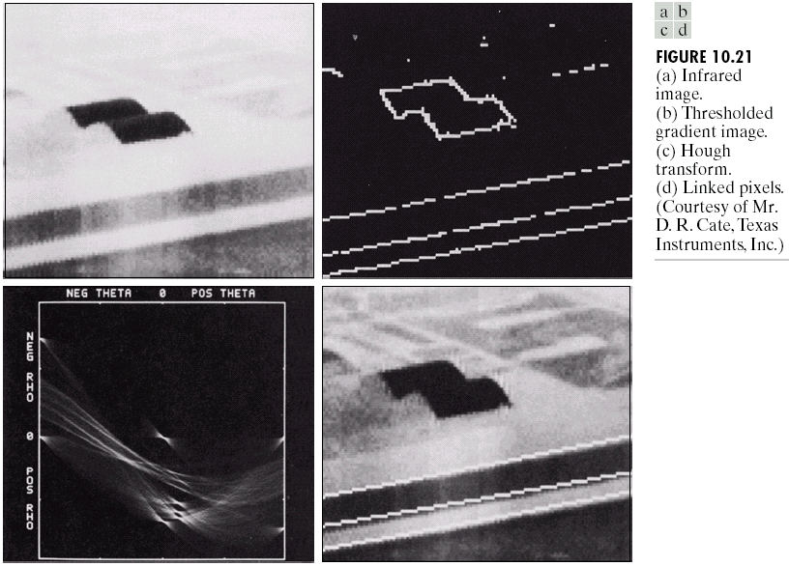
Chapter 10
Image Segmentation

Slide 22
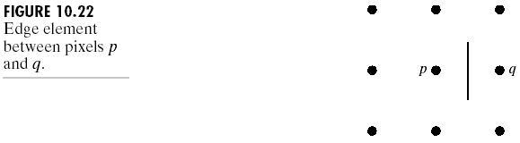
Chapter 10
Image Segmentation

Slide 23
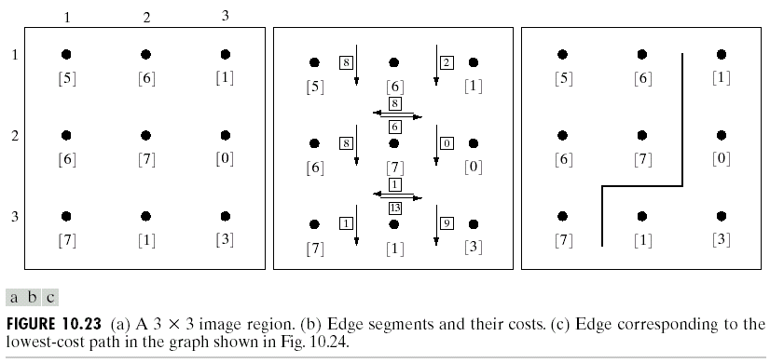
Chapter 10
Image Segmentation

Slide 24
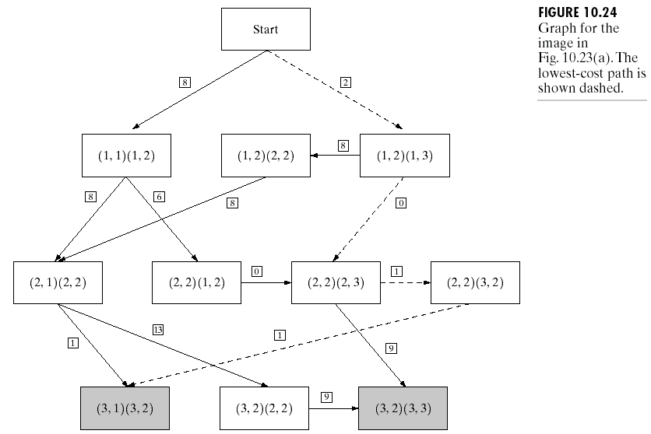
Chapter 10
Image Segmentation

Slide 25
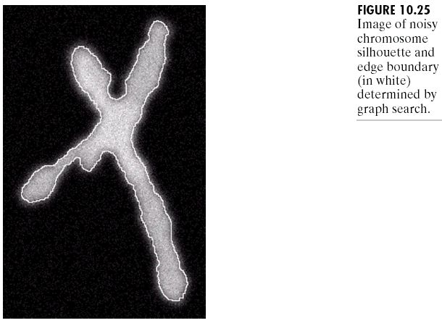
Chapter 10
Image Segmentation

Slide 26
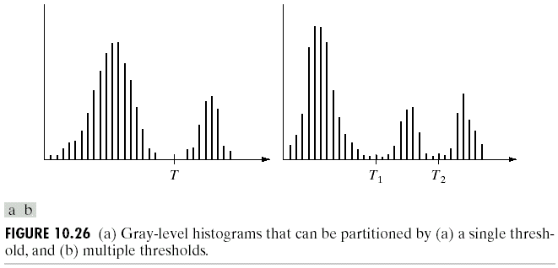
Chapter 10
Image Segmentation

Slide 27
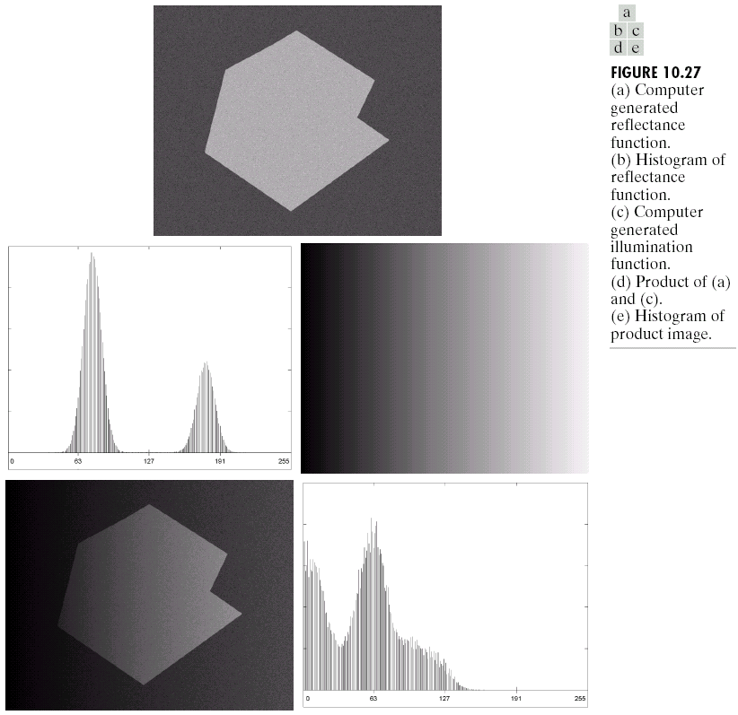
Chapter 10
Image Segmentation

Slide 28
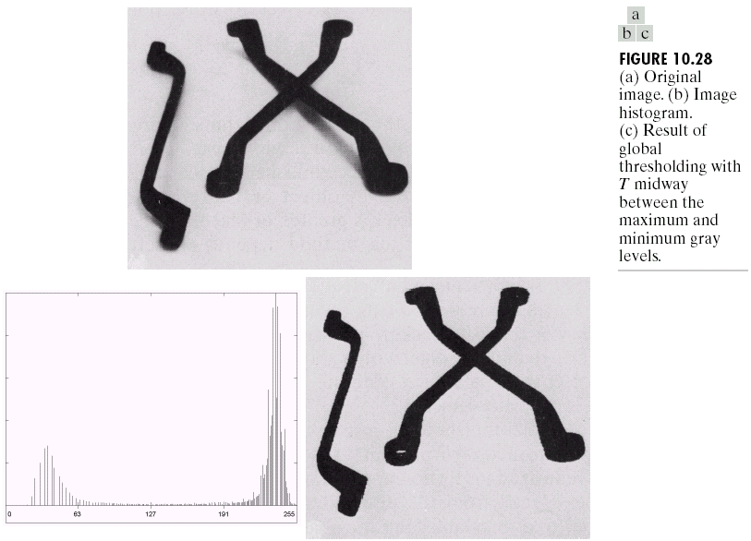
Chapter 10
Image Segmentation

Slide 29
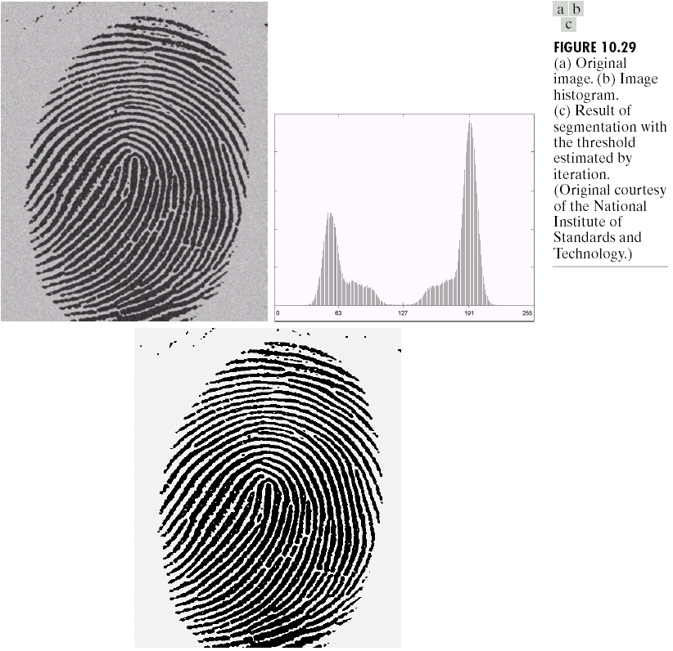
Chapter 10
Image Segmentation

Slide 30
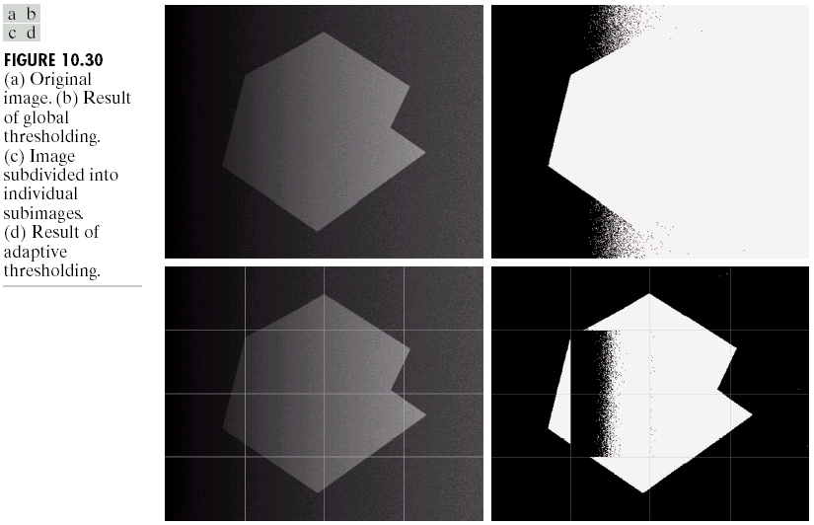
Chapter 10
Image Segmentation

Slide 31
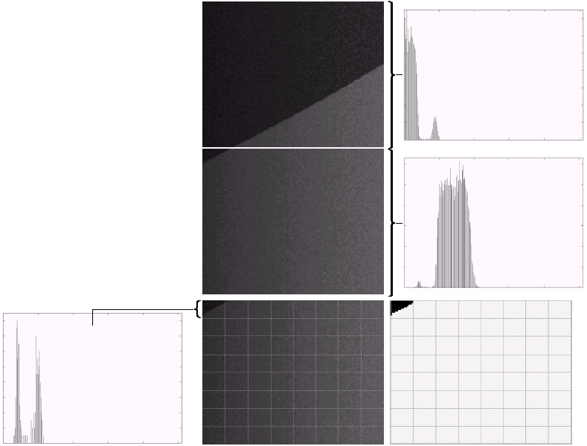
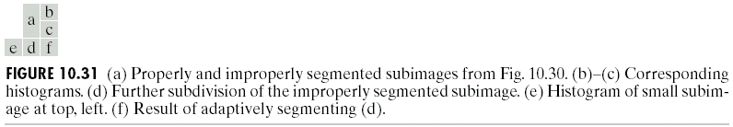
Chapter 10
Image Segmentation

Slide 32
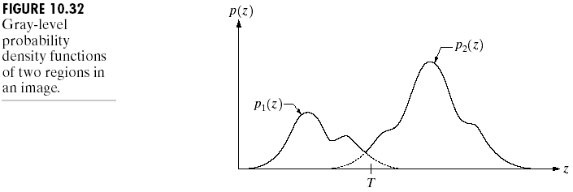
Chapter 10
Image Segmentation

Slide 33
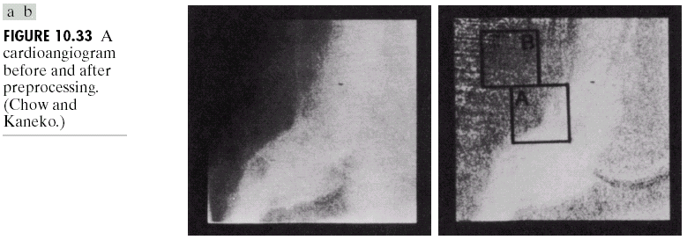
Chapter 10
Image Segmentation

Slide 34
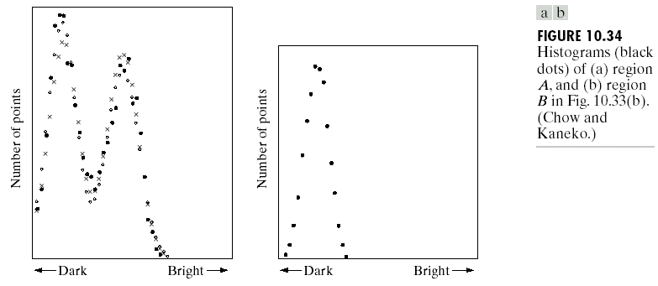
Chapter 10
Image Segmentation

Slide 35
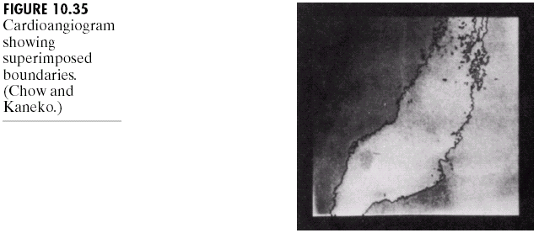
Chapter 10
Image Segmentation

Slide 36
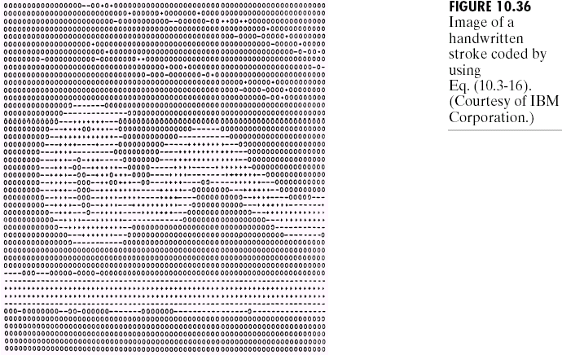
Chapter 10
Image Segmentation

Slide 37
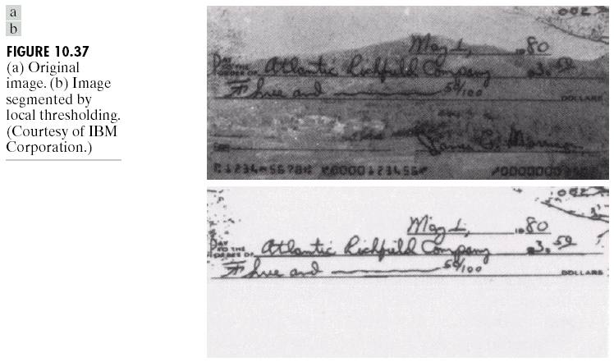
Chapter 10
Image Segmentation

Slide 38
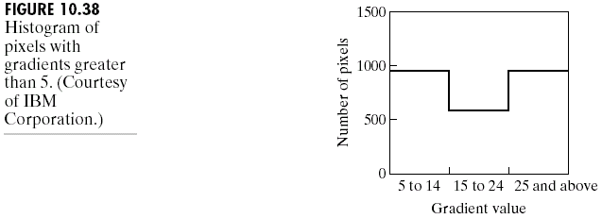
Chapter 10
Image Segmentation

Slide 39
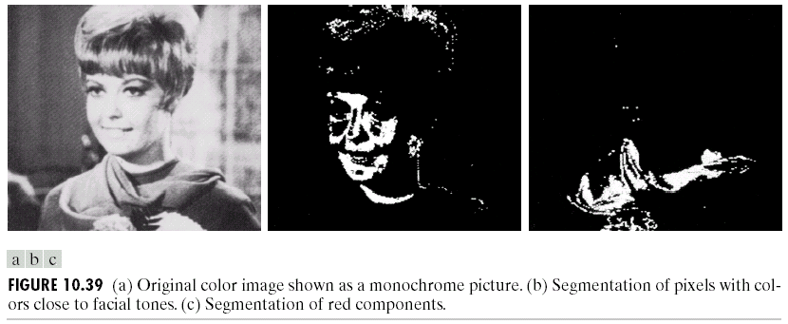
Chapter 10
Image Segmentation

Slide 40
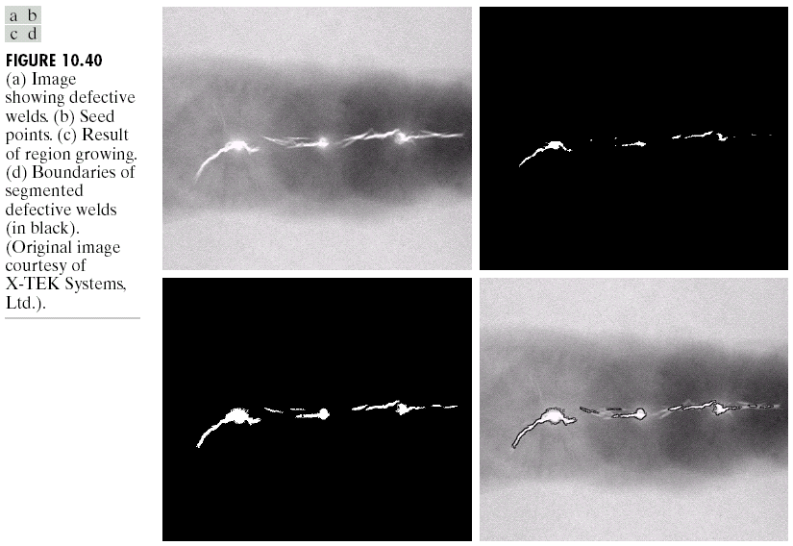
Chapter 10
Image Segmentation

Slide 41
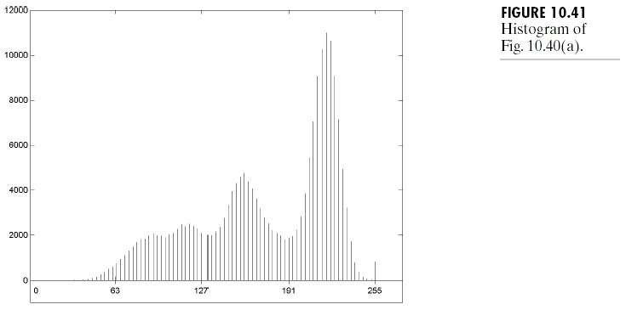
Chapter 10
Image Segmentation

Slide 42
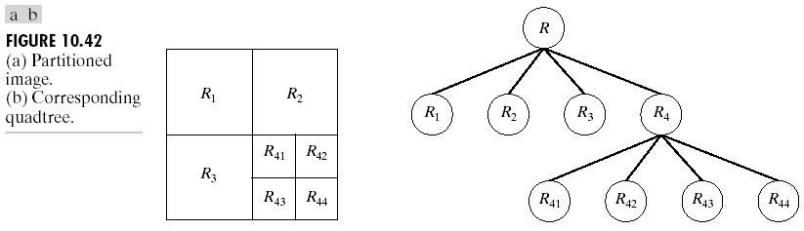
Chapter 10
Image Segmentation

Slide 43
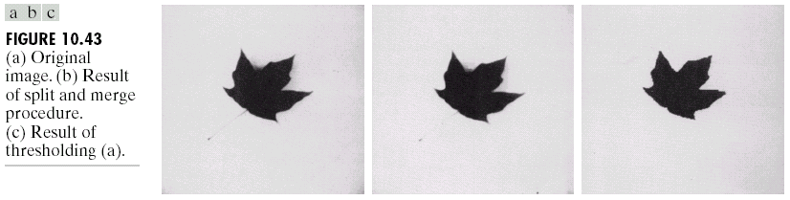
Chapter 10
Image Segmentation

Slide 44
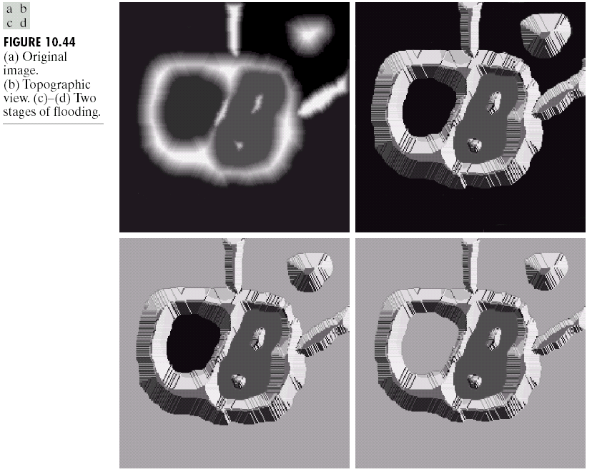
Chapter 10
Image Segmentation

Slide 45
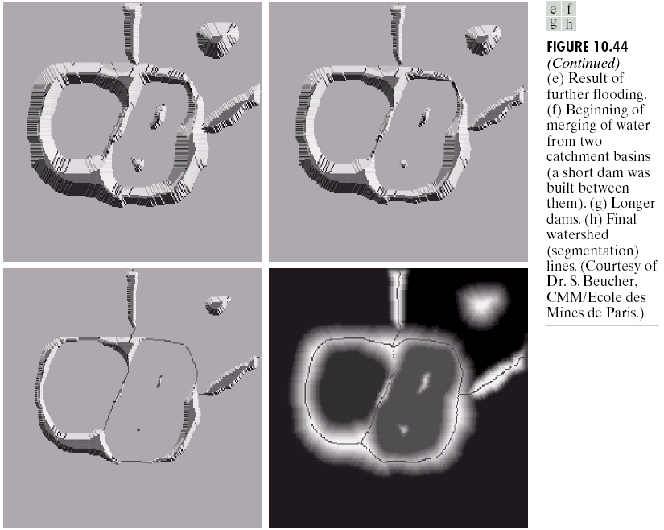
Chapter 10
Image Segmentation

Slide 46
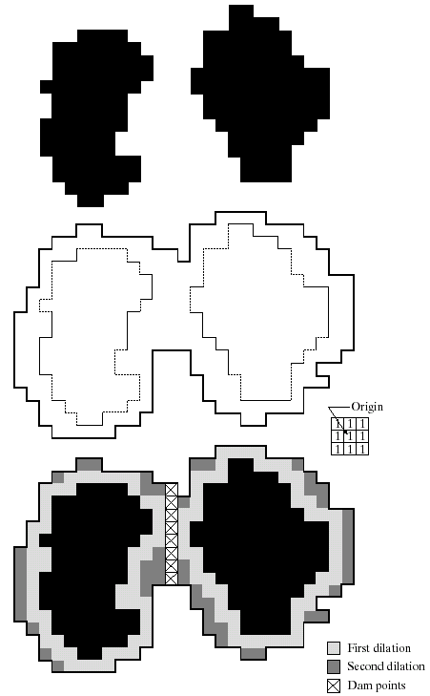
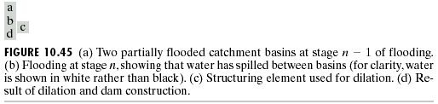
Chapter 10
Image Segmentation

Slide 47
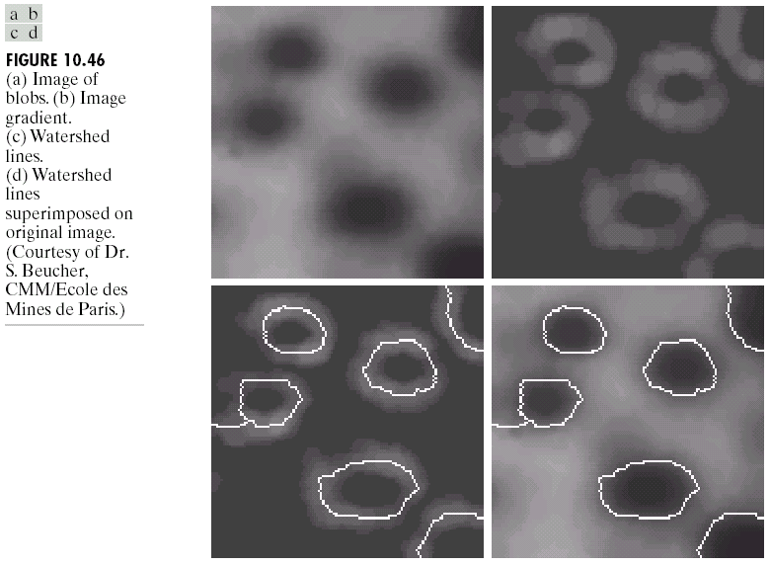
Chapter 10
Image Segmentation

Slide 48

Chapter 10
Image Segmentation

Slide 49

Chapter 10
Image Segmentation

Slide 50

Chapter 10
Image Segmentation

Slide 51

Chapter 10
Image Segmentation

Slide 52

Chapter 10
Image Segmentation

Slide 53

Chapter 10
Image Segmentation

Slide 54

Chapter 10
Image Segmentation

Slide 55

Chapter 10
Image Segmentation

