Slide 1
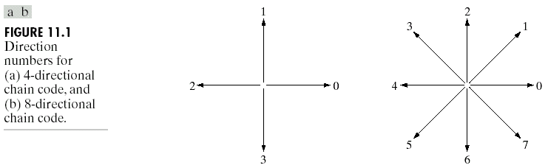
Chapter 11
Representation & Description

Slide 2
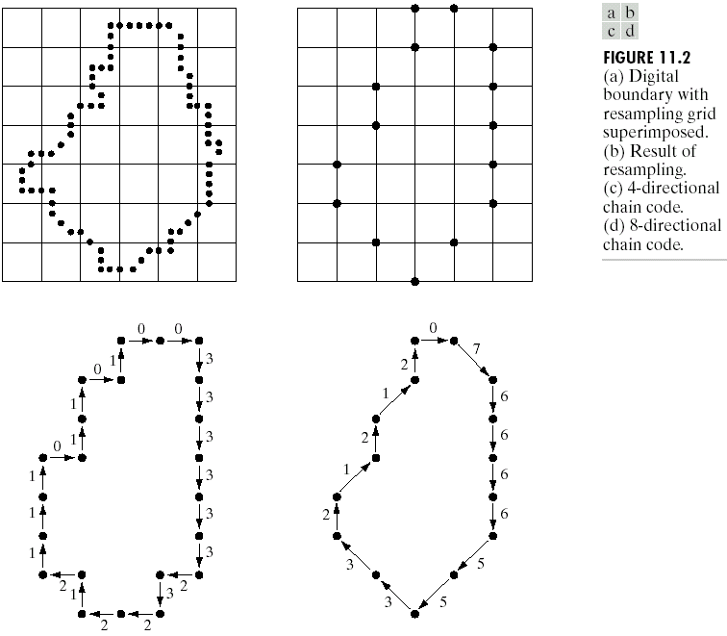
Chapter 11
Representation & Description

Slide 3
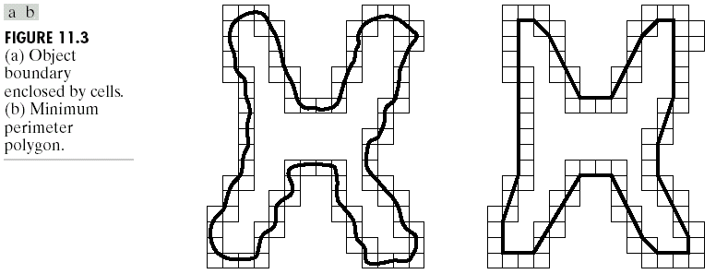
Chapter 11
Representation & Description

Slide 4
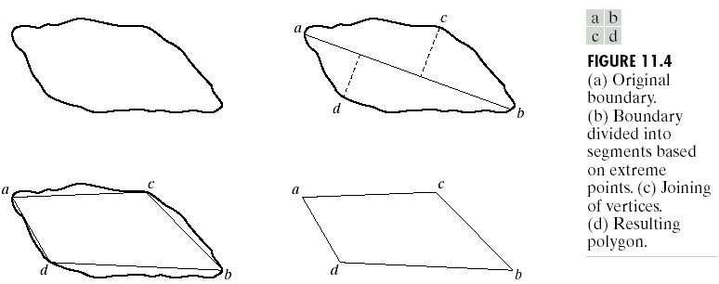
Chapter 11
Representation & Description

Slide 5
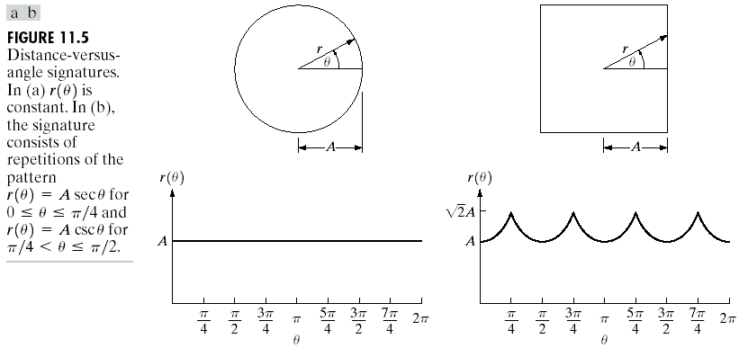
Chapter 11
Representation & Description

Slide 6
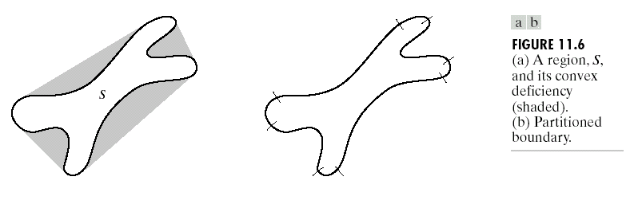
Chapter 11
Representation & Description

Slide 7
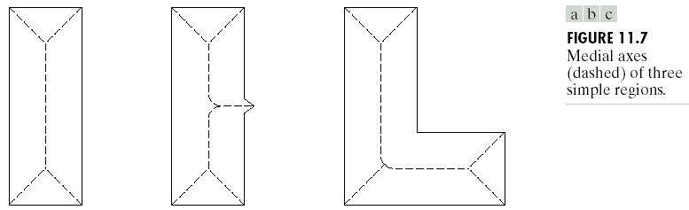
Chapter 11
Representation & Description

Slide 8
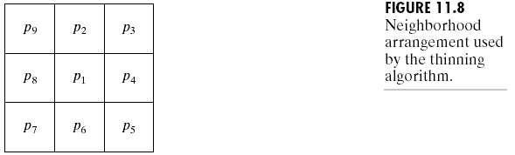
Chapter 11
Representation & Description

Slide 9
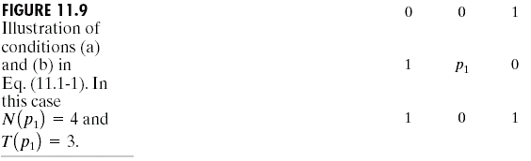
Chapter 11
Representation & Description

Slide 10
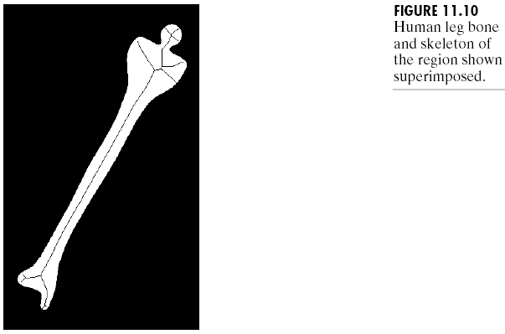
Chapter 11
Representation & Description

Slide 11
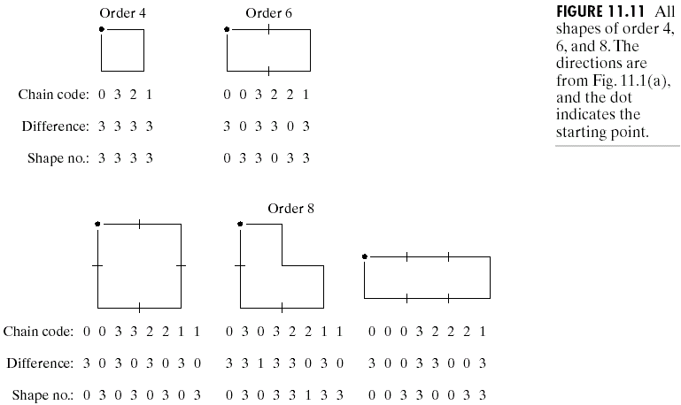
Chapter 11
Representation & Description

Slide 12
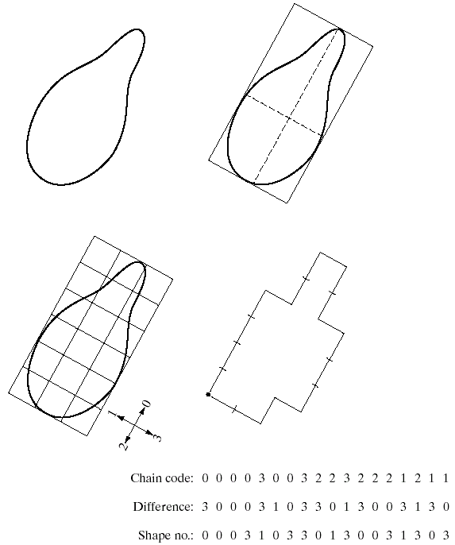
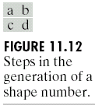
Chapter 11
Representation & Description

Slide 13
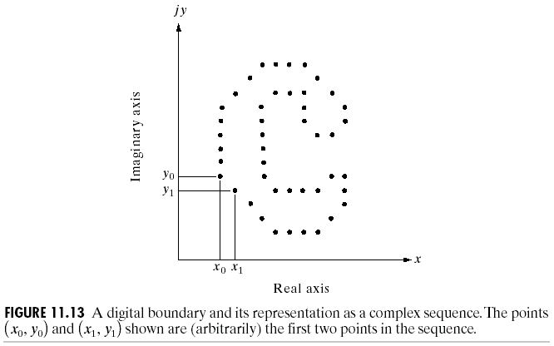
Chapter 11
Representation & Description

Slide 14
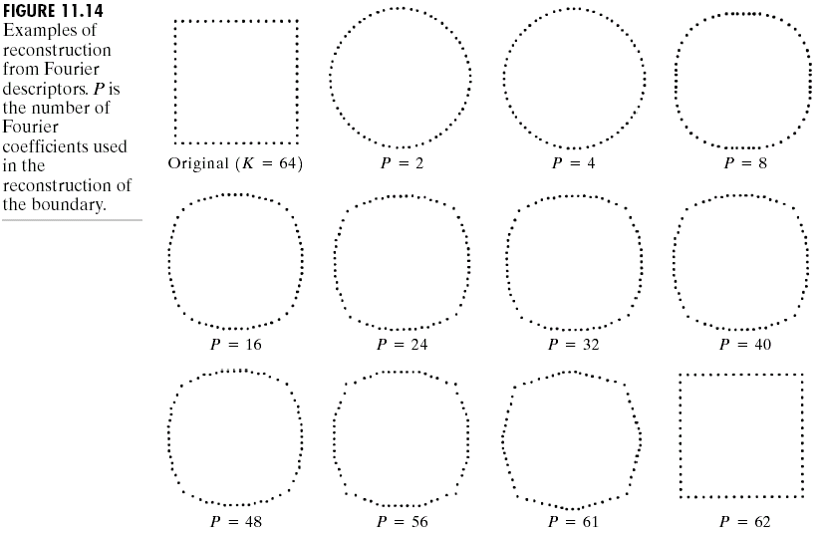
Chapter 11
Representation & Description

Slide 15
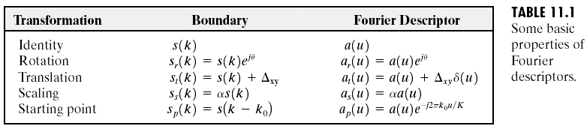
Chapter 11
Representation & Description

Slide 16
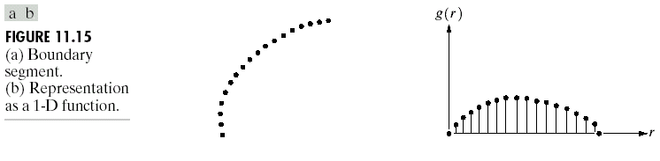
Chapter 11
Representation & Description

Slide 17
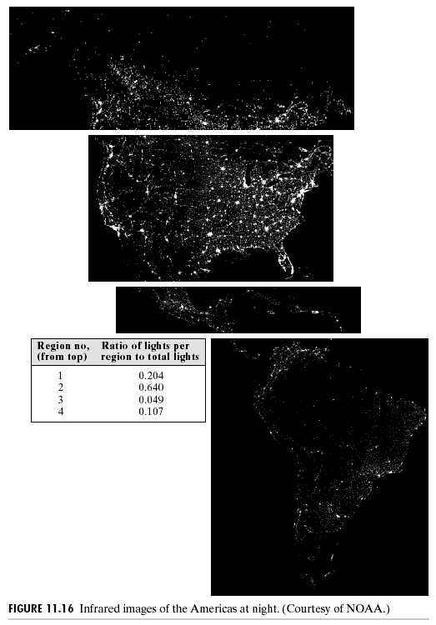
Chapter 11
Representation & Description

Slide 18
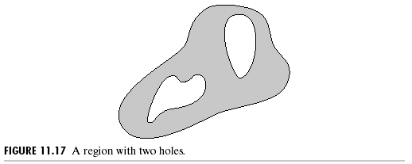
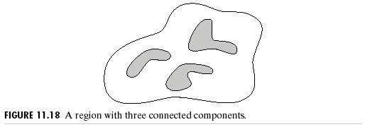
Chapter 11
Representation & Description

Slide 19
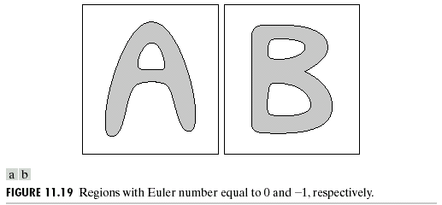
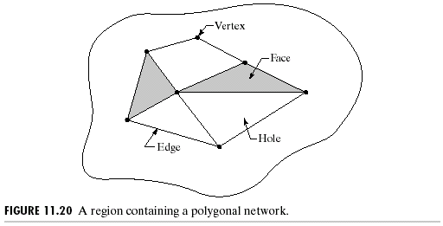
Chapter 11
Representation & Description

Slide 20
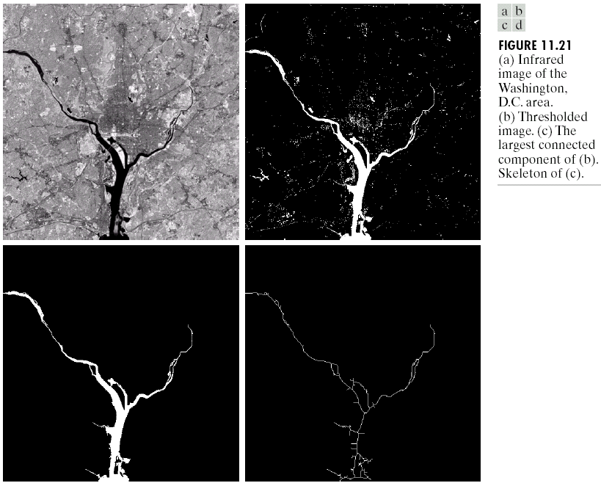
Chapter 11
Representation & Description

Slide 21
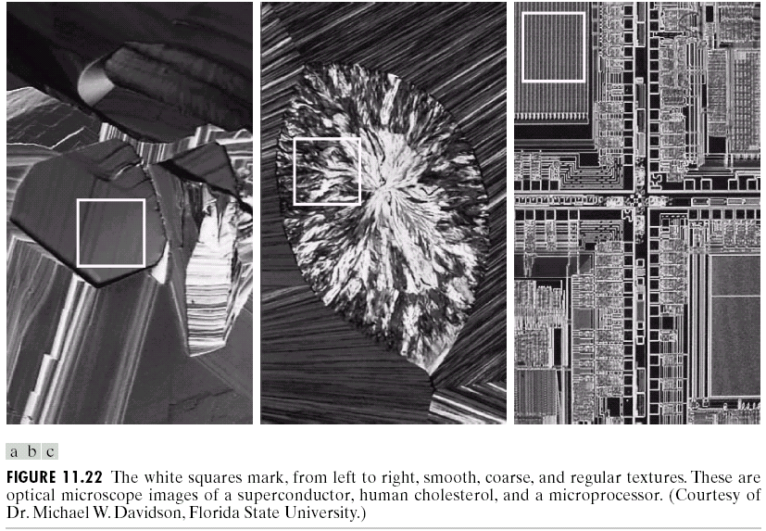
Chapter 11
Representation & Description

Slide 22
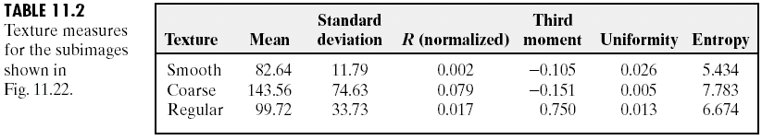
Chapter 11
Representation & Description

Slide 23
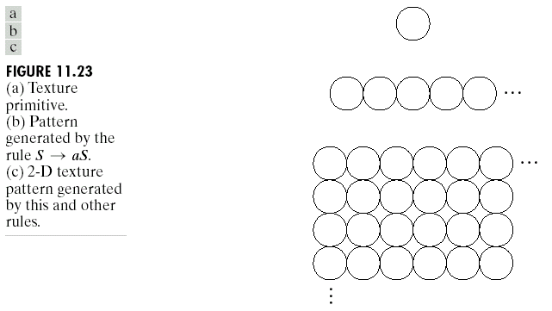
Chapter 11
Representation & Description

Slide 24
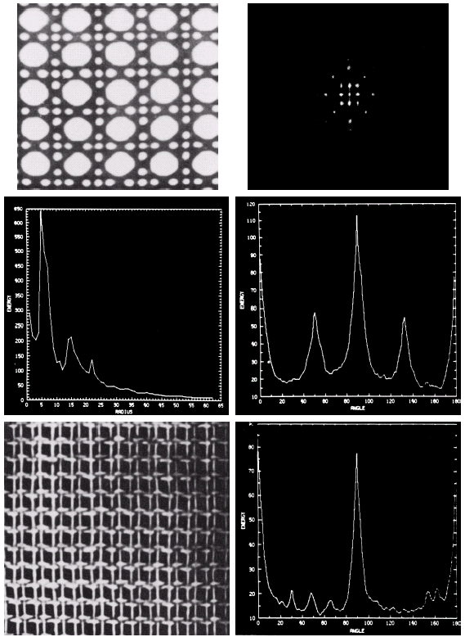

Chapter 11
Representation & Description

Slide 25
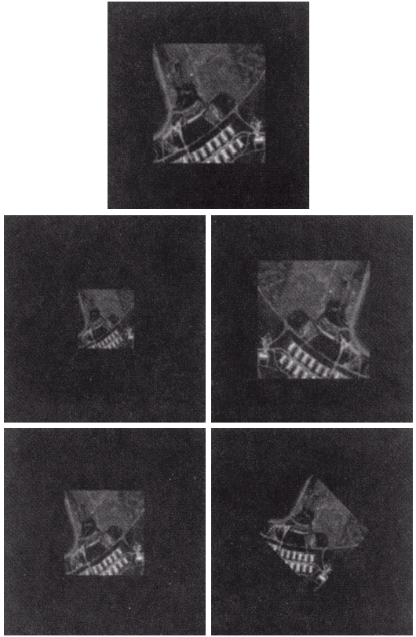
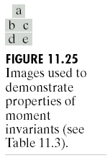
Chapter 11
Representation & Description

Slide 26
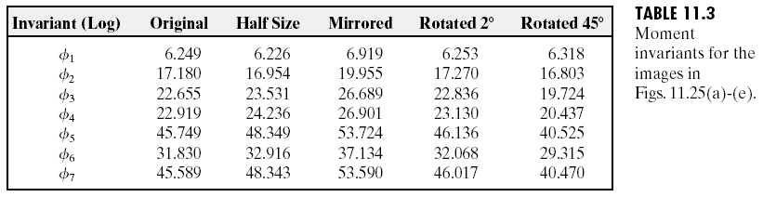
Chapter 11
Representation & Description

Slide 27
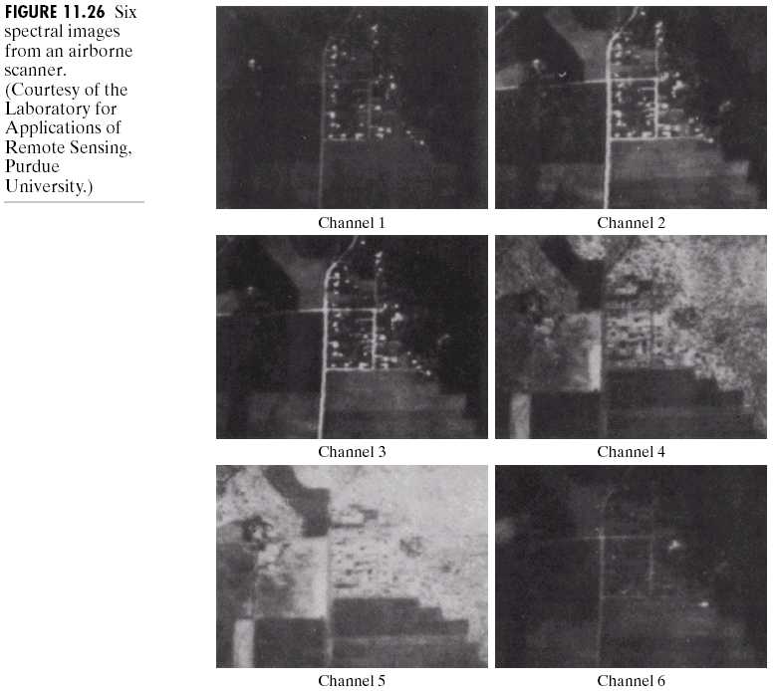
Chapter 11
Representation & Description

Slide 28
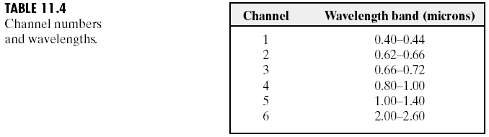
Chapter 11
Representation & Description

Slide 29
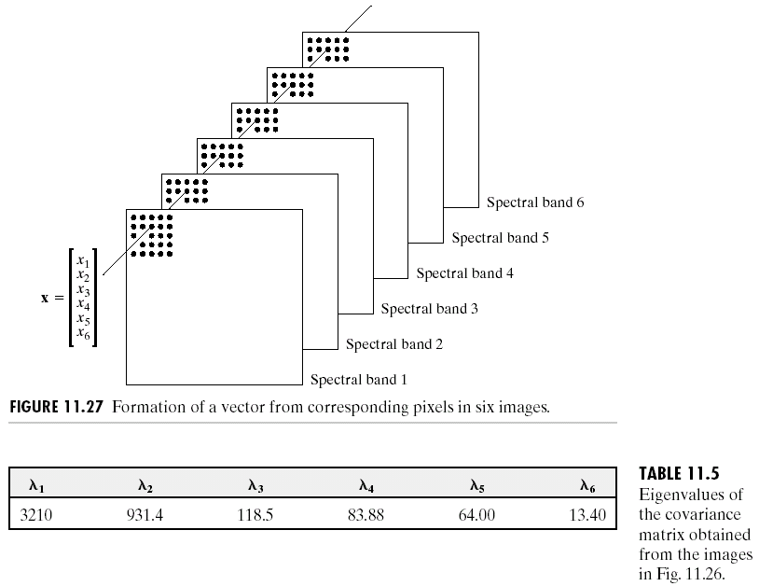
Chapter 11
Representation & Description

Slide 30
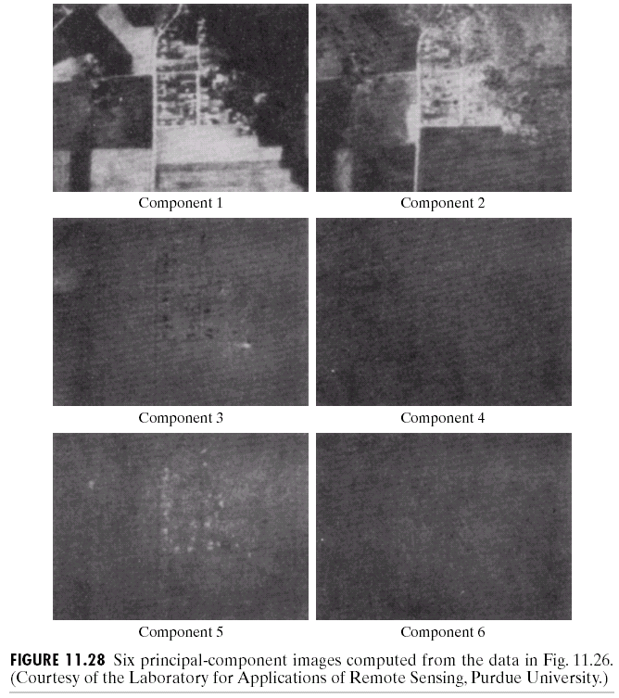
Chapter 11
Representation & Description

Slide 31
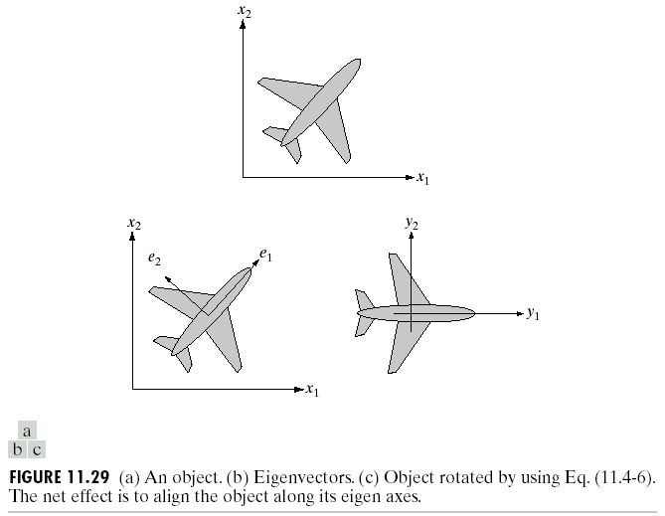
Chapter 11
Representation & Description

Slide 32
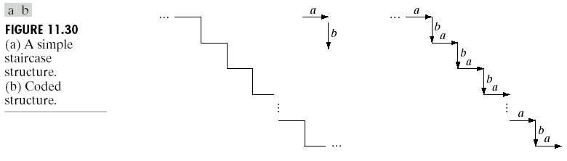
Chapter 11
Representation & Description

Slide 33
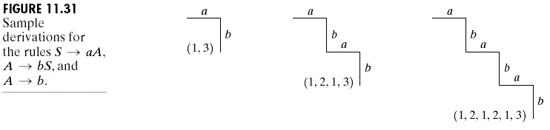
Chapter 11
Representation & Description

Slide 34
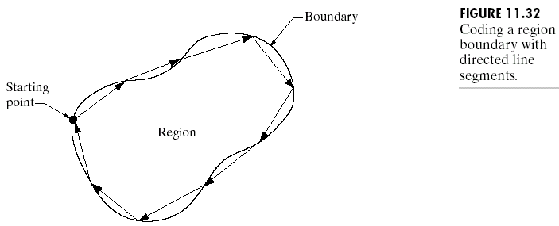
Chapter 11
Representation & Description

Slide 35
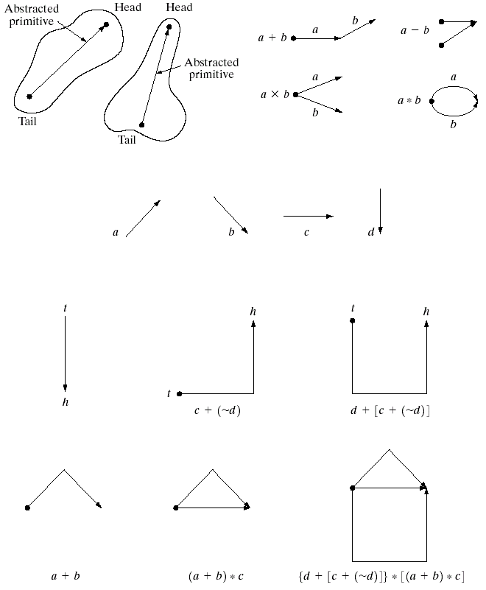
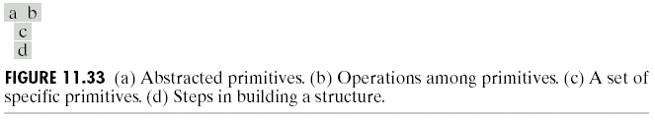
Chapter 11
Representation & Description

Slide 36
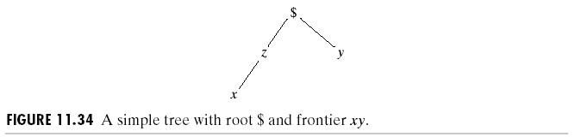
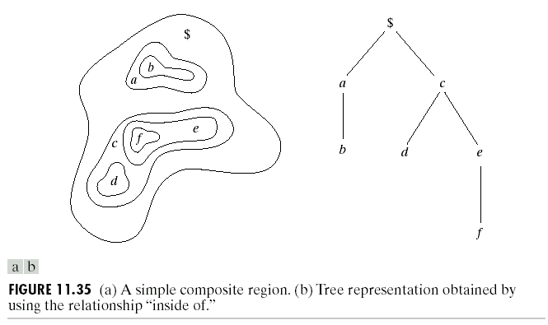
Chapter 11
Representation & Description

