Slide 1
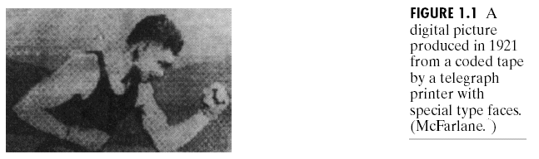
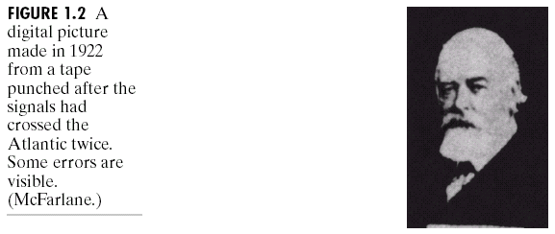
Chapter 1: Introduction

Slide 2
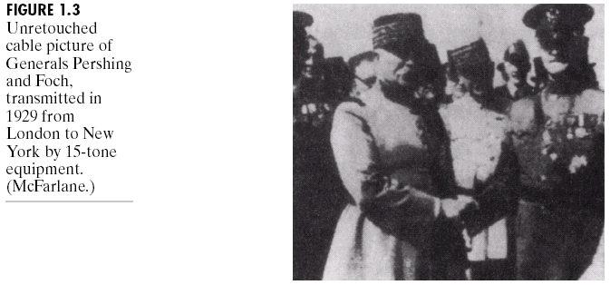
Chapter 1: Introduction

Slide 3
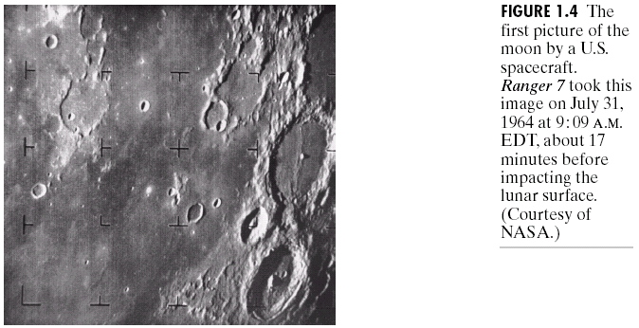
Chapter 1: Introduction

Slide 4
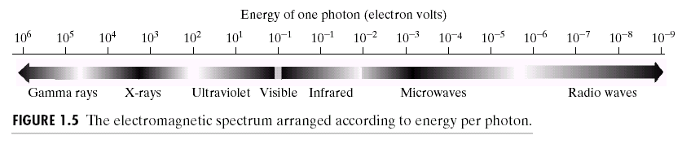
Chapter 1: Introduction

Slide 5
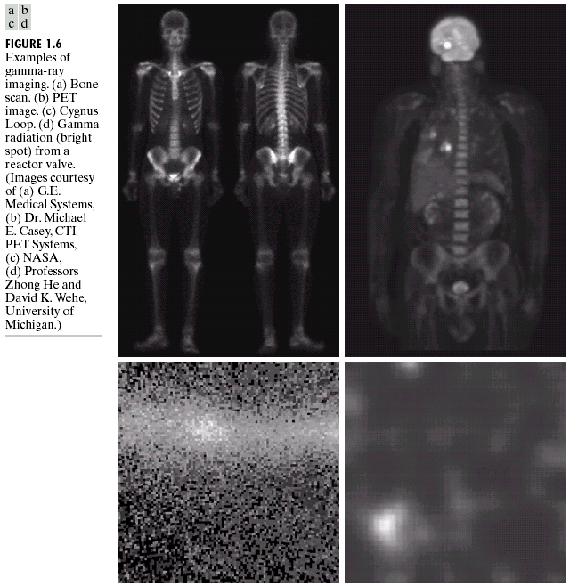
Chapter 1: Introduction

Slide 6
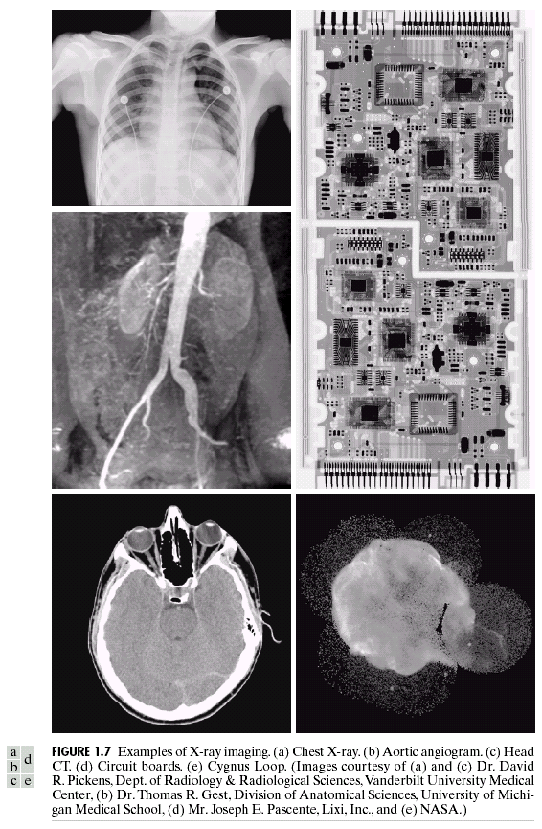
Chapter 1: Introduction

Slide 7
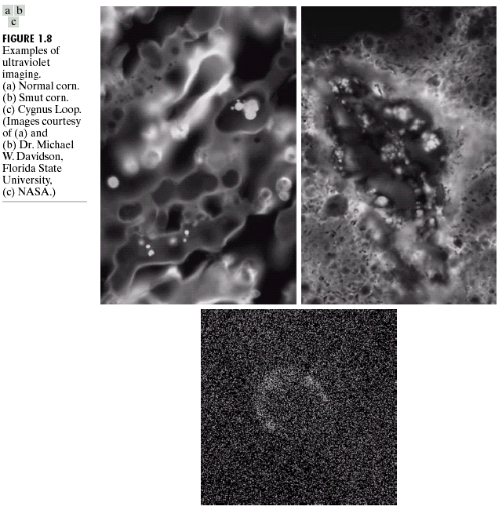
Chapter 1: Introduction

Slide 8
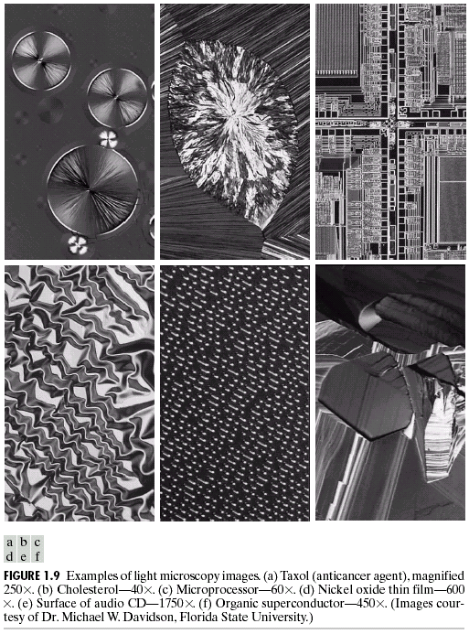
Chapter 1: Introduction

Slide 9
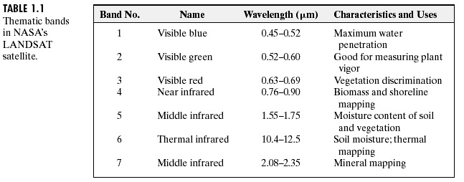
Chapter 1: Introduction

Slide 10
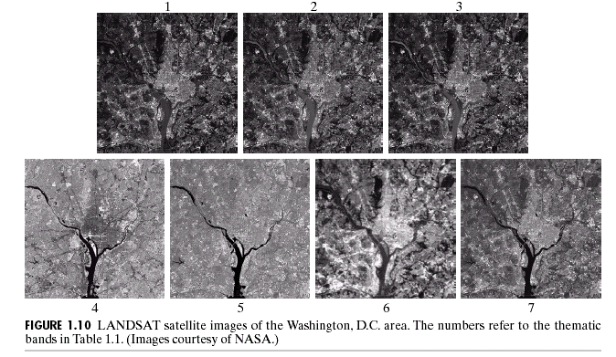
Chapter 1: Introduction

Slide 11
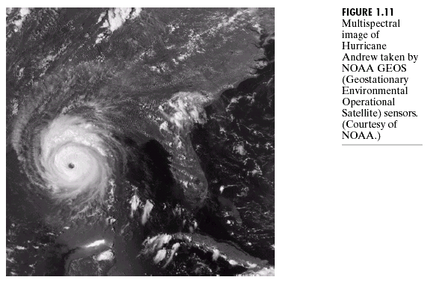
Chapter 1: Introduction

Slide 12
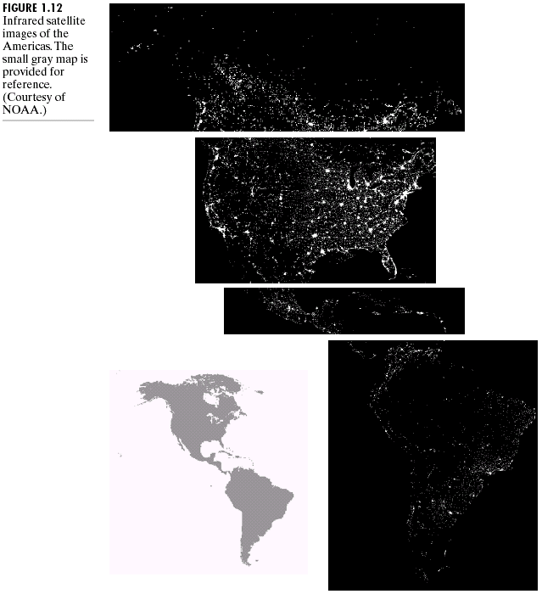
Chapter 1: Introduction

Slide 13
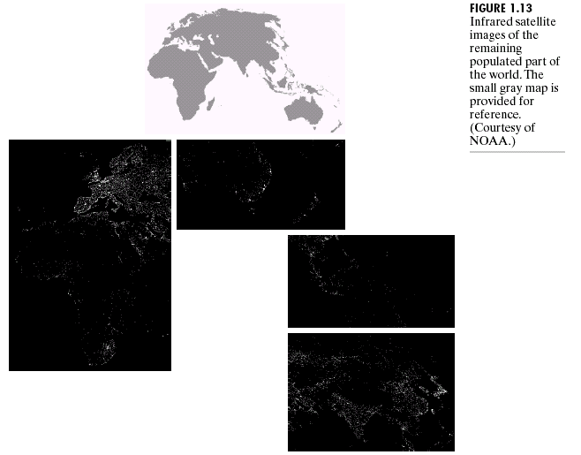
Chapter 1: Introduction

Slide 14
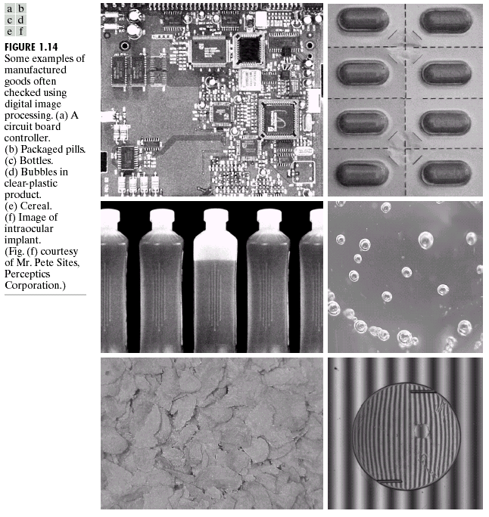
Chapter 1: Introduction

Slide 15
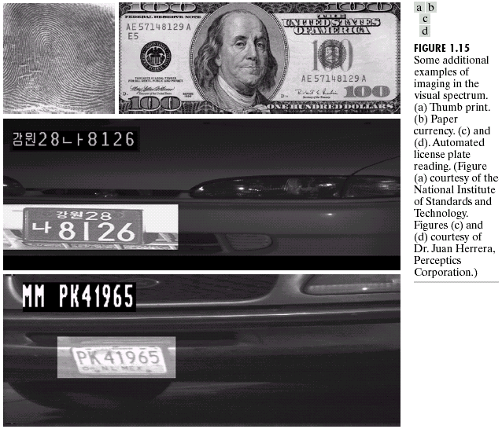
Chapter 1: Introduction

Slide 16
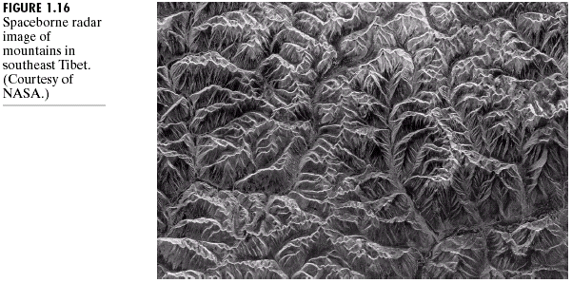
Chapter 1: Introduction

Slide 17
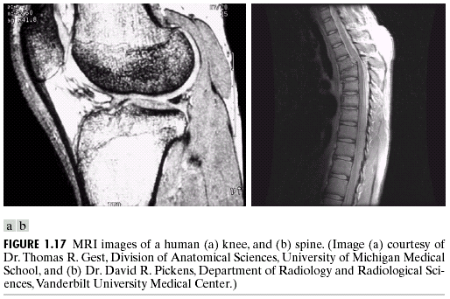
Chapter 1: Introduction

Slide 18
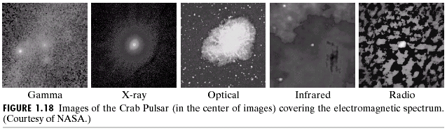
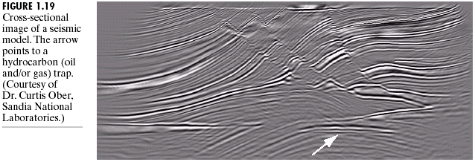
Chapter 1: Introduction

Slide 19
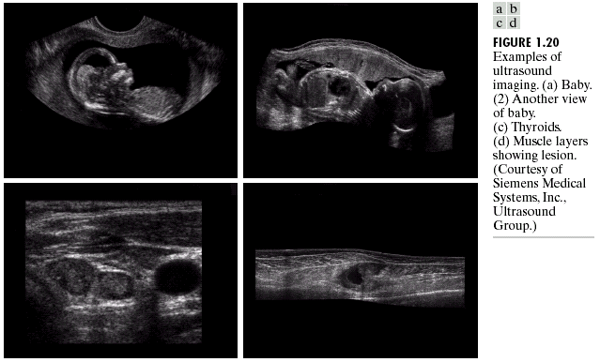
Chapter 1: Introduction

Slide 20
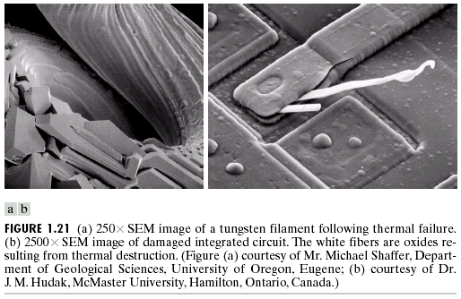
Chapter 1: Introduction

Slide 21
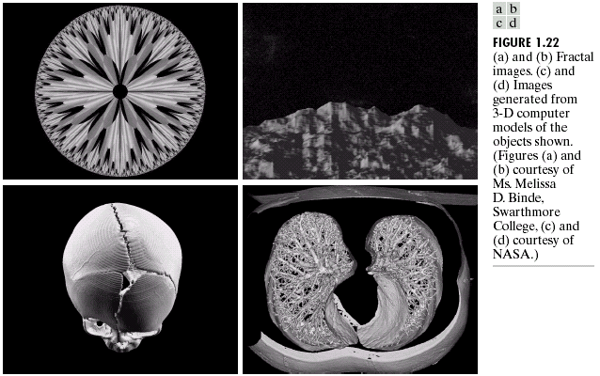
Chapter 1: Introduction

Slide 22
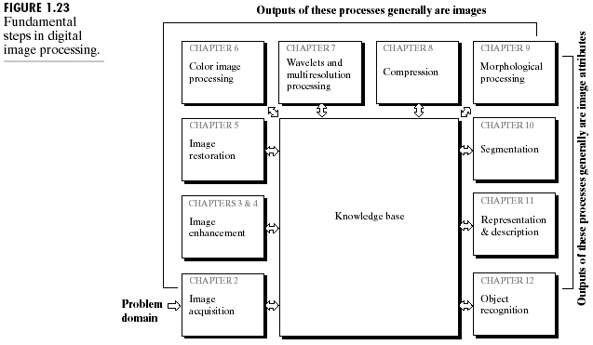
Chapter 1: Introduction

Slide 23
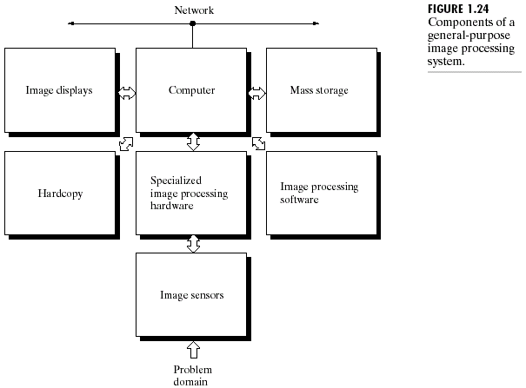
Chapter 1: Introduction

