Slide 1
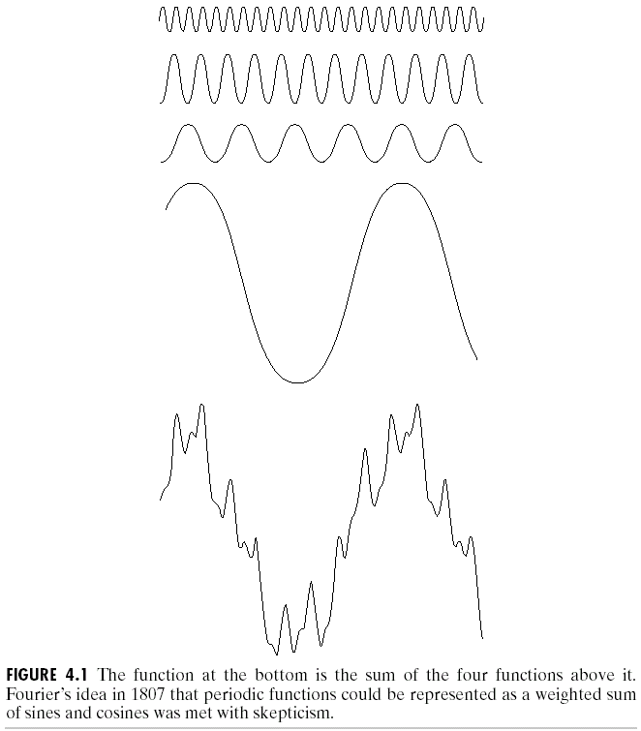
Chapter 4
Image Enhancement in the
Frequency Domain

Slide 2
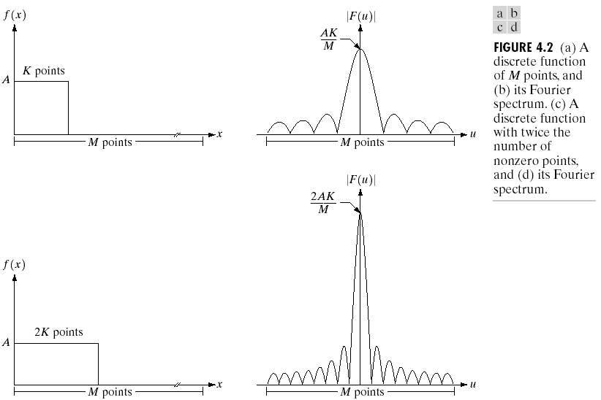
Chapter 4
Image Enhancement in the
Frequency Domain

Slide 3
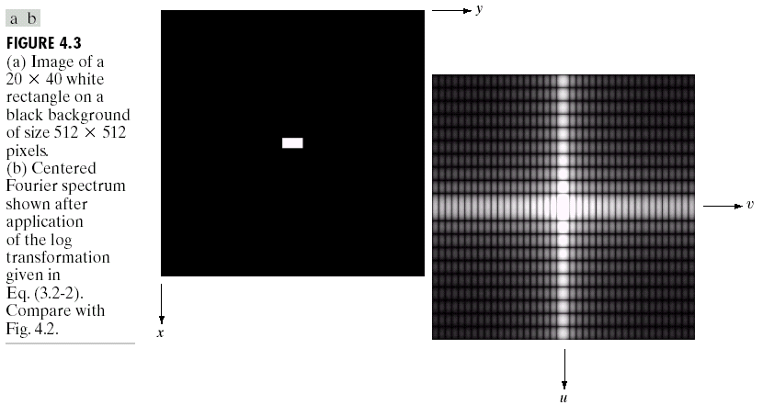
Chapter 4
Image Enhancement in the
Frequency Domain

Slide 4
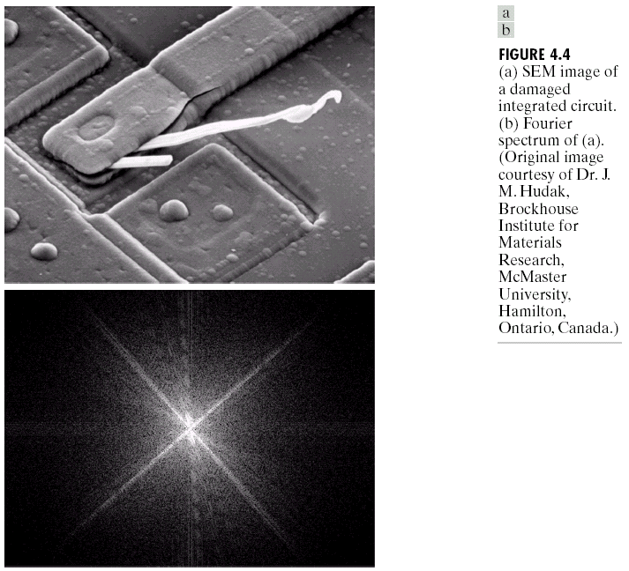
Chapter 4
Image Enhancement in the
Frequency Domain

Slide 5
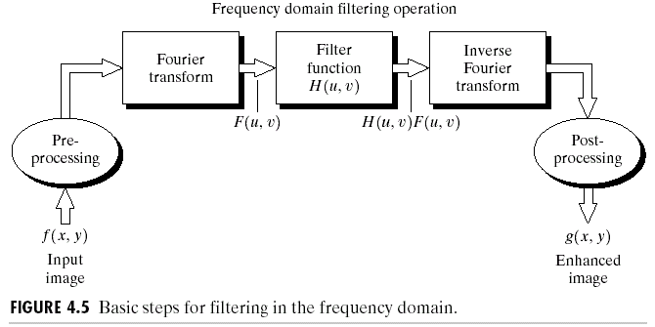
Chapter 4
Image Enhancement in the
Frequency Domain

Slide 6
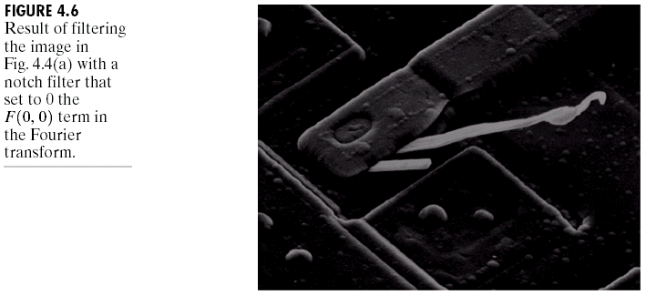
Chapter 4
Image Enhancement in the
Frequency Domain

Slide 7
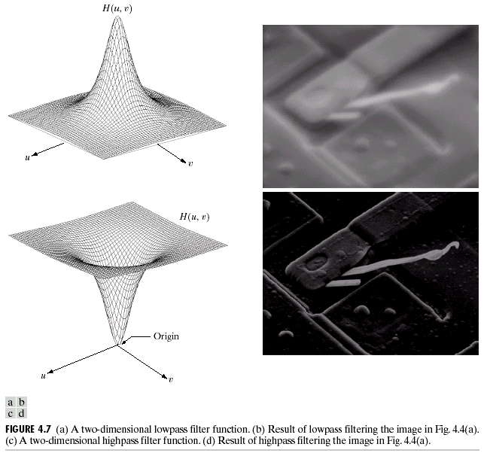
Chapter 4
Image Enhancement in the
Frequency Domain

Slide 8
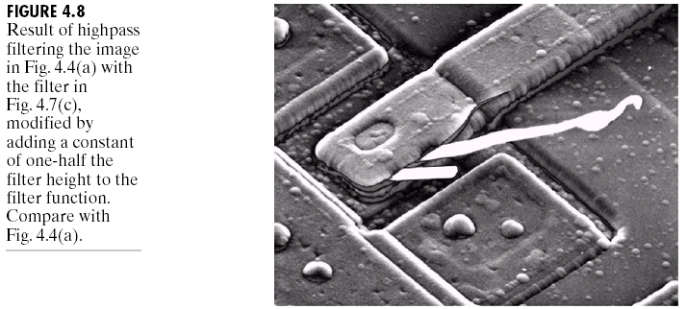
Chapter 4
Image Enhancement in the
Frequency Domain

Slide 9
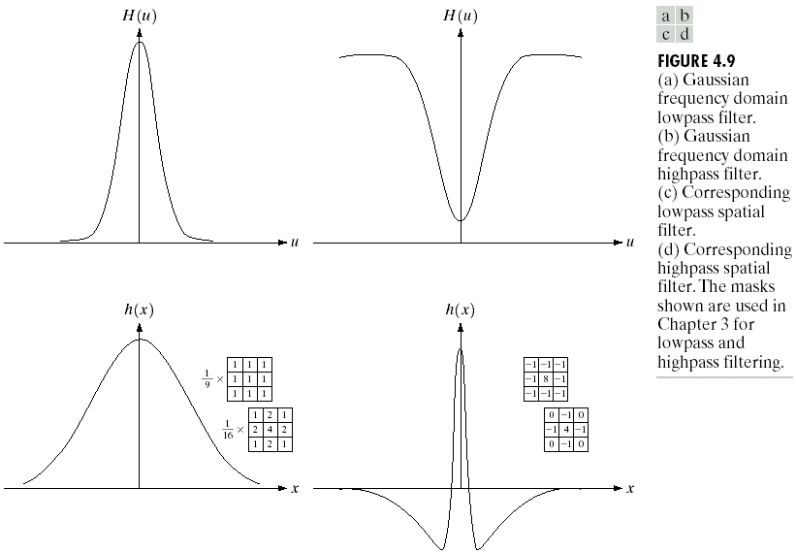
Chapter 4
Image Enhancement in the
Frequency Domain

Slide 10
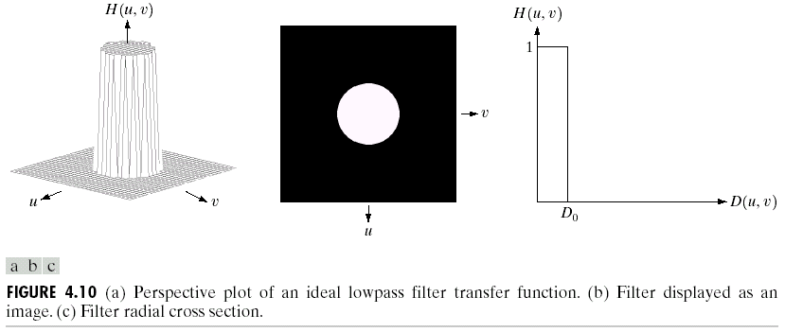
Chapter 4
Image Enhancement in the
Frequency Domain

Slide 11
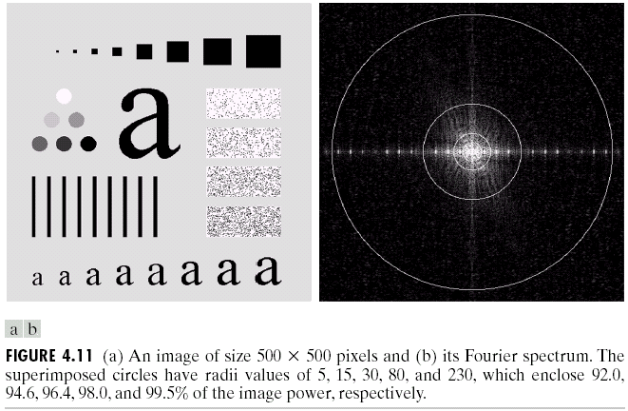
Chapter 4
Image Enhancement in the
Frequency Domain

Slide 12
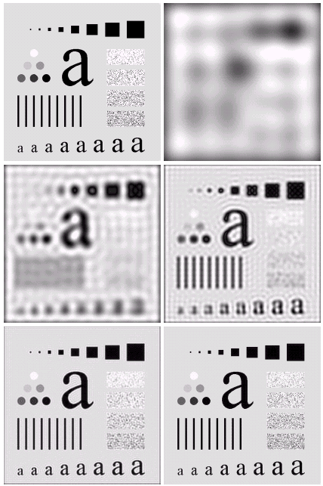

Chapter 4
Image Enhancement in the
Frequency Domain

Slide 13
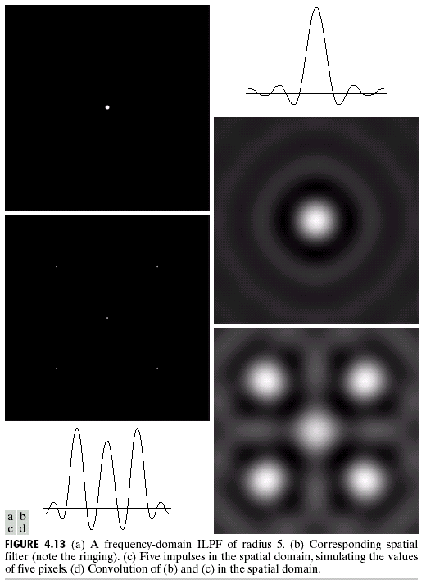
Chapter 4
Image Enhancement in the
Frequency Domain

Slide 14
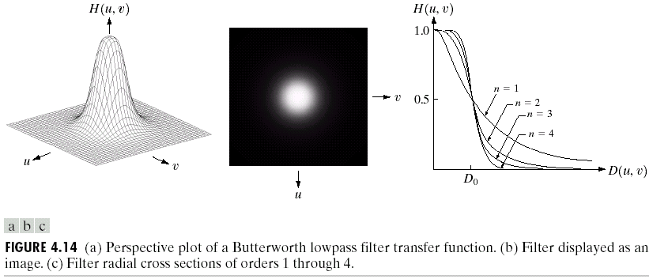
Chapter 4
Image Enhancement in the
Frequency Domain

Slide 15
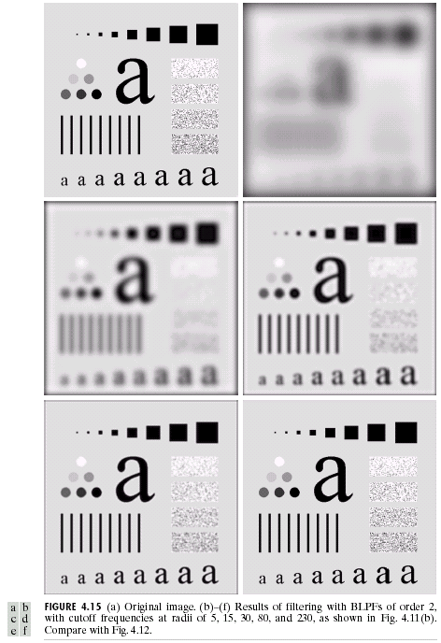
Chapter 4
Image Enhancement in the
Frequency Domain

Slide 16
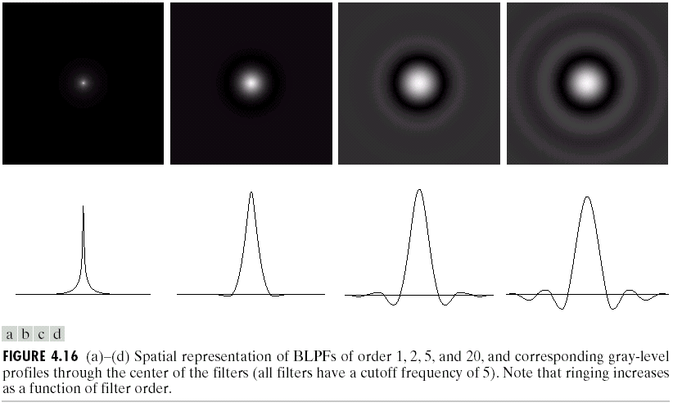
Chapter 4
Image Enhancement in the
Frequency Domain

Slide 17
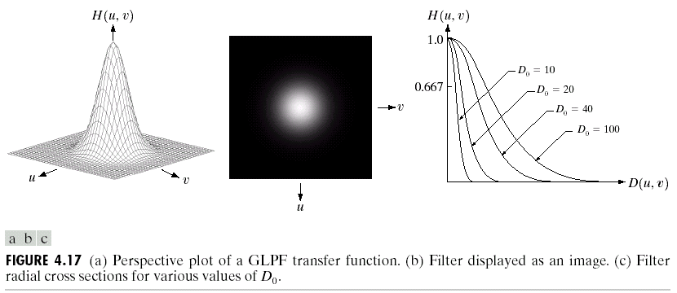
Chapter 4
Image Enhancement in the
Frequency Domain

Slide 18
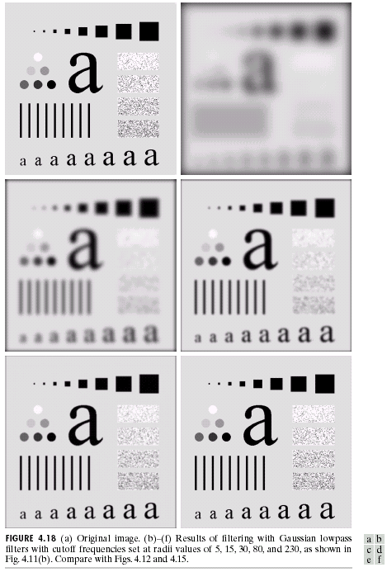
Chapter 4
Image Enhancement in the
Frequency Domain

Slide 19
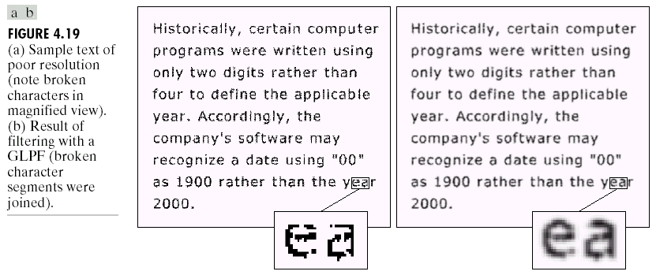
Chapter 4
Image Enhancement in the
Frequency Domain

Slide 20
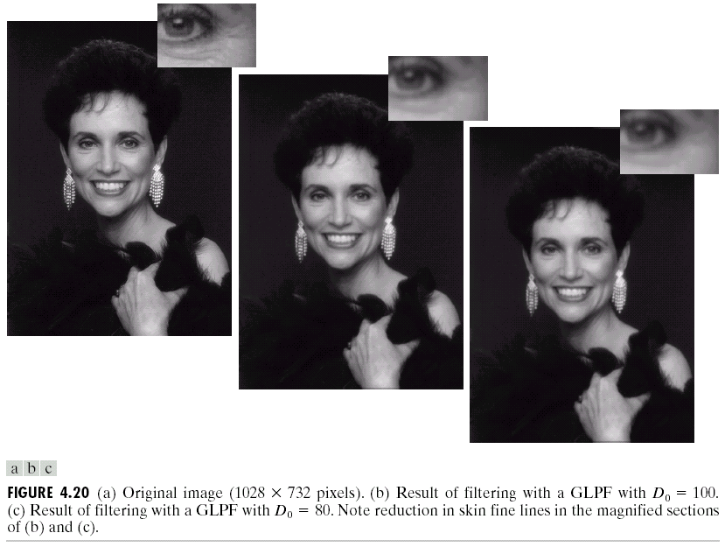
Chapter 4
Image Enhancement in the
Frequency Domain

Slide 21
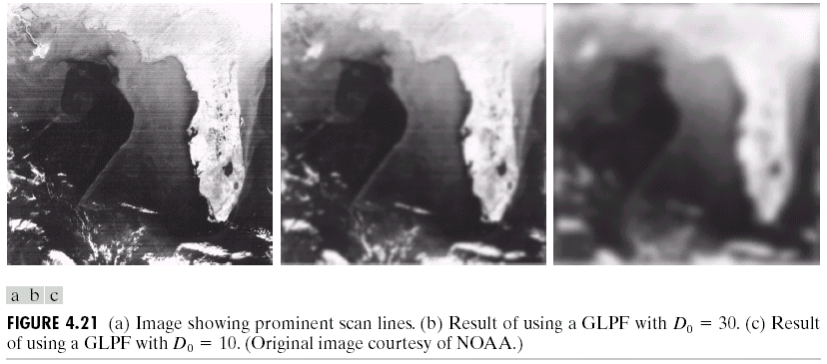
Chapter 4
Image Enhancement in the
Frequency Domain

Slide 22
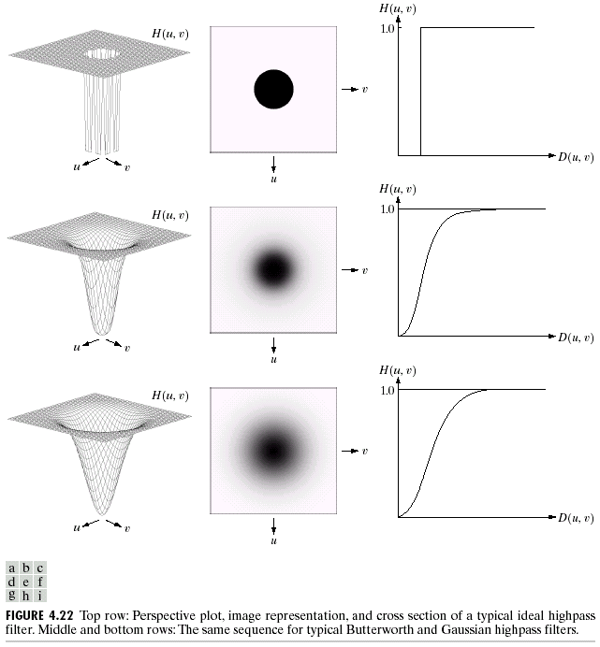
Chapter 4
Image Enhancement in the
Frequency Domain

Slide 23
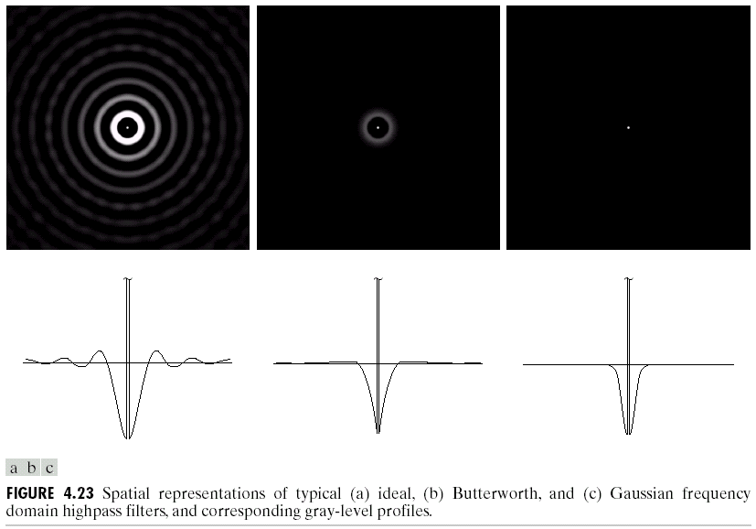
Chapter 4
Image Enhancement in the
Frequency Domain

Slide 24
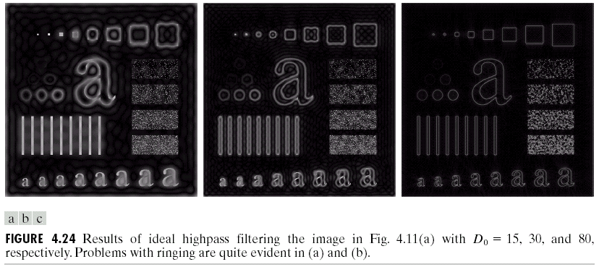
Chapter 4
Image Enhancement in the
Frequency Domain

Slide 25
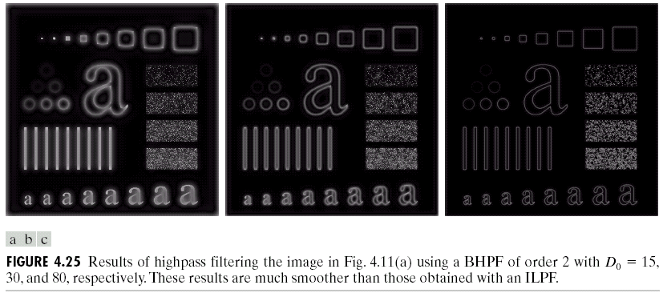
Chapter 4
Image Enhancement in the
Frequency Domain

Slide 26
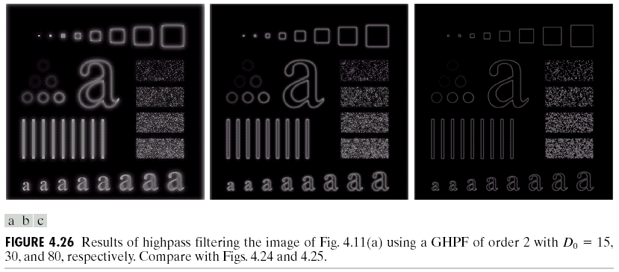
Chapter 4
Image Enhancement in the
Frequency Domain

Slide 27
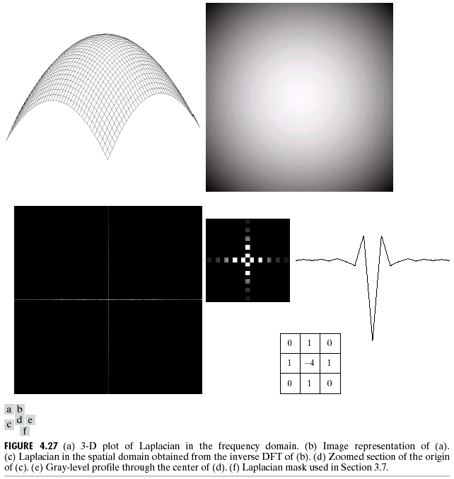
Chapter 4
Image Enhancement in the
Frequency Domain

Slide 28
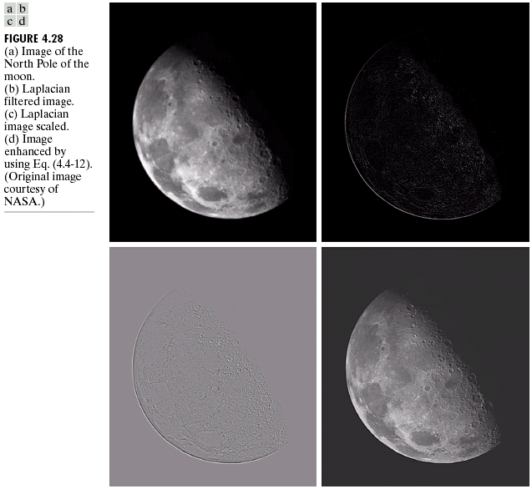
Chapter 4
Image Enhancement in the
Frequency Domain

Slide 29
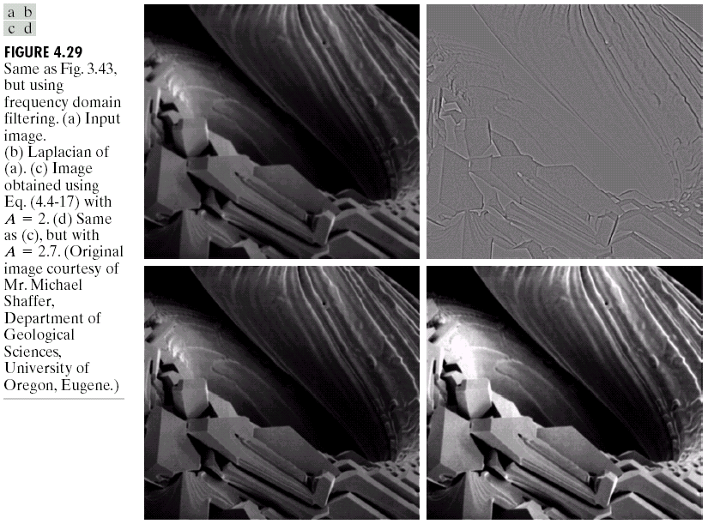
Chapter 4
Image Enhancement in the
Frequency Domain

Slide 30
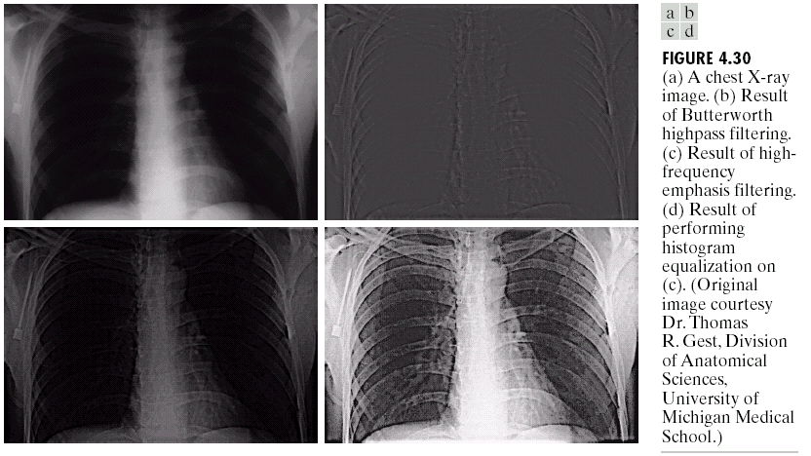
Chapter 4
Image Enhancement in the
Frequency Domain

Slide 31
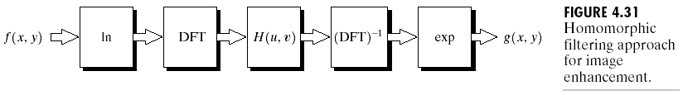
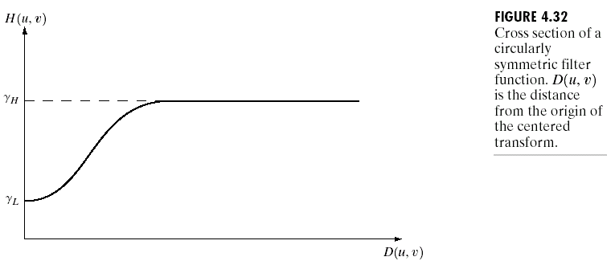
Chapter 4
Image Enhancement in the
Frequency Domain

Slide 32
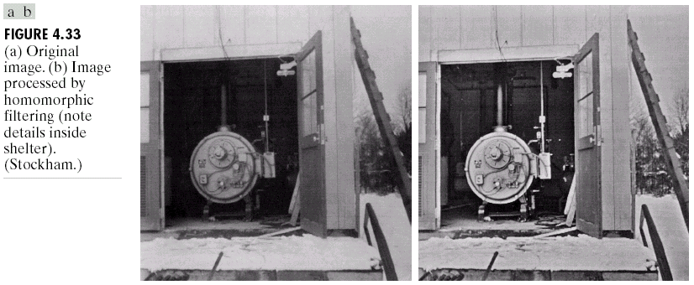
Chapter 4
Image Enhancement in the
Frequency Domain

Slide 33
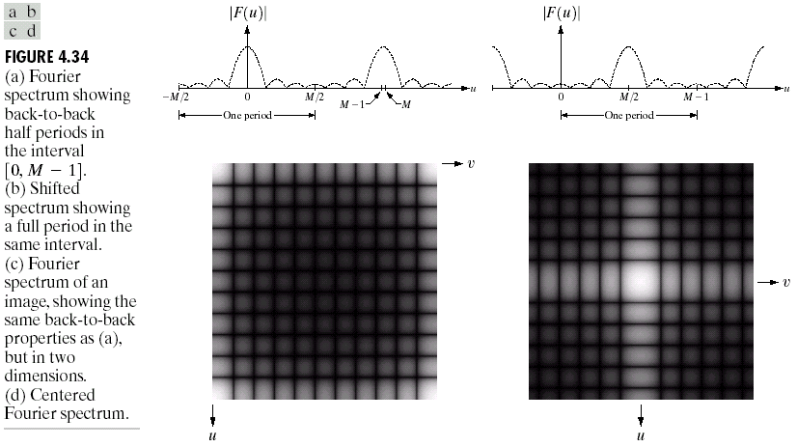
Chapter 4
Image Enhancement in the
Frequency Domain

Slide 34
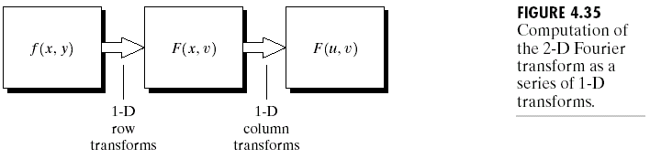
Chapter 4
Image Enhancement in the
Frequency Domain

Slide 35
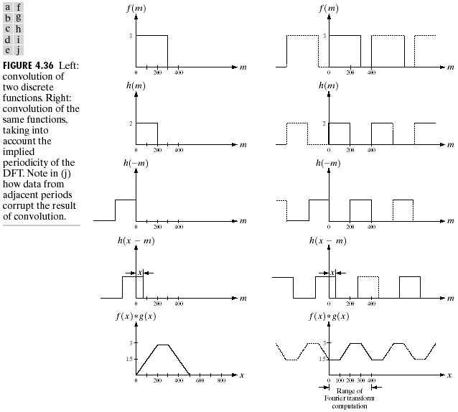
Chapter 4
Image Enhancement in the
Frequency Domain

Slide 36
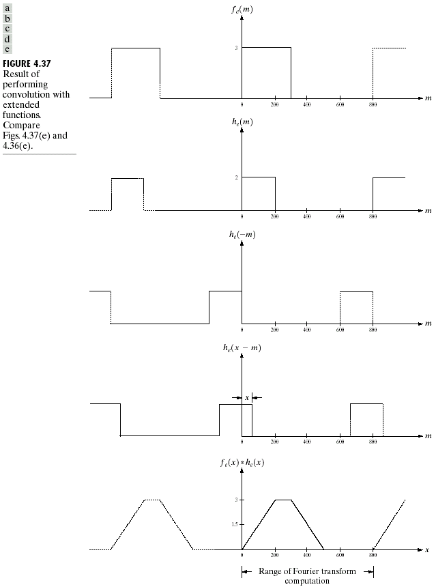
Chapter 4
Image Enhancement in the
Frequency Domain

Slide 37
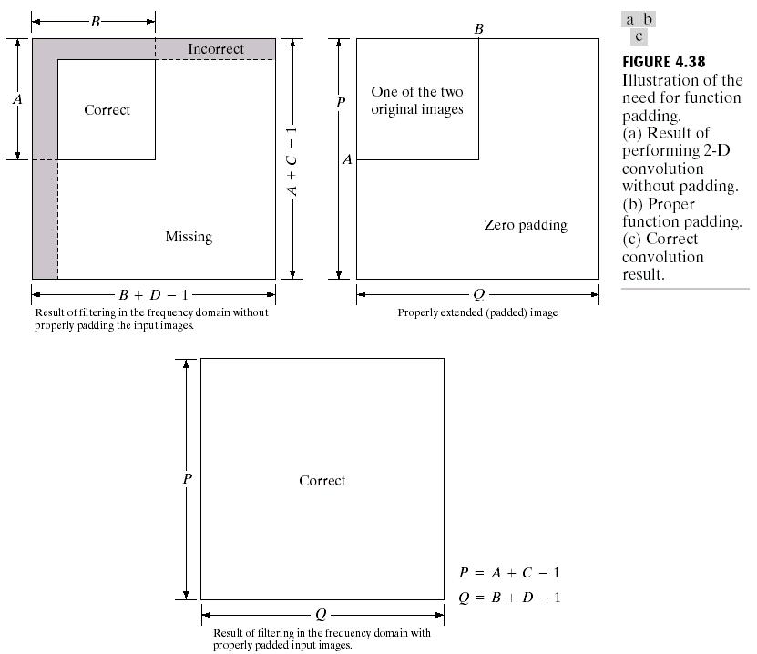
Chapter 4
Image Enhancement in the
Frequency Domain

Slide 38
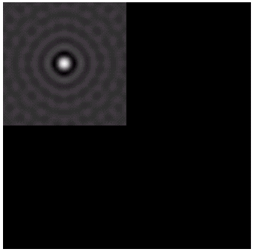

Chapter 4
Image Enhancement in the
Frequency Domain

Slide 39
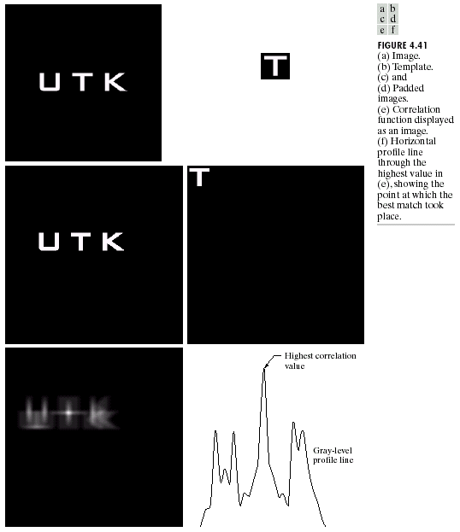
Chapter 4
Image Enhancement in the
Frequency Domain

Slide 40
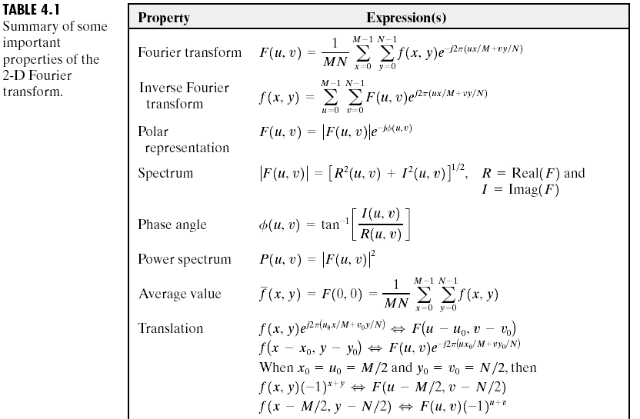
Chapter 4
Image Enhancement in the
Frequency Domain

Slide 41
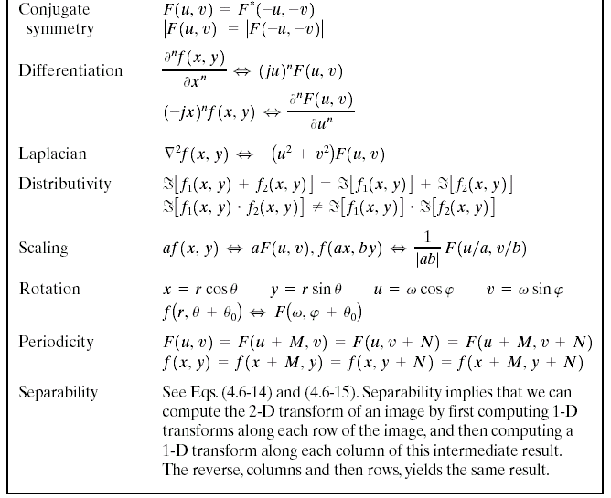

Chapter 4
Image Enhancement in the
Frequency Domain

Slide 42
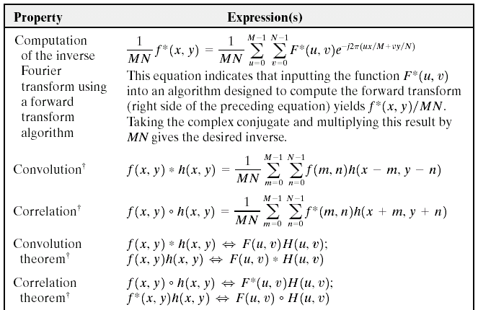
Chapter 4
Image Enhancement in the
Frequency Domain

Slide 43
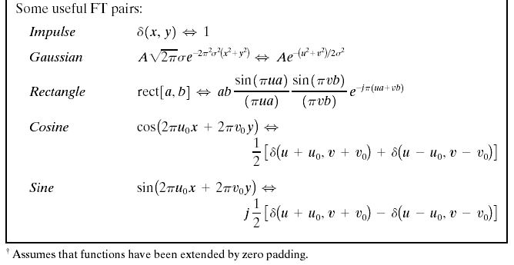
Chapter 4
Image Enhancement in the
Frequency Domain

Slide 44
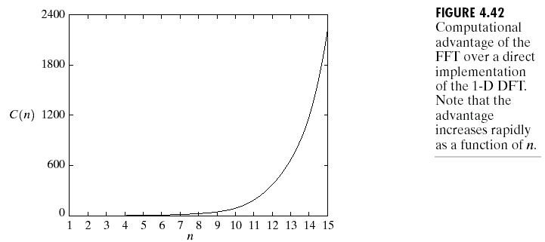
Chapter 4
Image Enhancement in the
Frequency Domain

