Slide 1
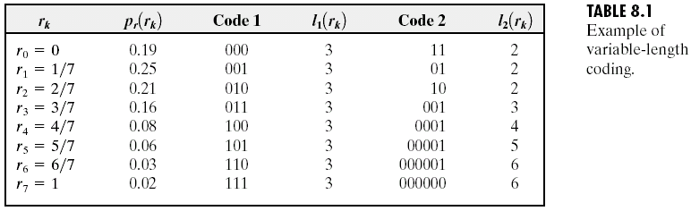
Chapter 8
Image Compression

Slide 2
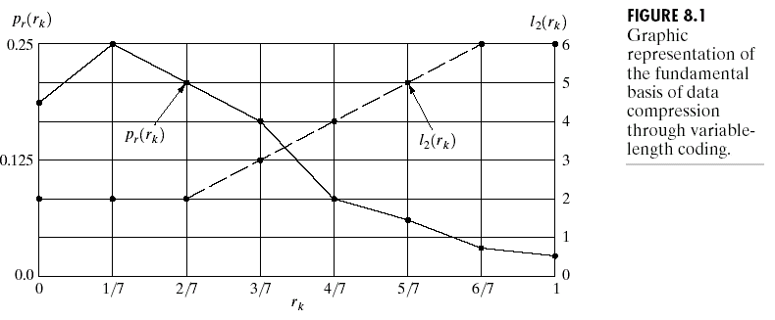
Chapter 8
Image Compression

Slide 3
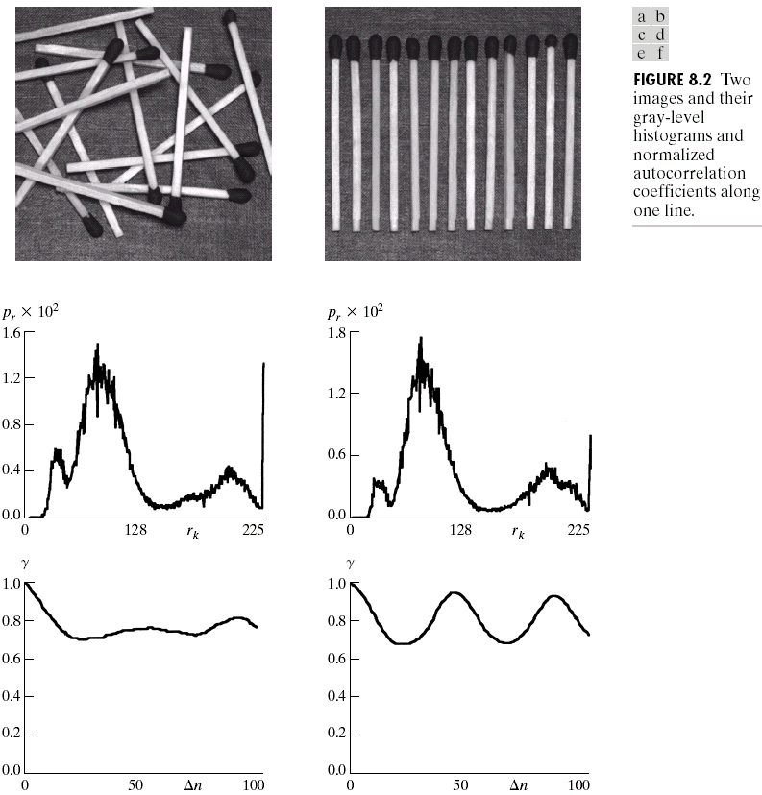
Chapter 8
Image Compression

Slide 4
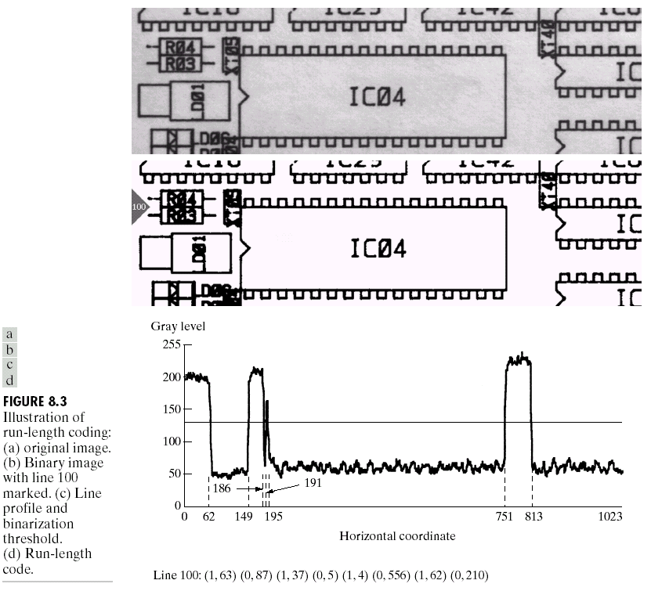
Chapter 8
Image Compression

Slide 5
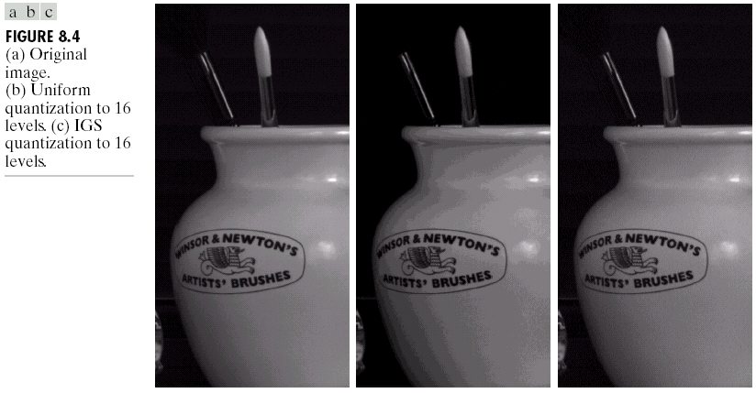
Chapter 8
Image Compression

Slide 6
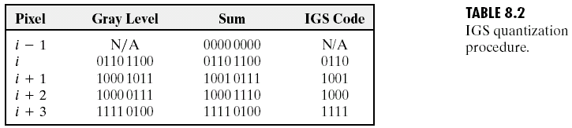
Chapter 8
Image Compression

Slide 7
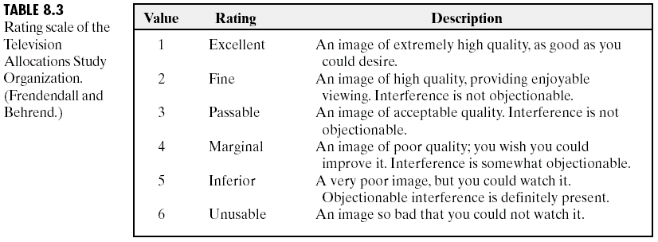
Chapter 8
Image Compression

Slide 8
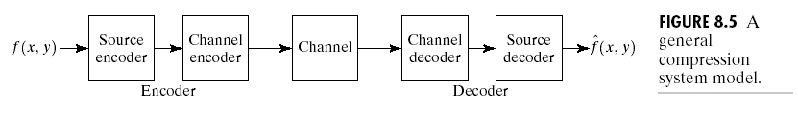
Chapter 8
Image Compression

Slide 9
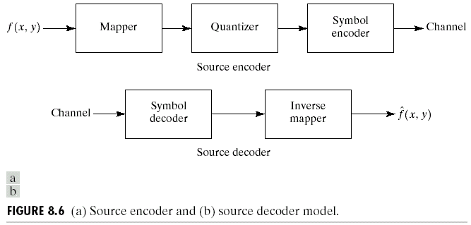
Chapter 8
Image Compression

Slide 10
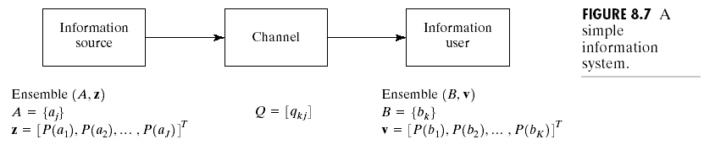
Chapter 8
Image Compression

Slide 11
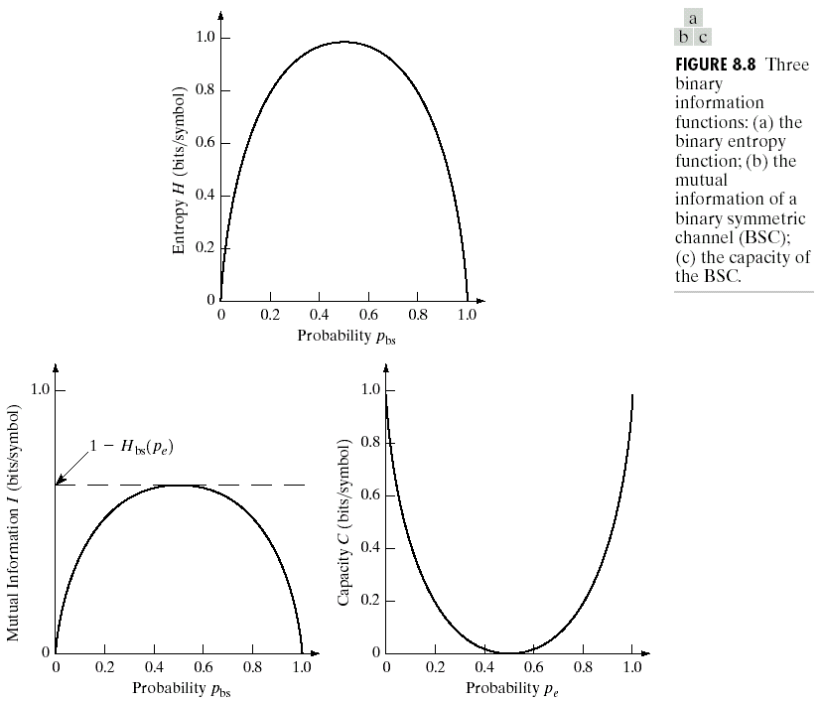
Chapter 8
Image Compression

Slide 12
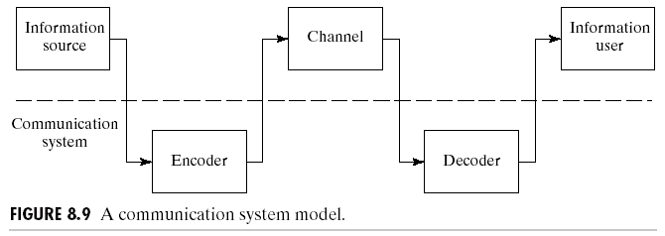
Chapter 8
Image Compression

Slide 13
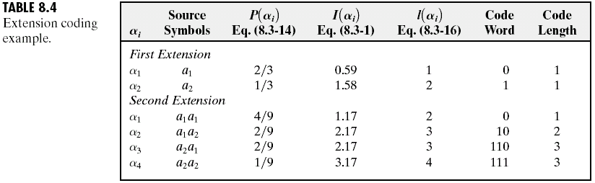
Chapter 8
Image Compression

Slide 14
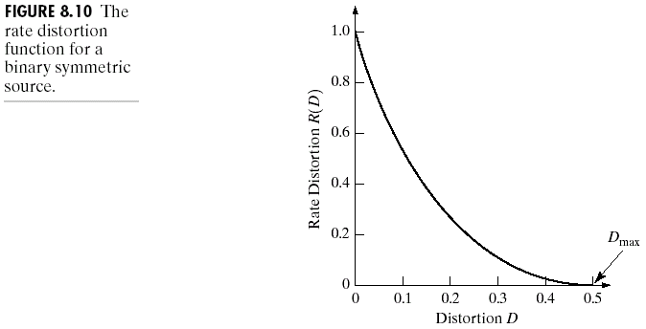
Chapter 8
Image Compression

Slide 15
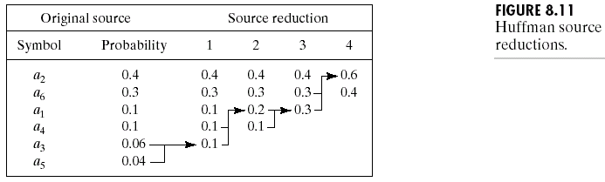
Chapter 8
Image Compression

Slide 16
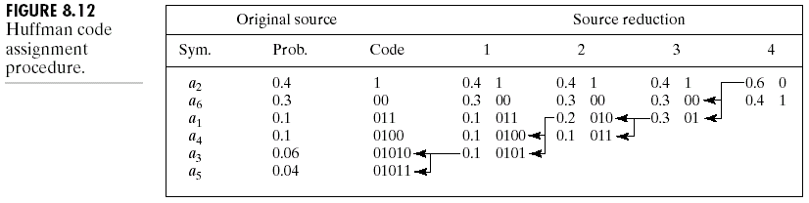
Chapter 8
Image Compression

Slide 17
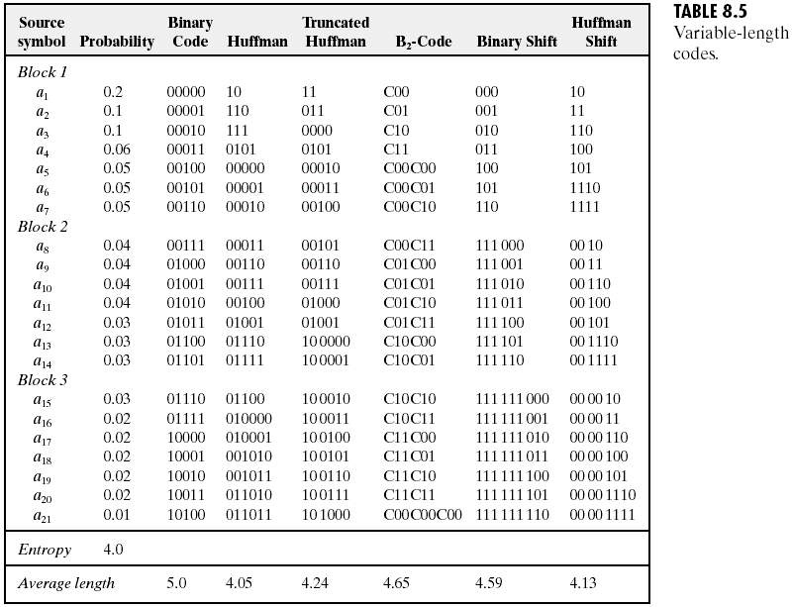
Chapter 8
Image Compression

Slide 18
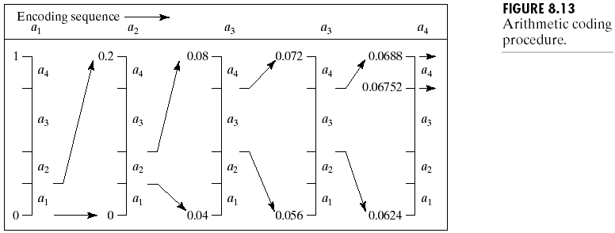
Chapter 8
Image Compression

Slide 19
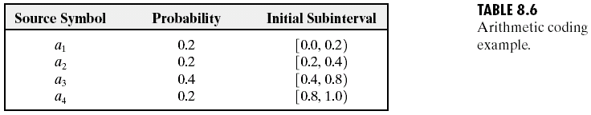
Chapter 8
Image Compression

Slide 20
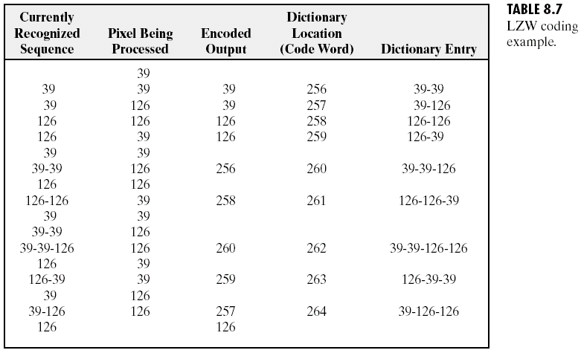
Chapter 8
Image Compression

Slide 21
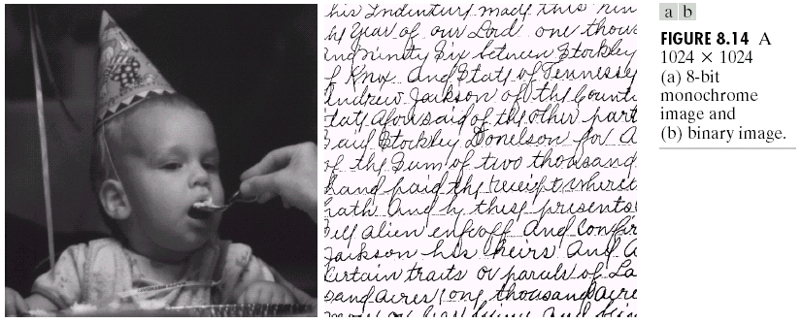
Chapter 8
Image Compression

Slide 22
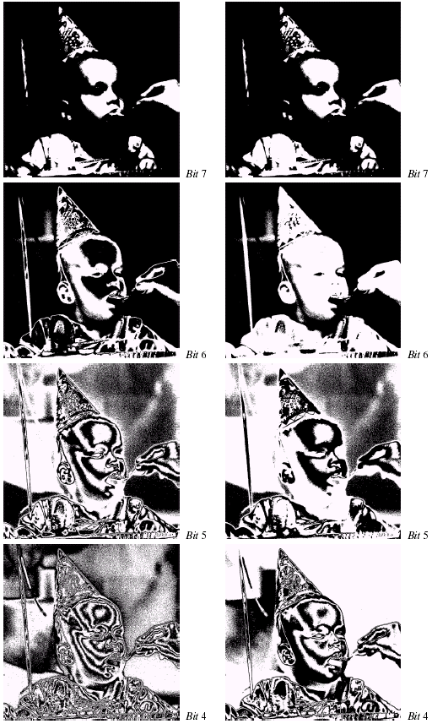
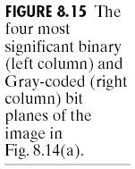
Chapter 8
Image Compression

Slide 23
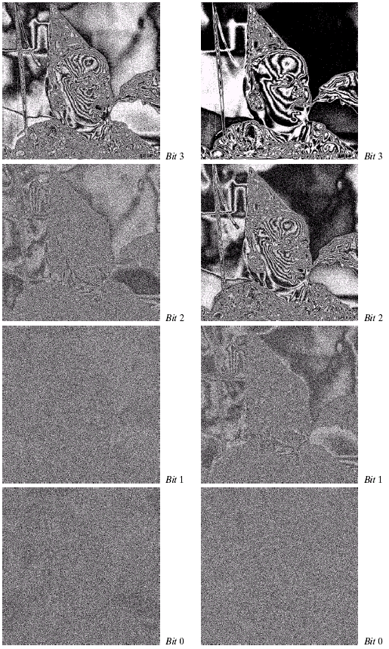
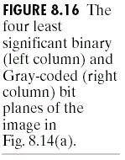
Chapter 8
Image Compression

Slide 24
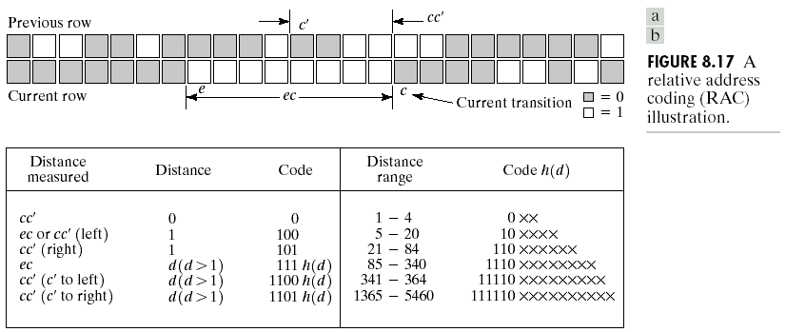
Chapter 8
Image Compression

Slide 25
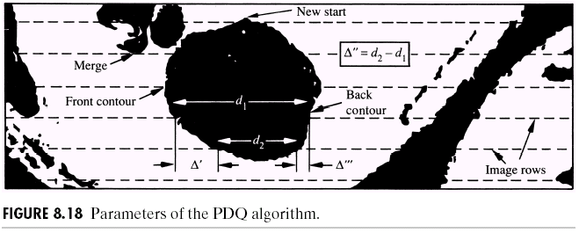
Chapter 8
Image Compression

Slide 26
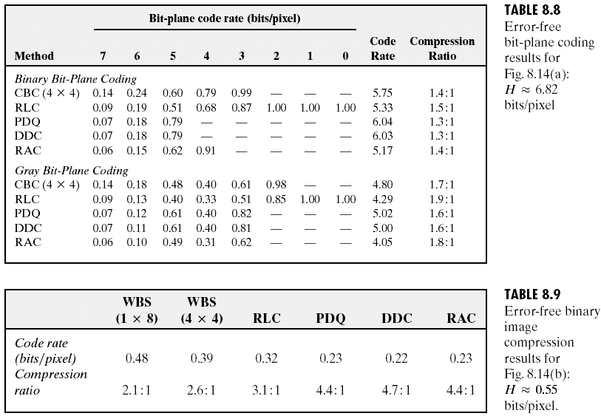
Chapter 8
Image Compression

Slide 27
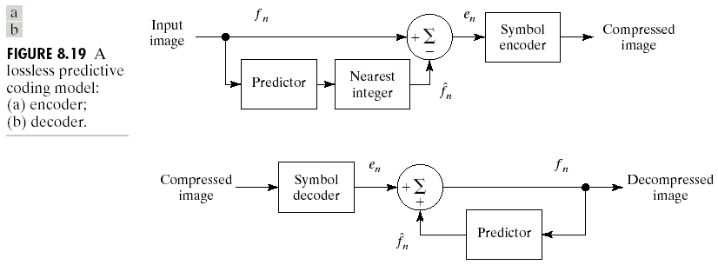
Chapter 8
Image Compression

Slide 28
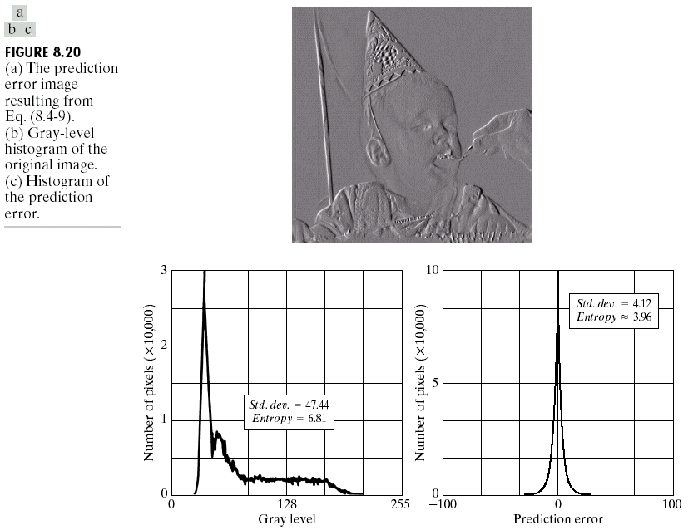
Chapter 8
Image Compression

Slide 29
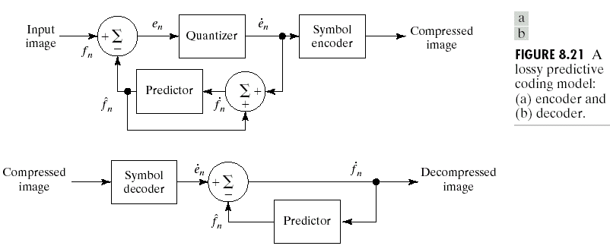
Chapter 8
Image Compression

Slide 30
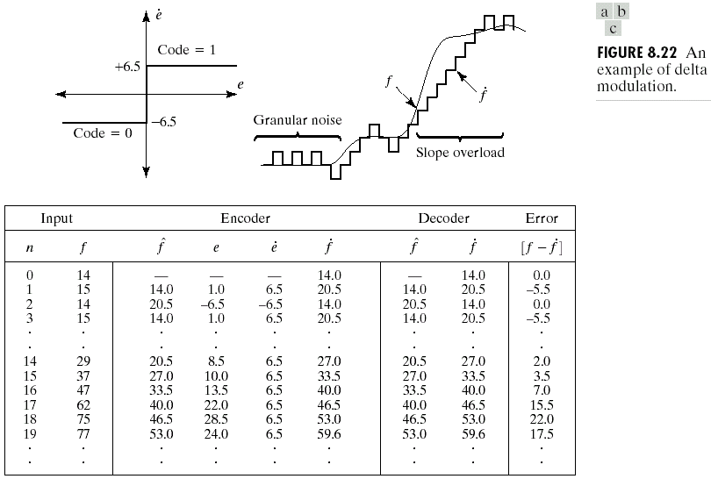
Chapter 8
Image Compression

Slide 31
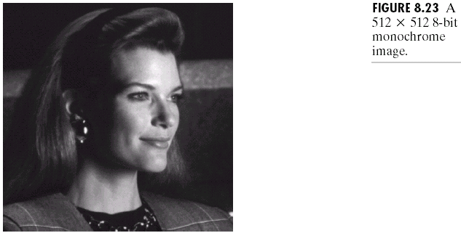
Chapter 8
Image Compression

Slide 32
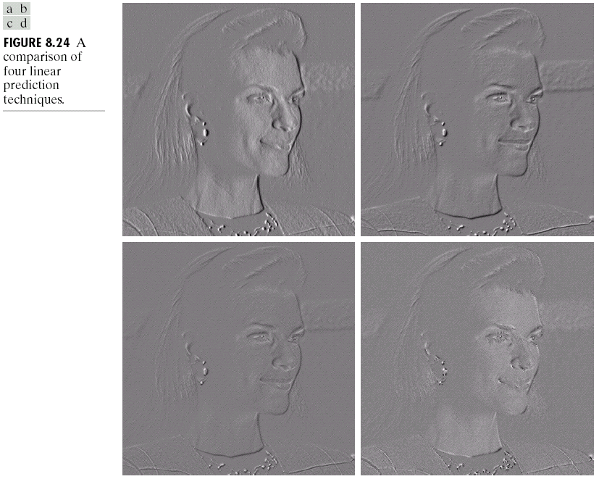
Chapter 8
Image Compression

Slide 33
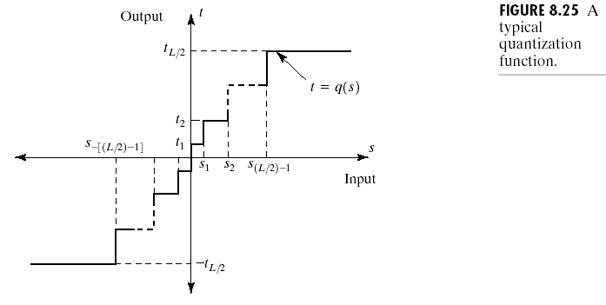
Chapter 8
Image Compression

Slide 34
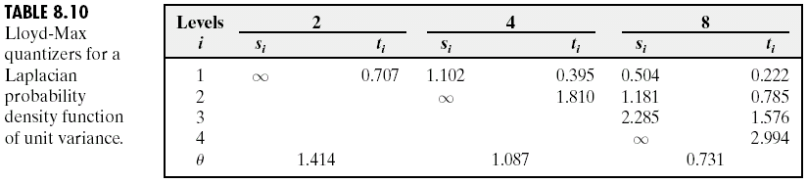
Chapter 8
Image Compression

Slide 35
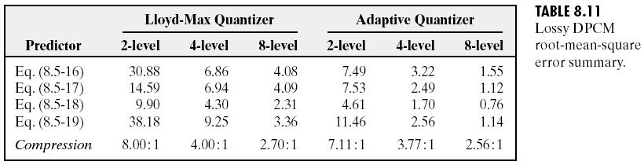
Chapter 8
Image Compression

Slide 36


Chapter 8
Image Compression

Slide 37
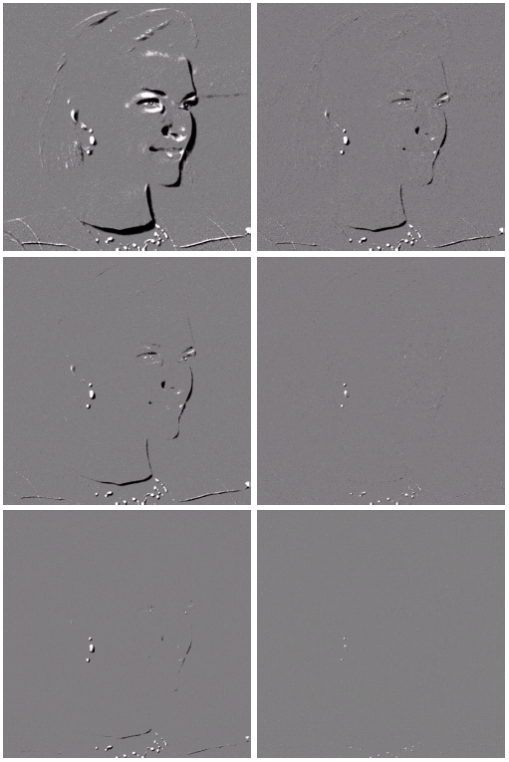

Chapter 8
Image Compression

Slide 38
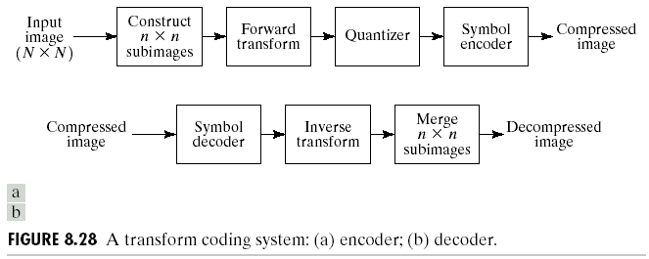
Chapter 8
Image Compression

Slide 39
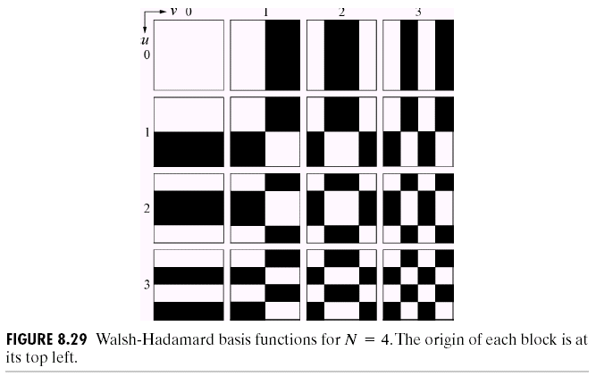
Chapter 8
Image Compression

Slide 40
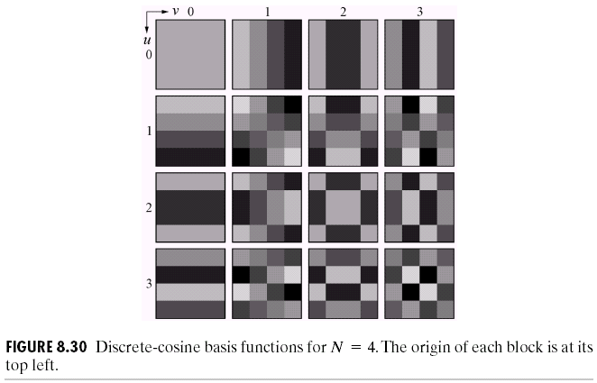
Chapter 8
Image Compression

Slide 41


Chapter 8
Image Compression

Slide 42
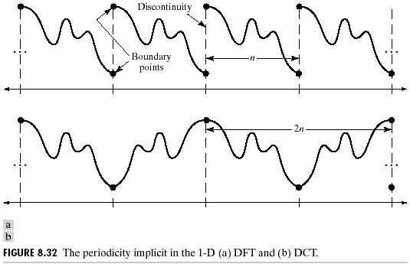
Chapter 8
Image Compression

Slide 43
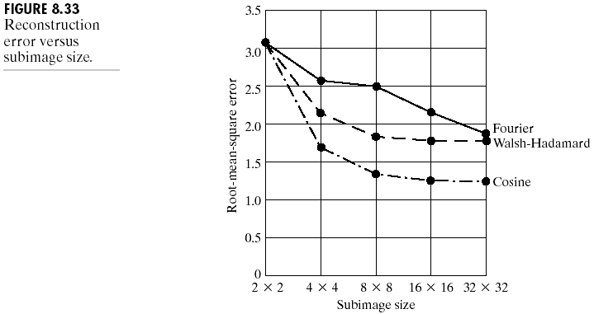
Chapter 8
Image Compression

Slide 44
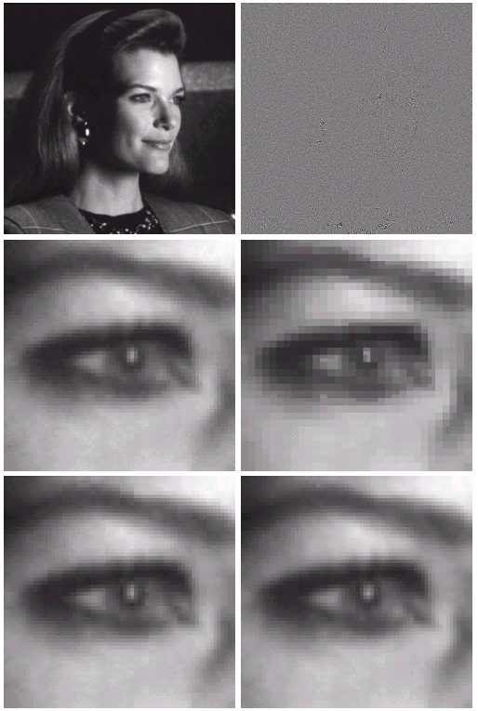
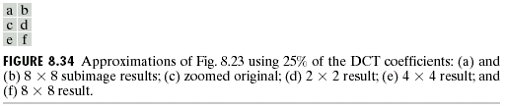
Chapter 8
Image Compression

Slide 45
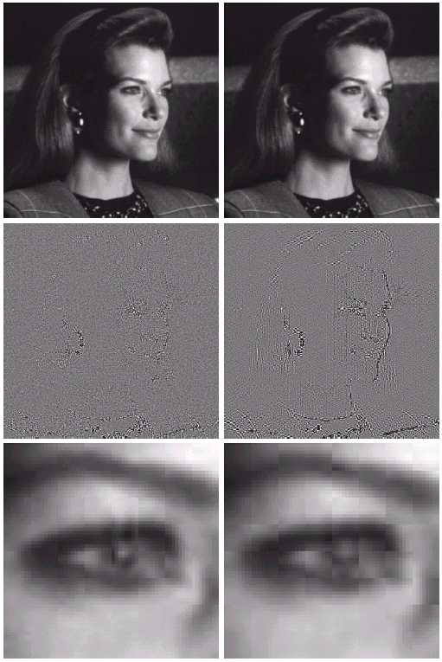

Chapter 8
Image Compression

Slide 46
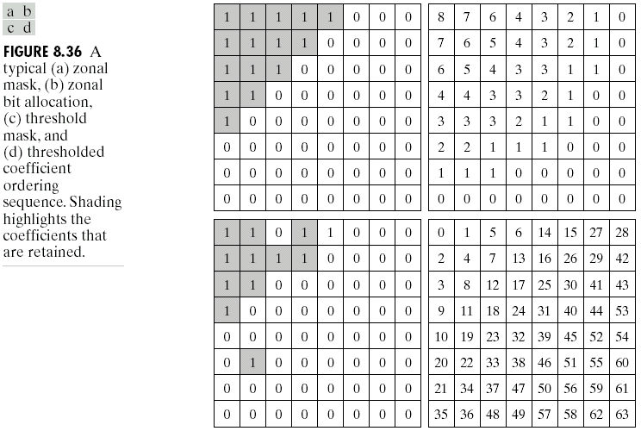
Chapter 8
Image Compression

Slide 47
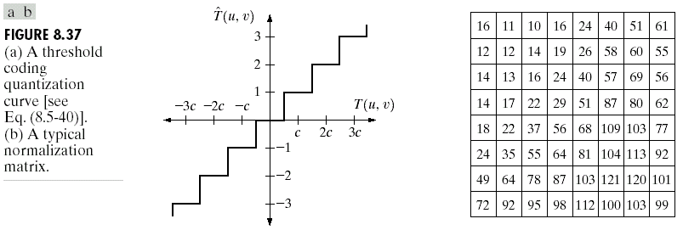
Chapter 8
Image Compression

Slide 48
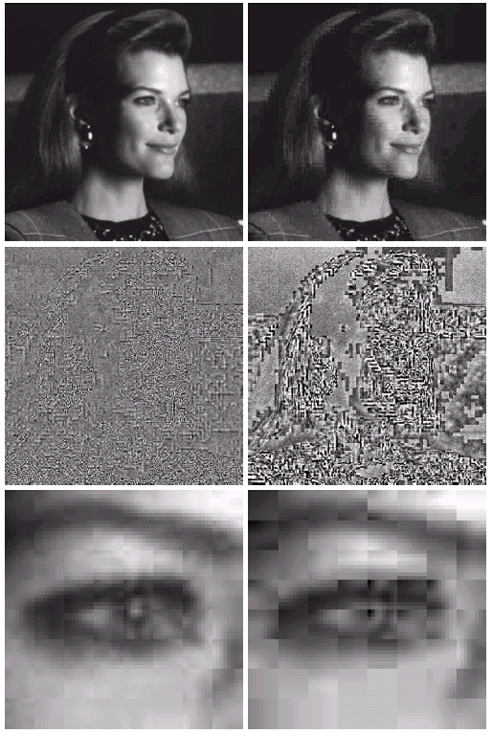

Chapter 8
Image Compression

Slide 49
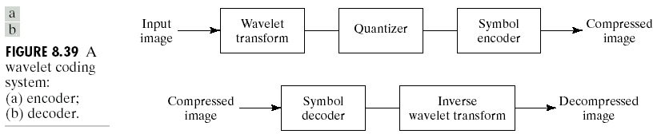
Chapter 8
Image Compression

Slide 50


Chapter 8
Image Compression

Slide 51


Chapter 8
Image Compression

Slide 52

Chapter 8
Image Compression

Slide 53


Chapter 8
Image Compression

Slide 54

Chapter 8
Image Compression

Slide 55

Chapter 8
Image Compression

Slide 56

Chapter 8
Image Compression
Table 8.14 (Cont’)

Slide 57

Chapter 8
Image Compression

Slide 58


Chapter 8
Image Compression

Slide 59

Chapter 8
Image Compression

Slide 60

Chapter 8
Image Compression

Slide 61

Chapter 8
Image Compression

Slide 62

Chapter 8
Image Compression

Slide 63

Chapter 8
Image Compression

Slide 64

Chapter 8
Image Compression
Table 8.19 (Con’t)

Slide 65

Chapter 8
Image Compression

Slide 66

Chapter 8
Image Compression

Slide 67

Chapter 8
Image Compression

