Slide 1
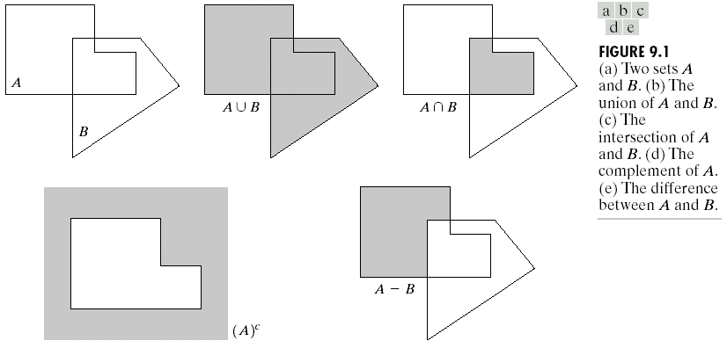
Chapter 9
Morphological Image Processing

Slide 2
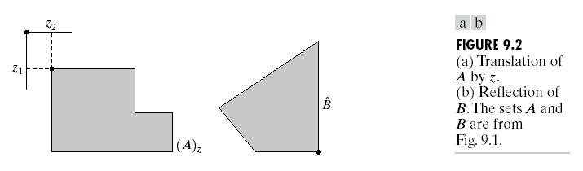
Chapter 9
Morphological Image Processing

Slide 3
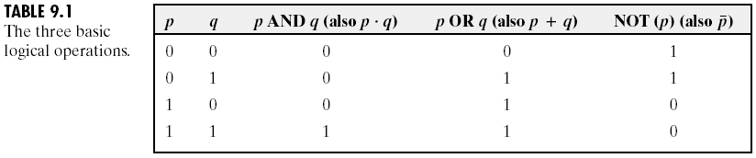
Chapter 9
Morphological Image Processing

Slide 4
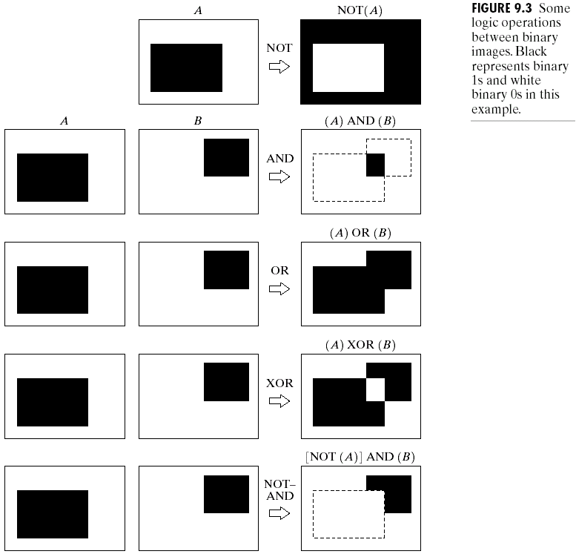
Chapter 9
Morphological Image Processing

Slide 5
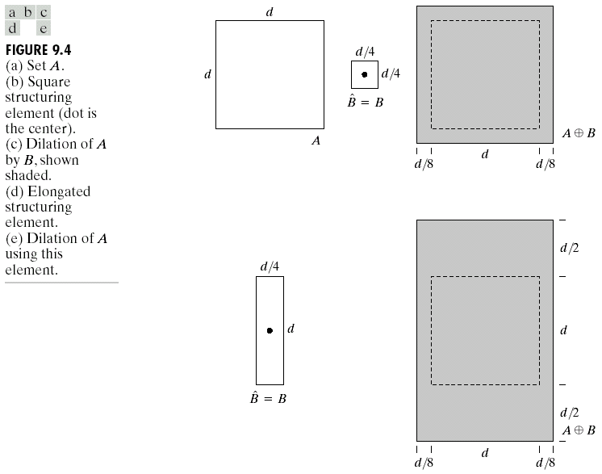
Chapter 9
Morphological Image Processing

Slide 6
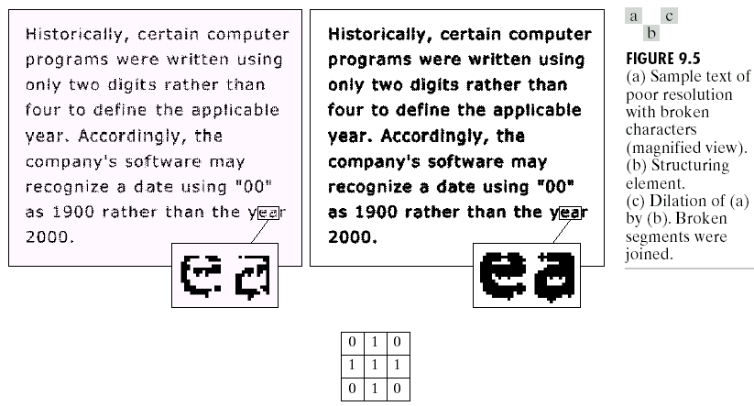
Chapter 9
Morphological Image Processing

Slide 7
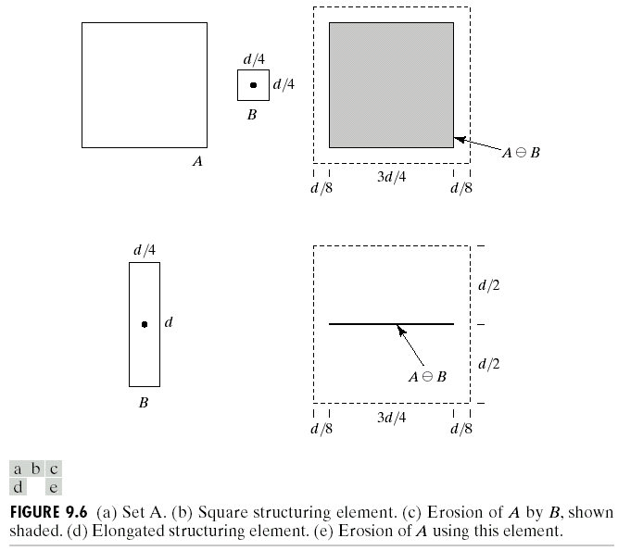
Chapter 9
Morphological Image Processing

Slide 8
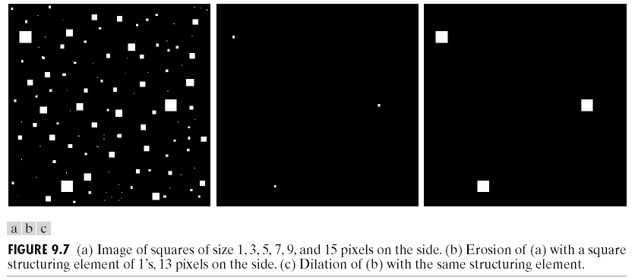
Chapter 9
Morphological Image Processing

Slide 9
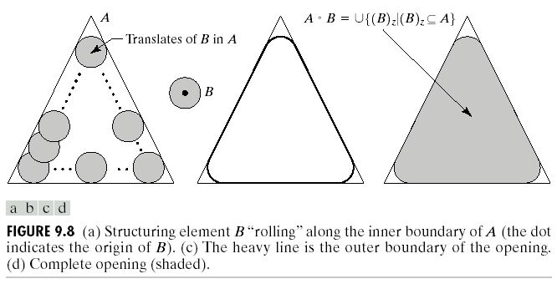
Chapter 9
Morphological Image Processing

Slide 10
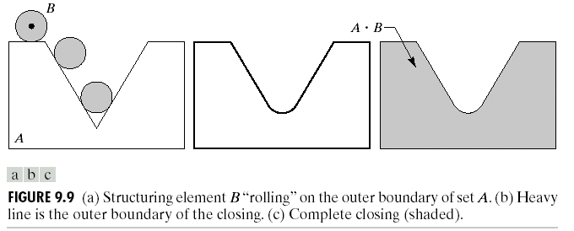
Chapter 9
Morphological Image Processing

Slide 11
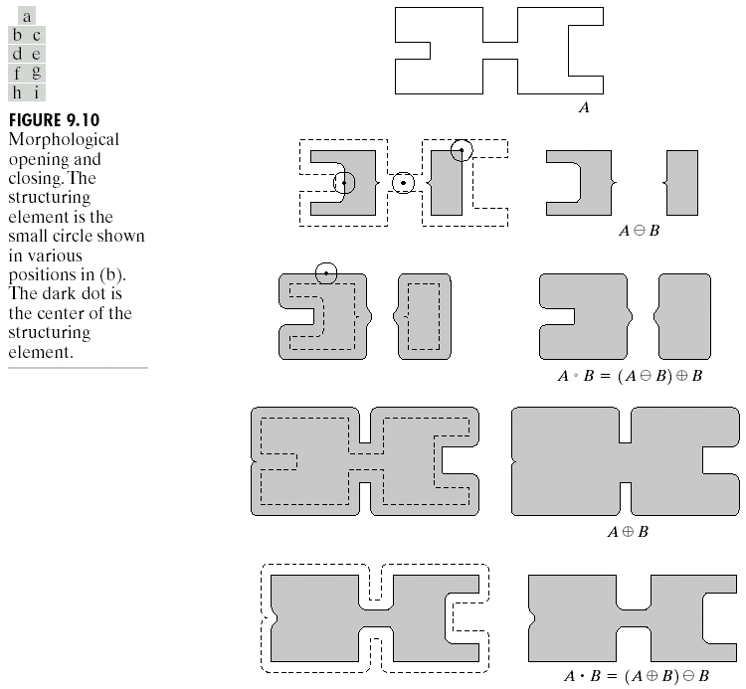
Chapter 9
Morphological Image Processing

Slide 12
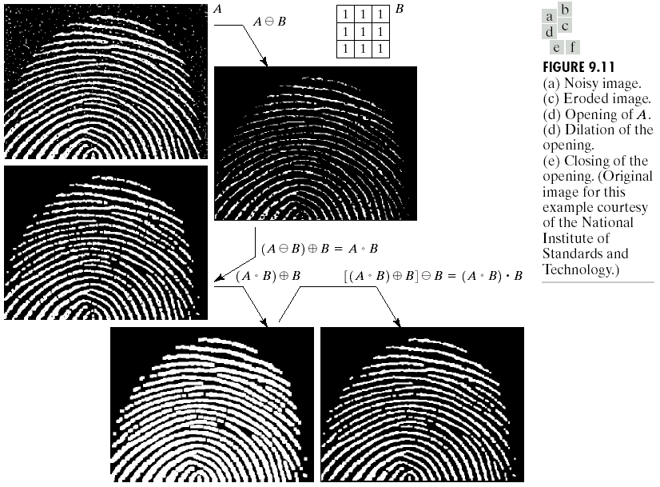
Chapter 9
Morphological Image Processing

Slide 13
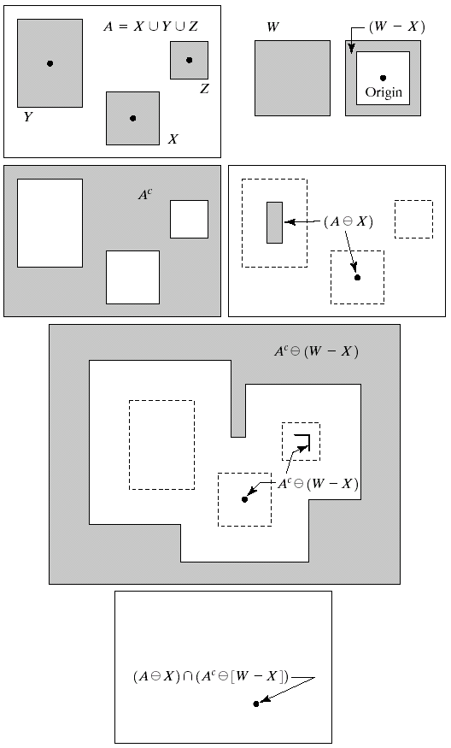
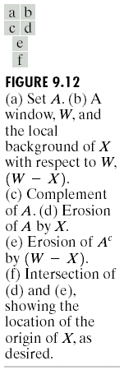
Chapter 9
Morphological Image Processing

Slide 14
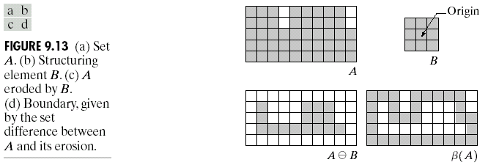
Chapter 9
Morphological Image Processing

Slide 15
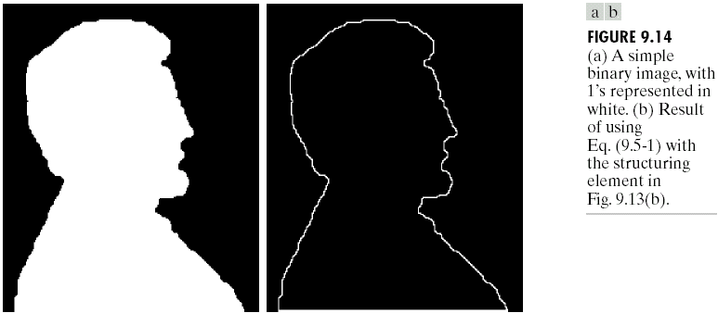
Chapter 9
Morphological Image Processing

Slide 16
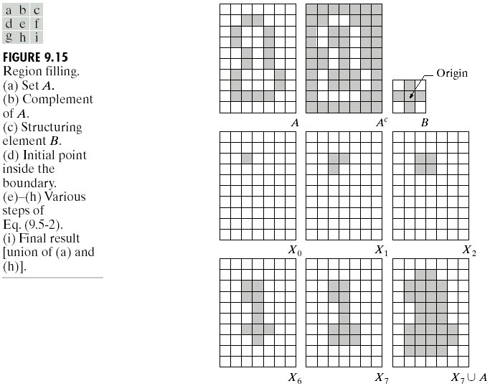
Chapter 9
Morphological Image Processing

Slide 17
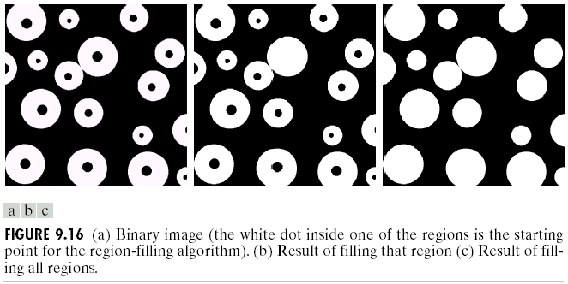
Chapter 9
Morphological Image Processing

Slide 18
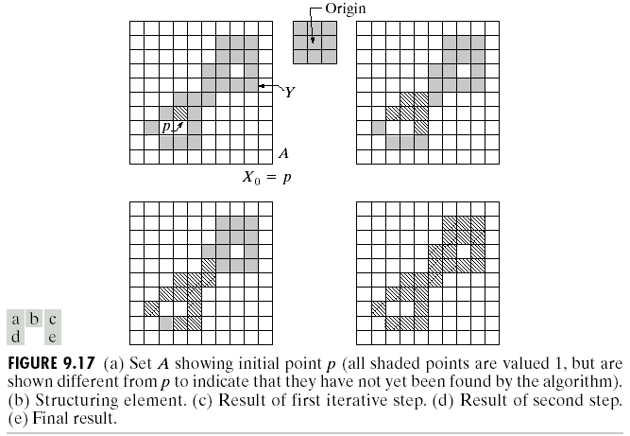
Chapter 9
Morphological Image Processing

Slide 19
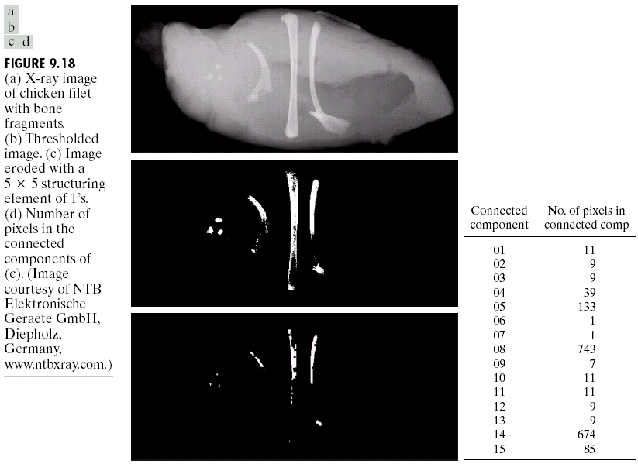
Chapter 9
Morphological Image Processing

Slide 20
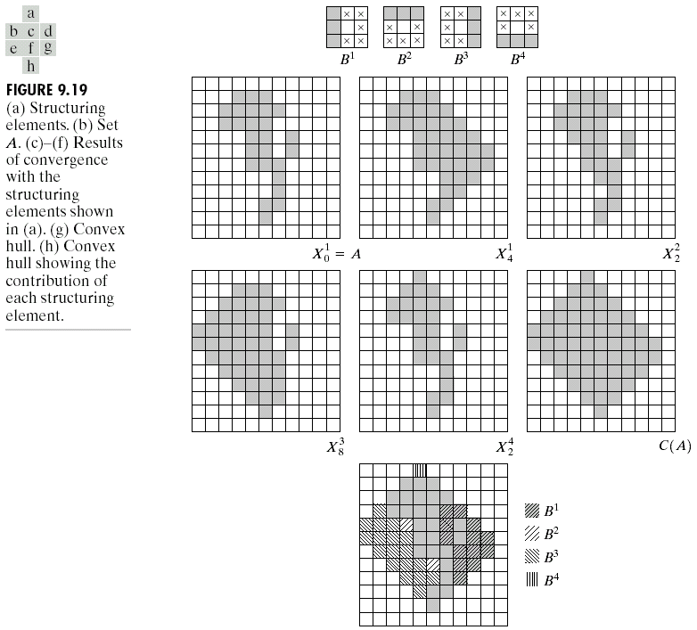
Chapter 9
Morphological Image Processing

Slide 21
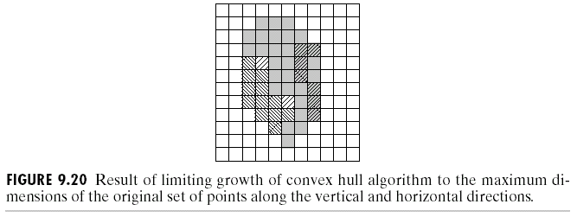
Chapter 9
Morphological Image Processing

Slide 22
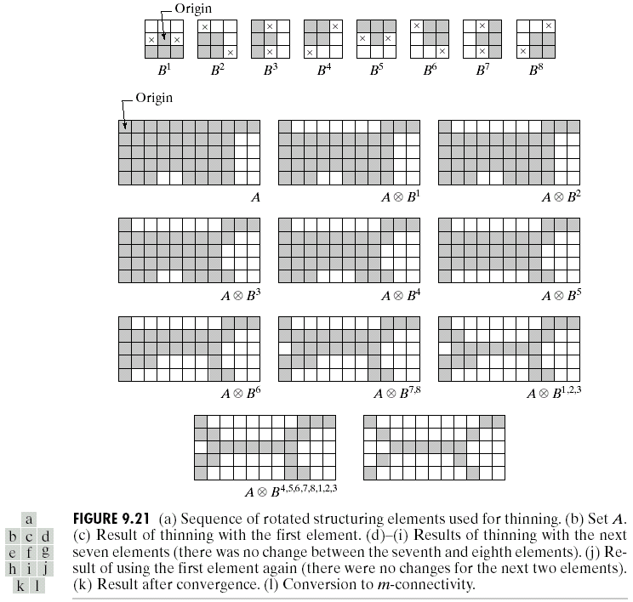
Chapter 9
Morphological Image Processing

Slide 23
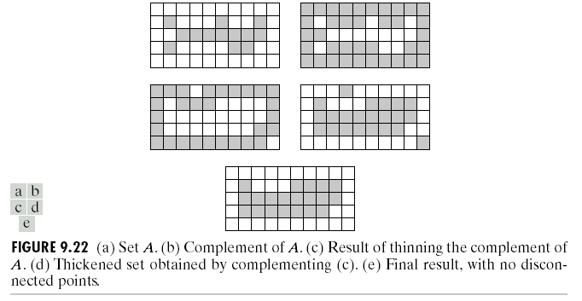
Chapter 9
Morphological Image Processing

Slide 24
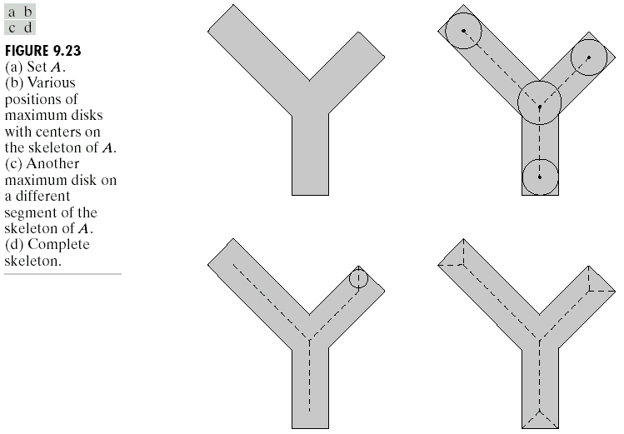
Chapter 9
Morphological Image Processing

Slide 25
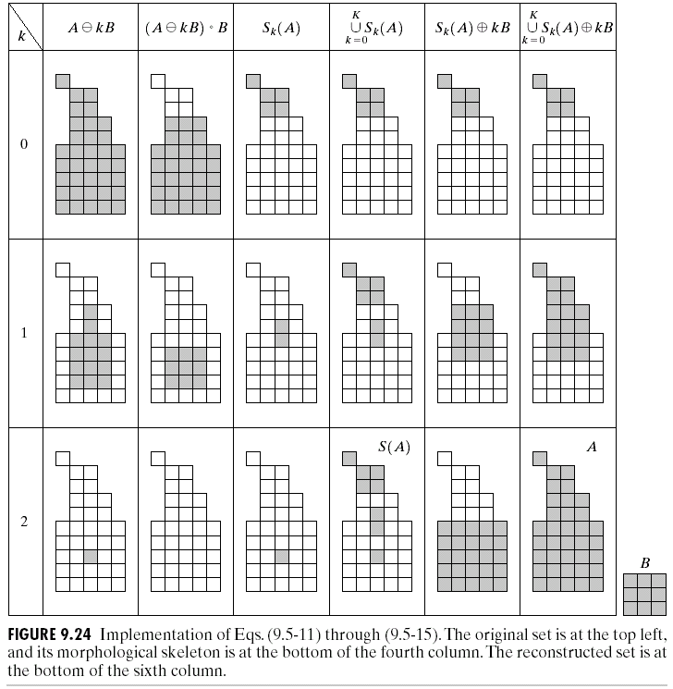
Chapter 9
Morphological Image Processing

Slide 26
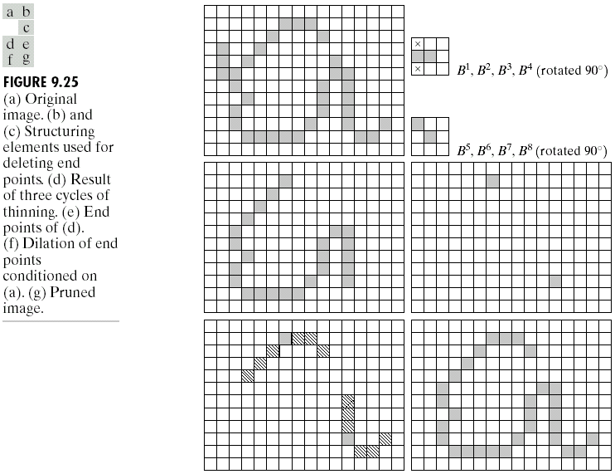
Chapter 9
Morphological Image Processing

Slide 27
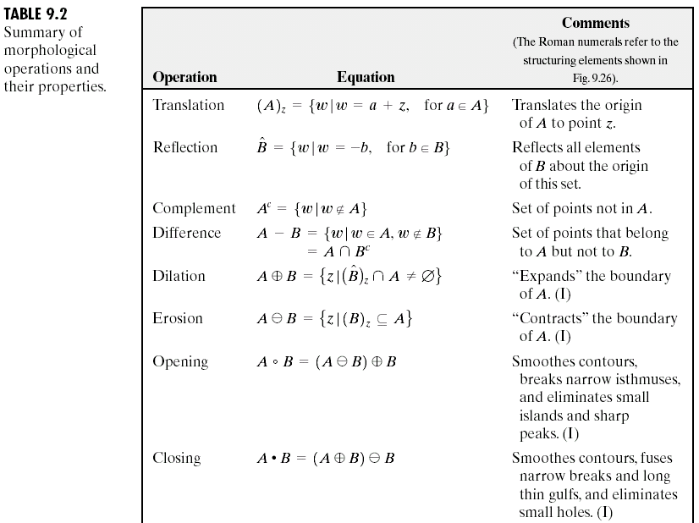
Chapter 9
Morphological Image Processing

Slide 28
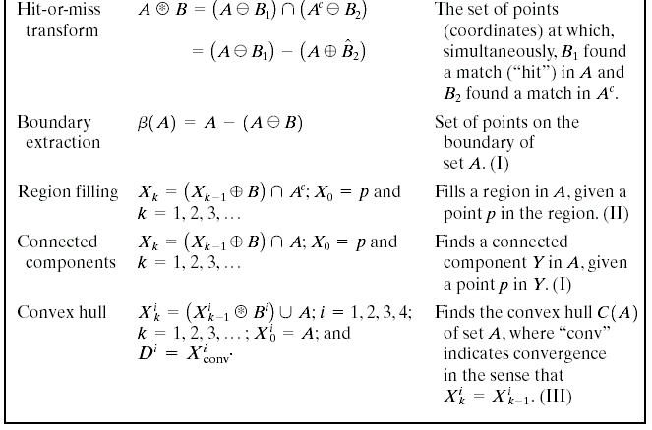
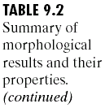
Chapter 9
Morphological Image Processing

Slide 29
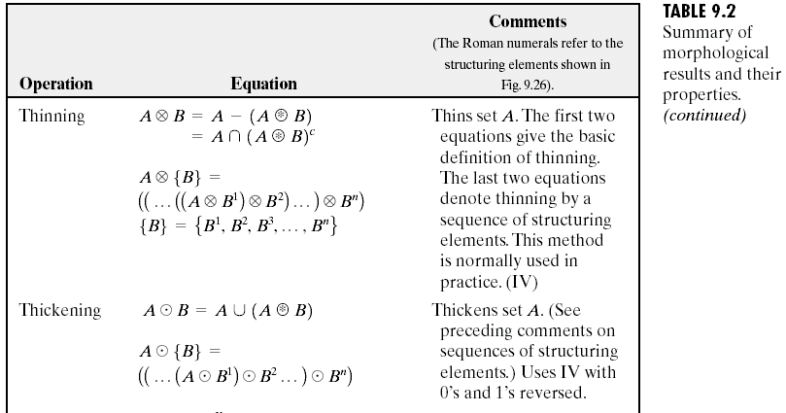
Chapter 9
Morphological Image Processing

Slide 30
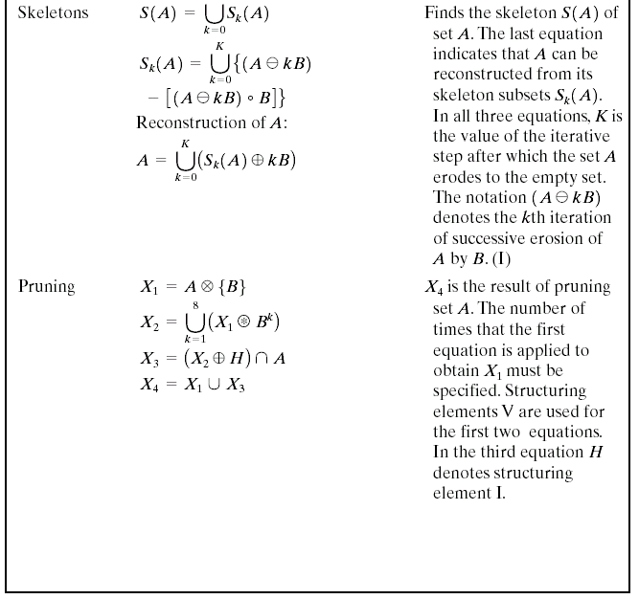
Chapter 9
Morphological Image Processing

Slide 31
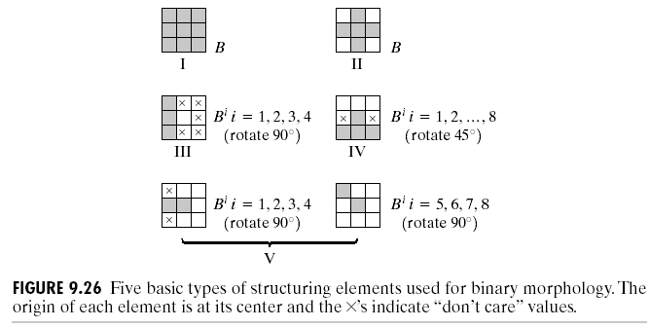
Chapter 9
Morphological Image Processing

Slide 32
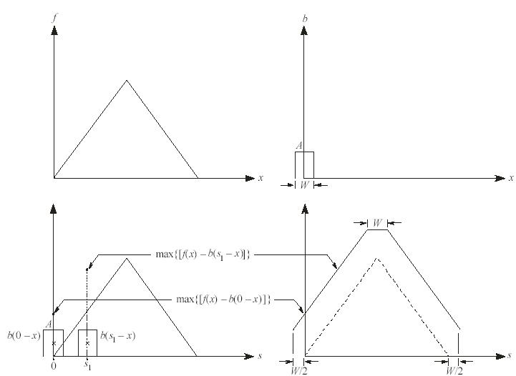
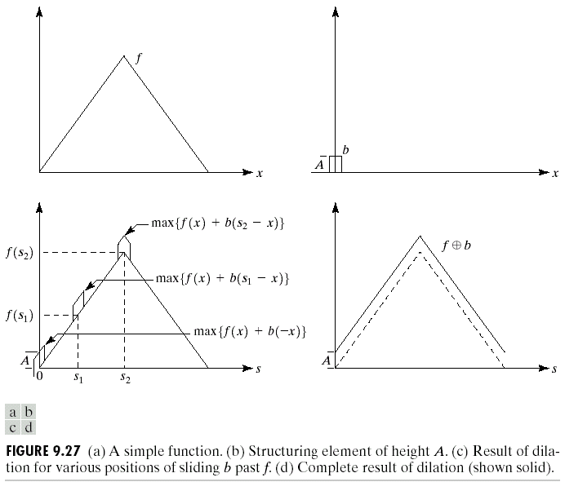
Chapter 9
Morphological Image Processing

Slide 33
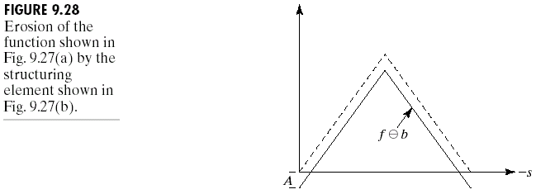
Chapter 9
Morphological Image Processing

Slide 34
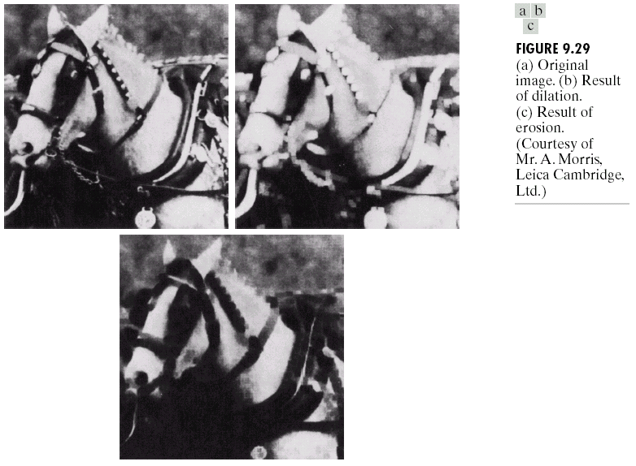
Chapter 9
Morphological Image Processing

Slide 35
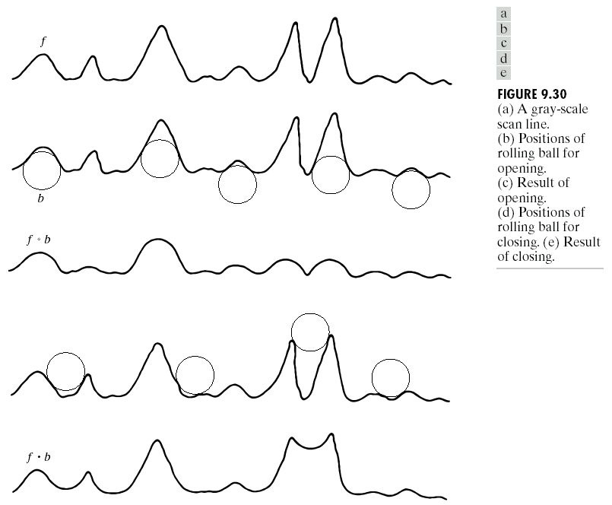
Chapter 9
Morphological Image Processing

Slide 36
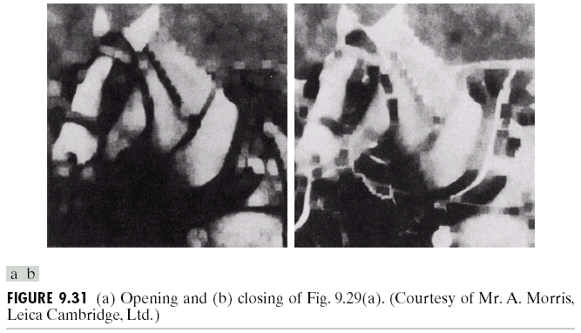
Chapter 9
Morphological Image Processing

Slide 37
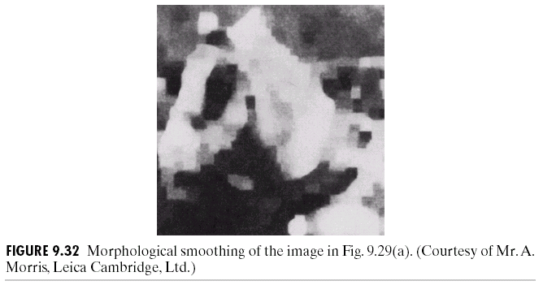
Chapter 9
Morphological Image Processing

Slide 38
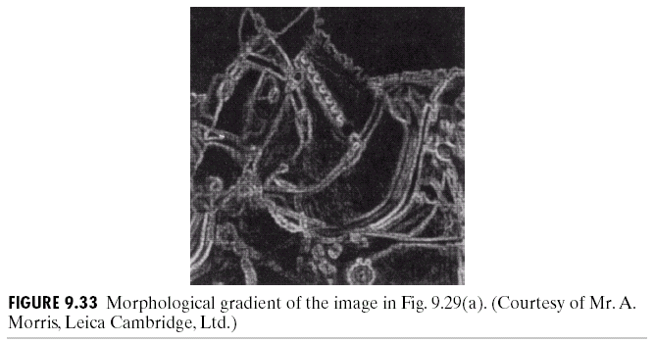
Chapter 9
Morphological Image Processing

Slide 39
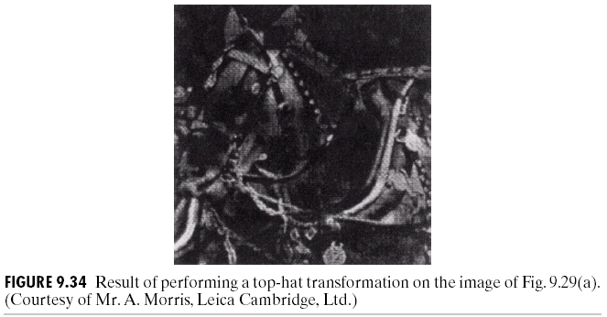
Chapter 9
Morphological Image Processing

Slide 40
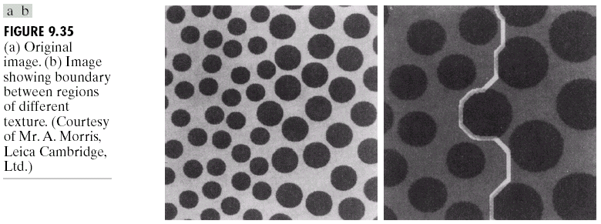
Chapter 9
Morphological Image Processing

Slide 41
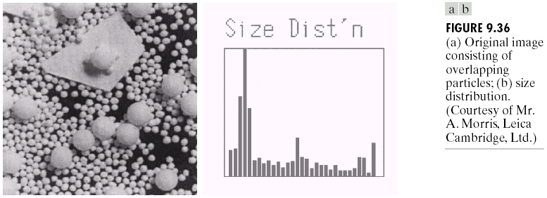
Chapter 9
Morphological Image Processing

