Slide 1
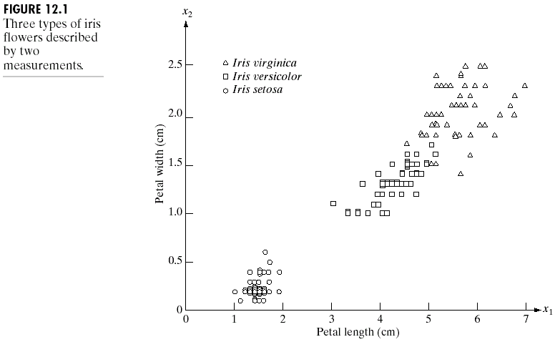
Chapter 12
Object Recognition

Slide 2
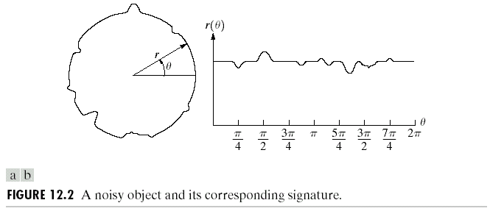
Chapter 12
Object Recognition

Slide 3
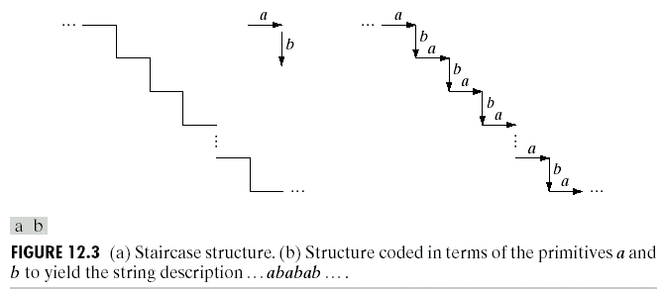
Chapter 12
Object Recognition

Slide 4
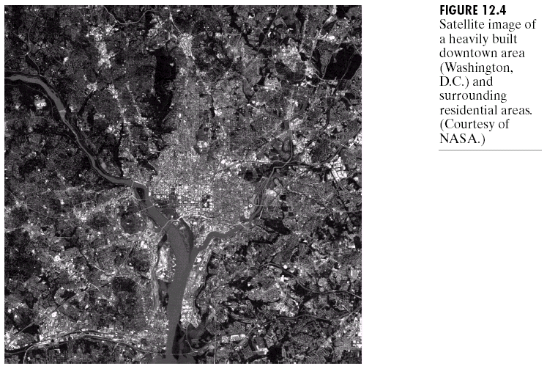
Chapter 12
Object Recognition

Slide 5
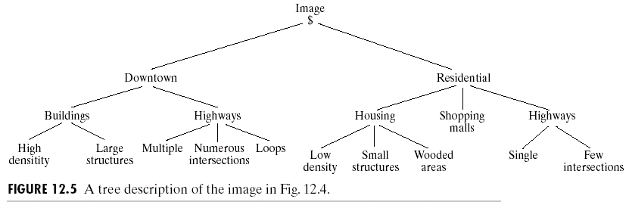
Chapter 12
Object Recognition

Slide 6
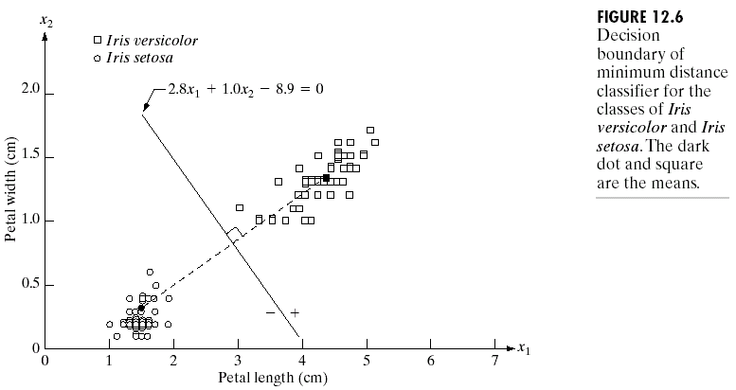
Chapter 12
Object Recognition

Slide 7
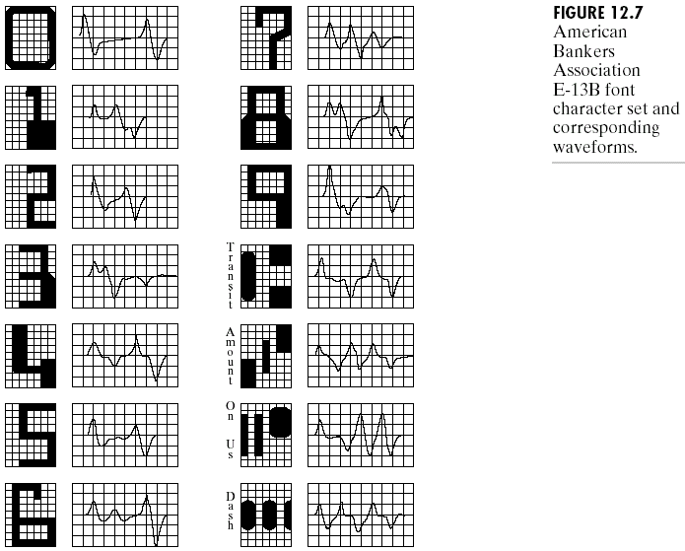
Chapter 12
Object Recognition

Slide 8
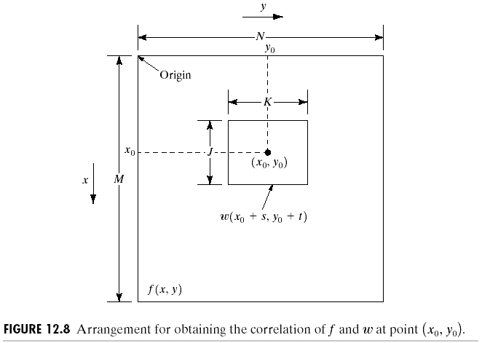
Chapter 12
Object Recognition

Slide 9
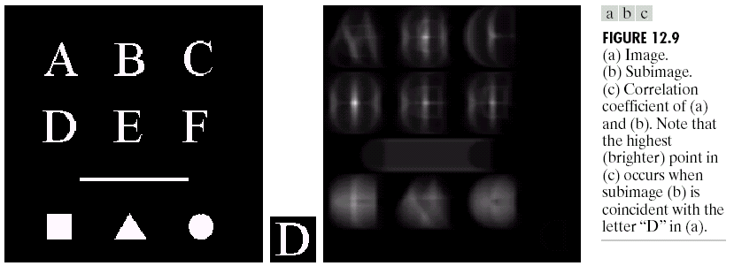
Chapter 12
Object Recognition

Slide 10
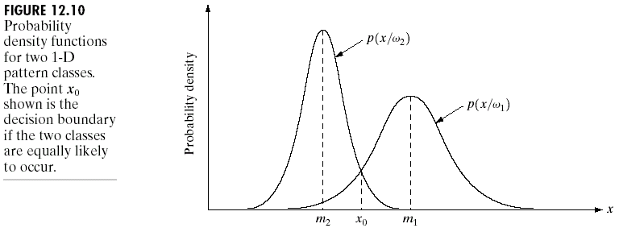
Chapter 12
Object Recognition

Slide 11
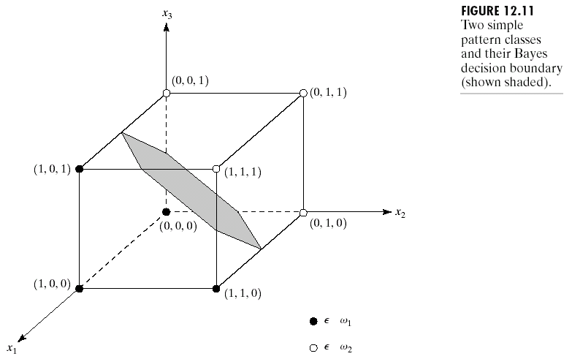
Chapter 12
Object Recognition

Slide 12
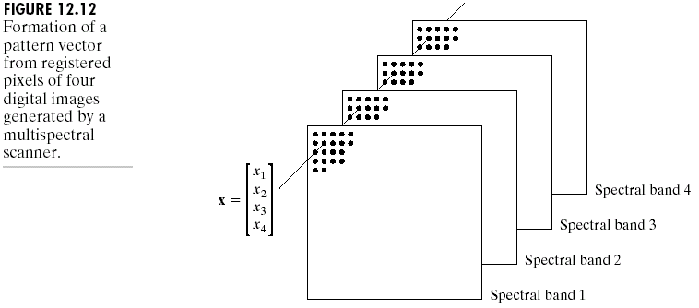
Chapter 12
Object Recognition

Slide 13
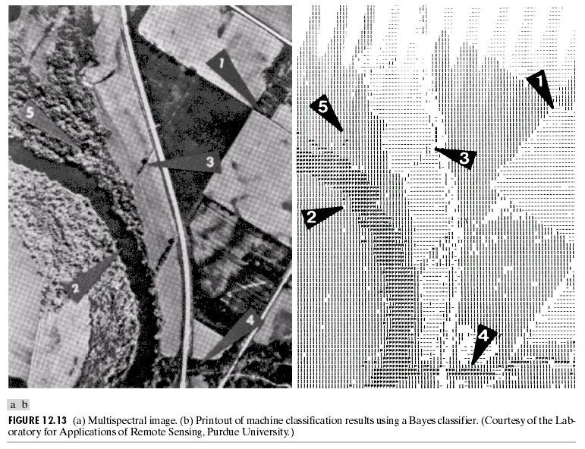
Chapter 12
Object Recognition

Slide 14
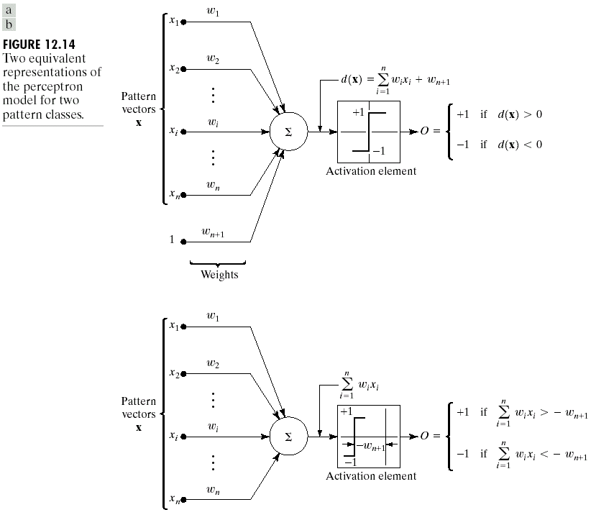
Chapter 12
Object Recognition

Slide 15
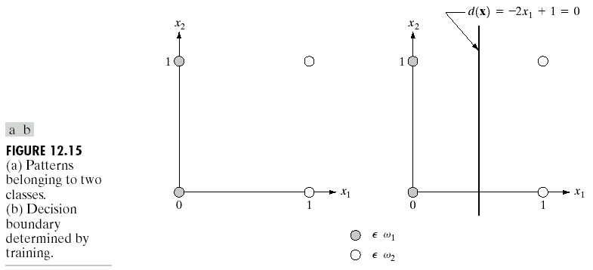
Chapter 12
Object Recognition

Slide 16
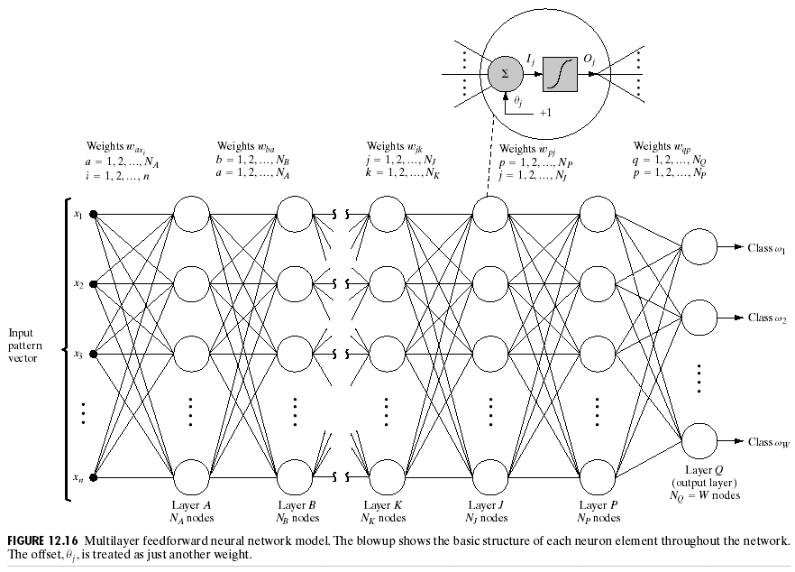
Chapter 12
Object Recognition

Slide 17
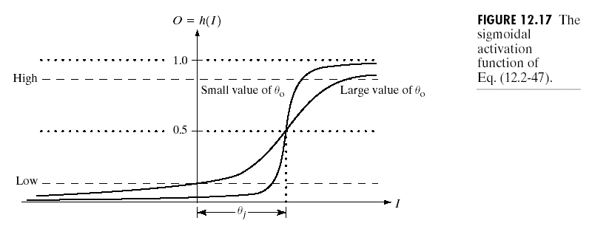
Chapter 12
Object Recognition

Slide 18
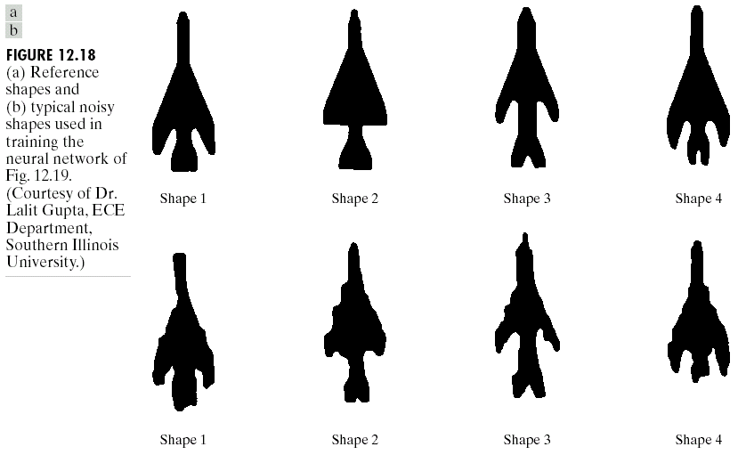
Chapter 12
Object Recognition

Slide 19
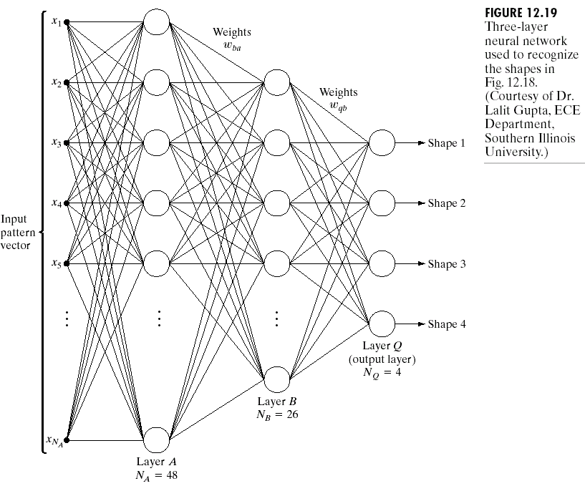
Chapter 12
Object Recognition

Slide 20
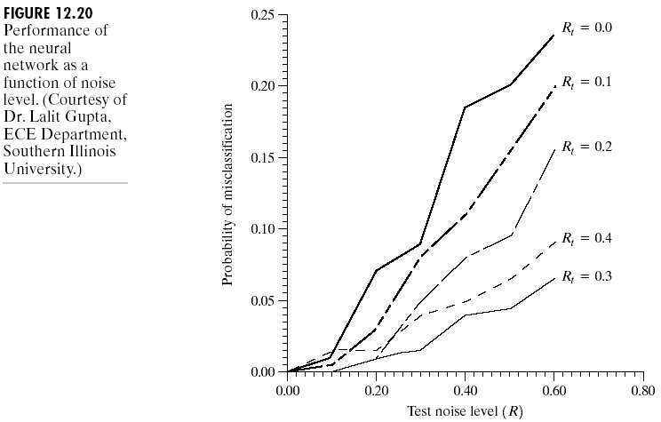
Chapter 12
Object Recognition

Slide 21
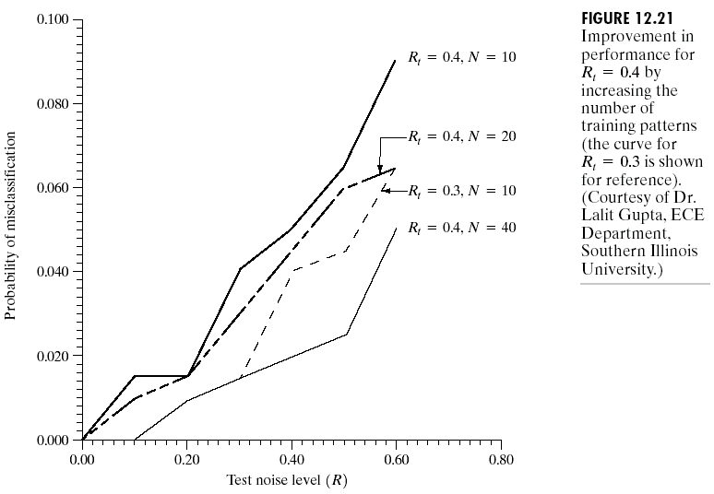
Chapter 12
Object Recognition

Slide 22
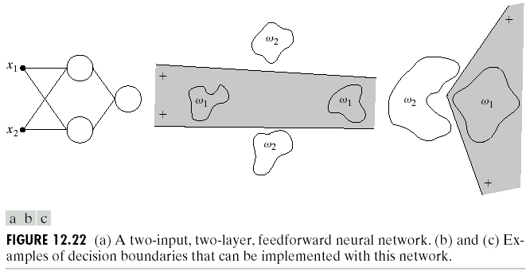
Chapter 12
Object Recognition

Slide 23
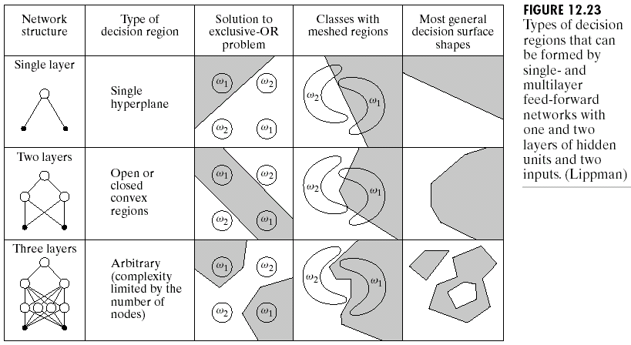
Chapter 12
Object Recognition

Slide 24
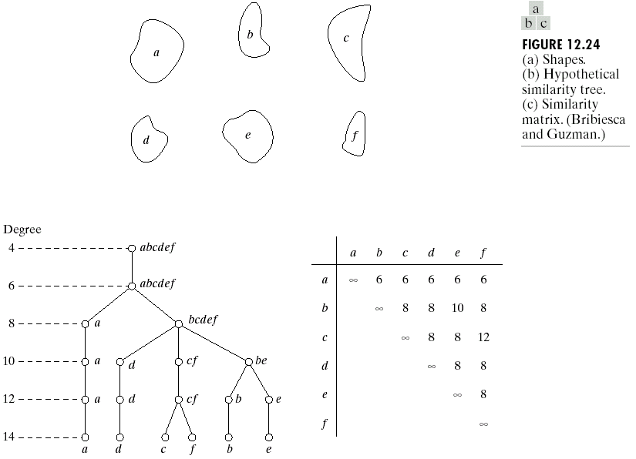
Chapter 12
Object Recognition

Slide 25
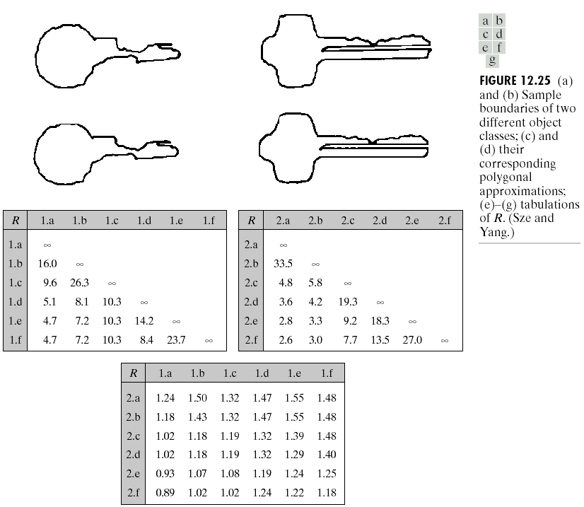
Chapter 12
Object Recognition

Slide 26
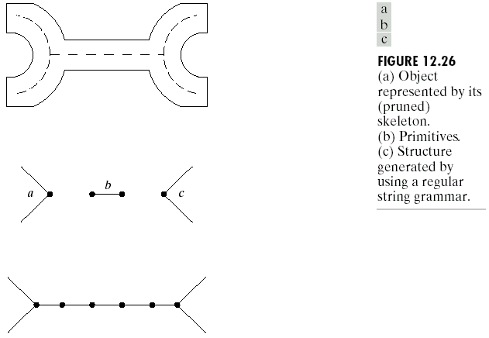
Chapter 12
Object Recognition

Slide 27
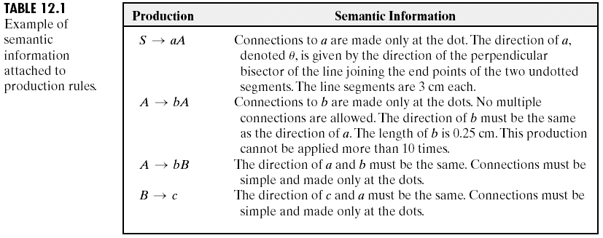
Chapter 12
Object Recognition

Slide 28
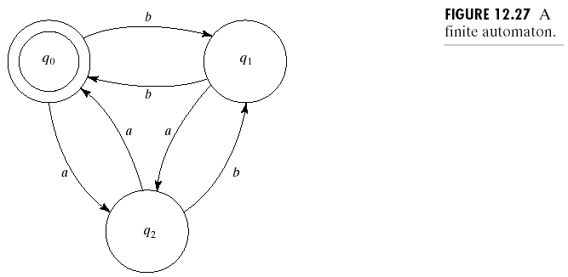
Chapter 12
Object Recognition

Slide 29
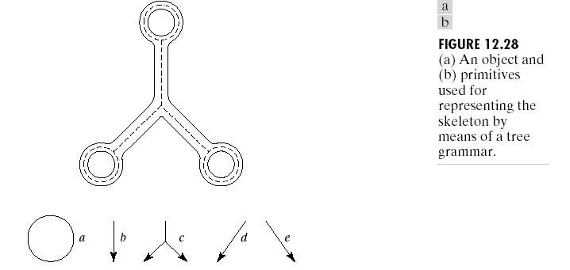
Chapter 12
Object Recognition

Slide 30
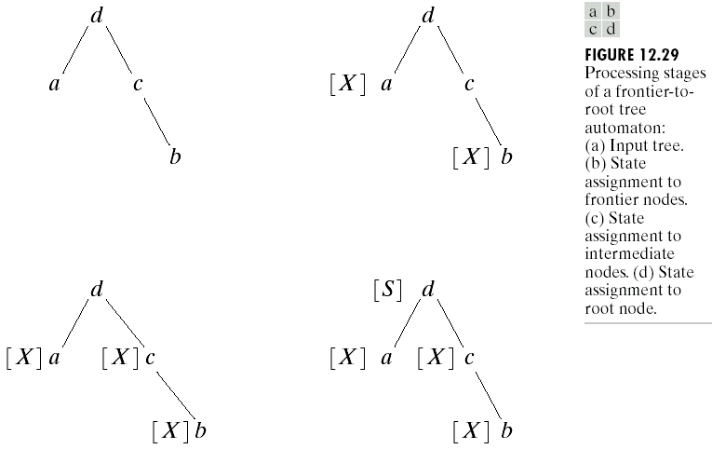
Chapter 12
Object Recognition

Slide 31
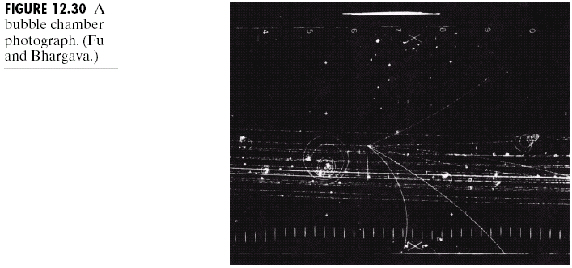
Chapter 12
Object Recognition

Slide 32
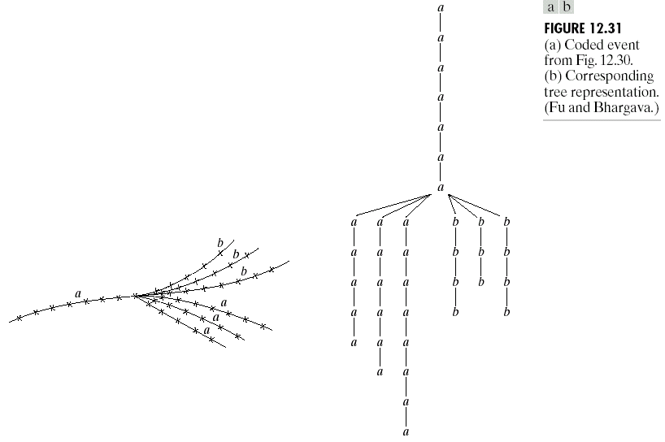
Chapter 12
Object Recognition

Slide 33
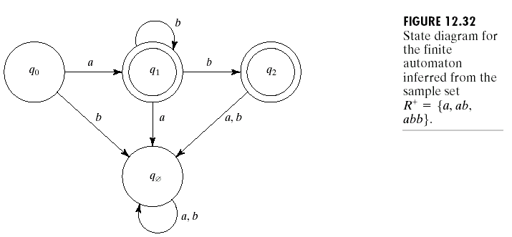
Chapter 12
Object Recognition

Slide 34
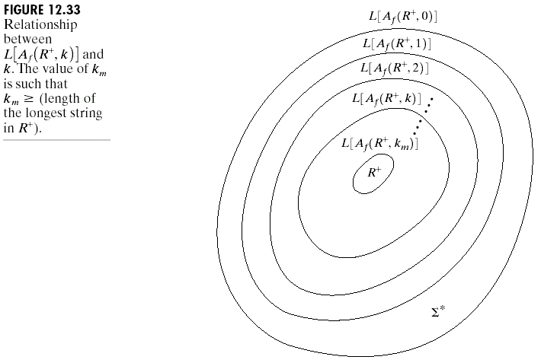
Chapter 12
Object Recognition

Slide 35
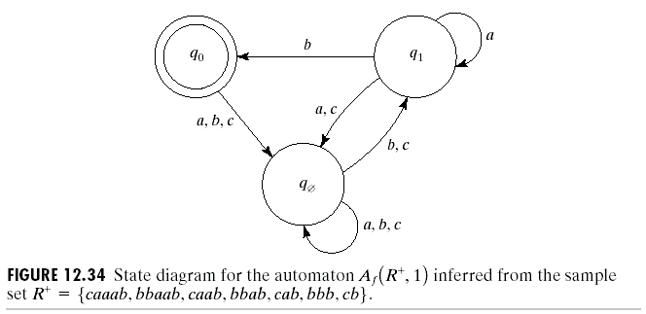
Chapter 12
Object Recognition

