Slide 1

I've been thinking for a long time about what we do in our life...
我從很久以前就想著在我這一身我要做些什麼

Slide 2



We start by being taught in school
how to become good citizens.
我們在學校開始被教育成
要成為一個好的國民
We spend a great part of our
childhood studying,
我們花了很多
童年的時光在學習上
and finally we get the diploma that will
ensure us “the position we deserve”.
最後我們獲得了一張文憑來確保地位

Slide 3



We participate to the increase
of unemployment
我們參與了一場場不被錄用面試
...until we find a job.
直到找到了工作
Through hard tests we are
accepted in the world of work.
通過了艱難的測試獲了一份工作

Slide 4




We perform a good professional career
filled with activity and efforts
花了很多的精力
讓我們在工作上有好的表現
…a lot, a lot of efforts...
很多很多的精力
till we fall down exhausted...
直到精疲力盡
BUT we are great professionals
with our valuable market share.

Slide 5





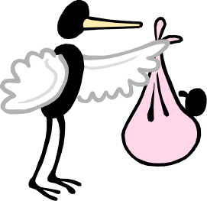

Time keeps on
passing, and...
...we select
new targets.
當時間慢慢過去
我們改變新的目標
...and promise
a neverending
love.
We meet
the sweetheart
of our life...
我們遇見了生命中的另一半
而且承諾這段永恆的愛
and here comes
a baby into our
home.
Passionate hugs,
Damned night,
couldn’t close my eyes!
激情過後
家中增加了新的成員
多少夜晚
不能合上我的眼

Slide 6






trying to make
the best of
our time.
We keep on advancing
in the society
我們繼續提升社會地位
試著表現更好
and we are finally
RICH!
We are the stars
wherever we go
最後變成有錢人
無論到那都是受矚目的
But we need
some time more
to triumph completely.
但是我們需要更多的時間
獲得完全的勝利

Slide 7






Gosh! One day they tell
they can do
without you.
在這時候
你快瘋了
By this time,
you think getting
crazy,
天啊!有一天公司對你說不再需要你了
you feel you
lost means of
communication.
you feel
destroyed,
失去和他人溝通的意義
你感到破滅
Now time
does not pass
any longer,
still you are
loosing it.
You realise you are
cut off from everything.
你發現你被所有事擊倒
時間不再長久
而你失去了一切

Slide 8
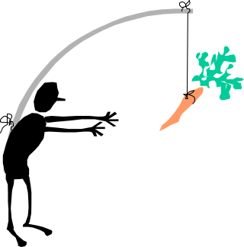





You realise
you’ve been living
in the fog
in search of
a silly target.
你發現你生活在霧裡
追求可笑的目標
You become
a walking
ghost
trying to escape
your enemies.
想要消滅所有的敵人
像行屍走肉般
You are the
only one
longing for the
hours to pass
till your time
comes.
直到你倒下
你渴望時間趕快過去

Slide 9

Upon this evaluation, an idea
came to my mind
on how to improve my life.
根據上述評斷,
腦中出現新的點子來改善我的生活

Slide 10






I'll take things
easy.
I'll try to open
my heart
to my love.
讓事情簡單
試著打開我的心去愛
I'll listen more
to the ones
surrounding me.
I'll save more time
to spend it
with my friends.
聽更多關於我身邊的事
花更多時間和我的朋友同歡
No,
karaoke I'll never do,
but I believe
I'll sing more.
I'll try
to travel
more.
有更多的旅行

Slide 11






I'll go
more times
to the seaside.
I'll make my best
to cook tasty food.
有更多的時間在海邊
試著去做最好吃的食物
I'll join
my friends’
warmth.
A bit love more.
多一點愛
溶入溫暖友情
I'll be happier
to get news
from my friends...
一起達到共同的目標
and achieve
together
common
objectives
高興獲得朋友的消息

Slide 12

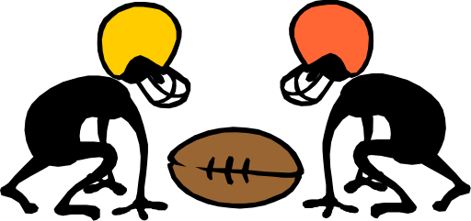

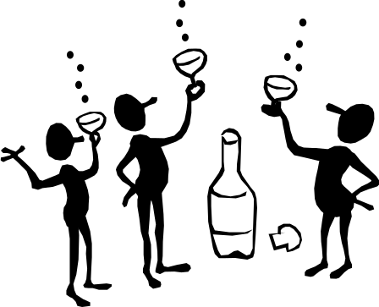

I can’t be sure,
but I believe
it worths trying.
“Well, say
what you want, but I am
a nice guy!”
我不能確定但這值得一試
說你想要什麼
我是個好人
I'll co-operate
clean the world
from nasty people.
No harm
from
a glass more.
HIC!
And I hope
they won’t stop me
when my time
comes.

Slide 13

我不知道是不是對每個人都是好的,但至少我將有美好的時光照我的方式來做
你認為呢
I do not know whether it is good for everybody, but
I’m sure that at least I will have had a wonderful time… which by the way is what counts more.
DON’T YOU THINK SO?

