Slide 1


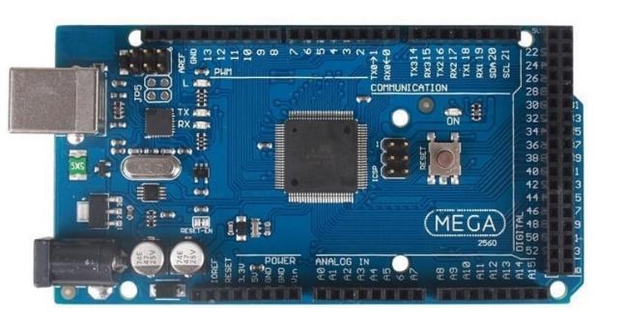
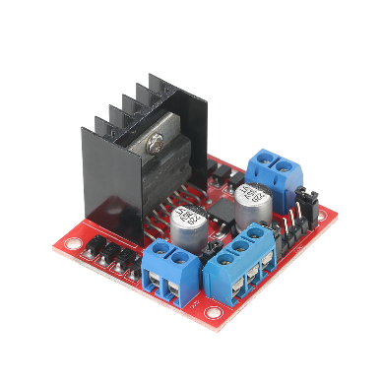
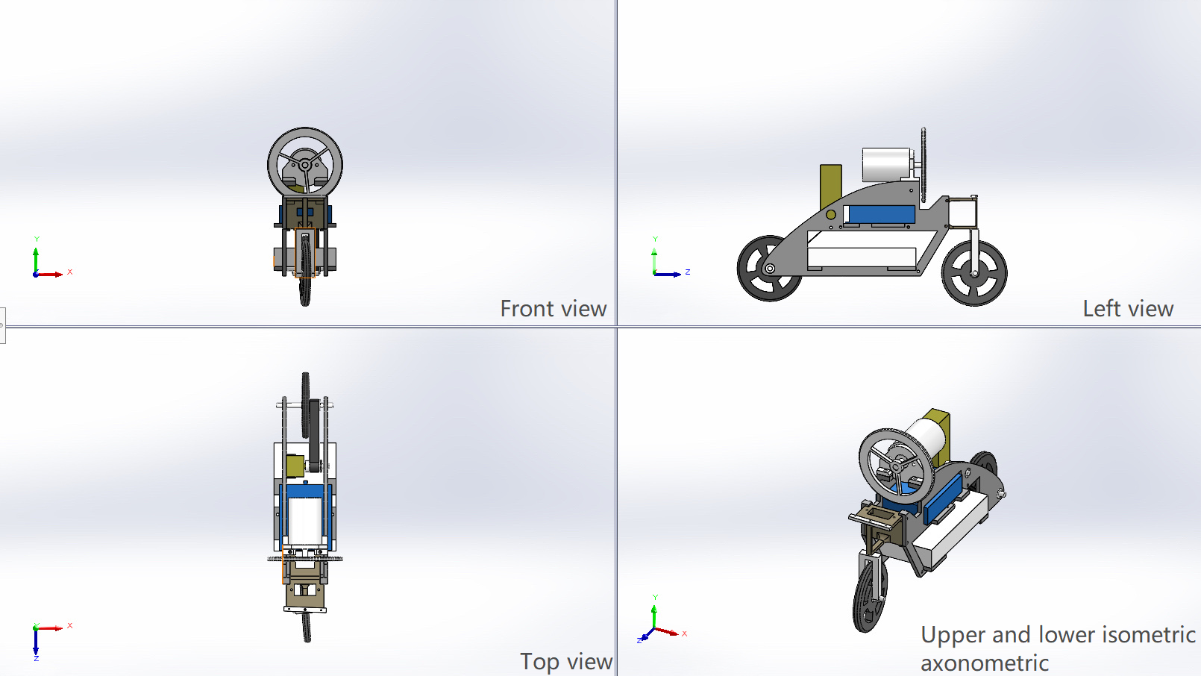
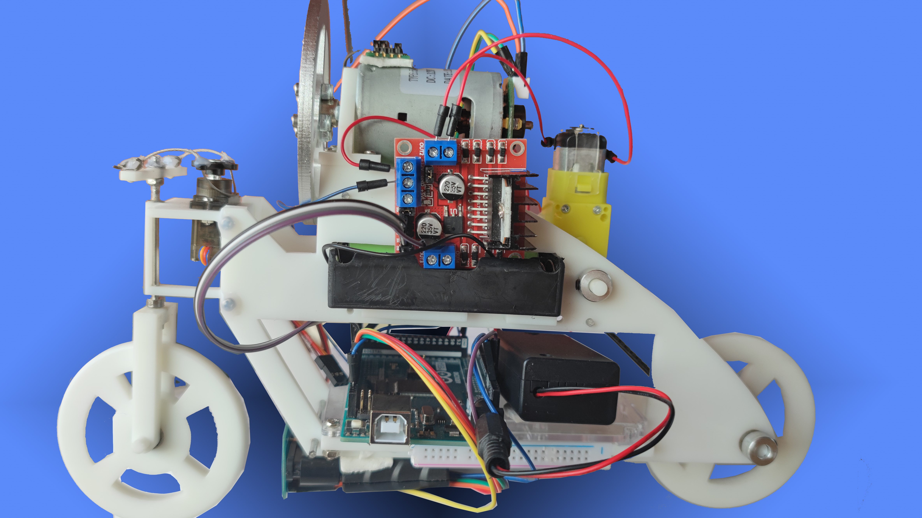
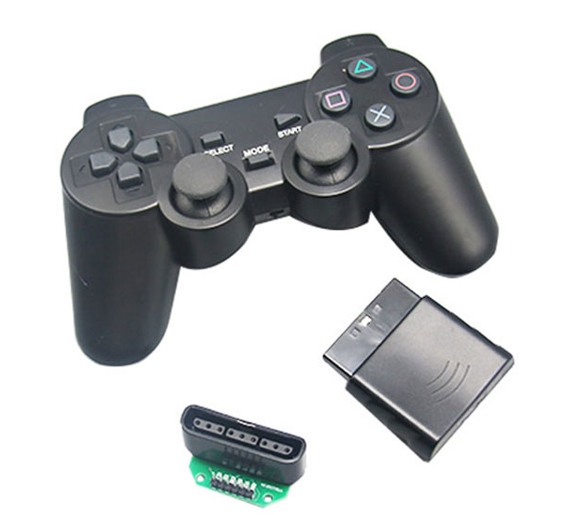
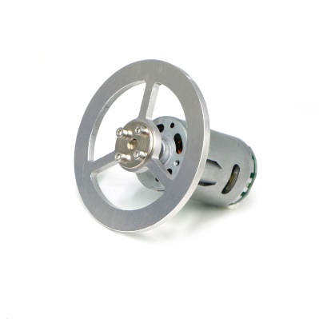
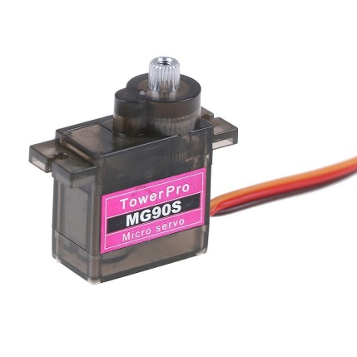
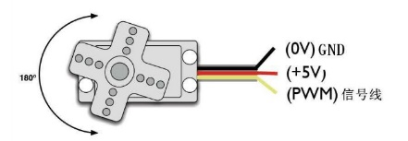
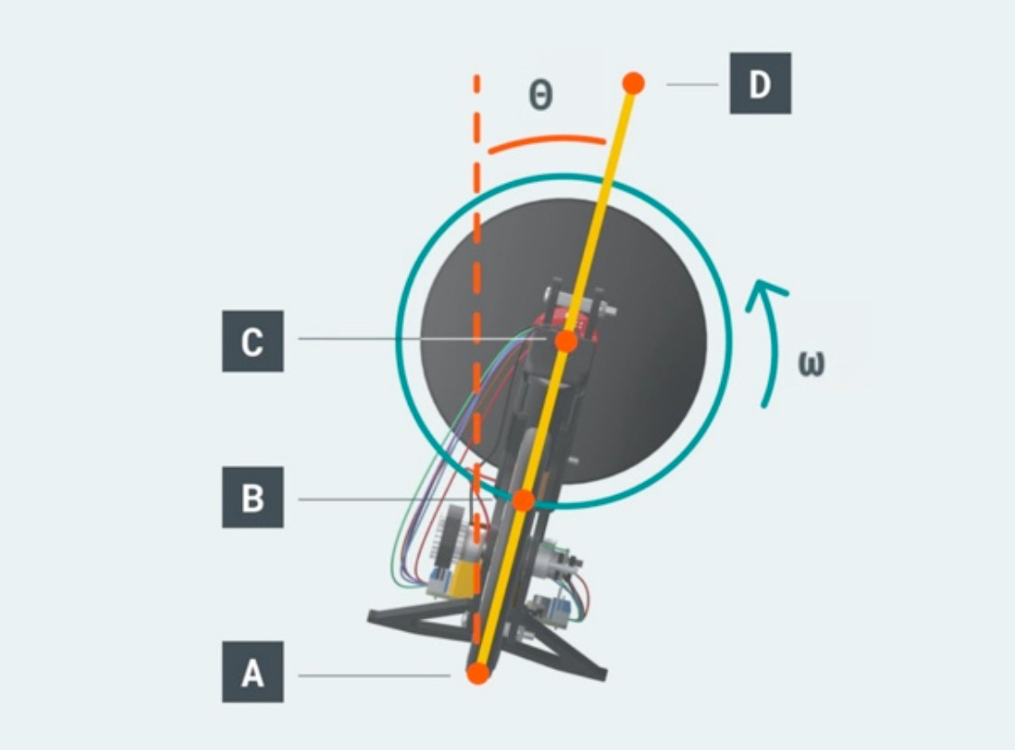
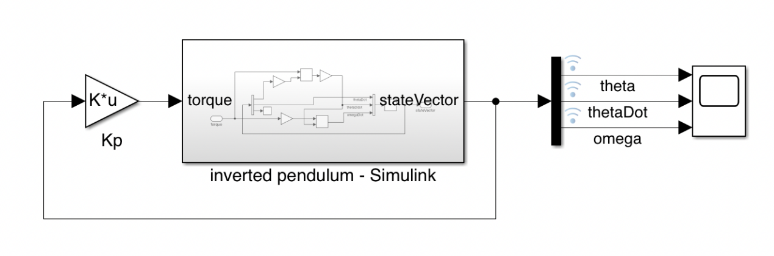
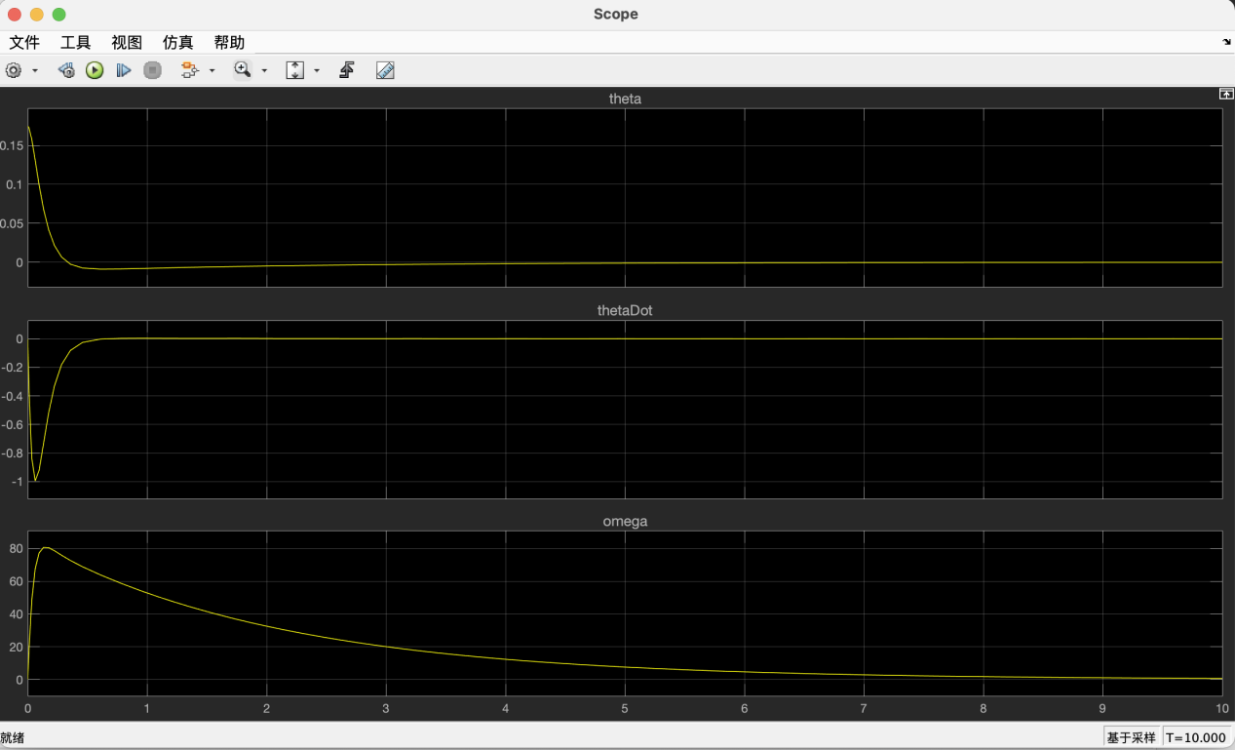
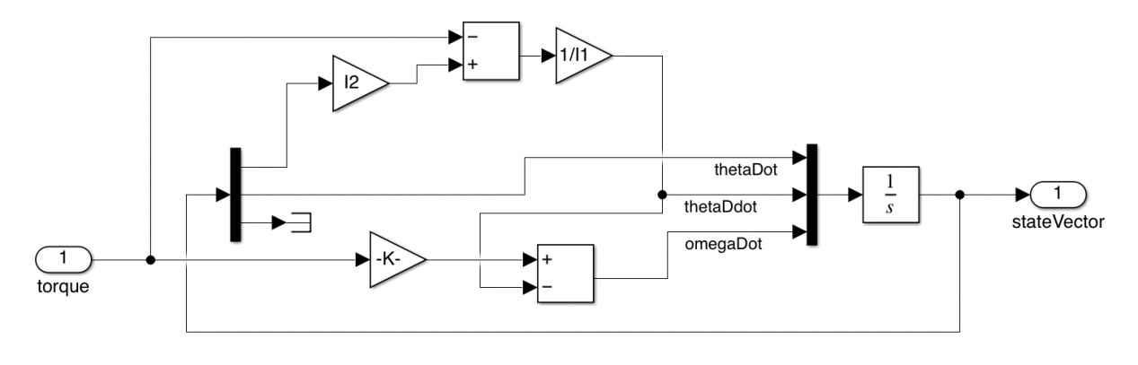




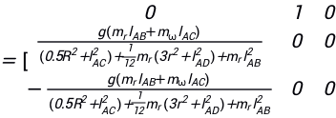
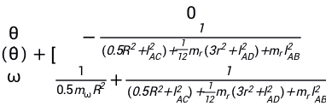
Self-balancing Motorcycle using Inertia Wheel
Boning Yang, Shifeng Lin, Feiyu Cai, Kailai Lian, Zhongnan Li
Supervisor: Yuqing Chen
School of Advanced Technology, Xi’ an Jiaotong-Liverpool University, China
SURF PROJECT CODE: 2021058
Abstract
The motorcycle project aims to develop a two-wheeled robotic system that can self-balance itself with an inertia wheel. The motorcycle consists of 1) two DC motors controlled by PS2 wireless controller to realize turning and moving functions, 2) a DC motor with encoder to rotate the inertia wheel and balance the motorcycle, 3) a gyroscope sensor to measure the tilt angle of the motorcycle, and 4) digital controller Arduino Mega 2560 to gather feedback signals from sensors and compute the optimal self-balancing control input for the inertia wheel. An LQR controlled is simulated and implemented on the self-balancing motorcycle system.
Introduction
The self-balancing motorcycle system integrates the knowledge of multiple disciplines such as electronic circuit system, mechanical engineering design, single-chip microcomputer, control system theory, software algorithm programming, etc. Compared with traditional four-wheeled vehicles, it has the advantages of energy saving, environmental protection and convenience. Compared with traditional two-wheelers, it is safer and smarter. The motorcycle in this research is composed of three parts: the vehicle body, the momentum wheel system and the control system. Through the collection and sorting of acceleration, offset angle and other data, it is transmitted to the controller to adjust the output speed and torque of the motor, and control vehicle body balance. Human balance is the source of inspiration for self-balancing design. When a person has a tendency to fall in one direction, the person's arms will instinctively swing in this direction to seek to maintain body balance. Similarly, when the motorcycle has a tendency to lean to the left or right, after the sensor collects the corresponding signal, the DC motor will control the steering and speed of the momentum wheel to maintain the balance of the vehicle body.
Result and discussion
Motorcycle model
Drive and control
In this research, the entire vehicle body structure is inspired by real bicycles and is designed to achieve the functional requirements of maintaining balance.
First, use Solidworks 2021 to establish a three-dimensional model. Considering battery life, motor power, vehicle center of gravity, space utilization and other factors, we designed the model in Figure 1. The motorcycle is 29cm long, 11cm wide, and 19.5cm high. The curved structure of the upper part of the vehicle body strengthens the load capacity of the vehicle body and avoids structural failure caused by stress concentration.
Mega2560
The Mega 2560 is a microcontroller board based on the ATmega2560. It has 54 digital input/output pins (of which 15 can be used as PWM outputs), 16 analog inputs, 4 UARTs (hardware serial ports), a 16 MHz crystal oscillator, a USB connection, a power jack, an ICSP header, and a reset button. It contains everything needed to support the microcontroller.
L298N
L298 compatible with standard TTL logic, is a high voltage, high current double full bridge driver, capable of driving inductive loads, such as relays, solenoid valves, DC motors, stepper motors, etc.
Ps2
The PS2 gamepad is designed to control the motorcycle's drive. The left joystick of the handle controls the motorcycle forward and backward, and the right joystick controls the motorcycle's turning. Through PWM control, this project can realize speed regulation by changing the degree of left-hand rocker propulsion. Compared with Bluetooth control, gamepad control makes speed regulation function better and has higher stability.
Figure 1. Four views of the vehicle
Figure 2. Motorcycle designed in this research
Coded Motor
A DC motor with an encoder connected to the flywheel exists to provide angular momentum to the motorcycle through rotation to force the motorcycle to achieve self-balance. To solve the problem of motorcycle self-balancing, students need to provide a control system, but to achieve control, the angular speed of flywheel rotation must be known. The purpose of the coded motor is to measure the real-time angular velocity of the flywheel rotation, providing this vital data to help complete the control system.
Then the momentum wheel of the motorcycle is manufactured by machining method, and the required vehicle body components are manufactured with the aid of 3D printing rapid prototyping technology. The vehicle body material is mainly photosensitive resin, which has higher structural strength in the case of lower quality. All parts are fixed together by the cooperation of protrusions and grooves and screws, and stoppers are used at important transmission shafts to prevent misalignment. The steering function is completed by the steering gear and the handlebar-front wheel system. The design of the drive transmission separation can effectively increase the reliability of the system and reduce the loss caused by partial failure. The power of the motorcycle forward and backward is provided by a rear motor, and the power is transmitted from the motor to the rear wheels by a synchronous belt. The center of gravity of the motorcycle is centered, which is more conducive to forming an inverted pendulum and maintaining balance.
APC
CD8⁺
Steering Motor
There are three wires on the steering motor. In this project, the red line of the steering motor is connected to the VCC of Arduino board, the black line is connected to GND, and the brown line (PWM signal line) is connected to the no. 8 signal port.
APC
CD8⁺
CD8⁺
Calculation and Simulation of the Equilibrium
Figure 3. Physical Model
Figure 4. Controller in Simulink
The problem of balancing motorcycles can be considered a problem of controlling the inverted pendulum.
We model the motorcycle as an inverted pendulum composed of two key components:
1.A pendulum rod connected to the ground through a rotary joint with a certain degree of freedom.
2. The inertia wheel connected to the pendulum rod through another rotary joint with a certain degree of freedom.
Calculation of the equation and the final state space model
By analyze torques, moments of inertia, and equation of motion, we get:
Figure 5. Simulation Results
By implementing the above equation in software, to allow simulating the behavior of this dynamical system and designing a feedback controller.
Finally, derive the state space expression:
]
]
Conclusion

