Slide 1
Citi Bike Rebalancing With RL and Heuristic Baselines
March 2026

Slide 2
Problem
Empty origin stations create unmet trips.
Full destination stations create overflow and operational waste.
Rebalancing is sequential: moving bikes now can help later demand, but every move has a cost.
The project goal is to test whether RL can beat a strong forecast-based heuristic under a realistic temporal holdout.

Slide 3
Research Question
Can RL outperform a demand-aware heuristic on a strict future-month test set?
Why this matters: beating a no-op baseline is easy to overstate, but beating a forecast-aware operational baseline is meaningful.
Final evaluation: train on January 2025 through January 2026 and test on February 2026.

Slide 4
Environment Setup
Five-station Jersey City subproblem: JC115, HB101, HB106, JC009, JC109
State: inventory, calendar, holiday/weather, and demand-profile features
Actions: no_op plus fixed-size directed bike transfers
Reward: served-trip reward minus unmet-demand, move, and overflow penalties

Slide 5
Data
Citi Bike Jersey City monthly trip files from January 2025 through February 2026
NOAA daily weather from station USW00014734
14 processed monthly flow files
423 daily demand episodes total
396 train episodes and 27 February 2026 test episodes in the primary holdout

Slide 6
Methods
baseline_no_op
heuristic_demand_profile
Tabular Q-learning progression: inventory only, then calendar, forecast, holiday, and weather context
Dueling Double DQN with dense state features
DQN move-margin regularization: only move when Q(move) >= Q(no_op) + margin

Slide 7
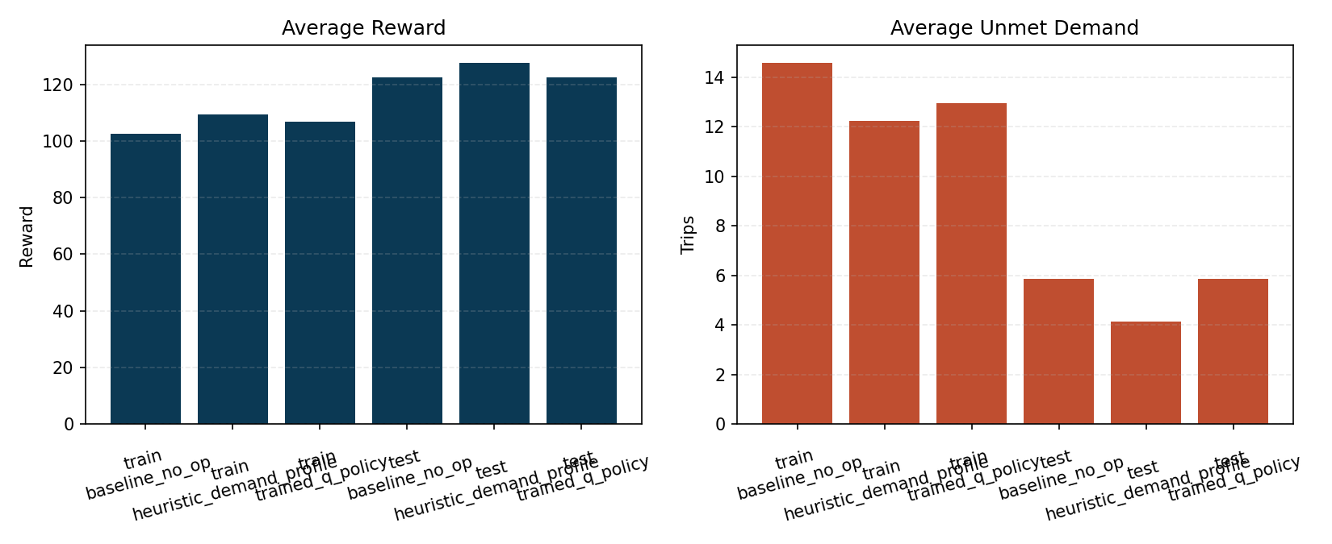
Development Result
On the early within-February split, the heuristic immediately became the real benchmark.
Calendar features helped tabular Q-learning close the gap to no-op.
But the demand-profile heuristic still won clearly.

Slide 8
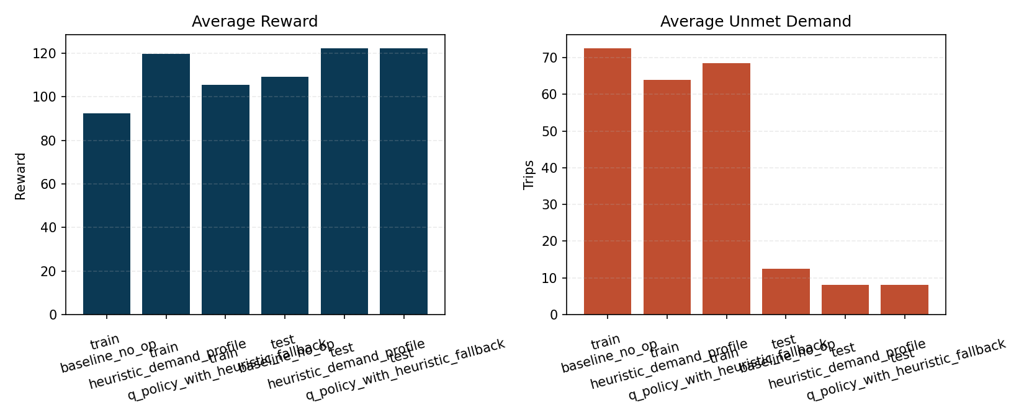
Main Seasonal Holdout Result
Strict holdout: train through January 2026, test on February 2026
No-op baseline: 109.33
Heuristic baseline: 122.45
Q table with heuristic fallback: 122.21
The Q-table is almost entirely fallback on this holdout: 23.96 fallback actions per day

Slide 9
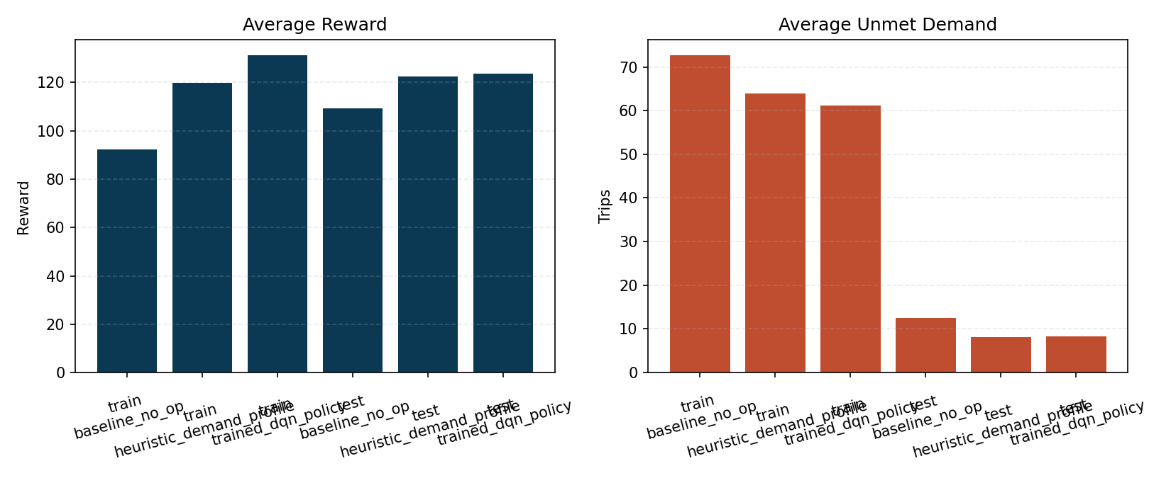
DQN Result and Caveat
Unregularized DQN over-moved bikes and underperformed the heuristic.
Move-margin regularization improved the best DQN run: 123.63 vs heuristic 122.45
But that win was not stable across seeds.

Slide 10
Robustness Check
Seed | DQN avg reward | Heuristic avg reward
7 | 123.63 | 122.45
11 | 113.61 | 122.45
19 | 116.95 | 122.45

Slide 11
Conclusion: the regularized DQN is promising, but not robust enough to claim a stable improvement.

Slide 12
Takeaways
The repo now contains a complete, reproducible RL research pipeline with real demand and weather data.
The demand-profile heuristic is the strongest robust policy on the February 2026 holdout.
The move-margin DQN best run is encouraging, but stability is still the main blocker.
Next modeling step: residual learning around the heuristic, plus broader seed and holdout evaluation.

