Slide 1
Hierarchical Multi-Agent Reinforcement Learning for Congestion-Aware Maritime Scheduling
SPRING 2026
Independent study
Supervisor: Prof. Amine Aboussalah
Project update: simulator background, reward redesign, continuous + ground_truth final run path, current progress, and next steps.
We now have a clean final path for the project: continuous scheduling, reliable forecasts, strong diagnostics, and a reproducible local run plan.
MARCH 31 UPDATE
Final path: continuous + GT
RESEARCH FOCUS
CURRENT SETUP
FORMAT
HMARL
Cont. + GT
12 slides
Coordinator, vessel, and port agents
Continuous environment with reliable forecasts
Presentation-ready update deck

Slide 2
CONTEXT
02
Why this project matters
Operational context
Congestion
Cost
Ports have limited berth capacity and nonzero service time.
Vessels trade off speed, fuel burn, emissions, and lateness.
Poor local choices can create downstream congestion and idle capacity elsewhere.
The system is naturally multi-agent, asynchronous, and resource-constrained.
Too many arrivals to one port can create queueing and delay at the whole network level.
Faster sailing can improve timing but increases fuel use, emissions, and operating cost.
Coordination
Research value
Ports and vessels need global guidance, not only local reactive behavior.
This is a strong testbed for hierarchical coordination under delayed information.

Slide 3
QUESTIONS
03
What we are trying to learn
Umbrella question
Can hierarchical MARL improve maritime scheduling under congestion and resource constraints?
RQ1
RQ2
How can heterogeneous agents coordinate using shared congestion forecasts?
Does proactive coordination improve over independent and reactive baselines?
RQ3
RQ4
Which forecast horizons and sharing strategies maximize decision quality?
How do coordination improvements affect fuel, delay, and carbon cost?
The project is organized around a chain of related questions: coordination, baselines, forecast design, and economics.

Slide 4
ENVIRONMENT
04
Current simulator setup
Topology
Synthetic port distance matrix (nautical miles)
5 ports, 8 vessels, 3 docks per port
Rows and columns are ports P0–P4; the diagonal is 0, and the matrix is symmetric.
The values are synthetic and scaled so multiple voyages can complete within one rollout.
Time scale
P0
P1
P2
P3
P4
1 hour per step and 6 hour default service time
P0
0
84
22
34
78
P1
84
0
98
61
54
Travel
Synthetic port-distance matrix with routes from 22 to 98 nautical miles
P2
22
98
0
55
59
P3
34
61
55
0
82
Fuel
P4
78
54
59
82
0
Default fuel is 100, with refueling only after real service completion

Slide 5
EXPERIMENT
05
How the current baseline is trained and evaluated
Main operating baseline
Final completion path
Algorithm: MAPPO with centralized training and decentralized execution
Parameter sharing across vessels and across ports
100 training iterations and rollout_length = 64
Environment horizon = 69
Seed = 42
Local CPU run for the reported baseline
continuous episodes
ground_truth forecasts
one artifact run plus one five-seed run
designed to isolate control quality while finishing the project
Primary evaluation metrics
On-time rate
Completed arrivals
Port service events
Dock utilization
Total operating cost

Slide 6
ARCHITECTURE
06
Three decision layers with delayed coordination
Fleet coordinator
Vessel agents
Port agents
Strategic destination guidance Slowest decision cadence
→
Speed control Arrival-slot requests
→
Request acceptance Service and berth decisions
The environment is intentionally asynchronous, so the policies must coordinate under delayed information and physical travel time.

Slide 7
MECHANICS
07
How one simulation step works
Transition kernel
Why this matters
The environment is not one big update; it moves through communication, travel, berth service, and reward calculation in sequence.
This is why delays, arrivals, and service completions show up at different times in the logs.
The next two slides separate reward intuition from reward formulas so the audience sees both the story and the technical definition.
1. Deliver messages
Apply due actions and delayed communications.
2. Advance vessels
Update motion, fuel burn, emissions, and arrivals.
3. Process ports
Update queue, berth service, service completion, and refueling.
4. Compute rewards
Log diagnostics and compute role-specific rewards.

Slide 8
REWARDS
08
Reward structure in plain language
Vessel reward
Reward = arrival and punctuality minus travel cost
What it rewards
What it penalizes
Arrival, On-time arrival
Fuel used, Delay added, CO2 emitted, Transit time, Schedule delay
Port reward
Reward = responsive berth management minus congestion cost
What it rewards
What it penalizes
Accepted requests, Vessels served
Rejected requests, Queue waiting, Idle docks
Coordinator reward
Reward = system flow and utilization minus network-wide cost
What it rewards
What it penalizes
Accepted requests, Vessels served, Berth utilization
Fuel, Queue, Idle docks, Delay, Schedule delay, CO2, Rejected requests
This is the audience-facing summary. The next slide shows the actual symbolic formulas used in the simulator.

Slide 9
REWARDS
09
Actual reward formulas used in the simulator
Symbolic form
Vessel reward
r_V(t) = r_arr·1[arrived] + r_on·1[on_time] − (w_fΔfuel + w_dΔdelay + w_eΔCO2 + w_tΔtransit + w_sΔsched)
Port reward
r_P(t) = r_acc·accepted + r_srv·served − r_rej·rejected − (queue·dt + w_idle·idle_docks)
Coordinator reward
r_C(t) = r_acc·accepted + r_srv·served + r_util·avg_occupied − (w_fΔfuel + w_qavg_queue + w_iavg_idle + w_dΔdelay + w_sΔsched + w_eΔCO2 + r_rej·rejected)
Δ terms are per-step increments; accepted, rejected, and served are event counts for the current step.

Slide 10
PROGRESS
10
What changed since March 6
Corrected vessel behavior
Fuel and stalling
Port service realism
No more collapse to constant minimum speed. Requested arrival times now become real schedule deadlines.
Fuel exhaustion now causes true mid-route stalling. Departures are checked for fuel feasibility.
Ports track actual vessel IDs. Refueling happens after real service completion.
Reward redesign
Final run cleanup
Visibility
Rewards moved from mostly aggregate penalties to event-driven, role-specific signals.
Moved the finish line to continuous + ground_truth and fixed training resets to vary reproducibly.
Action logs, event logs, reward components, and confidence diagnostics were added.

Slide 11
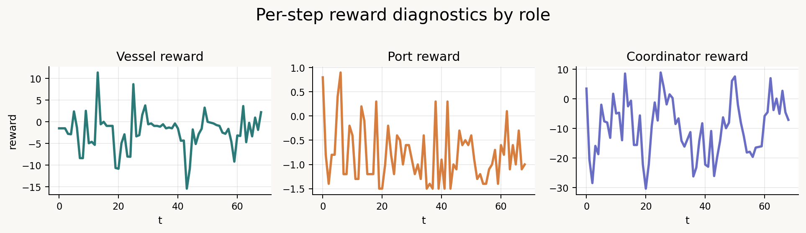
DIAGNOSTICS
11
Why the current results are more trustworthy
Transparency upgrades
Grouped plots separate aggregate, vessel, port, and coordinator behavior.
Per-step eval trace, action log, and event log are available.
Reward-component decomposition shows which terms dominate.
Policy-confidence metrics make near-uniform coordinator behavior easier to diagnose.
Role-specific reward traces over one evaluation episode. We show all three because vessel, port, and coordinator each optimize a different part of the task.
TRACE FILE
ACTION LOG
EVENT LOG
eval_trace.csv
eval_action_trace.csv
eval_event_log.csv

Slide 12
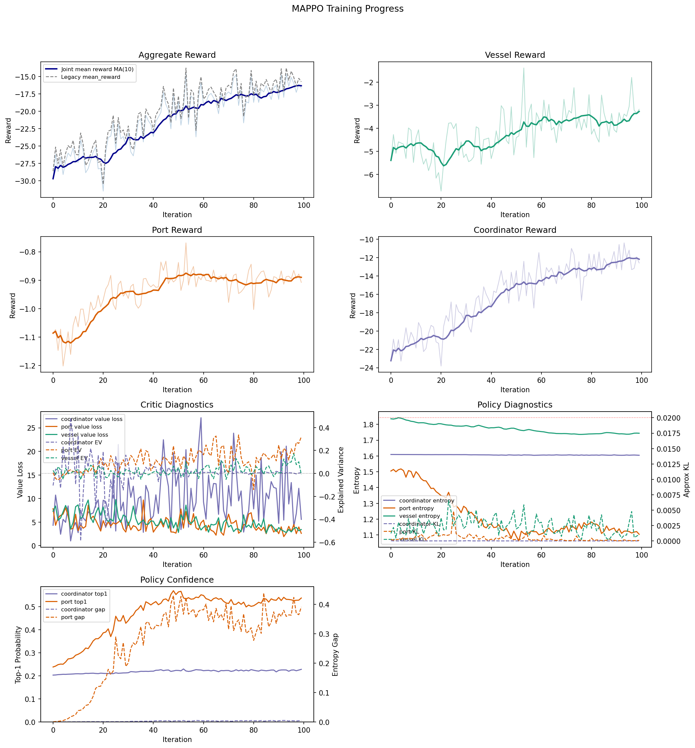
BASELINE
12
Current recommended baseline: transit-rebalanced v3
Preferred operating balance
TOTAL REWARD
ON-TIME RATE
-923.38
0.928
COMPLETED ARRIVALS
PORT SERVICE EVENTS
26.8
36.2
DOCK UTILIZATION
OPS COST
0.28
$1.330M

Slide 13
RUN PLAN
13
Final full-scale run plan
Artifact run
Multi-seed run
ENVIRONMENT
Continuous
ENVIRONMENT
Continuous
FORECAST
Ground truth
FORECAST
Ground truth
ITERATIONS
100
ITERATIONS
100
SEED
42
SEEDS
42, 49, 56, 63, 70
PURPOSE
Figures, traces, report, and saved model
PURPOSE
Final quantitative stability claim
OUTPUTS
report.md + trace CSVs + plots
OUTPUTS
summary.csv + experiment_summary.json
Takeaway
The project now finishes on one clean task definition: continuous scheduling with reliable forecasts, using one representative artifact run and one five-seed stability run.

Slide 14
NEXT STEPS
14
What is simplified, and what comes next
1. Run the artifact seed
2. Run five seeds
3. Write the result
4. Keep scope honest
5. Future work
Generate the final figures, traces, report, and saved model from seed 42.
Use the same continuous + ground_truth setting for the final stability claim.
Use the artifact run for examples and the multi-seed run for the main numbers.
Frame the result as control quality under reliable forecasts.
Reintroduce imperfect forecasts and real-port geography afterward.
This finish line is intentionally narrow: complete the project cleanly on the continuous environment, then expand realism afterward.

